Slide 1








The Integrative Genomics of Early Prostate Cancer Dr. Paul C. Boutros University of California, Los Angeles

Slide 2
Pathway
Prostate Cancer
Genome
Transcriptome
Proteome
Integration
Summary

Slide 3
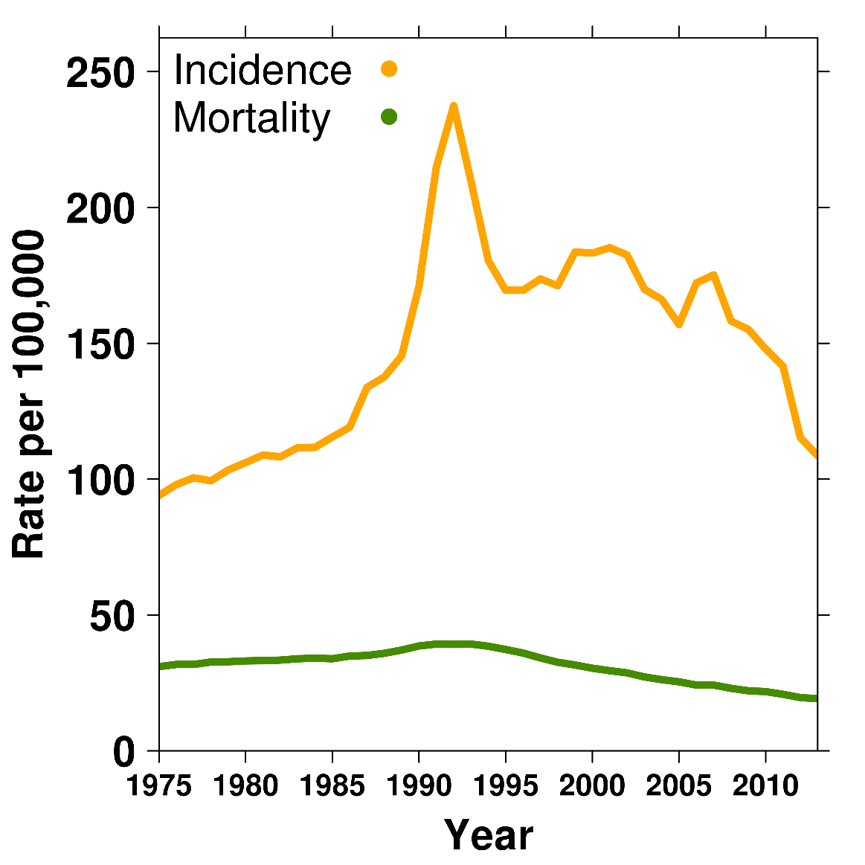
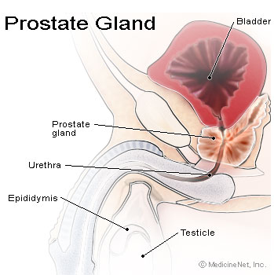
Prostate Pathology: Epidemiology
Incidence:
~1 in 7 men
(1,515 per million)
Mortality: ~1 in 4 patients
(242 per million)
Risk factors:
Age
Family history
High-fat diet
African ancestry
Notes:
3
Canadian stats
Third most common cancer death in males

Slide 4
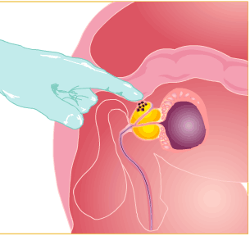
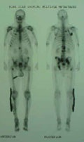
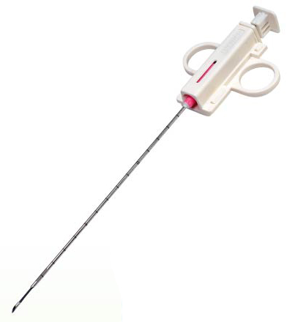
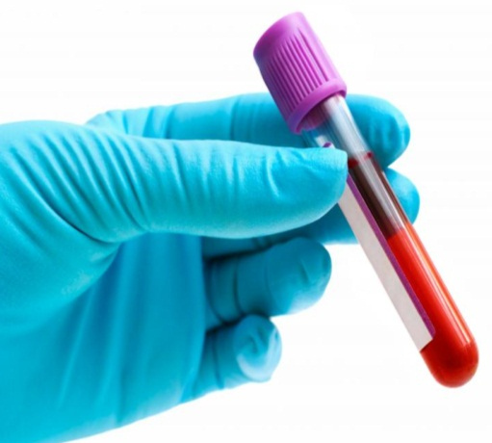
Prostate Cancer Prognosis
Digital Rectal
Exam Imaging Biopsy Blood test
TNM stage Tumour grade PSA
Low
risk
Intermediate
risk
High
risk
Metastatic
Localized cancers

Slide 5
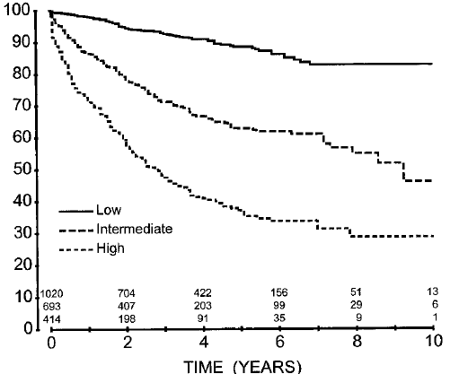
Clinical stratification of localized cancer
% Biochemical RFR
Low
Active Surveillance
Intermediate
Radiotherapy or Radical prostatectomy
High
Radiotherapy or Radical prostatectomy
+ adjuvant treatment
D'Amico et al. 2001

Slide 6
CPC-GENE: Clinical Outcome Studies
All patients reconsented
IGRT Cohort
(Radiotherapy)
300-patient TMA
150 cases
150 specimens
Mostly matched blood
O₂ measurements
10-year median follow-up
Central Pathology
2-3 Pathologists
>70% tumour cellularity
Gleason concordance
WGS
Methylation
H3K27Ac
RNA-Seq
Proteomics
RP Cohort
(Surgery)
300 cases
350 specimens
Matched blood
8-year median follow-up
Multiple national TMAs

Slide 7
Pathway
Prostate Cancer
Genome
Epigenome & Transcriptome
Proteome
Integration
Summary

Slide 8
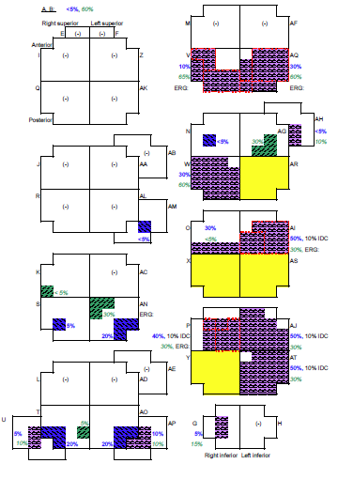
Spatial Sampling of Prostate Cancer
Boutros et al. Nature Genetics 2015

Slide 9
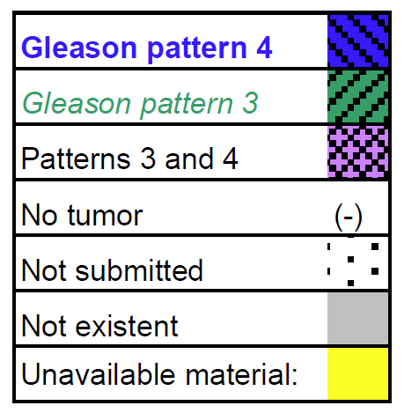
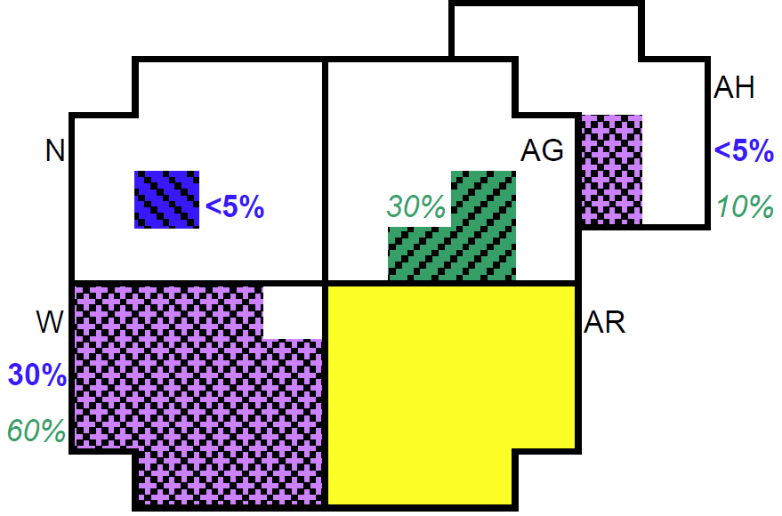
Boutros et al. Nature Genetics 2015

Slide 10
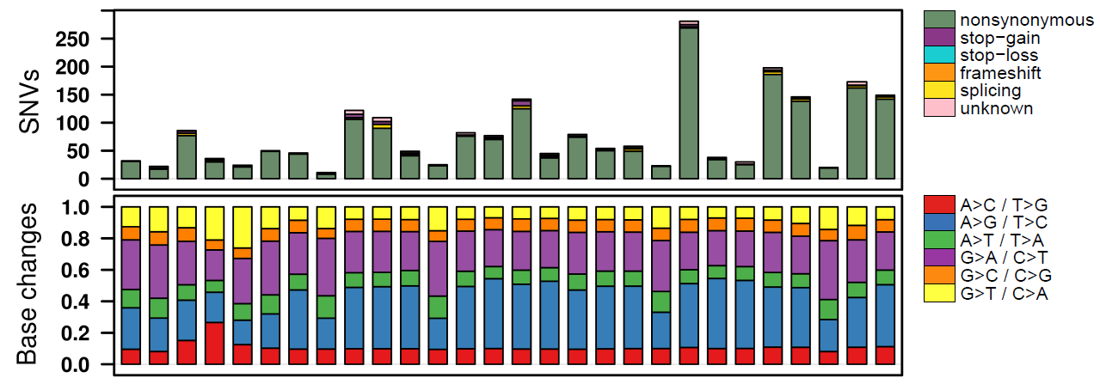
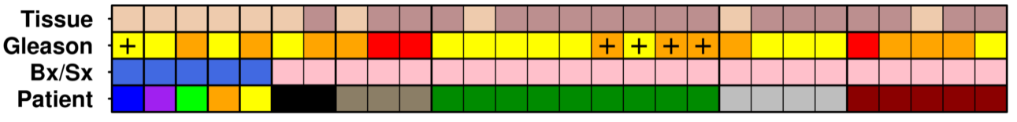
Immense Intra-Prostatic Diversity…
Boutros et al. Nature Genetics 2015

Slide 11
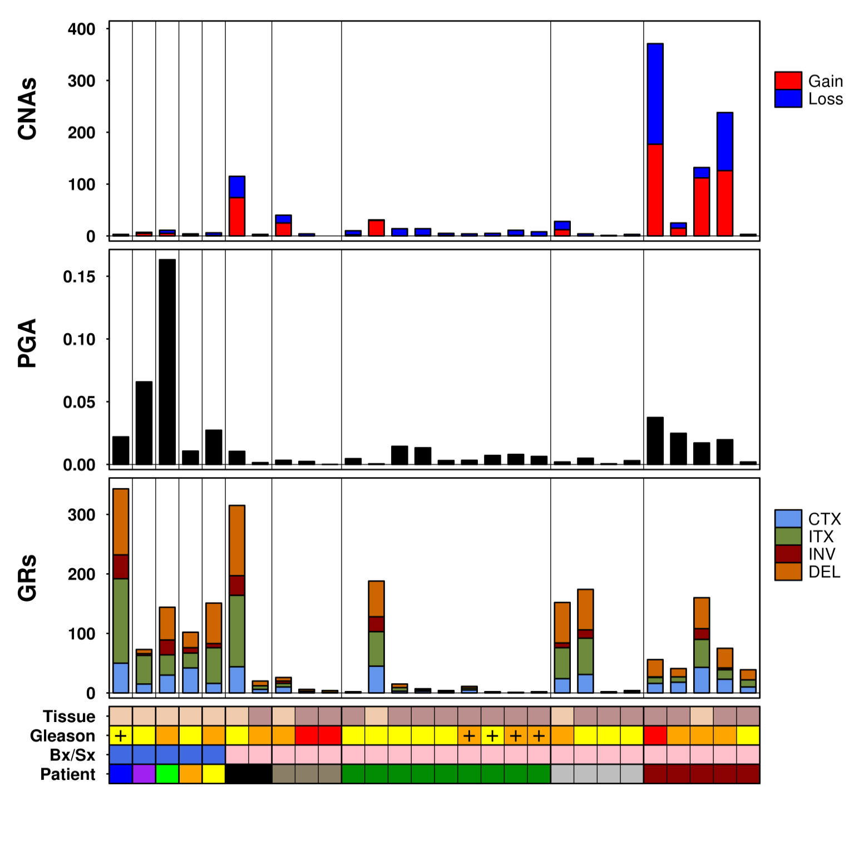
…At All Levels of Investigation

Slide 12
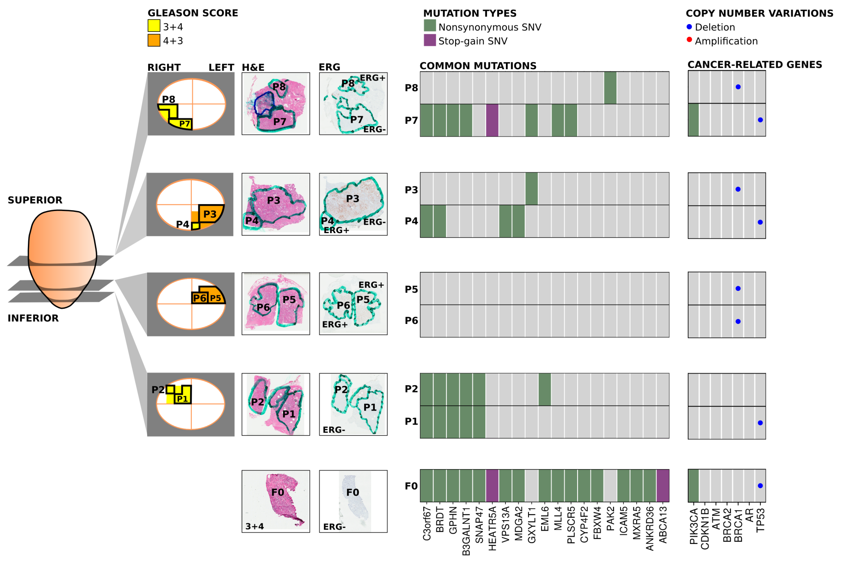
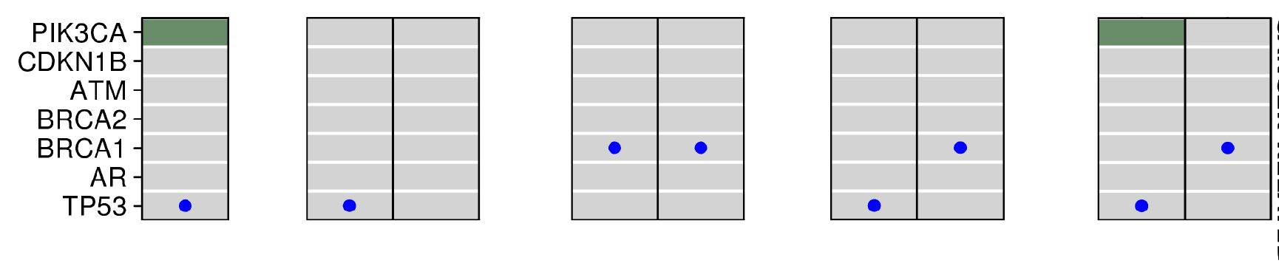
Is This Heterogeneity Clinically Relevant?
3+4
3+4
3+4
4+3
4+3
3+4
4+3
3+4
3+4
Boutros et al. Nature Genetics 2015

Slide 13
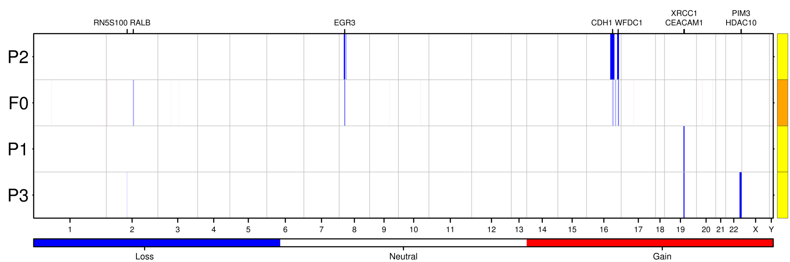
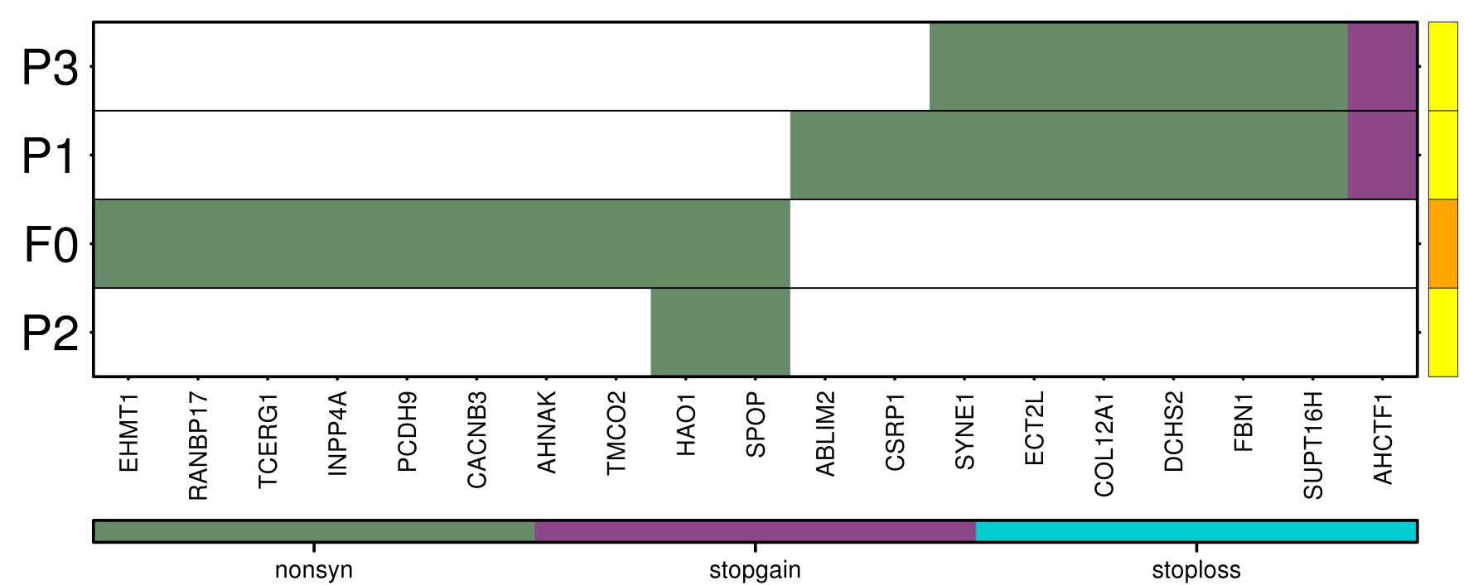
Multiple Primaries

Slide 14
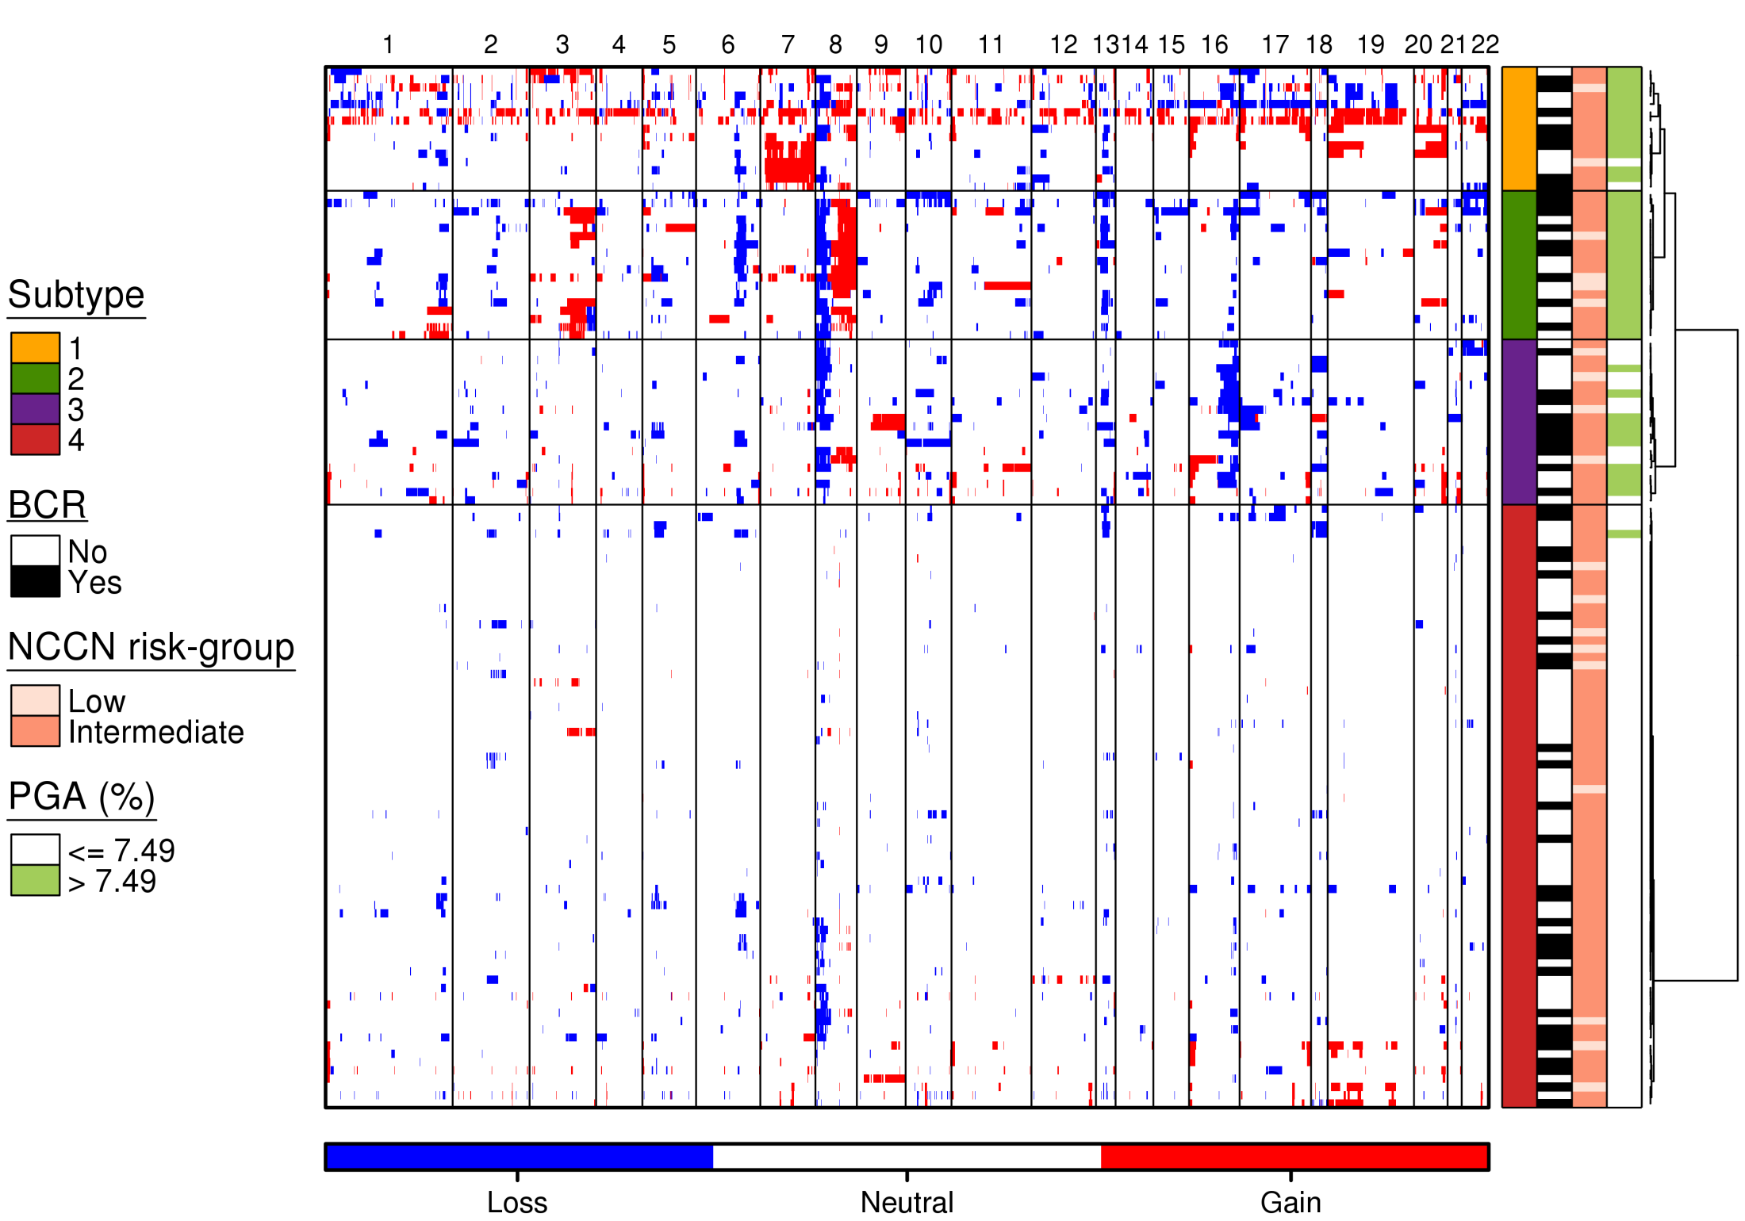
Training Cohort
RB1
MYC
NKX3-1

Slide 15
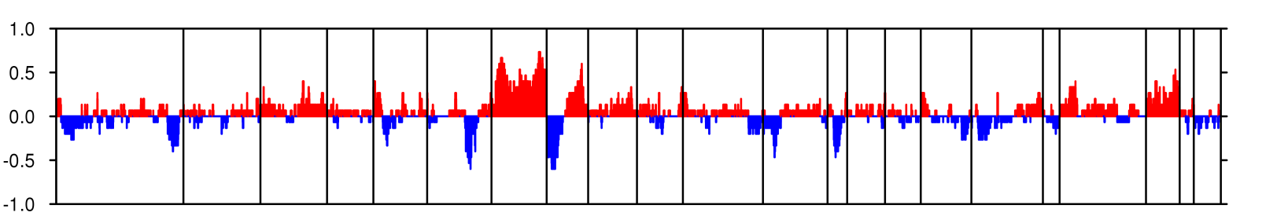
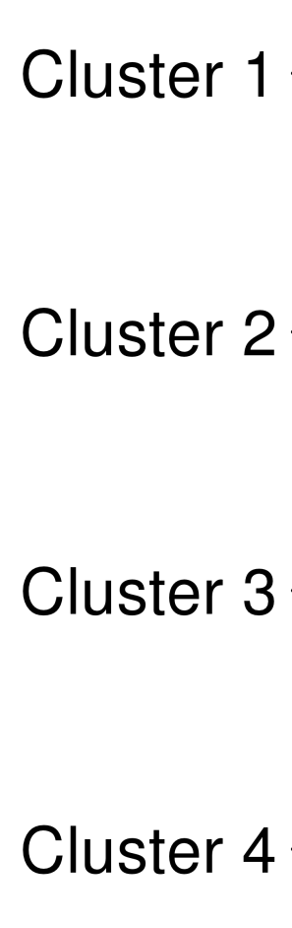
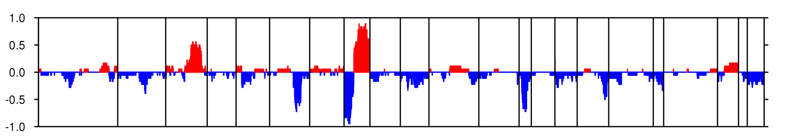
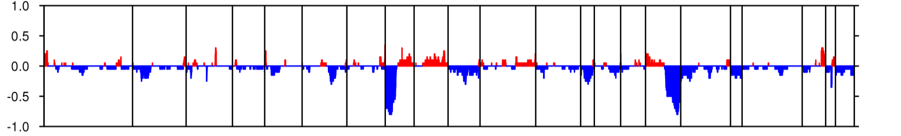
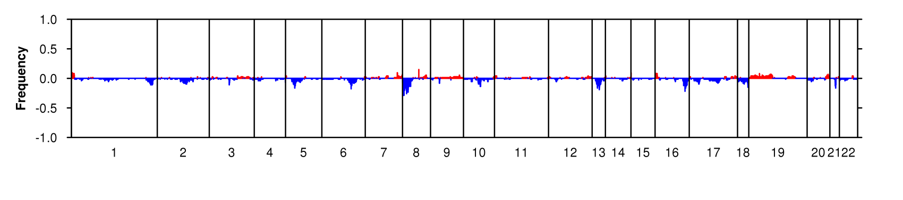
Cluster CNA profiles
Lalonde et al. Lancet Oncology 2014

Slide 16
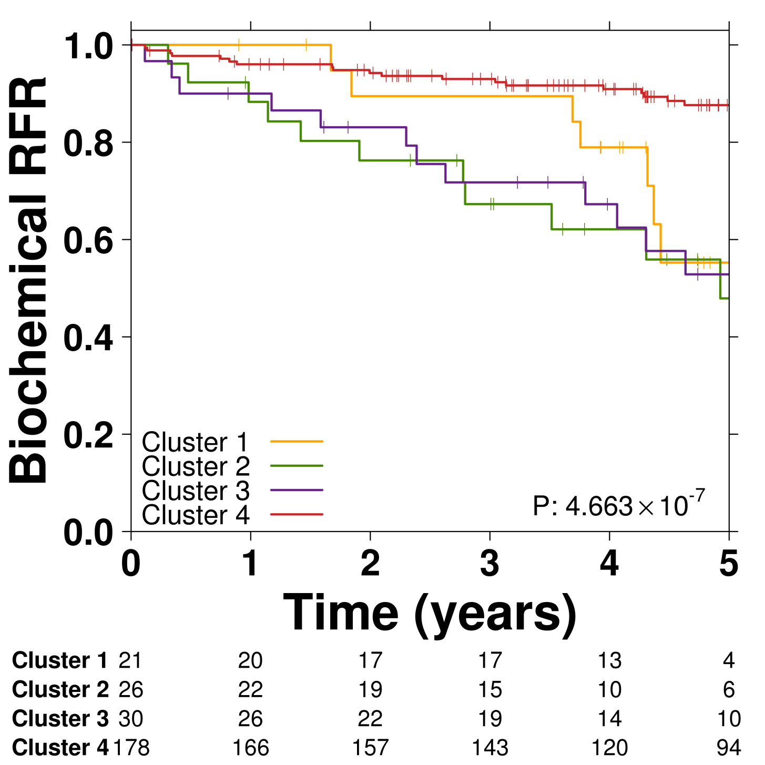
Clusters are associated with outcome

Slide 17
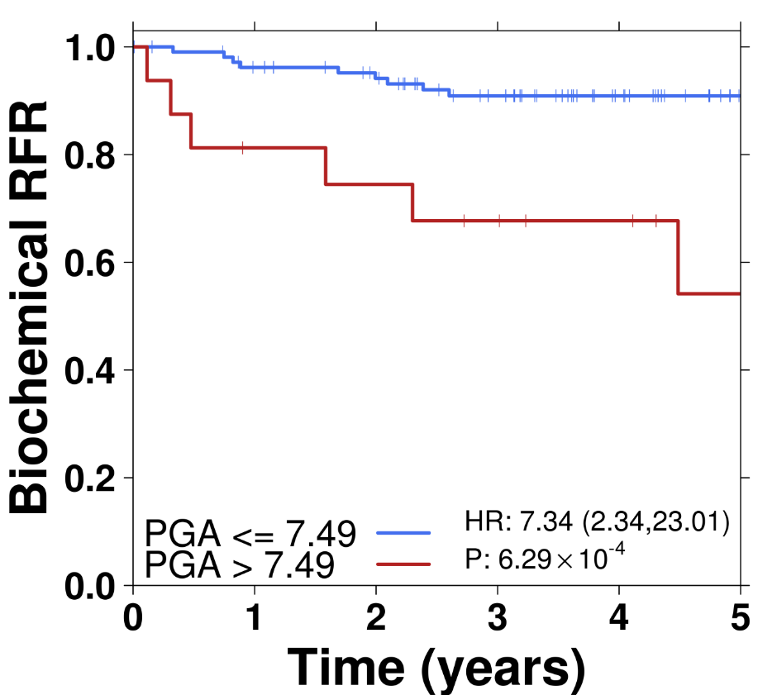
PGA as a biomarker
PGA =
Percent Genome
Altered
Lalonde et al. Lancet Oncology 2014

Slide 18
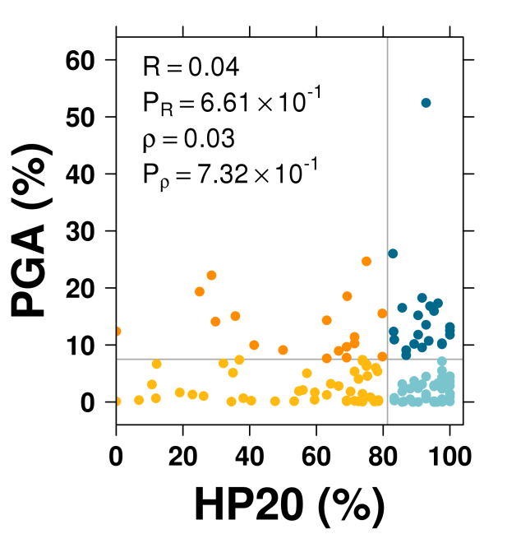
Hypoxia and genomic instability
Hypoxia (%)
Lalonde et al. Lancet Oncology 2014

Slide 19
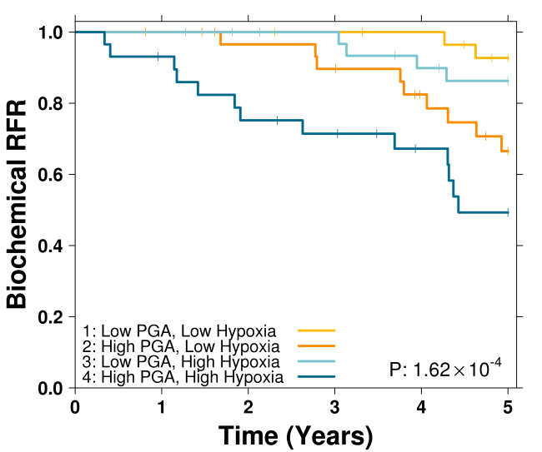
Hypoxia and genomic instability
Low Hypoxia
Low Genomic Instability
High Hypoxia
High Genomic Instability

Slide 20
Aside: Hypoxia-Somatic Interactions
Bhandari et al. Nature Genetics 2019

Slide 21
Aside: Hypoxia-Somatic Interactions
Bhandari et al. Nature Genetics 2019

Slide 22
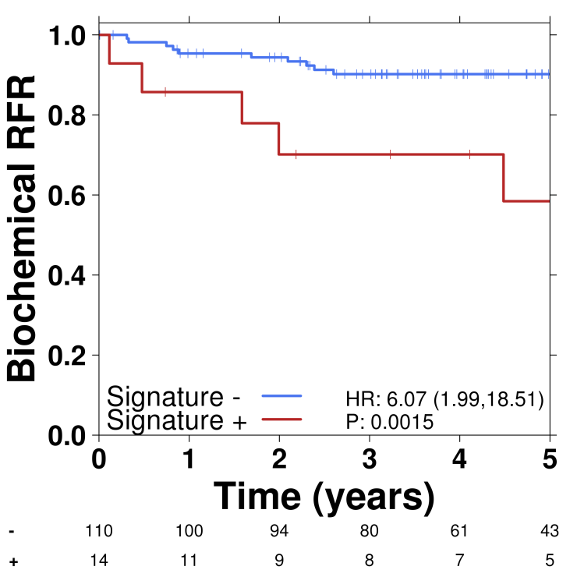
Classifier evaluation
 | Predictions
Accuracy | 77.5%
Sensitivity | 50.0%
Specificity AUC | 83.8% 0.658
100 genomic regions or 245 genes
Lalonde et al. Lancet Oncology 2014

Slide 23
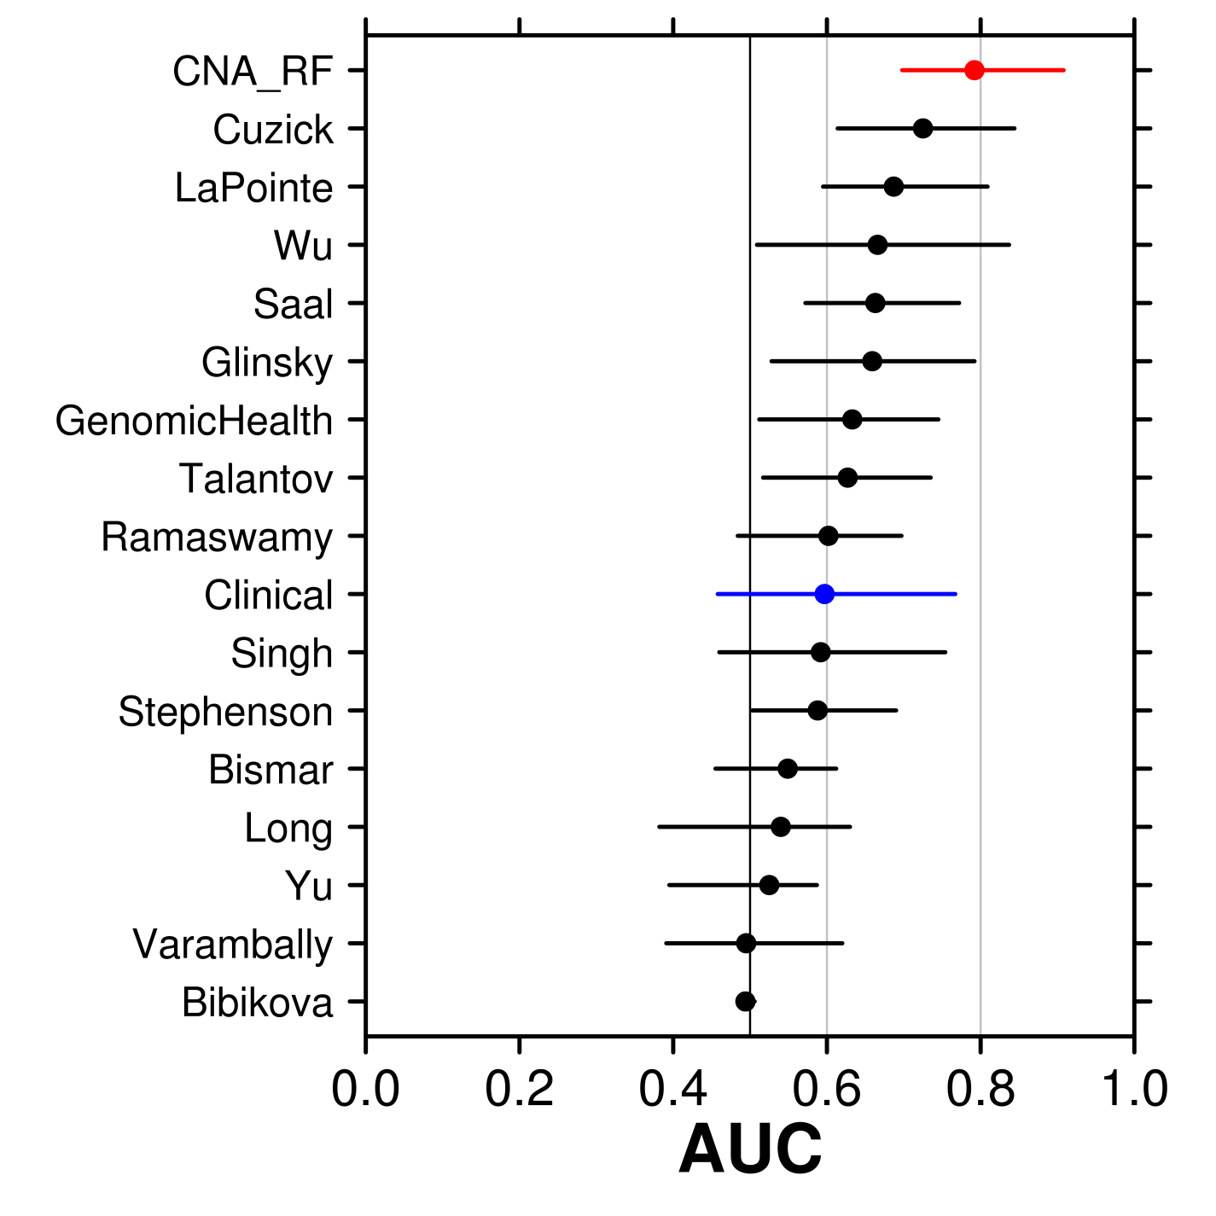
This Is the Best Performing Signature
With GenomeDx

Slide 24
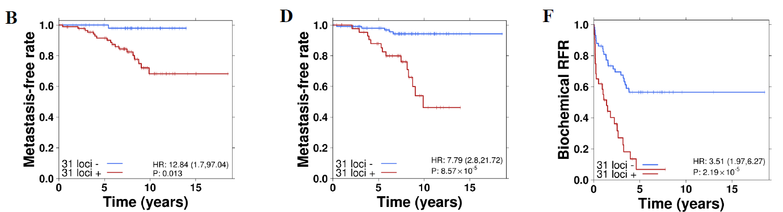
Validation in >500 Patients
Low-Risk
Intermediate-Risk
High-Risk
AUC ~0.8 in tertiary validation cohorts
Lalonde et al. European Urology 2017

Slide 25
What About Other Mutation Types?
200 Newly Diagnosed Intermediate-Risk Tumours
WGS of tumour/normal pairs (~80x coverage)
Array-based Methylomes
Array-based RNA profiling
Clinical outcome
Fraser et al. Nature 2017

Slide 26
What About Other Mutation Types?
Fraser et al. Nature 2017

Slide 27
WGS of 200 Prostate Tumours

Slide 28
WGS of 200 Prostate Tumours
Fraser et al. Nature 2017

Slide 29
Pathway
Prostate Cancer
Genome
Epigenome & Transcriptome
Proteome
Integration
Summary

Slide 30
Methylome & Enhancer Landscapes
619 Methylomes (450k) from Localized Tumours
Shiah et al. in review

Slide 31
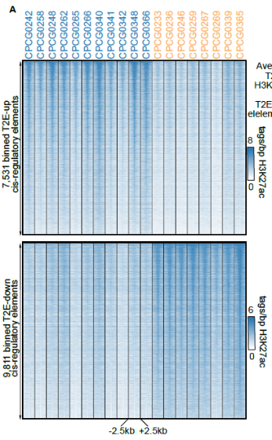
Methylome & Enhancer Landscapes
Kron et al. Nature Genetics 2017

Slide 32
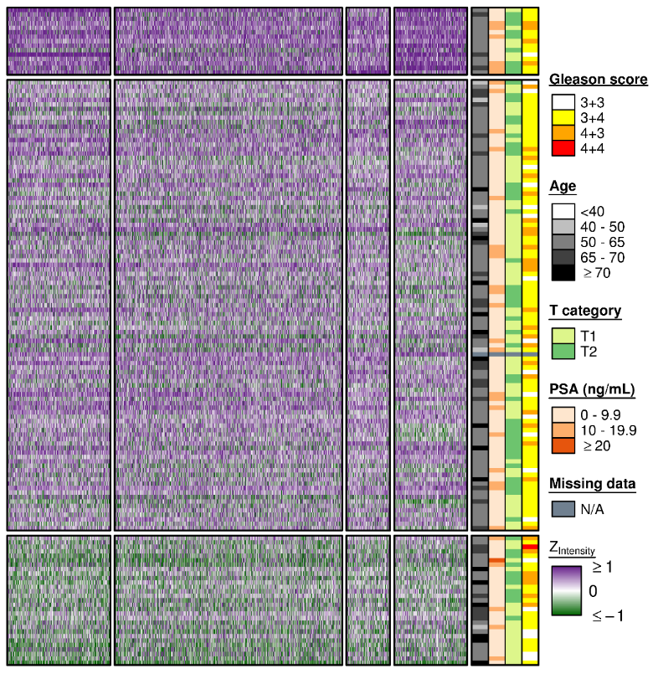
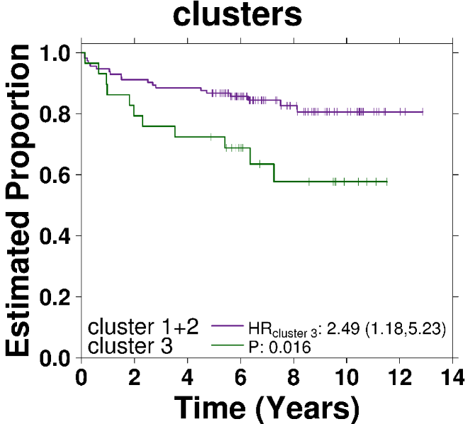
Transcriptome: circRNAs
Samples: 155 intermediate-risk tumours
Median: 450M reads/sample
Chen et al. Cell 2019

Slide 33
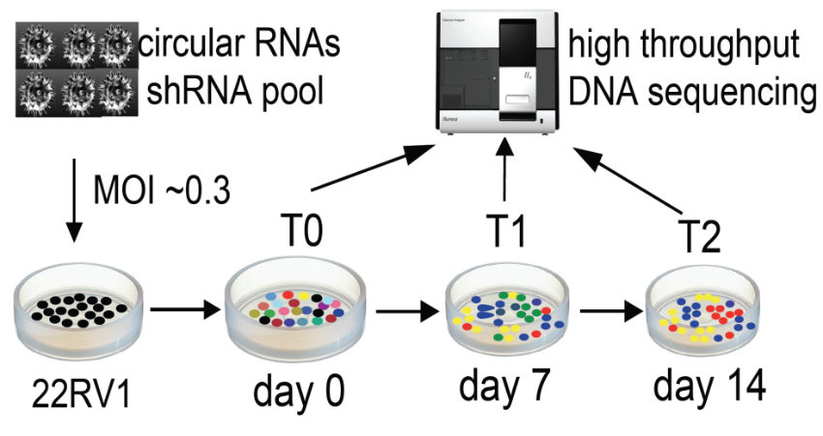
Transcriptome: circRNA dropout screen
Functional screen in prostate 4 cancer cell lines, PC3, 22RV1, V16A, LnCap

Slide 34
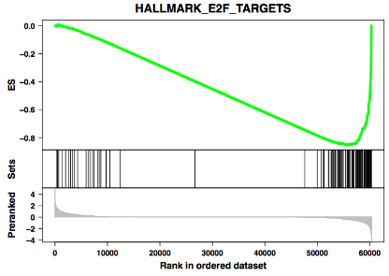
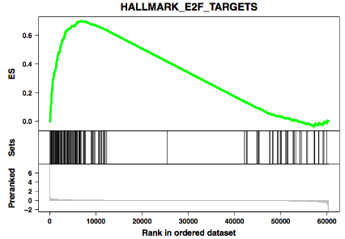
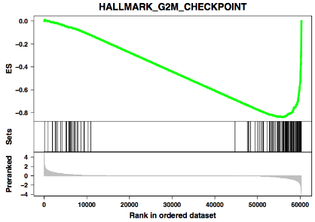
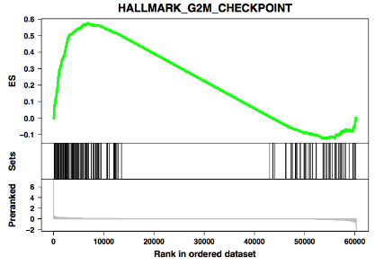
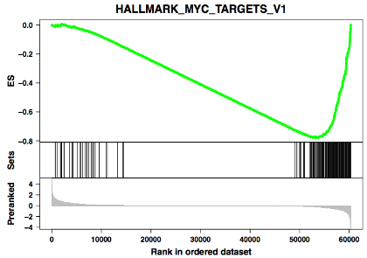
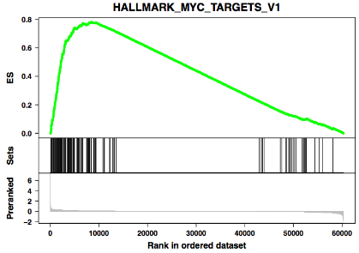
Transcriptome: circRNAs
KD38
OE38

Slide 35
Pathway
Prostate Cancer
Genome
Epigenome & Transcriptome
Proteome
Integration
Summary

Slide 36
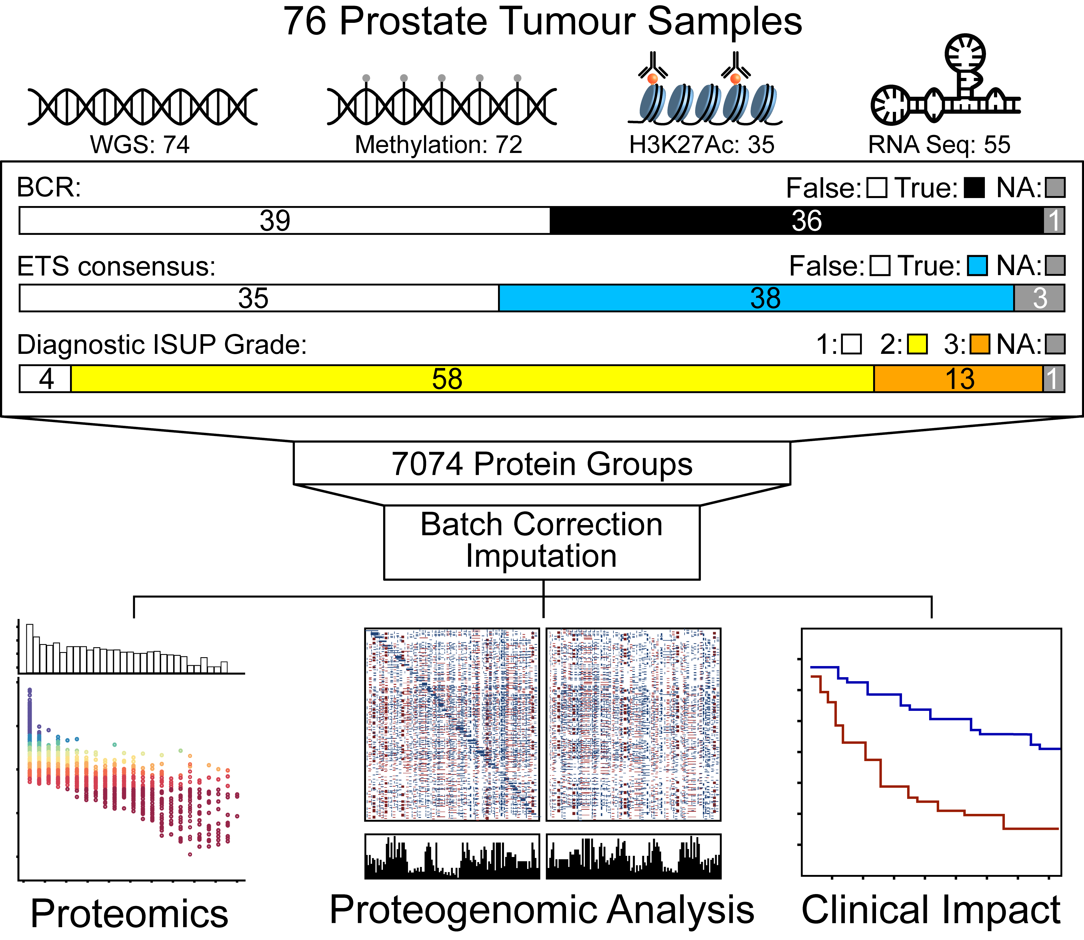
What About the Proteome?

Slide 37
Protein Has Greater Dynamic Range
Sinha et al. Cancer Cell (in press)

Slide 38
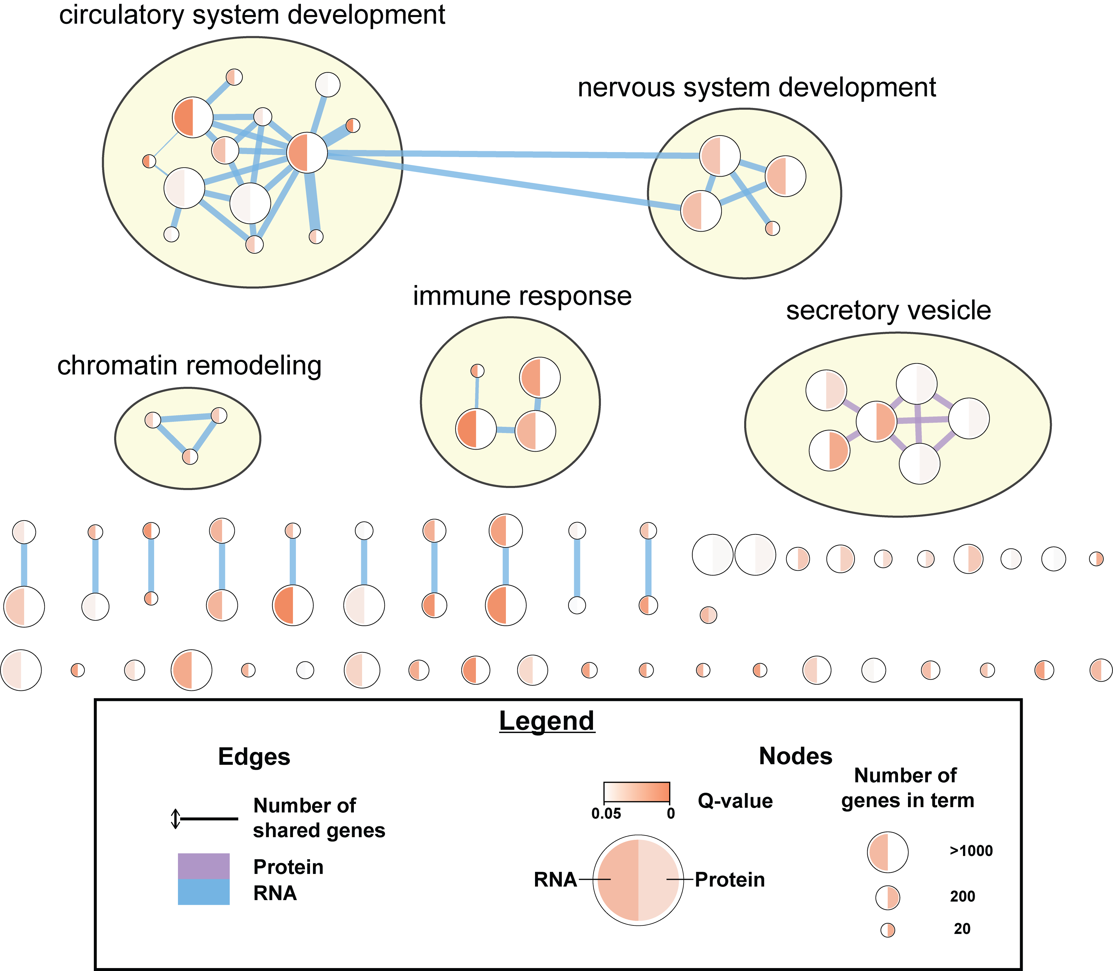
Divergent Pathways from RNA & Protein

Slide 39
Protein Weakly Associated to RNA
Sinha et al. Cancer Cell (in press)

Slide 40
RNA Complements Protein Biomarkers
Sinha et al. Cancer Cell (in press)

Slide 41
Pathway
Prostate Cancer
Genome
Epigenome & Transcriptome
Proteome
Integration
Summary

Slide 42
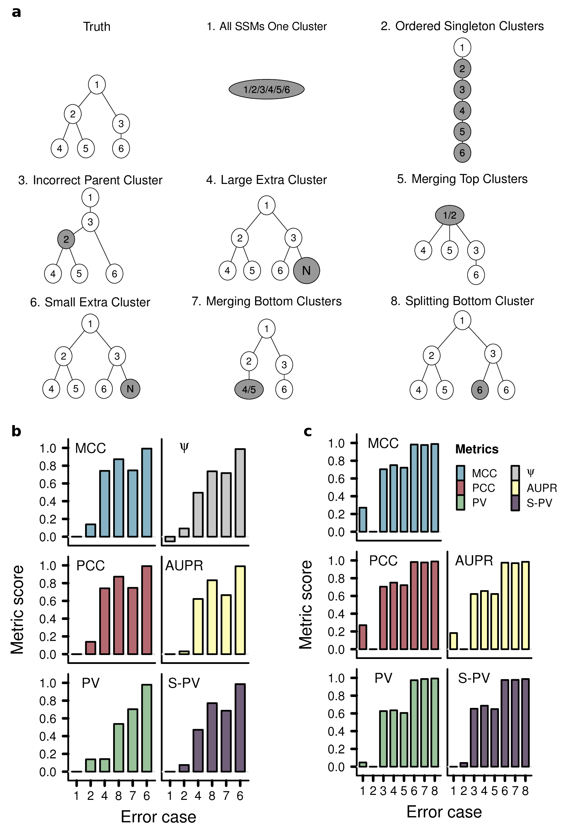
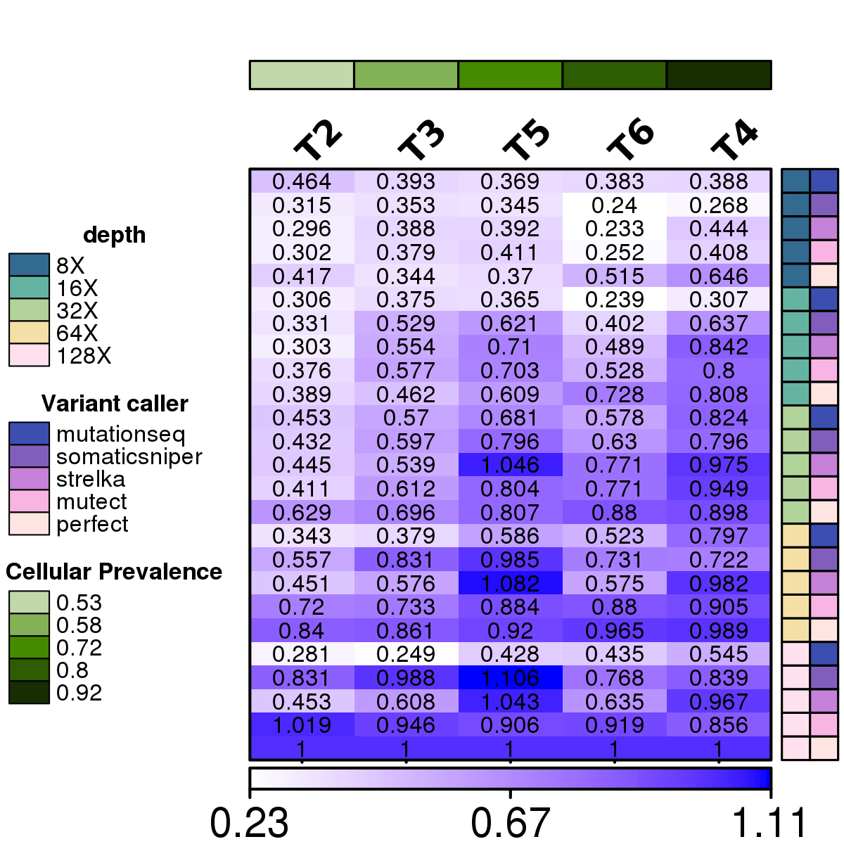
Algorithm Benchmarking: SMC-Het
Salcedo et al. in review

Slide 43
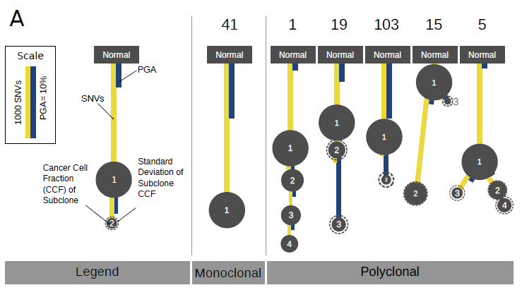
Perhaps it matters how we get there?
Espiritu et al. Cell 2018

Slide 44
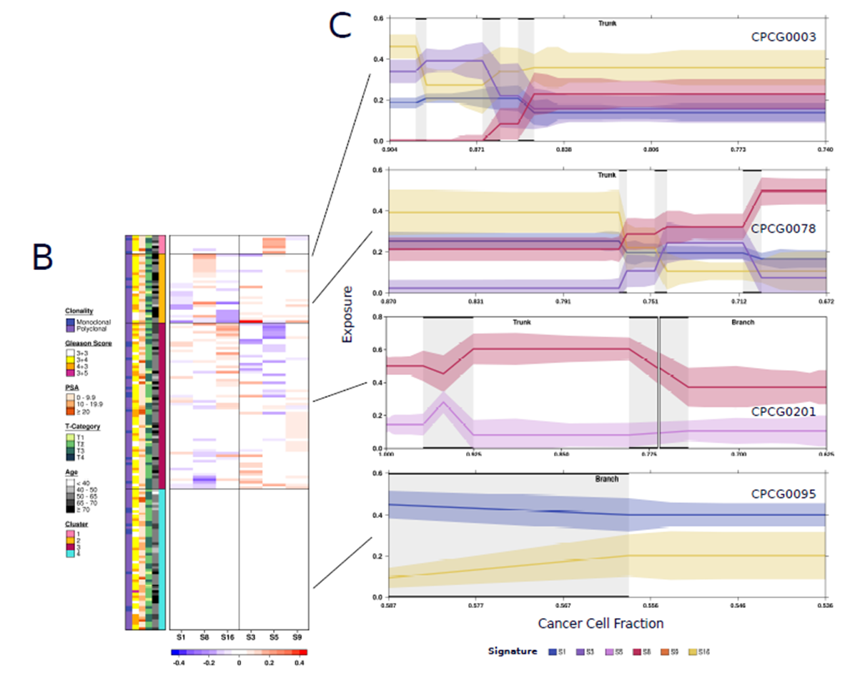
Changing Mutational Processes During Evolution

Slide 45
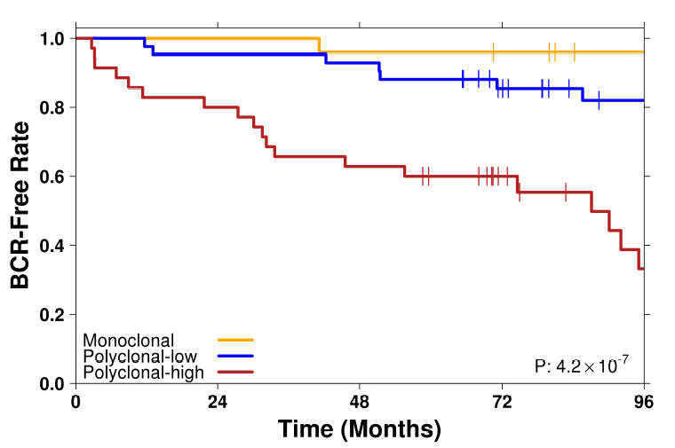
Evolution Drives Aggressivity
Monoclonal
Normoxic
Stable
MRI-invisible
IDC/CA
Polyclonal
Hypoxic
Unstable
MRI-visible
IDC/CA

Slide 46
Summary
Biomarkers can overcome spatial heterogeneity by considering tumour:
Mutation Density
Histology
Micro-Environment
Radiologic Visibility
Evolutionary Features
Actively working via the EDRN to translate these to non-invasive diagnostics (Semmes, Kislinger, Nyalwidhe)
These data call for composite germline, somatic, imaging and fluid biomarkers to diagnose, prognose and monitor progression.
These studies required extensive inter-disciplinary team-work and collaboration (and funding!).

Slide 47

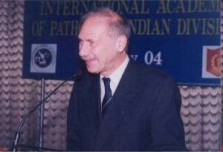
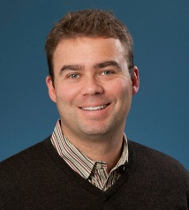
CPC-GENE: The People Involved
Dr. Robert Bristow
Dr. Theodore van der Kwast
Dr. Thomas Kislinger
PIs & PMs
Melania Pintilie
Hansen He
John McPherson
Colin Collins
Michael Fraser
Thomas Hudson
Mathieu Lupien
-Omics
Taryne Chong
Ankit Sinha
Michelle Sam
Jeremy Johns
Lee Timms
Nicholas Buchner
Ada Wong
Boutros Lab
Julia Hopkins
Sujun Chen
Vinayak Bhandari
Vincent Huang
Emilie Lalonde
Takafumi Yamaguchi
Katie Houlahan
Julie Livingstone
Natalie Fox
Sylvia Shiah
Lawrence Heisler
Shadrielle Espiritu
Veronica Sabelnykova
Informatics
Timothy Beck
Fouad Yousif
Robert Denroche
Xuemei Luo
Clinico-Molecular
Dominique Trudel
Alice Meng
Alejandro Berlin
Melvin Chua

Slide 48
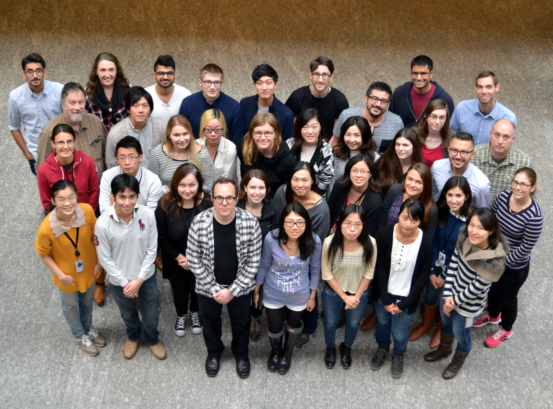
Questions?
Positions Available: pboutros@mednet.ucla.edu

