Slide 1
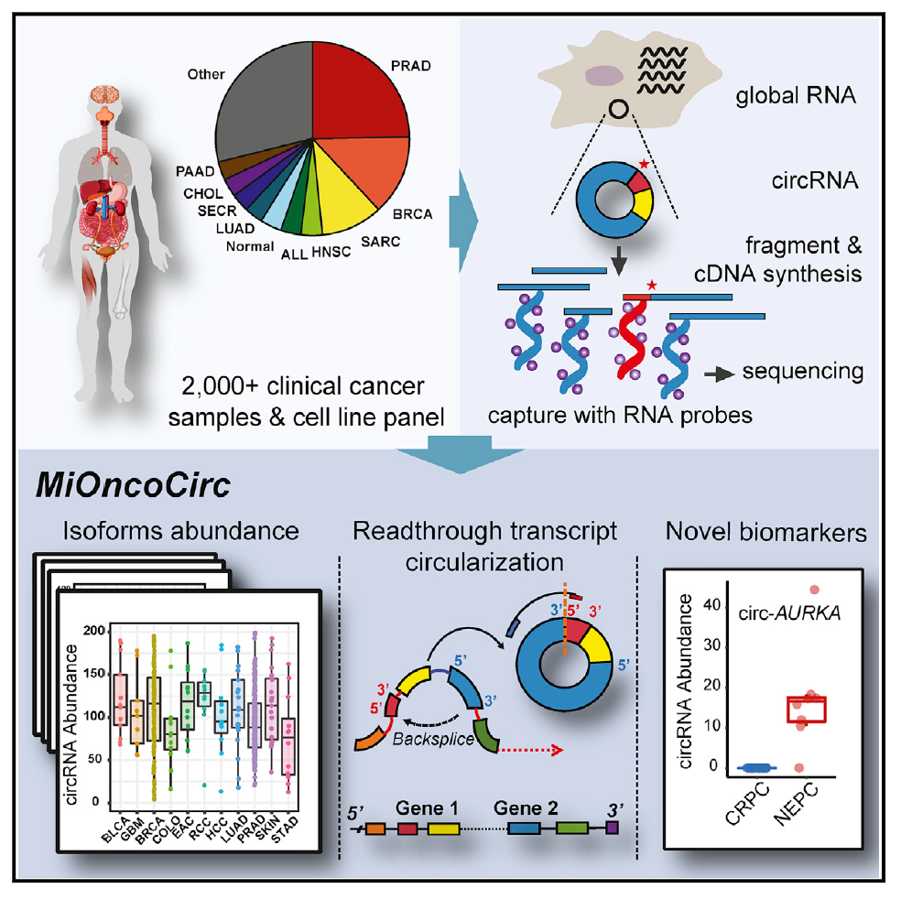
Development of Circular RNAs as Cancer Biomarkers
Arul M. Chinnaiyan, M.D., Ph.D.
EDRN BDL
University of Michigan
Howard Hughes Medical Insitute

Slide 2

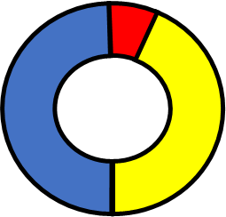
circRNAs
Class of non coding RNA formed from pre-mRNAs through backsplicing (first characterized >25 years ago)
Single-stranded and covalently closed; lack Poly A
RNA seq based technologies have discovered thousands of circRNAs
Often expression does not correlate with cognate linear RNA
Varied biological roles have been suggested (e.g., miRNA sponges, EMT, tumorigenesis)
Due to their covalently closed structure are resistant to exonucleases
Due to enhanced stability can be found in biospecimens such as plasma
Circular Exonic RNA

Slide 3
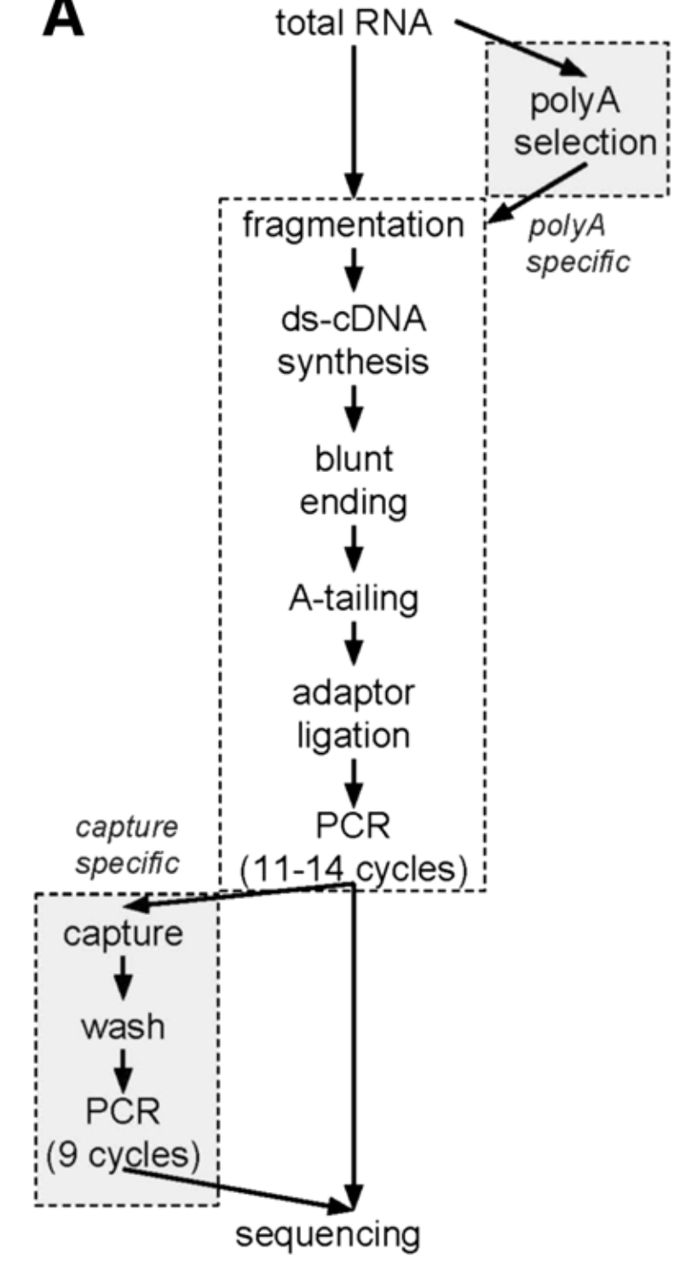
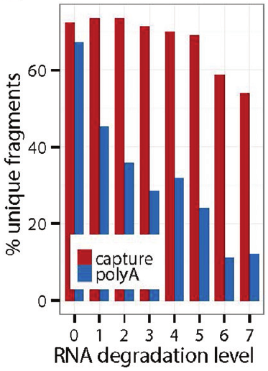
Cieślik et. al, Genome Research 2015

Slide 4
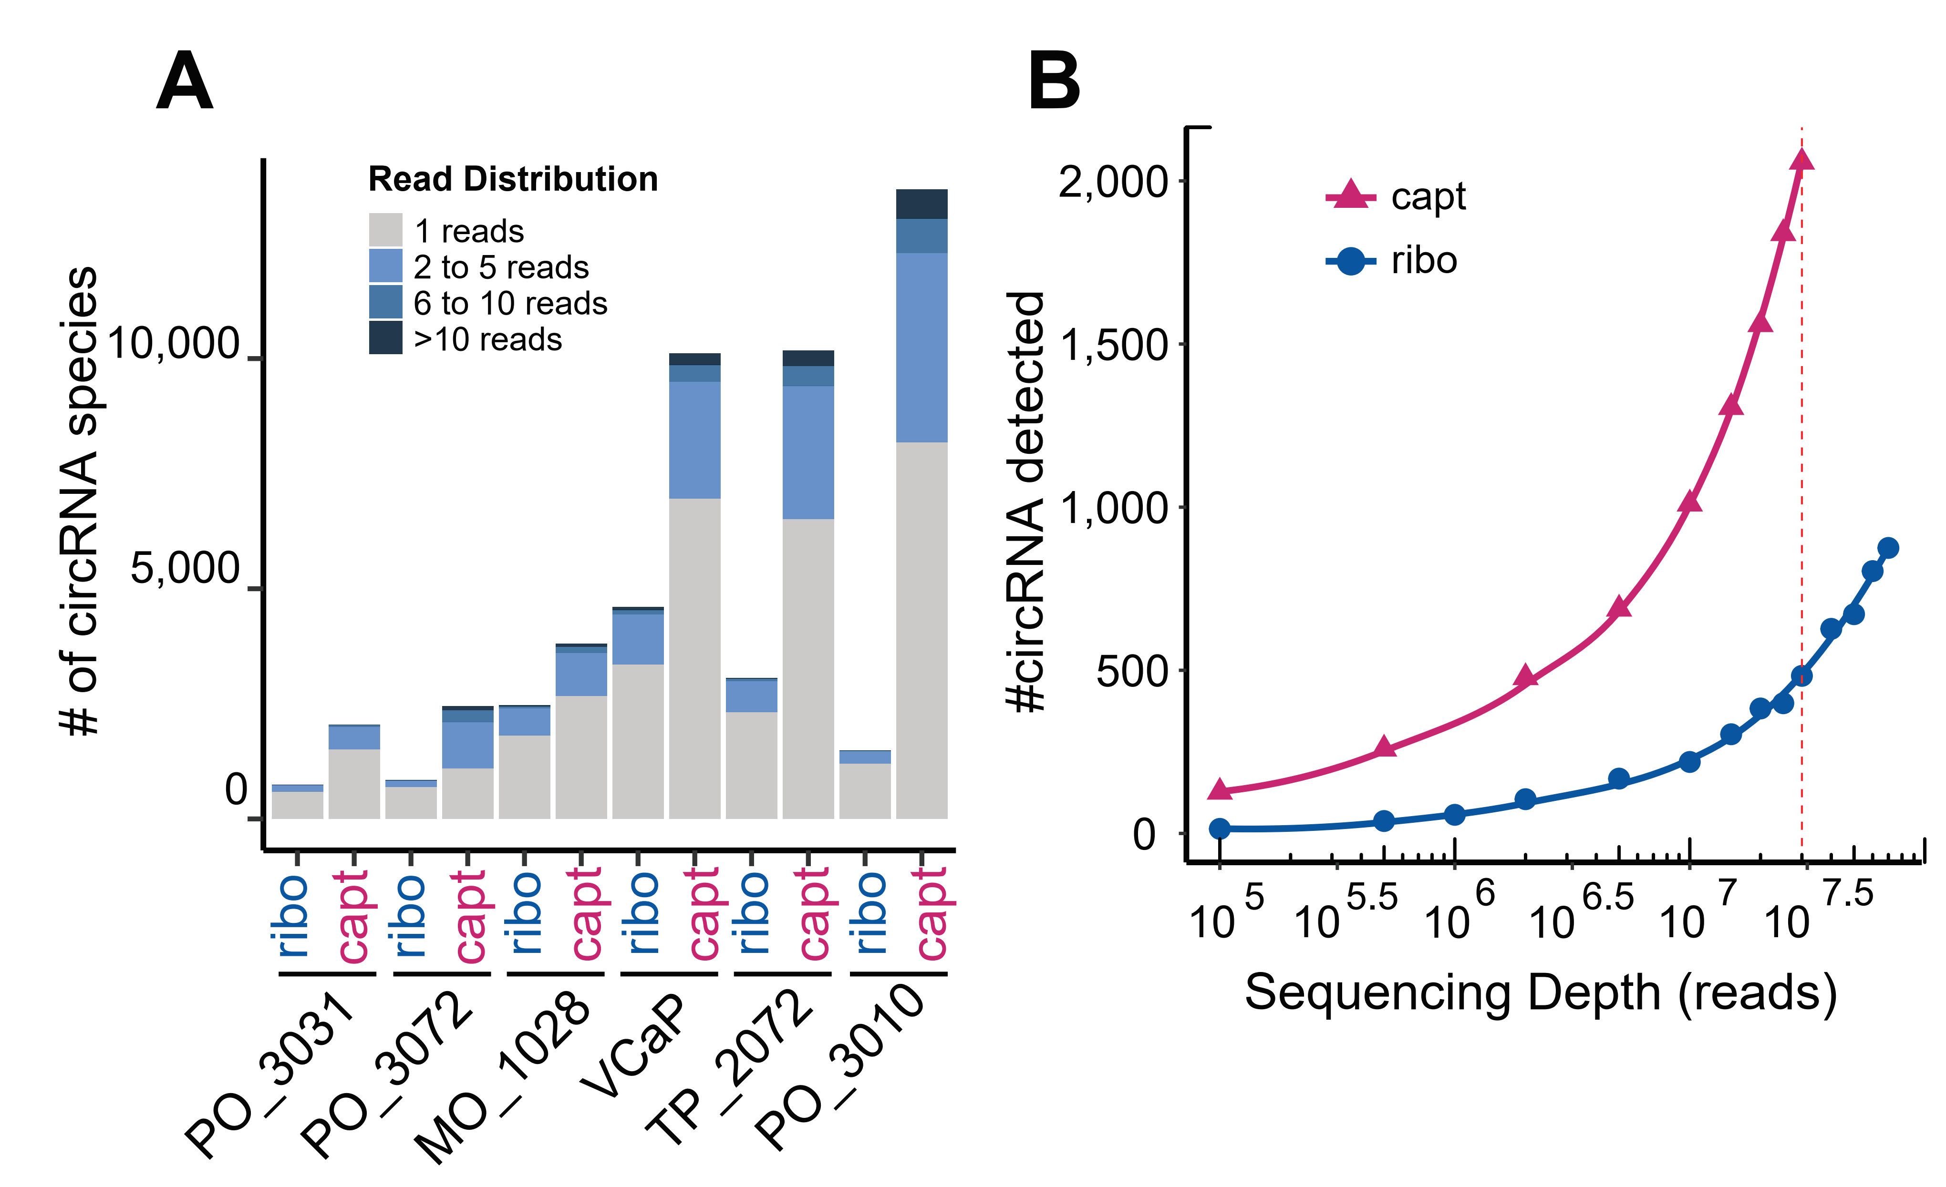
Exome Capture RNA-Seq Is an Effective Method
to Profile circRNAs

Slide 5
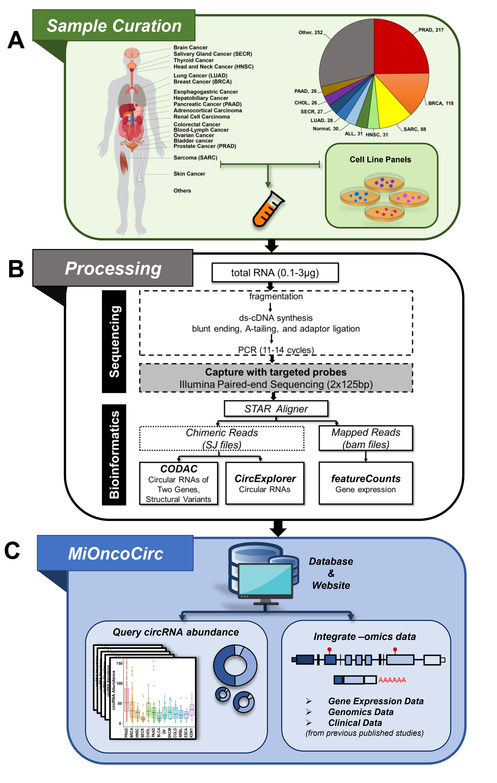
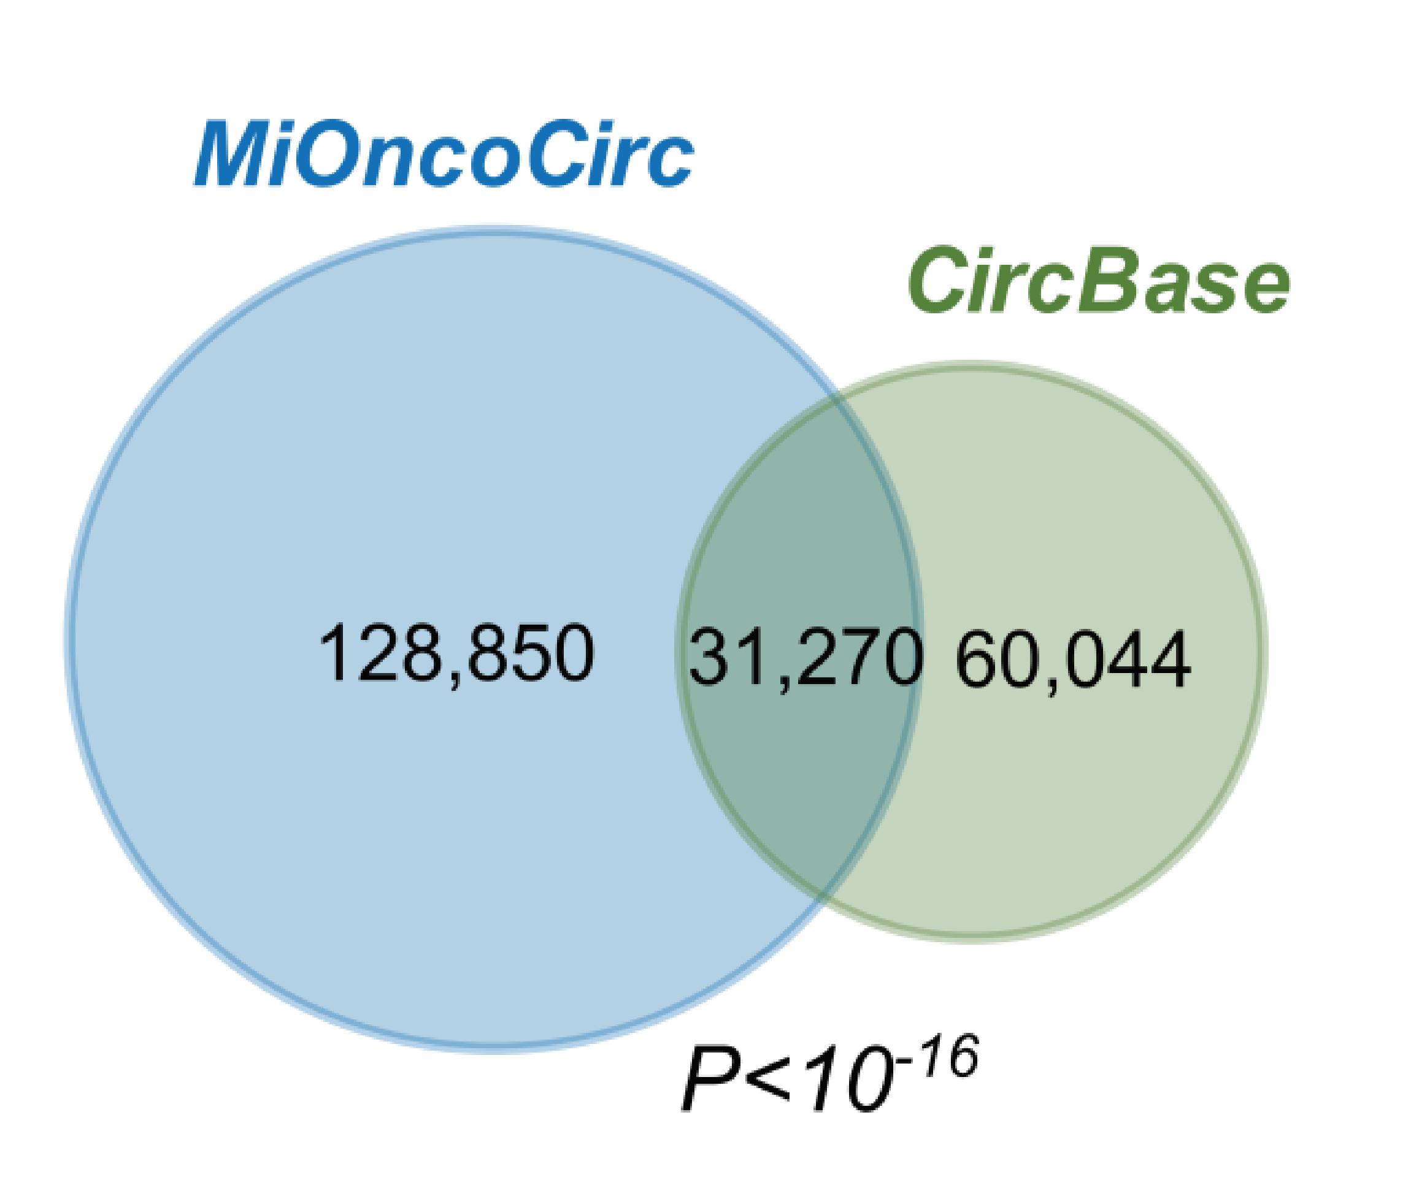
Building the MiOncoCirc Compendium with Exome
Capture RNA-Seq
>2000 tumors, >30 tumor types, > 30 metastatic sites
Vo et al Cell 2019

Slide 6
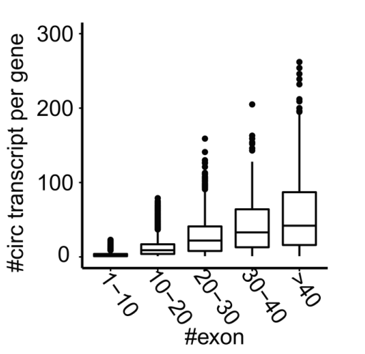
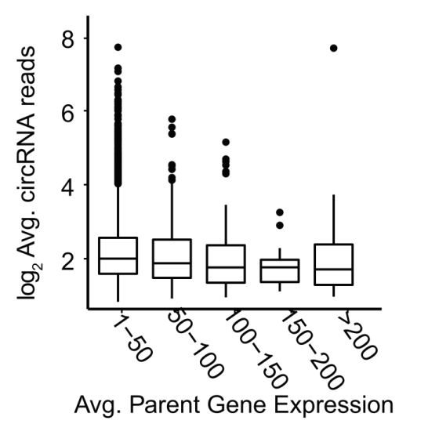
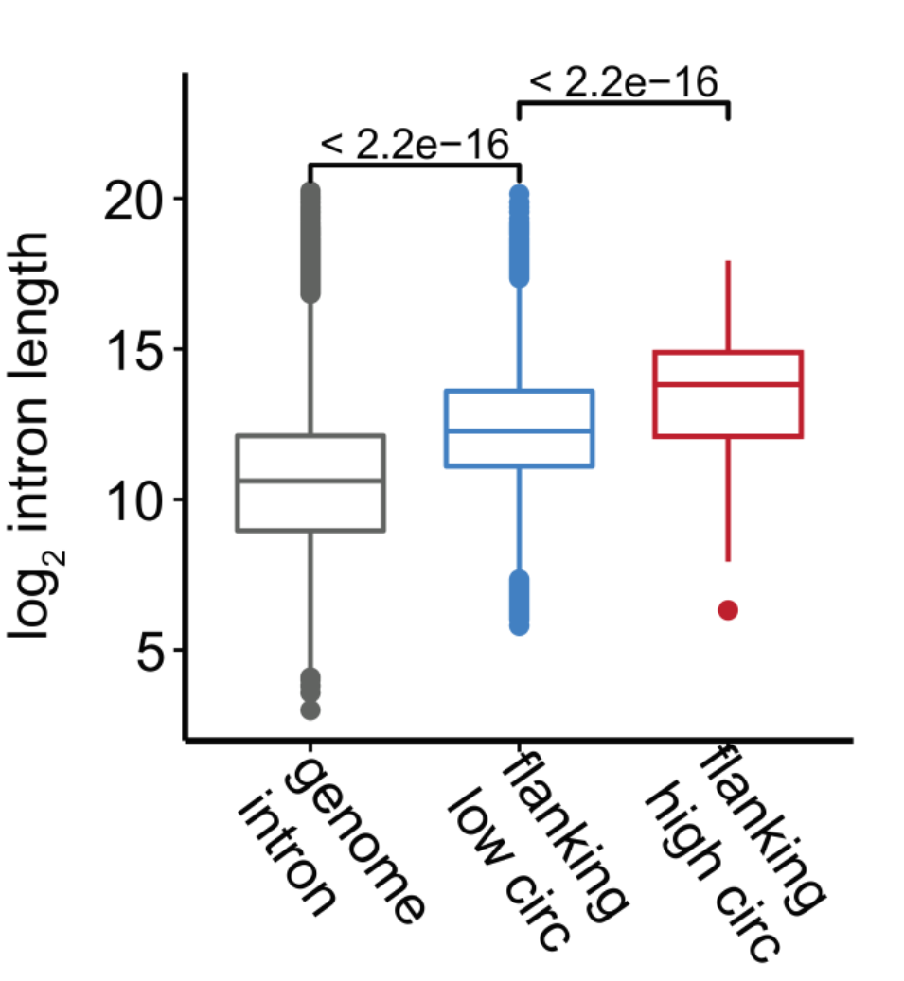
Characteristics of circRNAs in MiOncoCirc

Slide 7
Identification of novel read-through circRNAs

Slide 8
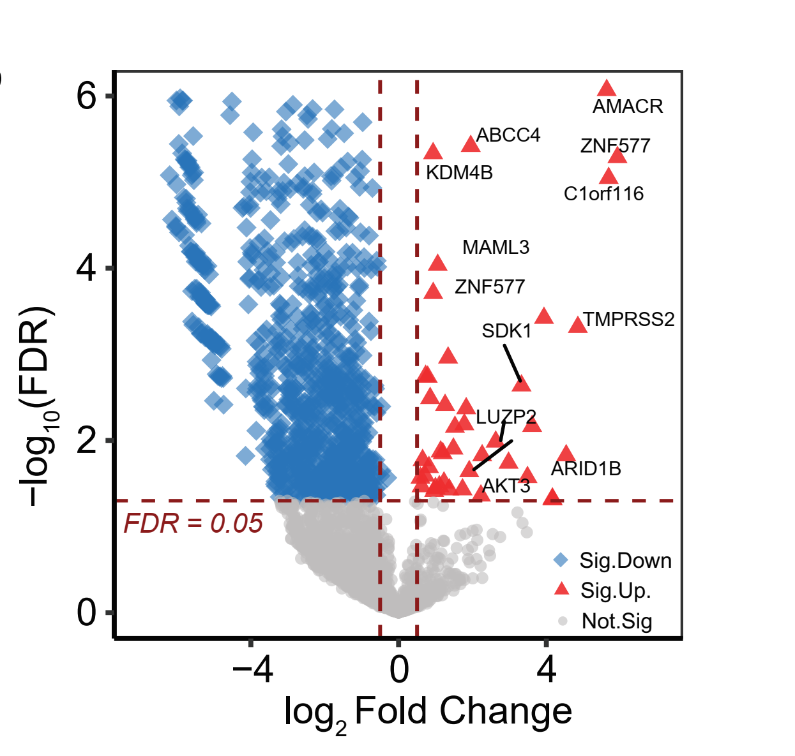
Expression Patterns and Characteristics of circRNAs in Cancer

Slide 9
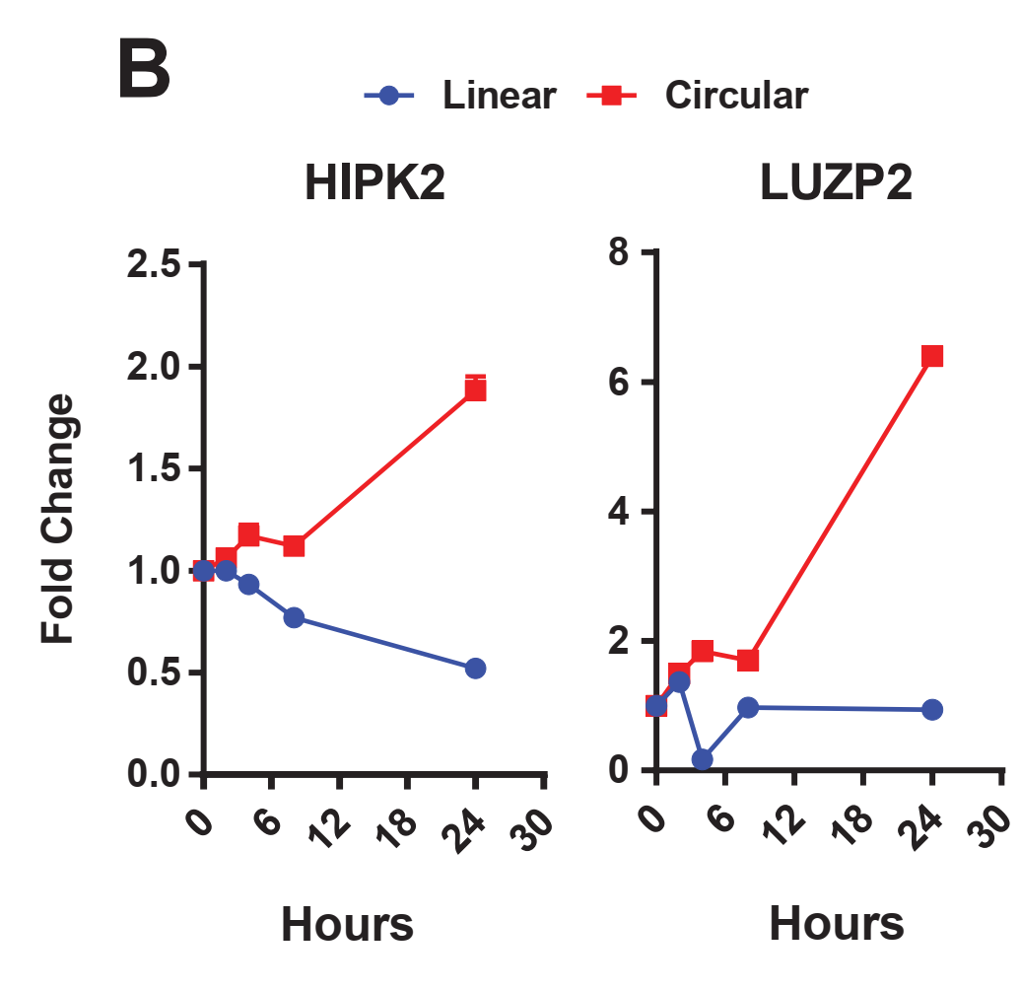
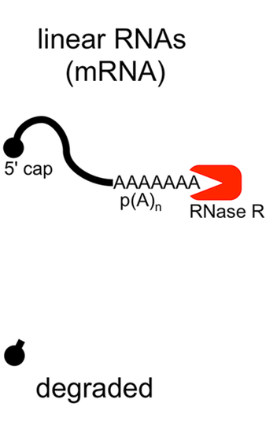
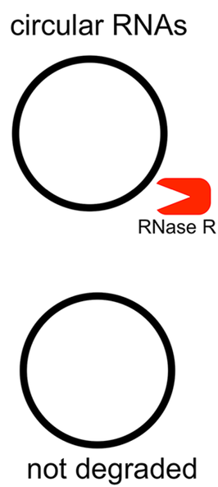
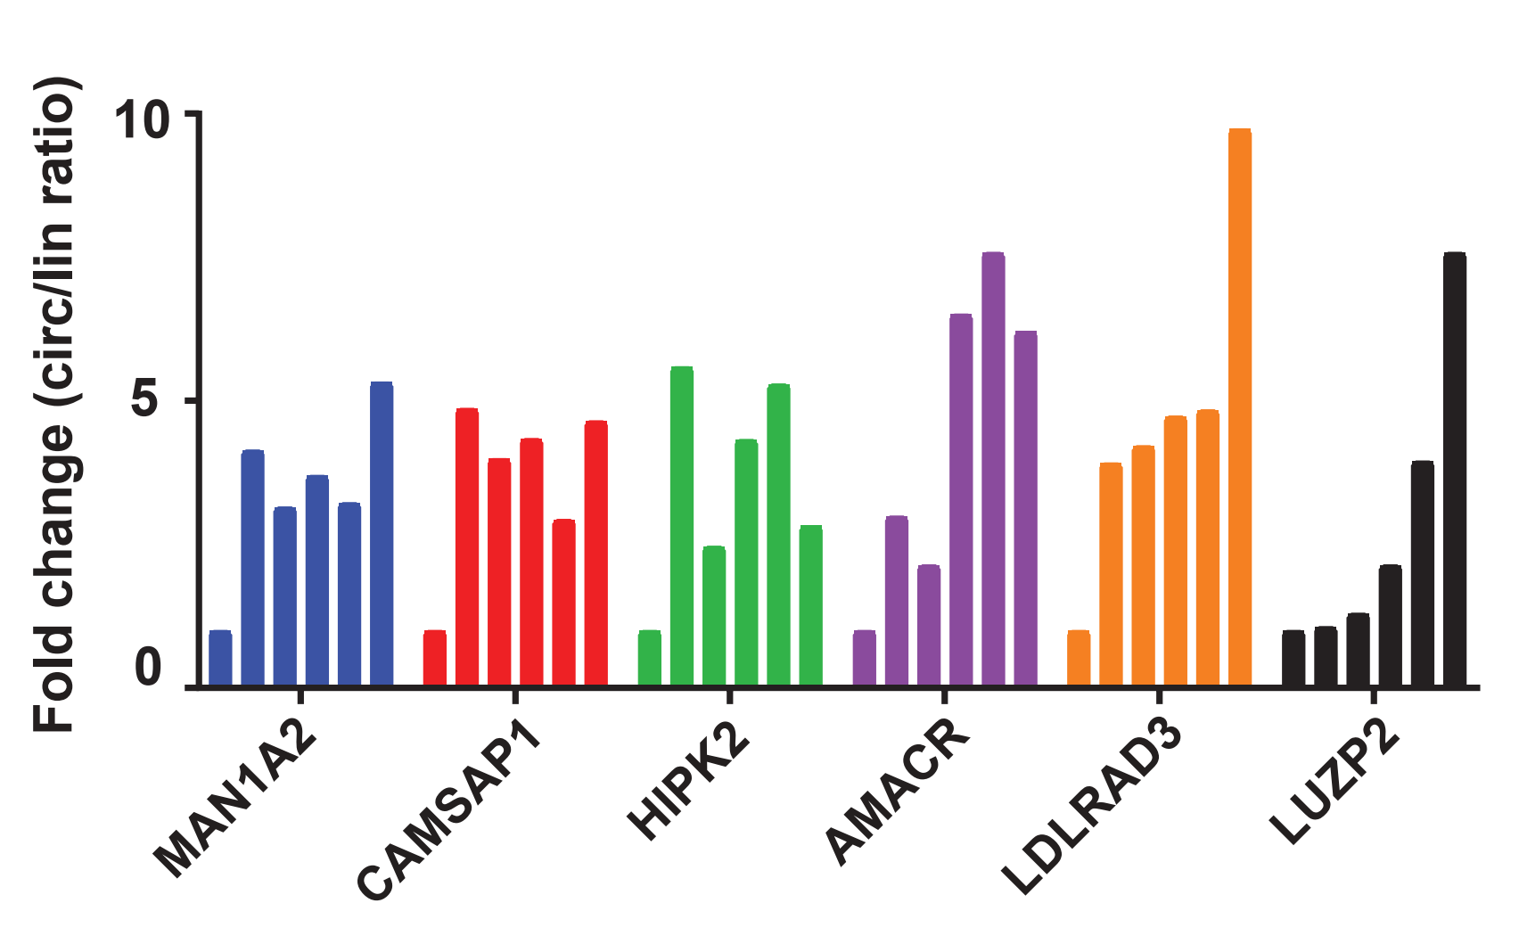
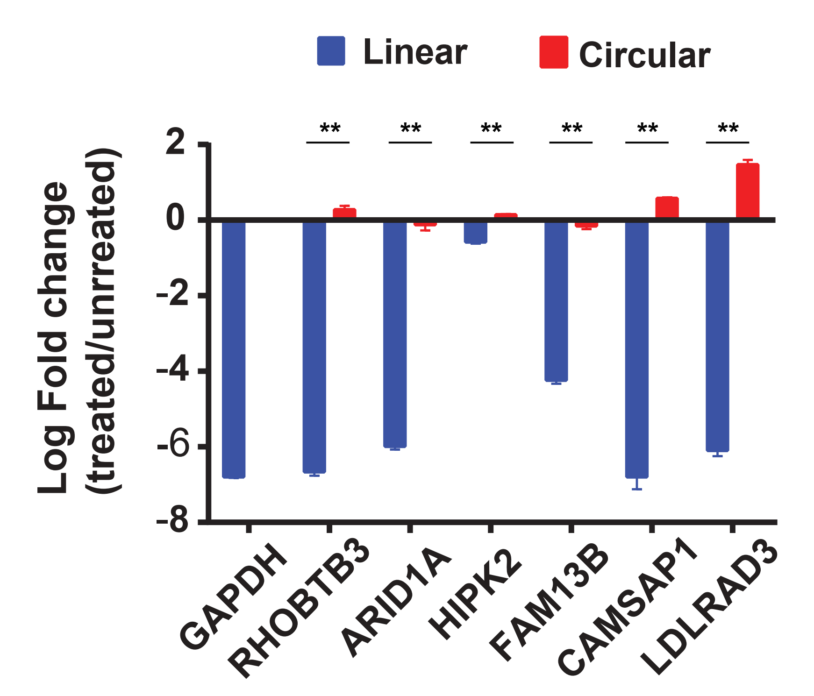
Assess the Stability of CircRNAs in Extracellular Spaces
Assess the Stability of CircRNAs in Extracellular Spaces
Incubate RNA in human plasma → “Mimic” circulating RNAs in blood
Samples were harvested at 0, 15, 30, 45, 60, and 75 min.

Slide 10
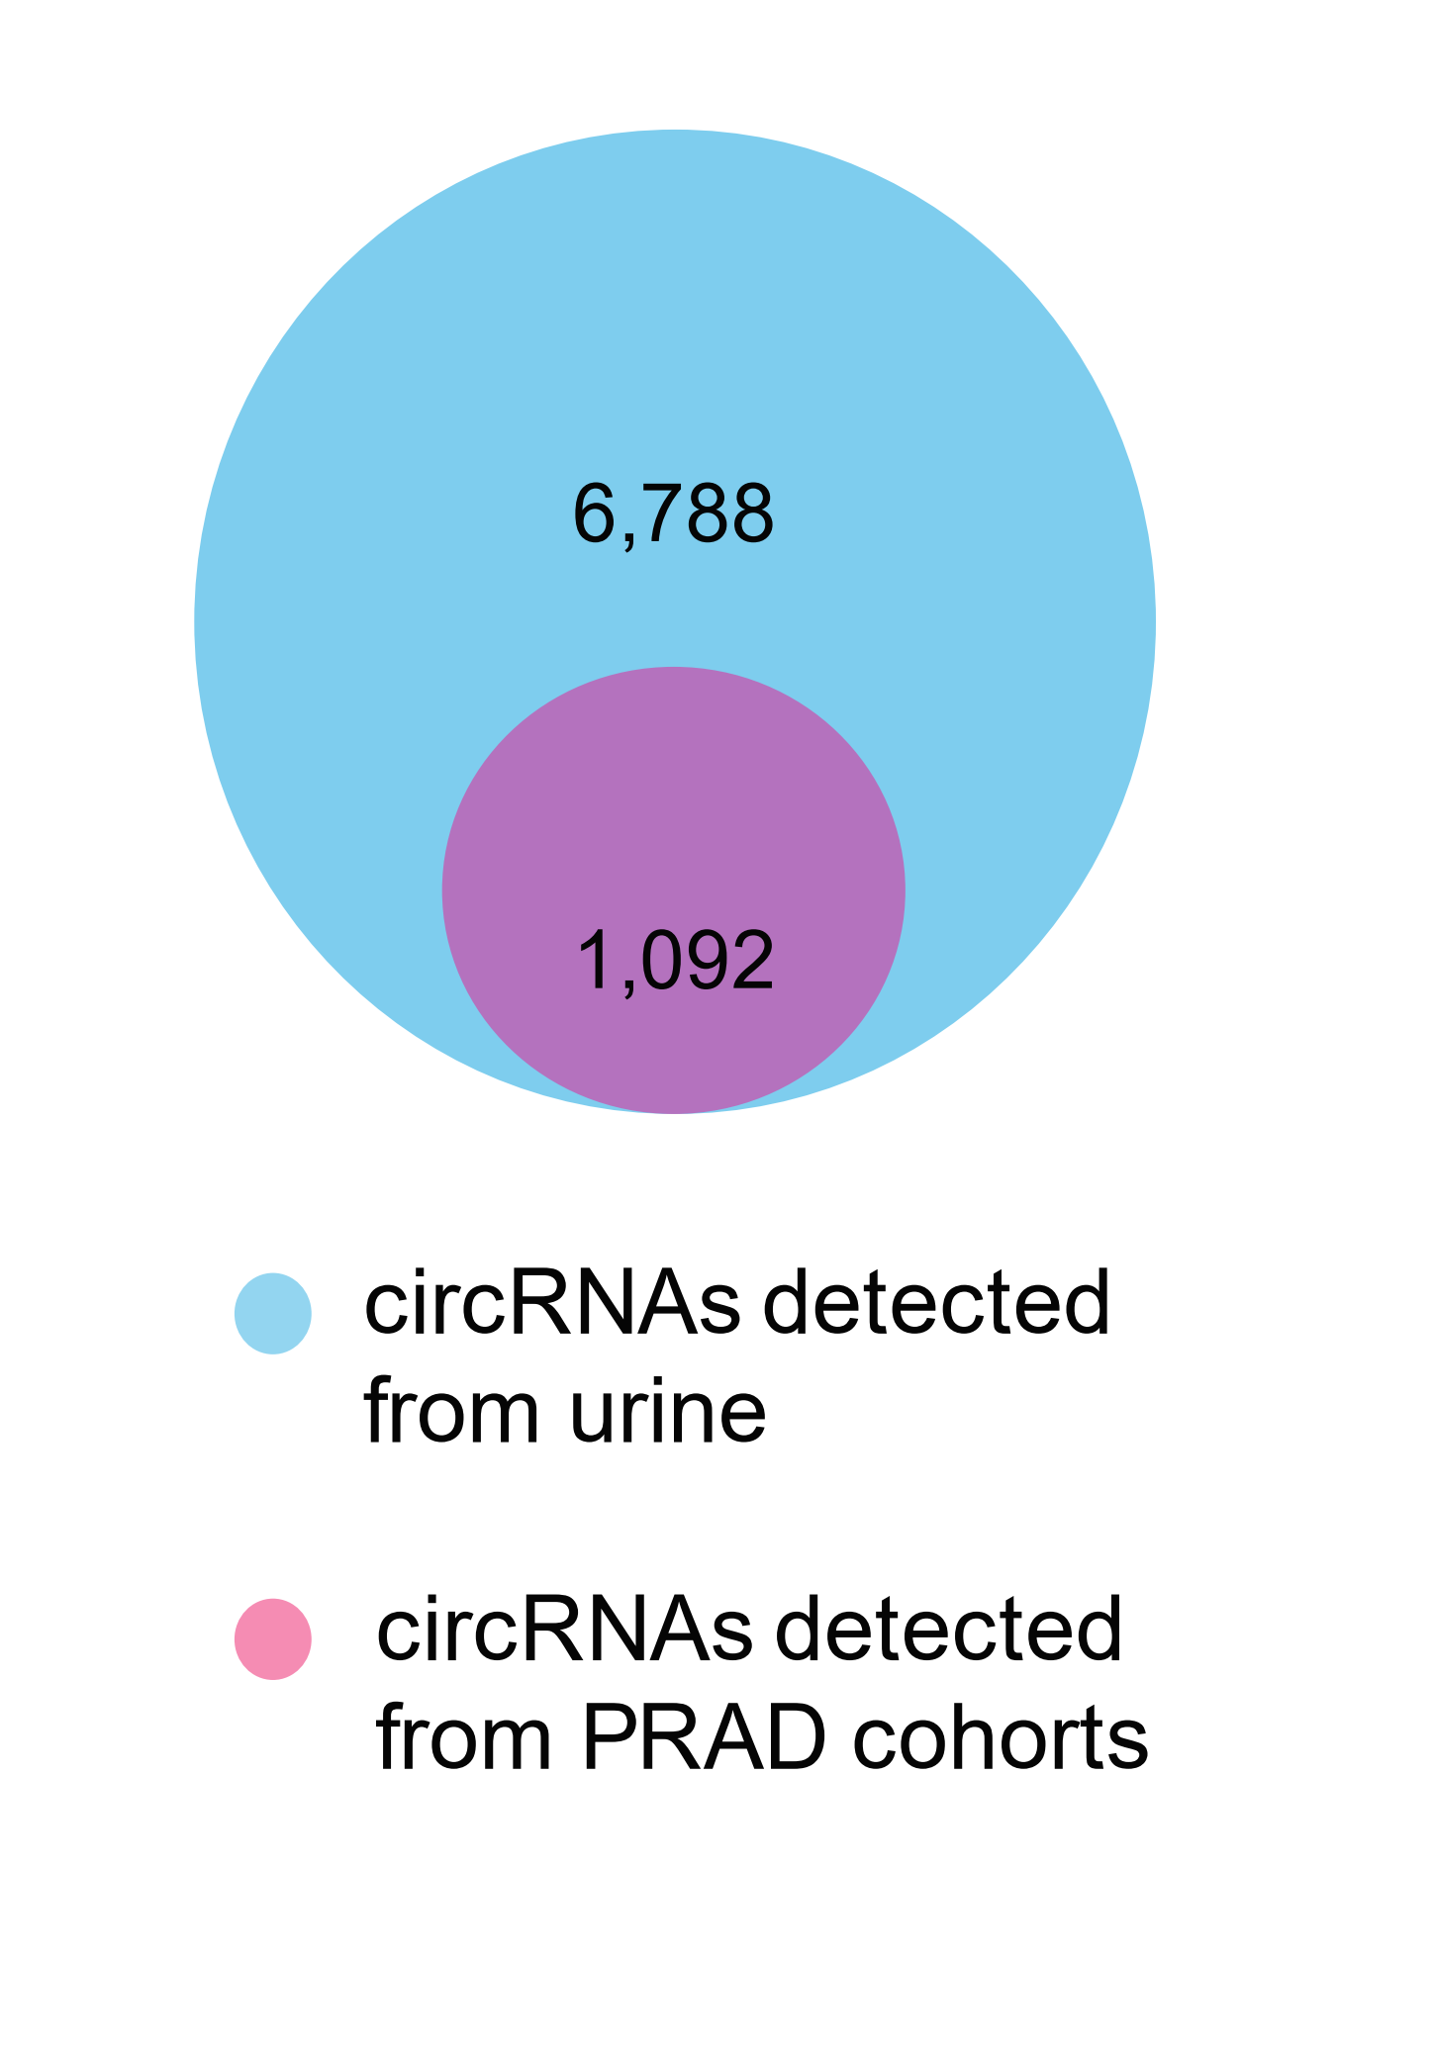
circRNAs Detectable in Urine
Capture RNA-Seq
qRT-PCR

Slide 11
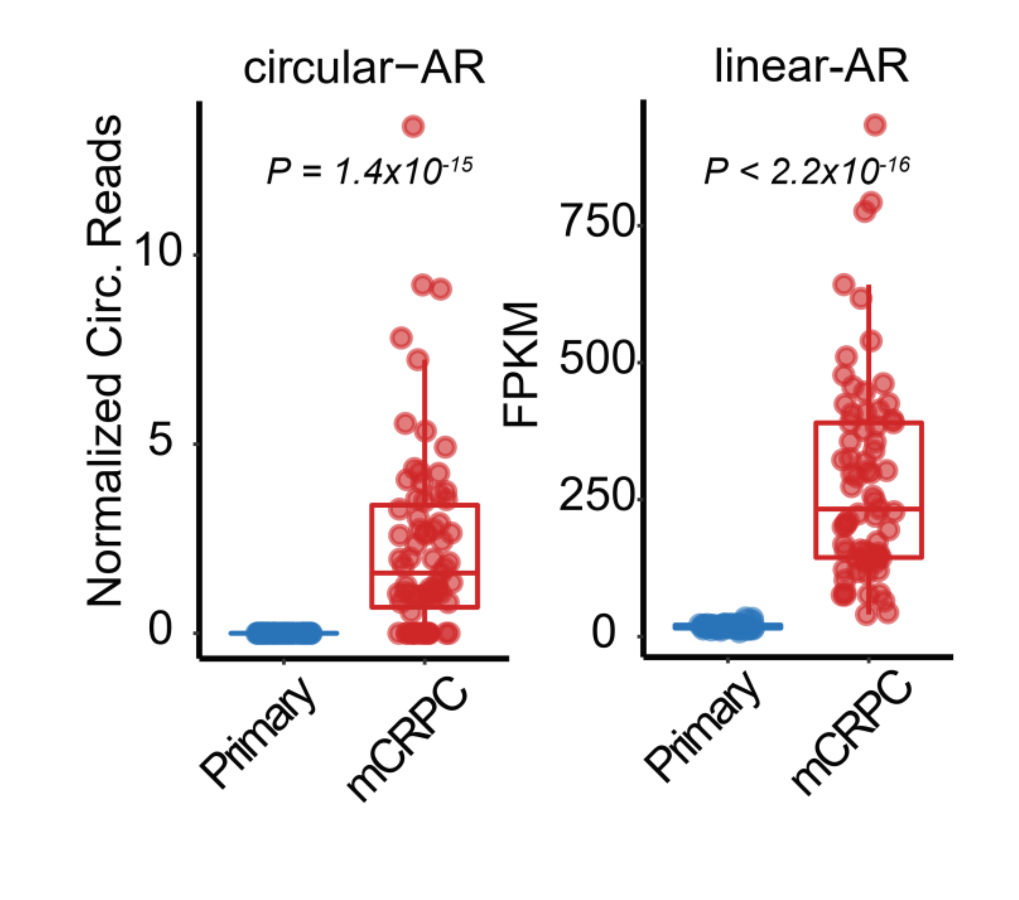
circRNA biomarkers of prostate cancer

Slide 12
Take home points
Capture exome RNA-seq is an efficient approach to detect (exon containing) circRNAs
We identified a novel class of circRNAs called read-through circRNAs
Many novel circRNAs identified employing a compendium of >2000 RNA-seq dataset of primarily advanced cancers
MiOncoCirc serves as resource to identify circRNA biomarkers from clinically obtained tumor samples
Tissue and cancer specific circRNAs were nominated
circRNAs are more stable than linear RNAs and thus can be detected in non-invasive samples (e.g., blood, urine, and saliva)

Slide 13

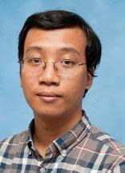
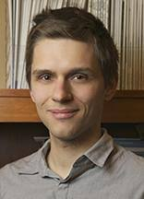

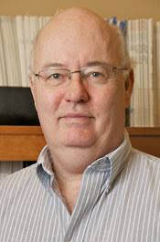
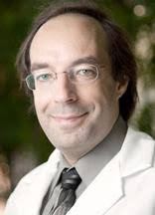


Acknowledgements
Yajia Zhang
Sudhanshu Shukla
Lanbo Xiao
Yuping Zhang
Yi-Mi Wu
Saravana M. Dhanasekaran
Carl Engelke
Xuhong Cao
Mi-Oncoseq Program
Josh N. Vo
Marcin Cieslik
Dan R. Robinson
Alexey I.
Nesvizhskii

Slide 14
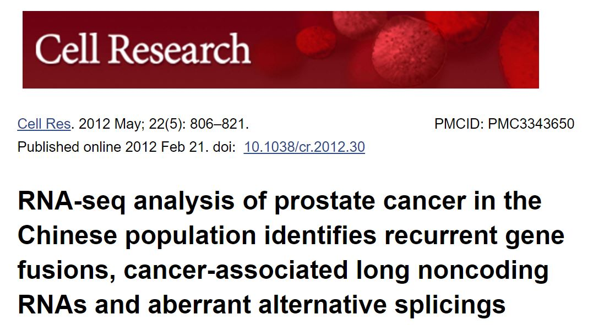
A “structural rearrangement” of USP9Y-TTTY15

Slide 15
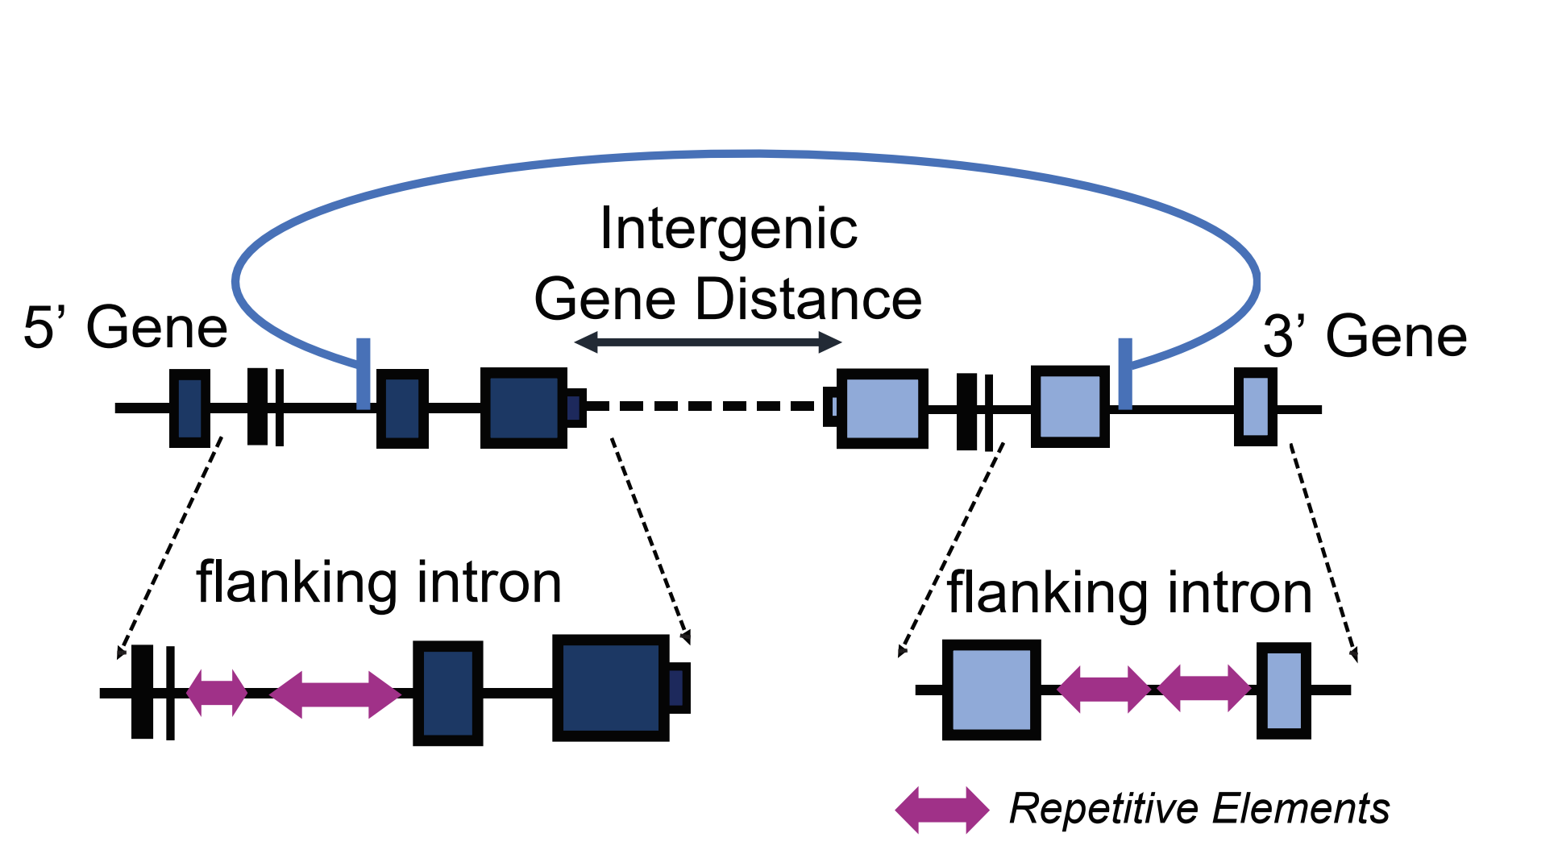
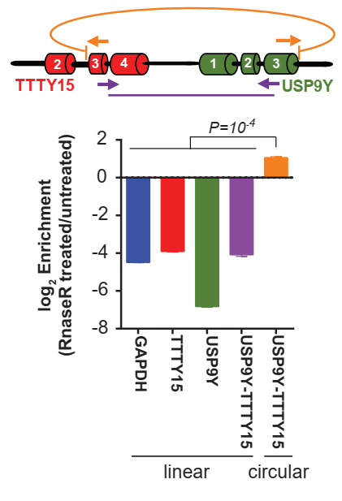
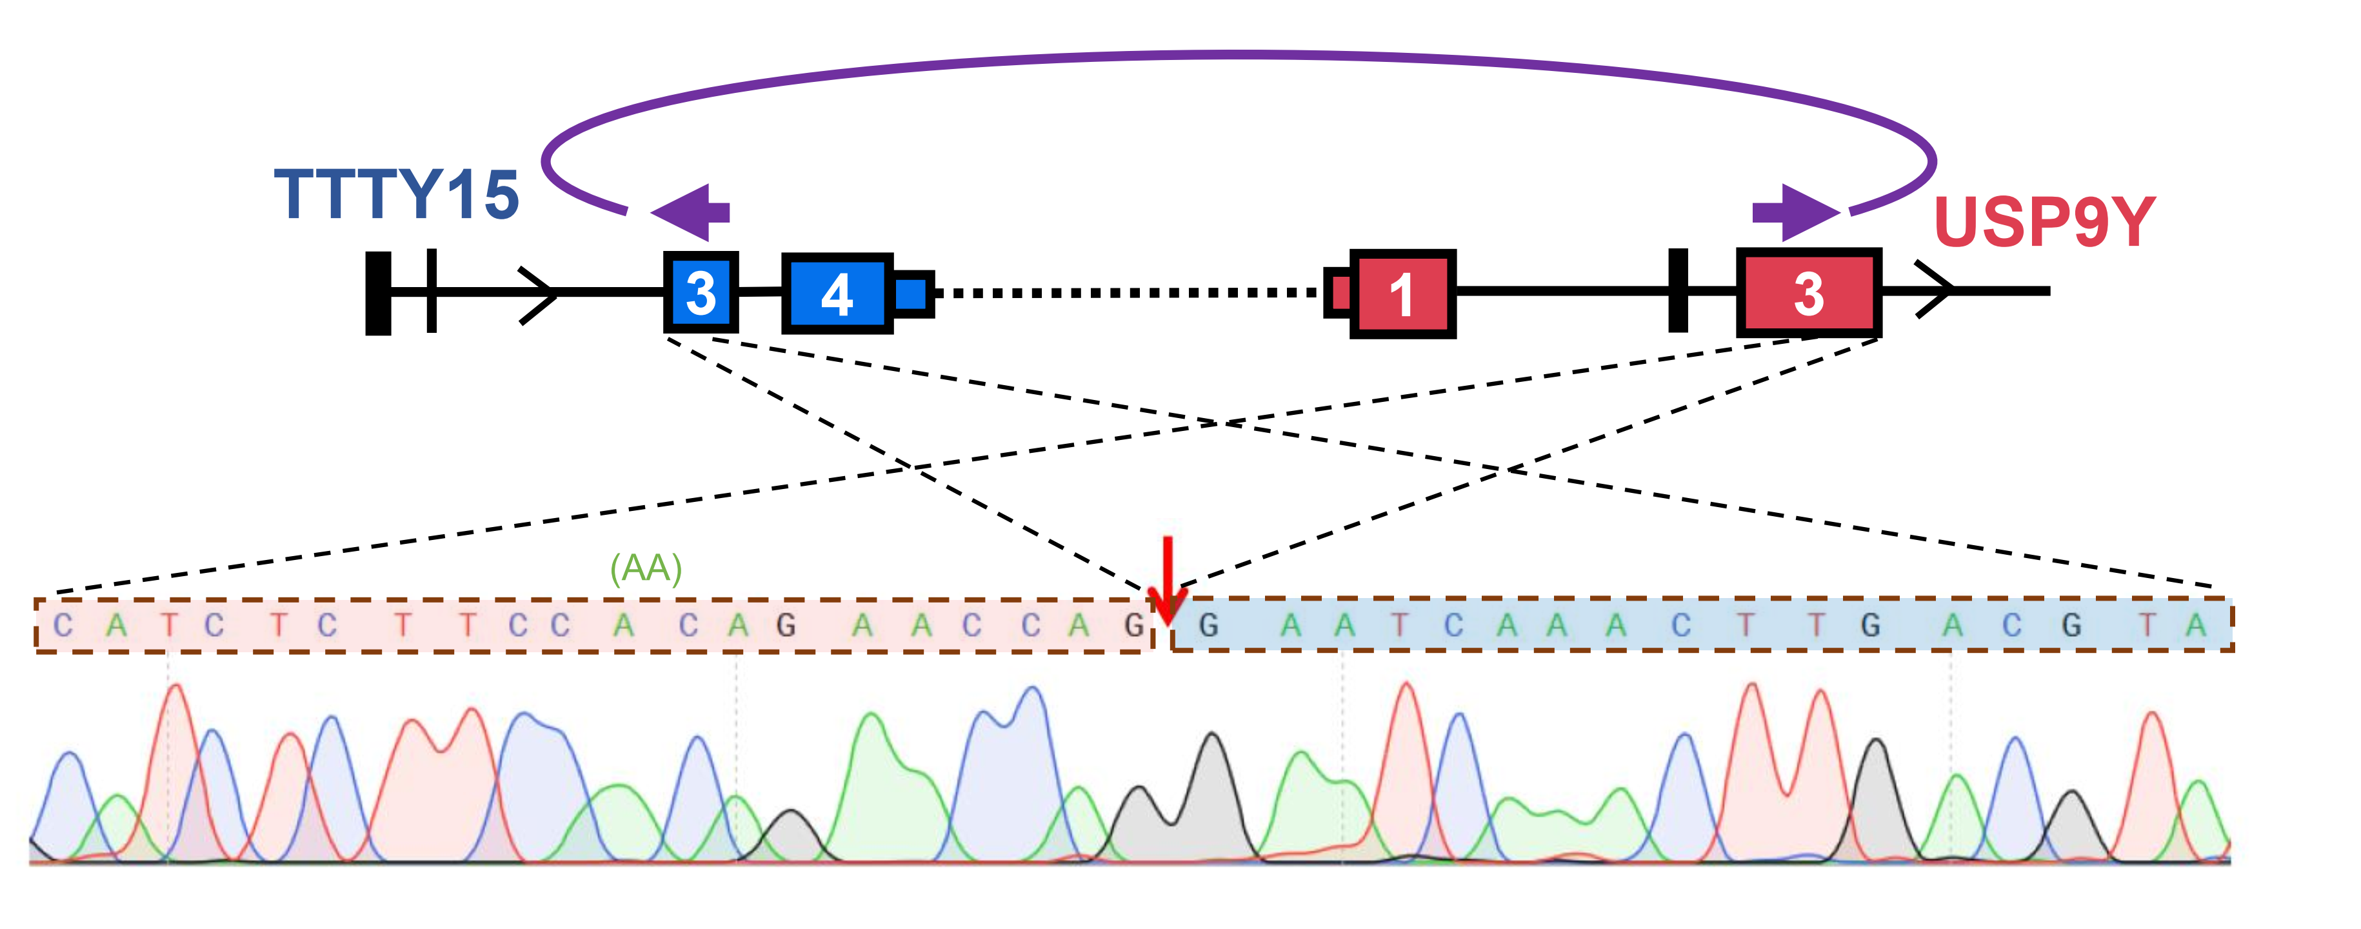

Slide 16
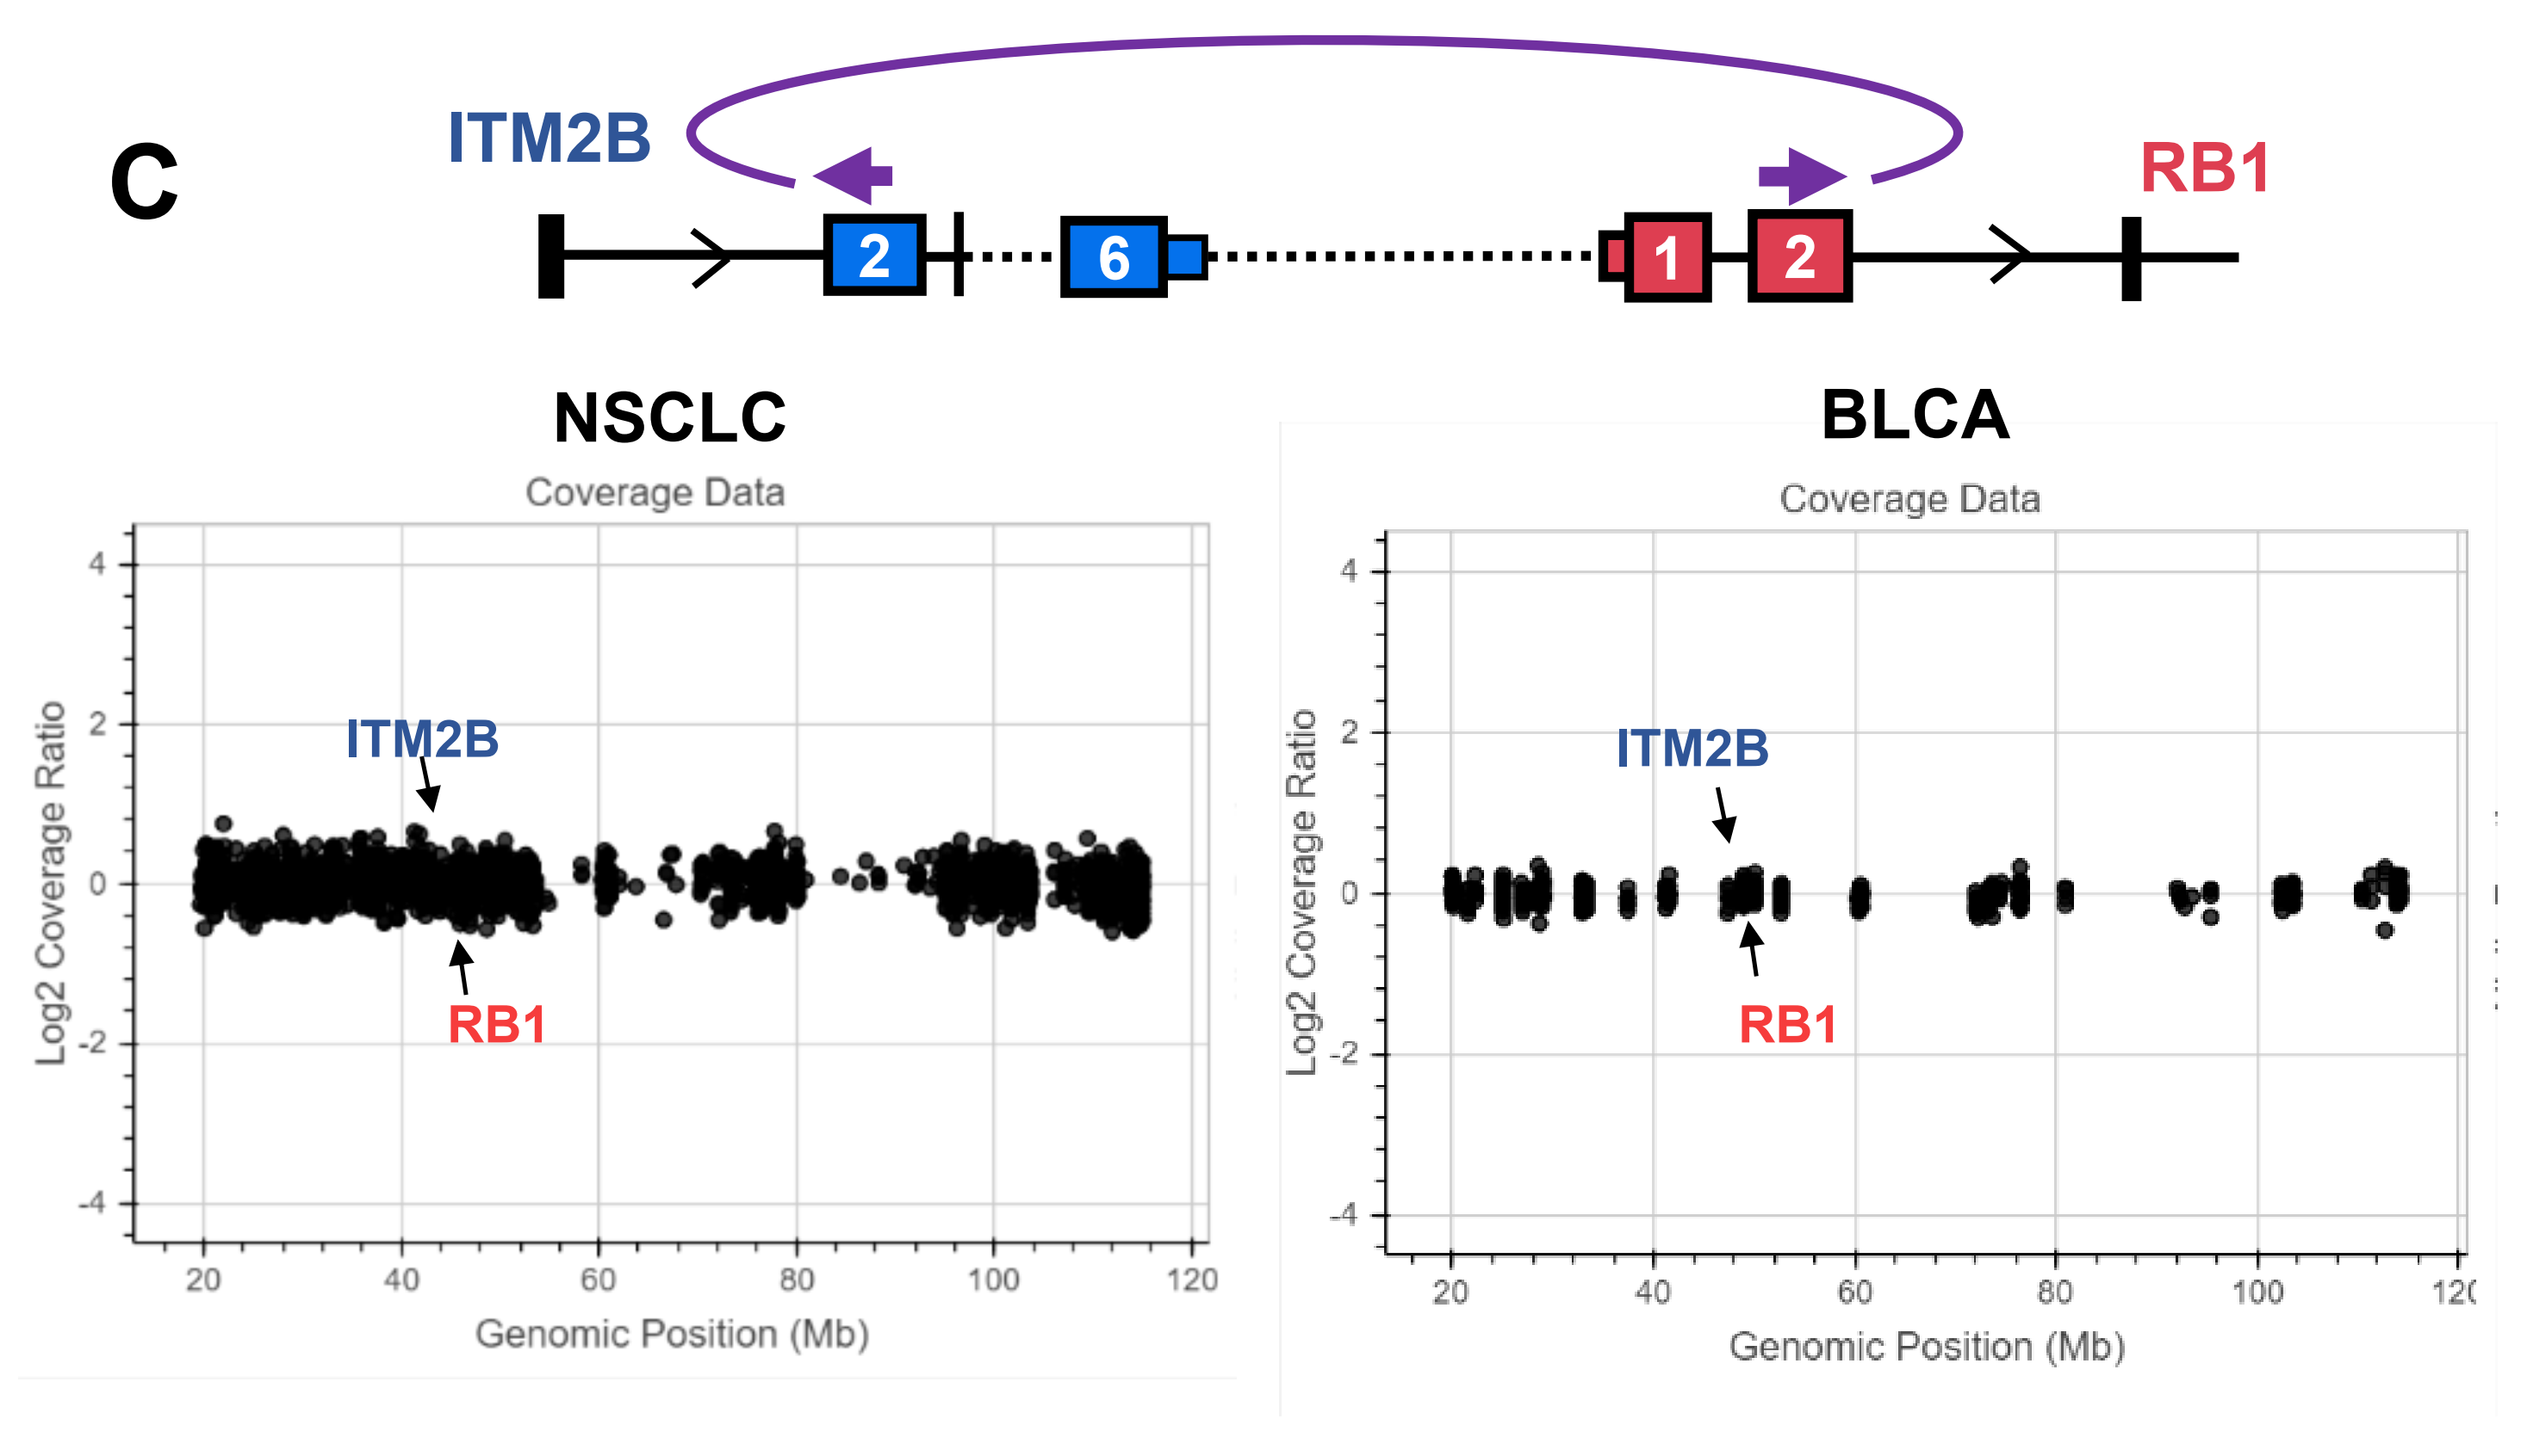
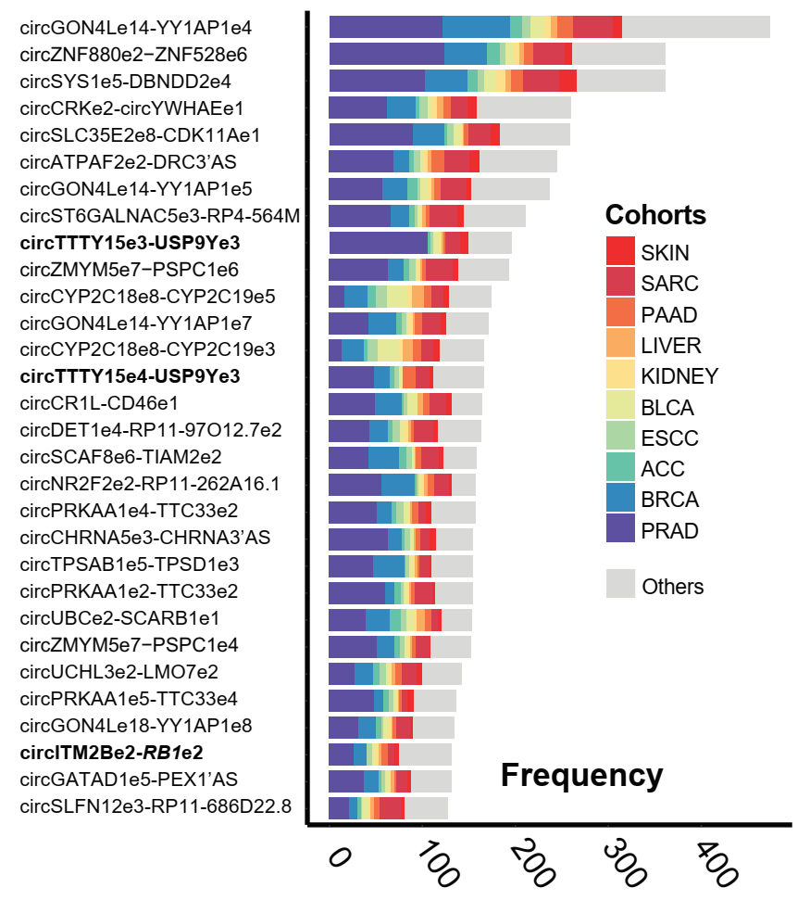
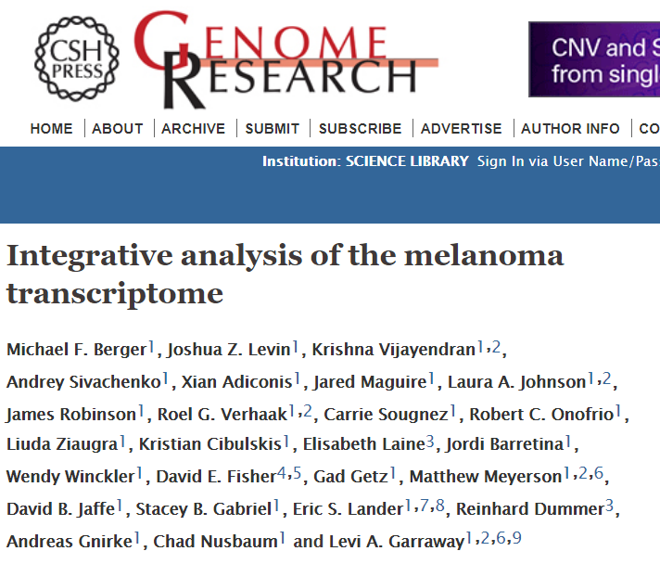

Slide 17
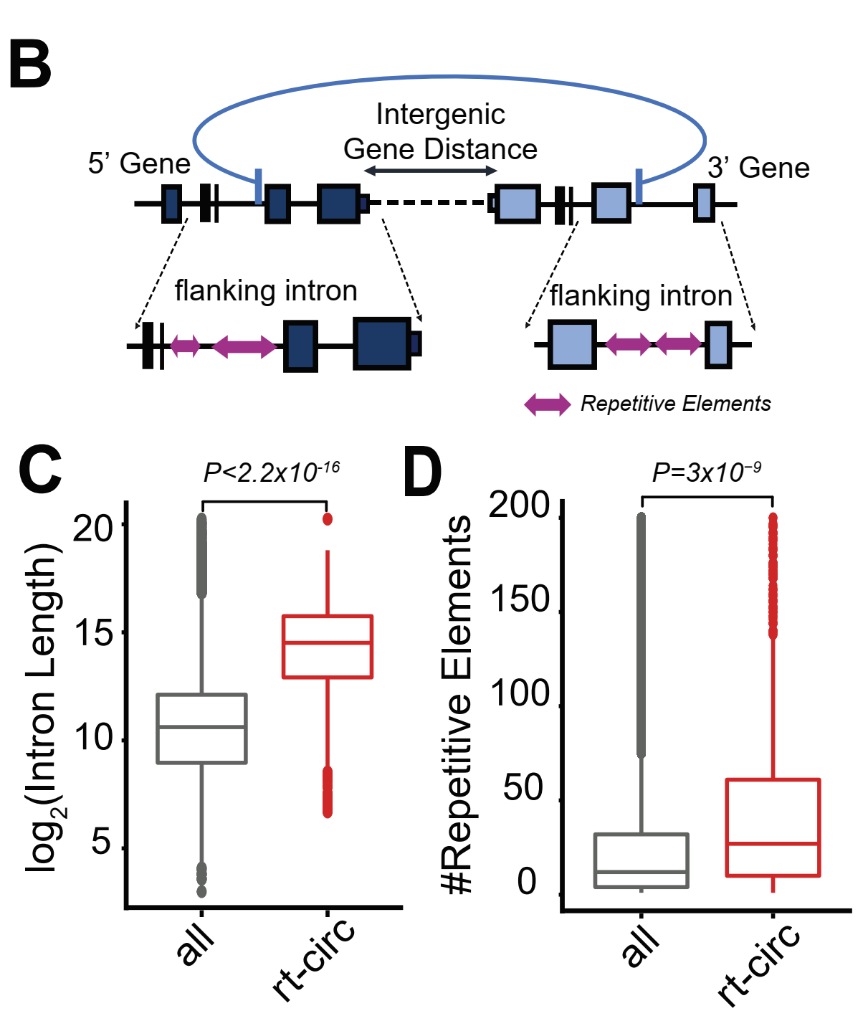
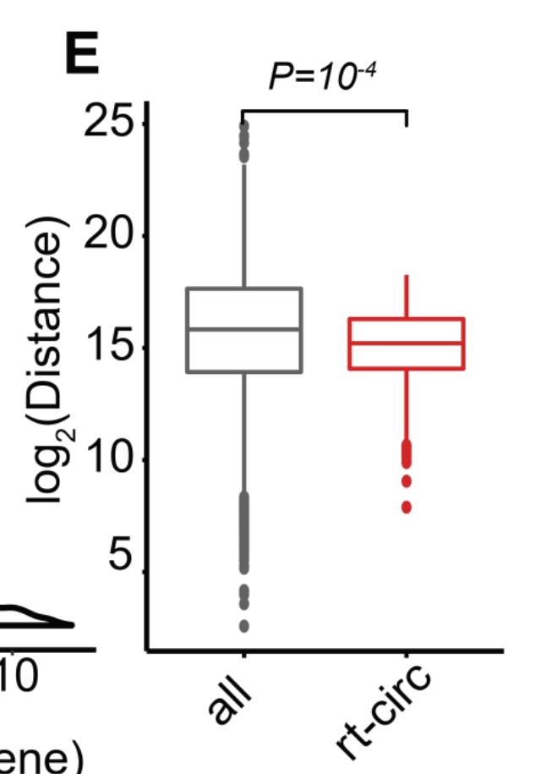

Slide 18
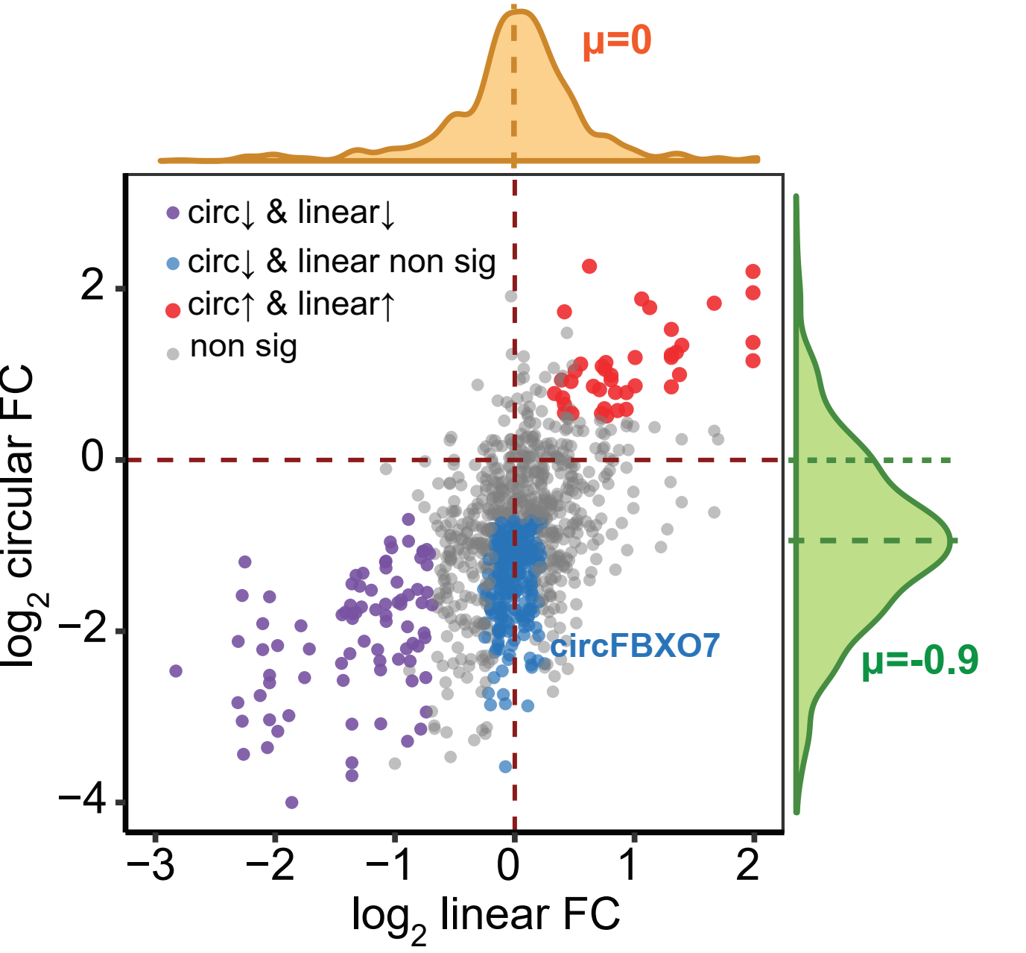
25 localized prostate cancer vs. 25 matched adjacent normal

Slide 19
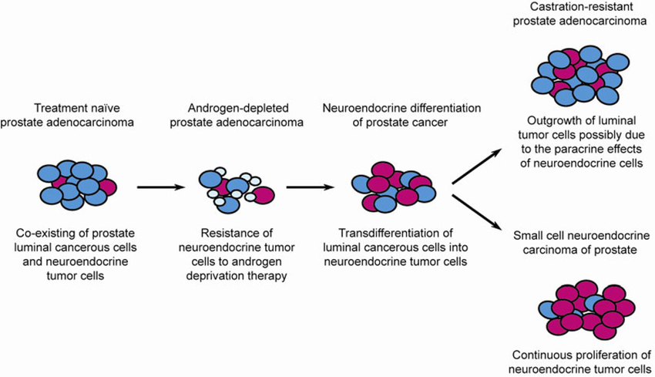
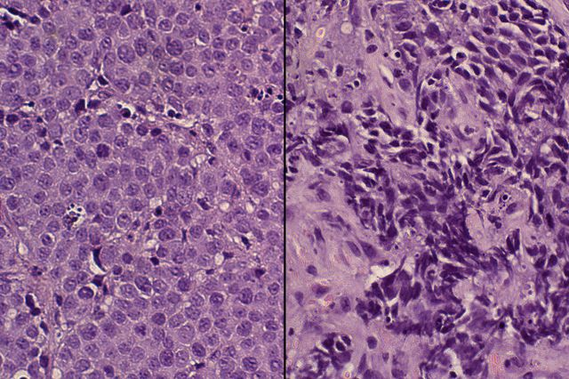
Example 1: Neuroendocrine Differentiation in Prostate Cancer (NEPC)
Notes:
Source: https://link.springer.com/article/10.1007/s11427-013-4522-0

Slide 20
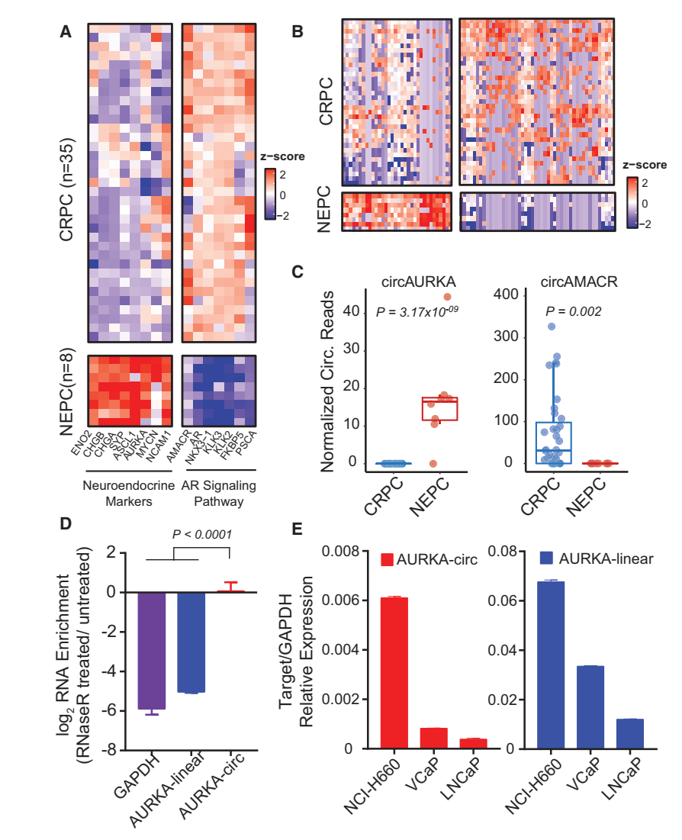

Slide 21
Assess the Stability of CircRNAs in Extracellular Spaces

Slide 22
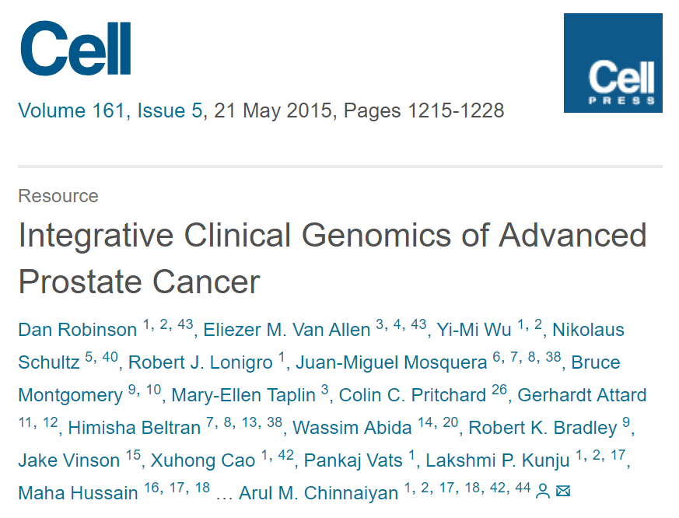
Example 2: AR Amplification in CRPC
*included mCRPC cases with more than 5 copies of AR

Slide 23
Incubate in human plasma → “Mimic” circulating RNAs in blood
Samples were harvested at 0, 15, 30, 45, 60, and 75 min.

Slide 24
Rnase-R treated
(degrade open-ended RNAs)
Actinomycin-D treated
(Inhibit transcriptions)

