Slide 1

Measurement and inference of contextual biomarkers
Ruedi Aebersold, Ph.D
Institute of Molecular Systems Biology, ETH-Zürich;
Faculty of Science, University of Zürich

Slide 2
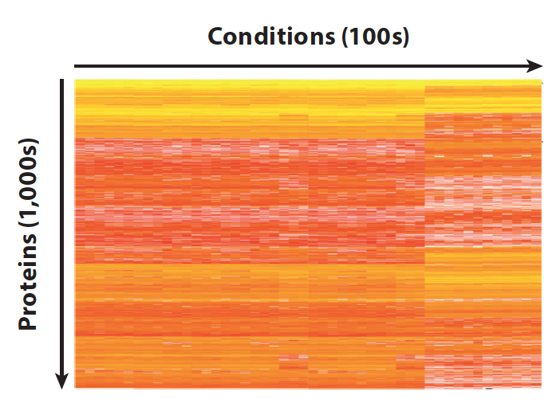
Common data structure for protein biomarker research
Protein identification and quantification
replicates
proteins

Slide 3
Common data structure for protein biomarker research
Protein identification and quantification
samples
Such datasets are used in biomarker research for:
Clustering
PCA
Machine learning
Regression
Correlation
proteins

Slide 4
Common data structure for protein biomarker research
Protein identification and quantification
samples
The larger n (replicates) the more information
The more precise n (proteins) the more information
SWATH/DIA MS has emerged as a powerful method to quantify large numbers of biological replicates
Initially the number of proteins quantified per sample was criticized
The method is still rapidly evolving
proteins

Slide 5
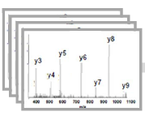
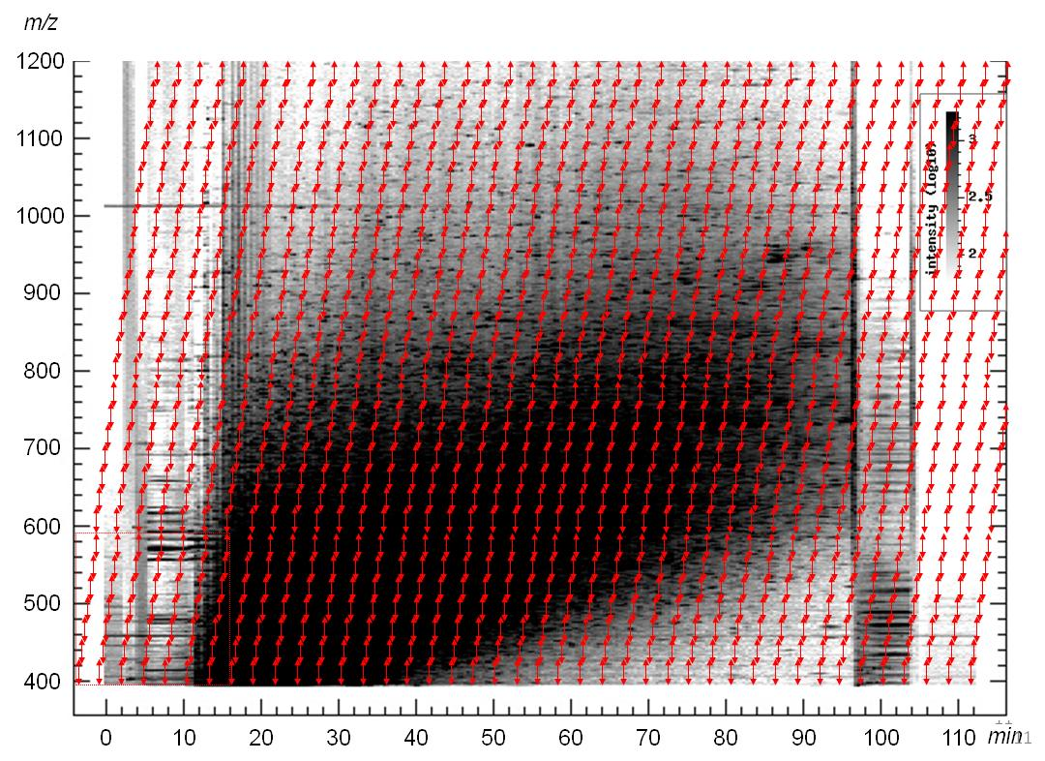
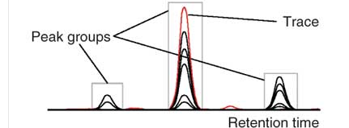
SWATH/DIA-MS principle: Peptide-centric data analysis
Reference library
  Data independent MS scan of all peptides
  Targeted data analysis (peptide-centric) using reference spectra as prior information
  Generation of permanent digital record of a sample
  10.000’s of peptides analyzed in a sample at low cv and high reproducibility
  20-60 samples a day per machine
Query Peptides
Proteins
MS Coordinates
Best fragment ion signals,
Relative ion intensities,
Retention time
Data extraction
Reiter et al. Nature Methods, 2011;
Roest, Rosenberger et al, Nature Biotechnol. 2014
(Rosenberger, et al, Nature Scientific Data. 2014. 140031)
Schubert, O. T., et al. (2015) Nat Protoc 10(3): 426-441
Kusebauch et al . (2016) Cell.
Gillet et al (2012) MCP

Slide 6
State ca. 2016
Total -- 4,960 proteins / 39,928 peptide PGs
Site median – 4,691 / 34,286 PGs
(1% protein FDR / 1% peptide PG FDR)
accumulated proteins detected
Total HEK293 cell lysate
Triple TOF instrument
Ca. 1 microgram total peptide
For tissue this is biopsy level (~50ug peptide per mg of tissue)
Cv ~12%
Collins D, Hunter c et al, Nat. Comm. 2017

Slide 7
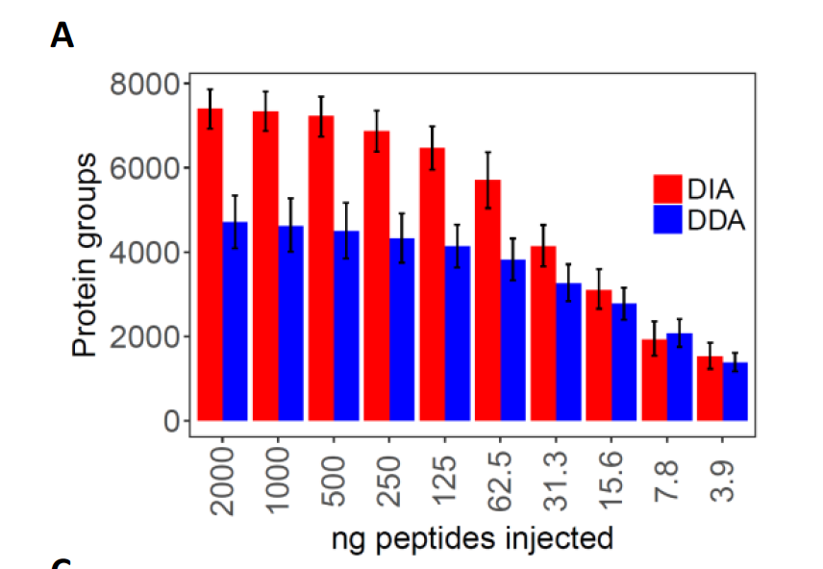
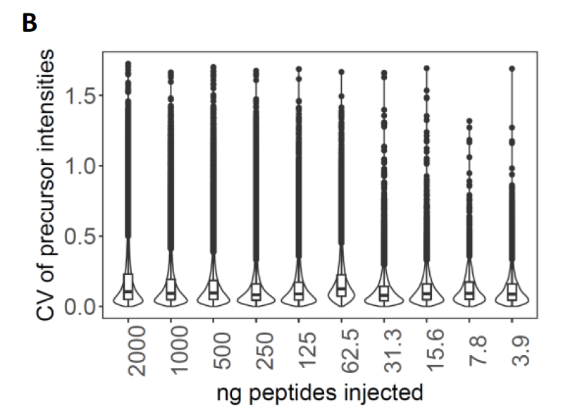
Present state: Lumos trapping instrument
Total human cell lysate
Lumos instrument
Variable amounts of peptide injected
Ca. 10 HeLa cells
equivalent
Amon S, Meier-Abt F et al , revision

Slide 8
Protein function depends on structure and modularity
Pauling | 1949 | Sickle cell anemia as a molecular disease: Mechanistically connecting genomic variability to phenotypic variability
Anfinsen | 1961 | Protein function depends on structure; protein sequence contains fold info.
Hartwell, et al | 1999 | Modular Cell Biology
UltUlti
Ultimately altered phenotypes (cancer) are the result of altered biochemistry

Slide 9
Can we use contextual information as biomarkers ?
A supervised algorithm to identify dysregulated protein complex across various conditions

Slide 10
SWATH MS protein abundances
Expression levels of proteins that are in the same complex tend to correlate across different samples
Example: ATP synthase subunit alpha (proteins ATP5A1 and ATP5B)
Protein abundance
Panel of 60 cancer cell lines (NCI60)
Notes:
Protein quantity levels measured by SWATH mass spectrometry
Abundances of protein complex members tend to correlate
60 cancer cell lines representing different tissues (NCI60)
Abundance levels of proteins that are in stable complexes tend to correlate
p-value < 10⁻¹⁵ when compared to other protein pairs
100 times enrichment in high correlation values (i.e. correlation > 0.8, p-value < 10⁻¹⁵ )

Slide 11
Proteins in the same complex tend to have stable quantitative ratios
H
Blue: all possible pairs in the NCI-60 dataset
Dark red: all possible interactions between NCI-60 proteins present in CORUM
Light red: CORUM interacting pairs
Figure: Chiara Auwerx
A
C
E
A
C
E
A
C
E
A
C
E
A
C
E
A
C
E
B
D
F
B
D
F
B
D
F
B
D
F
B
D
F
B
D
F

Slide 12
Method
Method is available as an R package
Buljan et al: Proceedings of the 64th ASMS Conference on Mass Spectrometry and Allied Topics, 2016.
Notes:
I makli smo outliers s precise varijabilnosti u normal
Selection of a representative interaction for each protein that drives the signal.
I multipl testing correction.

Slide 13
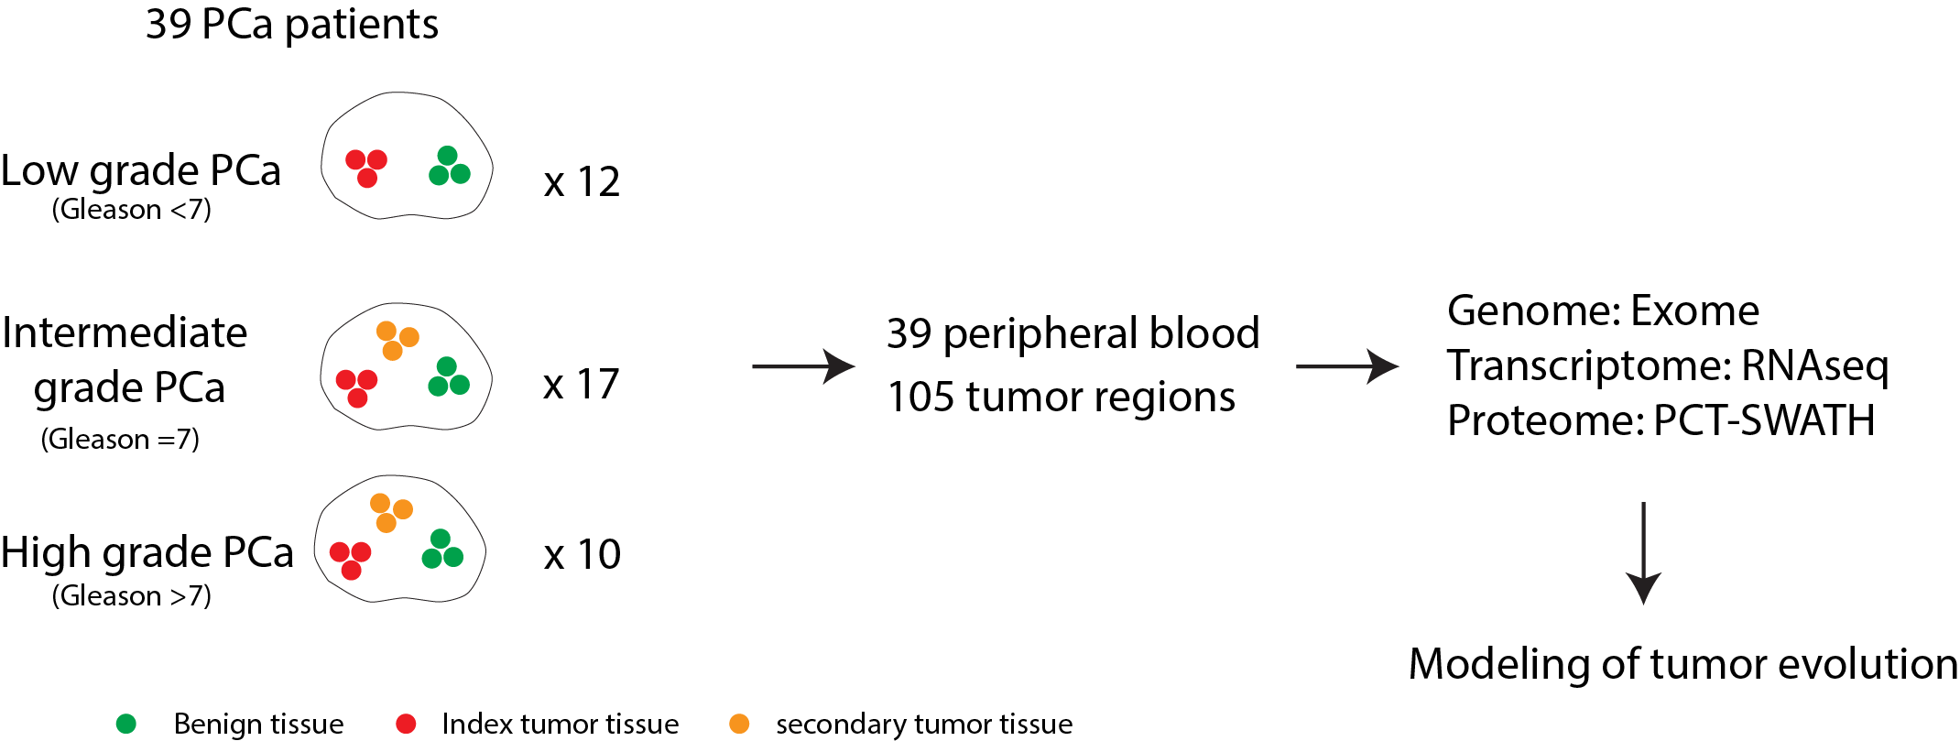
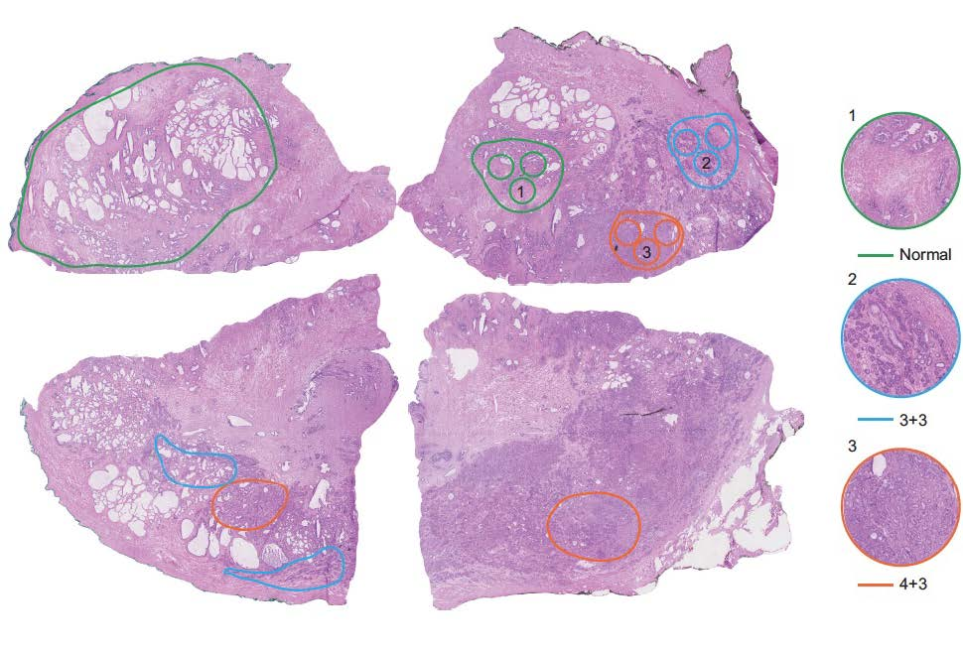
Graphical abstract
H&E staining of tissue sections from one patient
Biopsies from prostate glands for 39 prostate cancer patients with known outcome
Proteomics data for 105 prostate punches, 2 replicates, 210 proteomes

Slide 14
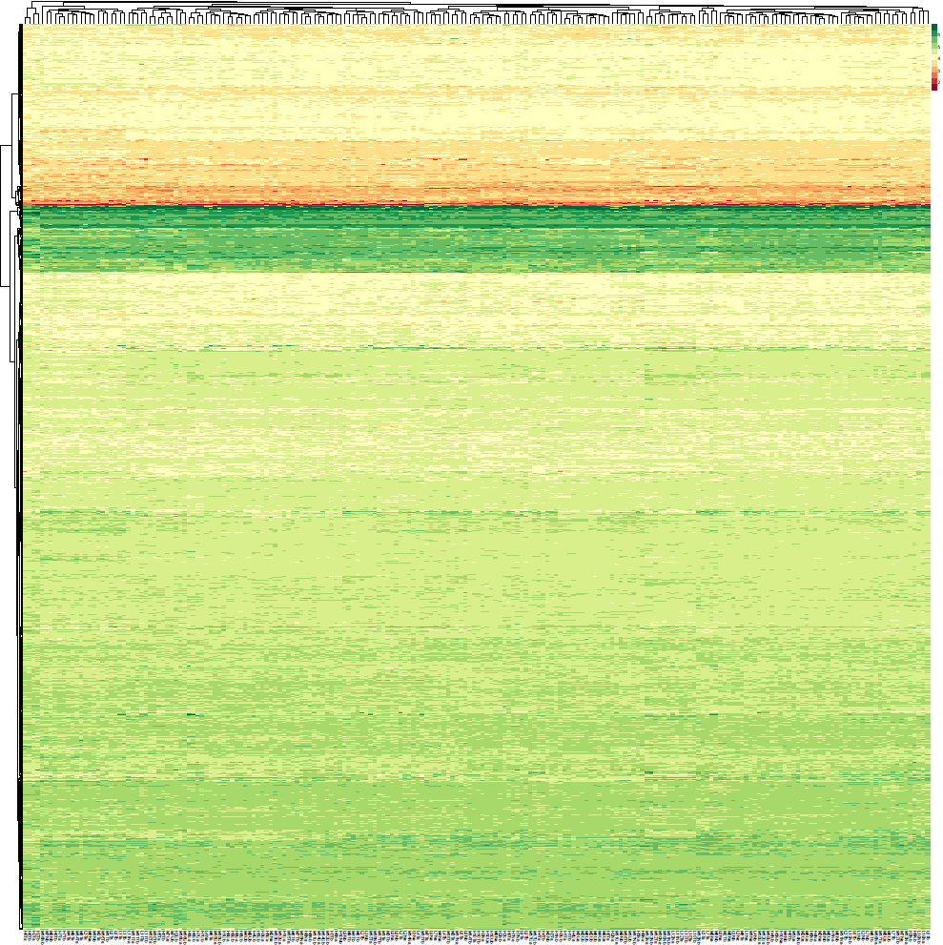
Proteomic data: Protein quantification via SWATH-MS
Classical approach:
Correlate abundance of individual proteins with clinical phenotype
210 SWATH runs for 105 tissue punches
3812 proteins quantified across samples

Slide 15
Significant differences between 7a and 7b samples
Strongest signal:
CCT2,3,4,8/ILK 1.7 x10⁻⁸
VDAC1/CAV1/VCP 1.1 x10⁻⁷
YWHAZ/YWHAB 1.4 x10⁻⁶
CCT2,CCT3,CCT4 and CCT8 are highly upregulated and drive the shift (Chaperonin complex).
CAV1 integrates several oncogenic signaling pathways with membrane proteins
  Regulates metabolism in cancer and is associated with cancer progression and prognosis
  Contradictory role in prostate cancer: reported both as a TS and Oncogene
VDAC1 is at the crossroads of cell metabolism, apoptosis and cell stress
VCP promotes cell invasion and migration in prostate cancer cell lines
Notes:
CAV1
The scaffolding protein encoded by this gene is the main component of the caveolae plasma membranes found in most cell types. The protein links integrin subunits to the tyrosine kinase FYN, an initiating step in coupling integrins to the Ras-ERK pathway and promoting cell cycle progression. The gene is a tumor suppressor gene candidate and a negative regulator of the Ras-p42/44 mitogen-activated kinase cascade. Caveolin 1 and caveolin 2 are located next to each other on chromosome 7 and express colocalizing proteins that form a stable hetero-oligomeric complex.
https://www.genecards.org/cgi-bin/carddisp.pl?gene=CAV1
GSN
ILK/HSPB90AA1 1.4 x10⁻⁷
BZW1 basic leucine zipper and W2 domains 1
— promotes cell growth, stimulates cell cycle regulation
integrin-linked kinase (ILK)
Molecular Exploitation of Apoptosis Pathways in Prostate Cancer
https://books.google.ch/books?isbn=1848164491
Natasha Kyprianou - 2012 - ‎Medical
Importantly, however, in cancer cells ILK activity is constitutively activated in PTEN-negative human cancers, such as prostate cancer,
U google: ilk prostate cancer

Slide 16
What if we do not have prior classification?
An unsupervised algorithm to identify dysregulated protein complex across various conditions

Slide 17
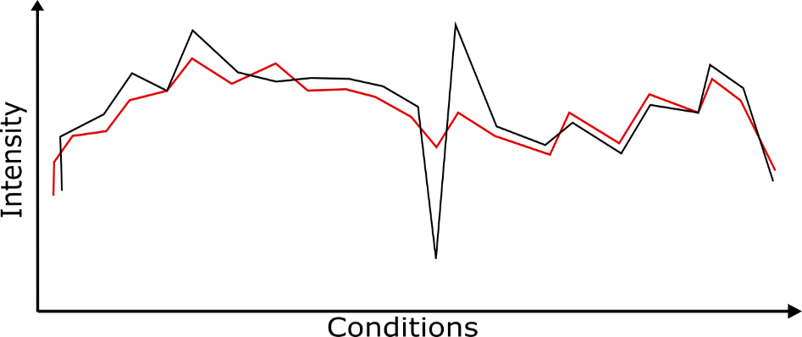
Concept
dysregulated
regulated
regulated
Abundance of protein 2
Abundance of protein 2
Abundance of protein 1
Outlyers computed by Mahalanobis distance (M)
Abundance of protein 1
Notes:
The whole idea was started from a Nat Biotech paper by Hass and colleagues.
There are three shortcomings in their algorith,
1. They can maximally identify one outlier per pair/interaction with their algorithm (this is a very significant one since finding something biologically interesting with a single outlier is quite hard. We usually look for a pattern and one sample/condition identified is not enough. We usually have a dataset with several small sub-groups. In the case of my Mtb dataset, there are strains from different lineages. Or NCI60, several cell lines from various tissues and so on)
2. Sometimes, the identified outlier (sample) is not dysregulated. Rather that pair in the sample is highly either upregulated or downregulated (red dots on the plot).
3. There is no global FDR correction while they have analyzed thousands of protein interactions (this is not 100% necessary and can be justified by a statistical reason – Testing a new protein interaction doesn’t add the number of the dysregulated samples in the previous pair. So they are independent!)
Therefore, we developed a new algorithm to address the shortcomings.

Slide 18
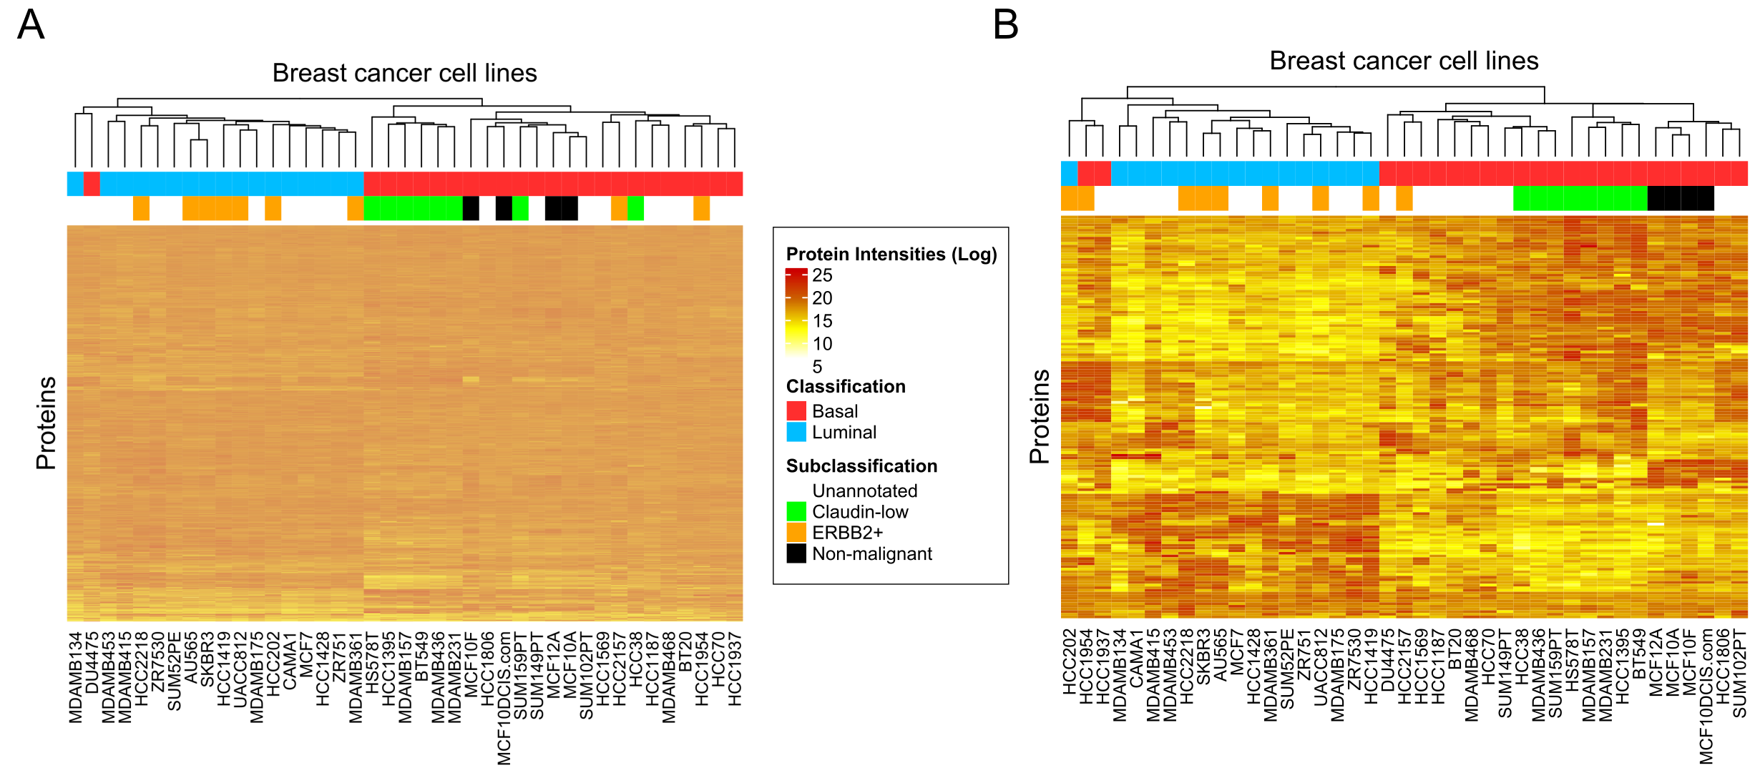
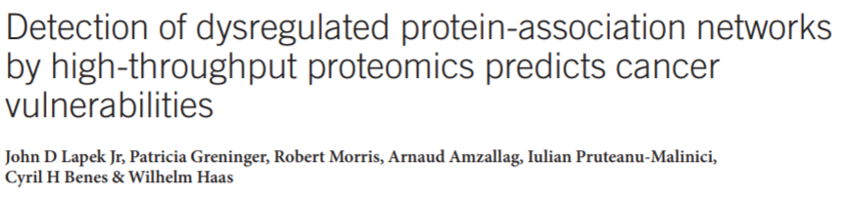
Benchmarking (~7000 vs 152 proteins)
Data source:

Slide 19
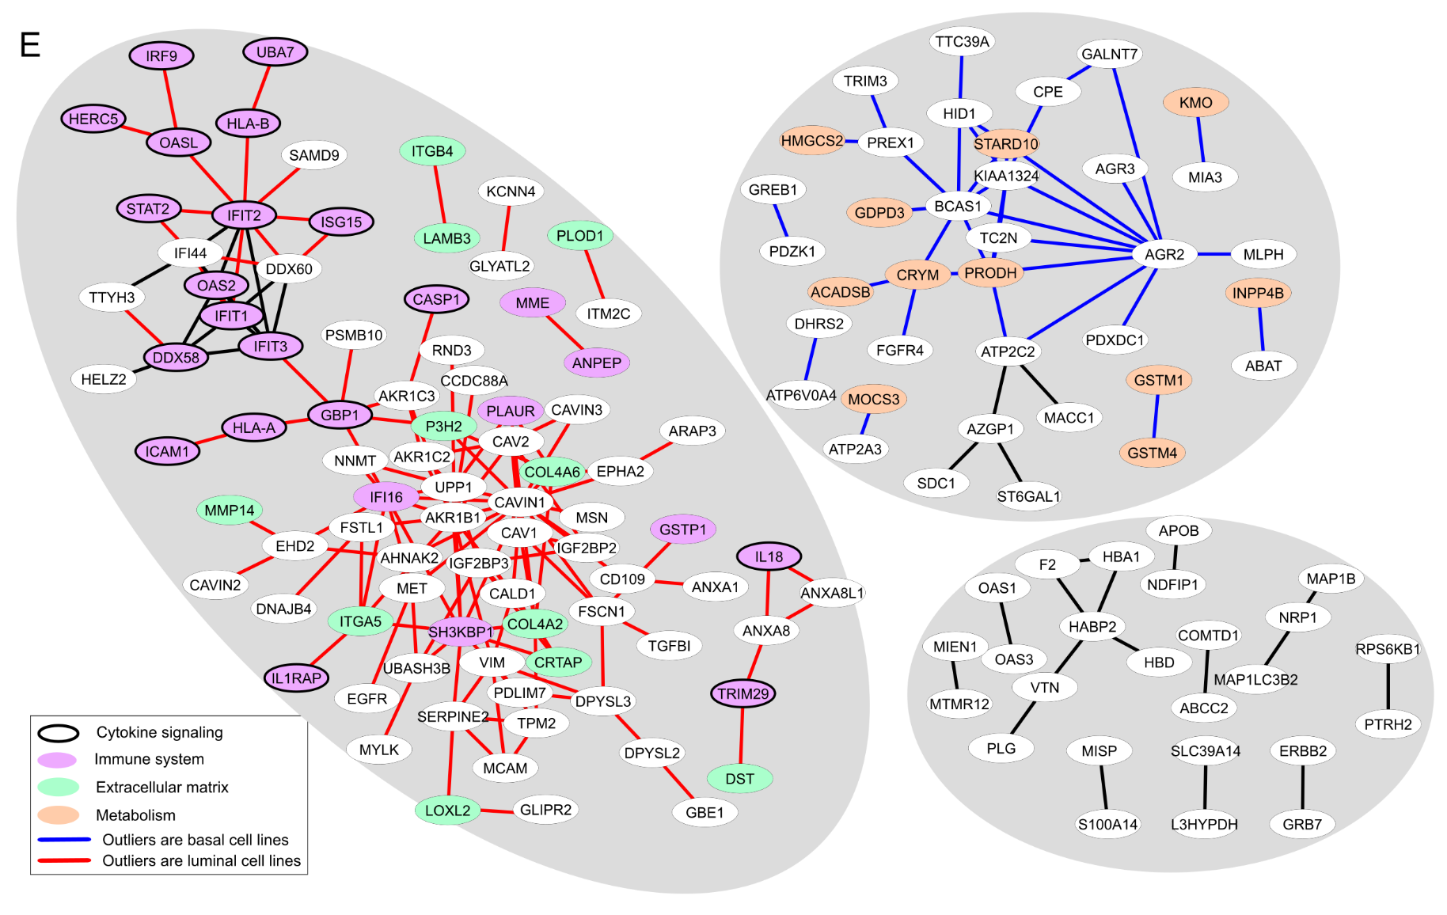
Benchmarking: Basal, luminal and non-malignant cells show different network states

Slide 20
Can we use identify subgroups using the non-supervised method to inform the supervised biomarker algorithm?
Mertins et al. Proteogenomics connects somatic mutations to signalling in breast cancer, Nature 2016.
Data:
The samples comprise of: Luminal A (23), Luminal B (24), Her2 (12) and Basal (18).
Here we use Basal the 18 basal samples because they are a heterogenous group

Slide 21
non-supervised analysis of dysregulated complexes identifies two groups of basal samples
We now use these as input for supervised analysis
This is not a circular argument because different proteins are used by either algorithm

Slide 22
Proteins with altered quantitative ratios in tested samples
303 proteins in total (170 pairs)
They are enriched in Reactome pathways related to cell invasion, proliferation and mitotic regulation
Notes:
Also: epigenetic regulation and DNA damage repair

Slide 23
Proteins with altered quantitative ratios in tested samples
Many of the proteins have connected biological roles and several of them form stable protein complexes

Slide 24
Summary
Swath/DIA MS generates high quality and now also deep protein matrices
Proteins generally act in cooperation with other proteins
We developed and benchmarked a supervised and an non-supervised algorithm to use SWATH/DIA data matrices to find new subgroups and to detect contextual biomarkers
The two algorithms are complementary
Additional results from same data -- new information for free

Slide 25
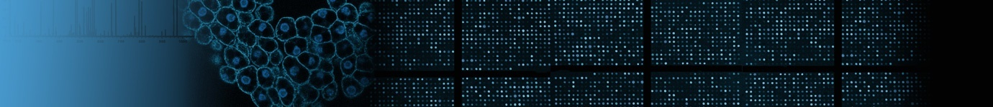




Institute of Molecular Systems Biology
Acknowledgements
Supervised contextual algorithm
Marija Buljan
Chiara Auwerx
Amair Banaei
Non-supervised contextual algorithm
Amir Banaei
Marija Buljan
Swath development:
Ludovic Gillet
Pedro Navarro
Ben Collins
Yansheng Liu
George Rosenberger
Sabine Amon
Fabienne Meier-Abt
SNSF
NIH/EDRN

Slide 26
