Slide 1
Collaborative Opportunities
EDRN and MCL

Slide 2
Tools for Characterizing Biology
Expression profiling (Ultralow risk threshold);
Intratumor heterogeneity. Copy number,
Immune profiling (via expression arrays, multiplex immunohistochemistry)
Imaging features (amorphous vs. linear calcifications, stroma density)

Slide 3
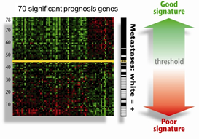
Expression Profiling- Ultralow Risk Threshold
Validation: STO-3 Trial, Raster, MINDACT
Van’t Veer Nature 2002
Esserman, Shieh BCRT 2013
Van’t Veer, Glas BCRT 2017

Slide 4
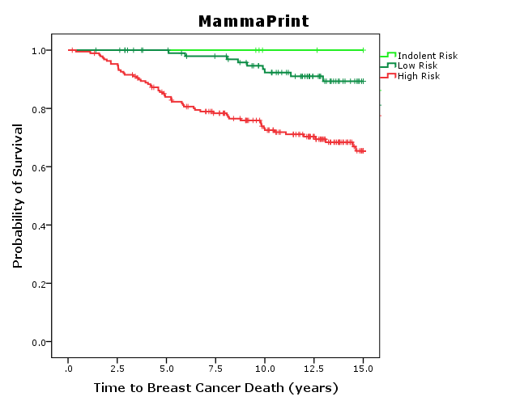
Breast Cancer Specific Survival of the Transbig Data set: TEST SET

Slide 5
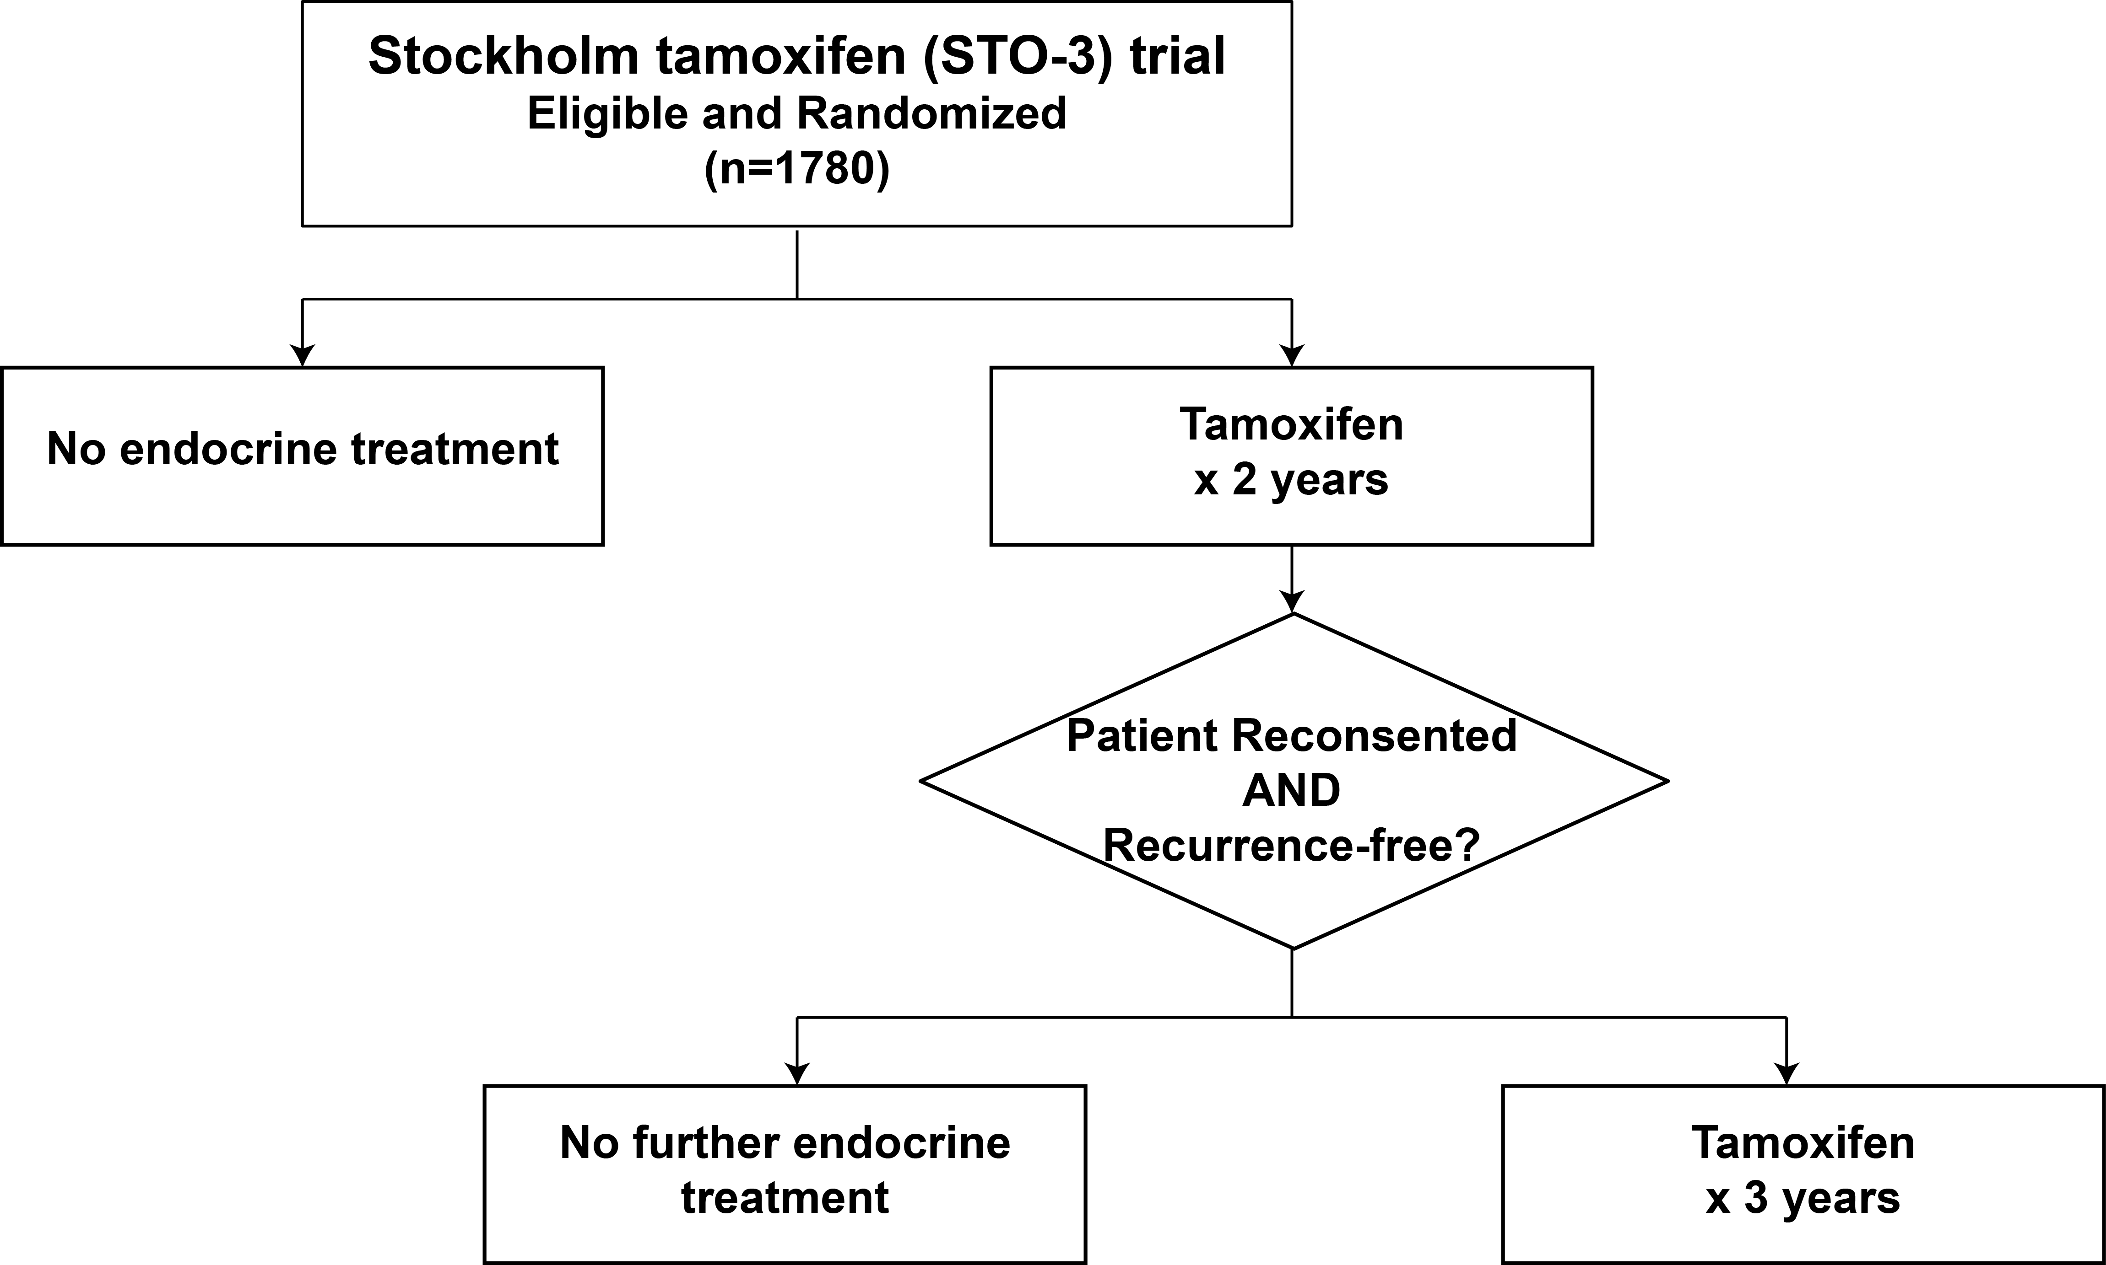
Validation in the STO 3 Trial conducted in Stockholm: postmenopausal women, <3cm, N0 tumors
1976-1991

Slide 6
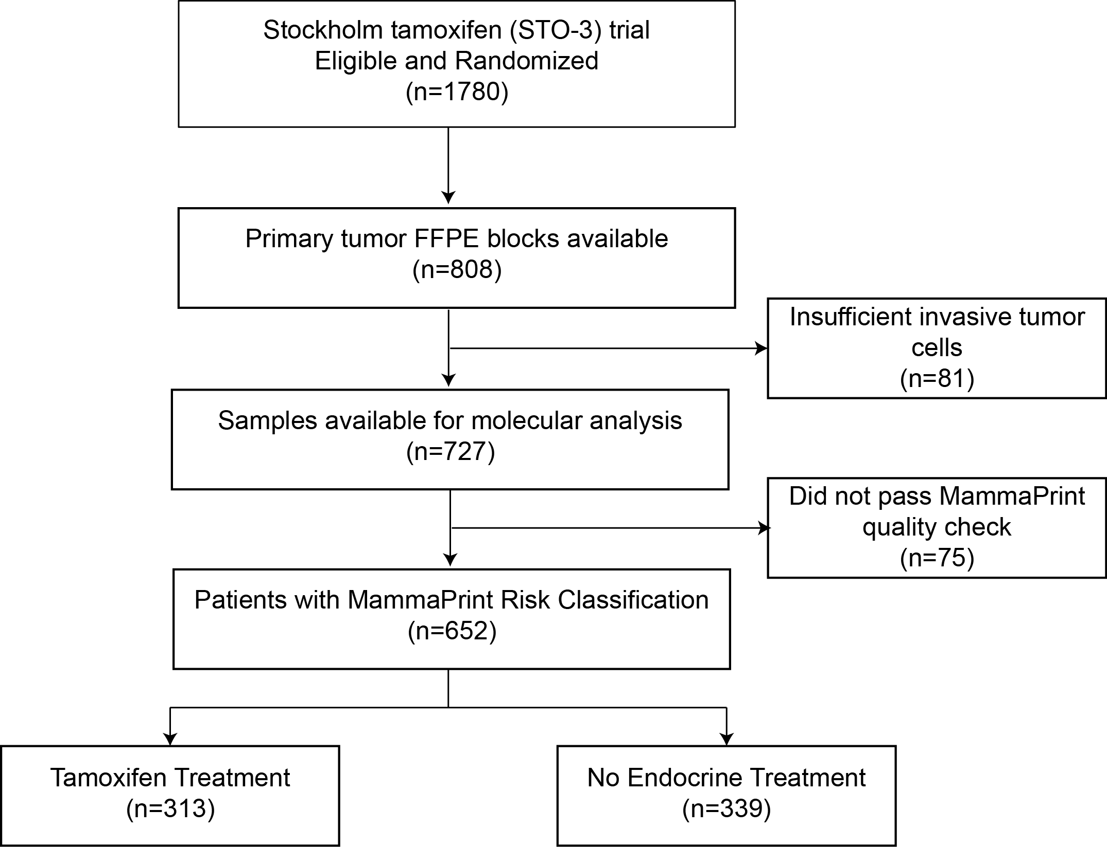
STO-3 trial
1976-1991
Low Risk Breast cancer postmenopausal women Tumors <3cm, N0
Randomized to Tamoxifen x 2 years OR No Endocrine Treatment
Esserman, Yau, Borowsky,Benz, van’t Veer, Lindstrom et al in press JAMA Oncology 2017

Slide 7
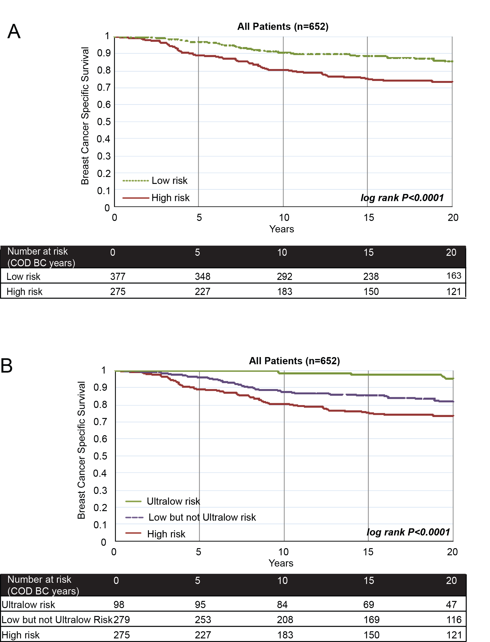
All Patients by 70 Gene,
Ultralow, low≠ultralow, high
Esserman et al JAMA oncology in press 2017

Slide 8
What are the most critical Drivers?
Recursive partitioning can provide insights about biology . . .

Slide 9
recursive partitioning (tree) models
Nonparametric method for:
  selecting predictors of outcome (variable selection)
  selecting splitting points (e.g. cut-points in continuous variables)
  testing (all) interactions
Does not rely on assumption of proportional hazards
Easy to understand – output consists of decision tree rather than hazard ratios
General idea of tree models:
  Allow for the presence of multiple “groups” self determined by the data
  Split the data into increasingly homogeneous sub-groups
  Inference not so well developed

Slide 10
recursive partitioning (tree) models
2 methods available in R
  rpart - splits predictors to minimize node impurity
    selects split that makes survival in each branch homogeneous
    often leads to overfitting so tree must be pruned
  party - splits predictors based on statistical tests
    survival in each branch of split is statistically different
    eliminates need for pruning

Slide 11
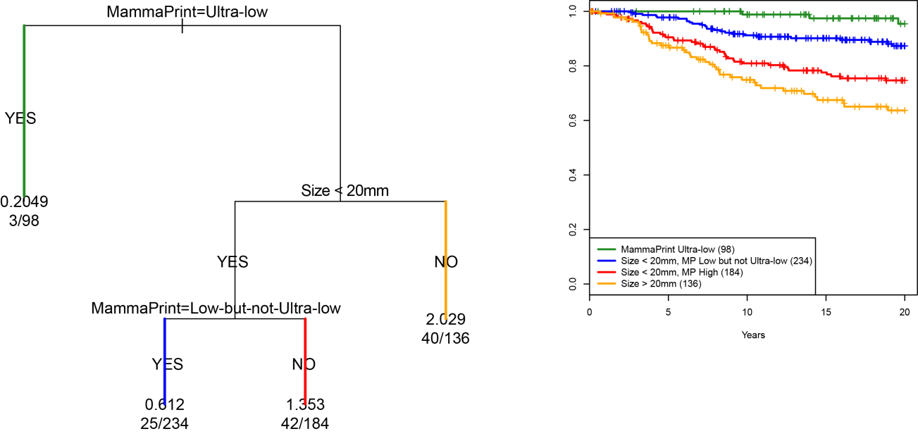
Recursive Partitioning (R:PART) in STO3 Tamoxifen Trial based on breast cancer specific survival
INPUTS
MammaPrint risk groups
BluePrint Subtypes
Tumor Grade
Tumor Size (<2, >2)
HR and HER2 status
Ki67
EARLY
EVENTS
Esserman, Yau, Borowsky,Benz, van’t Veer, Lindstrom et al in press JAMA Oncology 2017

Slide 12
Clinical Impact

Slide 13
What is the biology driving Ultra-Low tumors?
What are the molecular features of Indolent Breast Cancers?
What can we use across other cancer types?
Christina Yau, Laura van’t Veer, Laura Esserman, Linda Lindstrom

Slide 14
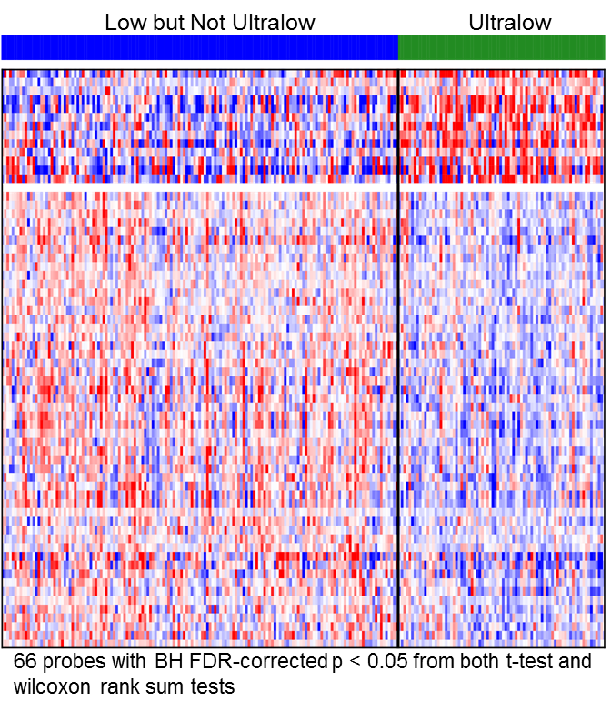
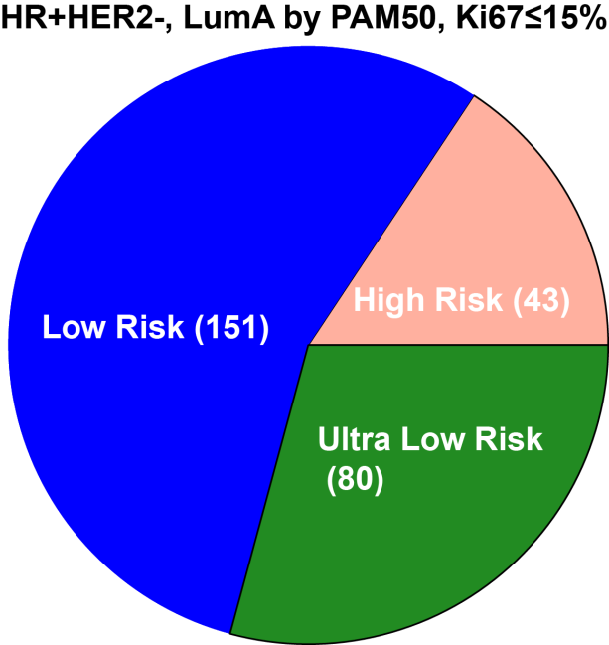
Significant expression differences can be found between MP Ultralow and MP low risk cases even within the HR+HER2-, Luminal A, Ki76-low subset of patients in the STO-3 trial
Differential Expression Analysis comparing Low (but not Ultralow) Risk with Ultralow Risk
Risk assignment by MP
Nominal enrichment in processes relating to DNA packaging, intracellular transport and second-messenger mediated signaling
UNIQUE TO ORGAN TYPE OR COMMON AMONGST TUMORS ACROSS ORGANS OF ORIGIN?

Slide 15
Opportunities

Slide 16
Common Nomenclature for Lesions that are not life threatening
Early detection will make more difference if you can eliminate the ultralows at time of diagnosis
  Are we ready to Ultralows need to be demoted from cancer status (like Pluto)
What is common across cancers and how can we learn across the groups?
Common features of ultralow risk disease (“x of 6" →IDLE classification)
  Tumor Gene expression: DNA packaging genes? (UC Breast team)
  Immune environment? (MCL consortium)
  Radiomics features (Denny, Gillies, others)
  Exosome in the Urine (Semmes)
  Exosomes in the plasma (Paulovich)
  Methylation markers (Herman)

Slide 17
Highest Risk cancers
May grow too quickly or spread too early to benefit from serial screening
Goal should be identifying risk factors
  Establish high risk cohorts (e.g.WISDOM, xxx, xxx)
  Develop and validate Markers of risk for most consequential (aggressive) cancers
    Markers of failure to repair DNA (Anderson)
    Circulating inflammatory markers
    ?Microbiome
    Autoanbiobies (Anderson)
Focus on prevention
  Especially important for cancers that can be cured with immuno-oncology combinations earlier in disease course (neoadjuvant)

Slide 18
Cohorts with serum at NCI Frederick
Consider acquiring the associated blocks and characterizing the tumors as ultralow, late recurrence risk, and early recurrence
  EDRN Cohort 1 (screen detected)
  EDRN Cohort 2 (diagnostic)
  CPTAC collection 1500 cases from 4 sites

Slide 19
Integrate Measures of Overdiagnosis, Harm into Screening/Biomarker Studies at Inception
Model the potential harms as well as benefits
Establish thresholds for SPECIFICITY below which interventions cause more harm than good
Educate the public, clinicians about the need to study cohorts, find risk factors, but avoid intervention unless certain conditions are met
All prospective studies should include measures of overdiagnosis, molecular profiling, tumor immune environment

