Slide 1
Regulatory considerations for In Vitro Diagnostic Multivariate Index Assays (IVDMIA)
Aaron Schetter, PhD MPH
Food and Drug Administration (FDA)
Center for Devices and Radiological Health (CDRH)
Office of In Vitro Diagnostics and Radiological Health (OIR)
Division of Molecular Genetics and Pathology (DMGP)

Slide 2

Disclaimer
This presentation is intended for informational purposes only and does not constitute legal or regulatory advice. Please see the Federal Food, Drug, and Cosmetic Act and 21 CFR Subchapter H for a full list of requirements by FDA

Slide 3
What is an IVDMIA?
IVDMIA is a in vitro diagnostic device (IVD) that:
Combines the values of multiple variables using an interpretation function to yield a single, patient-specific result (e.g., a “classification,” “score,” “index,” etc.), that is intended for use in the diagnosis of disease or other conditions, or in the cure, mitigation, treatment or prevention of disease, and
Provides a result whose derivation is non-transparent and cannot be independently derived or verified by the end user.”
Draft definition from 2007 FDA draft guidance on “In Vitro Diagnostic Multivariate Index Assays”

Slide 4
What is an IVDMIA?
Analyte A
Analyte B
Test Positive
Analyte C
Black Box Algorithm
Analyte D
Test Negative
Analyte E
Analyte X

Slide 5
What can an IVDMIA Measure?
Analytes
Sample Matrix
RNA
DNA
Protein
Other
Can be combination of any or all.
Tissue
Blood
Stool
Other body Fluids
Can be combination of multiple matrices.
Each IVDMIA has a unique combination of analytes in different sample matrixes. Specific analytical requirements depend on the specifics of the test.

Slide 6
Why IVDMIAs?
Potential that combination of multiple biomarkers may improve clinical accuracy compared to single biomarker.
One Analyte Test
Two Analyte Test
sensitivity
Three Analyte Test
Multi - Analyte Test
1-specificity

Slide 7
Intended Use (not test complexity) determines device classification
Class II
(moderate risk)
Class III
(high risk)
Traditional
510(k)
De novo 510(k)
(no predicate)
Pre-market
Application
(PMA)
FDA Clearance
Device shows
substantial
equivalence
to a legally
marketed
predicate
FDA
Classification
Device
Demonstrates
Safety and
Effectiveness
With Special
Controls
FDA Approval
Device Demonstrates
Safety And
Effectiveness
Early detection cancer markers are generally considered as cancer screening devices. This type of device is usually considered a class III (high risk) device that requires a PMA.

Slide 8
Examples Approved IVDMIAs
Banyan Brain Trauma Indicator (DEN 170045). Qualitative test measuring the levels of 2 proteins in blood of to help identify patients with mild traumatic brain injury (i.e. concussions)
Cologuard (P130017). Qualitative test evaluating the presence of DNA methylation of specific genes, DNA mutations of specific genes and the presence of hemoglobin in stool. Colorectal cancer screening test.
Prosigna (K130010). Qualitative gene expression profiling test that evaluate the expression of 58 genes from breast cancer tissue. The test assesses a patient’s risk of distant recurrence of disease.
OVA1 TEST (DEN090004). Qualitative serum test using 5 immunoassays as a aid to help further assess likelihood of malignancy for ovarian cancer.
Pathwork Tissue of Origin Test (K080896). Evaluates RNA expression of 1550 genes using microarrays and compares against a database for 15 common malignancies to measure similarity of gene expression patterns.
AlloMap Molecular Expression Testing (K073482). Evaluates RNA expression of 20 gene from peripheral blood to aid in the identification of heart transplant recipients with stable allograft function.
Mammaprint (K062694). Qualitative gene expression profiling test that evaluate the expression of 70 genes from breast cancer tissue. The results of the test are to be used as a prognostic marker for breast cancer recurrence.

Slide 9
Review Challenges of IVDMIA
1. Lock down your assay before you begin your analytical and clinical validation studies
2. Lock down your assay before you begin your analytical and clinical validation studies
3. Lock down includes EVERYTHING from how analytes are measured to the algorithm, to the final patient report (Biomarker (+) vs (-)).
Clinical trial specimens/patients are precious.
Patients whose samples were used for assay development can’t be included in your final pivotal study.
Making modifications to a assay after testing specimens of patients from your pivotal studies could result in all of them being considered exploratory.
Some changes are unavoidable (i.e. clinical trial assay versus final assay), and may require bridging studies. Details should be discussed before testing.

Slide 10
Review Challenges of IVDMIA (2)
If you intend to market your IVDMIA, the platform you use must be labeled for IVD use.
IVDMIAs are frequently developed on Research Use Only (RUO) platforms.
FDA approval of your test will requires that your assay can be run on an IVD labeled test system (including platform and software).
As your research progresses and you plan on developing an test, plan for how your test could run on an IVD labeled system and/or plan on bringing the platform (as well as assay) for approval.
Discuss with the Agency

Slide 11
Analytical requirements for IVDMIA
Each IVDMIA is unique and presents their own specific analytical challenges.
Contains all of the same components as single Analyte tests.
The key analytical studies should be designed to evaluate the variability in the final IVDMIA score. It will also evaluate the variability of the individual Analyte measurements.
Note: Correlation analysis of all analytes vs all analytes as R values are not interpretable in terms of the analytical reproducibility of the test.

Slide 12
Analytical requirements for IVDMIA
Comprehensive analytical validation studies (including pre-analytical studies)
Does it measure the analytes (and final score) accurately and reliably in the hands of the intended users with the various sources of variability that are expected?
Requires clinical specimens from intended use sample type.
What specimen handling is required?
Sample type/matrix: Serum, EDTA/Heparin Plasma, Urine
Collection /transport/storage: Preservative/stabilizer
Preparation: Fixation/sectioning, micro-/macro-dissection
Sample stability: Real-time, freeze thaw
Especially important for use of archived samples for clinical studies

Slide 13
IVDMIA analytical considerations
Biomarker distribution in intended use specimens
Evaluate the range if IVDMIA scores and range of levels of the individual analytes in IU specimens. Provides information about the samples that should be included in analytical studies.
Helps guide acceptance criteria for analytical studies.
Helps estimate False detection rates at given variability.
Sensitivity/Linearity (LOB/LOD/LOQ)
Analyses should be designed to evaluate the individual analytes and your final IVDMIA score.
Evaluate how changing total Analyte amounts affect final IVDMIA score.
Validate minimum amount of specimen is needed for a reliable IVDMIA score.

Slide 14
IVDMIA analytical considerations
Precision (Repeatability / Reproducibility)
Need patient samples that span the range of IVDMIA scores.
Must have patient samples near decision cutoff of IVDMIA score.
Provide analyses of qualitative call and variability of IVDMIA score (i.e. SD, %CV, etc).
Limitless combinations of factors to achieve a final IVDMIA score and likely not possible to includes samples that accurately test precision characteristics these combinations.
May request simulations. Recommend discussion with Agency prior to study initiation.

Slide 15
Cologuard ®
Example of FDA approved IVDMIA for colorectal cancer screening
Summary of Safety and Effectiveness
https://www.accessdata.fda.gov/cdrh_docs/pdf13/P130017b.pdf

Slide 16
Cologuard
Intended Use:
Cologuard is intended for the qualitative detection of colorectal neoplasia associated DNA markers and for the presence of occult hemoglobin in human stool. Cologuard is for use with the Cologuard collection kit and the following instruments: BioTek ELx808 Absorbance Microplate Reader; Applied Biosystems® 7500 Fast Dx Real-Time PCR; Hamilton Microlab® STARlet; and the Exact Sciences System Software with Cologuard Test Definition.
Indications for Use:
Cologuard is intended for the qualitative detection of colorectal neoplasia associated DNA markers and for the presence of occult hemoglobin in human stool. A positive result may indicate the presence of colorectal cancer (CRC) or advanced adenoma (AA) and should be followed by diagnostic colonoscopy. Cologuard is indicated to screen adults of either sex, 50 years or older, who are at typical average-risk for CRC. Cologuard is not a replacement for diagnostic colonoscopy or surveillance colonoscopy in high risk individuals.

Slide 17
Device Description
Stool based test in which patient collects stool into preservatives and mails the specimen to test lab.
Laboratory measures the following:
DNA analytes:
Methylated DNA (NDRG4, BMP3)
Specific DNA mutations (KRAS)
Total human DNA (ACTB)
Protein analyte:
Hemoglobin
Aggregate of these individually weighted markers determines the composite score (0-1000).
If composite score ≤ 183, then negative. Only the qualitative result is included in the final report.

Slide 18
Algorithm Development and Cut-off Determination
Algorithm development included 953 samples including 794 normal samples, 73 advanced adenomas and 86 cancers.
Derived sensitivity specificity for training set was 98% for cancer and 57% for advanced adenoma.

Slide 19
Clinical Validation Study
Prospective, cross-sectional, multi-center study of subjects between ages 50-84 who were at average risk for the development of colorectal cancer.
12,776 patients were enrolled
10,023 in primary analysis
2,753 excluded due to unusable data (e.g., no colonoscopy, untestable stool sample,)
90 sites in the US and Canada, including colonoscopy centers primary care sites
Stool samples tested at one of 3 labs

Slide 20
Primary Effectiveness Results
Cologuard | CRC Category 1 | AA Category 2 | Categories 3-6
Negative | 5 (7.7) | 438 (57.6) | 7967 (86.6)
Positive | 60 (92.3) | 322 (42.4) | 1231 (13.4)
Category 1: CRC stages 1-4
Category 2: Advanced Adenoma
Category 3-6: non-advanced adenoma and negative colonoscopy
CRC Sensitivity: 92.3% (60/65)
1-sided 95% lower confidence bound is 84.5%. Study goal of ≥ 65% was met.
Specificity: 86.6% (7967/9198)
1-sided 95% lower confidence bound is 86.0%. Study goal of ≥ 85% was met.

Slide 21
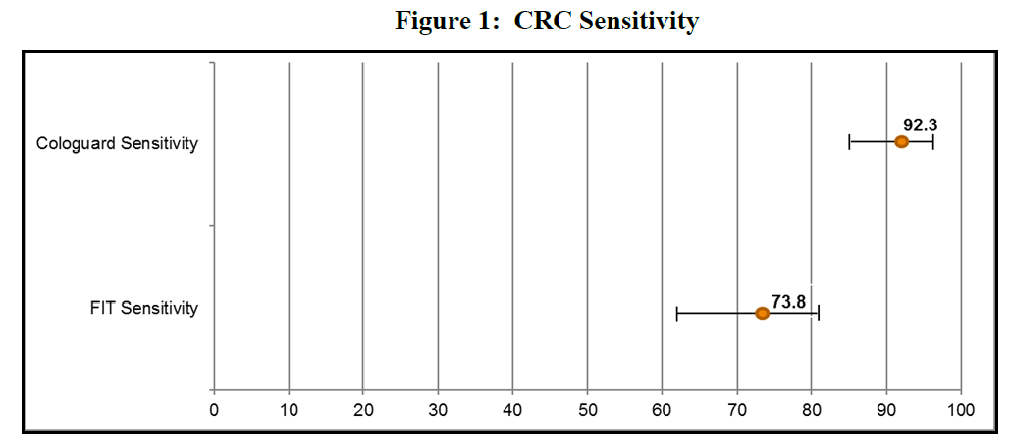
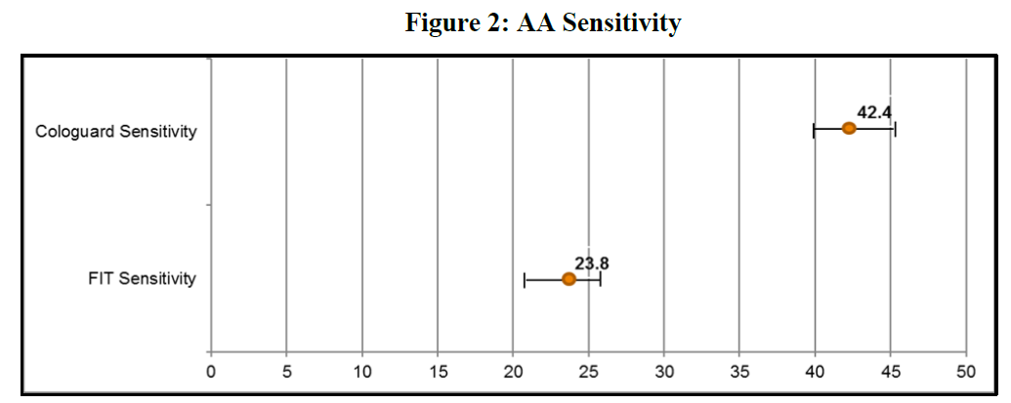
Secondary Effectiveness: Comparison to FIT test

Slide 22
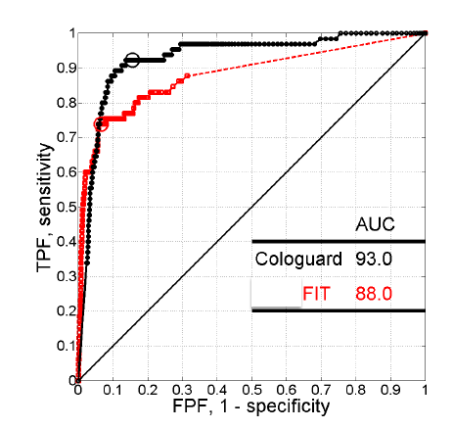
Secondary Effectiveness: Comparison to FIT test

Slide 23
Summary of Analytical Studies
Analytical Sensitivity
Limit of Detection
Limit of Quantitation
Limit of Blank
Linear Range, Linearity
Analytical Specificity
Double KRAS mutation
Partially Methylated Targets
WT KRAS
Cross-Reactivity
Interfering Substances, Carry-Over, and Cross Contamination
Development and Validation of the Cologuard Algorithm and Cut-Off
Precision and Reproducibility (lab-to-lab and lot-to-lot)
Robustness
Serial Stool Study
Analytical Specificity to Other Cancers
Shelf-Life and Packaging Testing

Slide 24
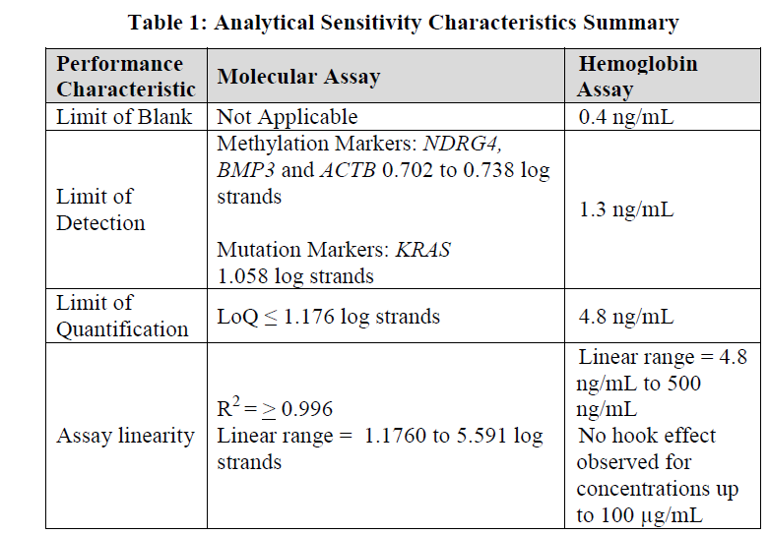
Sensitivity (LoB, LoD, LoQ and Linearity)
Sensitivity data provided for each analyte

Slide 25
Specificity
For KRAS mutation detection: Evaluated for specificity using wild type KRAS DNA.
For Methylation of BMP3 and NDRG4: Evaluated for specificity using partially methylated BMP3 and NDRG4.
For Hemoglobin: Evaluated for cross-reactivity with animal hemoglobin and myoglobin.

Slide 26
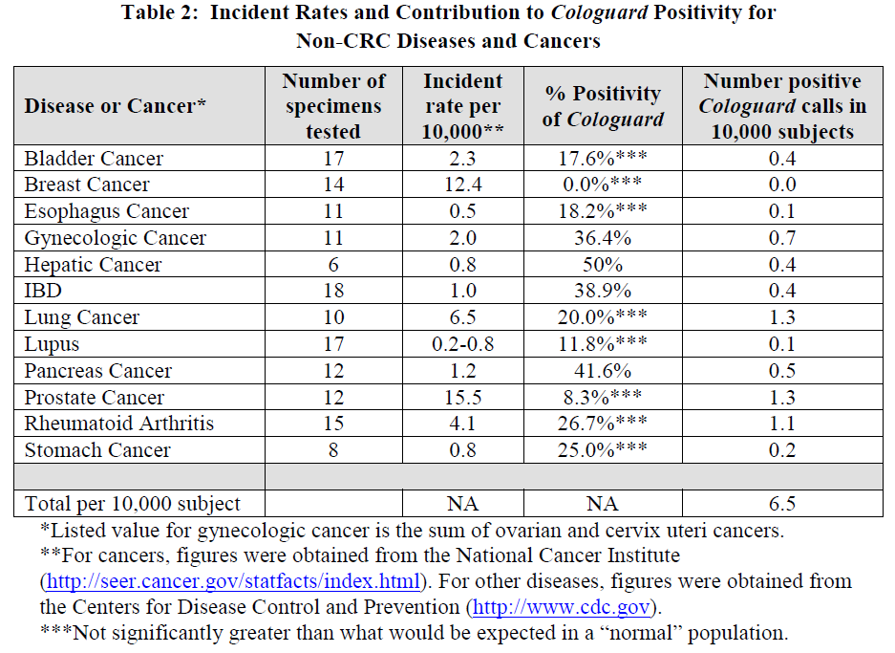
Cross-reactivity with non-colorectal cancer

Slide 27
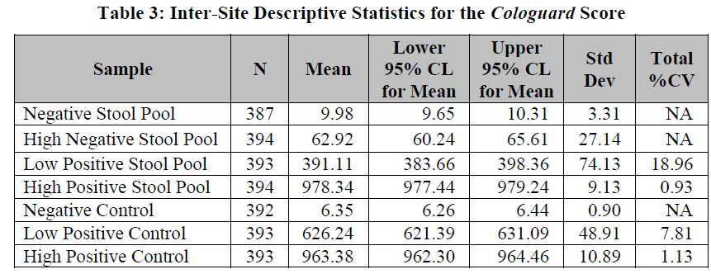
Precision and Reproducibility
Study design based on CLSI EP15-A2.
3-sites, with 2 operators per site
22 runs per site (11 per operator)
Samples for study:
Stool pools were representing negative, high negative, low positive and high positive positives were generated by pooling residual stools samples for molecular and adding human blood to normal patients stool for hemoglobin.
Negative, Low Positive and High Positive Controls.

Slide 28
Summary
FDA has approved/cleared/classified several IVDMIAs. Decision summaries are publically available.
Lock down the assay prior to initiating analytical and clinical validation studies.
Specific analytical considerations are needed to validate each analyte and the final IVDMIA score using appropriate specimens.
Need a strategy to bring both test and platform to market.
Encourage interaction with the Agency to ensure studies can meet their goals.

Slide 29
Thank you! Questions?

