Slide 1
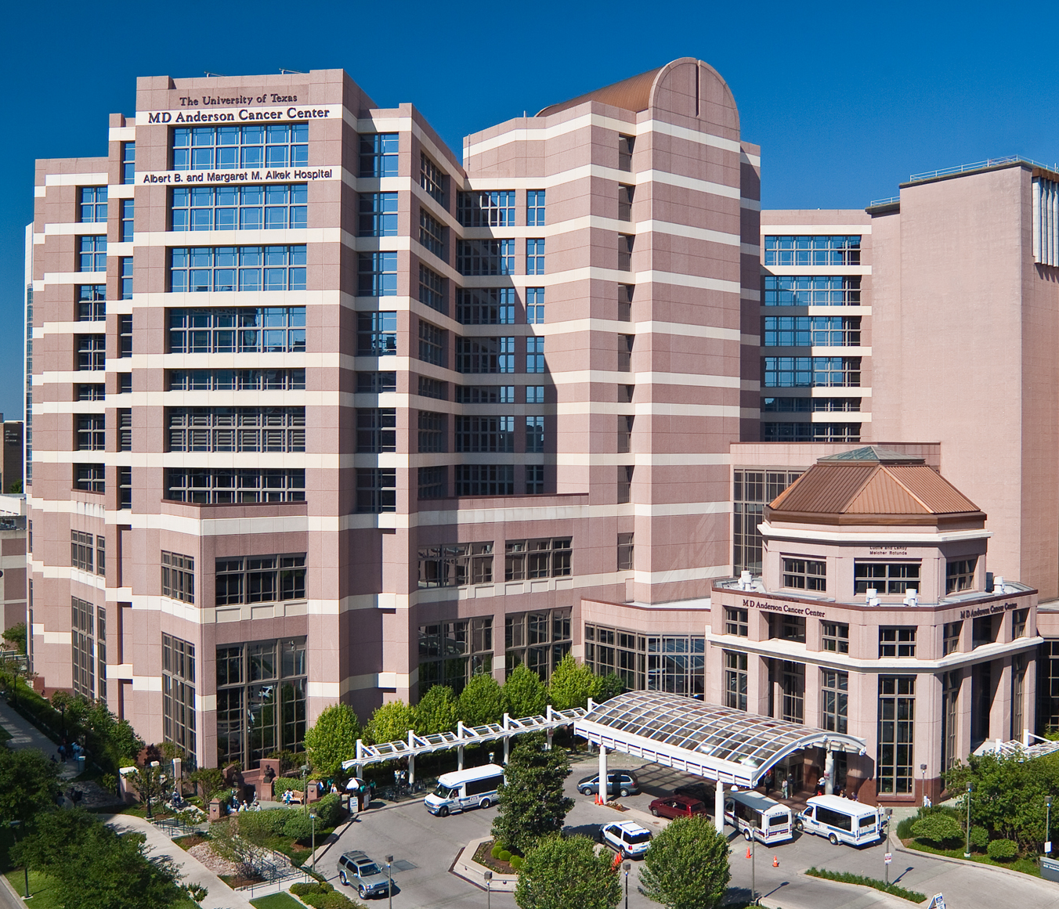

The Continuum of
Risk Assessment and Early Detection through Blood Based Biomarkers
S. Hanash

Slide 2

Risk assessment
Preventive intervention
Early detection
Effective Treatment
The Strategic Cancer Continuum

Slide 3
Biomarker needs across the cancer continuum

Slide 4
Different flavors of risk biomarkers
1-Lifetime risk assessment
2-Risk of harboring a developing cancer triggering preventive intervention and monitoring

Slide 5
Center for Global Cancer Early Detection
Center for Global Cancer Early Detection
Mission: Address unmet needs for risk assessment and effective early detection of common cancers to reduce mortality
Approach: Develop partnerships among stakeholders (Academia, Philanthropy, Government and Industry) to achieve intended applications
Targeted cancers: Lung, pancreas, breast, ovarian, colon, liver…

Slide 6

MD Anderson As a Critical Cog in the National PDAC Biomarker Efforts
Extramural
Vogelstein
Kinzler
CancerSEEK (Science 2018)
PanCAN Early Detection Initiative
Maitra PI
Hanash Co-PI
NCI/NIDDK
CPDPC
NOD cohort
Feng (PI)
Maitra
(Co-PI)
MDACC
NCI BRPC
& BPPC Alliance
Hanash
Maitra
Feng
NCI MCL Consortium
Maitra (PI)
Hanash
Koay
NCI EDRN
Maitra (PI)
Hanash
Feng
Koay

Slide 7
EARLY DETECTION OF OVARIAN CANCER AT MD ANDERSON CANCER CENTER
Normal Risk Ovarian Cancer Screening Study (NROSS) - Karen Lu, Robert Bast, Steve Skates
Two stage strategy where rising CA125 by the risk of ovarian cancer algorithm (ROCA) triggers transvaginal sonography (TVS).
No more than 3 operations will be required to detect each case of ovarian cancer.

Slide 8
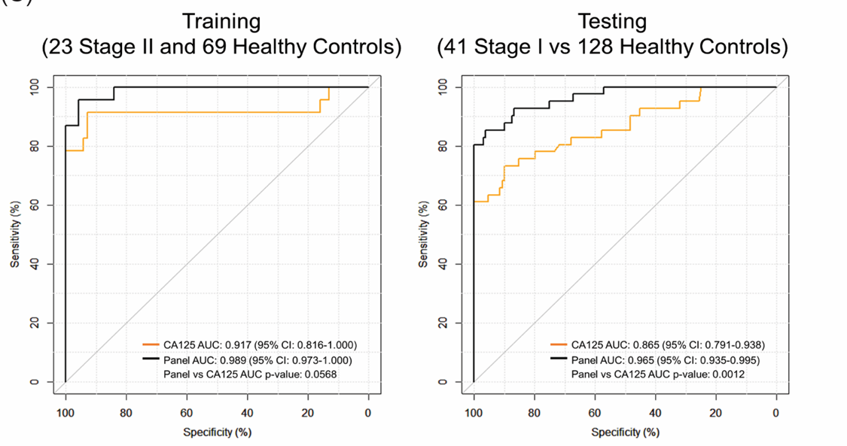
EARLY DETECTION OF OVARIAN CANCER AT MD ANDERSON CANCER CENTER
Autoantibodies– Robert Bast, Wei-Lei Yang, Zhen Lu, Sam Hanash and Makoto Kobayashi

Slide 9

MERIT Cohort
Center for Global Cancer Early Detection
Sept 2017
Diagnostic Imaging
Blood Biomarkers
Behavior Science
Mammography
Early detection biomarkers
Risk assessment
Imaging
Technologies

Slide 10
Search for blood based biomarkers through cohort studies
Blood collected up to 10 yrs
prior to Dx
Risk signatures
Blood collected
at Dx
Blood collected
0-24 months
prior to Dx
Molecular
Classification
Early detection
Signatures

Slide 11
Integrative discovery strategy
Mouse models
Genomics
Glycomics
Proteomics
Biomarker panels
Cancer cells
Human studies
♦ whole cell extracts
♦ secretome/exosome
♦ surface proteins
♦ nuclear proteins
♦ plasma/serum
♦ tissues
Immunomics
Metabolomics

Slide 12
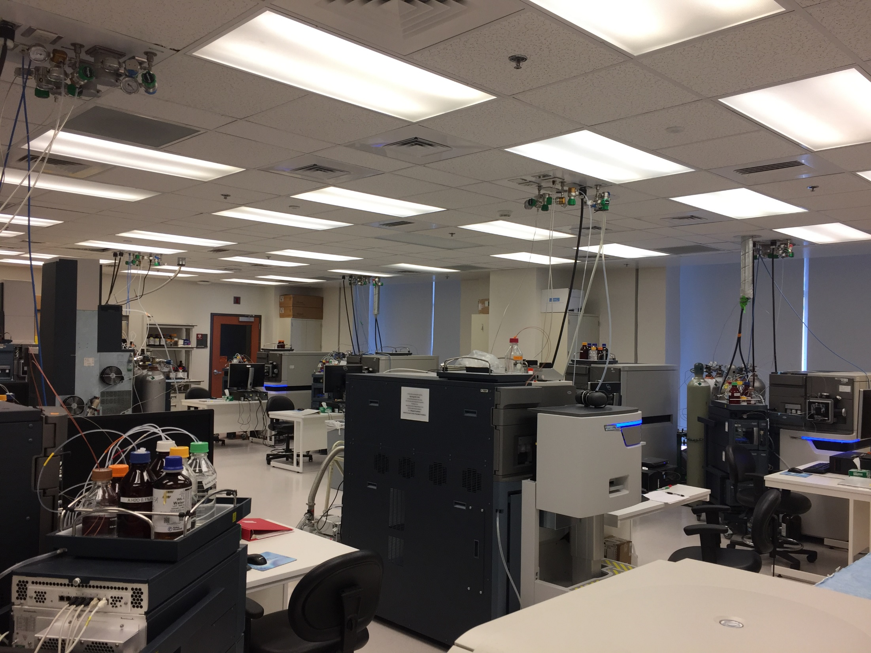

Slide 13
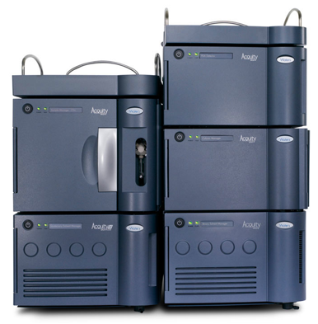
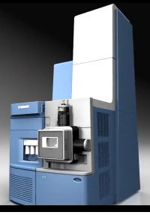
Metabolomics Platform
Liquid-Chromatography-based Mass Spectrometry
Untargeted Profiling; 2 column Configuration
Four Instruments in Lab
Assay #1
Assay #2
Assay #3
Small Molecules
Complex Lipids
Exogenous Compounds
Assay #4
Assay #5
ACQUITY
UPLC System
Xevo
G2-XS QTof
Assay #6
> 500 Annotated
Compounds

Slide 14
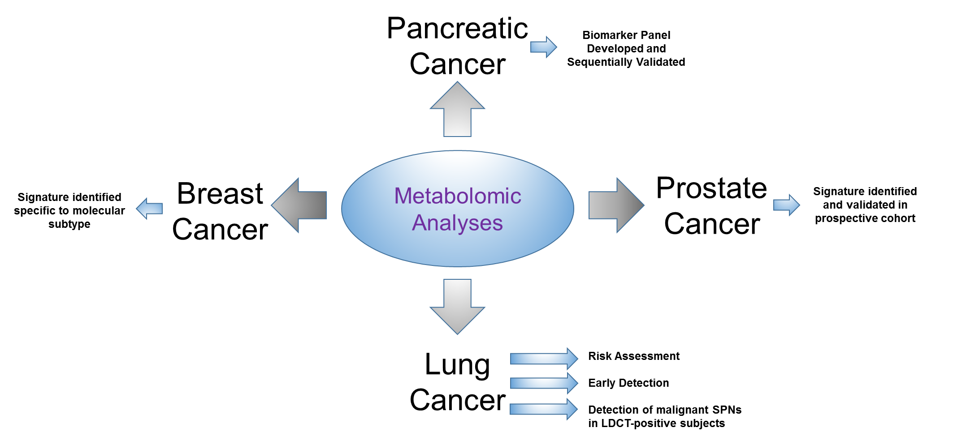
Risk Stratification/Early Detection

Slide 15
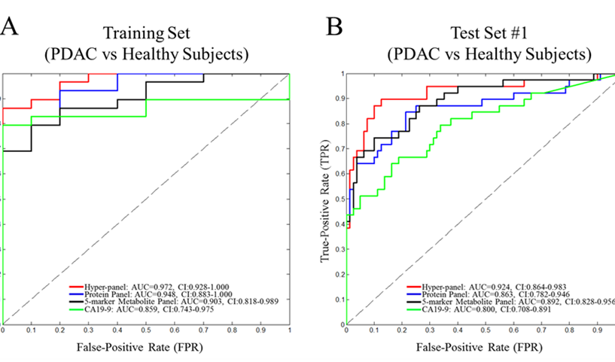
Early Stage PDAC vs Healthy Subjects

Slide 16
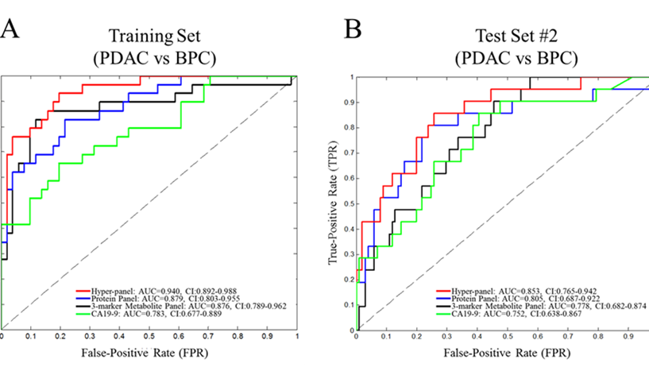
Early Stage PDAC vs Benign Pancreatic Cysts

Slide 17
The need for biomarkers for lung cancer screening

Slide 18
The US Preventive Services Task Force recommends low-dose CT annually only for high risk adults
CT
30 pack-year smoking history, currently smoke or quit within the past 15 years
?
Increasing
Risk
<30 pack-year smoking history
(Ever smokers)
Never smokers
Total deaths from lung cancer in the US in 2015: 160,000

Slide 19
The US Preventive Services Task Force recommends low-dose CT annually only for high risk adults
CT
30 pack-year smoking history, currently smoke or quit within the past 15 years
Blood test
followed
by CT
(most impactful for mortality reduction)
Increasing
Risk
<30 pack-year smoking history
(Ever smokers)
Never smokers
Total deaths from lung cancer in the US in 2015: 160,000

Slide 20
Lung Cancer Screening Study Goals
Enroll 10,000 subjects in a screening cohort
Develop and test a biomarker panel to determine need for CT screening
Develop and test a biomarker panel to reduce the false positive rate of CT

Slide 21
Lung Cancer Screening Study Goals
Enroll 10,000 subjects in a screening cohort
Develop and test a biomarker panel to determine need for CT screening
Develop and test a biomarker panel to reduce the false positive rate of CT
Investigate ultra-low dose CT for lung cancer screening
Develop improved algorithms for interpreting CT

Slide 22
n validate individual markers and develop a panel with a combination rule :
New Dx early stage + WHI, CARET, PHS cohorts
Validation of Combination Rule:
EPIC and Umea cohorts
Panel Validation with Clinical Grade Assays
PLCO cohort
MD Anderson Screening Cohort

Slide 23
n Validation of Individual Markers and Panel Development for Indeterminate Nodules:
Nodule Clinics and Screening Cohorts
Panel Validation with Clinical Grade Assays
MD Anderson Prospective Screening Cohort
Pan Canadian +
Pittsburgh
Lung Cancer
Screening studies

Slide 24
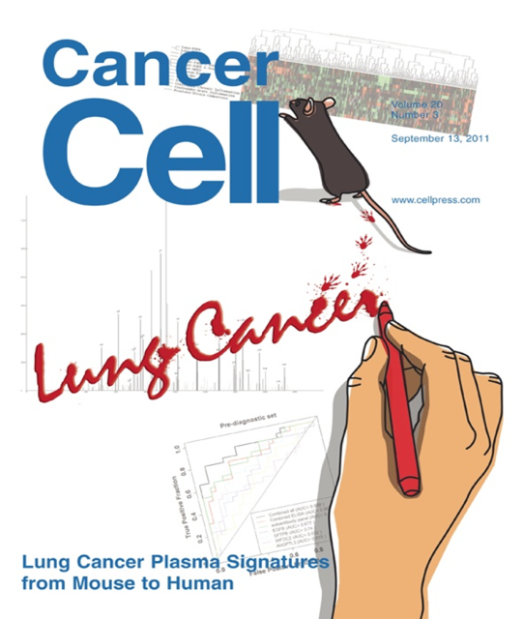
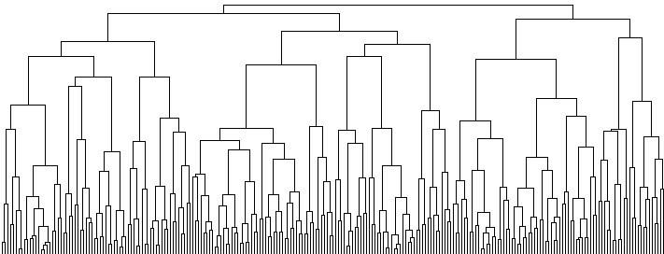

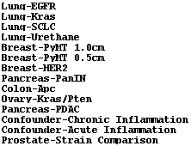



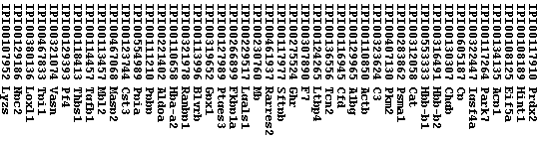
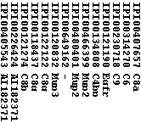
NKX2-1 signature proteins in
lung cancer blood
Notes:
24

Slide 25
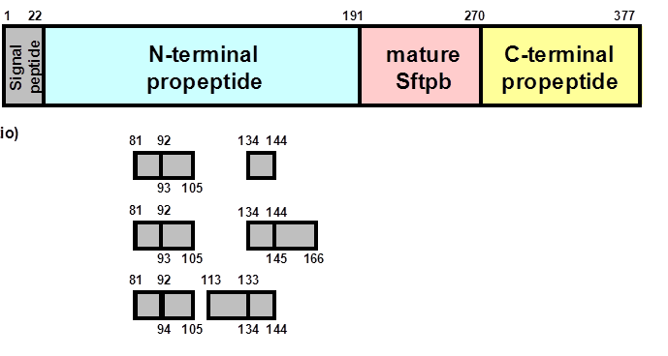
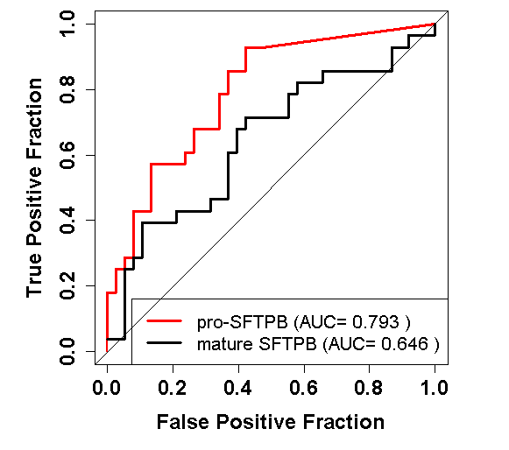
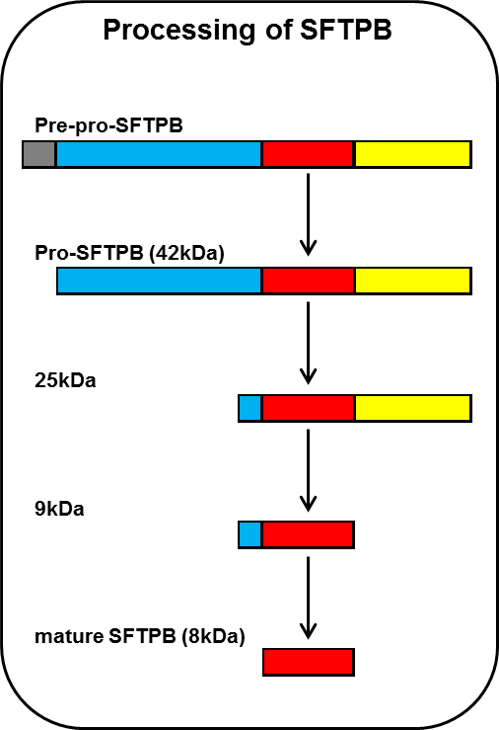
Identification of pro-SFTPB as a biomarker for lung cancer

Slide 26
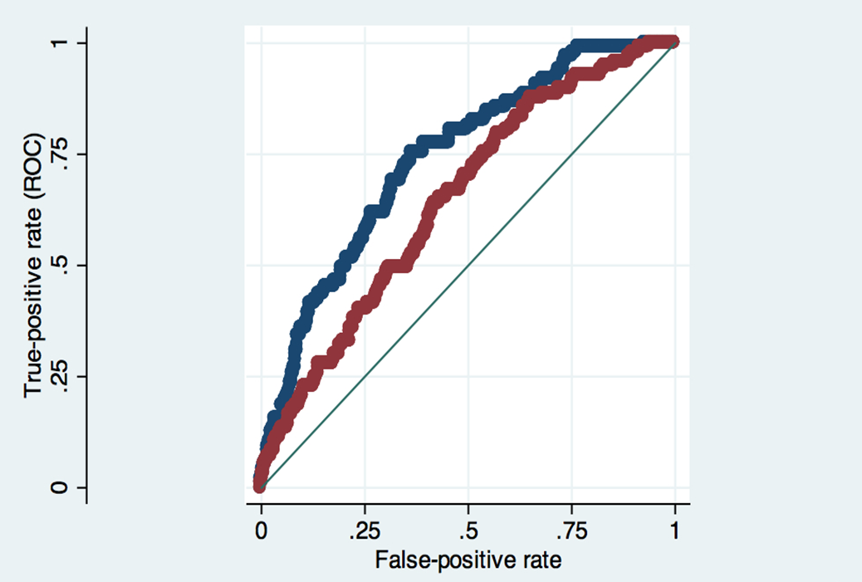
Is there evidence that blood markers could be useful? Validation of proSFTPB in the pan Canadian Lung Ca screening study
Red: Base model”|: AUC= .642
Blue: Base model + 1 marker (AUC = .736
Difference in AUCs p = .0002
Sin D et al JCO 2015

Slide 27
Obs | variable | group | Control N | Control Median | Control 25th %tile | Control 75th %tile | LC case N | LC case Median | LC case 25th %tile | LC case 75th %tile | AUC | P value (Wilcoxon test)
1 |  | Total | 216 | 2.5E-01 | 1.4E-01 | 3.7E-01 | 108 | 4.2E-01 | 2.6E-01 | 6.8E-01 | 0.70 | 0.0000
2 | case_exp | Asbestos | 70 | 2.5E-01 | 1.4E-01 | 3.4E-01 | 35 | 4.4E-01 | 2.2E-01 | 8.4E-01 | 0.72 | 0.0003
3 | case_exp | Heavy smoker | 146 | 2.5E-01 | 1.3E-01 | 3.9E-01 | 73 | 4.0E-01 | 2.7E-01 | 6.7E-01 | 0.69 | 0.0000
4 | sex | Female | 66 | 2.6E-01 | 1.6E-01 | 3.9E-01 | 33 | 5.2E-01 | 2.8E-01 | 7.5E-01 | 0.69 | 0.0018
5 | sex | Male | 150 | 2.4E-01 | 1.4E-01 | 3.5E-01 | 75 | 4.2E-01 | 2.6E-01 | 6.2E-01 | 0.70 | 0.0000
6 | smstatus | Current smoker | 144 | 2.6E-01 | 1.7E-01 | 3.9E-01 | 72 | 4.8E-01 | 2.8E-01 | 7.4E-01 | 0.71 | 0.0000
7 | smstatus | Former smoker | 72 | 2.1E-01 | 1.1E-01 | 3.2E-01 | 36 | 3.5E-01 | 2.0E-01 | 5.8E-01 | 0.69 | 0.0011
8 | case_stage | I and II | 52 | 2.6E-01 | 1.5E-01 | 3.7E-01 | 26 | 4.3E-01 | 2.8E-01 | 6.2E-01 | 0.69 | 0.0062
9 | case_stage | III and IV | 128 | 2.5E-01 | 1.3E-01 | 3.8E-01 | 64 | 3.9E-01 | 2.2E-01 | 7.1E-01 | 0.69 | 0.0000
10 | case_his | Adenocarinoma | 80 | 2.5E-01 | 1.6E-01 | 3.9E-01 | 40 | 3.3E-01 | 2.1E-01 | 6.8E-01 | 0.63 | 0.0177
11 | case_his | Squamous cell | 76 | 2.3E-01 | 1.4E-01 | 3.5E-01 | 38 | 4.5E-01 | 3.1E-01 | 7.5E-01 | 0.75 | 0.0000
12 | case_his | Other NSCLC | 60 | 2.5E-01 | 1.3E-01 | 3.7E-01 | 30 | 5.1E-01 | 2.6E-01 | 6.6E-01 | 0.72 | 0.0008
13 | lt6ge6mos | 0 to 6 months | 80 | 2.5E-01 | 1.4E-01 | 3.8E-01 | 40 | 4.3E-01 | 3.2E-01 | 7.4E-01 | 0.74 | 0.0000
14 | lt6ge6mos | 6 to 12 months | 136 | 2.5E-01 | 1.4E-01 | 3.5E-01 | 68 | 4.0E-01 | 2.2E-01 | 6.7E-01 | 0.67 | 0.0001

Slide 28
Pro-Surfactant Protein B Identifies Incident Lung Cancers
N= 819 N=17 N=107 N=1544
Notes:
comparing incidence to abnormal p=0.055 comparing incidence to prevalence p=0.550

Slide 29
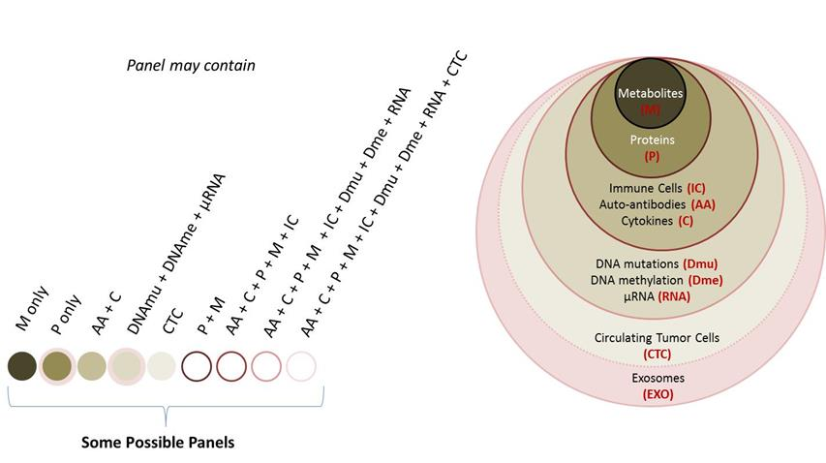
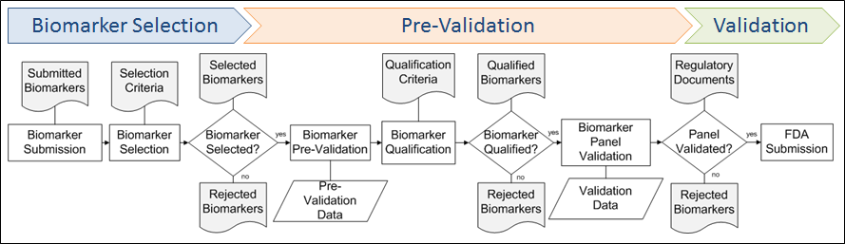
Biomarker Development
Literature Search:
Review articles from “Lung cancer biomarkers”: 10772 hits last 10 yrs in PubMed
+ commercial efforts
Biomarker Master List

Slide 30
Biopreserv Biobank. 2014 Dec;12(6):430-2. doi: 10.1089/bio.2014.0046.
Laboratory detective work identifies a mishandling problem in sample aliquoting.
Zhu C¹, Pinsky P, Huang WY, Purdue M.
Data from a recent ovarian cancer biomarker study using serum aliquots from the PLCO Biorepository showed that CA125 concentrations in these aliquots were significantly lower than those previously measured in the same subjects from the same blood draw

Slide 31
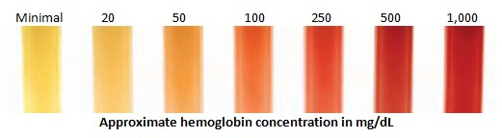
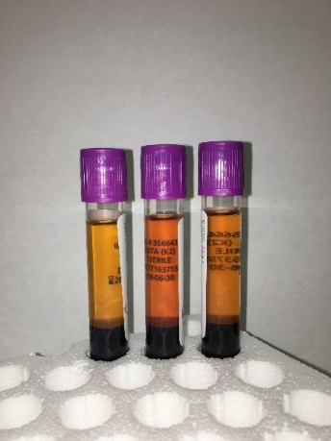
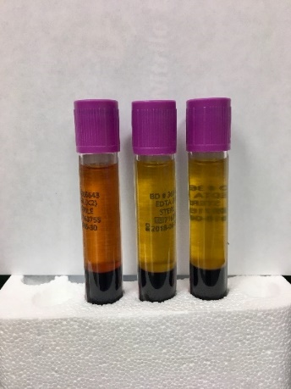
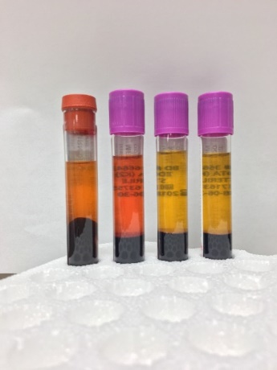
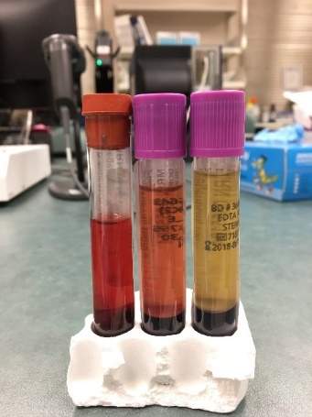
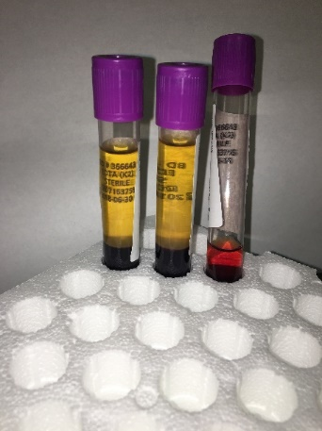
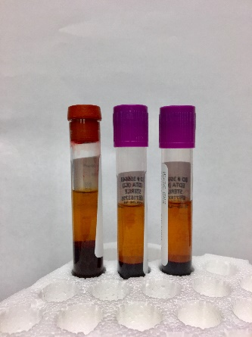
Low
Medium
High

Slide 33
Strategy for panel building
Carefully select anchor markers as panel members
Focus on analytical reproducibility of anchor markers, standardization → robust assays
Combine anchor markers to form the best performing panel

Slide 34
Diacetylspermine (DAS) Performance based on PanCan screening cohort
AUC: 0.6916 (0.5649 to 0.8184)
P: 0.0049

Slide 35
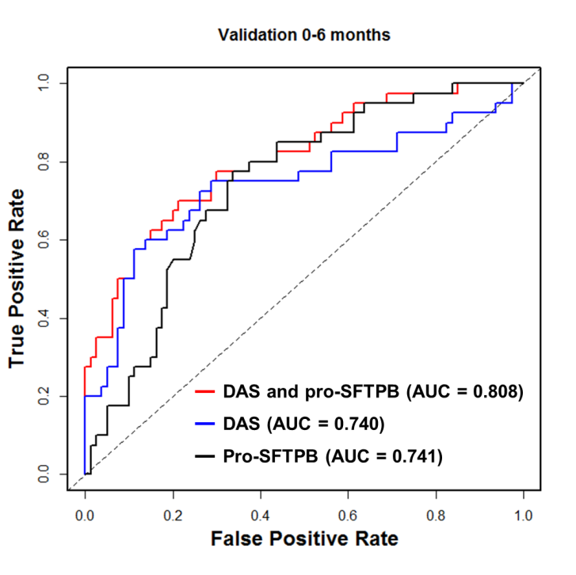
Testing of combinations of markers in pre-diagnostic samples
Sample collection: 0-6 months prior to diagnosis
P < 0.0001; vs. pro-SFTPB alone
Wikoff et al. JCO 2015

Slide 36
Performance of a Marker Panel Trained with CARET Pre-diagnostic Samples and Tested with ever smokers in the UMEA and EPIC Cohorts

Slide 38
Panel Validation with Clinical Grade Assays
PLCO cohort
Further Panel Refinement
MD Anderson Screening Cohort

Slide 39
MD Anderson Prospective Screening Cohort
US: MD Anderson, UT Tyler, USC, Stanford, MD Anderson Regional Centers
+
China (three provinces)
Europe ( France, Spain,)

Slide 40
Accrual March 3, 2018 8,614

Slide 41
Take home message
It takes a village to advance the field of early detection
Risk assessment through biomarkers enhances the prospects for prevention and early detection
Single markers or marker types unlikely to meet performance requirements given disease heterogeneity and subject diversity

Slide 43
Acknowledgements
Lab group: Mitzi Aguilar, Clemente Aguilar, Michela Capello, Julian Casabar, Muge Celiktas, Juan Chen, Jennifer Dennison, Dilsher Dhillon, Corinthia Emery, Johannes Fahrmann, Hiroyuki Katayama, Makoto Kobayashi, Deepali Kundnani, Jon Ladd, Vivuen liu, Amin Momin, Eunice Murage, Nikul Patel, Nan Sun, Ayumu Taguchi, Saty Tripathi, Peiling Tsou, Nese Unver, Jody Vykokal, Hong Wang, Peng Wang, Hanasen, Xu, B. Yang, Chuan-Yih Yu.
Lung Ca Collaborators: C. Amos, L. Bantis,, P. Brennan, A, G. Calin, K. Do, Z. Feng, O. Fiehn, D. Gandara, S. Gambhir, A. Gazdar, G. Goodman, M. Johansson, M. Katz, J. Kim, K. Kinzler, C. Lee, H. Levine, S. Moghaddem, V. Nair, E. Ostrin, F. Perera, R. Prentice, A. Rundle, H. Sesso, E. Szabo, A. Taguchi, M. Tammemagi. M. Thornquist, H. Varmus, B. Vogelstein, D. Wilson, I. Wistuba, H. Ying, J. Yuan, EPIC UMEA INVESTIGATORS

Slide 44
FUNDING SUPPORT
Lung Cancer Studiess
CARET NCI EDRN, DOD LRCP
WHI NHLBI BAA
PHS NCI R21
EPIC NCI UO1, NCI SCLC Consoritum
PLCO NCI UO1, NCI SCLC Consortium
Other cohorts NCI U19
Foundations: Canary, Lungevity, Rubenstein
Family, Houston Cancer Fighters, Lyda Hill

Slide 45
