Slide 1
Prediction of Progression and Recurrence in the Vermont Cohort of Screen-detected Breast Cancer
Vermont Molecular Characterization Laboratory
Janet Stein, PhD
Brian Sprague, PhD
Donald Weaver, MD
Mark Evans, Jonathan Gordon, Julie Dragon, Pamela Vacek
Gary Stein

Slide 2
UVM MCL Projects
Projects related to predictors of progression
Tumor microenvironment (TME) cell composition in low and high-grade breast tumors investigated by iterative multiplexed IHC (mIHC)
LncRNA and mRNA expression in low and intermediate/high recurrence score invasive breast tumors and in DCIS with and without recurrence events
Vermont DCIS cohort (VBCSS), outcomes for 1488 cases diagnosed between 1993-2012.
Isolation of mesenchymal stem cells from fresh breast cancer and matched normal breast tissue

Slide 3
Project 1: TME investigation by mIHC
Aims
Develop an iterative multiplexed IHC assay for implementation using a Leica-Aperio VERSA whole slide imaging system.
Construct TMAs containing indolent screen-detected and aggressive interval-detected invasive breast tumors
Construct TMAs of low and high-grade DCIS
Select marker panel
Screen TMAs for cell composition
Assess cell types distributions and relation to disease grade

Slide 4
Project 1: TME investigation by mIHC
Iterative mIHC for Leica VERSA: Assay Development
Why not fluorescence?
Higher background staining
Histopathology interpretation less clear
Increased reagent expense
Signal bleaching

Slide 5
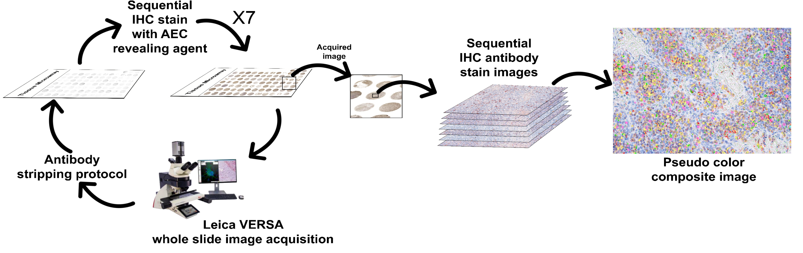


Project 1: TME investigation by mIHC
mIHC Approach for Leica VERSA

Slide 6
Project 1: TME investigation by mIHC
Iterative mIHC for Leica VERSA: Assay Development
Favored methodology
4 µm sections
Antigen retrieval step repeated for each new round of IHC
Antibody and AEC stripping by ethanol
Vector Labs Polymer antibody detection kit
AEC staining
Imaging after each antibody
Pseudo color assignment
Composite image construction in PhotoShop

Slide 7
Project 1: TME investigation by mIHC
Iterative mIHC for Leica VERSA: Issues
Large file sizes
Quantitative image pixel assessment requires uncompressed files (not JPEG)
Composite image construction time consuming and impractical for large cohort
How best to score and combine staining data?
  E.g., ‘‘IHC4’’ test score: 94.7 * (0.100 * ER10 0.079 * PgR10 þ 0.586 * HER2/neu0/1 þ 0.240 * Ln[1 þ 10 * Ki-67%pos])
  Similar approach required to relate TME stains to tumor ‘risk’?

Slide 8
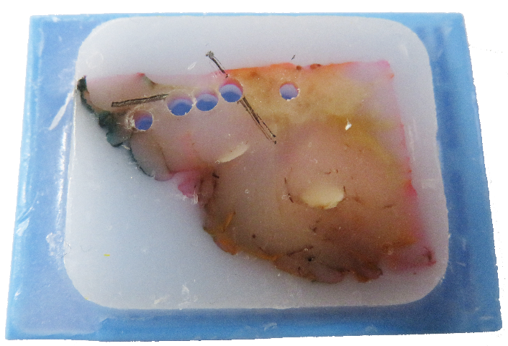
Project 1: TME investigation by mIHC
TMA construction: Basic Approach
Three 2 mm core punches
First straddling tumor/stroma interface estimated by H&E
Second and third perpendicular to first
Additional punches of tumor and stroma stored for potential molecular assay

Slide 9
Project 1: TME investigation by mIHC
Patient TMAs under construction
Indolent screen-detected and aggressive interval-detected invasive breast tumors
  Aim: up to ~200 each; currently ~110 samples in TMA form
Low and high-grade DCIS
  Aim: up to ~50 each: currently ~40 samples in TMA prep

Slide 10
Project 1: TME investigation by mIHC
TME Cell Markers
Cell type composition initial selection
MCL Immune Cell Panel
Marker | Cell Type
αSMA | Stromal fibroblasts
CD3 | Pan T-cell marker
CD34 | Lymphocytes, macrophages, mesenchymal stem cells (MSCs)
CD68 | Macrophages
NG2 | Pericytes
p63 | Basal cells
THY1/CD90 | MSCs (in conjunction with CD73, CD105, CD34 [under review])

Slide 11
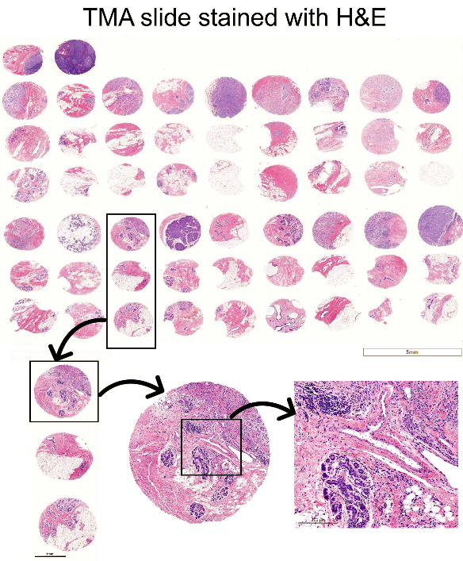
Project 1: TME investigation by mIHC
Cell markers application to MCL TMAs (in progress)

Slide 12
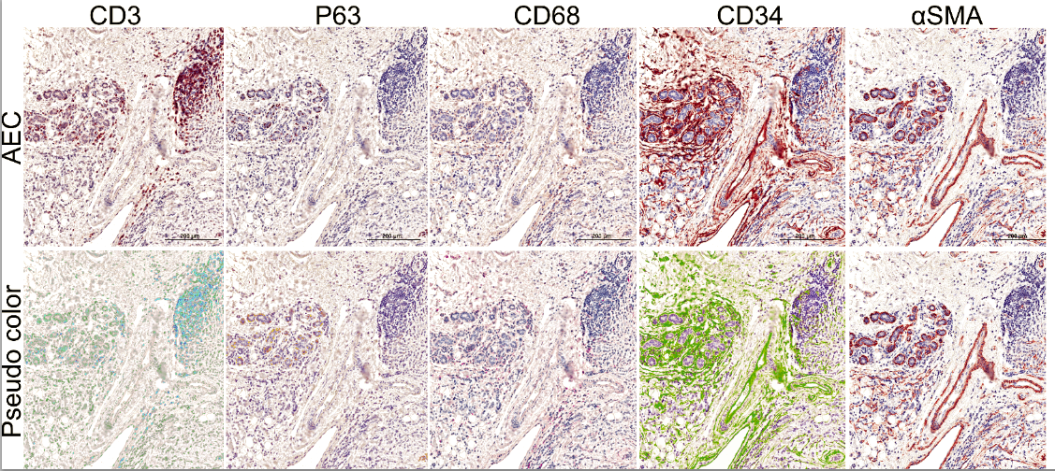
Project 1: TME investigation by mIHC
Cell markers application to MCL TMAs (in progress)

Slide 13
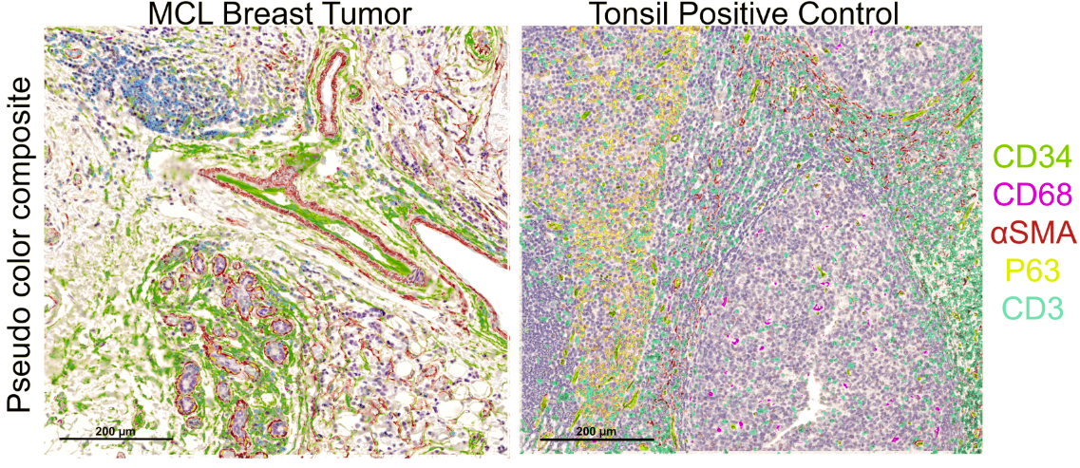
Project 1: TME investigation by mIHC
Cell markers application to MCL TMAs (in progress)

Slide 14
Project 1: TME investigation by mIHC
Conclusions
A multiplexed IHC assay has been optimized in our lab for use with the Leica-Aperio VERSA system.
Cell marker panel mIHC of patient TMAs is in progress.
Our main challenges are:
  Managing large file sizes
  Practicable construction of composite images
  Integrated staining pattern interpretation

Slide 15
Project 2: Breast RNA marker discovery (Reprise)
Aims, Methods, Results 1
De novo discovery of lncRNA and mRNA markers of breast cancer recurrence risk by microarray assay.
  FFPE RNA extracts from 8 low Recurrence Score (Oncotype DX) vs. 10 intermediate/high RS breast cancers
  7 lncRNAs and 10 mRNAs differentially expressed (P<0.05)

Slide 16
Project 2: Breast RNA marker discovery (Reprise)
Aims and Methods 2
RNA in situ hybridization (ACD RNAscope) marker validation
  TMA of low, intermediate and high RS breast cancers
  TMA of 84 DCIS, 55 with recurrence events
  Probes for microarray implicated lncRNAs (n=4) and mRNAs (n=4)
  Probes lncRNAs HOTAIR and H19
  Probe for MKI67
  Oncotype DX test ‘proliferation’ group probe cocktail: MKI67, STK15, BIRC5, Cyclin B1, MYBL2
  Mammostrat IHC test probe cocktail (gene correlates): SLC7A5, p53, NDRG1, HTF9C, CEACAM
  Binary staining score: <10% = negative; ≥10% = positive

Slide 17
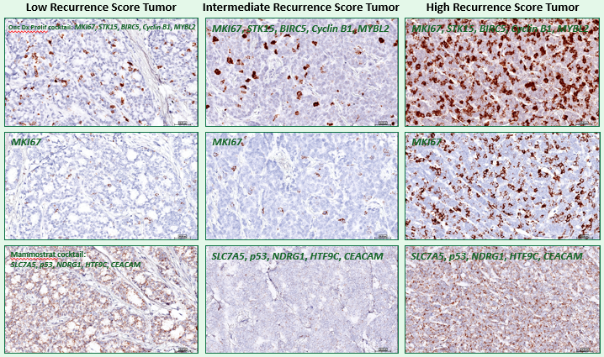
Project 2: Breast RNA marker discovery (Reprise)
Key RNA ISH Results: Invasive Tumors: no significant patterns overall

Slide 18
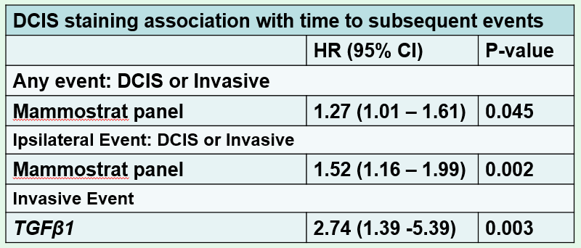
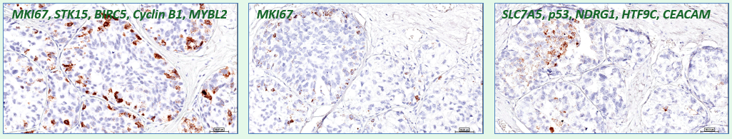
Project 2: Breast RNA marker discovery (Reprise)
Key RNA ISH Results: DCIS

Slide 19
Project 2: Breast RNA marker discovery (Reprise)
Conclusions
Simple correspondences between microarray generated data and RNA ISH staining were not observed. This may be due to sample size as well as different quantitative vs. qualitative technical endpoints.
Heterogeneous RNA ISH staining patterns that were noted may simply reflect inherent tumor nature.
Sophisticated stain scoring for integrating multiple markers in the context of heterogeneity may be required.

Slide 20
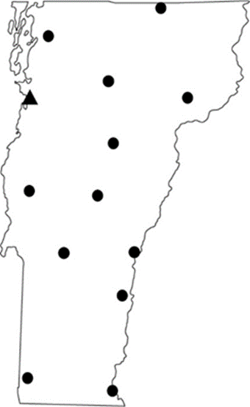
Project 3: Vermont DCIS Cohort
Assembled via the Vermont Breast Cancer Surveillance System
  DCIS diagnosed at any of the 15 breast imaging facilities in VT
  First primary breast cancer diagnosis, no concurrent invasive disease
  Diagnosed during 1993-2012
  N=1488
Clinical data available
  Self reported demographics, risk factors, medical history
  Mode of detection, breast density, screening history data from Radiology facility
  Pathology reports for initial diagnosis and subsequent diagnoses interpreted in VT
  Linked to statewide cancer registry and vital status records
Notes:
Background on how we assembled cohort.

Slide 21
Vermont DCIS Cohort
Tissue blocks retrieved for 1070 of the 1488 cases for centralized review
  Confirmed initial DCIS diagnosis
  Recorded standardized data on grade, size, necrosis, margin status
  Tissue specimens evaluated for preparation of TMAs
Additional resources
  Mammographic images available for 600 cases.
  Volumetric mammographic density measurements for entire breast and region surrounding DCIS lesion; N=170 (John Shepherd’s group at UCSF)
  Collagen organization in tumor microenvironment; N=100 (Patti Keely’s group at Wisconsin)
Notes:
Mention of centralized review and mention of additional data available on cohort.

Slide 22
DCIS Cohort Clinical Characteristics
 | N | %
Age
<40 | 37 | 2.5
40-49 | 370 | 24.9
50-74 | 896 | 60.2
75+ | 185 | 12.4
Family history of breast cancer
No | 1024 | 75.1
Yes | 339 | 24.9
Missing | 125
Mode of Detection
Screen-detected | 1087 | 84.0
Interval-detected | 60 | 4.6
Symptoms/no screening | 147 | 11.4
Missing | 194
 | N | %
Grade
Low | 180 | 14.2
Intermediate | 624 | 49.3
High | 461 | 36.4
Missing | 223
Size
<= 1 cm | 551 | 55.8
1.1-2 cm | 247 | 25.0
>2 cm | 190 | 19.2
Missing | 190
ER status
Negative | 120 | 17.9
Positive | 550 | 82.1
Missing | 818
Notes:
Baseline characteristics – demonstrates our ability to measure important factors, though much missing for grade/size/ER. Highlight mode of detection since MCL is about screen-detected lesions.

Slide 23
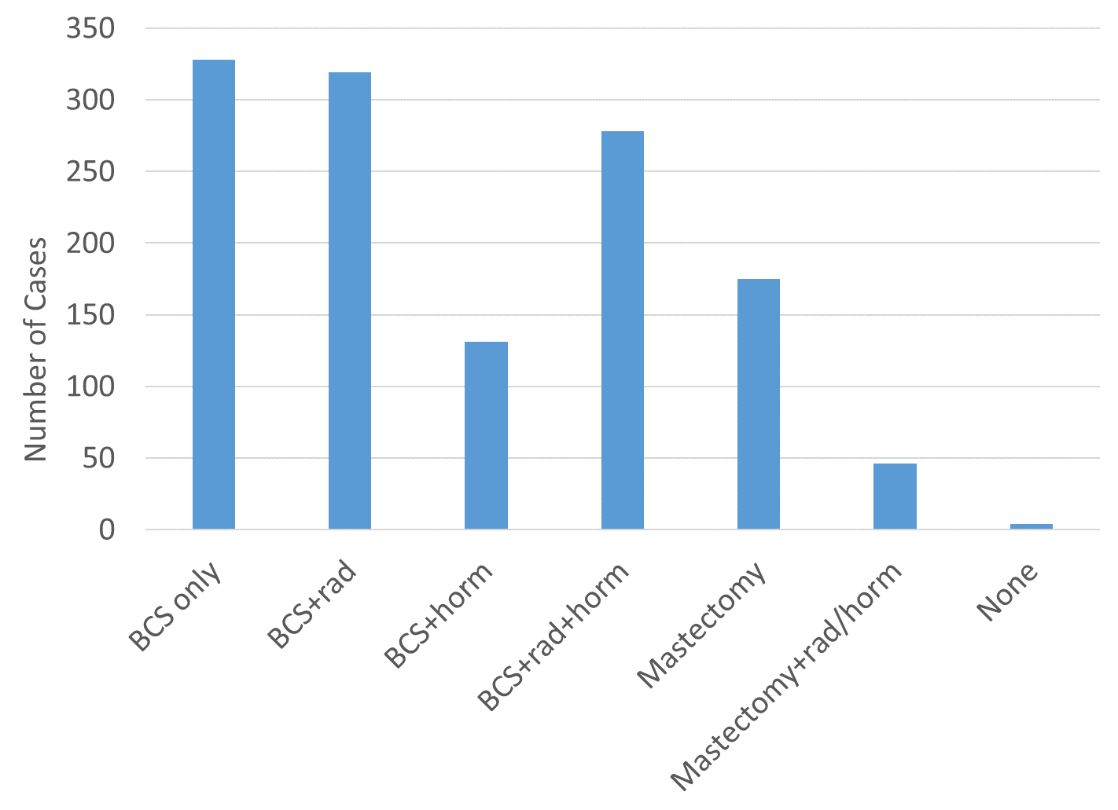
Treatments Received in DCIS Cohort
Varied Treatments
Breast Conserving Surgery
Mastectomy
Radiation Therapy
Hormonal
Notes:
Demonstrates range of treatments received in the cohort. We are dealing with observational real-life data, where a variety of management approaches are used. BCS=breast conserving surgery. rad=radiation therapy; horm = hormone (endocrine) therapy.

Slide 24
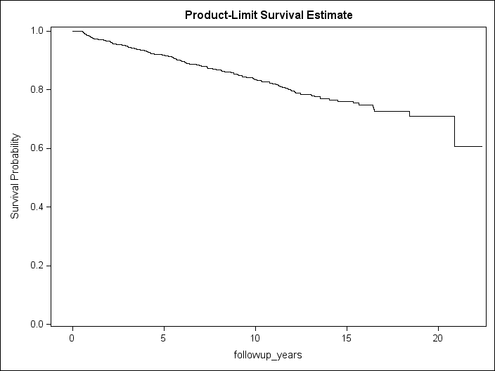
Recurrences
1326 cases have at least 6 months of follow-up
  Median 7.7 years (range 0.5 – 22 years)
  207 cases with second events (“recurrences”)
Notes:
We have lengthy follow-up on most cases. Total of 207 cases with a recurrence.

Slide 25
Characteristics of Recurrences (N=207)
 | N | %
Grade
Low | 27 | 17.5
Intermediate | 80 | 52.0
High | 47 | 30.5
Missing | 53
Size
<= 2 cm | 105 | 85.4
2.1-5 cm | 15 | 12.2
>5 cm | 3 | 2.4
Missing | 84
ER status
Negative | 19 | 14.1
Positive | 116 | 85.9
Missing | 72
 | N | %
Recurrence type
DCIS | 72 | 35.0
Invasive | 134 | 65.1
Missing | 1
Stage at recurrence
In situ | 44 | 31.7
Localized | 78 | 56.1
Regional | 13 | 9.4
Distant | 4 | 2.9
Missing | 68
Notes:
About 2/3rds of recurrences are invasive, and some of those are regional/distant; many are high grade.

Slide 26
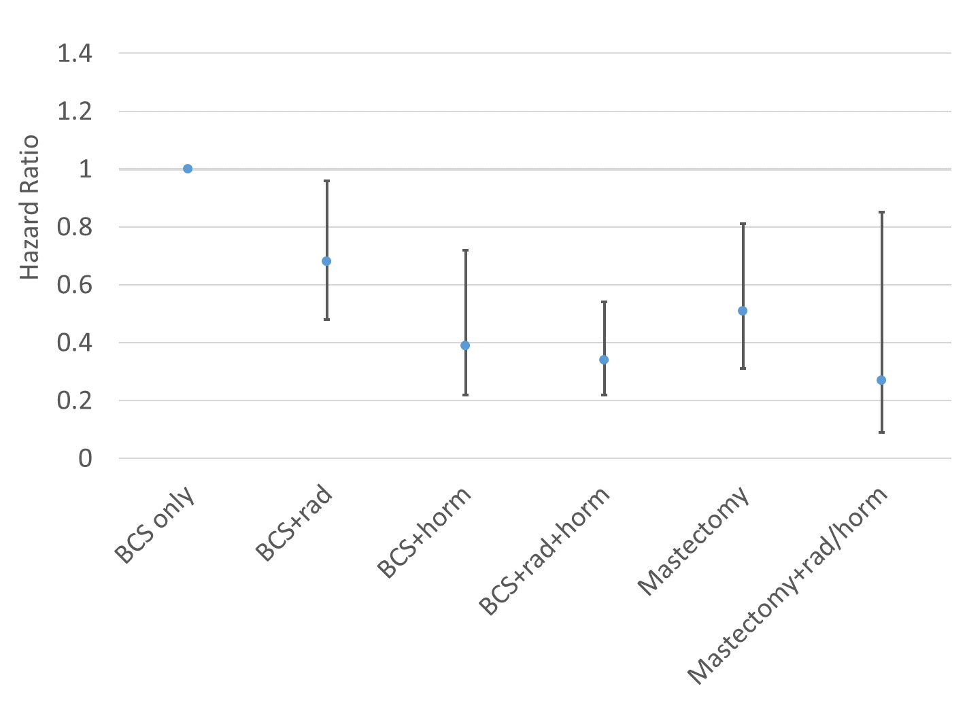
Risk of Recurrence by Treatment
Intense therapies have lowest recurrence
May lead to perpetuation of overtreatment
Notes:
Mastectomy and adjuvant treatments combined with BCS result in substantially lower risk of a second event. Hormone therapy reduces risk of any second event more than radiation.

Slide 27
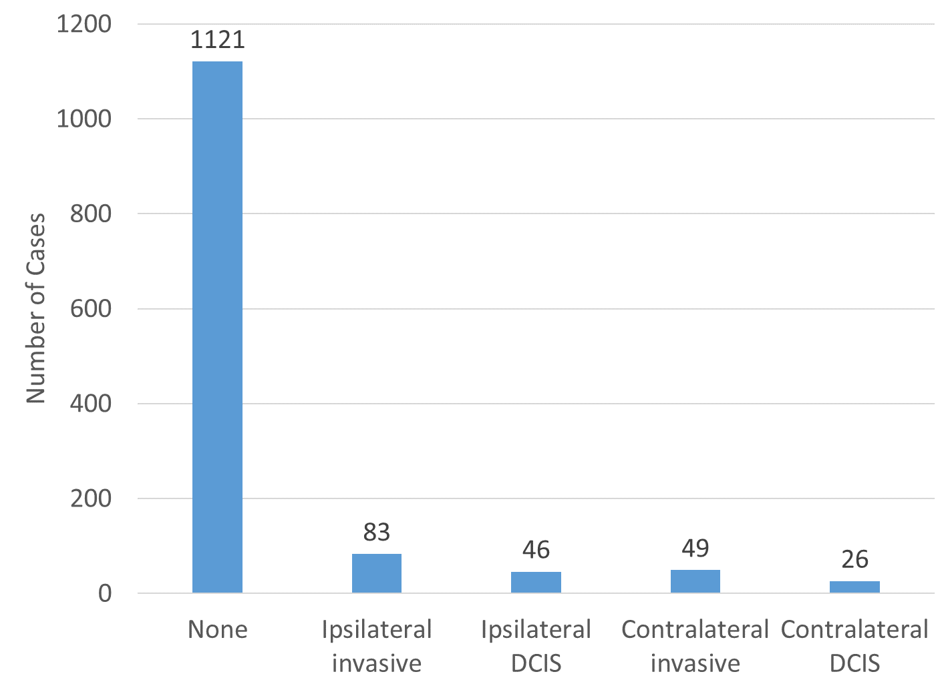
Types of Recurrences
Most patients do not recur
Caveat:
Cohort has been treated with surgery and adjuvant therapy
Notes:
Demonstrates the range of second events we are interested in. Ipsilateral invasive events are most common recurrence, but other types are common as well.

Slide 28
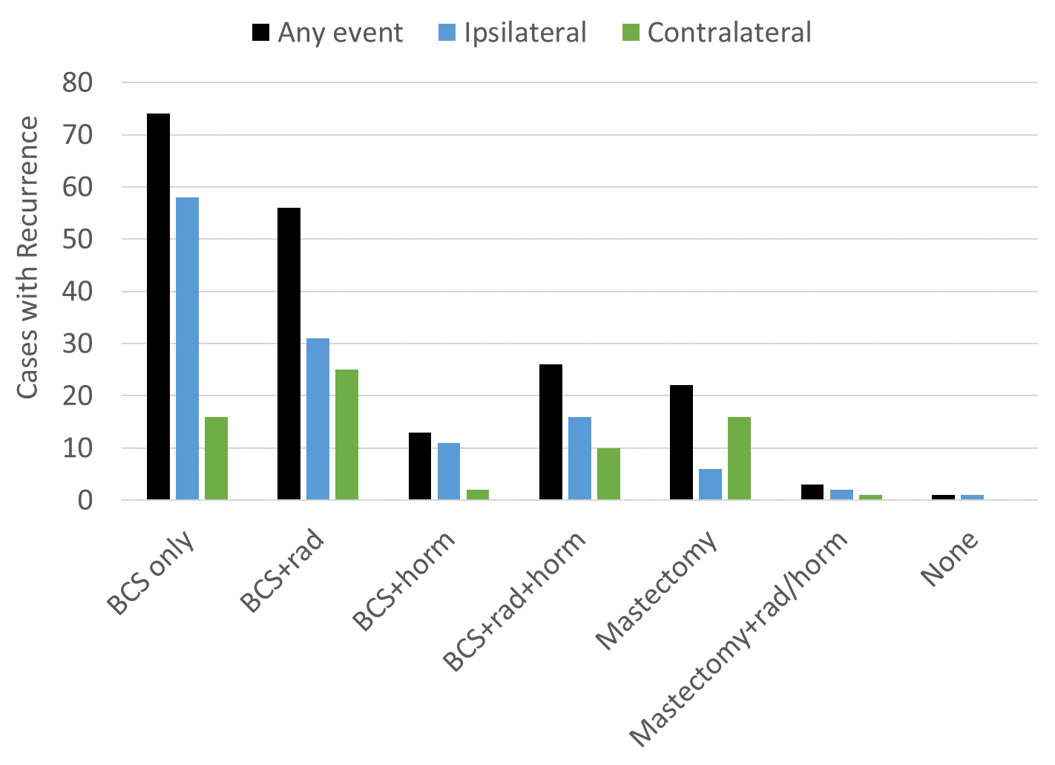
Types of Recurrence by Treatment
Notes:
Can compare the relative frequency of ipsilateral and contralateral events by treatment. Notably this slide does not depict the denominator number of cases for each treatment group, so that must be kept in mind while interpreting. We have relatively few events occurring after mastectomy (particularly ipsilateral events), so remaining slides focus on breast conserving surgery.

Slide 29
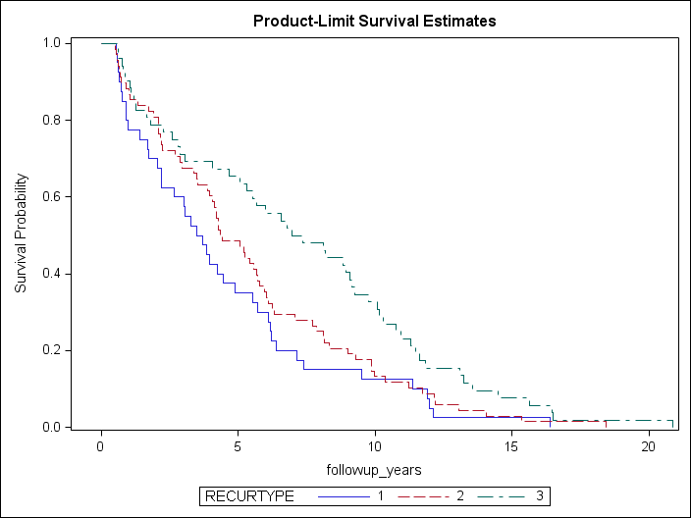
Recurrence after Breast Conserving Surgery
Ipsi DCIS
Ipsi Invasive
Contralateral
Notes:
THIS IS AMONG WOMEN WHO EXPERIENCED A RECURRENCE. Ipsilateral invasive events tend to have earliest time course, followed closely by Ipsi DCIS, then contralateral has substantially slower time course.

Slide 30
Time to Recurrence by Treatment (BCS)
Outcomes may be influenced by treatment…
but also by inherent biology and/or treatment selection bias
Hormone therapy group has stronger protection relative to RT or BCS alone
BCS+Horm
HR=0.4 (0.2-0.8)
BCS+Rad+Horm
HR=0.3 (0.2-0.6)
BCS+Rad
HR=0.6 (0.4-0.9)
BCS only
HR=1 (ref)
Notes:
Among women treated by BCS, this plot and hazard ratios show that hormone treatment offers stronger protection against risk of any event compared to radiation.

Slide 31
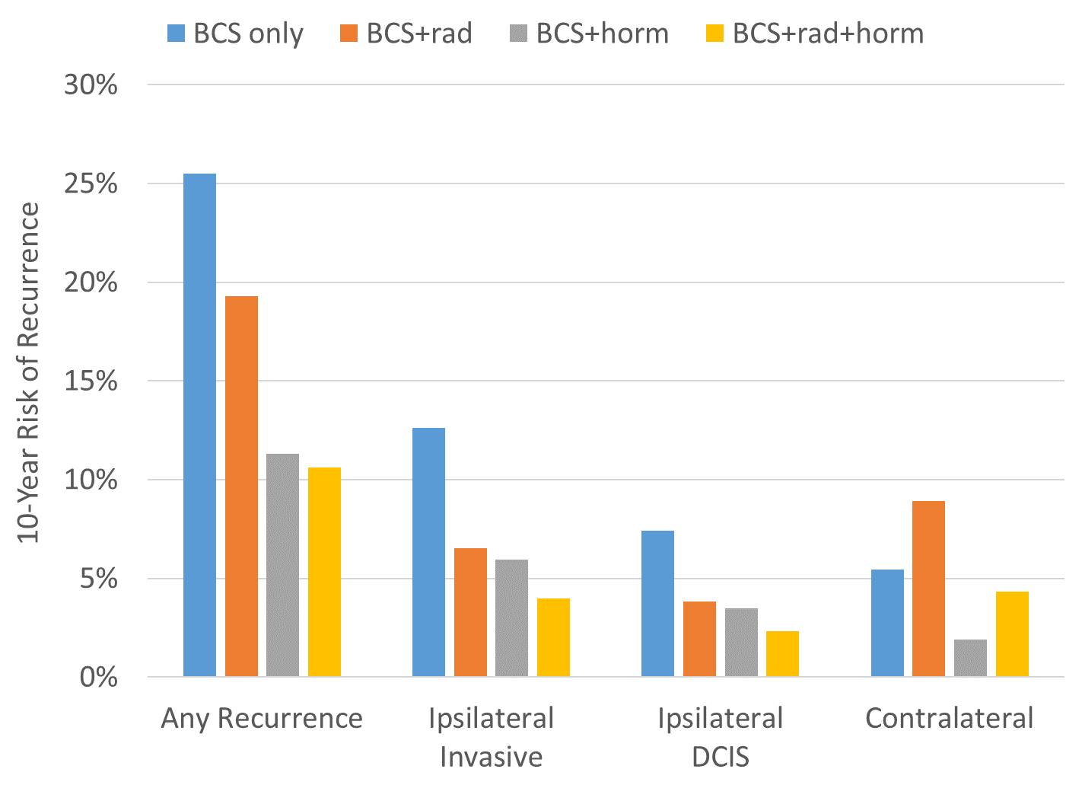
10-Year Risk of Recurrence by Treatment
Potentially complex relationships…
Estrogen receptor and hormone therapy
Aggressive phenotypes and radiation therapy
Notes:
10-year risk for BCS only is about 25%, but gets down to about 10% with hormone treatment. Can see here that hormone treatment offers better protection against any event, largely because hormones reduce ipsi and contralateral risk. Radiation only reduces ipsilateral risk.

Slide 32
Project 4: Isolation of mesenchymal stem cells
Jonathan Gordon, PhD

Slide 33
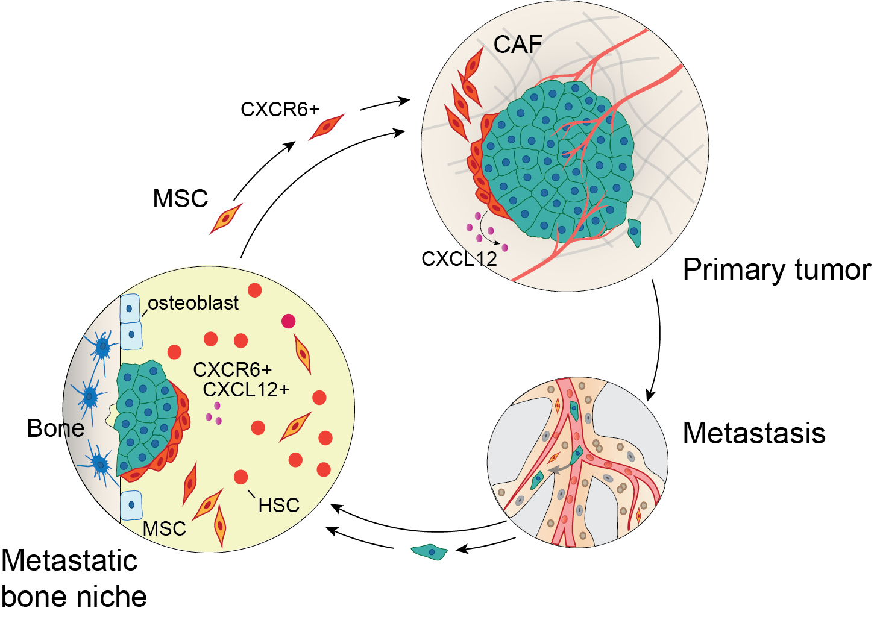

Slide 34
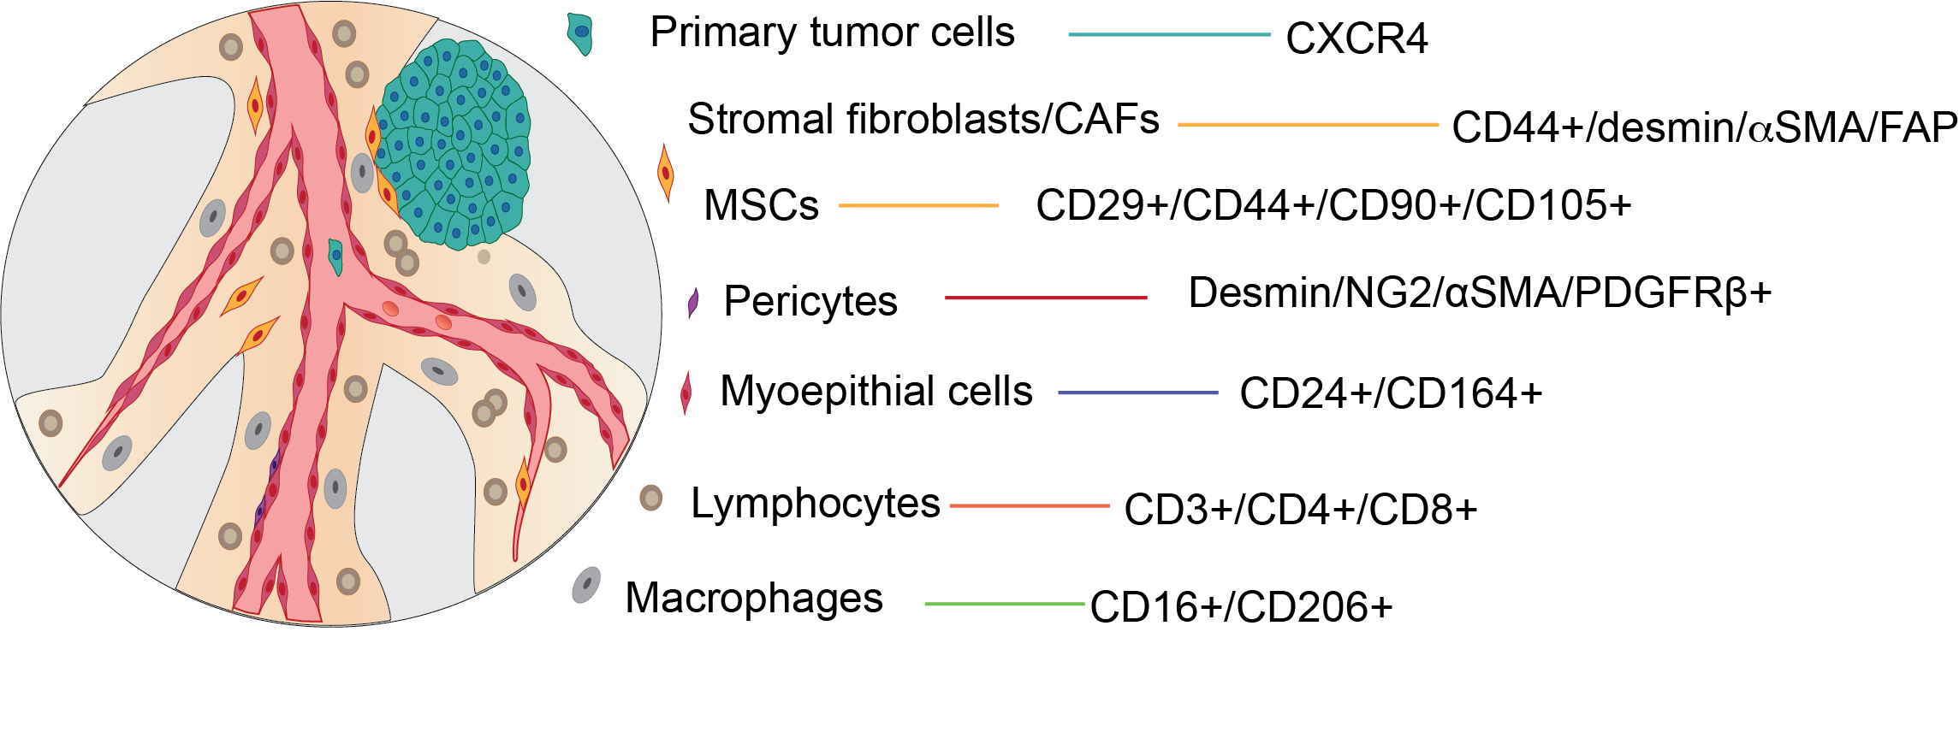

Slide 35
UVM MCL Projects

Slide 36
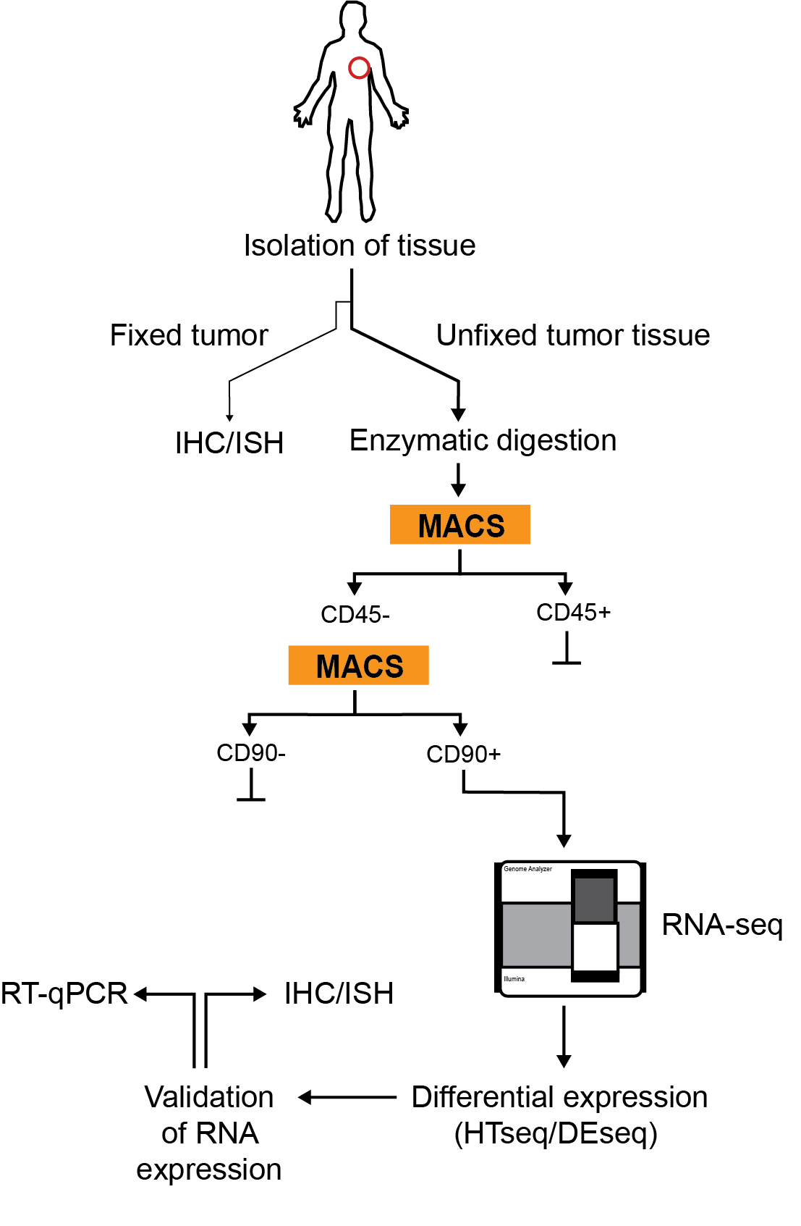

Slide 37
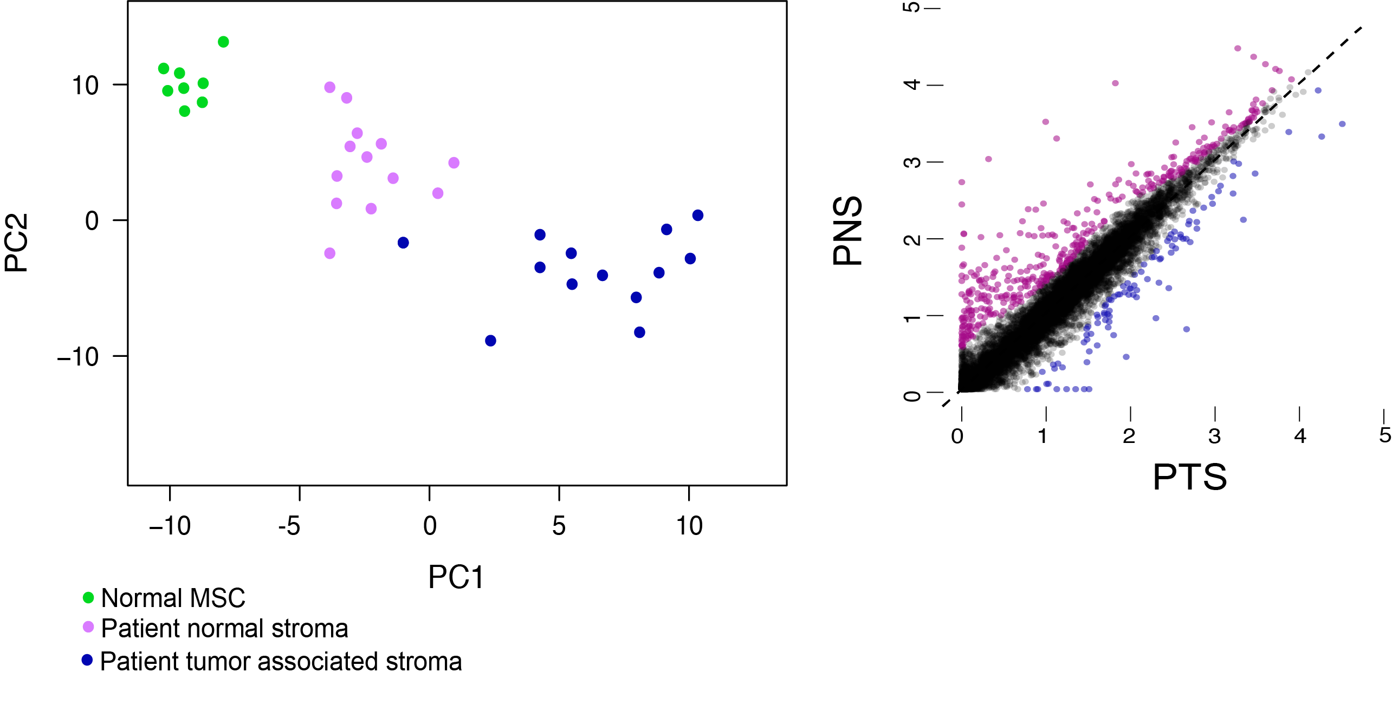
PCA and gene expression differences

Slide 38
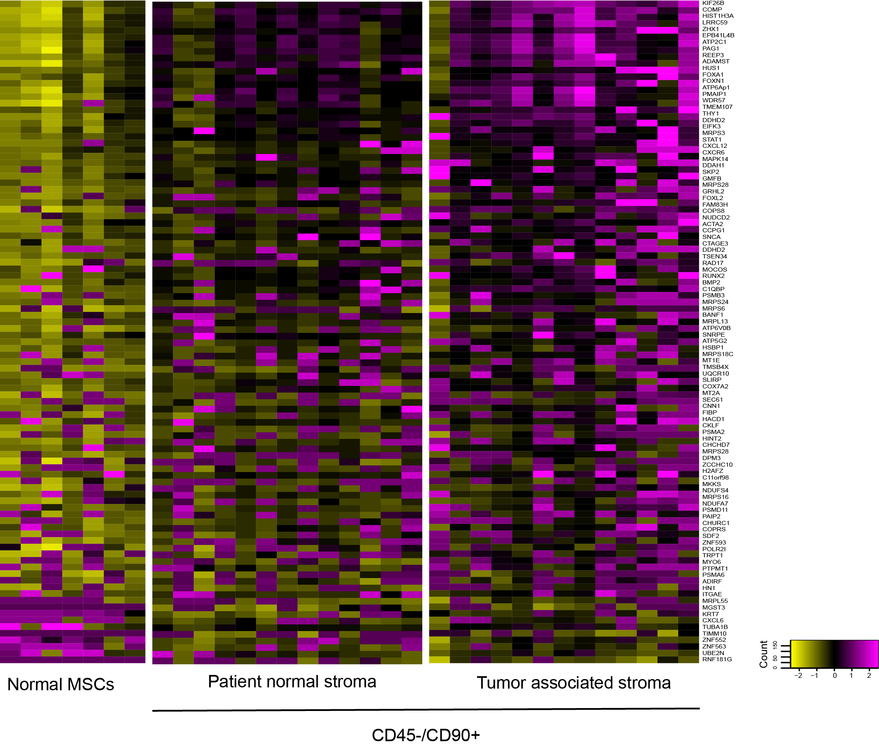
Gene expression changes in MSCs isolated from normal, patient normal stroma (PNS), patient tumor stroma (PTS)

Slide 39
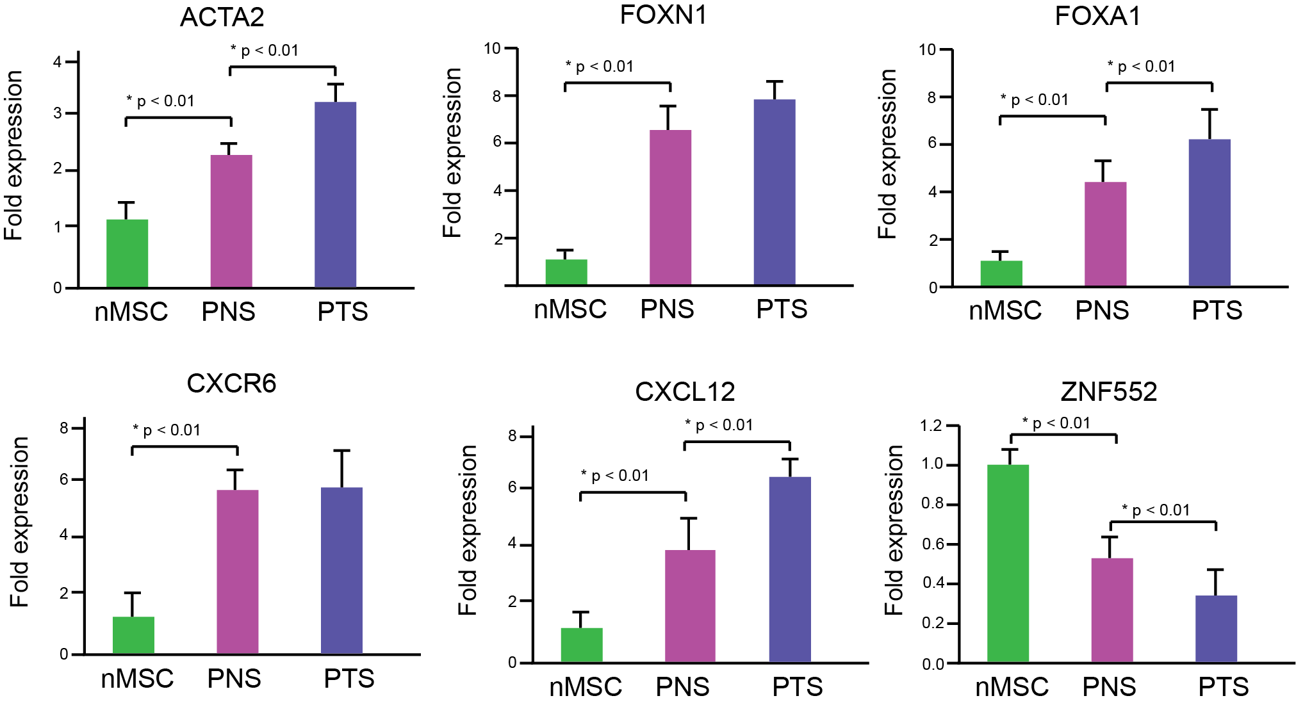
MSCs from patient tumor stroma demonstrate changes in the expression of CXC-related genes

Slide 40
Conclusions
Isolated CD45-/CD90+ cells from a small cohort of breast cancer patients with mixed diagnosis, including DCIS and invasive carcinoma subtypes.
Gene signatures from MSCs isolated from normal individuals differed from patient normal stroma or patient tumor-associated stroma.
Ongoing studies will increase sample sizes as well define these signatures in FFPE archival samples

Slide 41
Questions?

