Slide 1
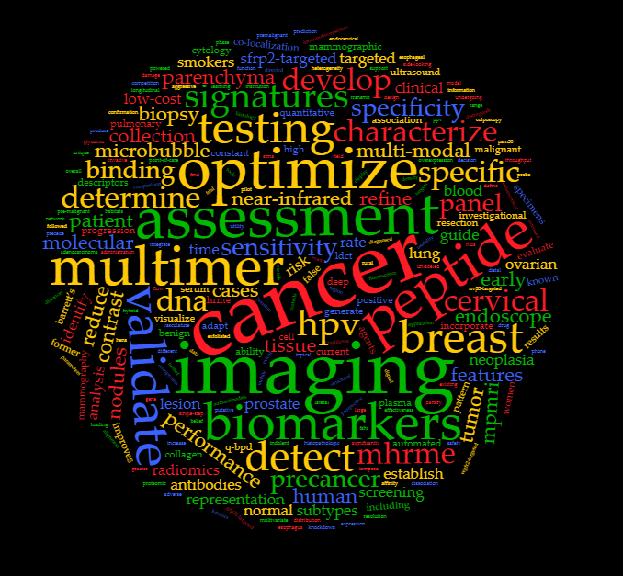
Consortium for Imaging & Biomarkers
U01: Early Detection of Aggressive Cancer
CIB Leadership:
Alan Pollack, MD, PhD, Radka Stoyanova, PhD, Thomas Wang, MD, PhD
10th EDRN Scientific Workshop in Bethesda, MD
March 6-8, 2018

Slide 2
Introduction to the Consortium for Imaging and Biomarkers (CIB)
Overview of the CIB
Brief History and Purpose
Investigator Research Objectives/Updates
Tools/Resources/Collaborations
Future Directions/Challenges

Slide 3
Imaging in cancer detection
Biomarkers are currently used as the primary tool to screen for a variety of diseases.
However, imaging is the primary screening tool used to identify some of our most prevalent and lethal cancers
Lung (X-ray, CT)
Breast (X-ray, US, MRI)
Imaging also plays an integral role in the assessment of:
Pancreatic (CT, US, MRI)
Ovarian (US, CT, MRI)
Prostate (US, MRI, CT)

Slide 4
Strategies for combining imaging and biomarkers
Imaging (screening, active surveillance) used to trigger a subsequent biomarker study
Biomarkers (screening, active surveillance) used to trigger subsequent imaging
Complementary Information
Biomarkers advantageous: cancer risk, presence and aggressiveness
Imaging advantageous: assess both tumor characteristics and adjacent normal tissue (microenvironment), 3D localization for biopsy
Integration improves decision-making (↓Cost)
Samples /data acquired on same day
Longitudinally measurements over time

Slide 5
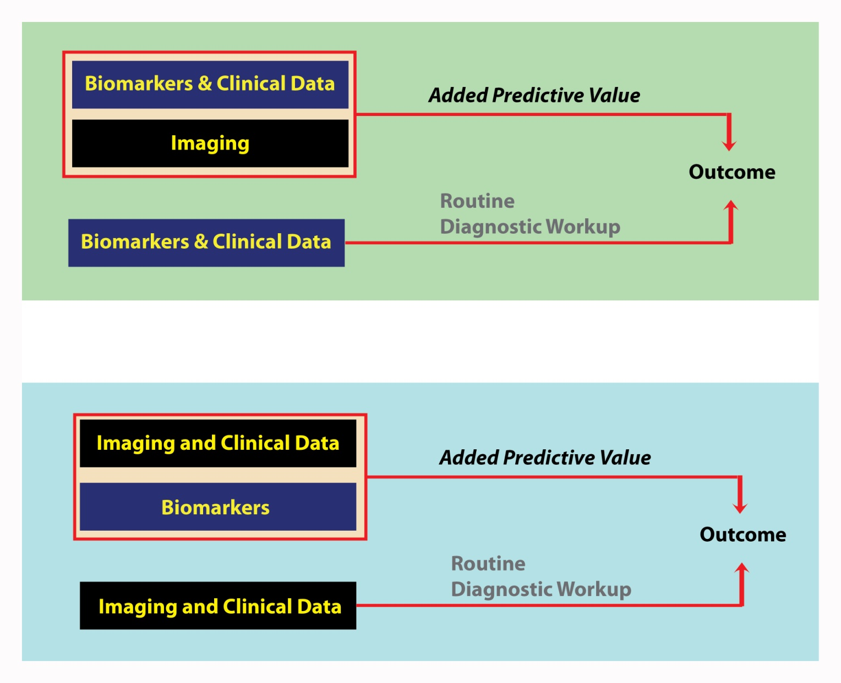
Two examples of how imaging and biomarkers might be used together
Example #1
Prostate
Biomarkers
are current
Standard of Care
Example #2
Lung
Imaging
is current
Standard of Care

Slide 6
CIB Funded Research Projects: Breast (n=5)
Organ Site | Imaging |  | Biomarkers |  | Tools & Resources
 | Clinical | Experimental | Tissue | Blood
Breast [1]: DeMore & Dayton |  | Endothelial Marker-Targeted Microbubble Ultrasound | SFRP2 |  | Targeted ultrasound molecular imaging
Breast [2]: Seewaldt | MRI |  | p53/Wnt WWOX |  | MRI and tissue obtained at the same time point; Prospectively collected longitudinal imaging and tissue data
Breast [3]: Wei | Mammogram |  |  |  | Quantitative risk descriptor
Breast [4]: Conklin |  | Collagen Fibers | Extracellular Matrix Structure proteins |  | Analysis tools for measuring Collagen matrix
Breast [5]: El-Zein & Bedrosian | Mammogram |  | PAM50 specific transcriptional field effects | Blood biomarkers | Quantitative image analysis to identify underlying subgroups
IMPROVING BREAST ULTRASOUND SPECIFICITY THROUGH SFRP2 TARGETED MOLECULAR IMAGING: Nancy K. DeMore, MD, Medical University of South Carolina; Paul Dayton, PhD, University of North Carolina at Chapel Hill
CombineD BREAST MRI and Wnt/p53-Biomarkers to Distinguish Aggressive Cancer from Benign Breast Lesions: Victoria L. Seewaldt, MD, City of Hope
Development of an Imaging-Based Biomarker from Mammographic Data to Assess Breast Cancer Risk in a Screening Population: Jun Wei, PhD, University of Michigan
COLLAGEN STRUCTURAL CHANGES AS AN EARLY BIOMARKER FOR BREAST CARCINOMA: Matthew Conklin, PhD, University of Wisconsin
Integrative Molecular and Imaging Approaches for Risk of Subtype Specific Breast Cancer: Randa A. El-Zein, PhD, Houston Methodist Research Institute; Isabelle Bedrosian, MD, University of Texas MD Anderson

Slide 7



Screening for Sporadic Breast Cancer -Ideal future state
Integrative Molecular and Imaging Approaches for
Risk Prediction of Subtype Specific Breast Cancer
R. El-Zein And I. Bedrosian
Reassess in 3-5 years
No imminent risk
Baseline
Screen-
Age 40
Intervention
based on
subtype
Imminent risk

Slide 8


R. El-Zein And I. Bedrosian
HYPOTHESIS: Each of the major breast cancer subtypes has a molecular field defect that results in unique mammographic parenchymal characteristics that when coupled with blood biomarker signatures can provide a novel, subtype specific, early detection tool
Study Overview & Design
Aim#1: Determine subtype specific imaging signatures of the
mammographically normal background breast parenchyma
Refine imaging signatures using blood based DNA damage markers
Breast Cancer Subtypes n=250
HR+[n=100]; HER2+ [n=75]
TNBC [n=75]
Cancer Free Controls n= 150
Archived Mammographic
Images & Blood
Generation of unique “premalignant signature” for each subtype
Aim#3: Determine whether the imaging signatures precede
the development of breast cancer
Breast Cancer Subtypes
HR+[n=35]; HER2+ [n=35]
TNBC [n=35]
Archived FFPE Breast Tissues
Aim#2: To identify the extent of field cancerization associated
with the different subtypes using RNAseq

Slide 9
Accomplishments
R. El-Zein And I. Bedrosian
Completed quantitative image analysis (QIA) on over 800 mammographic images, representing over 250 women in our case- control study.
QIA features are robust between observers
QIA features associated with cancer images are present at least one year antecedent to cancer events
QIA features can distinguish between cancers and controls
Completed Blood Biomarker analysis on about 200 patients
Generated bank of tissue samples to investigate subtype specific molecular field effect.
Transcriptional analysis ongoing

Slide 10
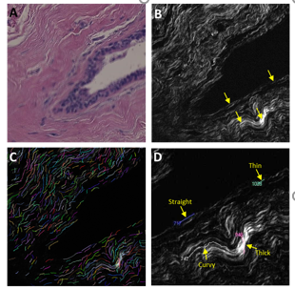
CIB Funded Research Projects: Breast, Experimental
Collagen structural changes as an early biomarker for breast carcinoma
Second Harmonic Generation (SHG) microscopy
Improving breast ultrasound specificity through Secreted Frizzled Related Protein-2 (SFRP2) targeted molecular imaging
SFRP2 - an angiogenesis factor overexpressed in breast tumor vasculature
Aim 1. Refine an SFRP2-targeted microbubble contrast agent’s ability to visualize breast tumor vasculature by optimizing antibody loading.
Aim 2. Determine SFRP2 targeted ultrasound molecular imaging’s sensitivity and specificity to detect breast cancer as a function of lesion size.
Aim 3. Determine if SFRP2-targeted microbubble contrast can detect tumor vessels with greater sensitivity and specificity than VEGFR2-targeted or αvβ3-targeted microbubble contrast.
Courtesy of Dr. Dayton (UNC) and
Dr. DeMore (MUSC)
Courtesy of Dr. Conklin, Univ of Wisconsin

Slide 11
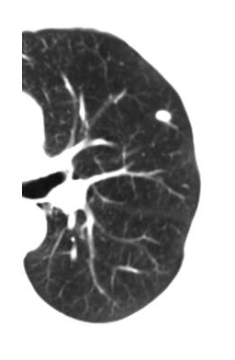
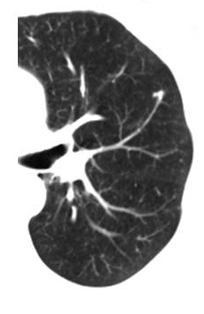
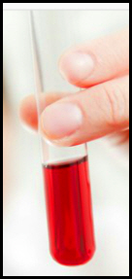
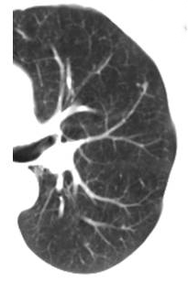
Biomarkers to improve imaging
assessments of indeterminate lesions …
2 years
8 mm
1 year
3 mm
Baseline
2 mm
Courtesy of Dr. Massion, Vanderbilt-Ingram Cancer Center

Slide 12
CIB Funded Research Projects: Lung (n=4)
Organ Site | Imaging |  | Biomarkers |  | Tools & Resources
 | Clinical | Experimental | Tissue | Blood
Lung [6]: Lampe & Houghton | CT |  |  | Proteomic, Glycomic and autoantibodies | Models of quantitative CT imaging, clinical factors and blood biomarkers
Lung [7]: Massion | CT |  |  | Blood biomarkers | Models of quantitative CT imaging, clinical factors and blood biomarkers
Lung [8]: Taguchi | CT |  |  | Seven protein and three autoantibody markers | Models of quantitative CT imaging, clinical factors and blood biomarkers
Lung [9]: Spira | CT |  | Bronchial gene expression biomarkers |  | Models of quantitative CT imaging, clinical factors and tissue biomarkers
Integration of Blood-Based Biomarkers with Computed Tomography to Improve Diagnostic Accuracy for the Early Detection of Aggressive Cancer from Benign Lung Nodules: Paul Lampe, PhD, Fred Hutchinson Cancer Research Center; McGarry Houghton, MD, Fred Hutchinson Cancer Research
Non Invasive Evaluation of Indeterminate Pulmonary Nodules; Pierre P. Massion, MD, Vanderbilt University
Development and Validation of a Biomarker Panel for Early Detection of Lung Cancer and Nodule Diagnosis with Integrating LDCT Imaging: Ayumu Taguchi, MD, PhD, University of Texas MD Anderson Cancer Center
MOLECULAR AND IMAGING BIOMARKERS FOR EARLY LUNG CANCER DETECTION IN THE SETTING OF INDETERMINATE PULMONARY NODULES: Avrum E. Spira, MD, Boston University

Slide 13
Integration of Blood-Based Biomarkers with Computed Tomography (CT) to Improve Diagnostic Accuracy for the Early Detection of Aggressive Cancer from Benign Lung Nodules
McGarry Houghton, MD Paul Lampe, PhD
Fred Hutchinson Cancer Research Center

Slide 14
Specific Aims
Aim #1. Test the ability of putative proteomic and glycomic biomarkers to identify malignant pulmonary nodules.
Aim #2. Determine if autoantibodies present in plasma are tumor-derived and assess their utility for the detection of cancerous nodules.
Aim #3. Perform multivariate analyses to integrate hybrid plasma biomarkers and pulmonary nodule features to distinguish malignant from benign nodules identified on CT imaging.
Notes:
lack of health insurance, lack of physician recommendation, and lack of awareness of the importance of CRC screening

Slide 15
Accomplishments: Aim 1Test the ability of putative proteomic and glycomic biomarkers to identify malignant pulmonary nodules.
In CHS pre-diagnostic samples (0-2 years prior to diagnosis) we found 81 proteins significantly higher (p<0.009) in people later diagnosed with lung cancer.
Of the 81 upregulated CHS proteins, 5 were validated at p<0.006 in 126 subjects with nodules later determined to be cancerous matched 1:1 with subjects with benign nodules from the Fred Hutch Lung Cancer Early Detection Clinic (LCEDC) [20x what would be expected by chance – 5/(81 x 0.006 x 0.5 up only)].
Examination of proteins with significant increases in sialyl Lewis-A and –X content in the CHS samples showed 14 proteins with increased sialyl Lewis-A (p<0.043) and 16 with sialyl Lewis-X (p<0.025) modifications.
The LCEDC samples showed validation of 4/14 and 2/16 of the glycomic markers at p<0.006 (95x and 42x expected by chance).
Currently testing locked down panel in second LCEDC set (130 case/130 control)

Slide 16
Accomplishments: Aim 1Test the ability of putative proteomic and glycomic biomarkers to identify malignant pulmonary nodules.
In CHS pre-diagnostic samples (0-2 years prior to diagnosis) we found 81 proteins significantly higher (p<0.009) in people later diagnosed with lung cancer.
Of the 81 upregulated CHS proteins, 5 were validated at p<0.006 in 126 subjects with nodules later determined to be cancerous matched 1:1 with subjects with benign nodules from the Fred Hutch Lung Cancer Early Detection Clinic (LCEDC) [20x what would be expected by chance – 5/(81 x 0.006 x 0.5 up only)].
Examination of proteins with significant increases in sialyl Lewis-A and –X content in the CHS samples showed 14 proteins with increased sialyl Lewis-A (p<0.043) and 16 with sialyl Lewis-X (p<0.025) modifications.
The LCEDC samples showed validation of 4/14 and 2/16 of the glycomic markers at p<0.006 (95x and 42x expected by chance).
Currently testing locked down panel in second LCEDC set (130 case/130 control)

Slide 17
Accomplishments: Aim 2 Determine if autoantibodies present in plasma are tumor-derived and assess their utility for the detection of cancerous nodules.
We found 51 IgG (p<0.01) and 33 IgM (p<0.023) autoantibody-autoantigen complexes significantly increased in the CHS samples. In LCEDC samples, 15/51 IgG and 2/33 IgM markers validate at p<0.02.
4/13 autoantibodies discovered in tumors validated in an expanded LCEDPC cohort
Currently testing locked down panel in second LCEDPC set (130 case/130 control)

Slide 18
Accomplishments: Aim 2 Determine if autoantibodies present in plasma are tumor-derived and assess their utility for the detection of cancerous nodules.
We found 51 IgG (p<0.01) and 33 IgM (p<0.023) autoantibody-autoantigen complexes significantly increased in the CHS samples. In LCEDC samples, 15/51 IgG and 2/33 IgM markers validate at p<0.02.
4/13 autoantibodies discovered in tumors validated in an expanded LCEDPC cohort
Currently testing locked down panel in second LCEDPC set (130 case/130 control)

Slide 19
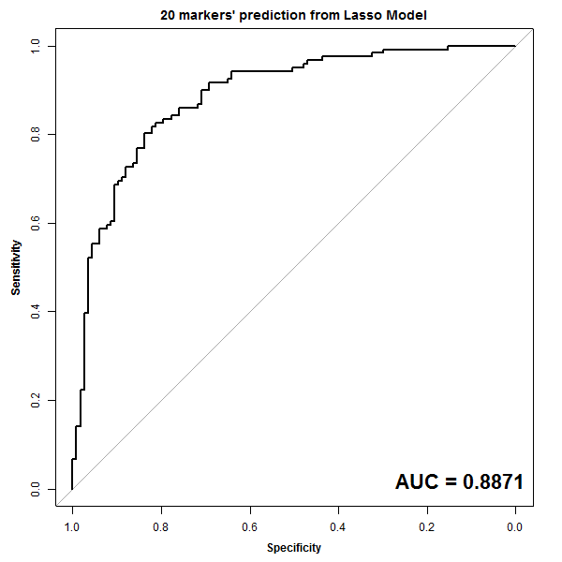
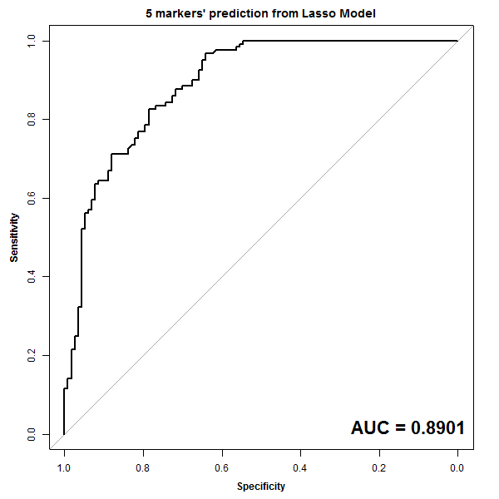
Accomplishments: Aim 3
Model | Number of subjects | Number of variables considered | Number of top predictors Lasso selected | All data (AUC) | Cross validation results (AUC | Note
Plasma Biomarkers | 238 | 106 | 20 | 88.7% | 89.4% | Lambda.1se
Clinical+Semantic | 238 | 22 | 5 | 89.01% | 87% | Lambda.1se
Sensitivity
Plasma
Biomarkers
Clinical+CT
Sensitivity
Specificity
Specificity
Currently finalizing rule to test combined plasma and CT in second LCEDC cohort

Slide 20
CIB Funded Research Projects: Misc (n=6)
Organ Site | Imaging |  | Biomarkers |  | Tools & Resources
 | Clinical | Experimental | Tissue | Blood
Prostate [10]: Pollack & Stoyanova | mpMRI |  | Gleason Score; Gene expression |  | mpMRI features, clinical features and transcriptomic models for AS
Cervical Cancer [11]: Richards-Kortum |  | Mobile high-resolution microendoscope (HRME) | HPV DNA and E7 |  | Display, analyze, and transmit images - portable
Esophageal Adenocarcinoma [12]: Wang | Endoscopy | Near-infrared imaging testing of peptide multimers | Cell surface proteins |  | Multimer immuno-fluorescence detection of HG and Ca lesions in Barretts
Ovarian Cancer [13]: Barua |  | Targeted ultrasound imaging | Microbubble targeting FSHR & GRP78 | Anti-nuclear matrix proteins | Microbubble targeted imaging combined with blood biomarkers
Hepatocellular Carcinoma [14]: Baretta | Contrast MRI in Surveillance | Contrast ultrasound |  | AFP, Proteins + Fatty Acids | Addition of proteins & Fatty acid triggers for MRI
Bile duct cancer [15]: Seibel | Endoscopy | Fluorescently stained multiplexed probes in novel endoscopy device |  |  | Distinguish cancer from nonlethal disease
MRI Imaging and Genetic Signatures to Manage Prostate Cancer Overdiagnosis: Alan Pollack, MD, PhD, University of Miami, Radka Stoyanova, PhD, University of Miami
High Resolution Imaging and HPV Detection for Global Prevention of Cervical Cancer: Rebecca Rae Richards-Kortum, PhD, Rice University
Develop/verify a Near-Infrared Approach for Real-Time Detection of High-Grade Dysplasia and Early Esophageal Adenocarcinoma: Thomas D. Wang, MD, PhD, University of Michigan
EARLY DETECTION OF OVARIAN CANCER BY SERUM MARKER AND TARGETED ULTRASOUND IMAGING: Animesh Barua, MD, Rush University
EARLY DETECTION OF HEPATOCELLULAR CARCINOMA: Laura Baretta, MD, M.D.Anderson
MULTIPLEXED IMAGING OF BILIARY INTRA-EPITHELIAL NEOPLASIA: Eric J. Seibel, PhD, University of Washington

Slide 21



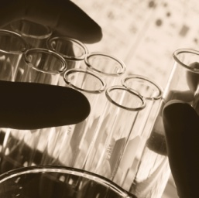
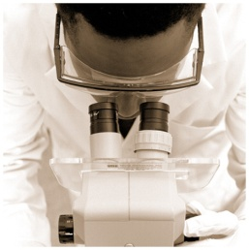
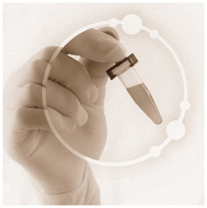
MRI Imaging and Genetic Signatures to Manage Prostate Cancer Overdiagnosis
Alan Pollack,¹ Radka Stoyanova,¹ Robert Gillies,² Yoganand Balagurunathan,² Charles Lynne,¹ Dipen Parekh,¹ Nicholas Erho,³ Lucia Lam,³ Christine Buerki,³ Ram Datar,¹ Richard Cote,¹ Merce Jorda,¹ Oleksandr Kryvenko,¹ Matthew Abramowitz,¹ Elai Davicioni,³ Sanoj Punnen¹
¹ University of Miami Miller School of Medicine, Miami, Florida ² Moffitt Cancer Center, Tampa, FL ³ GenomeDx Biosciences, Vancouver, British Columbia, Canada

Slide 22
Specific Aims
Aim 1: To assess the overall rate and temporal distribution of progression in men undergoing mpMRI assessments and directed prostate biopsies for AS in a prospective Phase II (MAST) trial.
166 patients consented and in pipeline: Goal 200 assessable
Aim 2. To establish mpMRI habitats and use high throughput analysis of mpMRI features (radiomics) to develop signatures related to adverse histopathologic parameters and patient progression.
Aim 3. To molecularly characterize the mpMRI-directed prostate biopsies obtained, develop a gene expression signature of indolent versus aggressive prostate cancers, and relate this information to the radiomics-derived signatures.

Slide 23
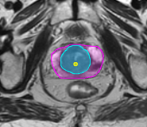
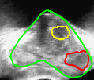
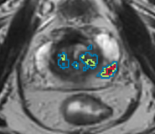
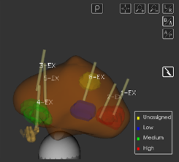
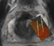
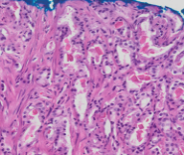

Schema
mpMRI Analysis
mpMRI of Prostate
Fusion Biopsy
Prostate Segmentation
Fusion of MRI targets with
3D Ultrasound
PI-RADS Scoring
Prostate Biopsies for mapping and tissue processing
Delineation of Tumor Habitats
Biopsy Tissue Histopathology and
Gene Expression
Mapping of Biopsy Location
Radiomic features
Radiogenomics
Transcriptomic features
Stoyanova R, Takhar M, Tschudi Y, et al Prostate cancer radiomics and the promise of radiogenomics. Transl Cancer Res. 5(4):432-447 (2016)
Notes:
Figure 1. Experimental Design. Multiparametric (MP-)MRI, consisting of anatomical (T2-weighted), perfusion (Dynamic Contrast Enhanced (DCE-)MRI and diffusion (Diffusion Weighted Imaging (DWI)) imaging sequences is acquired on 3T scanner. Upper left-hand side (shaded in blue) denotes the procedures for MRI-ultrasound fused targeted biopsies. The steps for radiomic analysis are presented at the right hand side in green. Histopathology results, gene expression analysis and radiomic features are fed in the radiogenomics analysis.

Slide 24
Radiogenomics: Stoyanova et al, Oncotarget 2016
Radiomic Features
Gene Expression Features

Slide 25
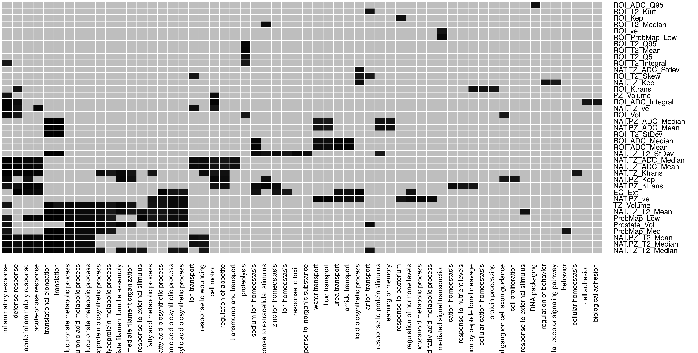
Gene Ontology Analysis
Inflammation
Metabolism
Transport
Adhesion
Normal Appearing:
Microenvironment?
Courtesy of R. Stoyanova

Slide 26
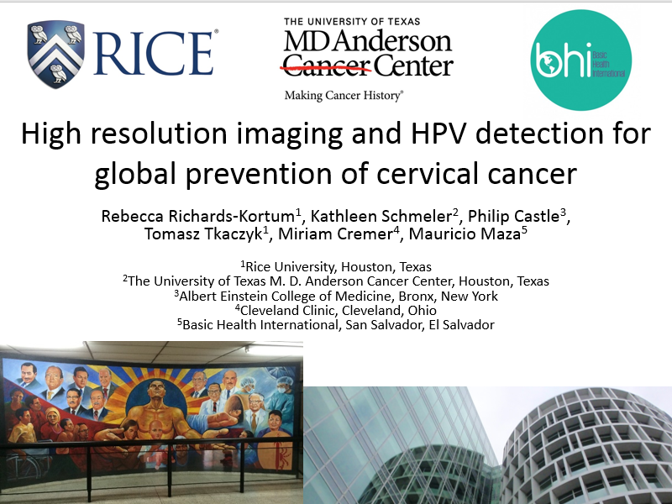
CIB Funded Research Projects – Cervical Cancer

Slide 27
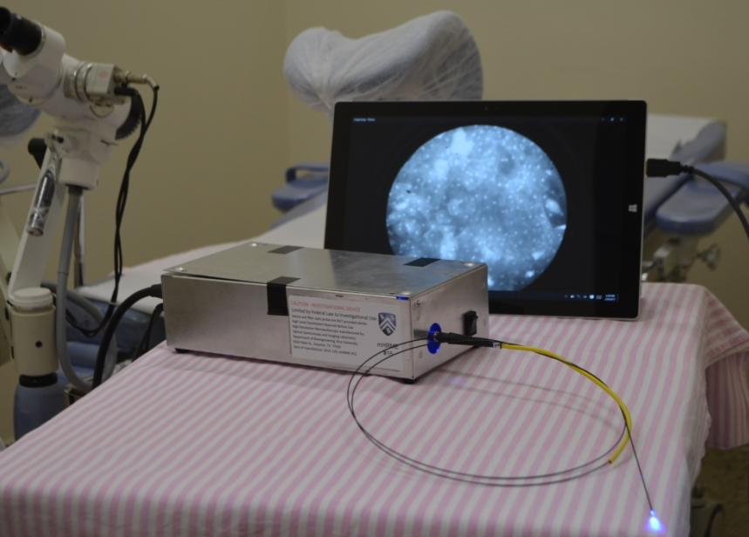
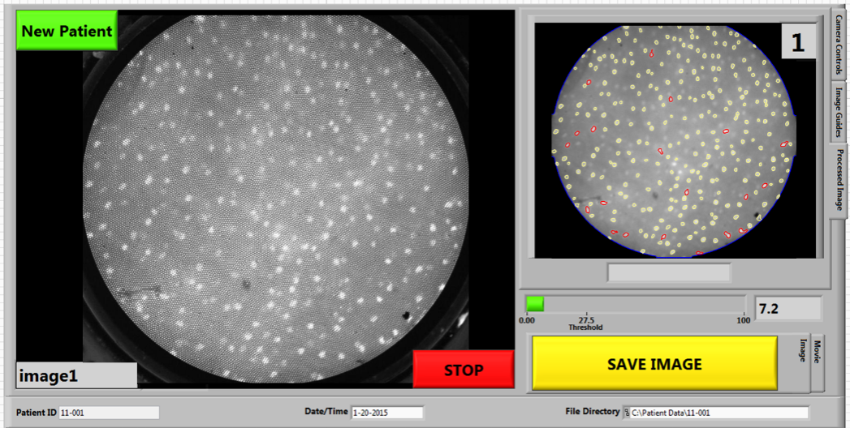
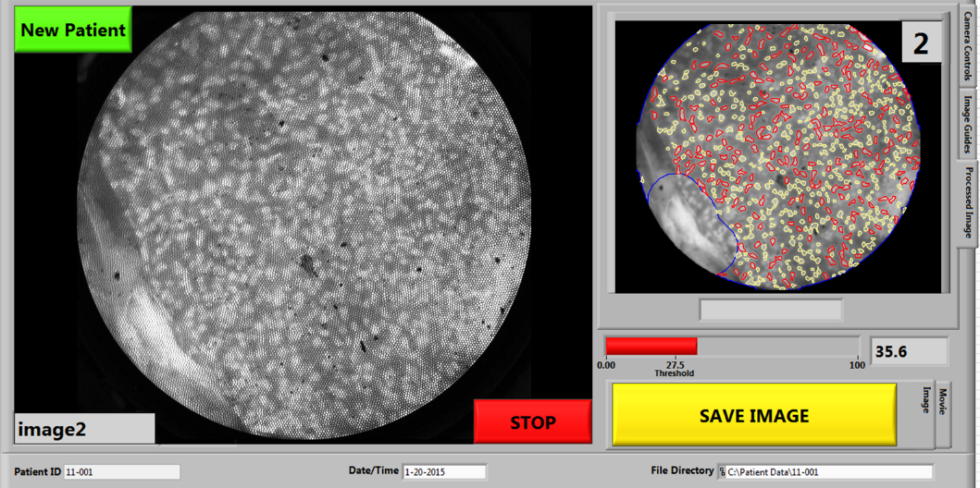
Aim 1 progress: Successfully adapted and implemented the HRME with real-time analysis tools in low-resource settings.
Tablet High Resolution Microendoscope
Patient: Normal/Non-Neoplastic
Patient: Abnormal/Neoplastic
Side viewing probe, and image of mouse colon tissue taken with it

Slide 28
Aim 2 progress: Study enrollment
725 patients enrolled in El Salvador
Complete results available for first 500 pts enrolled
38 were Visual inspection Acetic Acid (VIA)+
39 were HPV+
7 were VIA+ & HPV+
100/132 patients returned for a Visit2
91/100 have HRME results (186 sites)
Final Pathology Result per Patient | Number of Patients
Normal | 2
Inflammation | 29
CIN1 | 61
CIN2 | 3
CIN3 | 4
*Cervical biopsies were not collected for one of the 100 patients that returned for a Visit 2
73 patients enrolled in Rio Grande Valley of Texas

Slide 29
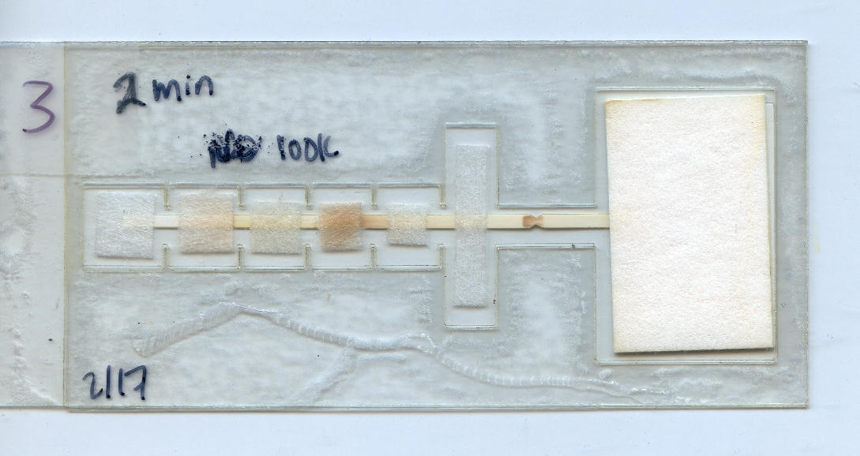
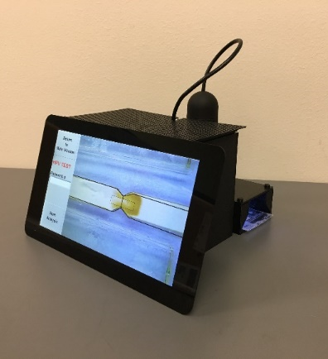
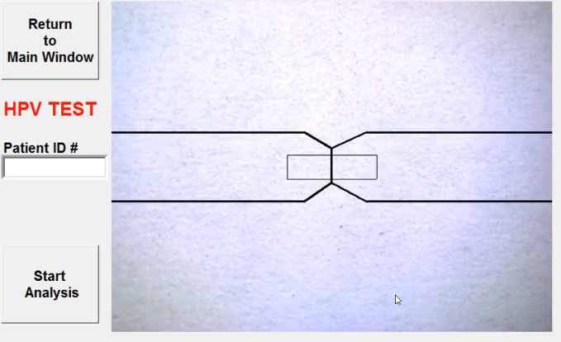
Aim 3: Develop a low-cost, point-of-care test for HPV E7 oncoprotein in exfoliated cervical cells
Expressed recombinant HPV E7 antigen proteins HPV16, 18, 45, 31, 11 in E. coli strain BL21(DE)3 and optimized immunogenic potential of the HPV E7 antigen
Identified monoclonal antibodies against HPV16 and HPV18 for cloning & expression in a mammalian system
Optimized long-term stability of assay reagents in hot and humid conditions, for point-of-care use
Carried out usability assessments of the paper-based point-of-care HPV test among health care providers in El Salvador
Developed a low-cost automated lateral flow assay reader

Slide 30
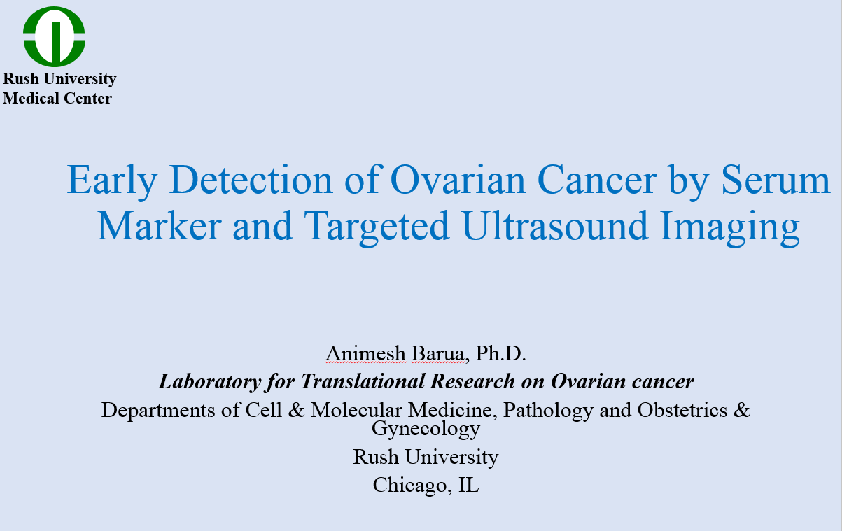
CIB Funded Research Projects – Ovarian Cancer

Slide 31
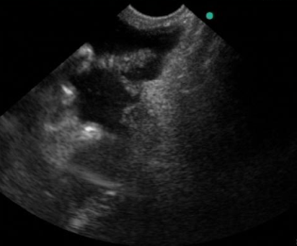
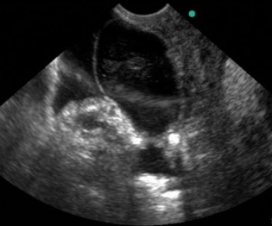
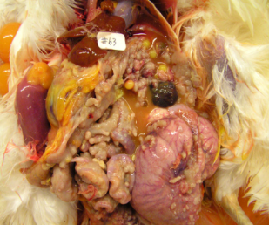
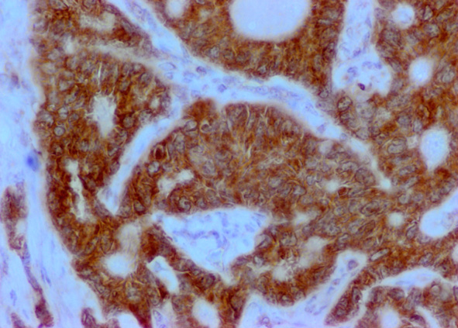
CIB Funded Research Projects – Ovarian Cancer
FSHR-targeted ultrasound
GRP78-targeted ultrasound
A)
B)
A)
B)
Ascites
Ascites
Ascites
Ascites
Pre-targeted
Post-targeted
Pre-targeted
Post-targeted
C)
D)
C)
D)
Tumor in ovary
S
Tumor in ovary
S
Tu
Tu
S
S
Gross
Adenocarcinoma
40X
Gross
Adenocarcinoma
40X
Courtesy of Dr. Barua, Rush University

Slide 32
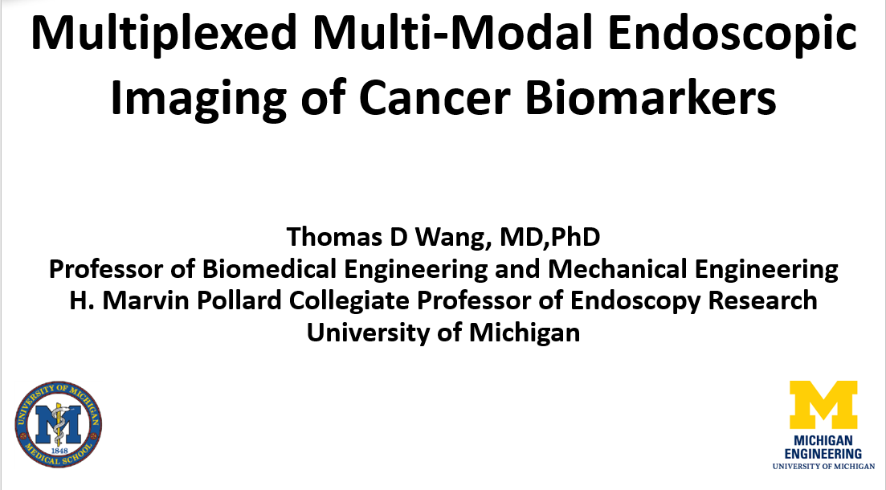
CIB Funded Research Projects – Esophageal Carcinoma

Slide 33
Specific Aims
Aim 1. To optimize, validate, and characterize a near-infrared peptide multimer specific for pre-malignant esophageal neoplasia. Optimize alignment of multimer to intended targets with structural model. Validate specific binding of optimized peptide multimer on competition with unlabeled peptide, siRNA knockdown, and co-localization with known antibodies. Characterize binding affinity (apparent dissociation constant kd) and kinetics (apparent association time constant k) of peptide multimer.
Aim 2. To validate specific binding of the optimized near-infrared peptide multimer on human specimens of Barrett’s neoplasia ex vivo using the multi-modal NIR molecular endoscope. Validate specific binding of optimized peptide multimer using immunofluorescence and co-localization with known antibodies. Adapt an existing multi-modal endoscope to collect near-infrared fluorescence images, produce quantitative results, and generate “red-flag” region in real time to guide tissue resection. Establish sensitivity of the multi-modal endoscope for detection of target overexpression using optimized peptide multimer over a clinically relevant range of distances.
Aim 3. To validate specific binding of the optimized near-infrared peptide multimer to Barrett’s neoplasia and guide tissue biopsy in a clinical study in human subjects. Prepare an Investigational New Drug (IND) application for “first-in-human” use of the optimized peptide multimer with the multi-modal endoscope. Evaluate safety for topical administration of the optimized peptide multimer in esophagus in a clinical study of n = 25 human subjects. Use optimized peptide multimer to guide tissue resection in n =2 5 human subjects.

Slide 34
Accomplishments
Used structural model to identify tri-ethylene-glycol as linker to optimize multimer binding to human OE33 EAC cells.
Peptide multimer demonstrated 3-fold greater fluorescence intensity and 2-fold improved binding affinity compared with either monomer alone.
Binding of peptide multimer to human OE33 EAC cells showed no effect on downstream cell signaling.
Peak tumor uptake was observed in mouse xenograft tumors at 2 hours post-injection with systemic clearance by ~24 hours.
Achieved 88% sensitivity and 87% specificity for detection of either high-grade dysplasia (HGD) or EAC on human esophageal specimens using immunofluorescence
Results for peptide multimer was better by comparison to that for either antibody alone.

Slide 35
Challenges, Needs, Tools
Challenge of Heterogeneity and tumor sampling
Tools for multi-spatial, multi-parametric, high-resolution profiling
- Defined cohorts that are ethnically/racially diverse
- Consensus on best practices for sampling and preservation
- Tools and Statistics for multi-scale data integration
Linked imaging/biomarkers for discovery & validation
Adapted from Dr. V. Seewaldt, City of Hope

Slide 36
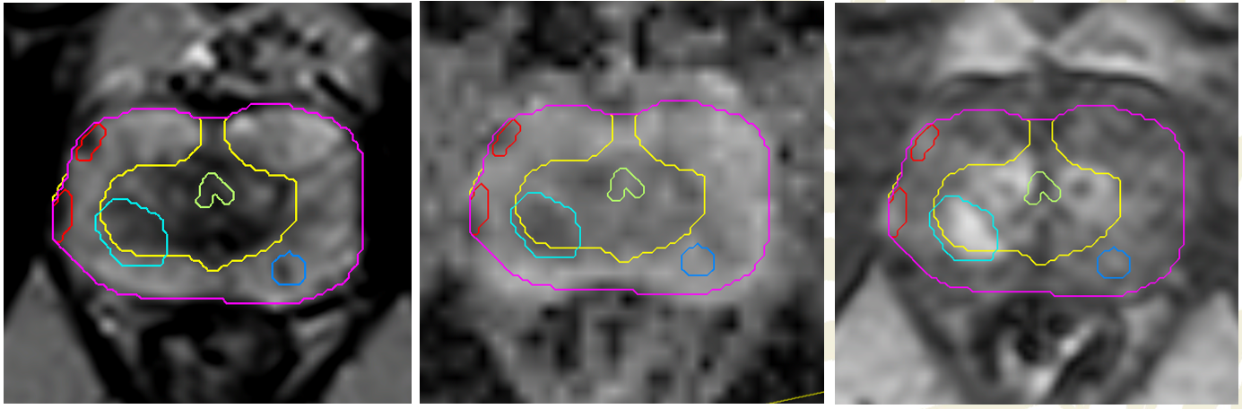
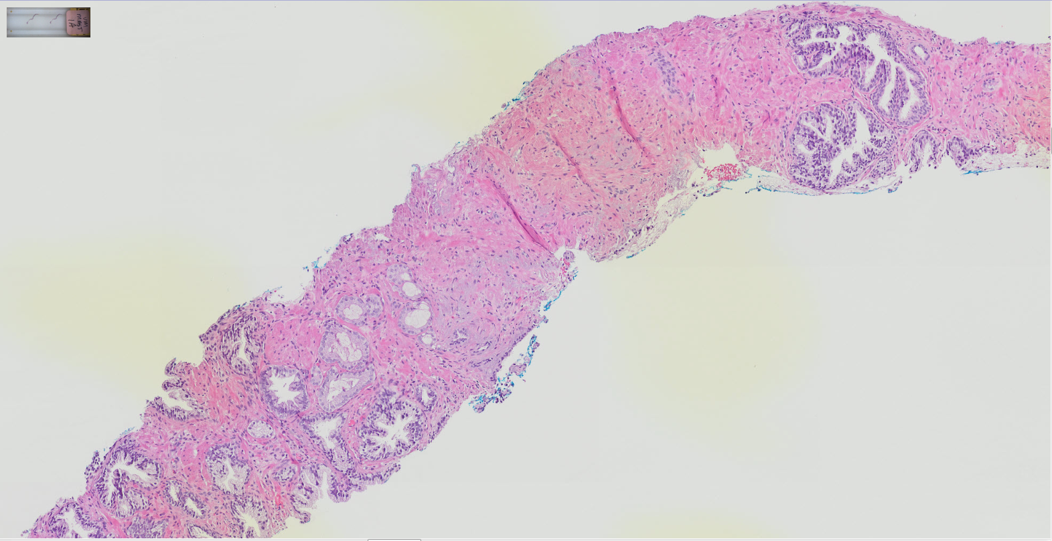
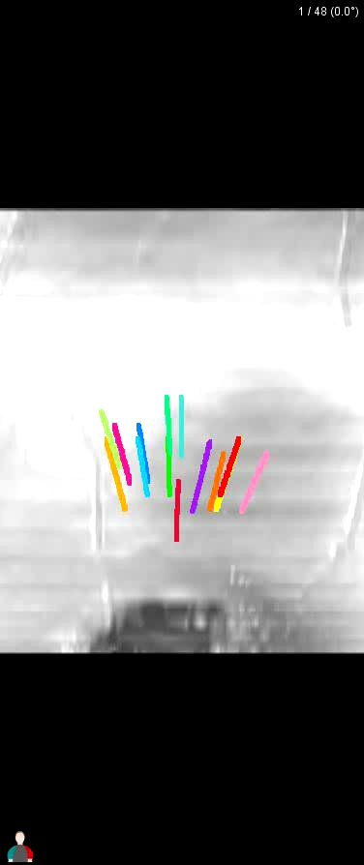
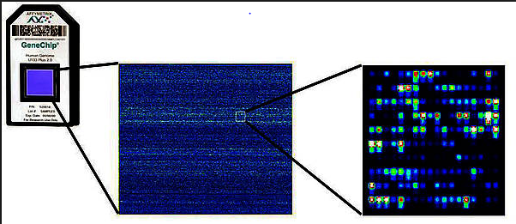
Common Themes – Opportunities for Collaborations
Create a multi-level vertically integrated map of tumors and at risk normal tissue that incorporates:
Images
Pathology
Molecular features/signatures
Create longitudinal multi-level integrated maps.
mpMRI/Biopsy
mpMRI/Biopsy
mpMRI/Biopsy
0
12 mo
24 mo
time

