Slide 1
By Design Approach in Biomarker Development, Validation, and Clinical Implementation
Zhen Zhang
Center for Biomarker Discovery and Translation
Johns Hopkins University School of Medicine

Slide 2
Disclosure
Through license agreements between Johns Hopkins University and Vermillion Inc., Dr. Zhen Zhang is entitled to royalty payment from OVA1 and Overa.
The two FDA cleared tests OVA1 and Overa were developed partially supported by a sponsored research agreement between Vermillion Inc. and Johns Hopkins University and funding from DOD and NCI/EDRN.
Clinical performance of the two tests will not be discussed.

Slide 3
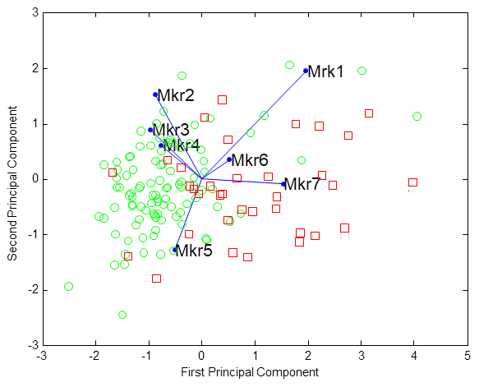
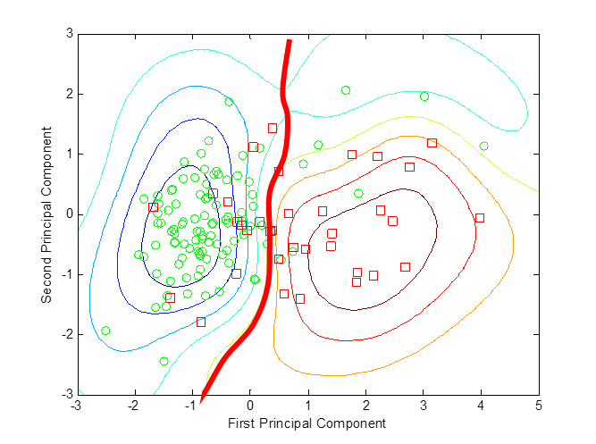
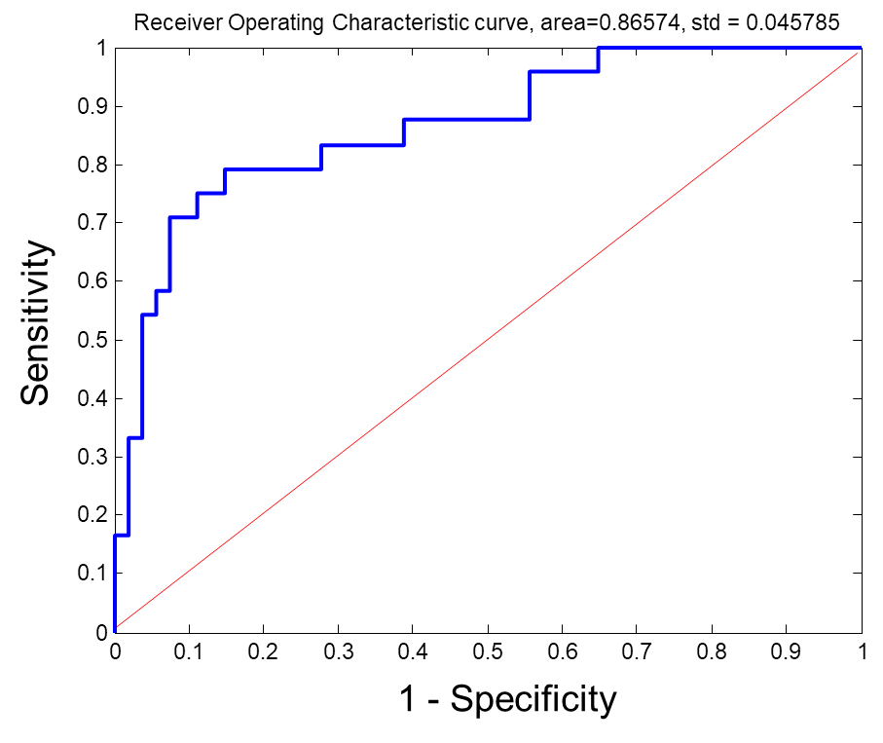

Development of IVDMIA
Biomarker data
Classification model
Clinical evaluation
… …
Study & experimental design
Model derivation via machine learning
Clinical Relevance
Statistical Soundness
Regulatory Requirements

Slide 4
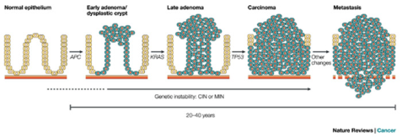
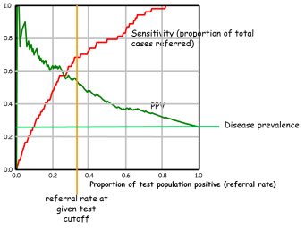





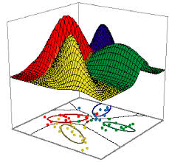



Critical elements in IVDMIA design and development
Knowledge of disease
Knowledge of biomarkers
Desired performance
Knowledge of machine learning & statistics
Knowledge of clinical needs
Sampling
Inclusion/exclusion
Designed samples for development
Knowledge of IVD assay requirements
Target population
Derivation of IVDMIA models
Trial population

Slide 5
By design approach
Identify needs
Product specification
Iterative prototyping
Driven by specifications and external constraints.

Slide 6
Needs: Develop the right biomarkers
Clinically useful
Safe and effective
Practically & commercially viable

Slide 7
Intended use and desired clinical performance characteristics

Slide 8
A test’s intended use is defined by the time point at which it is to be used along a disease process
Early Detection
Screening
Prognosis
Predicting response to Tx
Risk Assessment
Wellness?
Monitoring

Slide 9
The time point-defined intended use in turns helps to define IVDMIA target population (inclusion/exclusion)
and consider the following:
If test is positive, what are the options for clinical intervention? Will it likely alter patient outcomes?
What are the consequence for test false positive/false negative?
What are the current alternatives in testing for this intended use?
Availability of samples at this time-point under current gold standard Dx?
Will a meaningful size of patient population benefit from the test? (potential commercial market size)
……

Slide 10
Specifications: Design a test’s desired performance characteristics
Zhang, Z., & Chan, D. W. (2010). Cancer epidemiology, biomarkers & prevention

Slide 11
Biomarkers having sufficient discriminatory power with respect to desired performance?

Slide 12
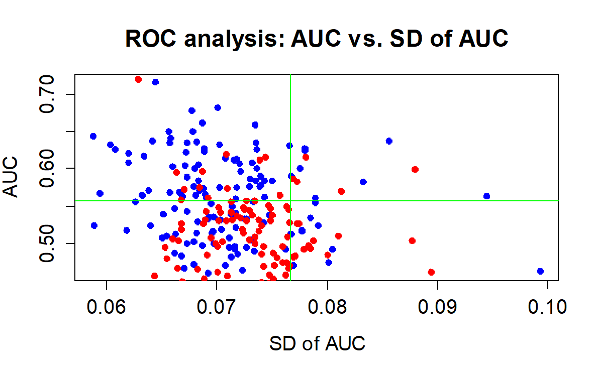
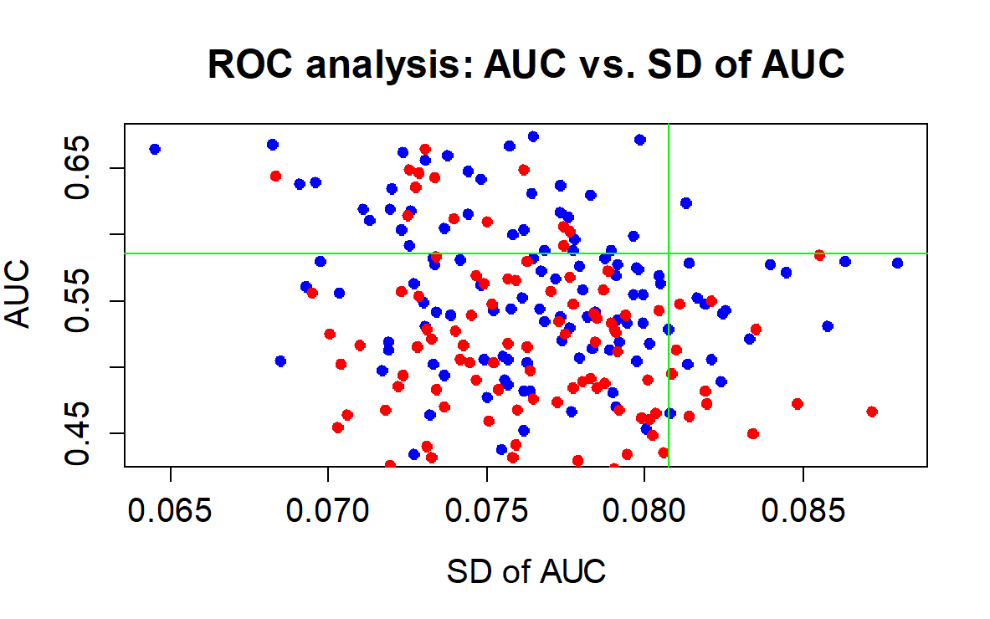
Marker performance statistically stable - Univariate analysis

Slide 13
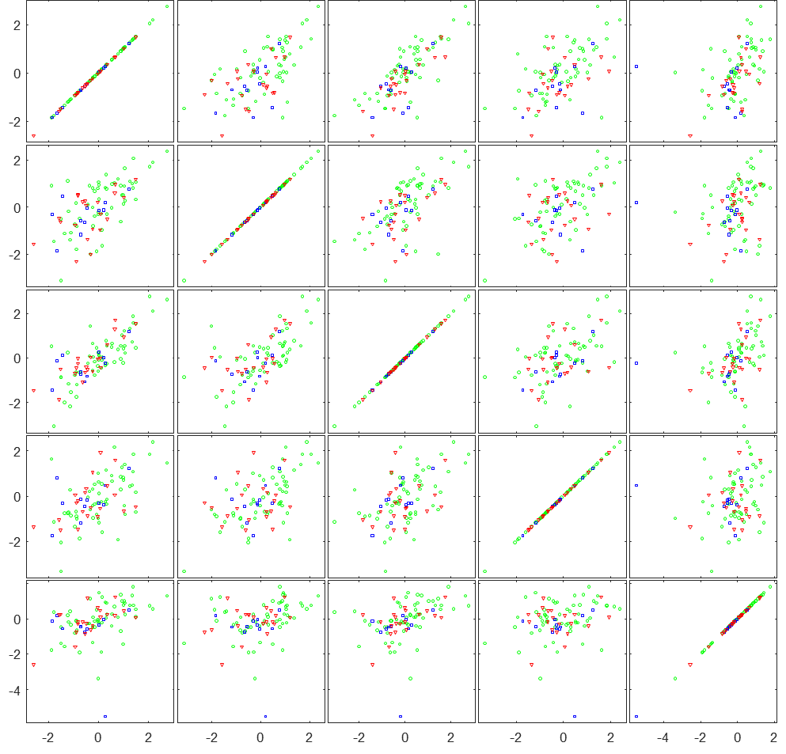
Markers complementary?

Slide 14
Performance generalize across multiple independent sites?
3
4
2
3
2
1
1
Second PCA Component
Second PCA Component
0
0
benign
LMP
ovarian cancer, stage I/II
ovarian cancer, stage III/IV
-1
-1
-2
-2
-3
-3
-4
-5
-4
-3
-2
-1
0
1
2
3
4
-5
-4
-3
-2
-1
0
1
2
3
4
5
First PCA Component
First PCA Component
Clinical Study
Rigshospitalet, prospective
Preclinical Studies
five sites, retrospective
Preliminary validation with multiple retrospective sets (n = 1,800)
Two large-scale (n>500) multicenter clinical trials validated the findings.

Slide 15
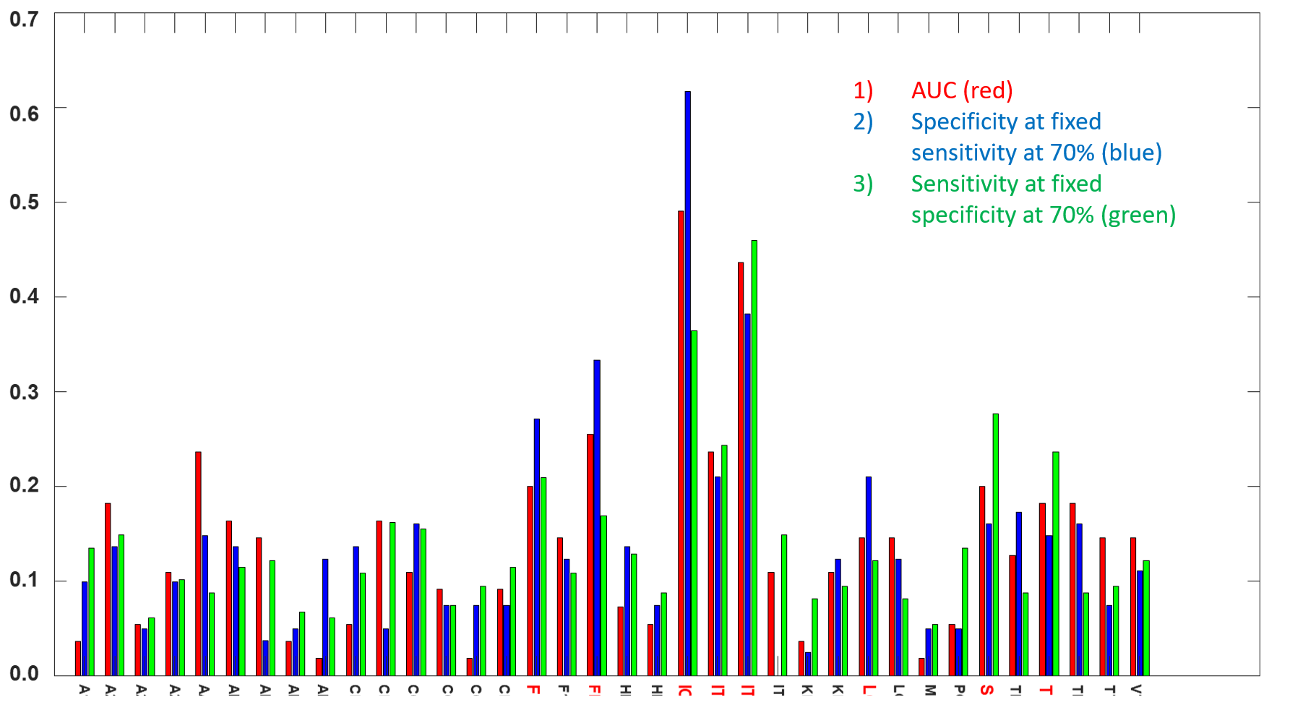
Iterative Selection: it’s not final until it’s final
376992xruns

Slide 16
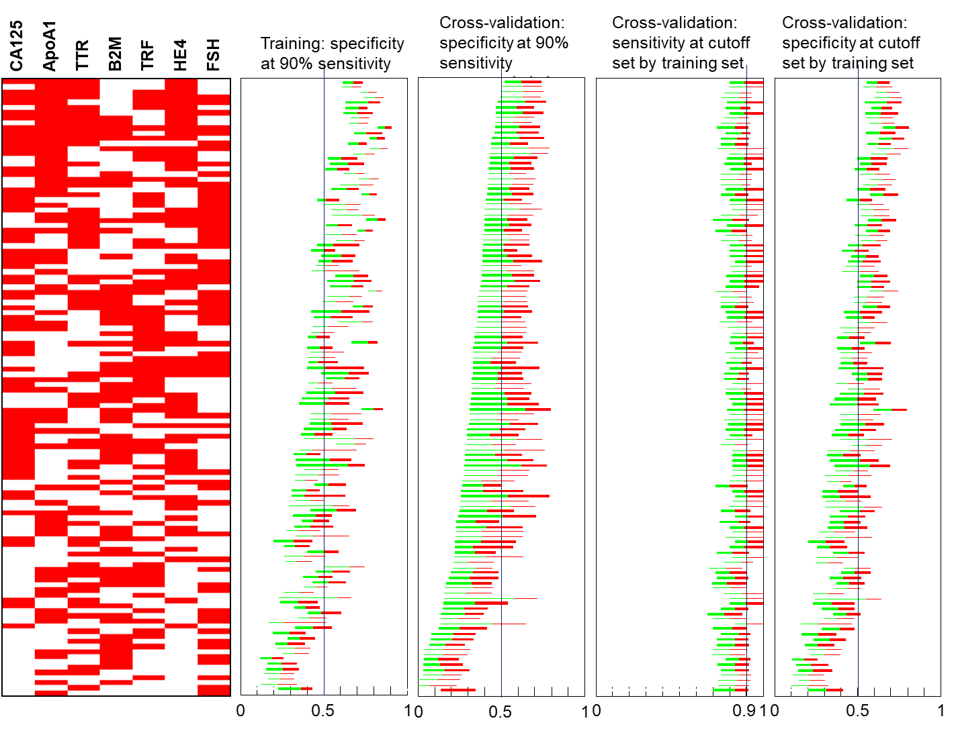
Finalize IVDMIA panel of biomarkers

Slide 17
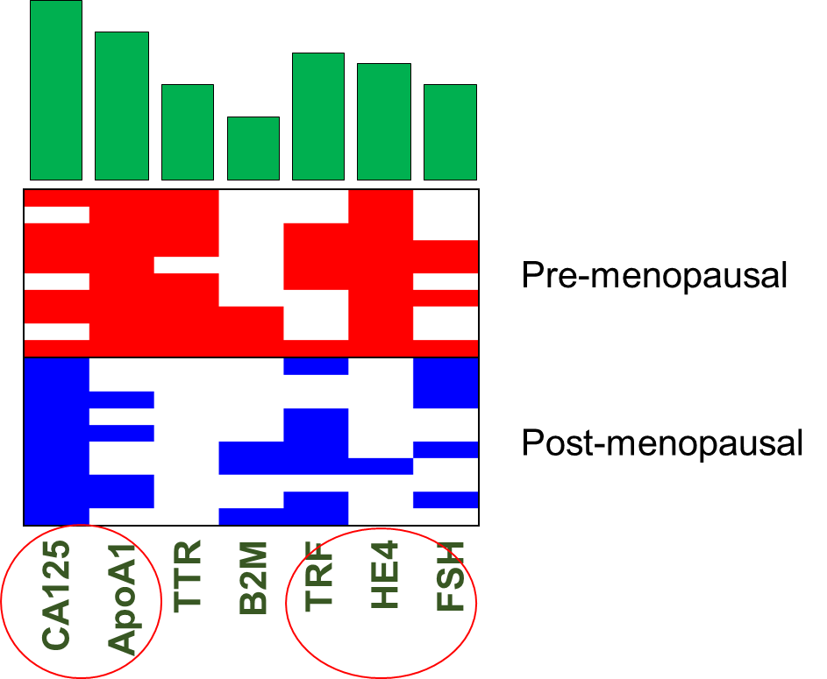
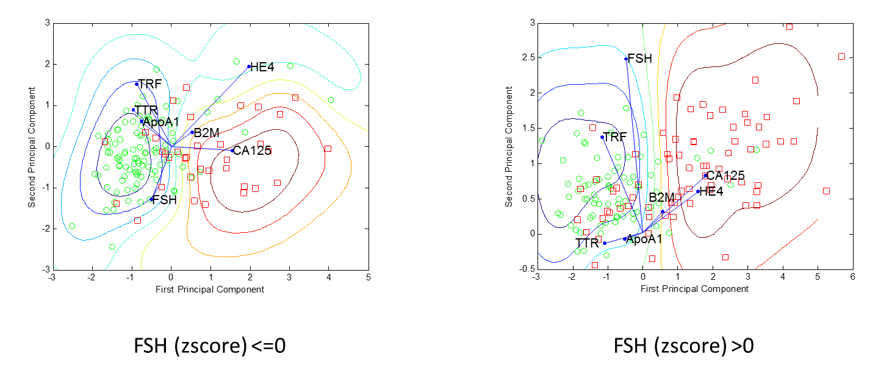
Biplot of biomarkers in training data and tentative classifier in projected 2D space

Slide 18
Derive models towards desired clinical performance

Slide 19
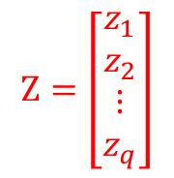

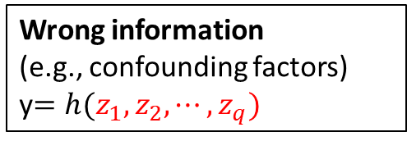
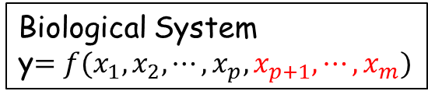
Imperfect or wrong information and labeling errors
Wrong information
(e.g., confounding factors)
y$=h(z_{1},z_{2},⋯,z_{q})$
Biological System
y$=f(x_{1},x_{2},⋯,x_{p},x_{p+1},⋯,x_{m})$
observed phenotypic differences (*may have labeling errors)
$$Z=\left[\begin{matrix}\begin{matrix}z_{1} \\ z_{2}\end{matrix} \\ ⋮ \\ z_{q}\end{matrix}\right]$$
$$X=\left[\begin{matrix}\begin{matrix}x_{1} \\ x_{2}\end{matrix} \\ ⋮ \\ x_{p}\end{matrix}\right]$$
Learning Algorithm
Model

Slide 20
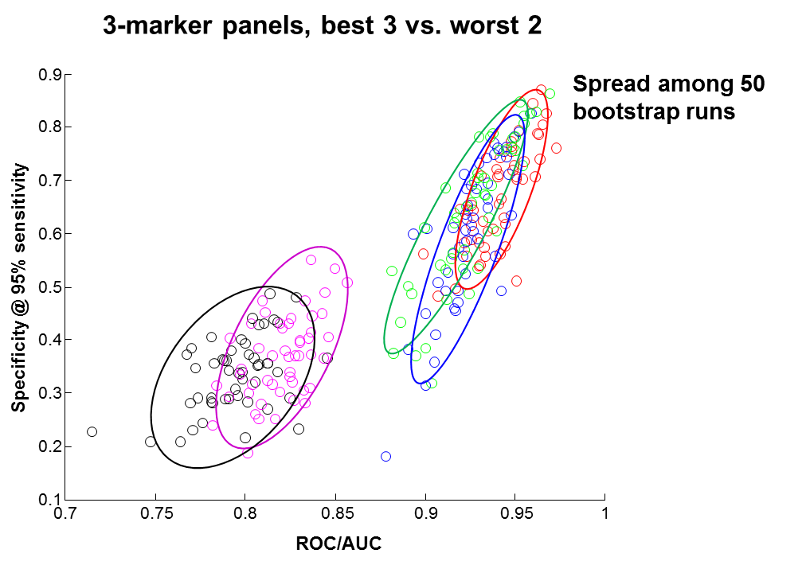

Stability in bias-variance tradeoff feature informativeness + learning efficiency + sample size
High Bias
High Variance
Validation
Error
Training
Model Capacity

Slide 21
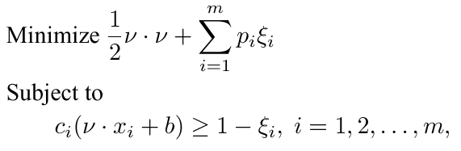


UMSA: a modified learning algorithm for SVM to integrate external knowledge/data in training
Individualized
Softness
Incorporating additional information into empirical risk minimization:
Data conditional distribution;
Sample quality, etc.
Adjustable parameters controls the influence of distribution information

Slide 22
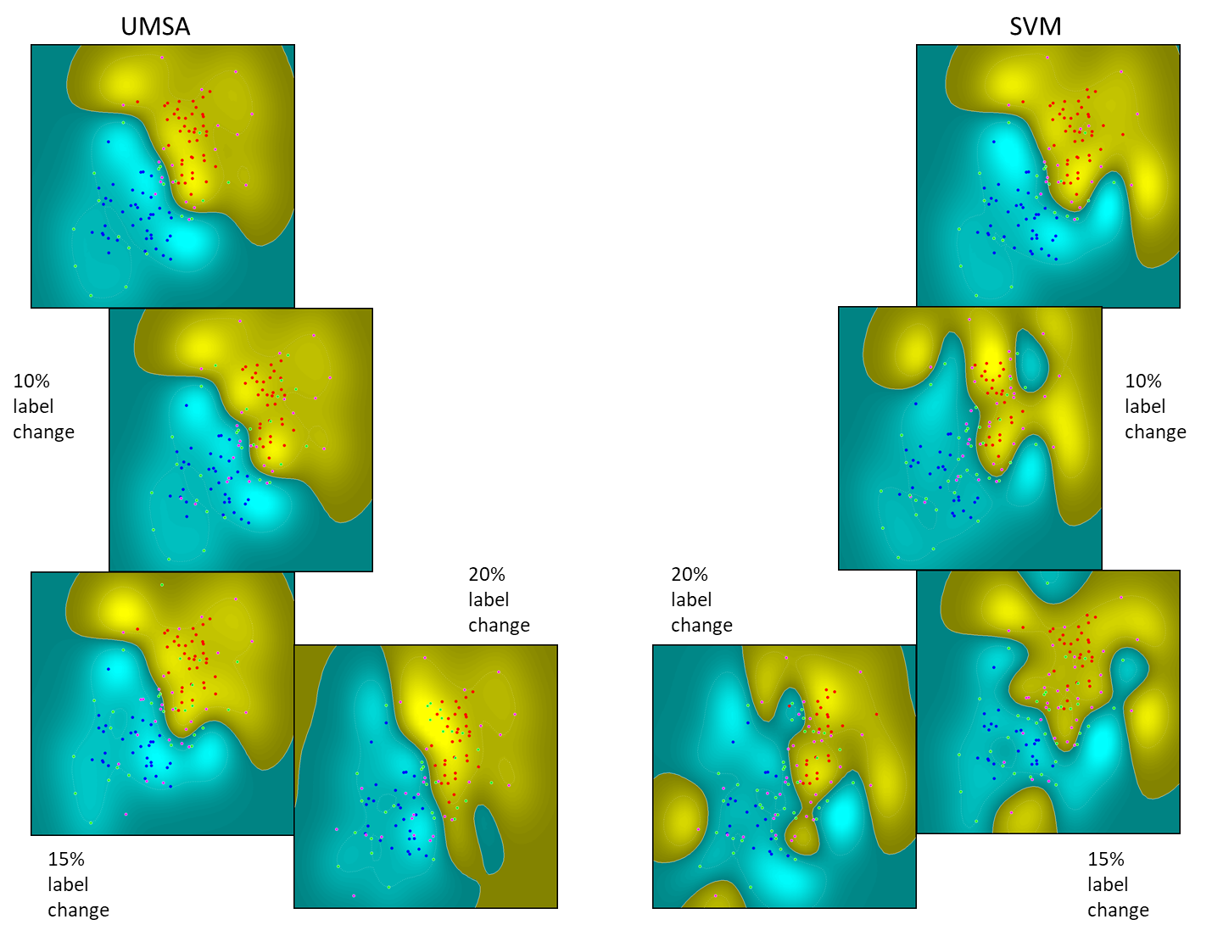
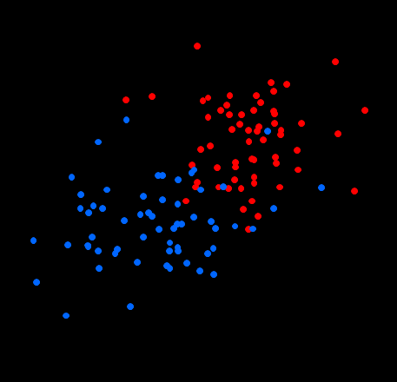
Resistance to sample labeling error

Slide 23
Knowledge of disease and clinical reality helps to set realistically achievable error rate
Error
Clinically achievable
Due to wrong information in data?
Model Capacity

Slide 24
By design model development
Select models with desired performance characteristics
Inclosing performance requirement as a part of cost function in training
Performance “shaping” by combining multiple models.

Slide 25
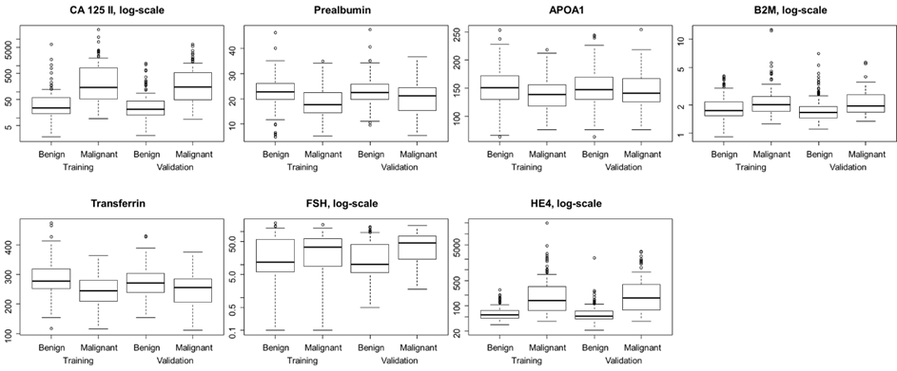
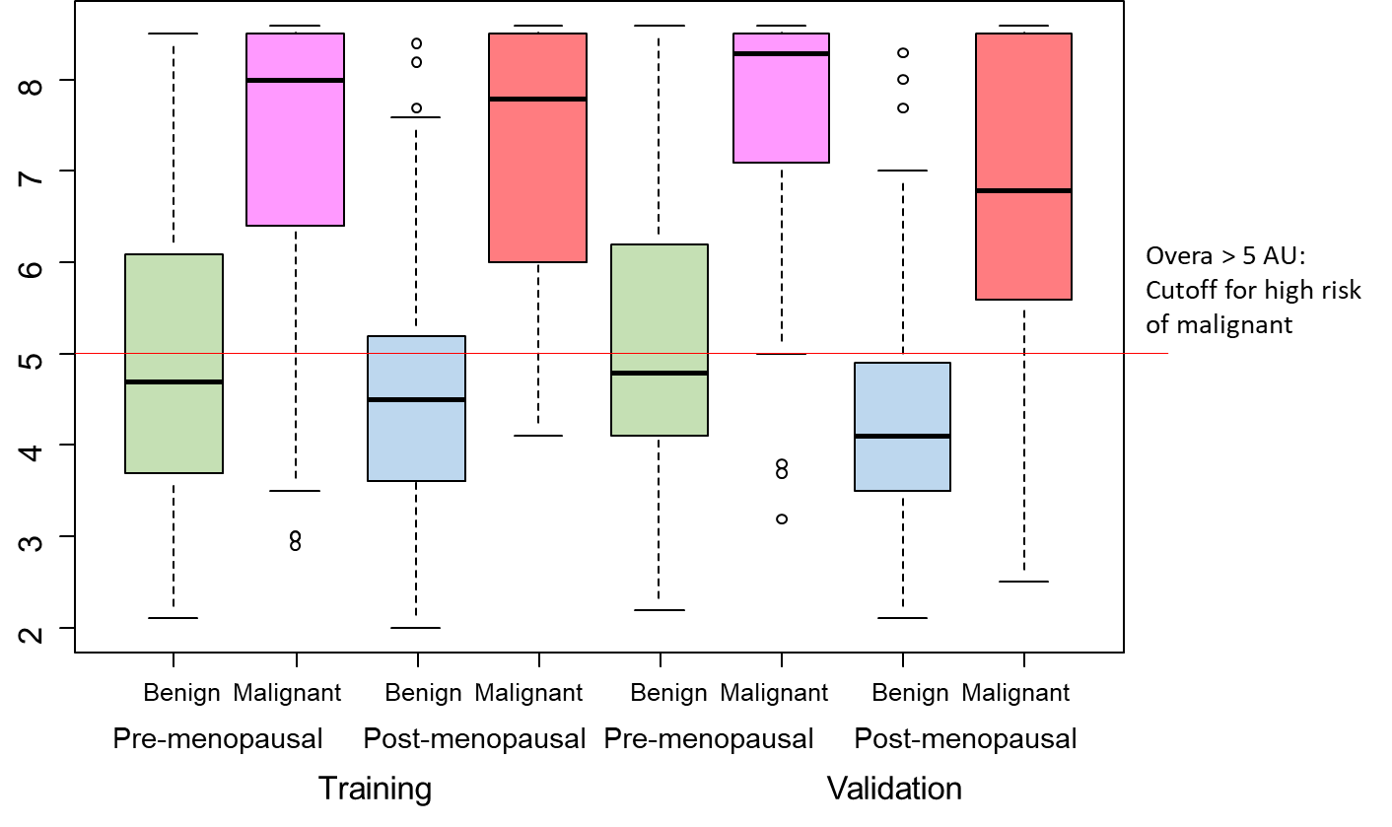
Bloxplots of individual markers and IVDMIA

Slide 26
Cutoff and clinical performance characteristics
1.0
NPV
Sensitivity
(% of disease detected)
0.8
Additional cases captured
0.6
Performance Metrics
Specificity
0.4
Enriched PPV over Prevalence
PPV
0.2
Prevalence
At cutoff=5.0AU, 38.0% of premenopausal samples were positive
0.0
0.0
0.2
0.4
0.6
0.8
1.0
Proportion of Test Positives

Slide 27
Derive models towards desired analytical performance

Slide 28
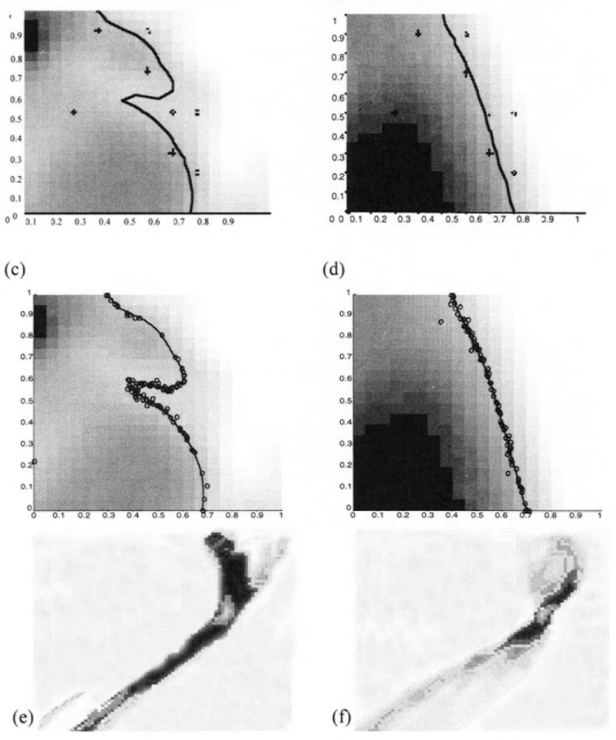
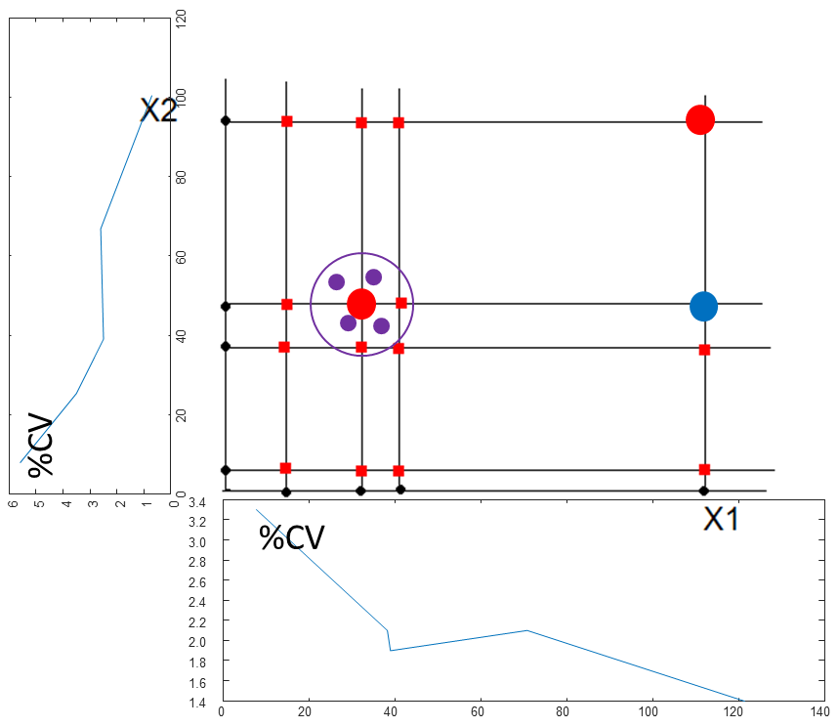
MC estimated analytical performance characteristics of IVDMIA
9
8
7
6
5
%CV of IVDMIA
4
3
2
1
0
2
3
4
5
6
7
8
9
10
Mean IVDMIA

Slide 29
Interdisciplinary knowledge in IVDMIA development
Knowledge of disease
Knowledge of biomarkers
Desired performance
Knowledge of machine learning & statistics
Knowledge of clinical needs
Sampling
Inclusion/exclusion
Designed samples for development
Knowledge of IVD assay requirements
Target population
Derivation of IVDMIA models
Trial population

Slide 30
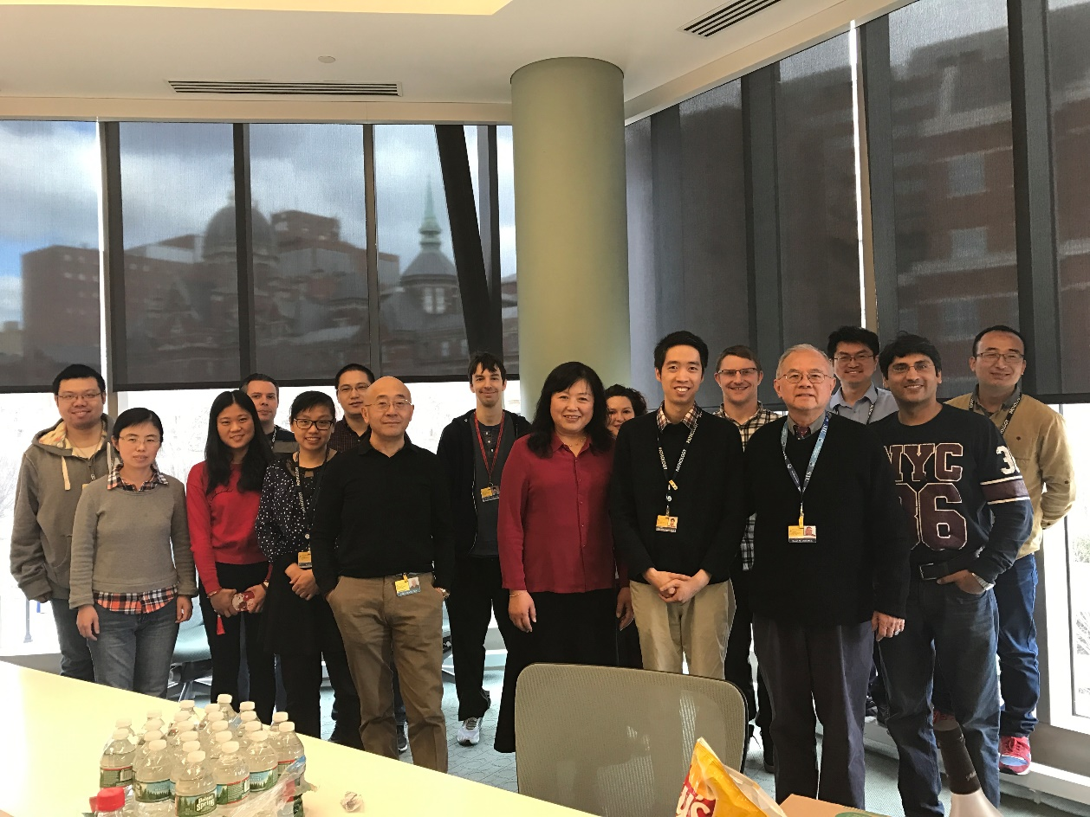
Center for biomarker discovery and translation

Slide 31
Acknowledgement
JHU
Current: Daniel W Chan, Lori Sokoll,, Hui Zhang, Jin Song.
Past: C Nicole Rosenzweig, Jinong Li, Alex Rai, Lily Chen, Bai Zhang.
Collaborators on ovarian cancer biomarker research
RC Bast, Jr., IJ Jacobs, A Berchuck, C Van Haaften-Day, NF Hacker, HW de Bruijn, AG van der Zee, F Ueland, R Bristow, ET Fung, D Munroe, S Skates.
Funding: NCI/EDRN BRL (D Chan), BDL (Z Zhang), CPTAC (H Zhang, Z Zhang, D Chan), DOD (Z Zhang), and Vermillion Inc.

Slide 32
Critical elements in IVDMIA design and development
Knowledge of disease
Knowledge of biomarkers
Desired performance
Knowledge of machine learning & statistics
Knowledge of clinical needs
Sampling
Inclusion/exclusion
Designed samples for development
Knowledge of IVD assay requirements
Target population
Derivation of IVDMIA models
Trial population

