Slide 1

High and Low Neuroendocrine subtypes of Small Cell Lung Cancer and their Clinical Significance
Adi Gazdar
UT Southwestern Medical Center
Dallas, TX
Disclosure: Dr. Gazdar receives licensing fees for the cell lines he has established
SCLC
There is always light at the end of the Tunnel

Slide 2
Timeline of SCLC Through the Ages
Gazdar, Bunn, Minna, Nature Reviews Cancer, 2017
Notes:
During its 90-year history, our knowledge of small-cell lung cancer (SCLC) has progressed through a series of phases that we refer to as Ages. During the Age of Initial Discoveries, SCLC was recognized as a form of lung cancer that was morphologically distinct from other forms, its neuroendocrine (NE) properties were discovered, and initial clinical trials appeared promising. The finding in 1973 that SCLC was almost always metastatic at diagnosis ushered the First Golden Age. Surgical resections with curative intent were seldom performed. Instead, promising responses to chemotherapy and prophylactic cranial irradiation generated considerable optimism. Large panels of cell lines were generated, and their study led to the discovery of the basic molecular pathogenesis of SCLC. However, the clinical advances all but ceased, no new drugs or therapies were introduced, and although some biological advances occurred during this Age, disillusionment with clinical progress led to the Forgotten Disease Age. In 2012, the US Congress designated SCLC as a recalcitrant disease, requiring special funding and scientific and clinical interest. At the same time, a worldwide awakening of interest led to rapid translational progress and the discovery of many potential molecular and pathway targets, some of which have been tested in clinical trials. This renewed enthusiasm and biological and clinical progress have changed the landscape of SCLC, ushering in the Second Golden Age. ACTH, adrenocorticotropic hormone; APUD, amine precursor uptake and decarboxylase; ASCL1, achaete-scute homologue 1; DLL3, delta-like ligand 3; GEMM, genetically engineered mouse model; NFIB, nuclear factor I B; NSCLC, non-SCLC; ROVA-T, rovalpituzumab tesirine; SLFN11, schlafen 11; TNM, tumour, node and metastasis; WHO, World Health Organization.

Slide 3
SCLC Targets Currently in Clinical Trials
Currently >740 clinical trials for SCLC listed at ClinicalTrials.gov (>460 in USA)
Target (General) | Target (Speciifc)
Immune Therapies | PD-1, PD-L1, Fucosyl GM1, other
Antibody drug conjugates | DLL3, Somatostatin receptor
DNA Repair | PARP, WEE1, CHK1, ATR, ATM
Stem Cell Inhibitors | Hedgehog
Notch pathway | DLL3, DLL4
PIK3/mTOR
RET
Aurora kinase | Aurora A, Aurora B, Pan Aurora
Apoptosis | BCL2
FGFR
JAK/STAT | JAK2, JAK3
Bromodomain
EZH2
LSD1
Gazdar, Bunn, Minna, Nature Reviews Cancer, 2017, Suppl Table

Slide 4
Lack of Resected Tumors places reliance on Preclinical Models
Cell lines
GEM models
PDXs
SCLC: Circulating Tumor cells (CTC) and their preclinical applications
Lallo et al,
Transl Lung Cancer Res, 2017
Caroline Dive
U. Of Manchester

Slide 5
Somatic mutations in human cancers
Alexandrov et al, Nature, 2013

Slide 6
Mutation changes characteristic of ever smoker and never smoker lung cancers
Tumor Type | Base change | Total number of mutations
Ever smokers | C:G to A:T transversions | Very high
Never smokers | C: G to T:A transitions | Very low
By combining the Transversion: Transition (T:T) ratio and the mutation count/mb, we can obtain an F score that predicts the degree of smoking damage in any individual lung cancer (Kai Song and Adi Gazdar )

Slide 7
Estimated percentage of lung cancers lacking evidence of smoking damage (TCGA)
Tumor Type | Estimated % Never smokers
Bronchial carcinoids | 41/41 (100%)
Adenocarcinoma | 111/563 (19.7%)
Squamous cell carcinoma | 18/492 (3.7%)
Small cell lung cancer | 2/57 (3.5%)
By F score analysis, Song and Gazdar 2018

Slide 8
Mutated genes in SCLC tumors (n = 81)
Key Points
TP53 and RB1 universally inactivated
Histone acetyltransferase genes EP300 & CREBBP
Notch genes
FMN2 and COL22A1 involve in collagen and actin binding and cytoskeleton
KIAA1211 - not much known
George et al, Nature, 2015
Notes:
FMN2 gene polarity and actin cytoskeleton. EP300 and CREBBP involved in chromatin remodeling and latter has a bromodomain.

Slide 9
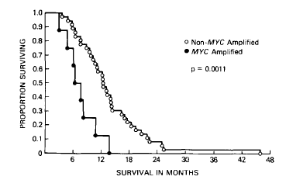
MYC family and FGFR1 amplification in SCLC
Frequency of MYC amplification
Pretherapy 7/52 (11%)
Post therapy 16/44 (36%)
Johnson, Gazdar, Minna et al, J Cell Biochem 1996
George et al, Nature, 2015
George, et al Nature, 2015
Notes:
Also Lmyc fusions and Max inactivation

Slide 10
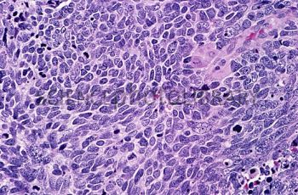
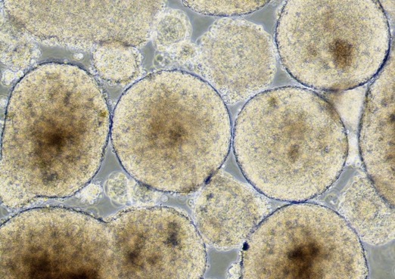
SCLC: A working definition (For Tumors and Cell Lines)
Pathological diagnosis of SCLC
RB1 Mutation or protein loss
Tumor
Cell line

Slide 11
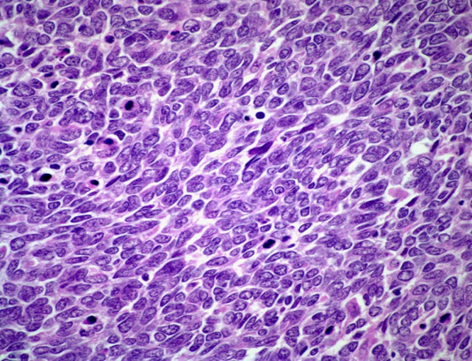
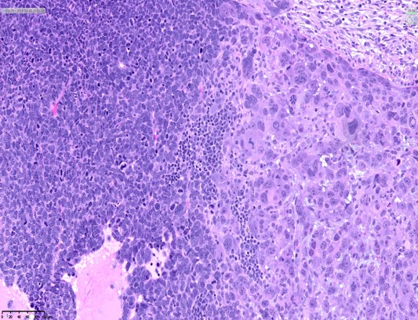
Is SCLC a Homogenous Cancer?
Only one morphologic type recognized by the WHO Classification 2015, although it may be combined with non-SCLC elements
Clinically it is treated uniformly, with adjustments for tumor extent/staging
No approved targeted therapies
Combined SCLC
(>10% NSCLC)
SCLC

Slide 12
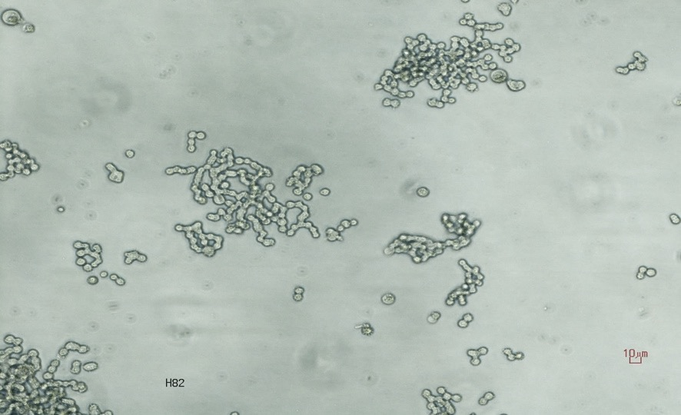
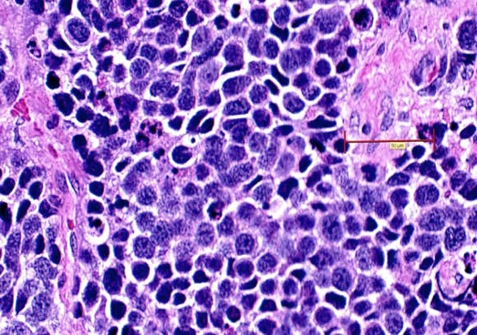
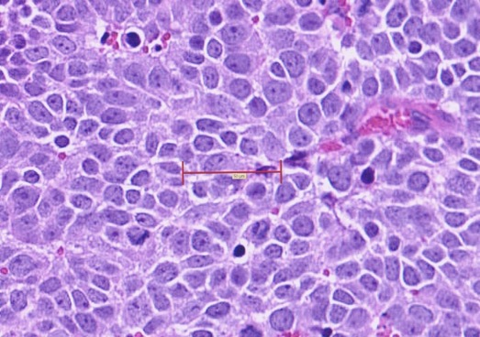
”Classic” and “Variant” forms of SCLC
Classic SCLC
NCI-H128 (NE=0.89)
Variant SCLC
NCI-H82 (NE=0.21)
A
Cell Culture
C
Properties of variant SCLC
Morphology
Substrate attachment
Increased growth & cloning
MYC overexpression
Radioresistance
Decreased NE properties
B
Xenograft
D
Gazdar et al, Cancer Res 1985

Slide 13
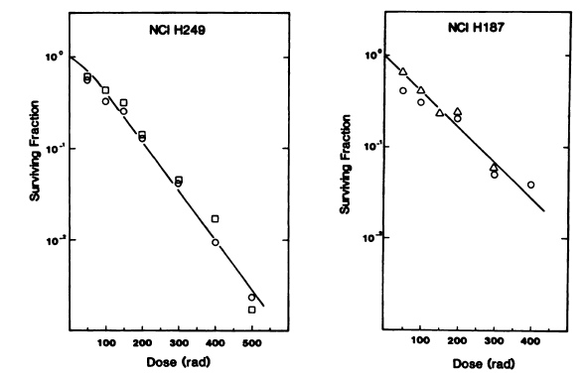
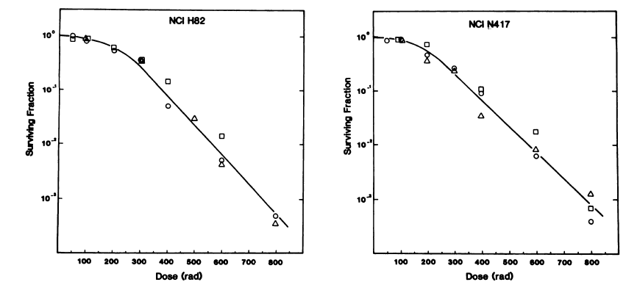
:
Radiation survival curves for classic and variant SCLC
Classic SCLC
Surviving fraction
at 200 rads 0.12
Surviving fraction
at 200 rads 0.17
Variant SCLC
Myc family amplified
Surviving fraction
at 200 rads 0.58
Surviving fraction
at 200 rads 0.56
Carney, DN et al, Cancer Res, 1983

Slide 14
SCLC is a Neuroendocrine (NE) Tumor
Definition of Neuroendocrine (NE) cells
The production of a neurotransmitter, neuromodulator or neuropeptide hormone (similar to neuronal cells)
The products are stored in membrane bound dense-core secretory granules from which the hormones are released by exocytosis in response to an external stimulus (similar to some neuronal cells)
The absence of axons and synapses (unlike neurons)
Barakat MT, Meeran K, Bloom SR, Endocr Related Cancer 2004

Slide 15
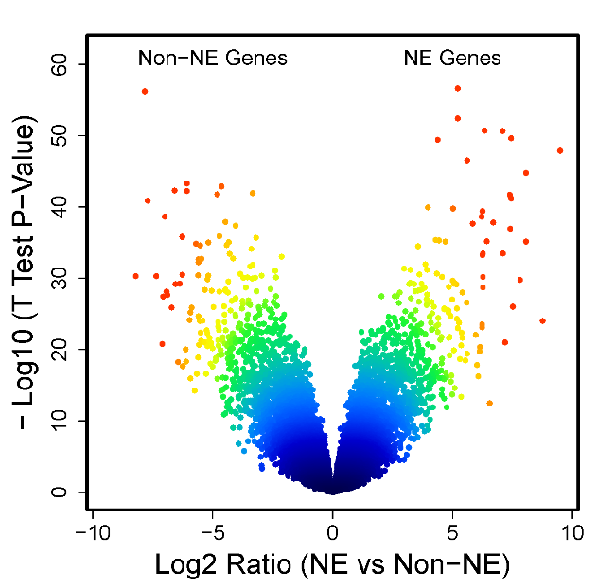
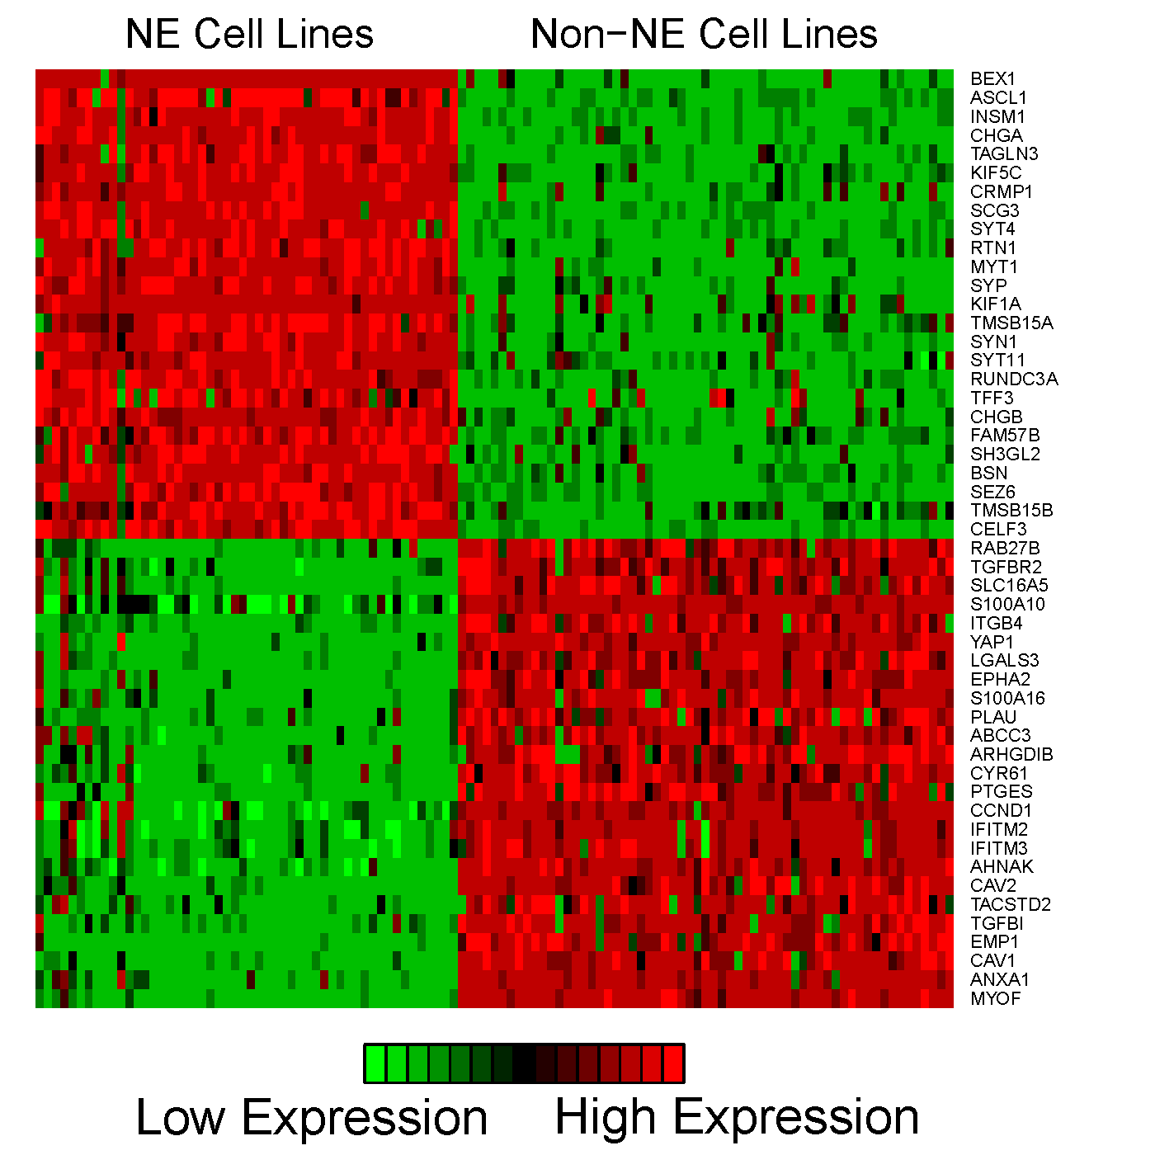
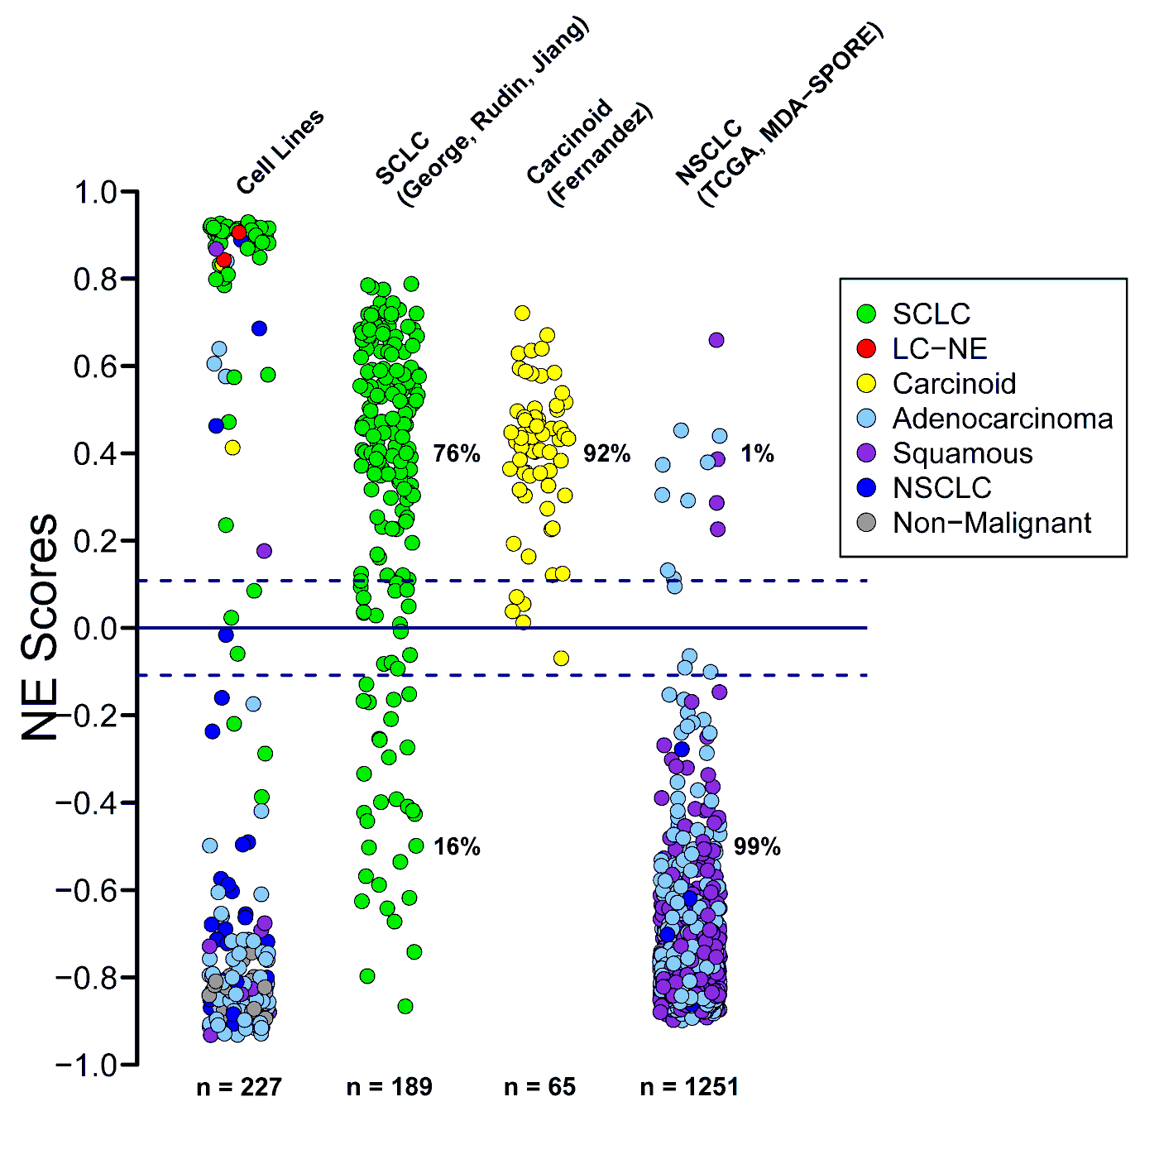
A Quantitative Signature for NE differentiation in lung cancers
Volcano Plot
Heat Map
Girard, Minna, Gazdar (Concept)
Zhang et al, Transl. Lung Cancer Res, 2018

Slide 16
Clustering analysis divides SCLC tumors and Cell lines into NE High and NE Low Subtypes (all samples have inactivation of TP53/RB1)
Tumors
(n = 81)
Cell Lines
(n = 68)
NE High
n = 62 (91%)
NE Low
n = 6 (9%)
NE Low
n = 17 (21%)
NE High
n = 64 (79%)

Slide 17
Reports of NE high and low SCLC subtypes (some with responses to chemotherapy/targeted therapies)
First author (Year) | Specimens studied | Nomenclature for NE High | Nomenclature for NE low
Zhang (2018) | Tumors/Cell lines/GEMM | NE High | NE Low
George (2015) | Tumors/GEMM | NE High | NE Low
Cardnell (2017) | Tumors/Cell lines | High TTF1/Low cMYC | High cMYC/Low TTF1
Udyavar (2017) | Tumors/Cell lines | NE/epithelial | Non NE/mesenchymal
Ito (2016) | Cell lines | NE positive/YAP1 negative | NE negative/YAP1 positive
Mollaoglu (2017) | GEMM/Tumors/Cell lines | NE | NE low
Lim (2017) | GEMM | NE | Notch active, non-NE
Calbo (2011) | GEMM | Neuroendocrine profile | Mesenchymal profile
Stewart (2017) | Cell lines, PDXs | (High E-cadherin) | (EMT)

Slide 18
Myc Family Overexpression & Amplification
NE Score High
NE Score Low
Tumor
ID
MYC
MYCL
MYCN
MYC r = -0.66, p = 7.0E-05
MYCL r = 0.12, p = 0.5
MYCN r = -0.21, p = >0.5

Slide 19
Notch Signaling in SCLC
Gazdar, Bunn, Minna, Nature Reviews Cancer, 2017
DLL3 expression is tightly correlated with the NE Score
(Correlation Coefficient = 0.641)
Notes:
The Notch pathway mediates juxtacrine signaling, and both signal-sending and signal-receiving cells are affected via ligand–receptor crosstalk^{159,160}. Notch signaling is activated by the binding of a Notch receptor to the extracellular domain of a Notch ligand. The canonical delta-like ligands DLL1, DLL3 and DLL4 and jagged ligands (JAG1 and JAG2) expressed on the cell surface can induce signaling in adjacent cells expressing the cognate receptors of the Notch family. Ligand binding promotes cleavage of the Notch receptors, resulting in release of the Notch intracellular domain (NICD), which interacts with transcriptional regulators in the nucleus to promote a Notch gene expression profile. These include transcriptional activation of hairy and enhancer of split 1 (HES1) and hairy and enhancer of split-related protein 1 (HEY1), which encode transcriptional repressors of achaete-scute homologue 1 (ASCL1). Thus, ASCL1 both activates Notch signalling and is repressed by it. Notch is inactivated in many small-cell lung cancer (SCLC) tumours and cells by at least three mechanisms, including inactivating mutations and expression of the non-functioning Notch ligand DLL3, which acts as an inhibitor of Notch signalling^{4,71,73}. Most ASCL1-expressing SCLC tumours express DLL3, which is predominantly localized to the Golgi, where it retains other Notch members and redirects them to endosomes for degradation⁷³. Some DLL3 is expressed on the cell surface, where it acts as a 'Trojan horse' neoantigen, which is not expressed in normal lung and may be targeted with rovalpituzumab tesirine (ROVA-T), a DLL3-targeted antibody–drug conjugate. Delta like non-canonical Notch ligand 1 (DLK1) is a non-canonical ligand that blocks Notch signalling in a dominant-negative manner^{161,162}, and its expression in SCLC is closely linked to ASCL1 expression⁴. As its mechanism of action is not fully understood, it is not included in the figure. ER, endoplasmic reticulum; NE, neuroendocrine; REST, RE1 silencing transcription factor.

Slide 20
Heterogeneity of NE differentiation in SCLC and predicted response to Targeted Therapies
NE Score High
NE Score Low
Genes involved in Targeted therapies
Tumor
ID
DLL3
FGFR1
DLL3 r = 0.64, p = 5.9E-06
FGFR1 r = -0.52, p = >0.5

Slide 21
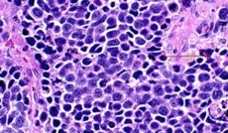
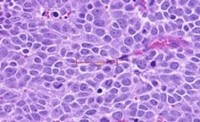
Molecular Changes Associated with Loss of NE Differentiation in SCLC
NE high SCLC subtype
(Classic morphology)
Up
Down
NE score
NE markers
ASCL1
NKX2-1
DLL3
DLK1
Epithelial
Genes (select)
ASCL1 High
NOTCH
MYC
REST
(ASCL2)
Hippo/YAP1
TGF β
Stem cells
Mesenchymal
Genes (select)
FGFR1
(NEUROD1 High)
Down
Dual negative
Up
(Variant morphology)
NE low SCLC subtype
Zhang et al, Transl. Lung Cancer Res, On line 2018

Slide 22
Adaptive and Innate Immunity
Adaptive immunity
Antigen specifc responses
(3-5 days+)
Innate immunity
Non-specific defenses activated by the antigen
(Within hours)
Notes:
nnate immunityInnate immunity refers to nonspecific defense mechanisms that come into play immediately or within hours of an antigen's appearance in the body. These mechanisms include physical barriers such as skin, chemicals in the blood, and immune system cells that attack foreign cells in the body. The innate immune response is activated by chemical properties of the antigen.Adaptive immunityAdaptive immunity refers to antigen-specific immune response. The adaptive immune response is more complex than the innate. The antigen first must be processed and recognized. Once an antigen has been recognized, the adaptive immune system creates an army of immune cells specifically designed to attack that antigen. Adaptive immunity also includes a "memory" that makes future responses against a specific antigen more efficient.

Slide 23
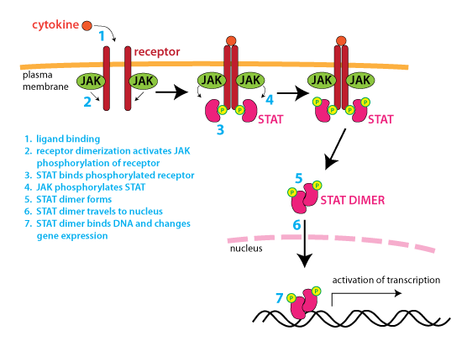
Toll-like Receptors
Cytokines (4 major families)
Interferon family including IFNγ
Interleukin family
Chemokine family
Tumor Necrosis Family
Complement System
Major Histocompatability Complex (HLA antigens)
The Inflammasome
Cellular responses – immune & Inflammatory cells
Neutrophils
Macrophages
NK cells
Dendritic cells
Eosinophils
Components of Innate Immunity
Cytokines act via JAK-STAT pathway
Punch line: All of these components of the Innate Immune system (22 cell types, >200 genes) are highly significantly up regulated in the low NE subtype of SCLC (Group and individual p values 5.8E-03 to 2.6E-11)
Notes:
nnate immunityInnate immunity refers to nonspecific defense mechanisms that come into play immediately or within hours of an antigen's appearance in the body. These mechanisms include physical barriers such as skin, chemicals in the blood, and immune system cells that attack foreign cells in the body. The innate immune response is activated by chemical properties of the antigen.Adaptive immunityAdaptive immunity refers to antigen-specific immune response. The adaptive immune response is more complex than the innate. The antigen first must be processed and recognized. Once an antigen has been recognized, the adaptive immune system creates an army of immune cells specifically designed to attack that antigen. Adaptive immunity also includes a "memory" that makes future responses against a specific antigen more efficient.

Slide 24
CD47 - The “Don’t Eat Me!” Antigen
CD47 is expressed at variable levels on the surface of most cells, including SCLC
It binds to the SIRPα receptor on macrophages sending a “Don’t Eat Me!” signal
Blocking this interaction results in greater cancer cell kill
Trillium Therapeutics
Tumor ID
CD47
(r = -0.54, p = 2.0E-05)

Slide 25
NE differentiation and PD-1 blockade
Meng et al, Cancer Treat Rep 2015
 | Symbol | r | p
PD1 | PDCD1 | -0.4 | 6.0E-03
PD-L1 | CD274 | -0.30 | 0.09
PD-L2 | PDCD1LG2 | -0.51 | 0.9
Interferon γ (IFNγ) | IFNG | -0.26 | 0.006
IFNγ Signature | NA | NA | 4.9E-04
NE Low vs NE High Subtypes

Slide 26
Predicted Therapeutic Responses of NE high and Low SCLC Subtypes
Therapy | Predicted Response NE High | Predicted response NE Low
Chemotherapy | Sensitive | Resistant
Radiotherapy | Sensitive | Resistant
PARP Inhibitors | Sensitive | Resistant
ROVA-T | Sensitive | Resistant
Topoisomerase inhibitors | Sensitive | Resistant
Polo-like kinase inhibitors | Resistant | Sensitive
HIPPO pathway Inhibition | Resistant | Sensitive
FGFR1 inhibitors | Resistant | Sensitive
Immunotherapy (PD-1 blockage) | Resistant | Sensitive
CD47 Inhibitors | Resistant | Sensitive

Slide 27
What remains to be done?
Heterogeneity observations must be extended to another large, fully characterized dataset
Predictions for differential responses to targeted therapies need to be tested in prospective and retrospective trials
Predictions for differential responses to PD-1 blockade must be confirmed in clinical trials

Slide 28
Summary: SCLC - Heterogeneity and Clinical Response
Recently, many new molecular targets have been identified for SCLC and several are in clinical trial
SCLC shows considerable intertumor heterogeneity, especially for expression of NE properties
Intertumor heterogeneity extends to the infiltrating immune & inflammatory cells
This heterogeneity must be considered for selection of subgroups more likely to respond to specific therapies
There is light at the end of the tunnel!

Slide 29
Acknowledgments
Gazdar Lab
Minna Lab
Wei Zhang
Mahboubeh Papari-Zareii
Victor Stastny
Yu-An Zhan
Luc Girard
Michael Peyton
Buddy Huffman
Brenda Timmons
Department of Clinical Sciences
Other UT Southwestern
Gaoxiang (Douglas) Jia
Guanghua (Andy) Xiao
Tao Wang
Jane Johnson (Neuroscience)
Melanie Cobb (Pharmacology)
Karine Pozo (Neuroscience)
MD Anderson
Other
Hans Ghayee (U Florida)
Karel Pacak (NIH)
Trudy Oliver (U. Utah)
Ignacio Wistuba

