Slide 1

Challenges in Moving Biomarkers from Bench to Bedside
John T. Wei, MD, MS
Professor of Urology
Dow Division of Urologic HSR
EDRN March 6, 2018

Slide 2
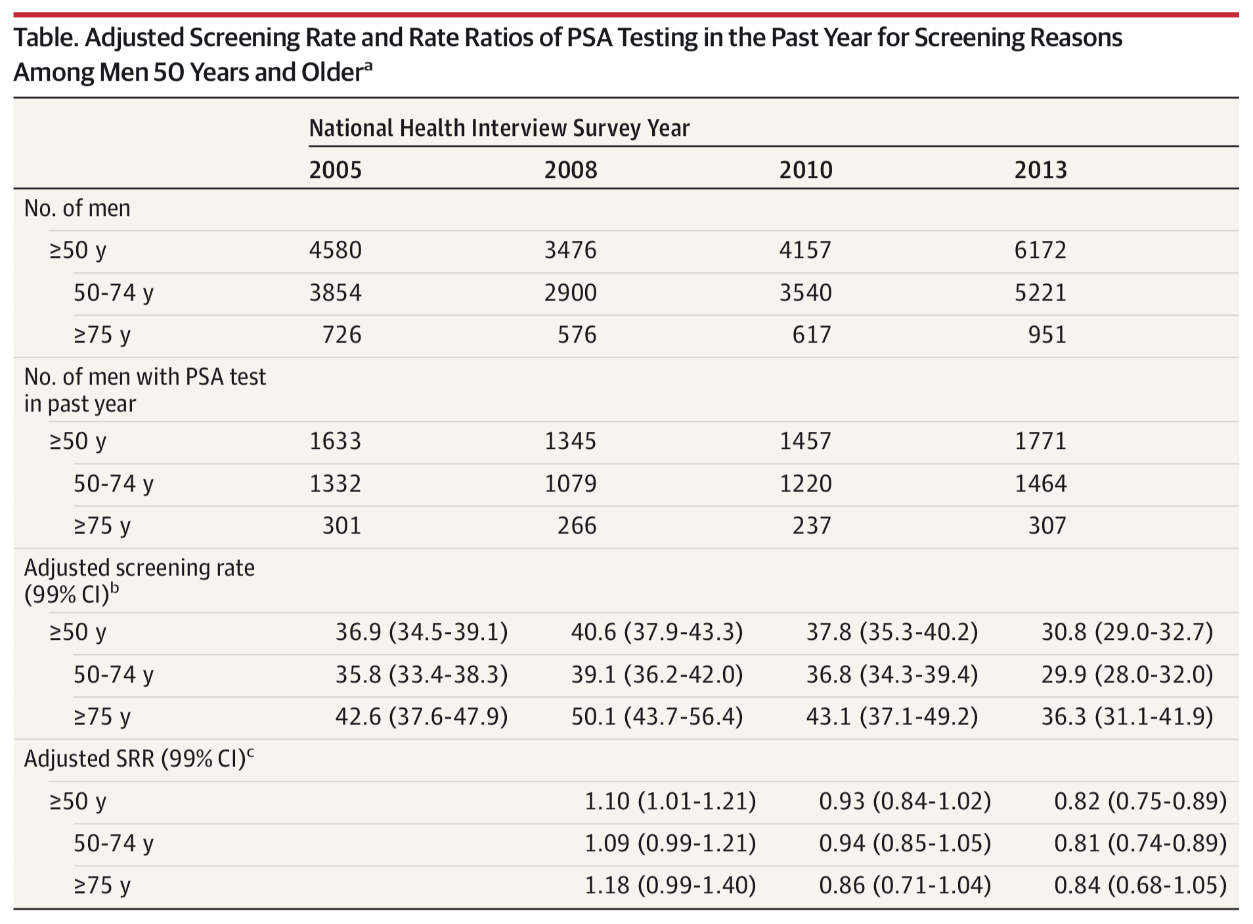
NHIS PSA Screening rates 2005-2013
Jemal et al. JAMA. 2015;314(19):2054-2061
Notes:
The percentage of men 50 years and older reporting PSA screening in the past 12 months was 36.9% in 2005, 40.6% in 2008, 37.8% in 2010, and 30.8% in 2013. In relative terms, screening rates increased by 10% (SRR, 1.10; 99% CI, 1.01-1.21) between 2005 and 2008 and then decreased by 18% (SRR, 0.82; 99% CI, 0.75-0.89) between 2010 and 2013. Similar screening patterns were found in age subgroups 50 to 74 years and 75 years and older.

Slide 3
[Insert your biomarker here] Screening rates 2005-2013
Modified from Jemal et al. JAMA. 2015;314(19):2054-2061
Notes:
Imagine if your biomarker had rates of use in these ranges…

Slide 4
Biomarker Impact
Impact is not just the discovery of a novel biomarker
Impact achieved when the biomarker gets into hands of end-users and is appropriately used
Landscape for Prostate cancer biomarkers
  10+ years ago
    Many biomarkers but few tests
  Today
    Bench to Market variable success
    Several tests available commercially (FDA, CLIA)

Slide 5
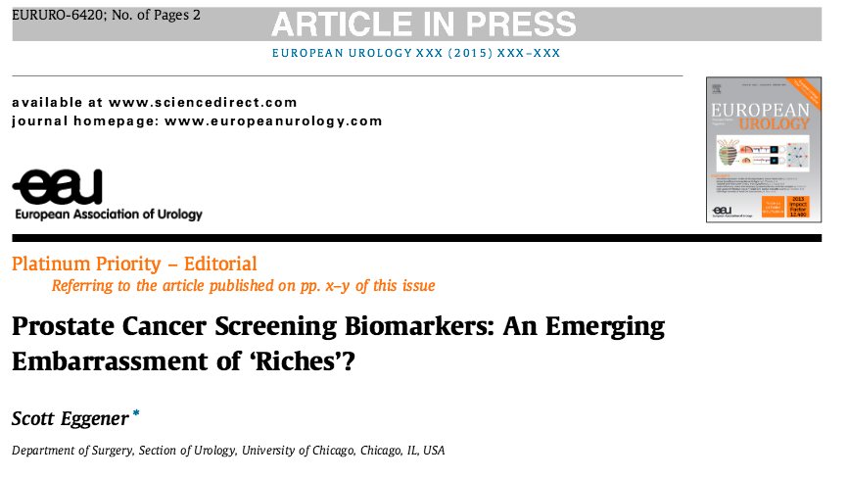

Slide 6
On the market…
PSA
PCA3
MIPS (PCA3+TMPRSS2:erg)
Select MDX
Exosome
PHI
4K
Tissue biomarkers – multiple
Limited impact on population level

Slide 7
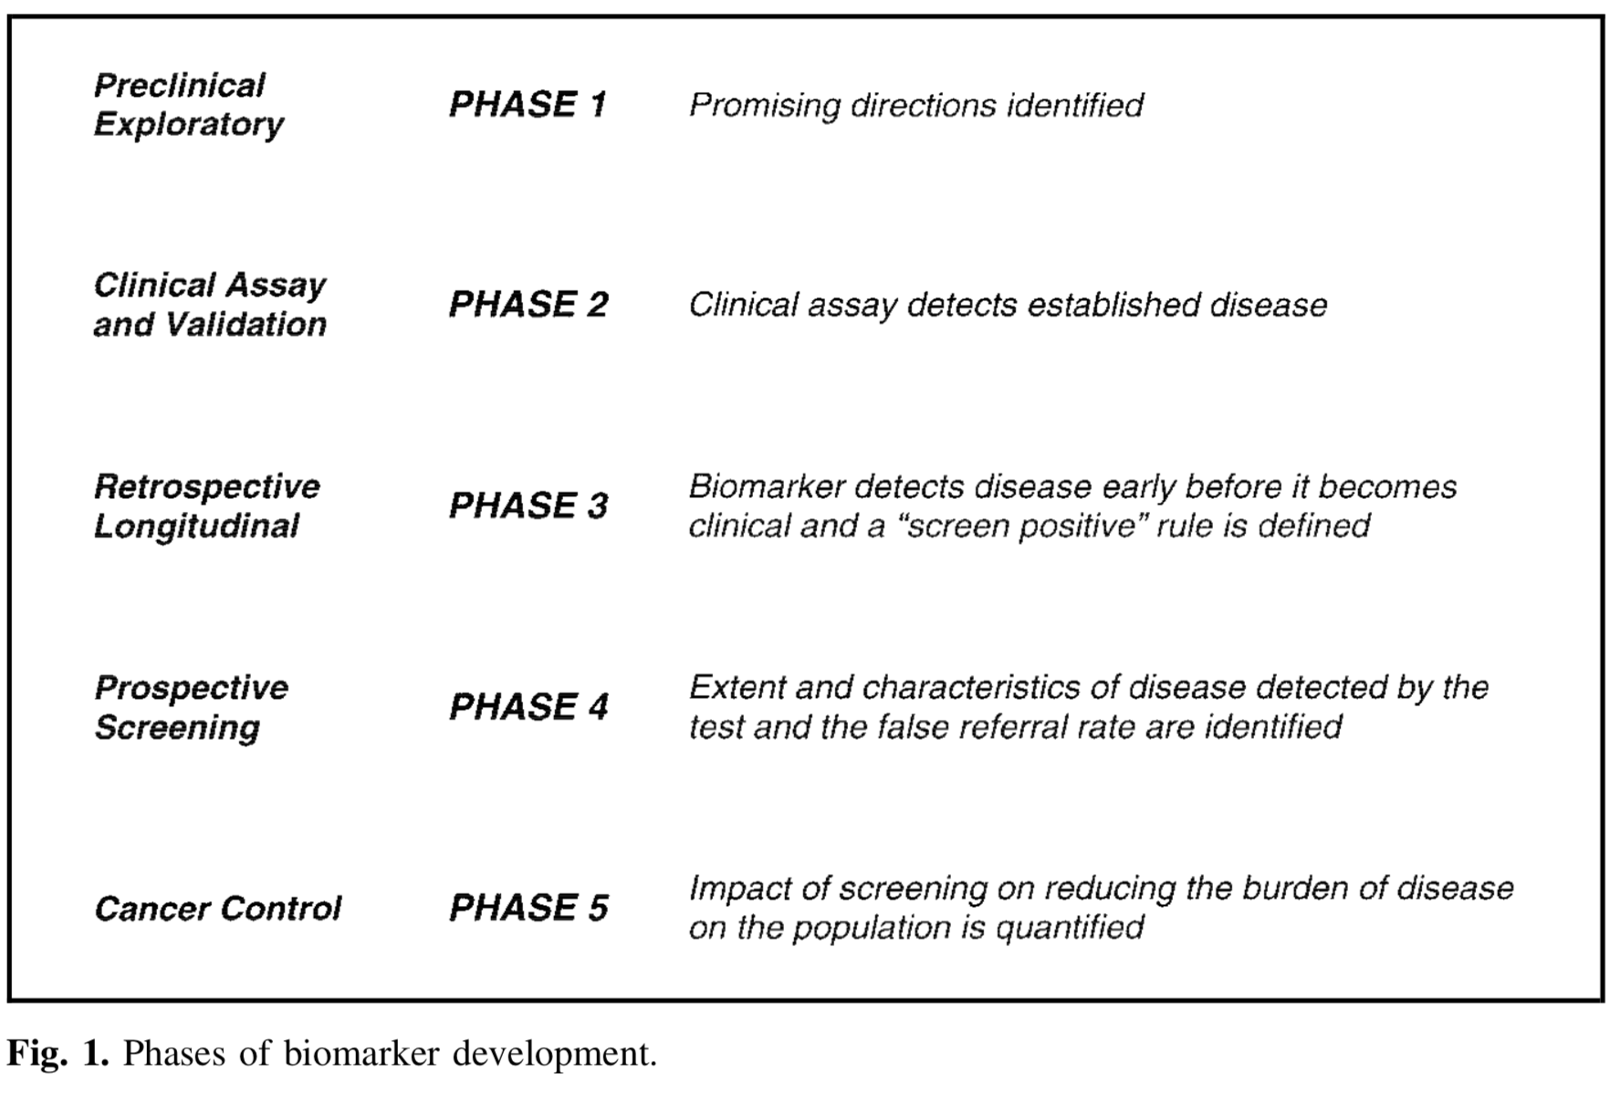
EDRN Playbook
Pepe, et al. Journal of the National Cancer Institute, Vol. 93, No. 14, July 18, 2001

Slide 8
Barriers and Lessons Learned
Biomarker Discovery
  EDRN BDL and BRL
Assay development, validation
  EDRN BDL and BRL
Clinical efficacy and effectiveness
  EDRN CEVC
    Prevalidation
  EDRN validation studies
Commercialization
  EDRN industry partners
  Navigating FDA and CLIA lab regulations
Dissemination
  …

Slide 9
EDRN Playbook
Dissemination
Pepe, et al. Journal of the National Cancer Institute, Vol. 93, No. 14, July 18, 2001

Slide 10

Its all about behavioral psychology…
Law of the few
  Need innovators, mavens and connectors
Stickiness of innovations
Context
  Market to each group differently

Slide 11
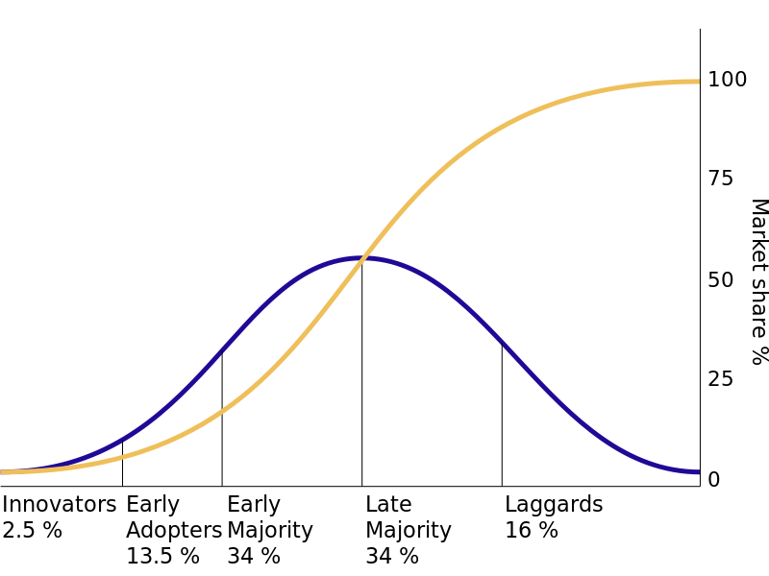
Theory of Diffusion of Innovations
Everett Rogers (1962)
Tipping point (inflection)
Rogers, Everett (16 August 2003). Diffusion of Innovations, 5th Edition. Simon and Schuster.
Notes:
Innovators – Jack Schalken, William Isaacs
Early adopters - academics
Early Majority is key – these are pragmatists

Slide 12
Winners and Losers
Why do some innovations take off while others do not
  Sliced Bread 15 years
  Facebook < 1 year
  PSA ~ 5 years
  PCA3 - FDA approved in 2012
Not always a problem with technology, science, or innovation
What happens after innovation often drives Impact

Slide 13
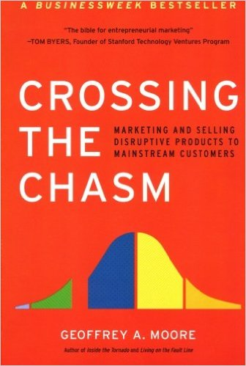
The Diffusion Chasm
Between early adopters and early majority
Failure to reach critical mass of users
Described need to target each diffusion subgroup differently
Geoffrey Moore Harper Business Essentials, 1991

Slide 14
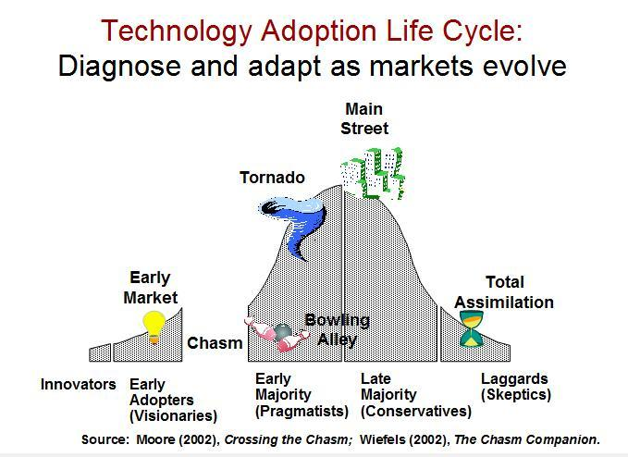
Chasm
Geoffrey Moore Harper Business Essentials, 1991
Notes:
Early adopters are willing put up with crap to be ‘first’, eg not being able to bill for pca3.
Majority of users are not, they are pragmatists and conservatives.

Slide 15
Overwhelming majority of end-users are pragmatists and conservatives
Expect ease of learning
  Expect high level of training/support
Expect ease of use
  How to reflex response in common settings/results
Want system integration
Believe in Standards
  Want to see in guidelines
  Want to see others using it and verification of value

Slide 16
Attributes of an Innovation that drive adoption
Perceived advantage
Compatibility with current practice or understanding of disease
Complexity of new test
  How hard is it to learn to use
Trialabilty
  How hard is it to get to try
Observability
  Peer pressure
Rogers, Everett (16 August 2003). Diffusion of Innovations, 5th Edition. Simon and Schuster.

Slide 17
Crossing the ‘Biomarker’ Chasm
Choosing a target market (eg PCA3)
  Urologists
  Men interested in screening
Understanding the whole product concept
  Why, What, How to use new biomarker (eg PCA3)
  In context with PSA and relevant clinical factors
Positioning the product
  Repeat biopsies (eg PCA3)
Building a marketing strategy
  Website (PCA3.org)
Choosing the most appropriate distribution channel
  Limited labs offering test (eg PCA3)
Pricing
  Billing complicated, not often covered completely by insurance, uses generic CPT

Slide 18
Take home messages
Impact requires getting test adopted widely by end-users
Bench to Market barrier has been breached
  Work with FDA or CLIA standard
Crossing the Adoption chasm is our next challenge
  Early adopter → Early majority
  Needs commercial sponsor to market and distribute
  Demonstrate cost effectiveness to third parties so they will cover new tests

Slide 19
Questions?

Slide 20
5 Stages of End-user Adoption
Knowledge – why use new biomarker
Persuasion – develop attitudes through interactions with others (KOL)
Decision – go ahead and try new biomarker
Implementation – initial use – more information needed
Confirmation - continued use is based on evidence of benefit
Rogers, Everett (16 August 2003). Diffusion of Innovations, 5th Edition. Simon and Schuster.

Slide 21
Crossing the Chasm
Choosing a target market
Understanding the whole product concept
Positioning the product
Building a marketing strategy
Choosing the most appropriate distribution channel
Pricing
Geoffrey Moore Harper Business Essentials, 1991

Slide 22
Likelihood of Biopsy after MIPS given change in risk
Increased risk
Decreased risk

