Slide 1
2018
Notes:
KFRF, founded after my husband, Peter died from pancreatic cancer several months after he was diagnosed with the disease.
Our Mission
Support innovative inquiry in early detection of pancreatic cancer by facilitating collaboration, encouraging idea generation, and promoting pioneering research

Slide 2
Worldwide Pancreatic Cancer
Facts
Just 9 percent of those diagnosed survive five years
Every day, more than 1,000 people worldwide will be diagnosed with pancreatic cancer, and an estimated
985 will die from the disease
It is estimated that 418,000 new cases will be
diagnosed globally by 2020
Notes:
o 9% is actually misleading since there is such a significant difference in relative survival when the disease is localized (31.5%) vs. distant disease, which is the bulk of those diagnosed with a 2.7% 5 year relative survival.

Slide 3

Building a Coalition Founding Steering Committee
Pancreatic Cancer Action Network (USA)
Pancreatic Cancer Action (UK)
Kenner Family Research Fund (USA)
Pancreatic Cancer UK (UK)

Slide 4
WPCC Structure
A collaborative effort of pancreatic cancer advocacy nonprofit groups
Coalition, not a legal entity
Leadership provided by a Steering Committee
Notes:
Also important that members are considered equal even though they may differ in size and scope.

Slide 5
Through global collaboration, members are able
to raise awareness of pancreatic cancer and strengthen
the individual efforts of all member organizations.
Our mission is to drive transformational change for
all those affected by pancreatic cancer.
Notes:
Support each other
Leverage each other’s strengths to make individual organization’s stronger
Creating stronger organizations around the globe lifts all of our individual efforts
Provide universal tools and resources
Create a united front for patients and researchers
Not duplicate efforts of member organizations
Through WPCD raise global awareness about pancreatic cancer
Global awareness lifts all of our efforts

Slide 6
History
May 2014 First European meeting in Zurich, Switzerland
May 2014 Steering Group formed to create World Pancreatic Cancer Day (WPCD)
November 14, 2014 Launched inaugural WPCD
2014 and 2015 European meetings in Amsterdam, Prague, Geneva, Brussels
July 2015 North American Pancreatic Cancer Meeting
July 2015 Meeting in London to outline coalition potential
November 13, 2015 2nd WPCD
December 2015 Invitations go out to potential WPCC members
May 11, 2016 Official launch and inaugural Annual WPCC meeting
November 17, 2016 3rd WPCD
May 10–13, 2017 2nd Annual WPCC meeting
November 16, 2017 4th WPCD
May 8–10, 2018 3rd Annual WPCC meeting

Slide 7
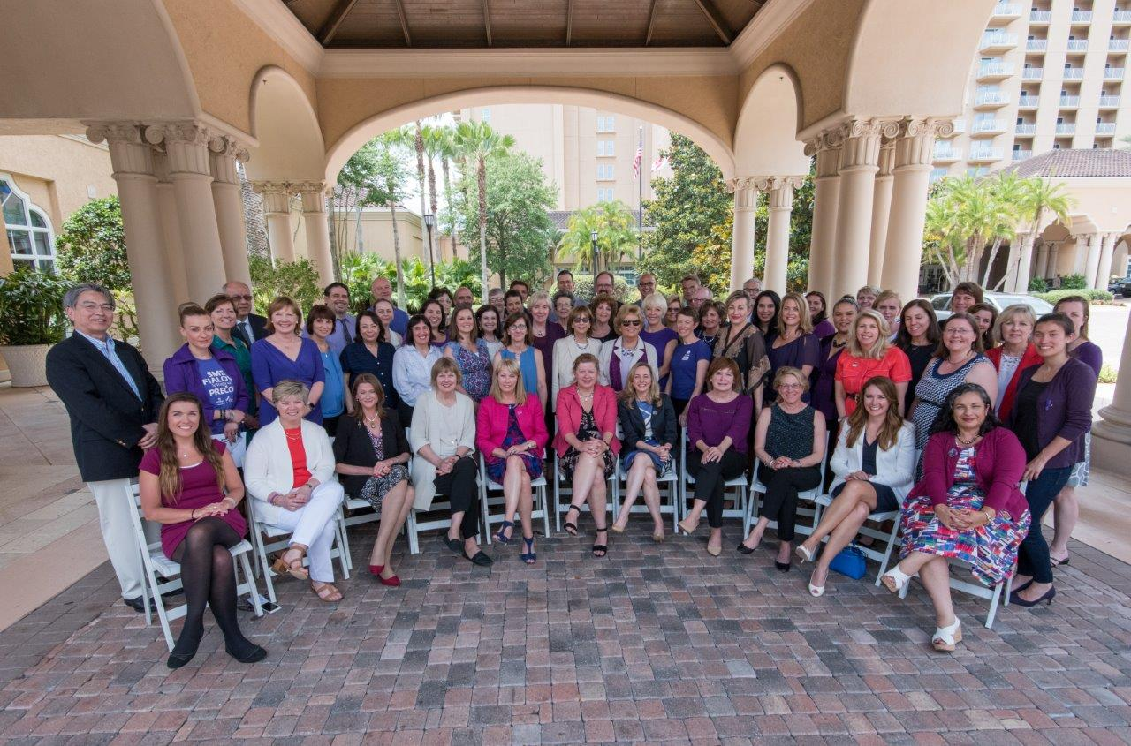
72 Member Organizations
31 Countries | 6 Continents

Slide 8
South Africa
Slovenia
CYPRUS
CANADA
AUSTRALIA
BRAZIL
SPAIN
ARGENTINA
FRANCE
Sweden
EUROPE
WPCC
United
THIS
YOUR
IS
Kingdom
United
States of
America
ITALY
MEXICO
BELGIUM
Greece
JAPAN
SLOVAKIA
AUSTRIA
Portugal
GERMANY
HUNGARY

Slide 9
Members

Slide 10
WPCC Member Organization Activities
Advocacy, Awareness and Fundraising
Services and Support (including information)
Education and Healthcare Professional Training
Research
Raising public awareness about pancreatic cancer
Providing support services for patients, their families/careers
Participating in pancreatic cancer educational activities
Funding pancreatic cancer research projects
Recruiting volunteers/advocates to raise awareness
Offering financial support
Training healthcare professionals
Undertaking or commissioning research to improve services
Participating in advocacy or campaigning activities
Organizing fundraising events
Notes:
We did a survey a year ago to understand more about our members, what they are involved in, as well as who we are as a growing group.
This is what we found.
The missions and initiatives of individual WPCC members are diverse and are best defined through four areas

Slide 11
Advocacy & Awareness How WPCC Members Advocate
Media Stories
Social Media
Leaflets/
Pamphlets
Advertising & PR
Face-to-Face

Slide 12
Advocacy & Awareness Opportunities to Communicate Online
Family/Care-giver
Experience
Webinars &
Blogs
Community forums/
Information days
Patient experience
Live chats

Slide 13
Support & Information Direct Clinical Services
Counseling, from psychologists
or other trained therapists
Nursing
support
Dietary or nutritional support, from
trained dieticians or nutritionists
Complementary therapy

Slide 14

Education & Training
Participate in educational activities
Provide health professional training opportunities

Slide 15
Research Funding*
Between 1997 and 2016
WPCC member organizations funded approximately
$200,000,000
in research funding,
representing over 500 individual research grants
*May 2017

Slide 16
Research Funding
Biology
Etiology
Prevention
Early Detection
Treatment
Cancer Control
14
11
11
21
18
5

Slide 17
Efforts of the Coalition
Annual Meeting
Members share experiences and expertise to
learn from each other and to strengthen the impact of
all Coalition members
World Pancreatic Cancer Day (WPCD)
Global collaboration to raise awareness
of pancreatic cancer to save lives

Slide 18
WPCC Annual Meeting
Inaugural Meeting in Orlando
May 10-13, 2016
42 organizations attended
18 countries represented
Second Annual Meeting in Montreal
May 10-13, 2017
51 organizations attended
21 countries represented
Third Annual Meeting in Coral Gables
May 8-10, 2018
Notes:
Meeting has evolved as we have matured as a group.
.. The science is presented by noted researchers presenting on early detection, treatment
. Workshops run by members are highly valued, using the talent from within.
. This year, 3 workshops – fundraising, the potential of social media, and becoming more media savvy

Slide 19
WPCC Assets
Websites
(WPCC and WPCD)
Social Media
Facebook, Twitter, Instagram and closed Facebook group for members
WPCC monthly member newsletter
WPCC member directory and
searchable database by activities
Notes:
Through the annual meeting, the assets for WPCC have been defined based on member group needs.

Slide 20
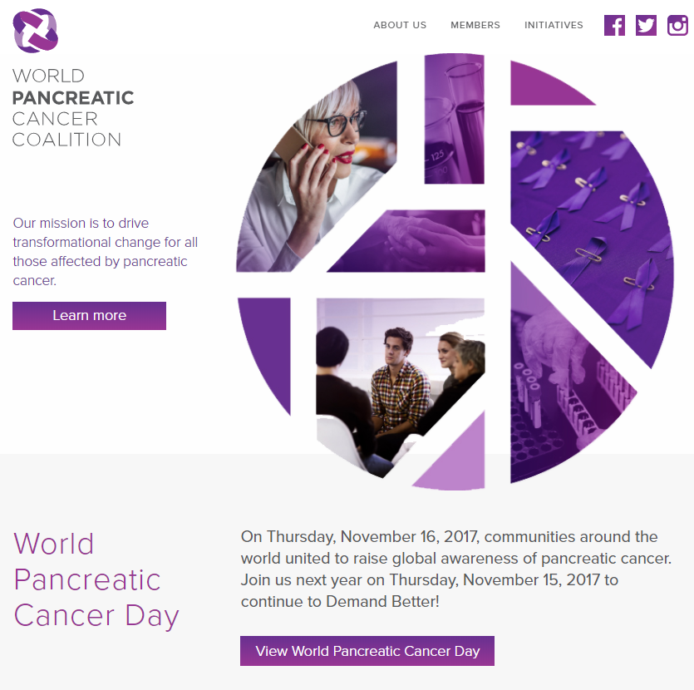
WPCC Website
www.worldpancreaticcancercoalition.org
Notes:
Used both for members and the public.

Slide 21
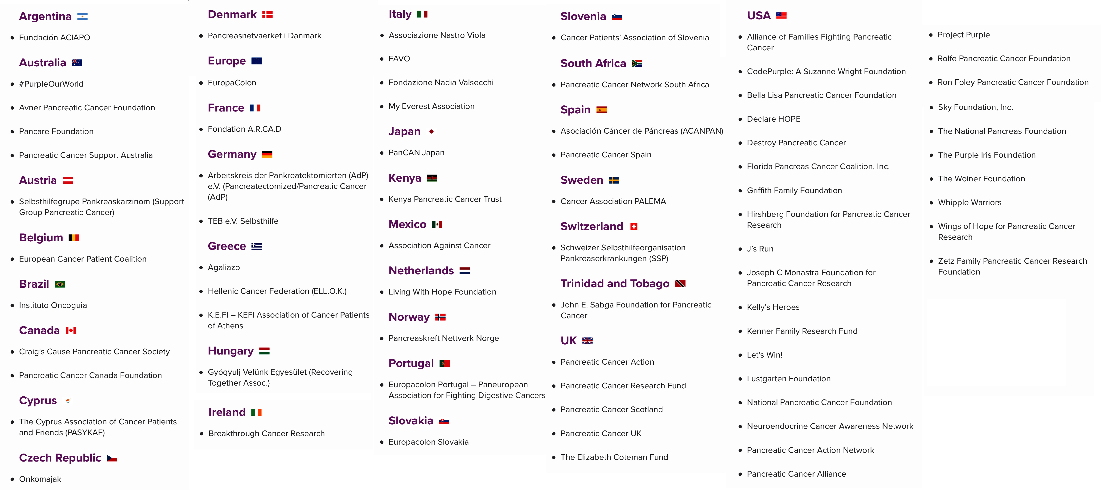
World Pancreatic Cancer Coalition members provide many services and support
for people living with and affected by the disease.
Notes:
Directory reachable through the site
Lists all members and if you click on a name, you will find details about that group

Slide 22
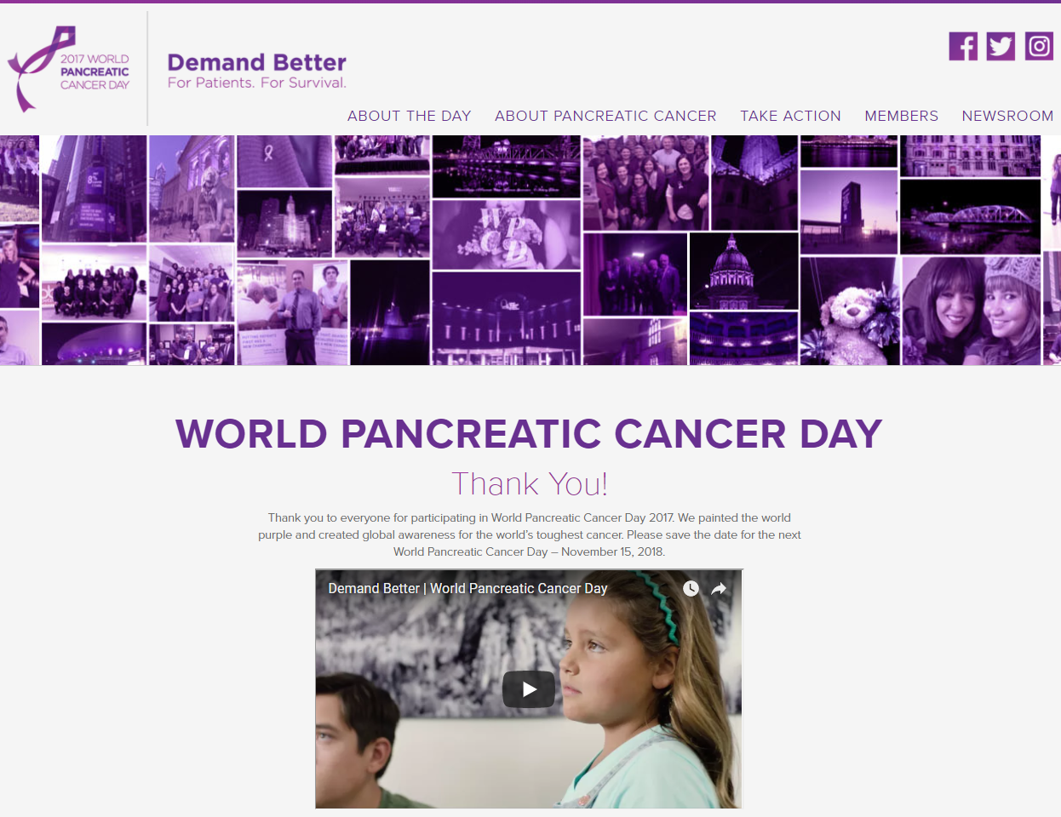
WPCD Website
www.worldpancreaticcancerday.org
Notes:
Increase awareness for WPCD for both coalition members and the public

Slide 23
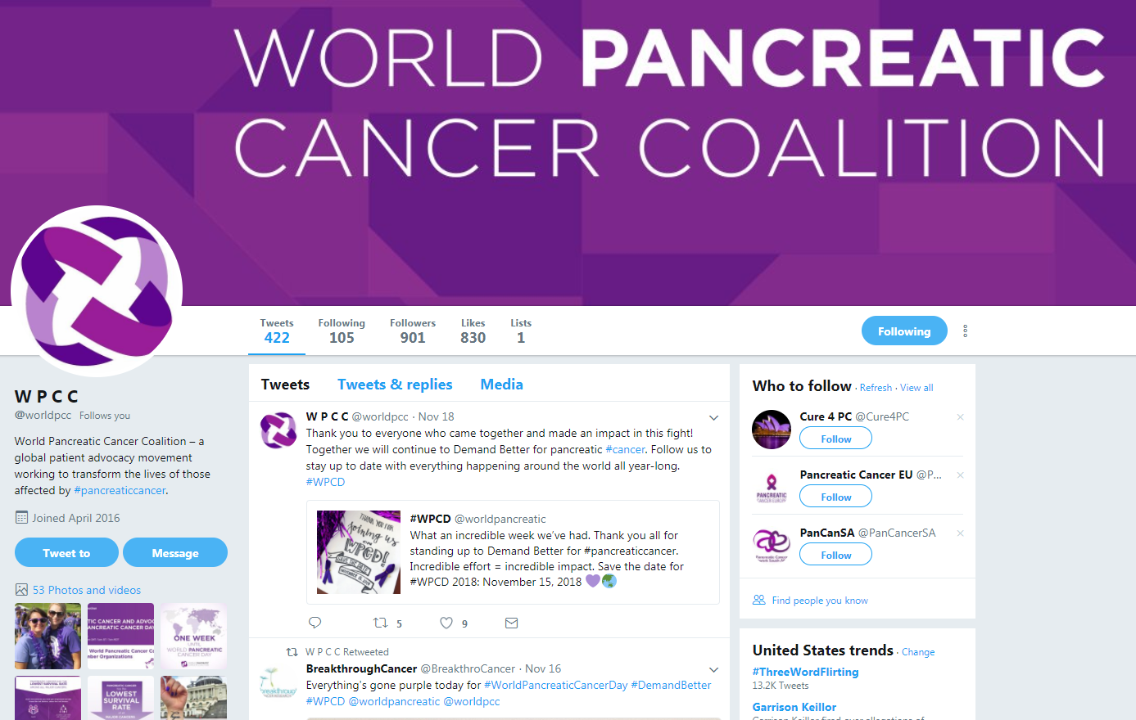
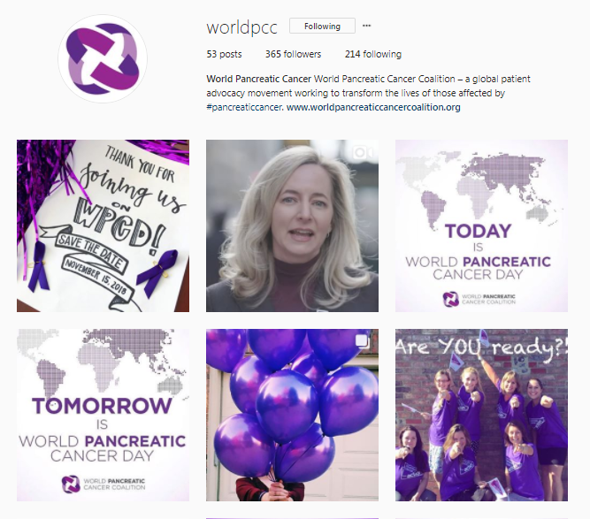
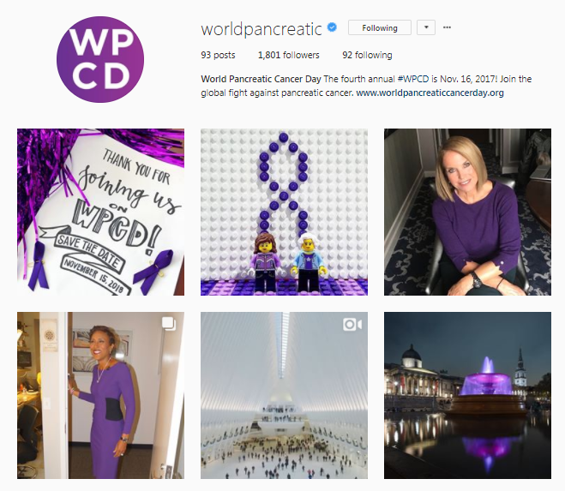
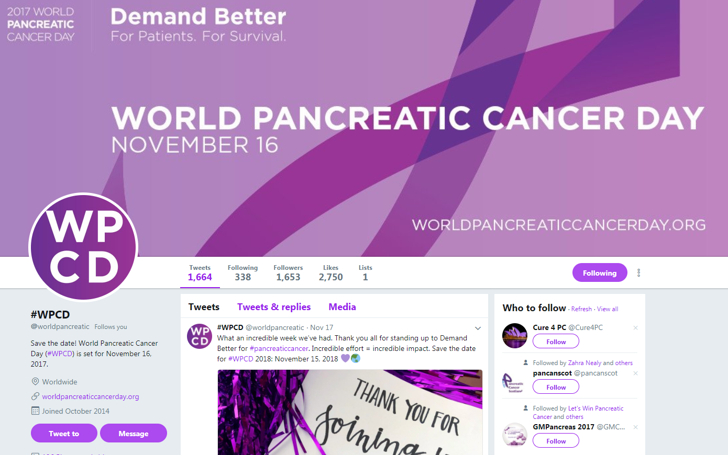
Social Media
Twitter
@worldpcc and @worldpancreatic
Instagram
@worldpcc and @worldpancreatic
Notes:
WPCC Twitter page
WPCC Instagram page

Slide 24
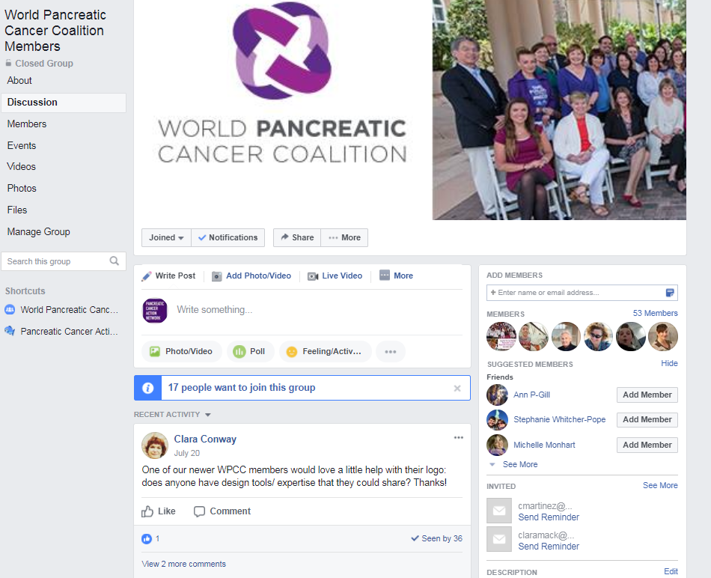
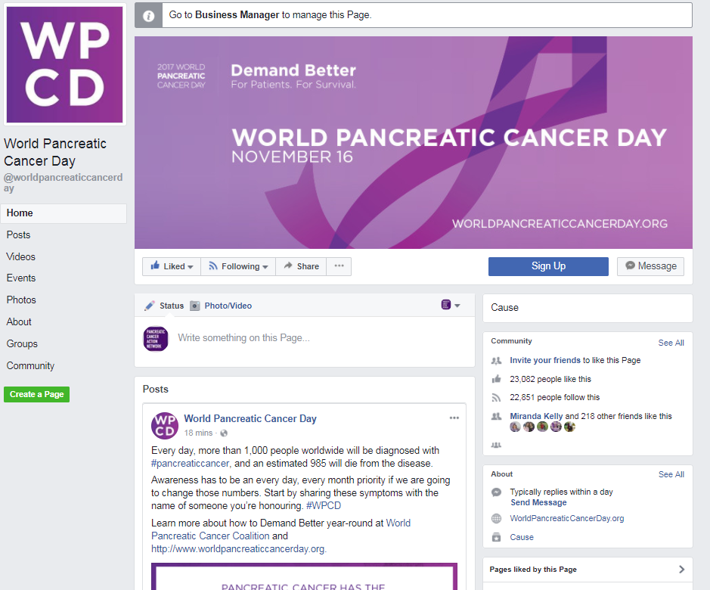
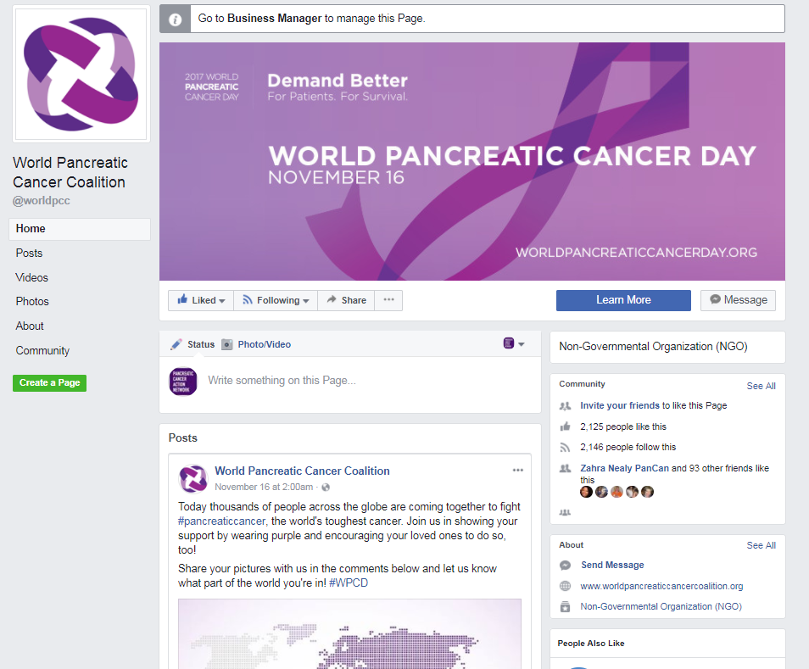
Facebook Group and Pages
Facebook Closed Group
https://www.facebook.com/groups/worldpcc/
WPCD Facebook Page
https://www.facebook.com/
worldpancreaticcancerday
WPCC Facebook Page
https://www.facebook.com/worldpcc
Notes:
WPCC Member Group Page

Slide 25
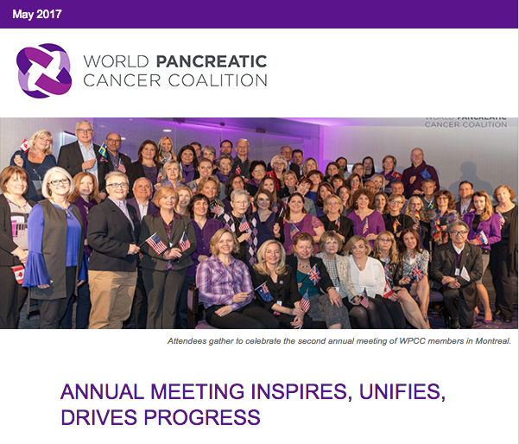
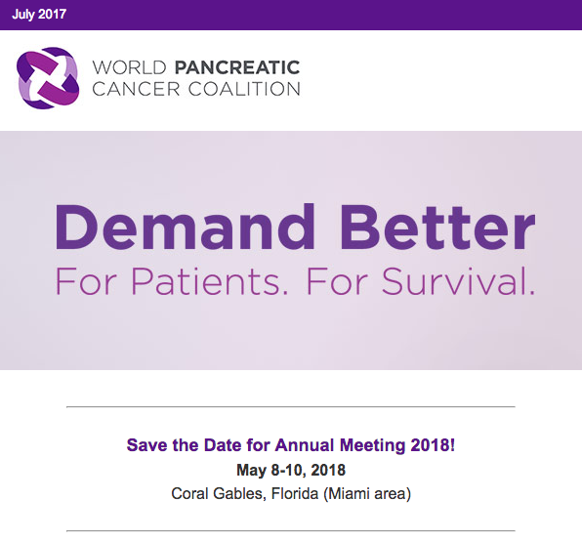
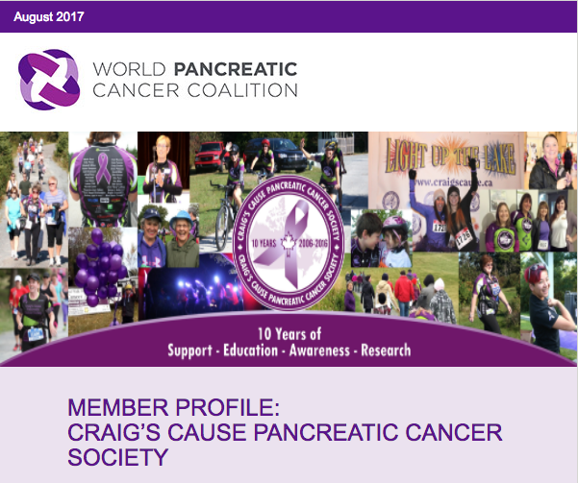
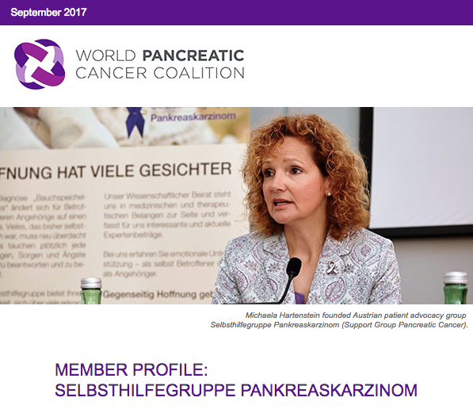
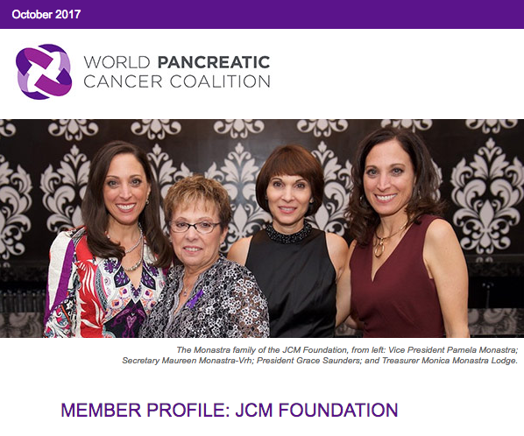
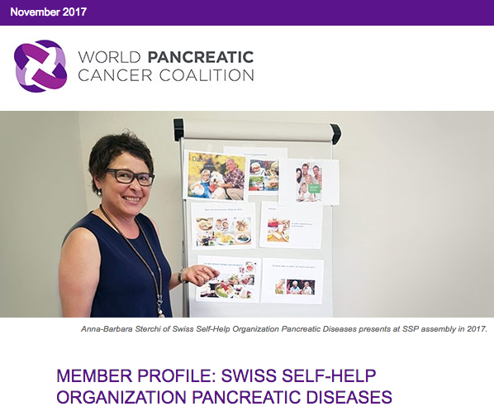

Newsletter
Notes:
To keep our members informed during the year

Slide 26
WPCD 2017
Notes:
A major asset of the coalition is WPCD. Provides growing awareness in the public

Slide 27
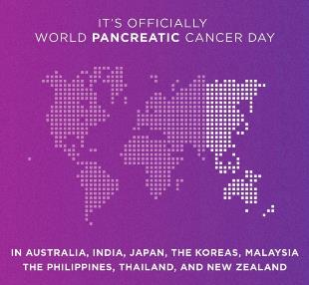
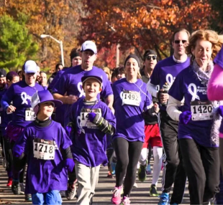
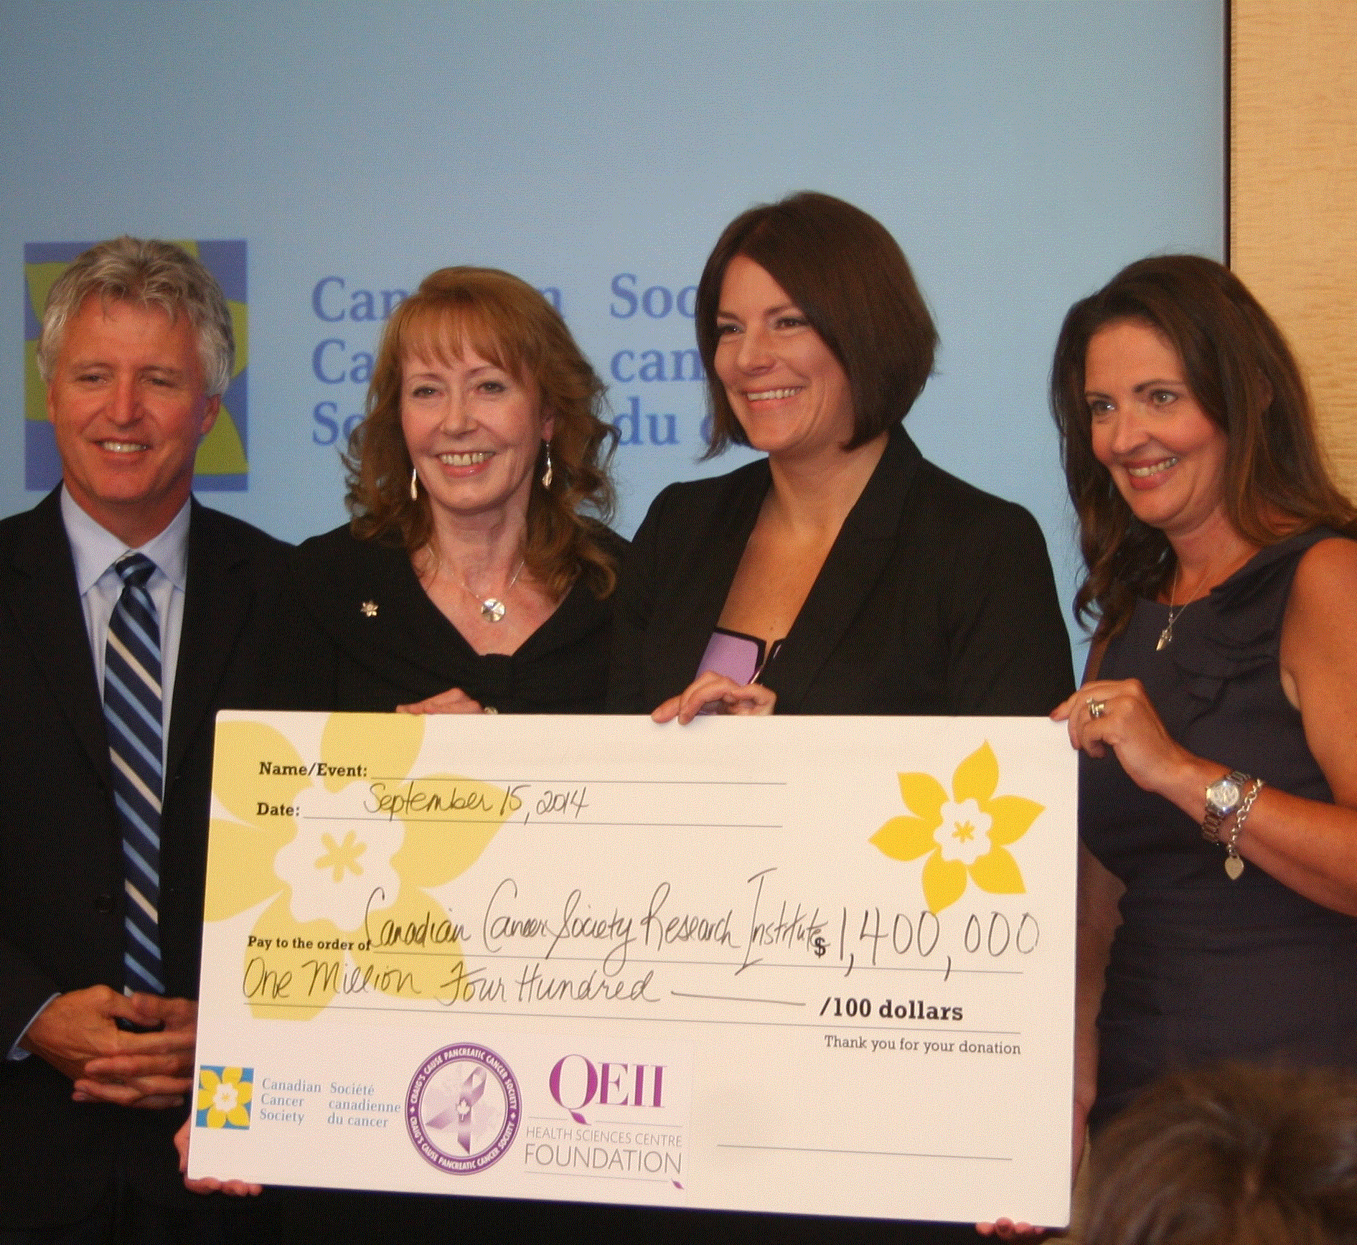
Goals
Raise awareness of pancreatic cancer symptoms and risks
Mobilize people to join and share in the movement to accelerate progress
Utilize WPCD 2017 to build capacity and momentum for WPCC (the “Coalition”)
Notes:
Larry – campaign overview

Slide 28

November 16, 2017
Notes:
Theme is: Demand Better means that all of us in the pancreatic cancer community are coming together to advocate for greater progress/urgency to defeat the world’s toughest cancer.
The status quo is not acceptable. We need better progress.
And better progress starts with earlier detection.

Slide 29
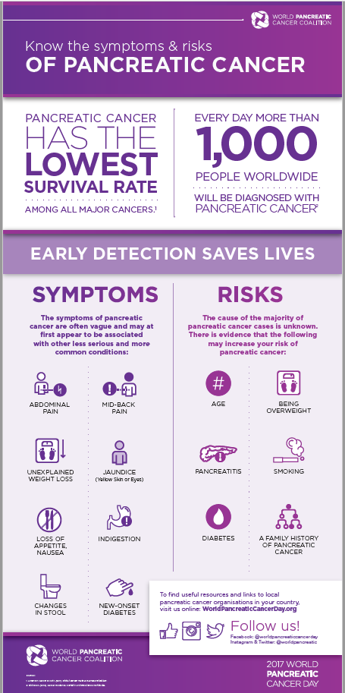
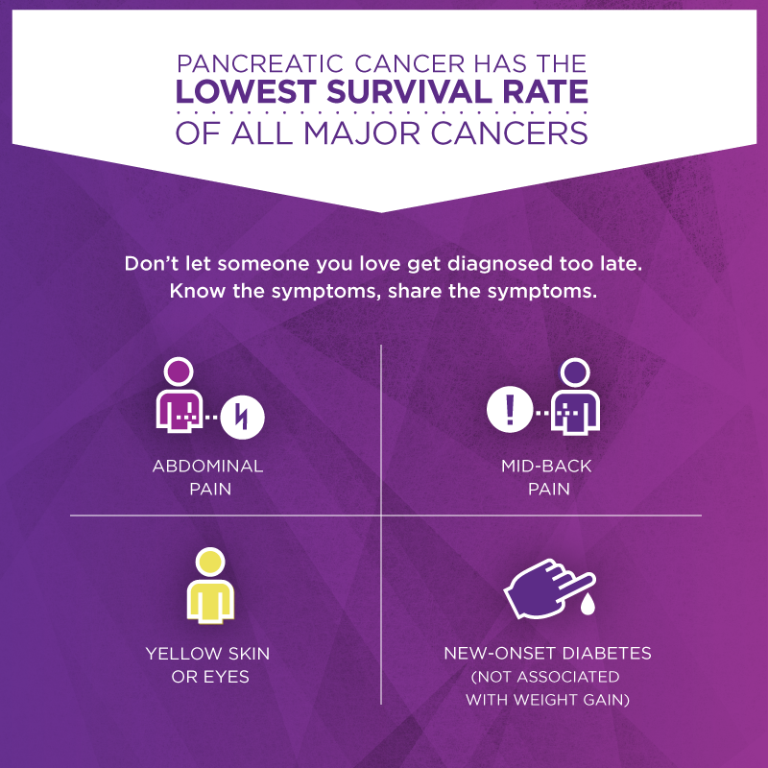
On World Pancreatic Cancer Day, people around the world united
to Demand Better in the fight against the world’s toughest cancer, starting with earlier diagnosis
Call to action — raise awareness about the symptoms and
risks of pancreatic cancer
Notes:
Infographics were available On-line but also some groups translated and printed the cards to hand out.

Slide 30
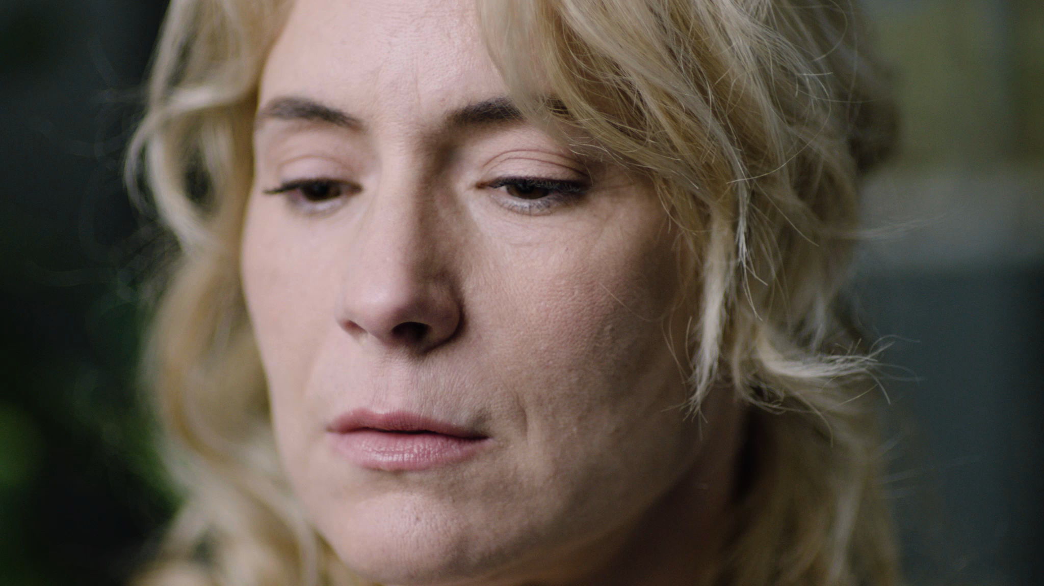
“At The Doctor”
Campaign Video
Notes:
Used globally, and translated

Slide 31
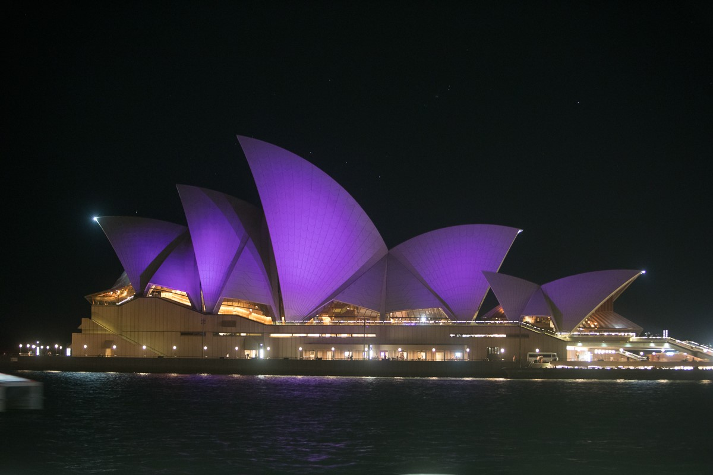
2017
World Pancreatic Cancer Day
Highlights
More than 150 landmarks around the world displayed purple lights. Images of these landmarks
were shared on social media.
Landmarks included:
Trafalgar Square, The Sydney Opera House, Niagara Falls
Notes:
Purple buildings were shared in Facebook album with 66 photos

Slide 32
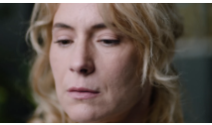
2017
World Pancreatic Cancer Day
Highlights
Infographic
“At The Doctor” Video
At the Doctor video was viewed 142,000 times on Facebook
Know the Symptoms infographic reached
more than 665,000 users on Facebook

Slide 33
864 million earned media impressions Almost 400,000 social media engagements (likes, clicks, comments and shares) More than 800 media placements worldwide Potentially 11.7 million shoppers viewed the Demand Better infographic on mall display screens throughout the U.S.

Slide 34
WPCC’s efforts show that collaboration among advocacy organizations is a very effective way to raise awareness of pancreatic cancer globally.

Slide 35
Save The Date WPCD 2018 November 15, 2018

Slide 36



Thank You to Our Sponsors

Slide 37
Thank You
www.worldpancreaticcancercoalition.org | www.worldpancreaticcancerday.org

