Slide 1





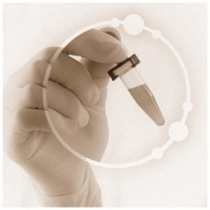
Deciphering Prostate Cancer Heterogeneity – Radiogenomics of Tumor Habitats
Radka Stoyanova,¹ Alan Pollack,¹ Robert Gillies,² Yoganand Balagurunathan,² Charles Lynne,¹ Dipen Parekh,¹ Nicholas Erho,³ Lucia Lam,³ Christine Buerki,³ Ram Datar,¹ Richard Cote,¹ Merce Jorda,¹ Oleksandr Kryvenko,¹ Matthew Abramowitz,¹ Elai Davicioni,³ Sanoj Punnen¹
¹ University of Miami Miller School of Medicine, Miami, Florida
² Moffitt Cancer Center, Tampa, FL
³ GenomeDx Biosciences, Vancouver, British Columbia, Canada

Slide 2
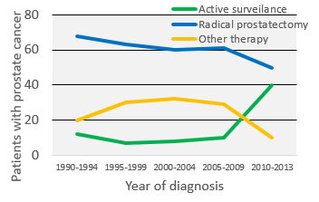

Background
Low grade prostate cancer is often overdiagnosed and overtreated, as most men will not become symptomatic or die from their disease;
Active Surveillance (AS) is an attractive alternative to primary therapy, preserving QOL in many patients for over 5 years;
The postponement of treatment is of primary importance, particularly for men in their 50’s and 60’s;
The number of patients at low risk on Active Surveillance is rapidly increasing;
Identify patients, who are not good candidates for Active Surveillance to avoid delay in treatment.
Notes:
It is well recognized that prostate cancer is often overdiagnosed and overtreated; Active surveillance, is becoming attractive alternative to primary treatment: surgery (prostatectomy) and radiation treatment; The postponement of treatment relativly young man – man in their 50s and 60s. These man have a long life expectancy and quality of life is of large significance. The number of patients at low risk in recent years have quadrupppeld, as shown on this graph in Jama. This is on expense of less patients treated with radical prostatectomy and radiation therapy. The key phrase in this statement is low risk, and determining the patients that are candidates for active surveillance is of large importance.

Slide 3
Rationale
  Prostate cancer exhibits spatial heterogeneity that can confound clinical-pathological and genomic assessment;
Additional tools are needed to improve the selection of patients for active surveillance;
A “habitats” concept based on mpMRI quantitative parameters was introduced to map and characterize tumor heterogeneity;
Habitat adverse histopathologic and quantitative imaging features reflect underlying gene expression markers associated with adverse patient outcome.
Notes:
These decisions are confounded by the prostate spatial heterogeneity; the histopatathology and genetic assesments are based on biopsies – random or targeted and the determine part of the tumor can be missed.

Slide 4
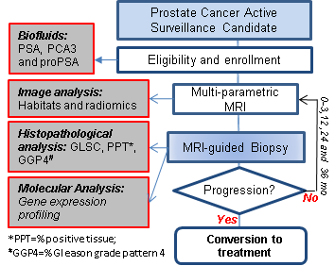
MRI-Guided Biopsy Selection of Prostate Cancer Patients for Active Surveillance versus Treatment: The Miami MAST Trial
Schema of the MAST Trial
Eligibility:
(i) ≤4 cores positive with GLSC=6 and ≤2 cores with GLSC 3+4;
(ii) ≤2 cores with GLSC 3+4 (GSC 4+3 and higher not eligible);
(iii) PSA ≤20 ng/mL;
(iv) cT1-T2a disease based on digital rectal exam;
(v) Patients with T2b or questionable extracapsular extension on mpMRI are eligible.
Progression:
(i) >4 positive cores of GLSC = 6;
(ii) >2 cores of GLSC = 7 (3+4);
(iii) any GLSC = 7 (3+4) core;
(iv) a GLSC 3+3 that becomes a GLSC 7;
(v) a GLSC 3+4 that becomes a 4+3 or higher.

Slide 5
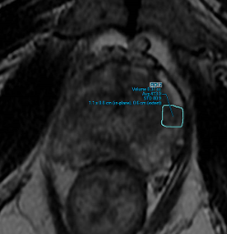
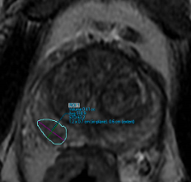
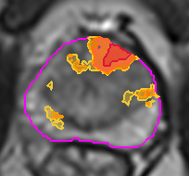
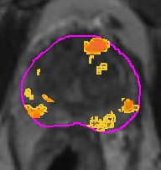

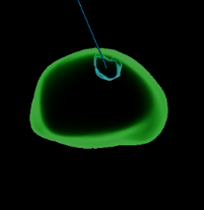
MAST – Importance of MRI Surveillance
PI-RADSv2 Directed biopsies
Habitat Risk Scoring
mpMRI_1
mpMRI_2
Diagnostic Biopsy
mpMRI Confirmatory Biopsy
mpMRI
Ist Surveillance Biopsy
Converted to Treatment
0
12 mo
Consent
HRS is a 10 point pixel by pixel analysis, displayed as a heat map
Target 1: 2 cores; “-” Target 2: 2 cores; “-”
Target 1: 1 core;
GS 4+5

Slide 6
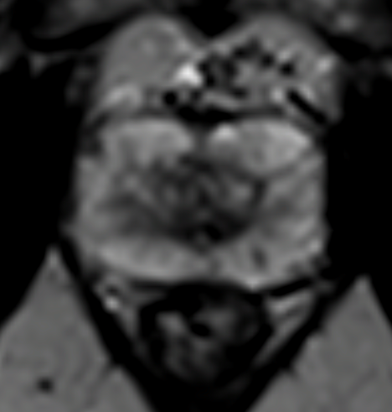
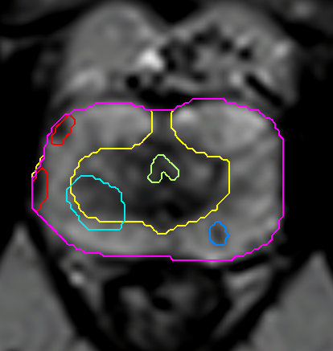
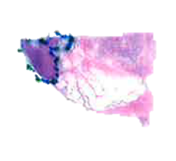
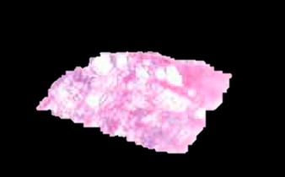
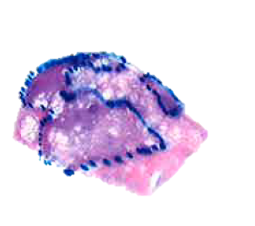
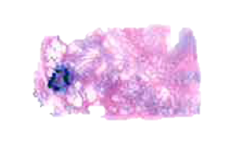
Histopathogy and MRI
Notes:
This is a transverse PSEUDO WHOLE MOUNT SECTION of RADICAL PROSTATECTOMY from A patient
with prostate cancer. On the right side the corresponding T2 image is shown. We can see that the prostate on imaging has two areas with different intensities: A bright rim, called peripheral zone and the central area, call transition zone. The brightness of the T2 signal is due to the fact that the peripheral zone contains mainly PROSTATIC ACINI AND DUCTS and the prostatic fluid in THEIR LUMINA riseS a strong signal. Alternatively, the transition zone HAS A HIGHER PROPORTION of PROSTATIC STROMA. We can notice the same picture on the histopathology sample, where the transition zone is surrounded by A porous tissue, CORRESPONDING TO FREQUENT GLANDULAR LUMINAE IN THE PERIPHERAL ZONE.

Slide 7
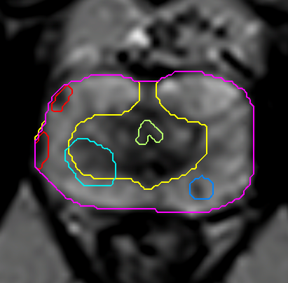
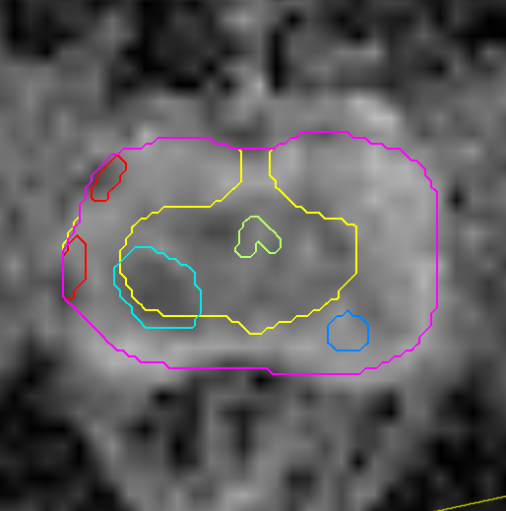
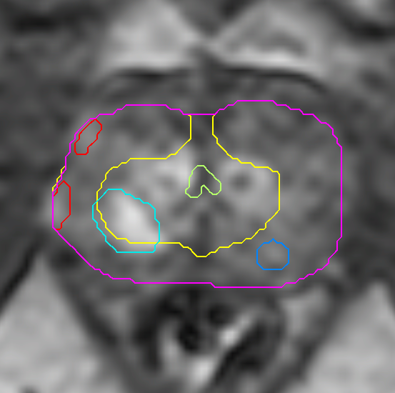
T2w
Diffusion
Perfusion
  Diffusion weighted imaging (DWI) – a specialized acquisition technique which highlights areas with restricted microscopic motion of water molecules.
  DWI provides information regarding cell density, membrane integrity and tissue microstructure.
Tumor vasculature – the lifeline/food supply necessary for survival and growth
Tumor microvasculature is aberrant, because
of tumor-derived factors that
  stimulate endothelial cells to form new small vessels (angiogenesis)
  affect the maturation of these vessels (vasculogenesis)

Slide 8

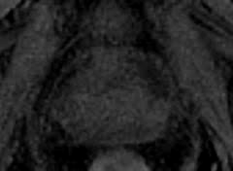

Pattern Recognition Approach
W (X) S (t)
D (X, t)
~
~
Stoyanova R, Huang K, Sandler K, et al. Transl Oncol. 2012
Chang Y, Ackerstaff E, Tschudi Y, et al. Delineation of Tumor Habitats based on DCE-MRI, Scientific Reports. 2017

Slide 9
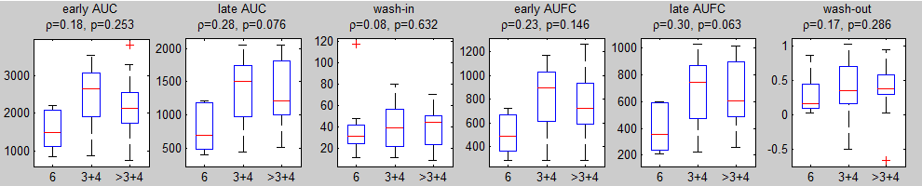
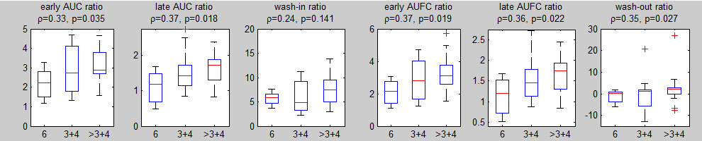
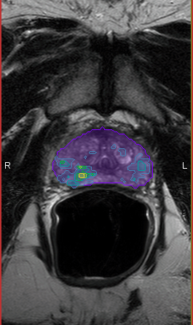
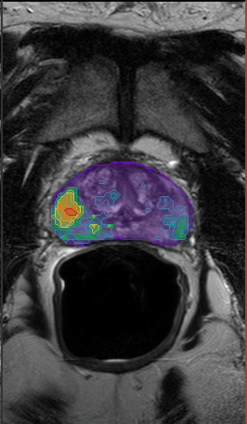
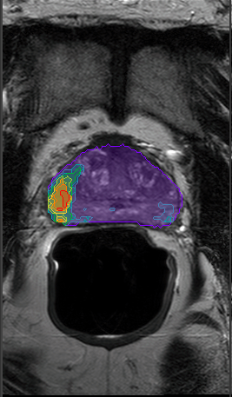
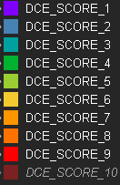



Quantitative DCE Score
Six semi-quantitative features, related to contrast washin and washout
65 patients
Normalized to muscle
TCIA (The Cancer Imaging Archive)
3+4
4+4
4+4
Parra N, Pollack A, Chinea F, et al. Automatic Detection and Quantitative DCE-MRI Scoring of Prostate Cancer Aggressiveness, Frontiers Oncology (2017)

Slide 10
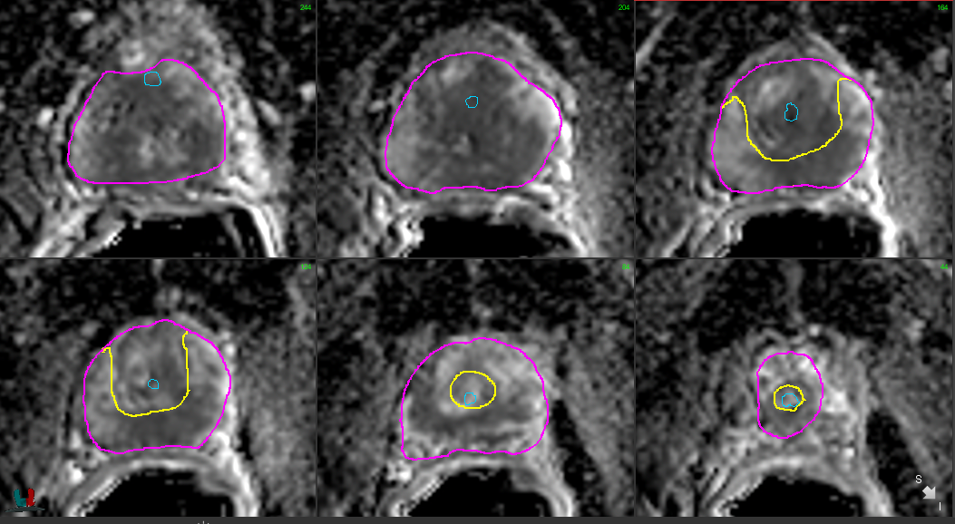
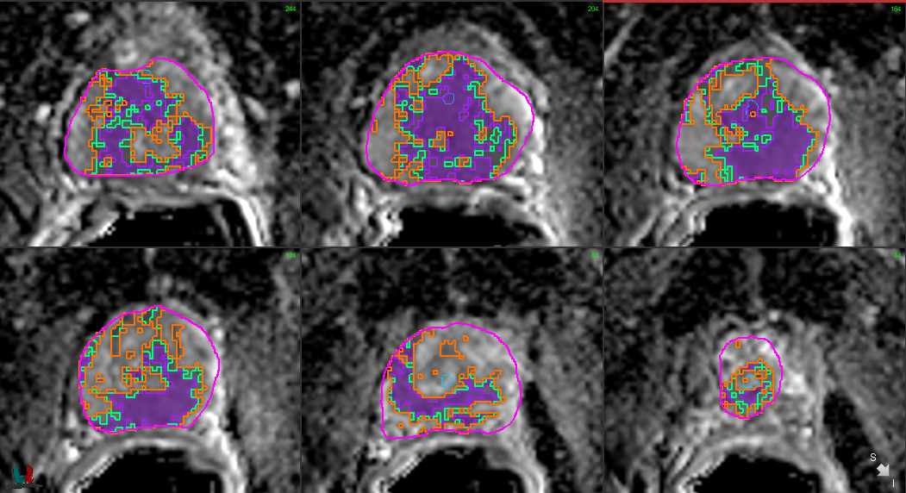

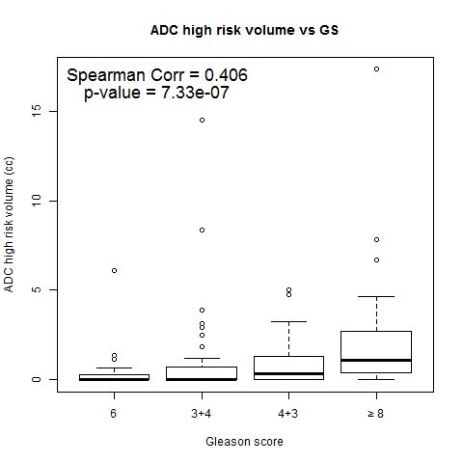
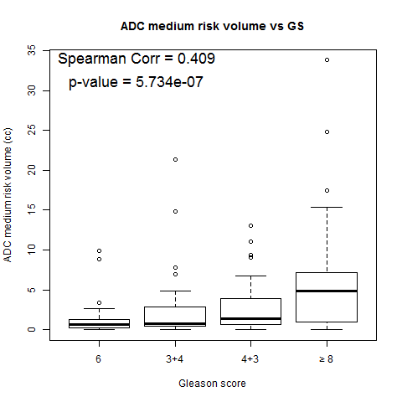
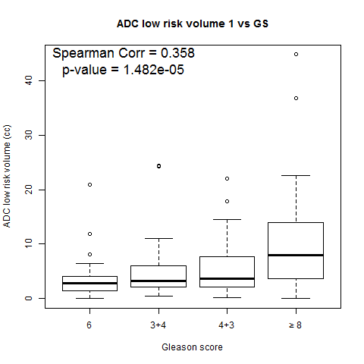
ADC Analysis
High Risk
Int Risk
Low Risk
139 Patients
Tschudi Y, Pollack A, Punnen S, et al, Association of Prostate Volumes with Restricted Diffusion and Prostate Cancer Aggressiveness, Radiology (revision)

Slide 11
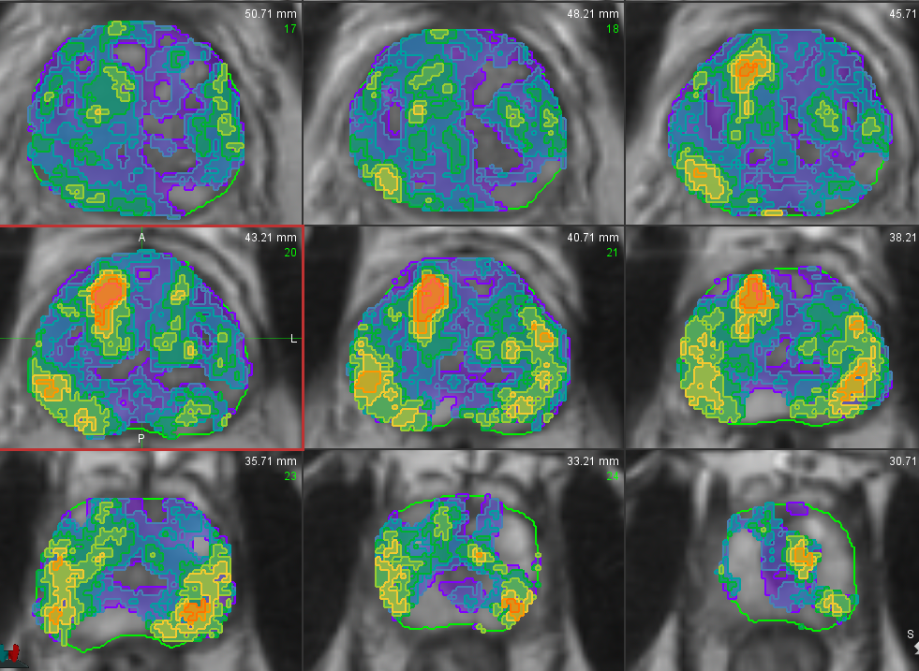
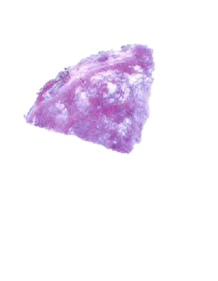
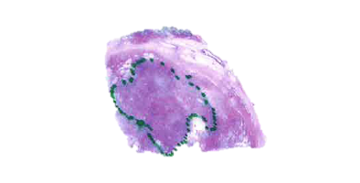
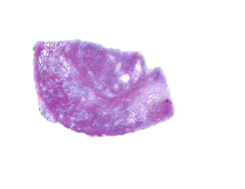
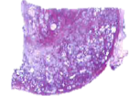
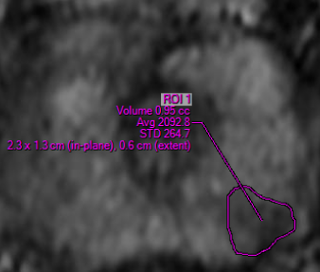
Habitat Risk Score

Slide 12
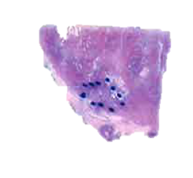
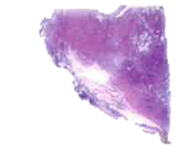

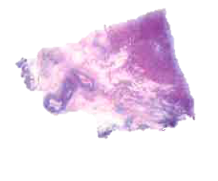
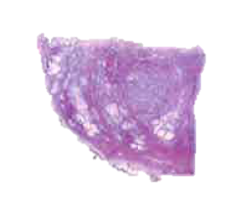
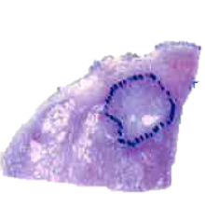
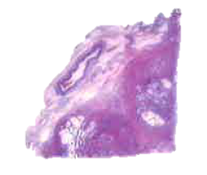
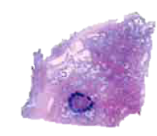
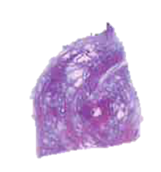
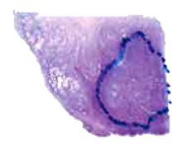
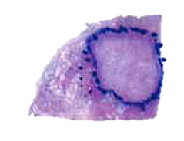
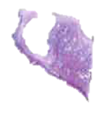

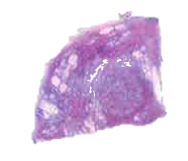
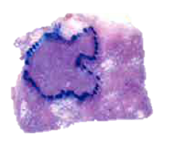
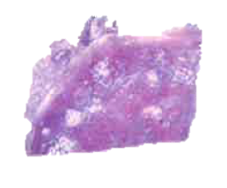
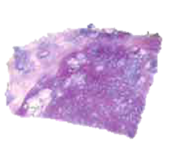












Habitat Risk Score and Histopathology
A
3+3=6
3+4=7
3+4=7
3+3=6
3+3=6
R
L
P
3+4=7
3+4=7
4+3=7
4+3=7
4+3=7
4+4=8

Slide 13







Registration of RP Histopathology with Imaging
Olympus VS120

Slide 14




























Habitat Risk Score – Performance
Gleason Score 4+5=9
RP ROIs
4+3
PIRADS 4
4+3
HRS maps
Notes:
In order to evaluate the power of HRS to predict GS≥7 cancer of RP specimens, we retrospectively analyzed data from 12 patients with mpMRI exam prior to RP (Figure 6). The histopathology was evaluated, ‘stitched’ and translated onto T2w in MIM software (for more details see section III.3.1.1.1). PIRADS areas were also translated into MIM. HRS maps were generated. Each MRI slice was divided into four cross-sectional quadrants and sliced complimentary to the pathology.

Slide 15

Habitat Risk Score – Performance
Cancer vs no Cancer
GS ≥ 7 vs GS = 6 and no Cancer
GS ≥ 8 vs GS = 6, 7 and no Cancer
Stoyanova R, Tschidu Y, et al. An Automated Multiparametric MRI Quantitative Imaging Prostate Habitat Risk Scoring System , Red Journal (under revision)
Notes:
Correlation of HRS 6 volumes with Prostatectomy ROI volumes with GS≥7 (left). ROC curves of PIRADS and HRS6 in discriminating Cancer vs No Cancer, GS≥7 vs No Cancer or GS = 6 and GS≥8 vs No cancer or GS = 6,7
39 tumor nodules (18 GS≥7 and 21 GS6) were examined. We plotted the volume of GS≥7 in the prostate and found impressive agreement with HRS6 volumes within the prostate (Figure 7, left). We then used a generalized linear mixed model (GLMM) regression to assess the association between the HRS6 and three histopathology outcomes in each tumor nodule: Cancer vs No Cancer, GS≥7 vs No Cancer/GS=6 and GS≥8 vs No cancer/GS=6,7. HRS6 was chosen because it was the most consistent at achieving our main objective of detecting significant cancers of GS ≥7. The corresponding receiver operating characteristic curves and areas under the (ROC-AUCs) are shown in Figure 7 plots 2-4 together with ROC-AUCs for model based on PIRADS only. HRS 6 provided an AUC=0.767 (95%CI: 0.719-0.816) for predicting the likelihood of GS≥7. By contrast, PIRADS had an AUC=0.631

Slide 16

Mapping of Biopsy Needle Tracks

Slide 17


Radiomics Analysis
ENTROPY
ENERGY
CONTRAST
CORRELATION
HOMOGENEITY

Slide 18
Radiomics Pipeline
Stoyanova R, Takhar M, Tschudi Y, et al. Prostate cancer radiomics and the promise of radiogenomics. Transl Cancer Res. 2016, 5(4):432-447

Slide 19



Genomic Biomarkers in Active Surveillance
Oncotype DX: GPS score
Myriad: Polaris
Genome Dx: Decipher

Slide 20
Radiogenomics
GPS
Decipher
CCP

Slide 21





MAST – Importance of MRI Surveillance
Habitat Risk Scoring
Consent
mpMRI Confirmatory Biopsy
mpMRI_1
mpMRI_2
Diagnostic Biopsy
Target: 2 cores; GS6
Random: 1 cores; GS6
9 cores with GS6,
GS 3+4, 4+3
High risk
Low risk
Diagnostic Biopsy

Slide 22

MAST - Time line and Summary of Data Collection
Consent
mpMRI Confirmatory Biopsy
mpMRI
Ist Surveillance Biopsy
mpMRI
IIst Surveillance Biopsy
mpMRI
IIIrd Surveillance Biopsy
Diagnostic Biopsy
time
0
12 mo
24 mo
36 mo

Slide 23




The MIAMI MAST Trial– Questions we Hope to Answer
Which constellation of molecular, imaging, and genomic markers add to clinical information for predicting progression on AS
Multi-level vertically integrated map of tumors.
Create longitudinal multi-level integrated maps.
mpMRI/Biopsy
mpMRI/Biopsy
mpMRI/Biopsy
0
12 mo
24 mo
time

Slide 24
Summary:
Preliminary results show high correlation of HRS maps with Gleason Score on prostatectomy;
HRS has a great potential to guide biopsies;
Acquired whole transcriptome gene expression data

Slide 25
Acknowledgments:
Imaging Group
  Yohann Tschudi, PhD
  Andres Parra, PhD
  Bryan Jimenez
  Yu-Cherng Channing Chang
  Adrian Breto
  Nicole Gautney
Radiation Oncology
  Alan Pollack, MD, PhD
  Matt Abramowitz, MD
  Kyle Padgett, PhD
  Chet Ford, PhD
  Felix Chinea, MD
Urology
  Sanoj Punnen, MD
  Dipen Parekh, MD
  Charles Lynne, MD
Pathology
  Merce Jorda, MD
  Oleksandr Kryvenko, MD
Radiology
  Felipe Munera, MD
  Rosa Castillo, MD
Moffitt Cancer Center
  Robert Gillies, PhD
  Yoganand Balagurunathan, PhD
Industrial Partners
  GenomeDx, Vancouver, CA
  MIM Software, Cleveland, OH
National Cancer Institute Grants: R01CA189295 and R01CA190105

Slide 26












Development Of A Habitat Risk Scoring System
HRS10
HRS9
HRS8
HRS7
HRS6
HRS5
HRS4
HRS3
HRS2
HRS1

