Slide 1


From Bench to Boardroom to Bedside: An Airway gene-expression biomarker’s 15-year journey Accelerating biomarker validation/implementation via academic-industry-federal partnerships
Avi Spira, MD
Boston University
aspira@bu.edu

Slide 2
Disclosures
Founder of Allegro Diagnostics Inc. (acquired by Veracyte Inc. Sept, 2014)
- consultant to Veracyte Inc.
Founder of Metera Pharmaceuticals Inc.
Sponsored Research Agreements with Janssen Pharmaceuticals
Consultant to JNJ

Slide 3
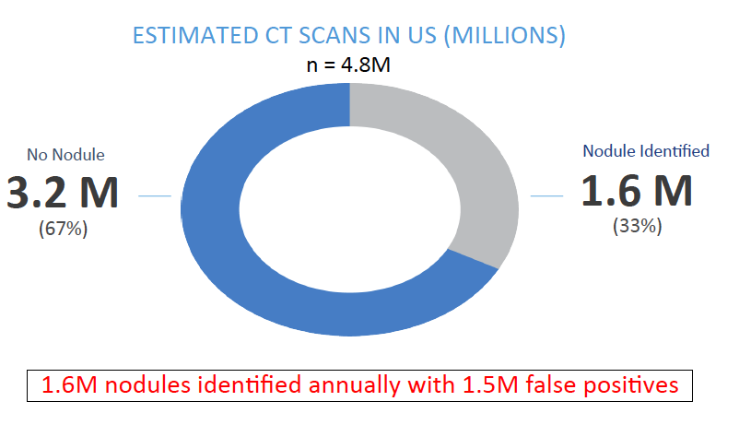
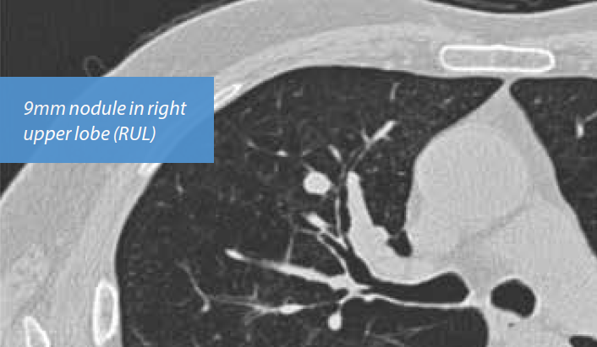
First step on journey: Addressing the unmet need of the Nodule Epidemic
68 yo male, ex-smoker (40 pack-yrs)
PET equivocal
Bronchoscopy: non-diagnostic
Gould et al. AJRCCM 2015
Notes:
Avi to edit slide

Slide 4
Bronchial Airway Genomic Biomarker was developed to address specific clinical unmet need: start with a TPP
lesion on CT Scan
Intermediate Risk of Cancer
Bronchoscopy¹
250,000
Inconclusive
100,000
Malignant/benign
?
Imaging Surveillance
Invasive Procedure
treatment
Unmet need for biomarker to guide next step in
management following a non-diagnostic bronchoscopy
1. Centers for Medicare and Medicaid Services, Hospital Outpatient Standard Analytical Files

Slide 5
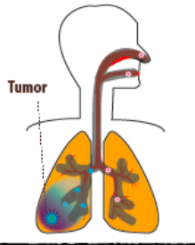
The next step: Leverage an old paradigm to address the need The airway ‘field of injury’/ ‘field cancerization’
Smoking (and other inhaled toxins) alters epithelial cell gene expression throughout the respiratory tract
Aberrant airway epithelial genomic response to and damage from smoking creates a susceptible microenvironment for cancer initiation : etiologic “field of injury”
Abnormal
cells
There are molecular changes in cytologically normal cells that may reflect clonal expansion of cells from which the tumor ultimately develops or may be related to direct effects of the tumor on surrounding tissue: “field cancerization”
Billatos et al. Clinical Cancer Research 2018

Slide 6

Our first investor on the journey
Only child of tobacco tycoon who died in 1925
Held the title of “Richest girl in the world” (age 13)
Left 1.3 Billion to Charity when she died in 1993
Her foundation provided a career development award for the work in 2002

Slide 7
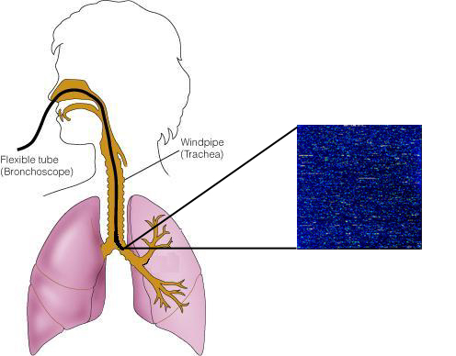
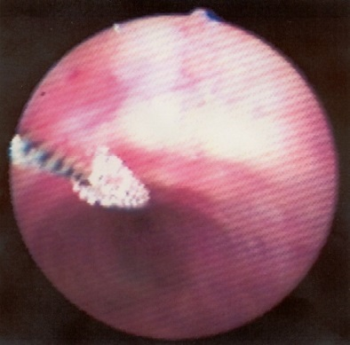
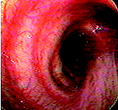
Developing a Bronchial airway gene expression biomarker of smoking and lung cancer via the Doris Duke Charitable Foundation and NCI (R21 and R01)
Smoking impacts airway and microRNA gene expression¹⁻³
Subset of changes are irreversible upon cessation⁴
Airway gene expression can serve as an early diagnostic biomarker for lung cancer⁵
R21 grant (2003) followed by R01 (2005)
RNA- Affymetrix microarray (~22,500 transcripts)
1. Spira et al. PNAS 2004;101:10143-48; 2. Shah et al. NAR 2005;33:D573-79; 3. Schembri et al. PNAS 2009:106:2319-24;
4. Beane et al. Genome Biology 2007;8:R201; 5. Spira et al. Nature Medicine 2007;13:361-366; 6

Slide 8
The Next Step on the journey:
Avoiding “the valley of death”
Our options in 2007 for conducting a phase-4 prospective validation study in the intended use population to move this biomarker into the clinic where it can benefit patients:
NIH/foundation support*
License to existing molecular diagnostics company
Startup company and raise venture capital (VC) financing

Slide 9
The road “less traveled”
ExproDx founded
2 clinical trials launched
PerceptaTM product launch and NEJM publication of AEGIS trials
BU provides
space, money & management
SBIR grant awarded by NCI
Validation of biomarker in AEGIS 2 trial
Raised another VC round of financing
Biomarker IP licensed
2007
2008
2009
2010
2011
2012
2013
2014
2015
Name change to AllegroDx
Validation of biomarker in AEGIS 1 trial
Acquired by Veracyte Inc.
First round of VC financing

Slide 10
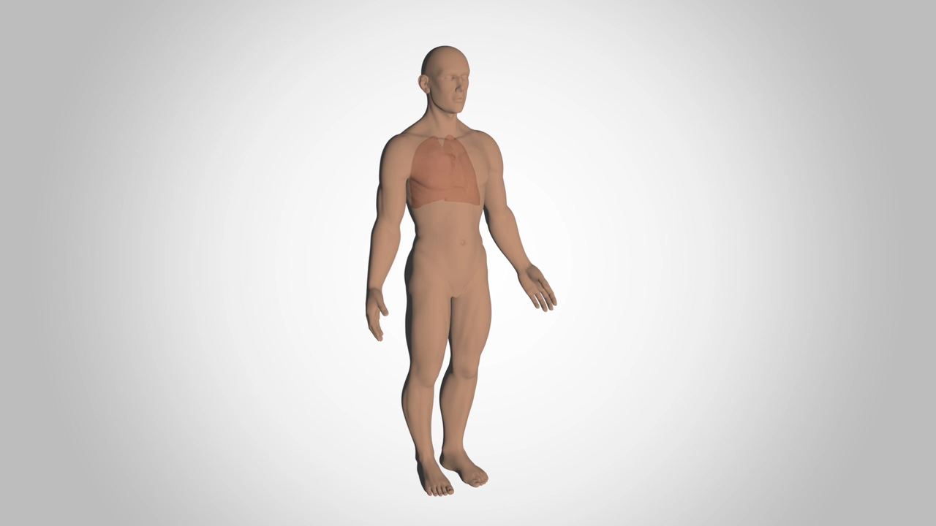
The elevator pitch!
Silvestri et al. NEJM 2015;373:243-251

Slide 11
The elevator pitch!
Silvestri et al. NEJM 2015;373:243-251

Slide 12
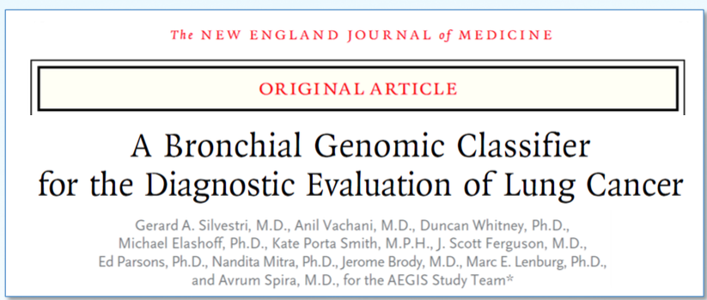
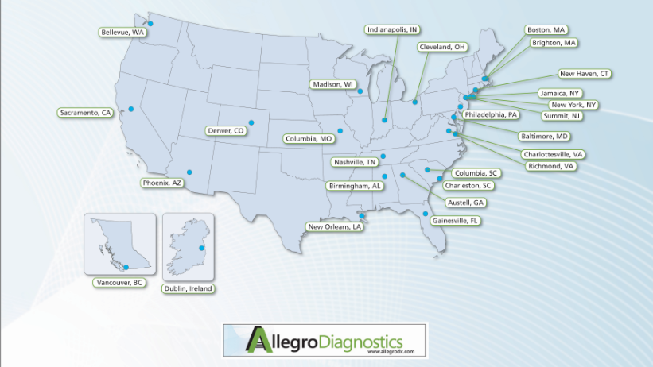
Prospective Validation of Bronchial Genomic Classifier (23 genes) in the Airway Epithelium Gene Expression In the DiagnosiS of Lung Cancer (AEGIS I and AEGIS II) clinical trials
What the VC investment ($10M+) and SBIR ($2.5M) funded

Slide 13
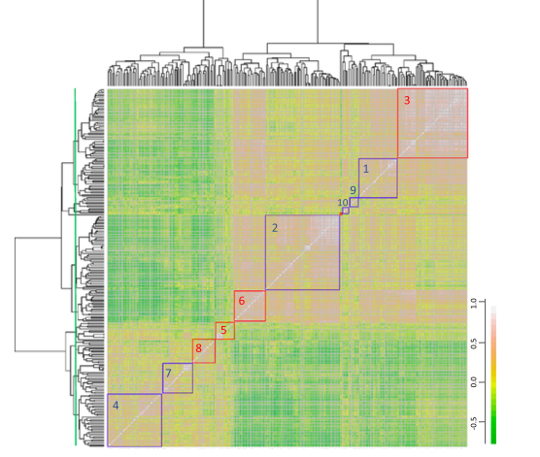
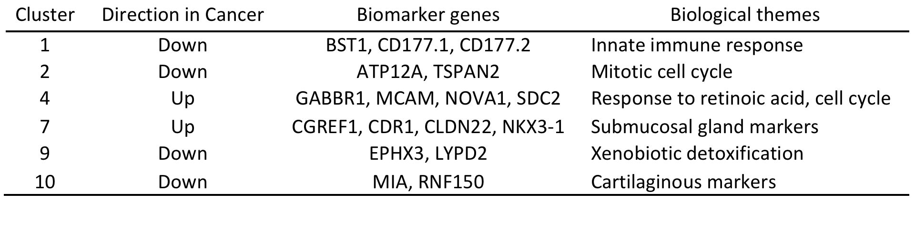
The key step: A prospective clinical validation in the intended use population: AEGIS Study
Prospective multicenter study of ~1000 current and former smokers undergoing bronchoscopy for suspect lung cancer.
AEGIS 1 (n=597): Feb 27, 2008 to Sept 9, 2011
AEGIS 2 (n=341): October 25, 2010 to July 10, 2012
23 gene biomarker refined on AEGIS-1 training set (n=299)
Whitney et al. BMC Medical Genomics, 2015
Validation in AEGIS-1 test (n=298) and AEGIS-2 (n=341)
-Patients were followed until a diagnosis was established or until 12 months after bronchoscopy.
Sensitivity 89%, Specificity 48%; NPV-91% in intermediate pre-test risk
Silvestri et al. NEJM 2015
CLIA test (PerceptaTM) launched April 2015 by Veracyte Inc.; 50+ medical centers

Slide 14
How the bronchial genomic classifier can impact the diagnostic workup
Pulmonary lesion on CT scan suspicious for lung cancer
(intermediate pretest risk of disease: 10-60%)
Bronchoscopy
Inconclusive
Malignant/benign
Bronchial Genomic Classifier
−
+
Low risk (<10% risk)
Intermediate risk
(10-60% risk)
Active CT surveillance
Pursue standard management

Slide 15
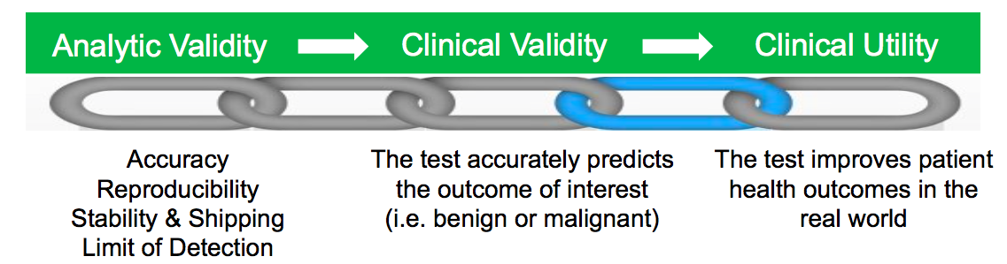
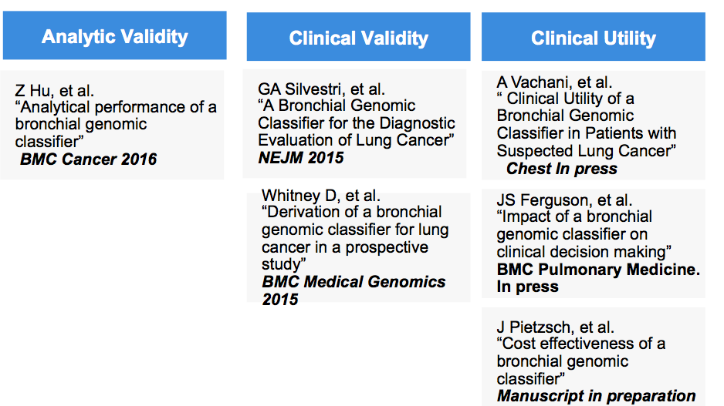
The most challenging step that Veracyte helped overcome: Developing a chain of evidence needed to move Molecular Diagnostics into the clinic via 3rd party payers
Analytic Validity
Clinical Validity
Clinical Utility
Medicare Coverage Decision in March 2017
A Vachani, et al.
“Modeling the Clinical Utility of a Bronchial Genomic Classifier in Patients with Suspected Lung Cancer
Chest 2016
Hogarth et al.
Measuring the impact of Percepta on patient outcomes in a real world setting
Chest/ACCP 2017
JS Ferguson, et al.
“Impact of a bronchial genomic classifier on clinical decision making
BMC Pulmonary Medicine 2016
D. Feller-Kopman, et al. “Cost effectiveness of a bronchial genomic classifier”
Journal of Thoracic Oncology 2017
Adapted from Teutsche SM, et al. Genetics in Medicine. 2009

Slide 16
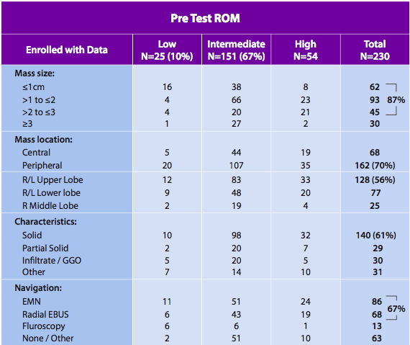
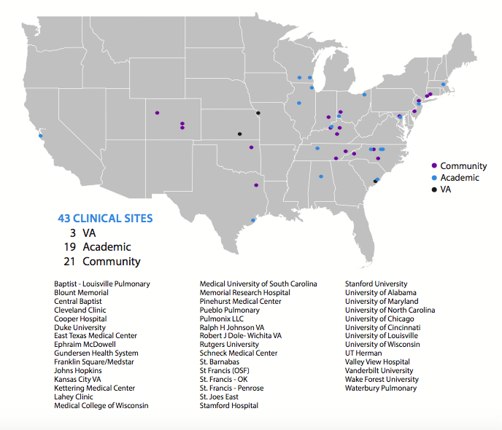
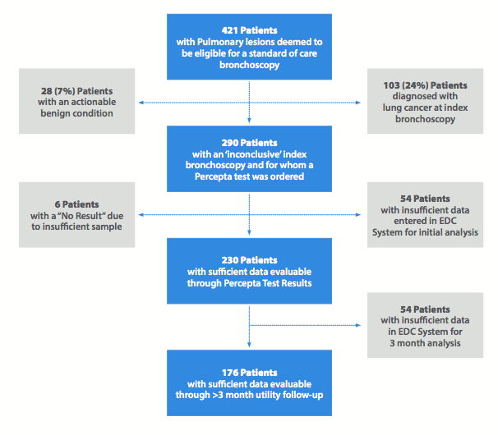
The Percepta registry
Lee et al. ACCP. 2017;.

Slide 17
Results of Registry to Date
69% of patients had a non-diagnostic bronchoscopy despite use of navigational techniques in ~70%
Percepta reclassified 34% of intermediate risk patients to low post-test risk (negative test result)
Among those with intermediate pre-test risk and a negative gene-expression classifier, there was a 51% reduction in invasive procedures post-non diagnostic bronchoscopy
In a central CLIA laboratory, 95% of samples received returned results
Lee et al. ACCP 2017.

Slide 18
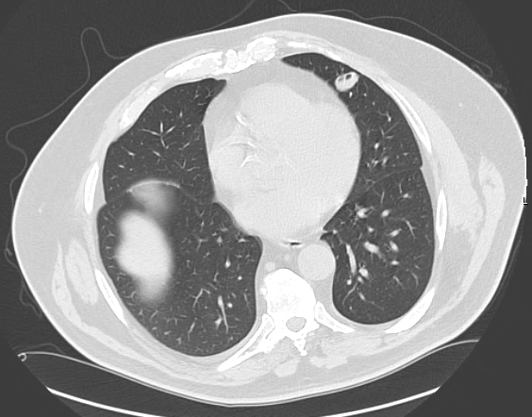
Case
72 y.o. male ex-smoker (25 pack-years)with 2 cm nodule in lingula on Chest CT
Equivocal PET with SUV 1.8
Navigational bronchoscopy: non-diagnostic
Genomic classifier negative (low risk)
Physician was planning biopsy, but elected to follow with serial imaging following genomic classifier results
No growth at 12 month follow-up CT
Courtesy of Peter Hahn, Tuality Healthcare, Oregon

Slide 19
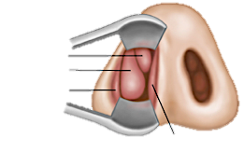
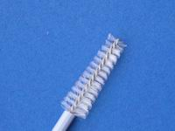
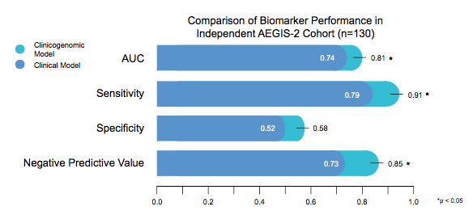
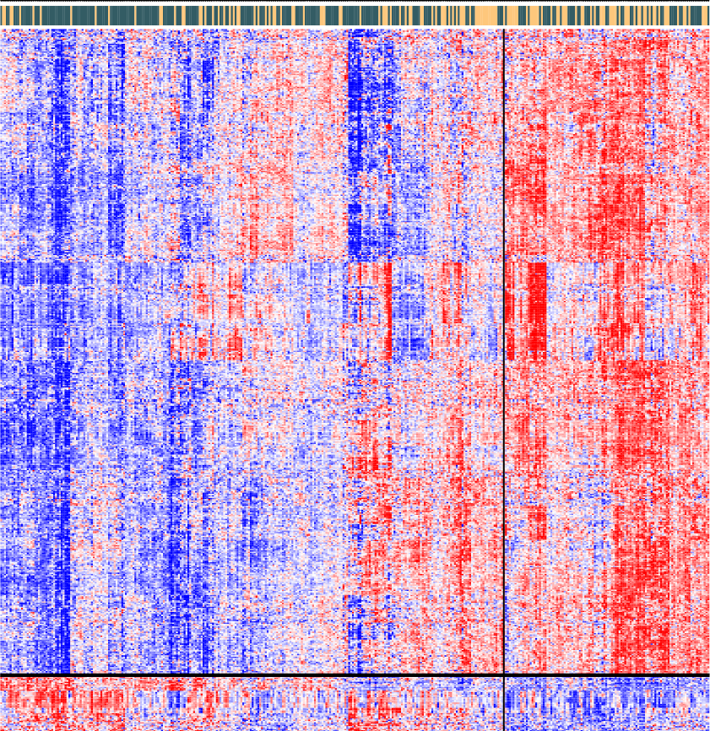
Extending the “field” to the nasal epithelium via EDRN
Validation of a clinical model vs. clinical model + 30 gene nasal marker (n=130)
Nasal
Epithelial
Cells
Lung Cancer
(n=243)
Benign Disease
(n=132)
z-score
-2
+2
Concordance of bronch and nose
Perez-Rogers et al. JNCI 2017

Slide 20
Potential clinical applications for a nasal biomarker

Slide 21
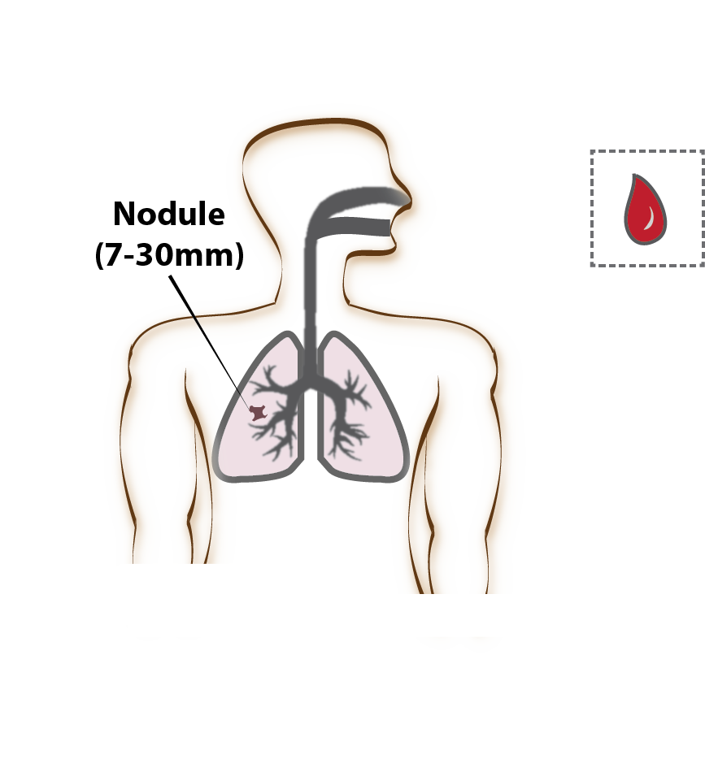

Aim 2A: Study Design
Developing integrated diagnostic biomarkers within the SU2C Lung Cancer Interception Dream Team
Multiple cohorts including DECAMP n = 930
Nasal epithelial
Brushings
Bulk RNA-seq
Single Cell RNA-seq
(subset only n = 200)
Semantic, Quantitative
Features
Imaging
(LDCT, PET)
PET Tracer Features
(subset only n = 50)
Plasma
TEC-seq for ctDNA
(subset only n = 580)
Inclusion criteria: >50yrs Age, >20 pack-years, additional risk factor
Deliverable: Develop an integrated diagnostic biomarker: imaging, nasal gene expression, ctDNA
(Dubinett, Aberle, Velcelescu, Brahmer, Gambhir, Meyerson, Swanton, Janes, Christ)

Slide 22
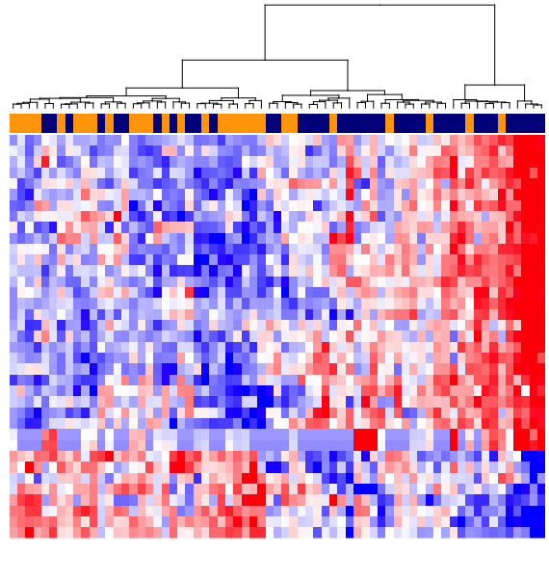
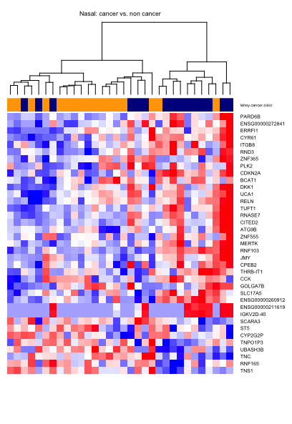
Developing a nasal gene-expression signature for early detection in DECAMP1 and Lahey Screening Cohort (IPNs) via RNA-seq
DECAMP 1 (n~100)
Lahey Screening cohort (n=24)
Kim Christ
Cancer
Non-cancer
Cancer
Cancer
Non-cancer
Non-cancer
29 Up
Genes
29 Up
Genes
8 Down
Genes
8 Down
Genes

Slide 23
Potential clinical applications for a nasal biomarker

Slide 24
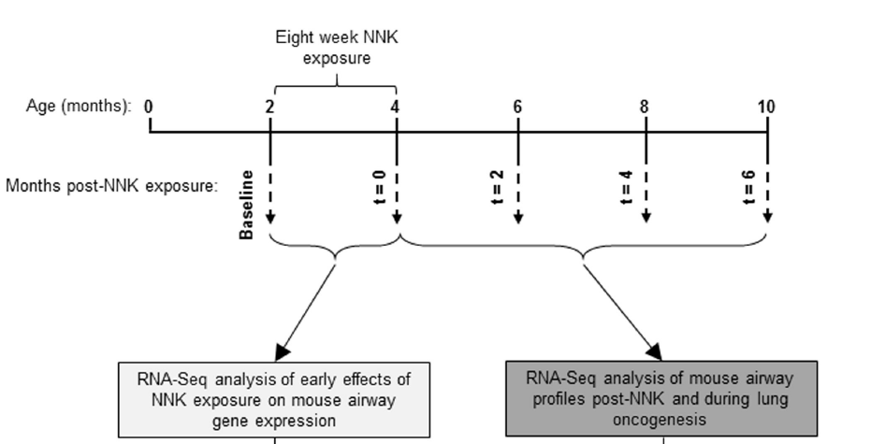
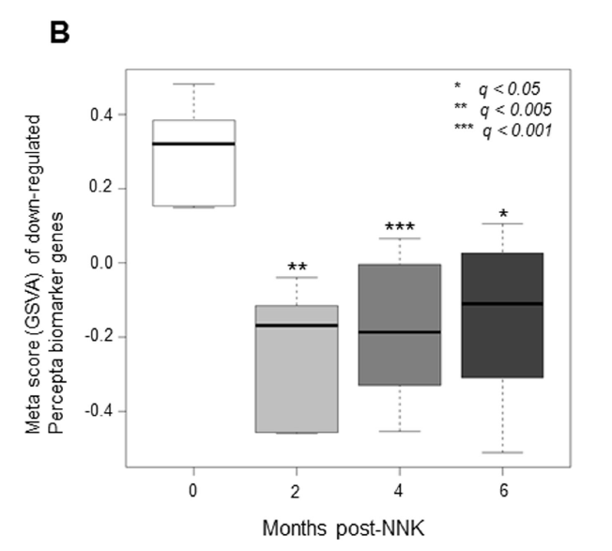
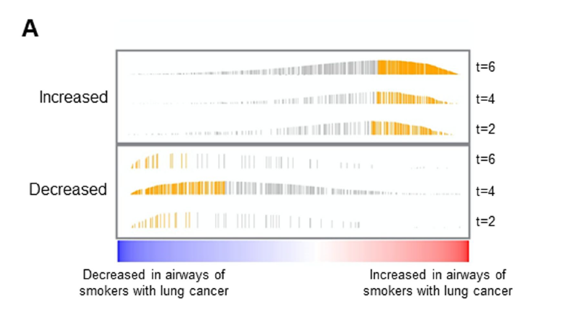
The potential for the “field” to predict future lung cancer development from mouse model (Gprc5a^{-/-})
Lung adenocarcinoma devleopment
Kantrowitz et al. In press

Slide 25
Summary of lessons learned
Federal and foundation funding for discovery of early detection biomarkers
- start with the end in mind: Target Product Profile (TPP)
-discover biomarker in the intended use population
Prospective clinical validation of locked-down biomarker in intended use population remains challenging
Acceleration via Federal-industry-academic partnerships: new models needed!
Translation of biomarker into clinical practice requires clinical utility data which is the ultimate challenge
Registry trials as practical path forward (vs. randomized trials)
Industry partnership critical at this stage

Slide 26
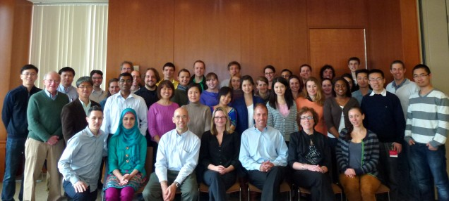
The team
UCLA: Steve Dubinett, Denise Aberle, David Ellashoff
Vanderbilt: Pierre Massion
Lahey Clinic: Kim Christ, Carla Lamb
UCL: Sam Janes, Charlie Swanton
Dana Farber: Matthew Meyerson
Stanford: Sam Gambhir
Hopkins: Victor Velcelescu, Julie Brahmer
Veracyte: Duncan Whitney and Kate Porta
AEGIS + DECAMP investigators
Funded by NCI/EDRN, DOD; Janssen, SU2C

