Slide 1
Impressions of a New NCI Director
Norman E. Sharpless, M.D.
Joint EDRN-MCL Scientific Workshop
Biomarkers in Precision Medicine
March 6, 2018

Slide 2
Impressions & Outlook

Slide 3
NCI: Leading the National Cancer Program
Bethesda, Maryland
Frederick, Maryland
NCI-Designated Cancer Centers
National Clinical Trials Network
Notes:
THE NCI is HUGGGGEEEE!
NCI meets the needs of all demographics—rich and poor, urban and rural, and all racial and ethnic populations.
NCI supports 69 NCI-designated cancer centers and more than 5,000 grantees across 600 organizations
Coordinates and supports all phases of clinical trials across 2,500 clinical trial sites nationwide, seeking the development of new and improved cancer treatments (National Clinical Trials Network).
NCI supports the Frederick National Laboratory for Cancer Research, the only federally funded research and development center dedicated exclusively to biomedical research

Slide 4
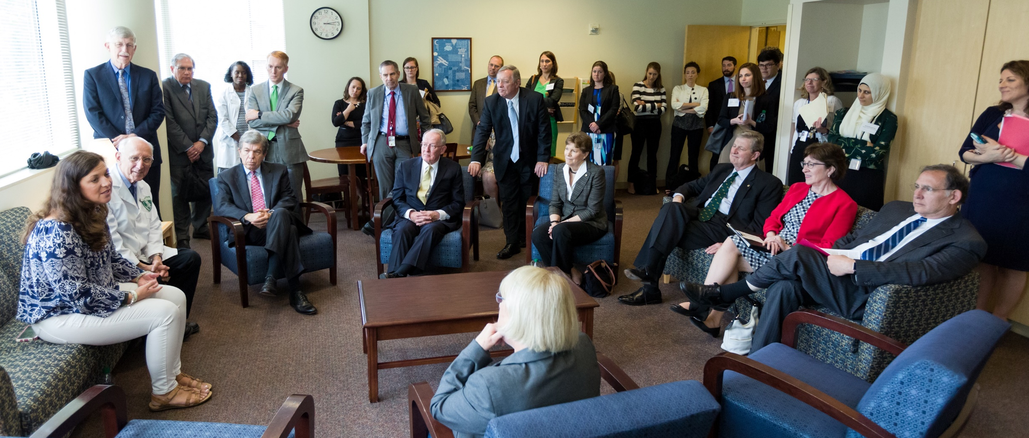
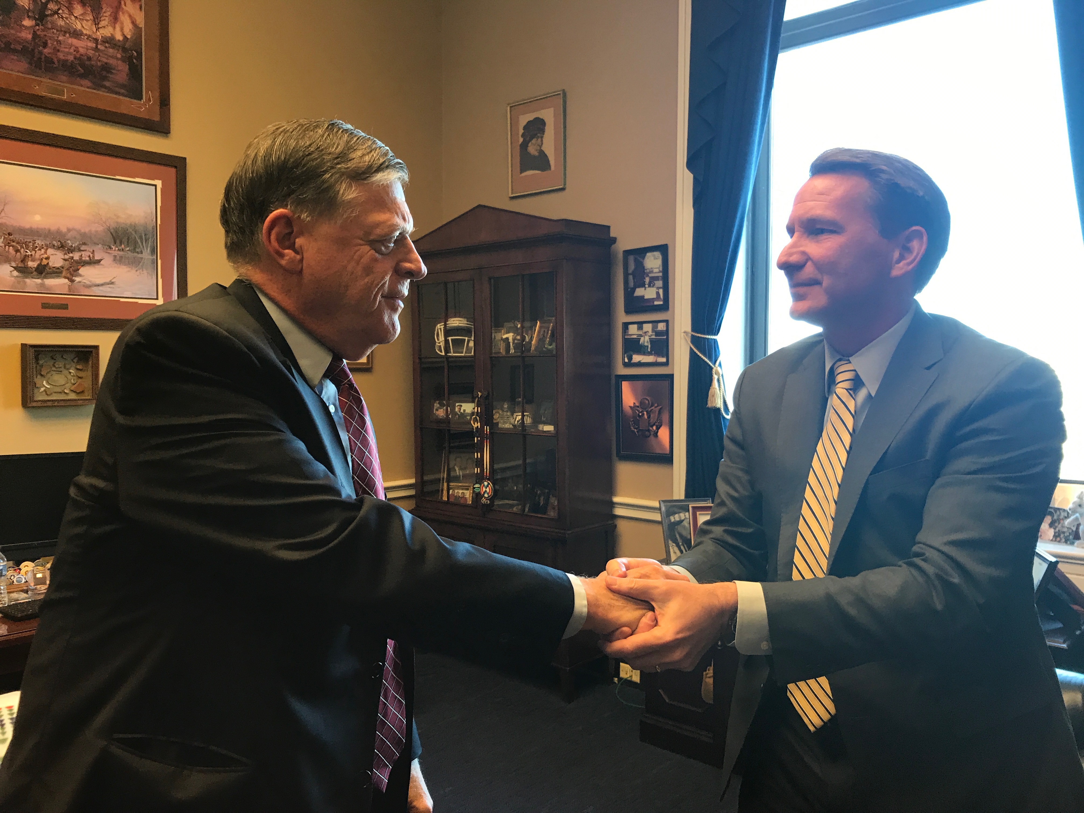
Bipartisan Support for NIH and NCI
Notes:
Making Progress Against Cancer Is Something Everyone Wants
It’s a rare issue in Washington where most everyone agrees. There is strong bipartisan support for NIH and for funding for cancer research, the NCI and its mission, which is to lead, conduct, and supports cancer research across the nation to advance scientific knowledge and help all people live longer, healthier lives. Members of Congress and the Senate are impressed by the work that’s done in their districts and states, and at the Clinical Center at the main NIH campus in Bethesda, MD. They take a real interest in NIH and NCI and often come to the campus to see our research firsthand.

Slide 5
NCI Appropriations FY 2013 - 2018 (in millions)
$5,689
$5,771
$5,858
$4,474
Source: NCI Office of Budget and Finance
Notes:
Annual Appropriations
Annual Appropriation ­- for the third year in a row, there’s been an increase for NIH & NCI. And we’ve been told by members of Congress and the Senate that they want to continue that trend. That’s good to know. Still, there is always the challenge of more good ideas worth funding than we have money for. But we are also challenged by not yet having a budget for FY2018, so we must be conservative in our planning at this point.
The 21st Century Cures Funding of the Cancer Moonshot is an example of the Congressional support for making progress against cancer (the red on top of the bars in the graph is the 21st Century Cures funding.
It is important to understand that the 21st Century Cures funding, anticipated to be provided by Congress in varying amounts over 7 years beginning in fiscal year 2017, will support specific elements of the Moonshot, but not the bulk of NCI's research portfolio. While the additional funds are vitally important to accelerate progress towards the Moonshot goals, this funding does not change the critical need for sustained increases to the NCI budget. Progress will come not from the Cancer Moonshot alone, but from the entire spectrum of cancer research.

Slide 6
Early thoughts on where we’re headed
Commitment to Basic Science
Translational Development
Big Data

Slide 7
Precision Prevention and Screening

Slide 8
National Lung Screening Trial (NLST) Smoking as a Risk Predictor:
Prospective, randomized trial comparing low-dose helical CT screening to chest x-ray screening with the endpoint of lung cancer specific mortality in high-risk participants
Ages 55 – 74
30+ pack-year smoking history
If former smoker, have quit within 15 years
N = 53,454 patients randomized between 8/2002 and 4/2004
Average follow up of 6.5 years at time of initial report

Slide 9
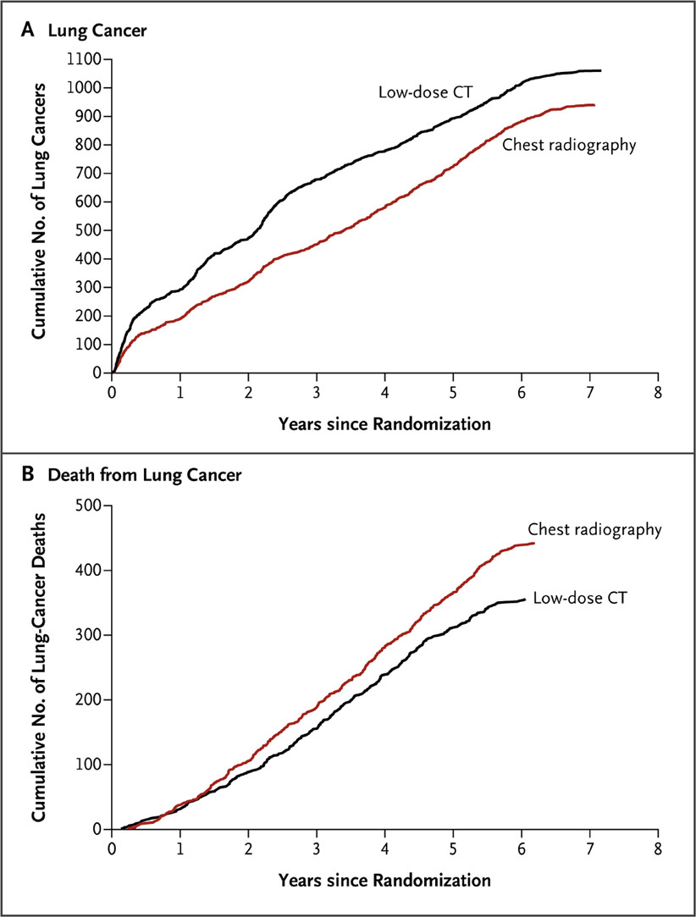

Lung Cancer Incidence and Mortality in NLST
Relative reduction in lung cancer mortality of 20%
The National Lung Screening Trial Research Team. N Engl J Med 2011;365:395-409.

Slide 10
HPV-based Precision Prevention Opportunities
Primary Prevention
Secondary Prevention
Over 90% of >30,000 cancers in the US and >600,000 cancers globally etiologically linked to HPV can be prevented by three licensed HPV vaccines (bi/quadri/nonavalent).
Age-appropriate HPV co-testing/primary HPV screening can improve sensitivity and reproducibility of Pap-based cervical cancer screening and reduce screening intervals.
EXISTING OPPORTUNITIES
Improving dosing, delivery and uptake of HPV vaccines
Development of next-generation, lower-cost HPV prophylactic and therapeutic vaccines
Improving triage of HPV DNA positive test results by biomarkers
Improving self-sampling protocols for expanding screening access
ONGOING NCI SUPPORTED EFFORTS

Slide 11
New-Onset Diabetes and Pancreatic Cancer
New-onset diabetics, age 50-85, are at elevated risk of pancreatic ductal adenocarcinoma (PDAC):
Cumulative incidence rate over 3 years – 0.85%*
6-8 fold higher risk of being diagnosed within 3 years of developing diabetes
25-40% of patients with PDAC develop diabetes between 6 and 24 months prior to PDAC diagnosis
Treatment of PDAC results in remission of diabetes

Slide 12
New-Onset Diabetes (NOD) Cohort
GOALS
Identify and follow a large cohort of subjects, between the ages of 50-85, diagnosed with diabetes (DM) within the prior 3 months
Develop a biorepository from the cohort
Clinically validate promising biomarkers of PDAC
Develop an early detection protocol for sporadic PDAC for subsequent prospective validation

Slide 13
Molecular Characterization Laboratories Consortium
7 MCLs and a coordinating center, supported by the Division of Cancer Prevention and the Division of Cancer Biology.
Phenotypically distinguishing between lesions that are likely to progress and those that are indolent and require no immediate treatment
Predicting whether lesions that are detected by sensitive screening tests are indolent (hence, not requiring immediate treatment) or progressive and potentially life-threatening
Increase in cancer incidence (particularly early stages),
but no change in mortality, may be an indicator of overdiagnosis.

Slide 14
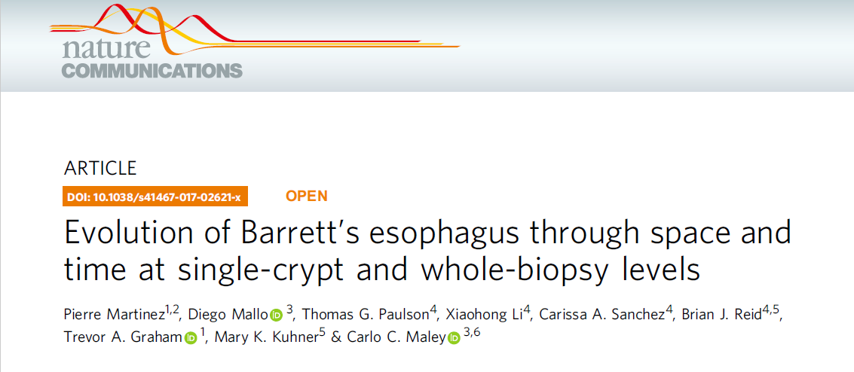
Molecular Characterization to Predict Pre-Invasive Lesion Progression

