Slide 1
Approaches to Characterization of Indeterminate Lung Nodules
Denise R. Aberle, MD
Professor of Radiology and Bioengineering
David Geffen School of Medicine at UCLA

Slide 2
Overview
Rationale and differences in approaches
Semantic feature analysis
Hand-crafted, quantitative features
Deep learning

Slide 3
Semantic feature analysis
Visual characterization of object(s) using commonly
understood terms & definitions
Time tested
Requires minimal software (DICOM viewer, calipers, ROI)
Agnostic to image acquisition/reconstruction parameters
Highly labor intensive
Not quantitative
Moderate to high inter-reader variability

Slide 4
Semantic features: The Brock model (screening)
Developed and validated in separate screening cohorts
    Developed: PanCan | 1871 persons had 7008 nodules
    Validated: BCCA | 1090 persons had 5021 nodules
    Average of 5 to 7 nodules per person
Combined clinical and imaging variables
Both parsimonious & full models | AUC > 0.90
Nodules of all sizes (high number nodules < 4 mm)

Slide 5
Brock Model (Parsimonious & Full)
9 Predictor Variables | Parsimonious Model
 | OR (95% CI) | P value
Age (Centered at 62; per year)
Sex (Female vs. Male) | 1.91 (1.19-3.07) | 0.008
FH (Yes vs. No)
Emphysema (Yes vs. No)
Nodule size (Centered at 4 mm) | Non-linear | < 0.001
Nodule consistency: GGN
PSN
Solid
Lobe: Upper vs. other | 1.82 (1.12-2.98) | 0.02
Nodule count per scan
Spiculation (Yes vs. No) | 2.54 (1.45-4.43) | 0.001
In test set: Parsimonious model AUC = 0.960 (0.927-0.980)
McWilliams A et al. NEJM 2013;369:910-919.
McWilliams M. NEJM 2013.

Slide 6
Brock Model (Parsimonious & Full)
9 Predictor Variables | Parsimonious Model |  | Full Logistic Regression
 | OR (95% CI) | P value | OR (95% CI) | P value
Age (Centered at 62; per year) |  |  | 1.03 (0.99-1.07) | 0.16
Sex (Female vs. Male) | 1.91 (1.19-3.07) | 0.008 | 1.82 (1.12-2.97) | 0.02
FH (Yes vs. No) |  |  | 1.34 (0.83-2.17) | 0.23
Emphysema (Yes vs. No) |  |  | 1.34 (0.78-2.33) | 0.29
Nodule size (Centered at 4 mm) | Non-linear | < 0.001 | Non-linear | < 0.001
Nodule consistency: GGN |  |  | 0.88 (0.48-1.62) | 0.68
PSN |  |  | 1.46 (0.74-2.88) | 0.28
Solid |  |  | Reference
Lobe: Upper vs. other | 1.82 (1.12-2.98) | 0.02 | 1.93 (1.14-3.27) | 0.02
Nodule count per scan |  |  | 0.92 (0.85-1.00) | 0.049
Spiculation (Yes vs. No) | 2.54 (1.45-4.43) | 0.001 | 2.17 (1.16-4.05) | 0.02
In test set: Parsimonious model AUC = 0.960 (0.927-0.980) | Full model AUC = 0.970 (0.945-0.986)
McWilliams A et al. NEJM 2013;369:910-919.
McWilliams M. NEJM 2013.

Slide 7
Diagnostic prediction in screening setting | NLST
CT arm of NLST using
Baseline positive screens
(N = 11,128 nodules in 6726 participants)
At nodule level (4-30 mm): Predict lung cancer in same lobe as nodule
Logistic regression with 10-fold cross-validation
AUC = 0.89 (0.87-09.03)
using clinical + imaging
Variable | OR | 95% CI | P-value
Age (per 1 year increase) | 1.047 | 1.023 – 1.071 | < 0.0001
Sex: female vs. male | 1.277 | 1.000 - 1.631 | 0.0500
Family history of lung cancer | 1.312 | 1.004 – 1.714 | 0.0469
Body mass index (per 1 unit) | 0.972 | 0.947 – 0.997 | 0.0285
Smoking status (current vs. former) | 1.226 | 0.960 - 1.564 | 0.1018
Pack-years (per 1 pack-year) | 1.011 | 1.006 – 1.015 | < 0.0001
Self-reported history of COPD | 0.928 | 0.600 – 1.435 | 0.7368
Nodule-specific features
Longest diameter (per 1 mm increment) | 1.148 | 1.125 – 1.171 | < 0.0001
Consistency: GGN vs. solid nodule | 0.654 | 0.479 – 0.894 | 0.0077
Consistency: PSN vs. solid nodule | 1.011 | 0.663 – 1.541 | 0.9605
Upper vs. middle lobe | 3.815 | 2.451 – 5.937 | < 0.0001
Upper vs. lower lobe | 1.671 | 1.306 – 2.137 | < 0.0001
Margins: spiculated/ill defined vs. smooth | 2.796 | 2.132 – 3.667 | < 0.0001
Nodule count per scan (per additional nodule) | 0.897 | 0.823 – 0.978 | 0.0140
Radiologist level of suspicion for lung cancer (high/moderately high vs. low/no) | 9.739 | 5.491 – 17.271 | < 0.0001

Slide 8
Limitations of semantic analysis
Time intensive
Low to moderate reader agreement
  Solid vs. subsolid nodules | K = 0.61
  Solid vs. PSN vs. GGN | K = 0.33
  Margin characteristics
  Size variations depending upon
  perception of nodule boundary
Yildririm A. Eur Congress Radiol; 03-2013.
Van Riel S. RSNA 2013.

Slide 9
Illustrated semantic atlas
Textual definitions & representative images with
consensus by thoracic radiologists
General features: Size | anatomic location
Consistency
Margins (Conspicuity and Type)
Shape features
Internal features
External (Peri-nodule surround) features

Slide 10
Consistency: Peri-cystic
Margins Serrated/Spiculated
Peri-nodule Stretching | Paracicatricial emphysema
Notes:
SEPTAL STRETCHING | May have EMPHYSEMA

Slide 11
Progress
Nearing completion of atlas
Reader study
  Atlas naive radiologists characterize nodules pre- and post-training
  Goal: Determine degree of convergence on semantic labels
  Determine robust semantic features
    Semantic analysis
    Make understandable the outputs of quantitative and machine learning features
Publish atlas

Slide 12
Quantitative hand-crafted features
Quantitative | Reproducible on same analytical platform
Requires dedicated analytical SW | Changes workflow
Challenge of standardization across platforms
  Affected by segmentation
  Hounsfield intensity value resampling (quantization)
  Mathematical formulae may be implemented differently
Some quantitative features sensitive to technique
  Acquisition: kV | mAs
  Reconstruction: Spatial resolution (slice thickness) | Algorithm | Kernel
Different groups are publishing independent analyses
  Limited multicenter efforts to compare results across common datasets

Slide 13
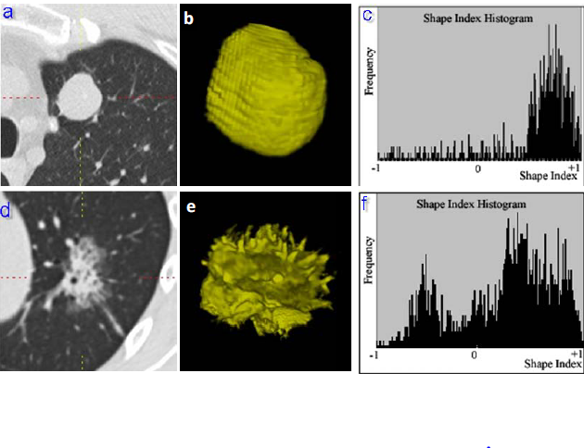
Radiomics: Hand-crafted features
Converts images to higher dimensional data
Quantitative features are extracted from segmentations
Frequency
-1 +1
Frequency
-1 +1
Gillies RJ. Radiology 2016; 278: 563-577/

Slide 14
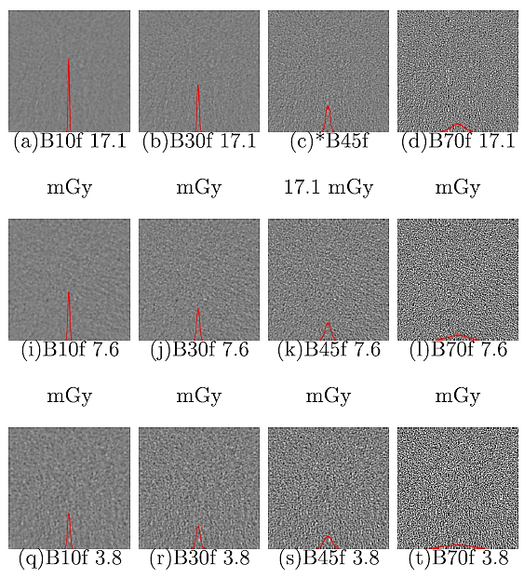
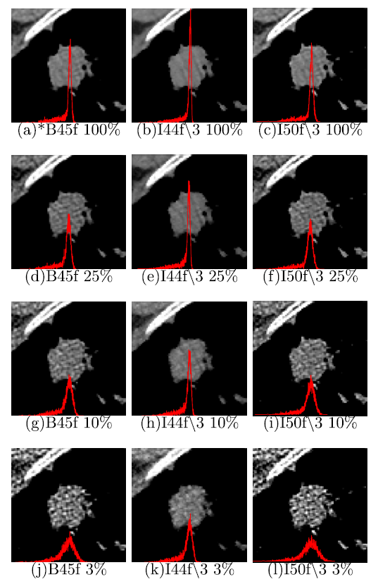
Effects of dose, kernel, and reconstruction on histogram
Homogeneous Water Phantom
Lung nodule segmentation
B10f B45f B70f
100% 30% 10%
Diagnostic dose
B10f B45f B70f
100% 30% 10%
Low dose dose
UPPER: Effect of three different kernels at diagnostic dose (17.1 mGy)
LOWER: Effect of three different kernels at low dose (3.8 mGy).
All images use filtered back projection (FBP).
UPPER: Effect of three different doses using b45f kernel and FBP.
LOWER: Effect of three different doses using I44f and IR.
Lo P et al. Med Phys 2016; 43(8):4854-4865.
Notes:
A filter function to smooth or enhance edges on images

Slide 15
Semantic features in screen-eligible patients
Consecutive individuals undergoing percutaneous lung biopsy (80%) or
being followed for indeterminate nodules (20%)
Age ≥ 50 | ever smokers | 6-27 mm mean diameter | FU > 2 years
N = 146 | 50 benign, 90 NSCLC, 6 well differentiated neuroendocrine
Parsimonious logistic regression model
Clinical & Semantic Features | OR | 95% CI | P-value
Age (per 1 year increment) | 1.061 | 1.007-1.118 | 0.027
Nodule size per mm | 1.12 | 1.053-1.211 | 0.001
Consistency (sub-solid vs. solid) | 3.579 | 1.162-11.020 | 0.026
Margin (non-smooth vs. smooth) | 3.538 | 1.201-10.424 | 0.022
Radiologist suspicion | 3.050 | 1.942-4.791 | 0.000
NPV = 86.84 | PPV = 84.26 | AUC = 0.90 (95% CI = 0.83-0.95)
Notes:
To determine the feasibility of clinical and imaging features to distinguish benign from malignant nodules, we studied a convenience sample of 146 individuals undergoing either percutaneous lung biopsy or imaging surveillance for indeterminate nodules. Patients were ≥ 50 yrs. of age, ever smokers, had nodules between 6-27 mm diameter, and FU of at least 2 years. Among the 146 individuals, 50 nodules were benign, 90 were NSCLC, and 6 were carcinoid tumors. In a logistic regression model, 4 features were significant: age, nodule consistency, nodule margins, and radiologist’s level of suspicion for lung cancer. With these 4 features, the model had PPV of 84.26, NPV of 86.84, and an area under the curve of 0.90. (Preeti: this is a pretty good model based on AUC).
We anticipate that by adding molecular features from readily accessible specimens (blood, nasal epithelial, or other), we can achieve AUCs on the order of .95 or better. This makes this approach feasible in the clinical setting.

Slide 16
Quantitative feature analysis
Consecutive individuals undergoing percutaneous lung biopsy (80%) or
being followed for indeterminate nodules (20%)
Segmentation: Automated, semi-automated, manual
1000 ➔ 18 features (sequential forward floating selection with 20-fold cross-over sampling)
5 texture features using logistic regression with back feature selection
Quantitative Features | OR | 95% CI | P-value
QMBLobness 40_skewness | -1.997 | -3.178- -0.816 | 0.001
QMLyy10_skewness | 1.547 | 0.447-2.646 | 0.006
QMSurfaceFrobeniusNorm10_kurtosis | 0.619 | 0.170-1.069 | 0.007
QMSurfaceGlcm32InfoCorrelationA | 24.015 | 13.088-34.942 | 0.000
QMSurfaceLz10_skewness | -2.189 | -4.371- -0.007 | 0.049
NPV = 73.81 | PPV = 81.73 | AUC = 0.86 (95% CI = 0.77-0.91)
Notes:
We used the same convenience sample of indeterminate nodules to study the performance of quantitative features in differentiating lung cancer from no lung cancer. To do this:
Lung nodules were segmented in primarily 2 ways:
Fully automated segmentation using the CVIB CAD program
Semi-automation based on seed point localization by a radiologist
Manual segmentation used in a small percentage of cases
Roughly 1000 quantitative features were analyzed. Dimension reduction was achieved by sequential forward floating selection with 20-fold cross-over sampling.
From these 18 features, five features were ultimately found to contribute to classification using logistic regression with back feature selection.
The AUC using quantitative features was 0.86, also reasonable.

Slide 17
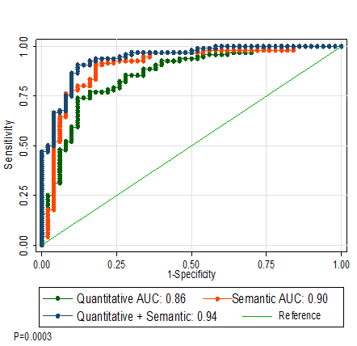
Semantic and quantitative performance
Notes:
This is the ROC curve showing the individual model performance using semantic features (red), quantitative features (green), and combined semantic and quantitative features (blue). These data are very preliminary. We are now going back to confirm that:
There is inter-reader agreement on semantic features using 2 independent readers
There is reproducibility of quantitative features based on independent nodule segmentations by 2 readers.
The highest performing imaging features will move forward for inclusion in regression models that include molecular features.

Slide 18
Deep learning using CNNs
Nonlinear alternative to ad hoc descriptors for pattern recognition
Input is the image
Output is prediction of indolent vs. aggressive | benign vs. malignant
Learns from the raw data itself: minimal preprocessing
Not dependent on segmentation
Relatively agnostic to image acquisition/reconstruction
Requires LARGE data sets
Several different architectures | transfer learning

Slide 19
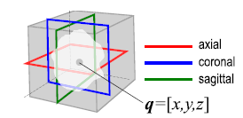
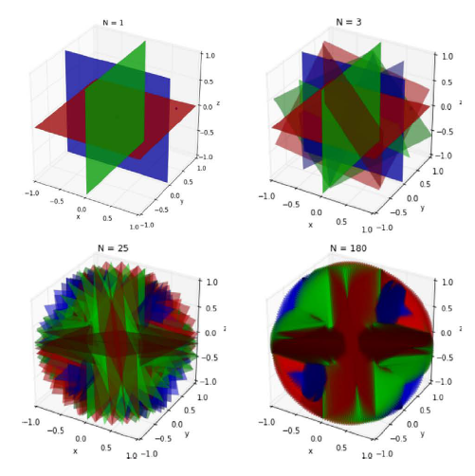
Data augmentation and scaling
Scaling used to identify local pixel attenuations as well as larger context.
Scales here are all 64 x 64 at 10, 20, 40 mm
Data augmentation by generating orthogonal images as inputs into CNN
Ciompi F et al. Nature Scientific Reports 2017; 7:46479 | DOI: 10.1038/srep46479

Slide 20
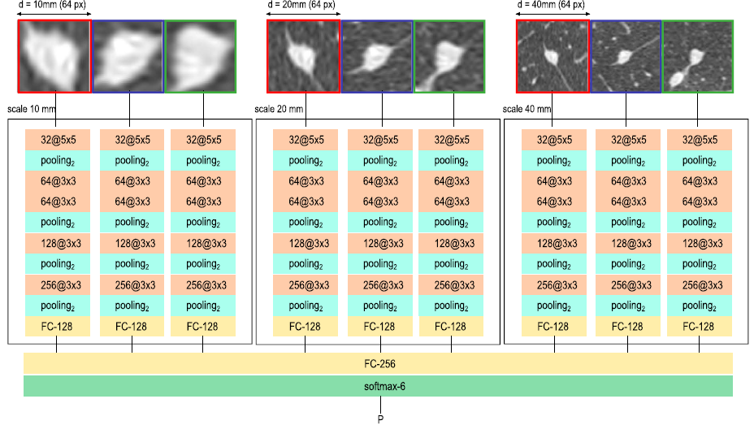
CNN architecture
Fully connected layer
Ciompi F et al. Nature Scientific Reports 2017; 7:46479 | DOI: 10.1038/srep46479

Slide 21
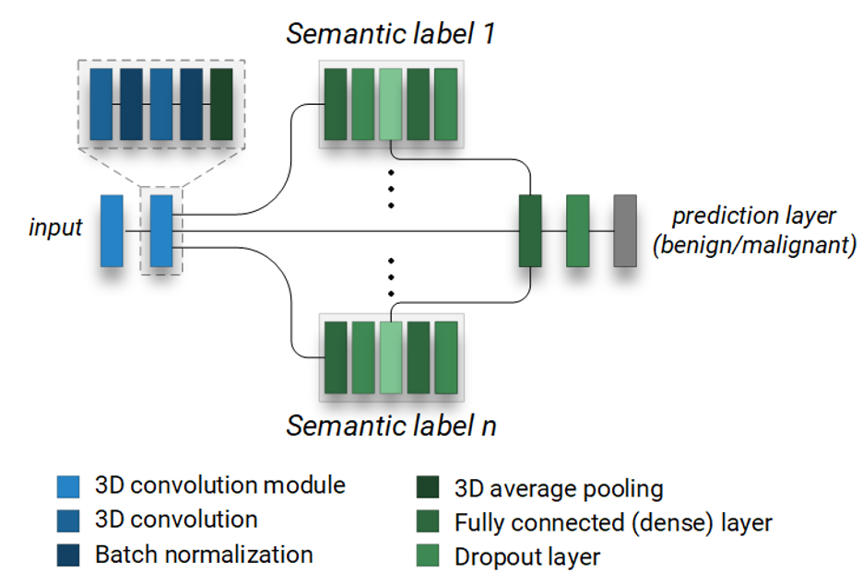
Using semantic features for learning
Train CNN with semantic labels to make output more intuitive to humans
Assess classification performance for semantic labels & diagnostic prediction
Comparison:
  3D hierarchical semantic network AUC = 0.856 (± 0.026)
  3D single CNN AUC = 0.847 (± 0.024)
  Mean difference = 0.005 (95% CI: 0.0051-0.0129); p = 0.009
Will Hsu, PhD
Notes:
The goals of the semantic hierarchical architecture are two-fold: 1) we wanted to automatically generate semantic labels for unannotated images; and 2) we wanted to create a deep neural network that was able to explain its benign/malignant prediction using these semantic labels. The architecture is unique in that each of the labels are simultaneously generated and optimized against the overall prediction of benign/malignant. The process is supervised in that the original training involves providing the labels for each nodule characteristic, but once trained, the model is capable of performing the labeling itself. In terms of results:
3D Hierarchical semantic network
The malignancy -- AUC is 0.856 + -0.026
The calcification -- AUC is 0.930 +- 0.035
The margin -- AUC is 0.776+-0.033
The subtlety -- AUC is 0.803 +- 0.015
The texture -- AUC is 0.850 +- 0.042
3D single CNN (where the labels are NOT being learned, the model is just predicting benign/malignant):
The malignancy -- AUC is 0.847 +- 0.024
Parried t-test to tell if the AUC is significantly different
P-value: 0.005
Mean difference: 0.009
Confidence interval of the difference: [0.0051, 0.0129]

