Slide 1
What makes a neoplasm malignant or benign? Is it in the genes?
Matthew Meyerson, M.D., Ph.D.
Dana-Farber Cancer Institute
Harvard Medical School
Early Detection Research Network annual meeting
Bethesda, Maryland
March 7, 2018

Slide 2
Disclosures
Inventor on patent for the use of EGFR mutations in lung cancer diagnosis, licensed to Labcorp
Research support from Bayer
Retired founder of Foundation Medicine (no longer have financial interest, but still have an “emotional conflict of interest”)
Scientific advisory board chair and equity holder of OrigiMed

Slide 3
Outline
Introduction to cancer genomes
General features of lung cancer genomes
Lung squamous carcinoma and pre-malignant lesions
Lung adenocarcinoma and pre-malignant lesions
What does it all mean?

Slide 4
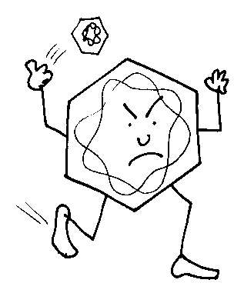
Cancer is a disease of the genome
Mutation
Amplification/deletion
Infection
AGT
Arg
CGT
Cys
TGT
Ser
GGT
Gly
Translocation
GAT
Asp
GCT
Ala
GTT
Val

Slide 5
Genomic changes that cause cancer: a word-centered view
Mis-spelling
Amplification/deletion
Dalmatian→
101 Dalmatians
Dancer→
Cancer
Translocation
Tropical + Bubble→
Troubble

Slide 6
“Happy families are all alike; every unhappy family is unhappy in its own way”. Leo Tolstoy, Anna Karenina
Every cancer genome is uniquely altered from its host normal genome
Normal human genomes are all (mostly) alike; every cancer genome is abnormal in its own way.
Each cancer genome has a unique set of genome alterations from its normal host
These alterations, however, are not random but act in common pathways and mechanisms

Slide 7
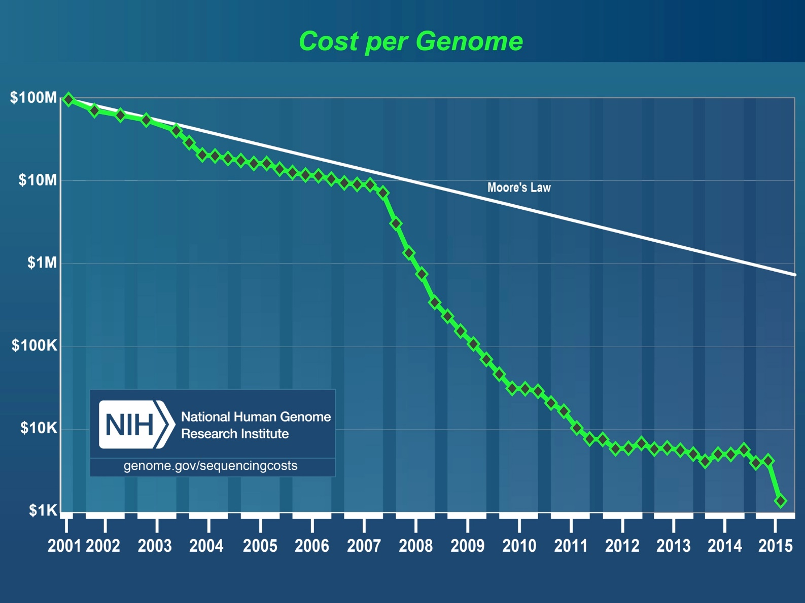
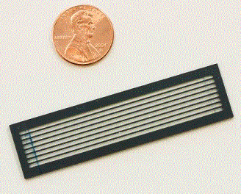
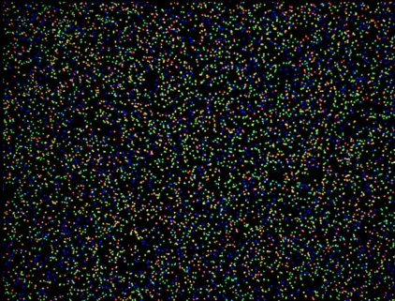
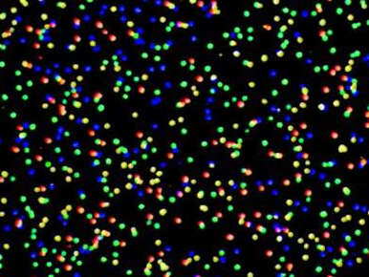
Increasing power of genome sequencing technology

Slide 8
Why somatic cell genomics of cancer?
Most cancer-causing mutations are somatic
Present in the cancer DNA but not in the germ-line DNA
Somatic alterations are internally controlled
Comparison between germ-line and cancer defines the cancer-specific alterations and allows accurate discovery/diagnosis
Somatic alterations provide therapeutic window for treatment
Targeted therapies kill cancer cells with unique genomic alterations
Immunotherapies kill cancer cells with unique neoantigens

Slide 9
Recurrent somatic genome alterations target oncogenes and tumor suppressor genes
Somatic alterations can provide a large therapeutic window
Present in cancer DNA but not in germ-line DNA
Genome-targeted treatments can kill genomically altered cancer cells and spare genomically normal cells
Oncogenes
Tumor suppressors
Wild-type proto-oncogene
Wild-type
Normal
cells
Activated oncogene
Inactivated
Cancer
cells
Target oncogenes directly: e.g. EGFR inhibitors
Target tumor suppressor genes indirectly: e.g. synthetic lethality of PARP inhibitors like olaparib with BRCA1/BRCA2 mutations

Slide 10
But how is this all different between cancer (malignant) and pre-cancer (benign)?
Many of the same genes are mutated in both cancers and benign lesions
Cellular or animal experiments often won’t help because they only show that a gene is important for cancer
So we need intensive sequencing of pre-malignant lesions and data analysis to begin to understand the relevant genes that turn a benign tumor into a malignant and deadly cancer!

Slide 11
Lung cancer genomes: general features

Slide 12
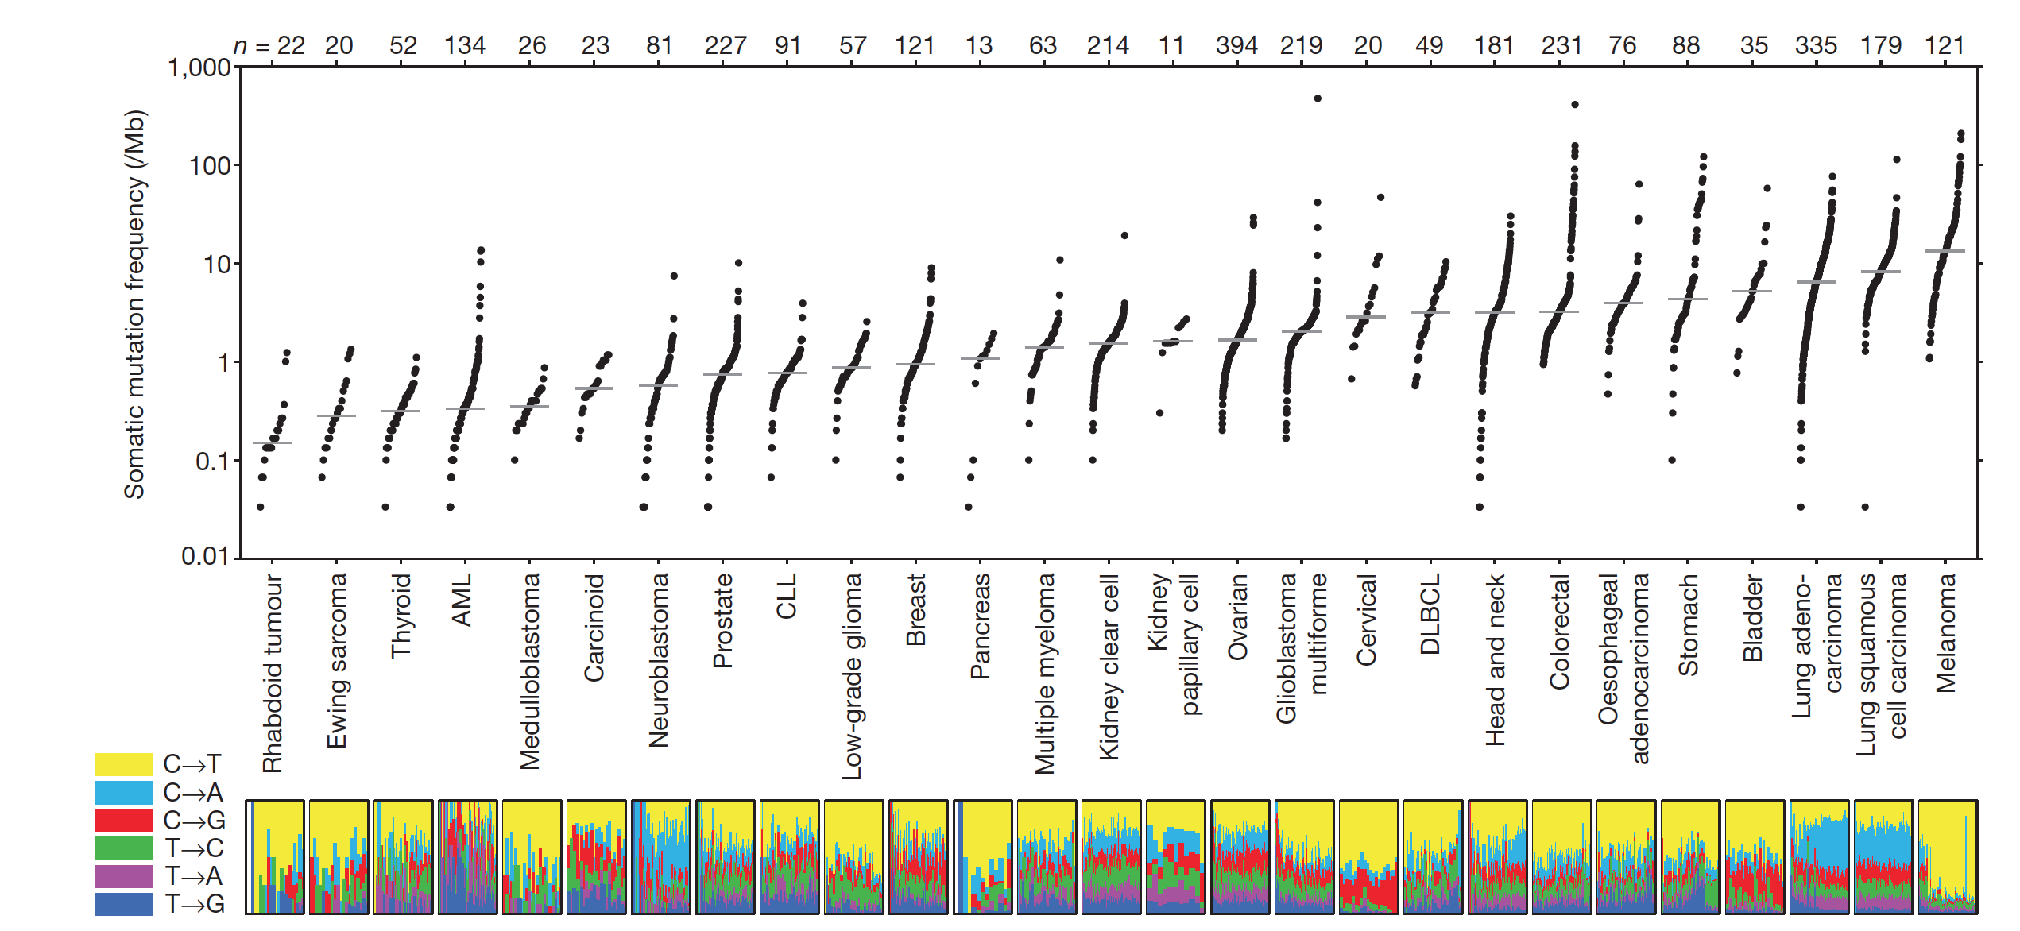
Lung cancers are genomically deranged with high mutation frequencies
Lawrence et al., Nature, 2013

Slide 13
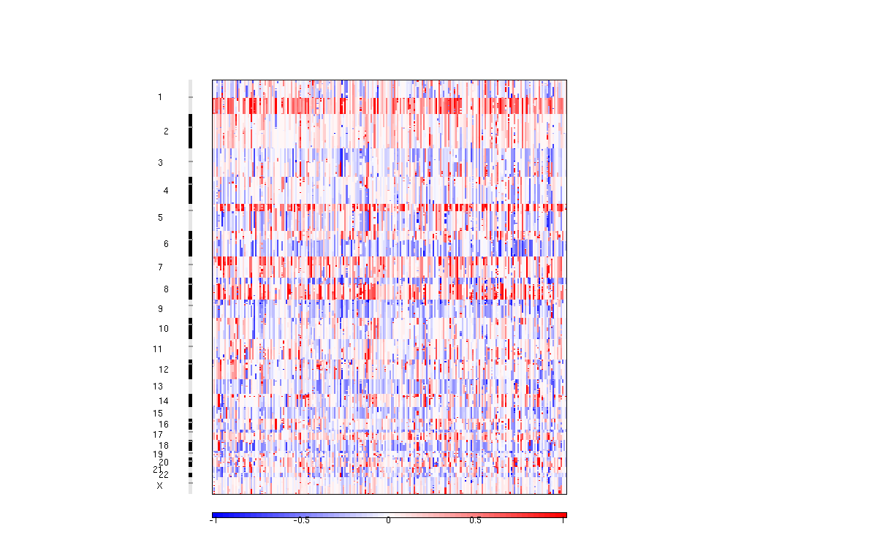
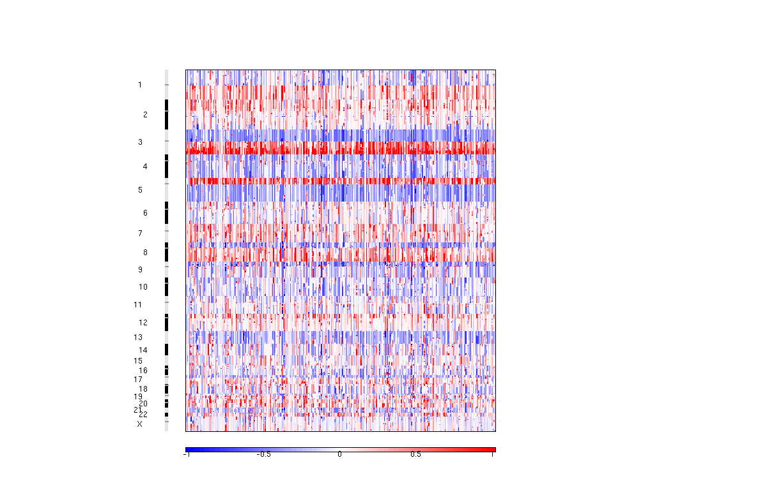
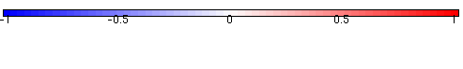
Lung cancers are characterized by common chromosome arm level alterations
Lung adenocarcinoma
Squamous cell lung carcinoma
Loss
Gain
TCGA, Nature, 2012, 2014

Slide 14
Lung squamous carcinomas and pre-malignant lesions (Josh Campbell, Avi Spira)

Slide 15
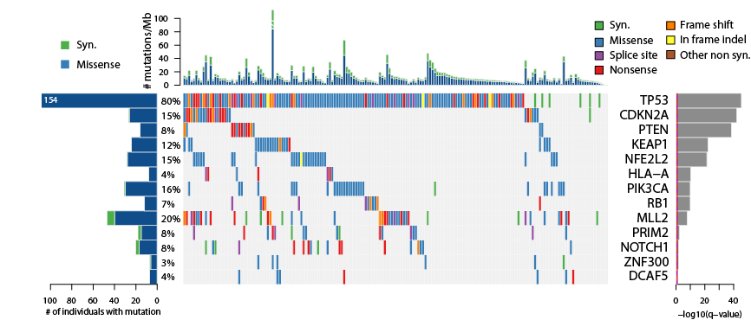
Top mutated genes in squamous cell lung cancer (expression-filtered significance)
TCGA, Nature, 2012

Slide 16
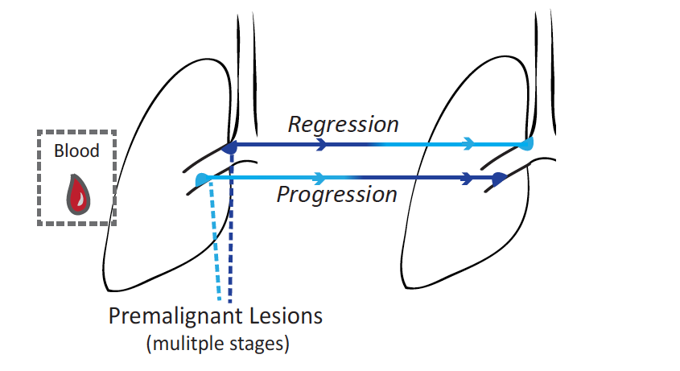
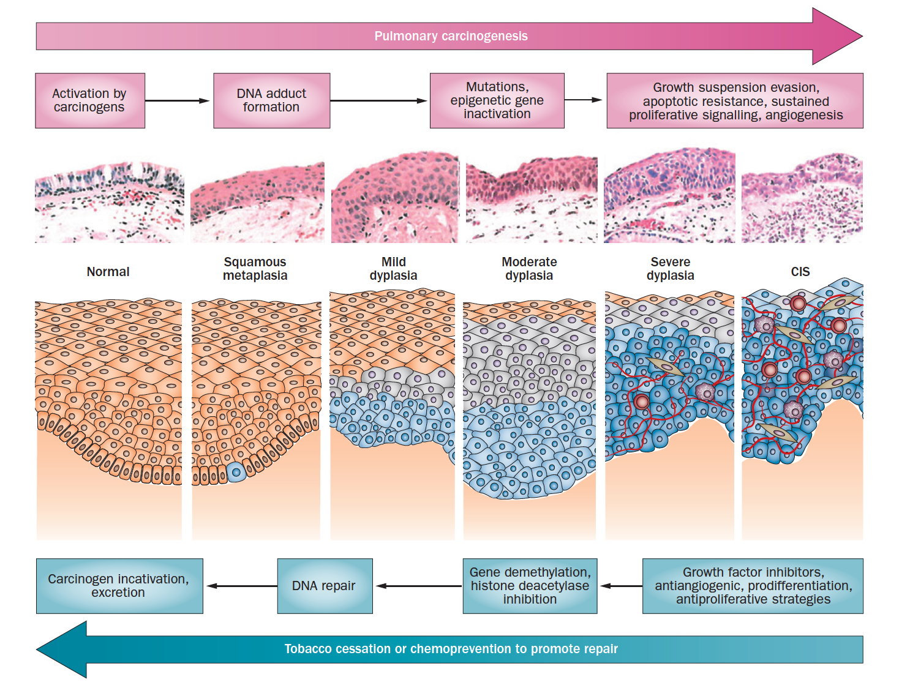

How do genomic alterations contribute to development of lung preneoplasia? (Josh Campbell)
Background
Study Design
Squamous Lung Carcinogenesis
Normal
Severe dysplasia
Carcinoma in situ
DNA-seq
Only a subset of airway premalignant lesions progress to CIS/tumor
Avrum Spira, BUSM
Mary Reid, RPCI
]
Many airway premalignant lesions will regress without intervention
Keith, R. L. & Miller, Y.E. Nat. Rev. Clin. Oncol. 2013
Breuer et al, Clin Cancer Res., 2005
van Boerdonk, AJRCCM, 2015

Slide 17
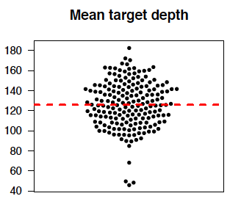
Sequencing of airway premalignant lesions
Uniformed Services University/ Walter Reed hospital
Matt Wilkerson
Clifton Dalgard

Slide 18
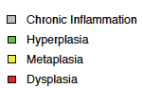
Mutational landscape of airway premalignant lesions

Slide 19
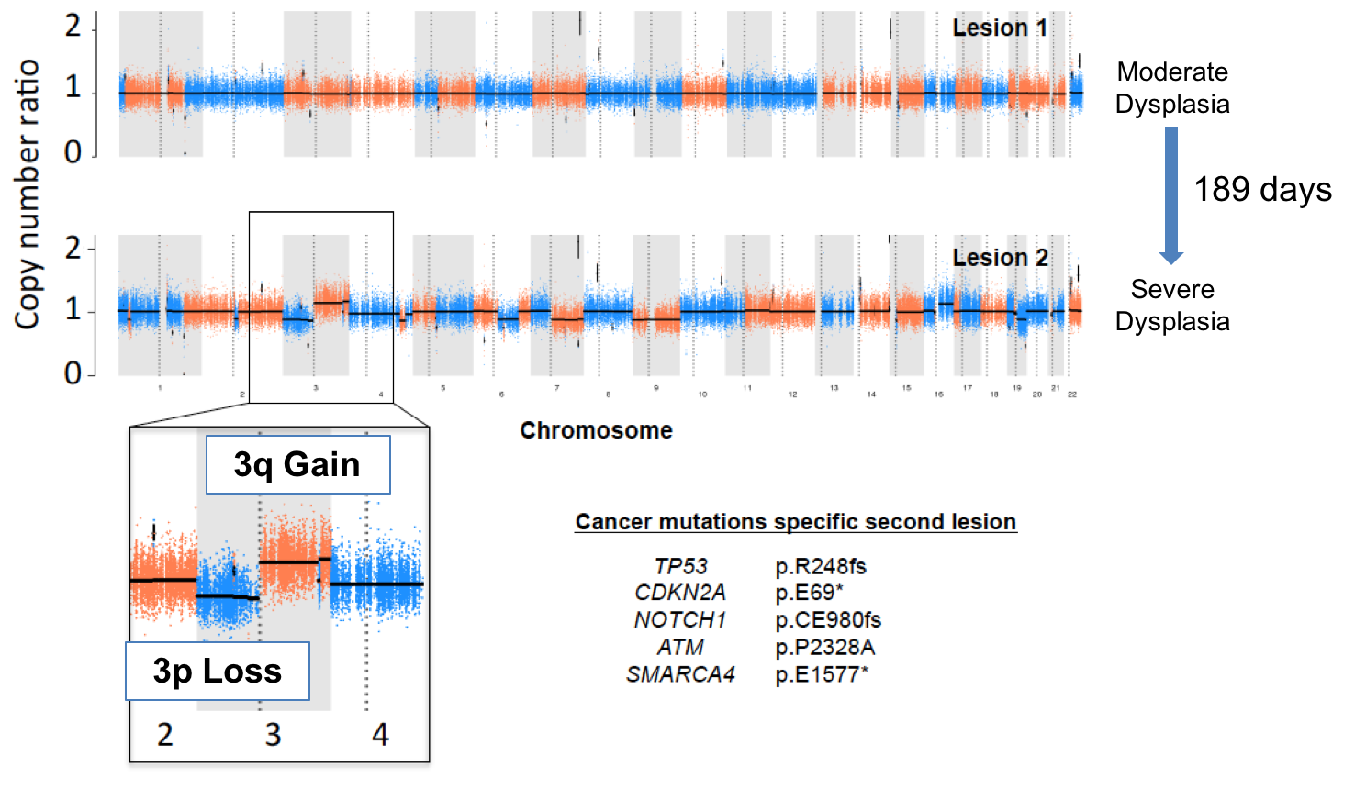
Unexpected findings: Example of “genomic” progression
History of SCC
High risk occupation
40 Pack years

Slide 20
Plans for next year: Development of ”2017” lung Targeted panel
SqCC
NFE2L2
HRAS
FGFR2
FGFR3
PTEN
NOTCH1
FAT1
CUL3
FBXW7
KDM6A
Both
PIK3CA
KLF5
NRAS
TP53
CDKN2A
NF1
RB1
KEAP1
STK11
ARID1A
RASA1
EP300
CREBBP
HLA-A
B2M
Adeno
KRAS
EGFR
ERBB2
MET
BRAF
HRAS
RIT1
U2AF1
SOS1
RAF1
MAP2K1
CTNNB1
SMARCA4
RBM10
SETD2
MGA
CMTR2
ATM
ARID2
APC
SMAD4
Campbell et al, Nat. Genet., 2016
Zhang et al, Cancer Discov., 2017
Common Fusion Breakpoints
ALK
ROS1 RET
NTRK1/2/3
MET
Aaron Thorner, PhD
Associate Director
Center for Cancer Genome Discovery
Dana-Farber Cancer Institute

Slide 21
What are the key events for squamous cell lung cancer progression?
TP53 mutations?
Copy number alterations? Aneuploidy?

Slide 22
Lung adenocarcinomas and pre-malignant lesions (Jian Carrot-Zhang, Yue Zhao)

Slide 23
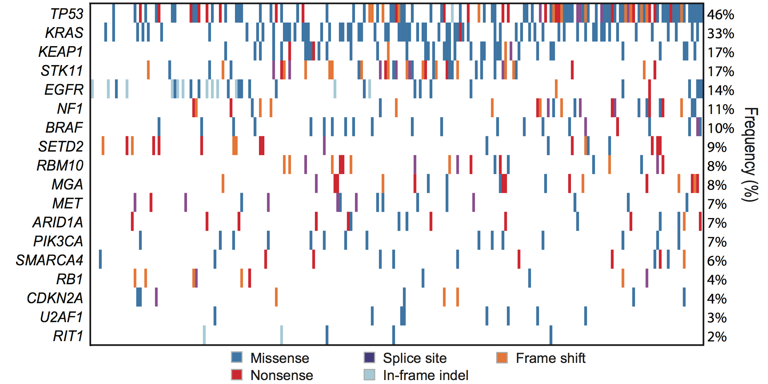
Landscape of significantly mutated genes in lung adenocarcinoma
(TCGA)
TCGA, Nature, 2014
Notes:
STK11, SMARCA4: Montse Sanchez-Cespedes
Unreported mutations?, MGA and RIT1

Slide 24
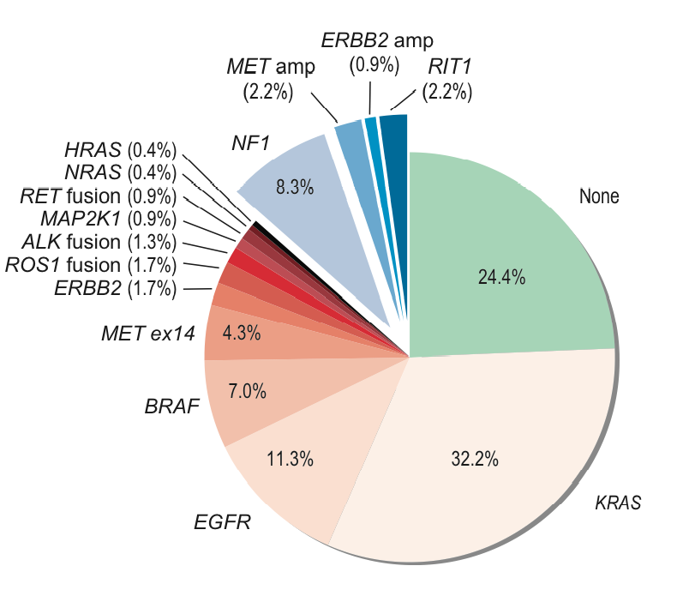
RTK/Ras-Raf driver mutations in lung adenocarcinoma—including MET, NF1 and RIT1
By including amplification of MET and ERBB2, MET exon 14 splicing mutations, RIT1 mutations, and NF1 loss-of-function mutations, the driver-positive group increases to 75% of cases
TCGA, Nature, 2014

Slide 25
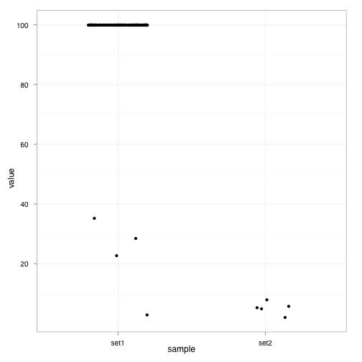
Alternative splicing of MET exon 14 in TCGA lung adenocarcinoma RNA sequencing data
Normal MET transcript: contains exon 14 in 220 samples
Abnormal MET transcript: lacks exon 14 in 10 samples—all of these cases are otherwise oncogene-negative
Percent Spliced In, %
Y1003*
3’ss 19bp del
5’ss +3
5’ss 12bp del
TCGA, Nature, 2014
Kong-Beltran et al. 2006, Onozato et al. 2009; Seo et al., 2012
No MET splice site mutation
MET splice site mutation

Slide 26
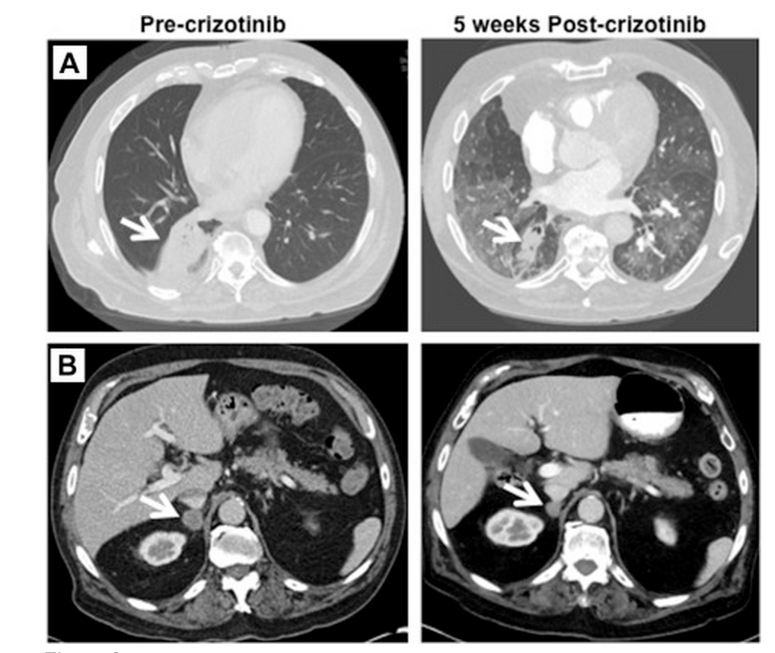
Response of metastatic lung adenocarcinoma with MET exon 14 splicing mutation to crizotinib
Jenkins et al., Clinical Lung Cancer, 2015

Slide 27
Study of minimally invasive adenocarcinoma/adenocarcinoma in situ (MIA/AIS) versus invasive lung adenocarcinoma
Patients from Fudan Cancer Center, Shanghai
100 MIA/AIS
100 invasive lung adenocarcinomas
Exome sequencing

Slide 28
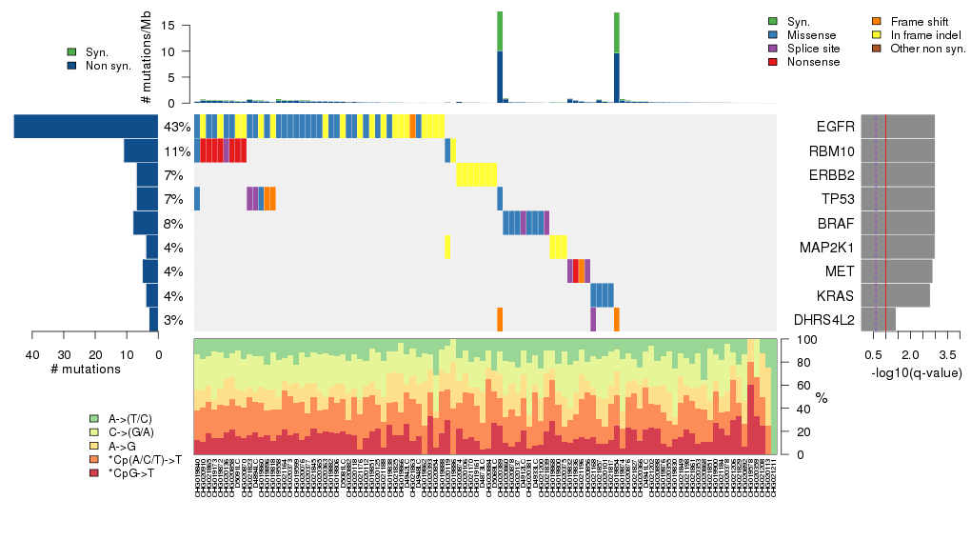
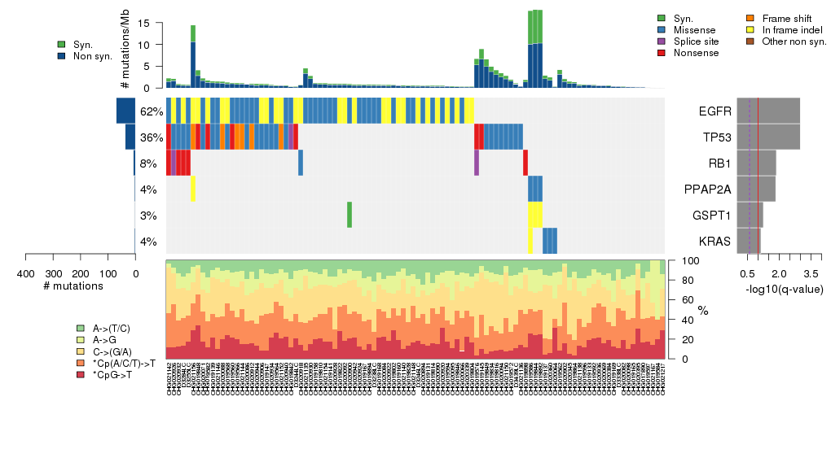
Significantly mutated genes in AIS/MIA group (left) and invasive group(right) by Mutect
and Mutect2 (consensus)

Slide 29
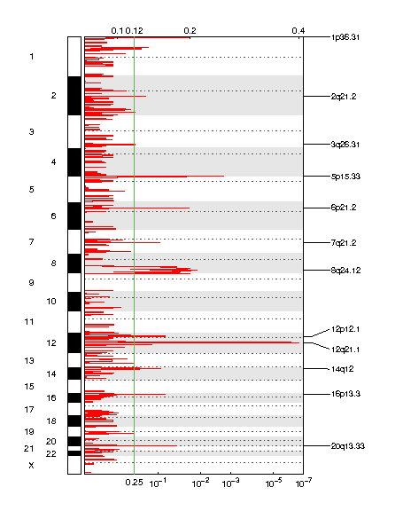
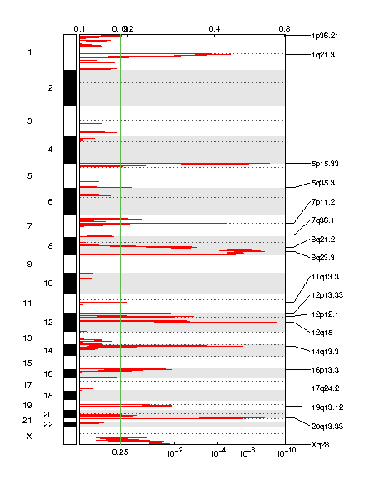
Copy number changes in AIS/MIA group (left) and invasive group(right)
MCL1
TERT
TERT
EGFR
KRAS
KRAS
NKX2-1

Slide 30
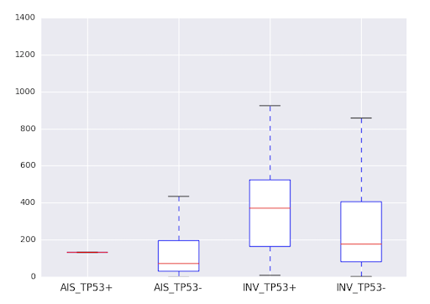
Correlation of TP53 and copy number events

Slide 31
What are the differences in between minimally invasive lung adenocarcinoma, and actual invasive lung adenocarcinoma?
Is it RB1 and TP53?
The same driver genes (MET, EGFR, ERBB2, KRAS) in pre-malignant and malignant
Can we use kinase inhibitors as prevention?
Same or different in Western populations?

Slide 32
The next steps: finding the key premalignant versus malignant drivers

Slide 33
The key will be statistical power!
Sequencing enough cases so that we can analyze pre-neoplasia versus neoplasia, in very large volume, and look for signatures of difference

Slide 34
Increasing power of genome sequencing technology

