Slide 1
The FDA/CDRH Pre-Submission Program
EDRN Workshop
March 2018
Anand Pathak, MD, PhD, MPH
Office of In Vitro Devices and Radiological Health
Division of Molecular Genetics and Pathology
Molecular Genetics Branch

Slide 2
What is a Pre-submission?
A pre-submission is a formal way for your to interact with FDA early in your test development, ask us questions about your assay, and help shape your analytical and clinical validation studies in a way that facilitates clearance or approval. FDA feedback takes about 75 days. It is free!

Slide 3
What is a Pre-submission? Early Interaction to Reduce Sponsor Uncertainty
Can address many types of sponsor questions, the more specific the better
Solicit comments and feedback on features of upcoming submissions, such as analytical studies, clinical study design, intended use, statistical analysis approaches and regulatory path
We have had successful submission for cancer screening tests such as Cologuard. Study design for screening tests may depend on cancer type.
Early interaction can be very valuable. Work towards a win/win. Can be useful at different stages of development
Future submission can be a PMA, 510(k), De Novo, or IDE
Voluntary interaction with the FDA
Notes:
This is where I mention that the FDA has dedicated team with expertise in AV/CV/Stats/Regulatory

Slide 4
Links to Information: Review the Info FDA has for You before Submitting a Pre-Submission
The Pre-Submission Guidance
Requests for Feedback on Medical Device Submissions: The Pre-Submission Program and Meetings with FDA Staff
Final issued February 18, 2014
http://www.fda.gov/downloads/MedicalDevices/DeviceRegulationandGuidance/GuidanceDocuments/UCM311176.pdf
eCopy Program
The page contains links to Guidance, video, FAQ, and tools, including a validation module https://www.fda.gov/MedicalDevices/DeviceRegulationandGuidance/HowtoMarketYourDevice/ucm370879.htm
Optional form 3514
Be clear about what you’re submitting, who you are, and whom we should contact – optional because a good cover letter can have all this
https://www.fda.gov/downloads/AboutFDA/ReportsManualsForms/Forms/UCM080872.pdf
Notes:
The last link is to clarify how to submit a presubmission . . . This information is provided for your reference.

Slide 5
What feedback is useful to get? Specific Questions are needed to get Specific Feedback Key Clinical Study Design Questions
Useful to ask about specifics of a proposed indication for use (the IFU should dictate the study design in general)
Define the population the device is intended to be used in (asymptomatic, at risk vs previously diagnosed)
What is the use? Diagnose, Screen, Confirm, Monitor
Sample type (e.g. DNA, RNA, microRNA, cfDNA, etc.)
How can banked samples be selected without bias for clinical validation studies?
Prescription, direct to consumer testing

Slide 6
What feedback is useful to get? Analytical Studies
Precision
Linearity/assay reportable range
Limit of Detection
Cross reactivity/ Interfering substances
Method comparison (to the predicate or reference method)
Matrix comparison
Traceability, Stability
Controls and calibrators
Reference range (in normal population)
Example: Does FDA agree with the proposal for use of banked samples in analytical studies described in Section X?
Example: Are the proposed study designs for demonstrating precision and accuracy adequate?

Slide 7
What feedback is useful to get? Conducting a Study if You are Unsure and Tips
When you are unsure:
Has a new intended use, new technology, or new analytes
Presents new clinical questions or complex data/statistical questions
Presents a significantly new approach to validation
Uses a predicate or reference method that is unclear or uncertain
Caution:
A pre-sub is not a dry run for a marketing application or IDE because the review team does not review data
Should present an analytical, clinical and statistical plan, including acceptance criteria for the success for all studies.

Slide 8

Tips for Successful Meetings with FDA: How to get the most out of your pre-submission.
Brand New
Diagnostic
Test

Slide 9
How to get the most out of your pre-submission?
Provide FDA sufficient information to get a complete picture of your device, analytical study design, intended use, clinical study design and statistical analysis plans.
Focus the meeting on what you want to get out of it
Allow 2/3 of the time for discussion, so your presentation should be about 1/3 of the time
Bring a dedicated attendee to take notes: there would be meeting minutes sent by the sponsor. You can ask for post meeting minute comments/clarifications.

Slide 10
Pre-Submissions cover a variety of interactions
Pre-Submissions are one of several interactions to which FDA assigns a tracking number beginning with the letter “Q”
Type | Features
Pre-Submission | Opportunity for sponsor to obtain FDA feedback prior to an intended marketing application or IDE
Submission Issue Meeting | To discuss deficiencies identified during a premarket review
Informational Meeting | To share information with FDA without expecting feedback
Study Risk Determinations | Risk determination for a prospective study

Slide 11
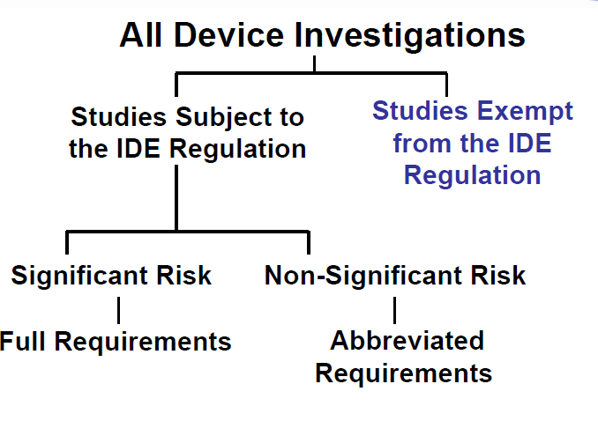
Study Risk Determination Pre-submissions and IDEs IDEs: Investigational Device Exemptions An investigational device exemption (IDE) allows the investigational device to be used in a clinical study in order to collect safety and effectiveness data.

Slide 12
Key questions with respect to risk for a SRD to determine whether an IDE is needed: Note: risk is conferred largely by the possibility of erroneous results
Will the results from the device be used for enrollment?
Will the results from the device cause patients to forego known effective/ approved therapy?
Will the results from the device cause patients to be subjected to unacceptable toxicities?
Will the results from the device cause patients to undergo a potentially high-risk biopsy?

Slide 13
IDE approval aims to ensure that:
Risks are outweighed by anticipated benefits to subjects and importance of knowledge to be gained.
Informed consent is adequate.
Investigation is scientifically sound.
Investigational device plausibly is effective.

Slide 14
Summary
Pre-submission are a mechanism for talking to the FDA early about analytical and clinical validation studies.
The information that should be contained in your pre-submission has been suggested.
Our response is dependent upon the information provided by you.
Talk to us early for a win-win situation.

Slide 15

Questions?

