Slide 1
Multiparametric image processing for early detection of cancer
Eugene J. Koay, MD, PhD
Anirban Maitra, MBBS
Peter C. Park, PhD
Division of Radiation Oncology
Sheikh Ahmed Center for Pancreatic Cancer Research
The University of Texas MD Anderson Cancer Center
NASA

Slide 2
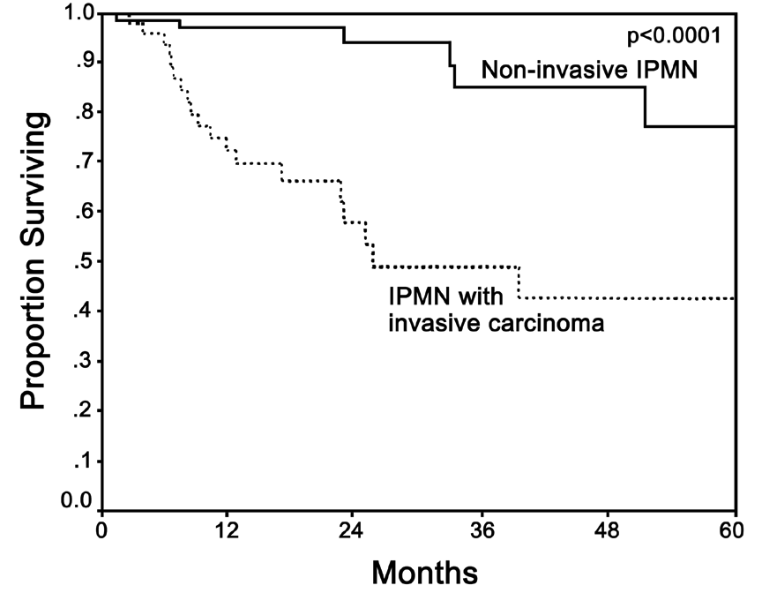
The importance of early detection: it saves lives
Most malignancies, including pancreatic and liver cancers, are found when the tumor is advanced
Finding these cancers early increases the chances of a cure
Current imaging is unable to do this reliably

Slide 3
Our objective: Achieve early detection of cancer by increasing the sensitivity of imaging
Electrical engineers
Software engineers
Imaging physicists
Early detection
Process engineers
Cancer researchers
Clinical experts

Slide 4
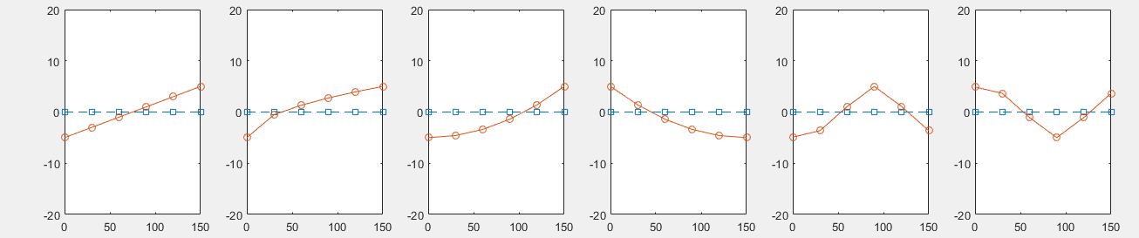
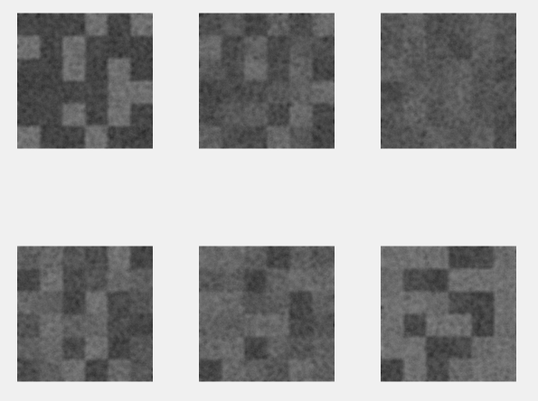
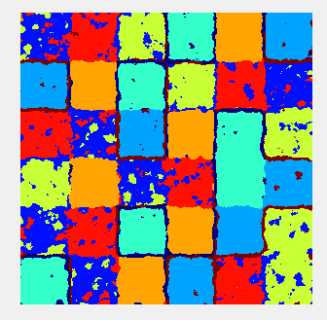
The idea: Classify tissues with multiparametric
enhancement pattern mapping (EPM)
1
2
3
4
5
6
6 distinct patterns based
on enhancement characteristics
Patterns
T1
T2
T3
Checkerboard phantom
with the 6 patterns and Gaussian noise and blurring
Clustering analysis based on EPM
T4
T5
T6

Slide 5
Challenges with multiparametric image processing
Organ motion
Image registration
Comparison models

Slide 6
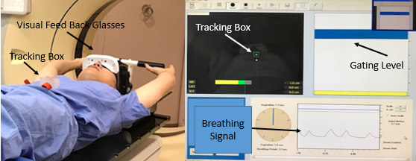
Motion management during image acquisition

Slide 7
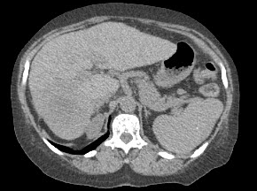
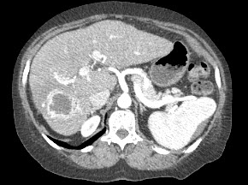
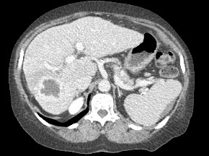
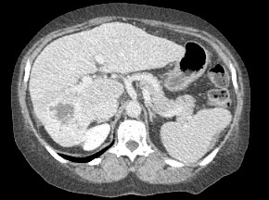
Deformable image registration technique

Slide 8
Normal liver models
Patient-specific
Population-based

Slide 9
CNR improved across a range of noise levels and tumor sizes using EPM

Slide 10
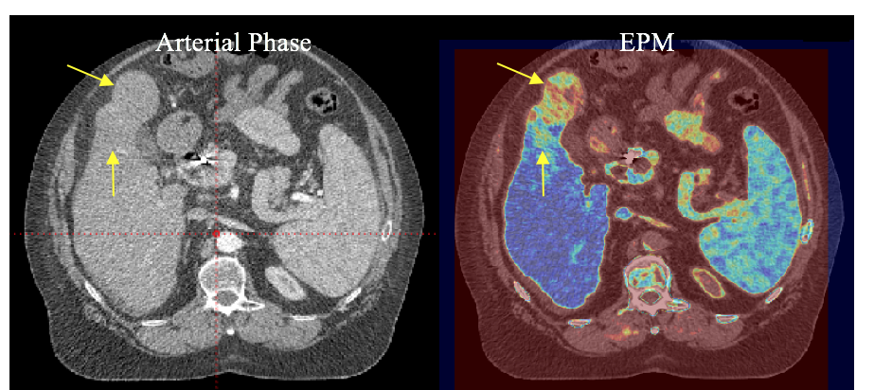
Application to patient scans: HCC

Slide 11
CNR improved in cholangiocarcinoma, HCC, and colorectal liver metastases

Slide 12
Early detection study design
We selected patients with colorectal cancer and hepatocellular cancer who had CT scans with contrast
All patients had liver tumors at the time of the baseline scan
Some developed new liver metastasis within 1-6 months after the baseline scan (follow-up scan)
We had experts identify signal abnormalities using EPM and the standard gray-scale images in a blinded fashion
We measured the sensitivity of detecting the primary lesion and liver metastasis on the baseline scan, using the follow-up scan as the gold standard

Slide 13
Study population
7 patients with colorectal liver mets
16 baseline lesions
15 new lesions within 1-6 months after baseline in 6 patients
12 patients with hepatocellular carcinoma
21 baseline lesions
28 new lesions within 1-6 months after baseline in 5 patients

Slide 14
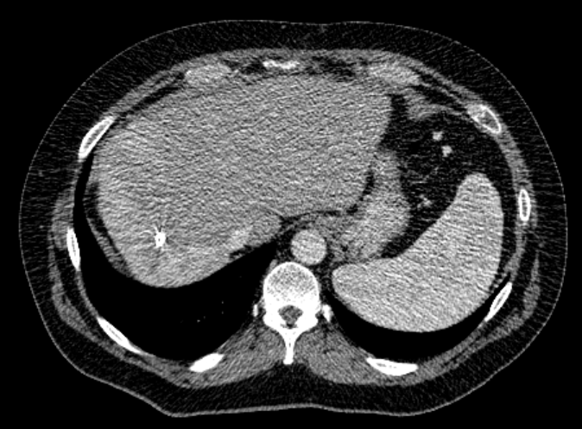
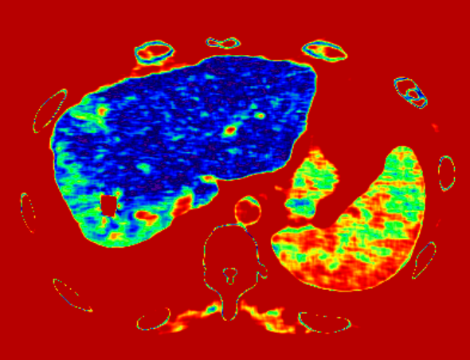
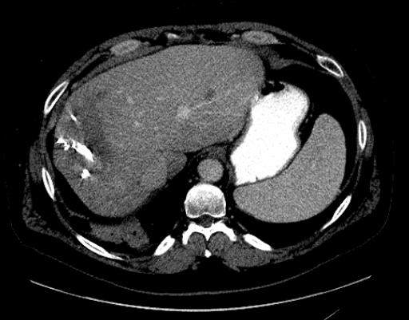
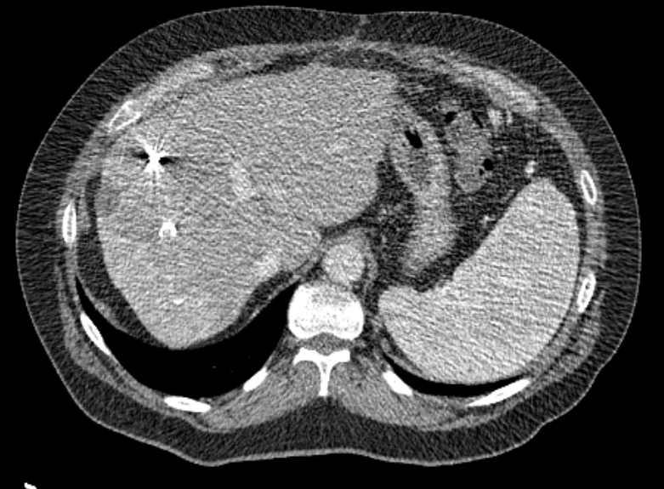
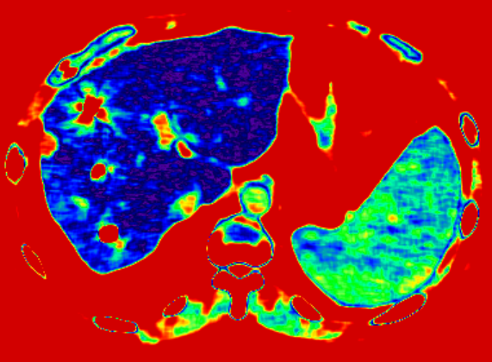
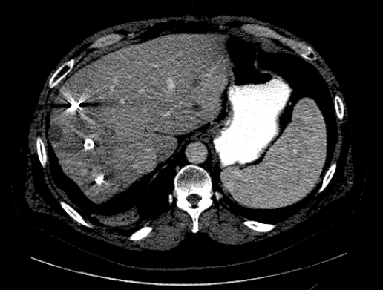
Signal abnormalities detected with EPM in colorectal liver metastasis
Future tumor
Known tumor
Baseline GS
Baseline EPM
Follow Up CT

Slide 15
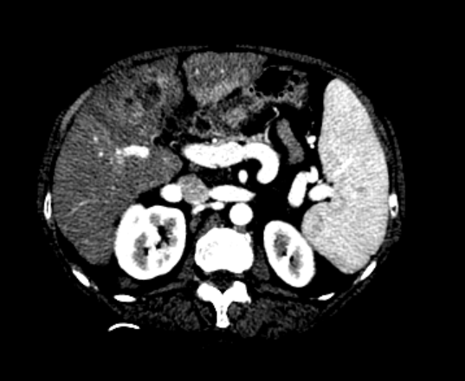
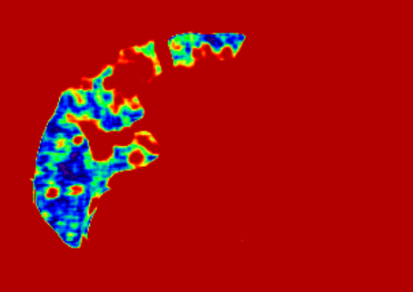
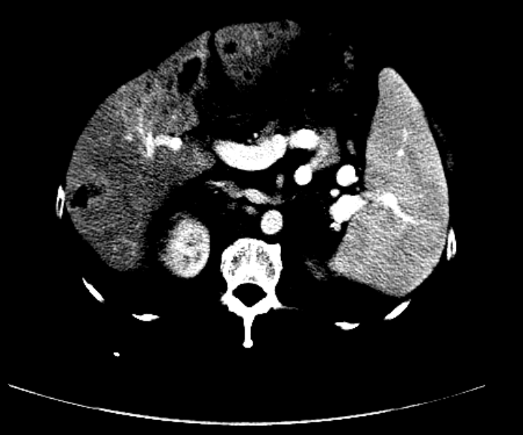
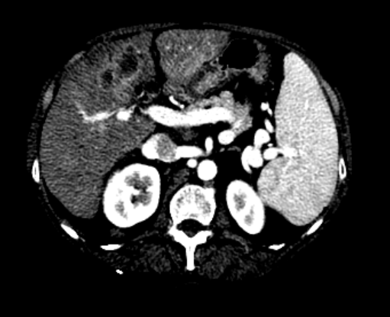
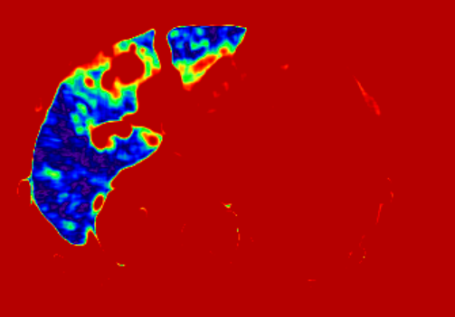
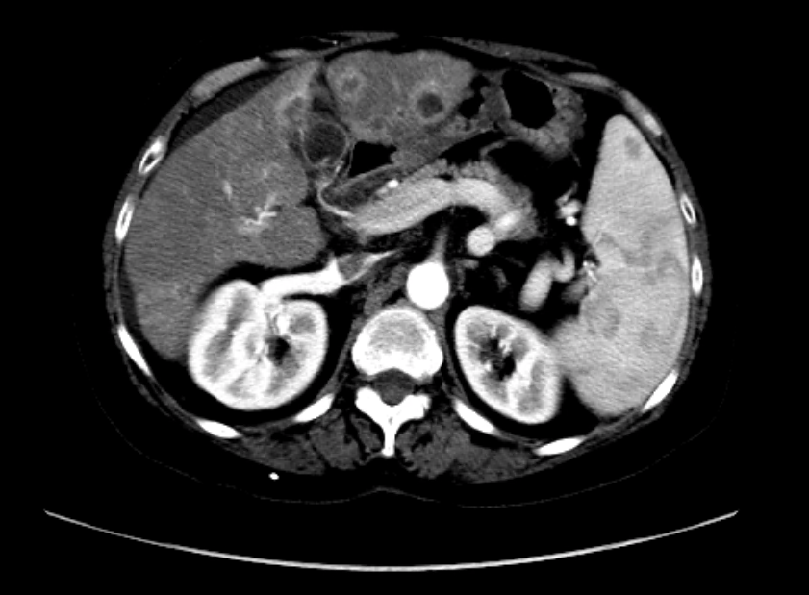
Signal abnormalities detected with EPM in HCC
Future tumor
Known tumor
Baseline GS
Baseline EPM
Follow Up CT

Slide 16
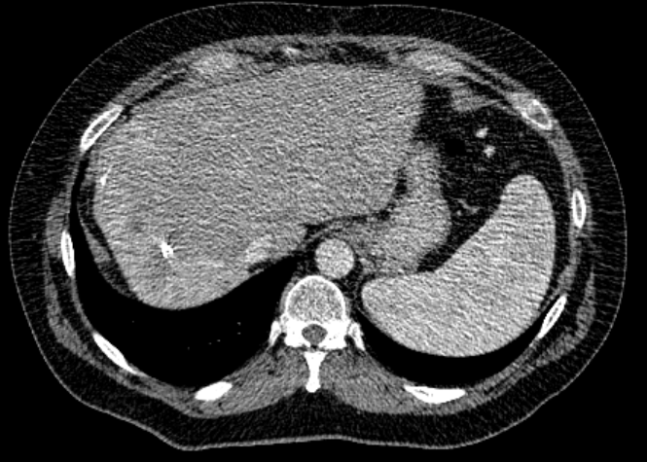
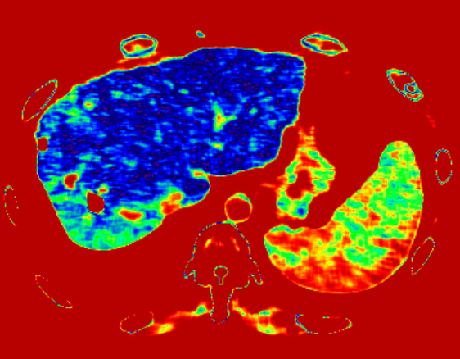
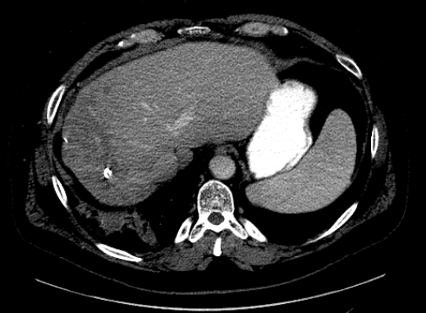
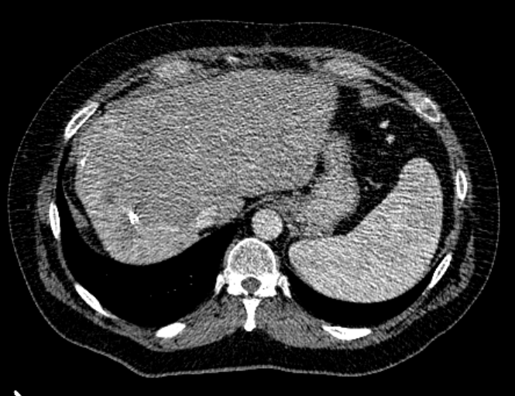
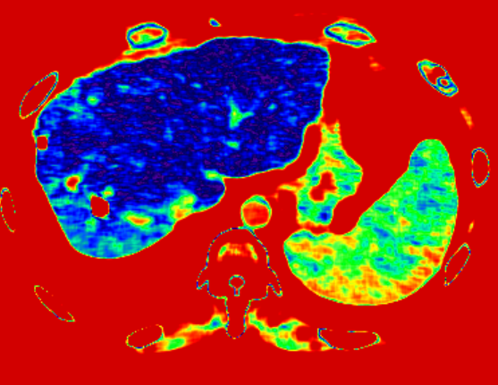
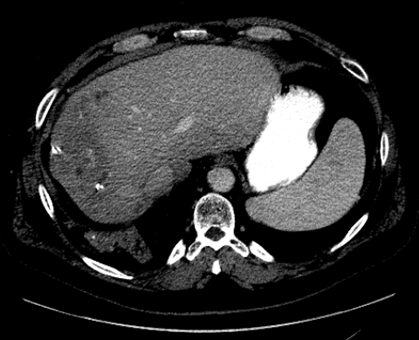
False positive detections with EPM
Abnormal signal
Abnormal signal
Baseline GS
Baseline EPM
Follow Up CT
Notes:
Lesion 14 and 15 are corresponding to a hyperdense opacity in BL.

Slide 17
Early detection achieved using EPM
Colorectal cancer
EPM: 7 of 15 early liver lesions → 46% sensitivity
20 false positives
Gray scale: 0 of 15 early liver lesions → 0% sensitivity
Hepatocellular cancer
EPM: 12 of 28 early liver lesions → 42% sensitivity
19 false positives
Gray scale: 0 of 28 early liver lesions → 0% sensitivity
Baseline lesions detected in all cases with EPM and gray scale

Slide 18
Summary: improved CNR and early detection with enhancement pattern mapping (EPM)
Multiparametric EPM achieved through
Motion management
Deformable image registration
Normal liver model
EPM results in
Significant improvement in CNR (6-7 fold)
An improvement in sensitivity to detect early liver metastasis
Objectives of ongoing work
Evaluate specificity
Increase number of patients/lesions

Slide 19
Future directions
Functional correlations
Pathological correlations
Calculation of other EPM-based features
Deep Learning

Slide 20
Acknowledgments
Mohamed Zaid
Baishali Chaudhury
Eric Tamm
Corey Jensen
Jingfei Ma
NIH:
EDRN
MCL
PSON
Project Purple
PANCAN
RSNA
Sabin Family Fellowship

Slide 21
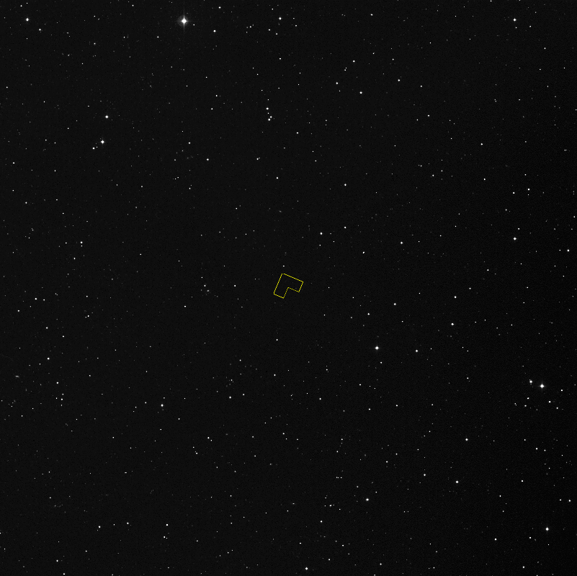
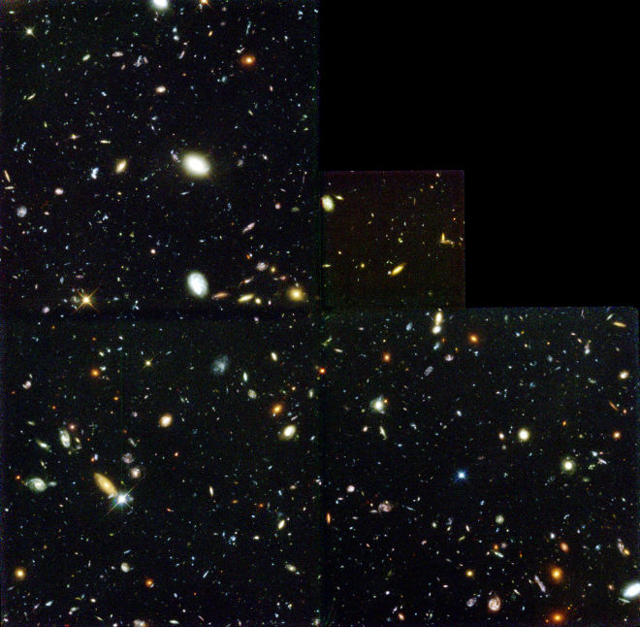
Questions

