Slide 1
EDRN-FDA Meeting 6 February 2018
Topic #1:
Pathway for EDRN investigators for an FDA pre-submission on proposed design(s) for early detection and/or diagnostic studies - without necessarily having an industry partner – with EDRN ovarian cancer example study
FDA described Pathway
  EDRN Investigator welcome to FDA Pre-Submission with or without industry partner
When should an EDRN Investigator approach FDA?

Slide 2
Biomarker Pipeline
Number of candidates
Many
Discovery
Verification
Validation
Few
Filter 2
too late
Filter 1
too soon
When should EDRN Investigator approach FDA?

Slide 3
Biomarker Pipeline
Technology platform
Many
Discovery
Verification
Validation
Few
Filter 2
Filter 1
ELISAs
High throughput
High accuracy
Targeted mass spec
Triple Quad
Med throughput
Med accuracy
High resolution Mass Spec
OrbiTrap
Low throughput
Lower accuracy

Slide 4
Biomarker Pipeline
Biospecimen Sets
Many
Discovery
Verification
Validation
Few
Filter 2
Filter 1
Easily accessible biofluid
(plasma, urine)
Preclinical serial samples
Easily accessible biofluid
(plasma, urine)
Unbiased diagnostic cohort
Disease or Proximal biospecimen
High signal/noise

Slide 5
Biomarker Pipeline
Sample Size
Many
Discovery
Verification
Validation
Few
Filter 2
Filter 1
100’s cases
1,000’s controls
50-100’s cases
50-100’s controls
10’s case, 10’s controls
10 – 4 SD separation
50 – 2 SD separation

Slide 6
Ovarian Validation Study – Early Detection
Modified design
150+ ovarian cancer candidates discovered in previous round of funding
Diamandis
Godwin
LaBaer
Li
Lokshin
Marks
Skates
Bioinformatics (in silico) mRNA filter (Toronto)
Accurate Inclusion
Mass Screening (Broad)
50 SRM Assays
PNNL (BRL)
8 high throughput assays
JHU (BRL)
+ 3 NAPPA (ASU)
Cases vs. Benigns at Diagnosis – rule out (FHCRC – CEVC)
Early Detection Biomarkers
11 candidates x Longitudinal samples (MGH/Broad)

Slide 7
Ovarian Validation Study – Early Detection
Modified design
Diamandis
Godwin
LaBaer
Li
Lokshin
Marks
Skates
Seven EDRN investigators put forward ovarian cancer biomarker candidates from previous investigations
165 plasma protein candidates contributed
Too many to create immunoassays for each candidate
Auto-antibody study in parallel at ASU (Anderson) using NAPPA technology (LaBaer)
NAPPA – nucleic acid programmable protein array nappaproteinarray.org

Slide 8
Ovarian Validation Study – Early Detection
Modified design
Bioinformatics (in silico) mRNA filter (Toronto)
Two existing transcriptomic databases reduce candidates based on levels at transcript from 165 to 100 candidates
Rank by sensitivity at 98% specificity
Level of specificity selected by experience with blood test followed by trans-vaginal sonography for positive blood test – 10 fold reduction in false positives
Achieves 20% positive predictive value (PPV)
1 in 2,500 → 1 in 5 ---------- 50 fold blood test x 10 fold TVS

Slide 9
Ovarian Validation Study – Early Detection
Modified design
Accurate Inclusion
Mass Screening (Broad)
AIMS – mass spectrometry technique to measure 100 candidates in two plasma pools
Reduce candidates from 100 to 50
Plasma pools from
Cases: serous ovarian cancer patients
Controls: serous benign ovarian disease

Slide 10
Ovarian Validation Study – Early Detection
Modified design
PNNL – Pacific Northwest National Lab (Rodland – EDRN BRL)
Developed antibody-free, targeted mass-spectrometric approach for
quantification of proteins at low picogram /mL levels in human plasma/serum
PRISM: high-pressure, high-resolution separations coupled with intelligent selection and multiplexing
50 SRM Assays
PNNL (BRL)
Developed selective reaction monitoring assays for 50 candidates
Where SRM not analytically sensitive enough, developed PRISM assay
Evaluated 50 candidates in graduated sample sets: 10 cases vs. 10 controls
20 cases vs. 20 controls

Slide 11
Ovarian Validation Study – Early Detection
Modified design
Johns Hopkins University – Dan Chan EDRN BRL – Biomarker Reference Laboratory
Developed 8 high throughput, low CV, low cost, immunoassays on Mesoscale Diagnostics (MSD) electrochemiluminescence platform
8 high throughput assays
JHU (BRL)

Slide 12
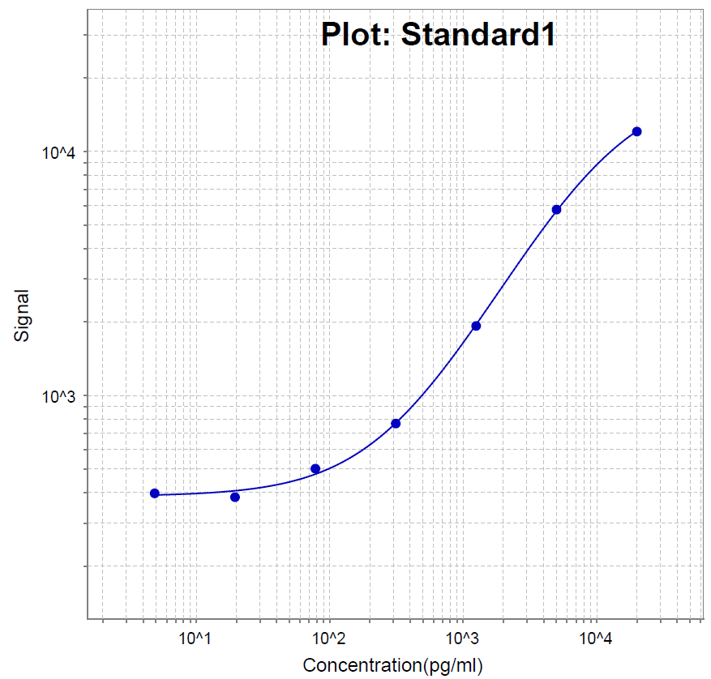
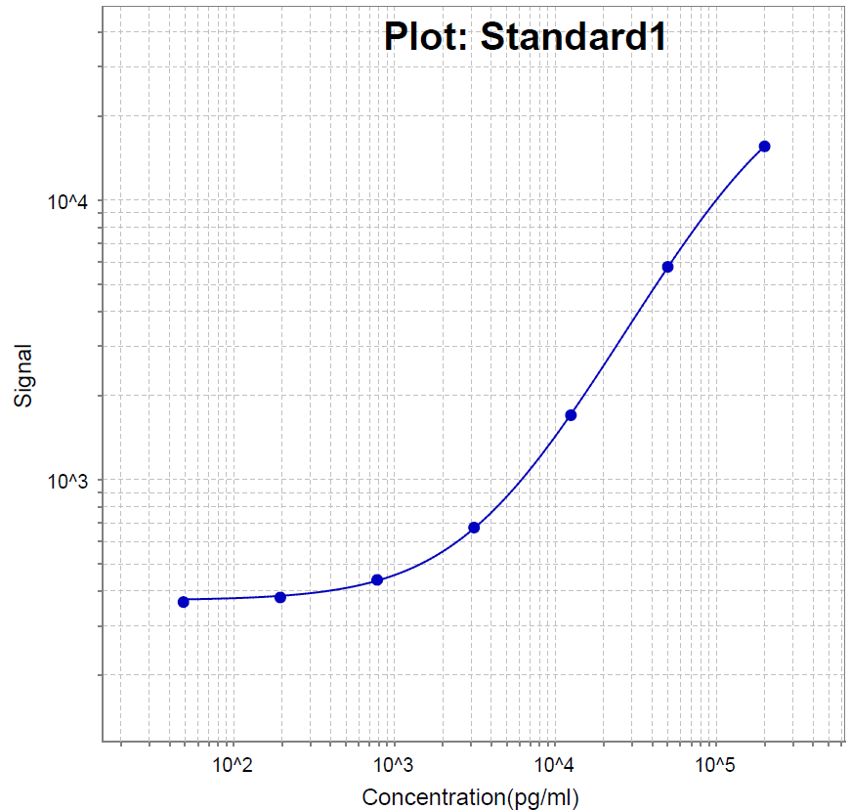
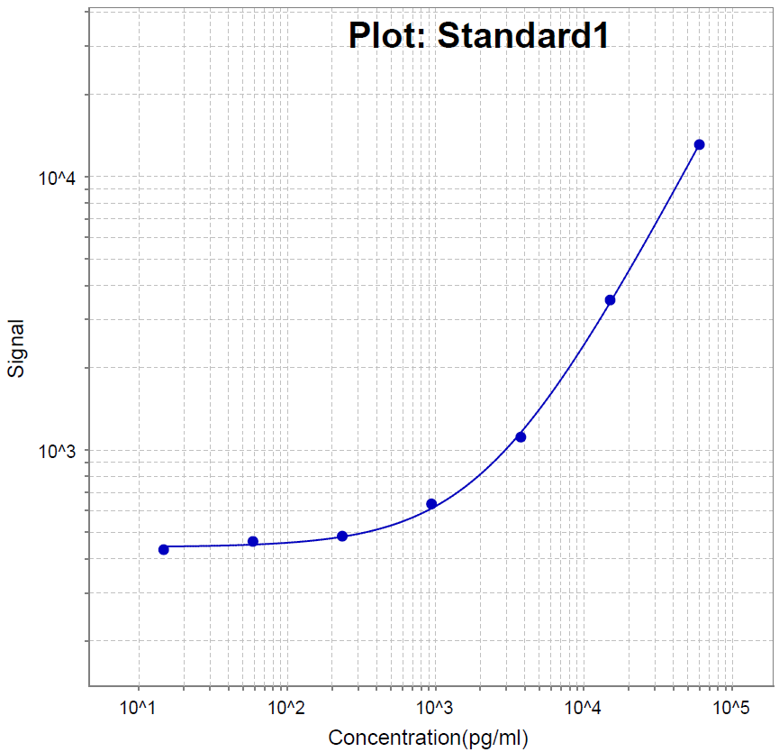
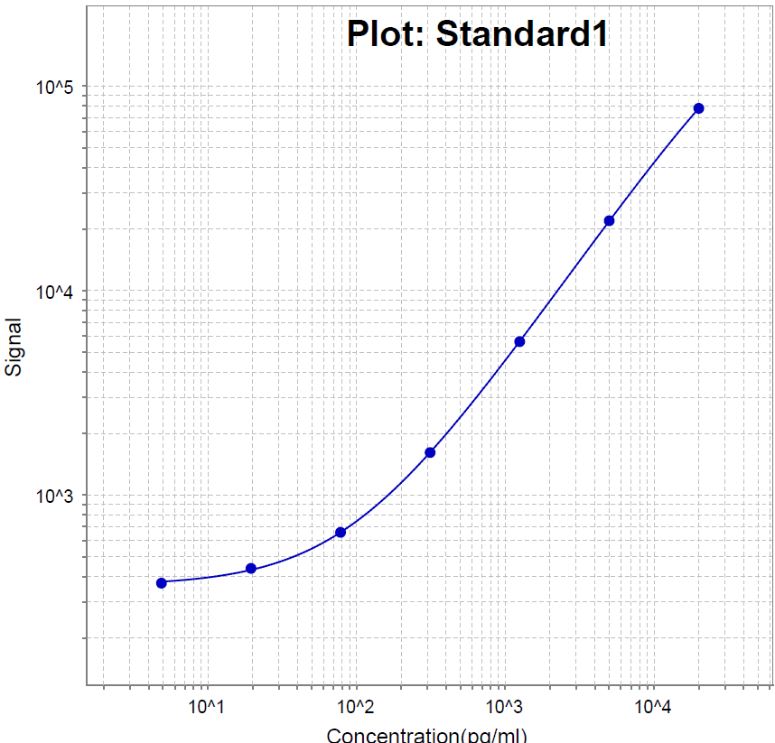
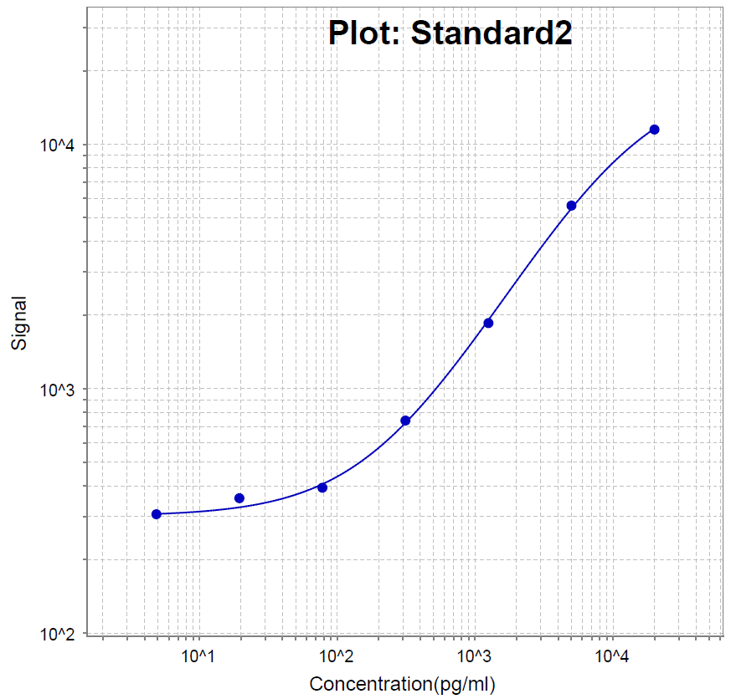
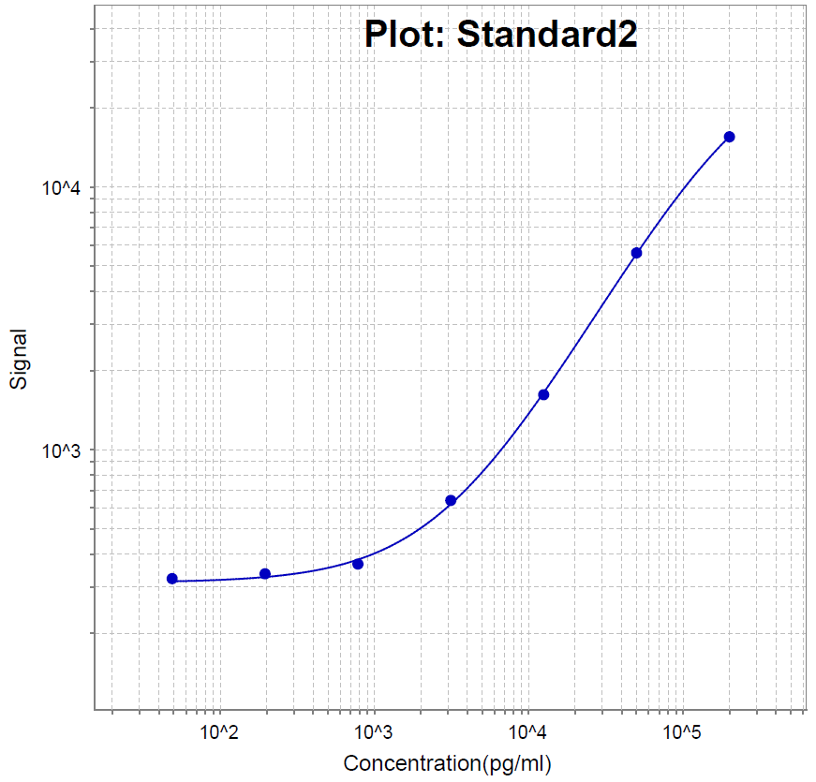

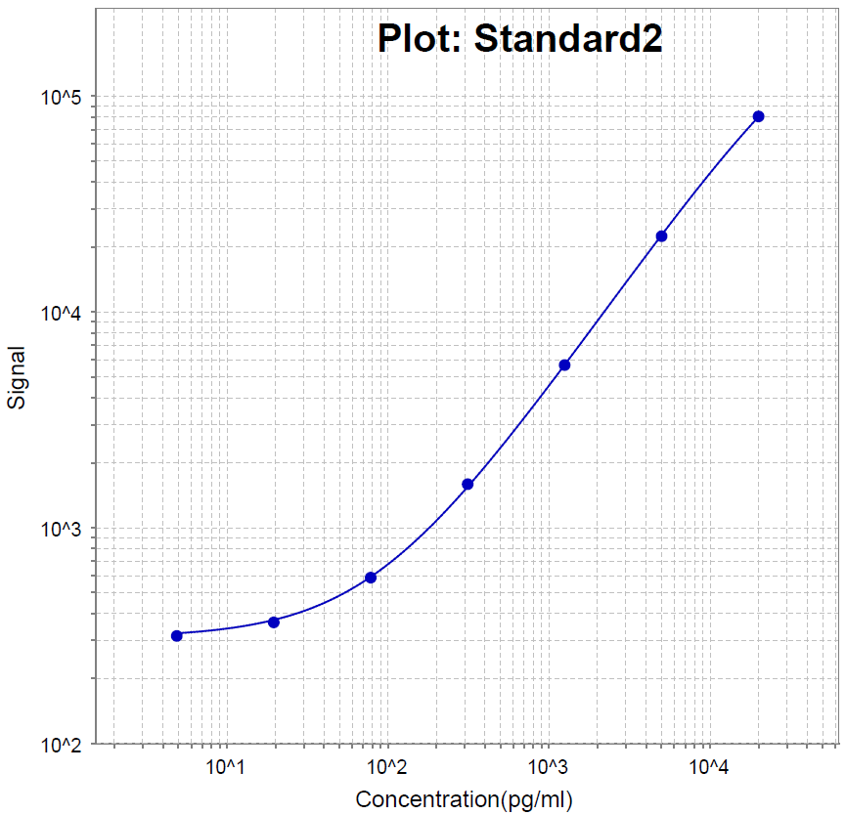
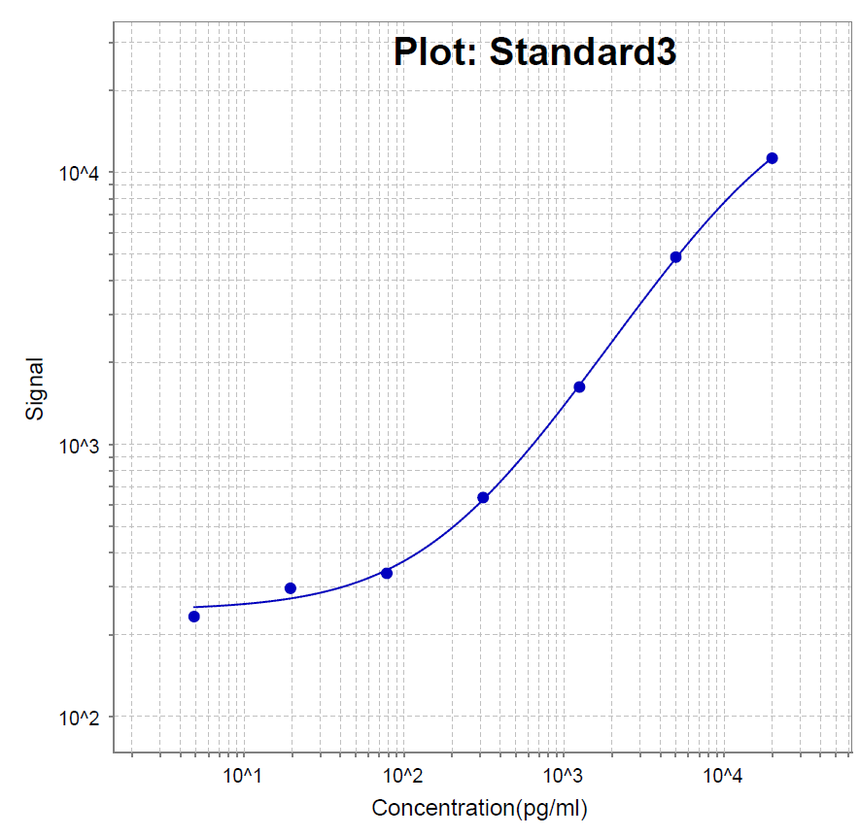
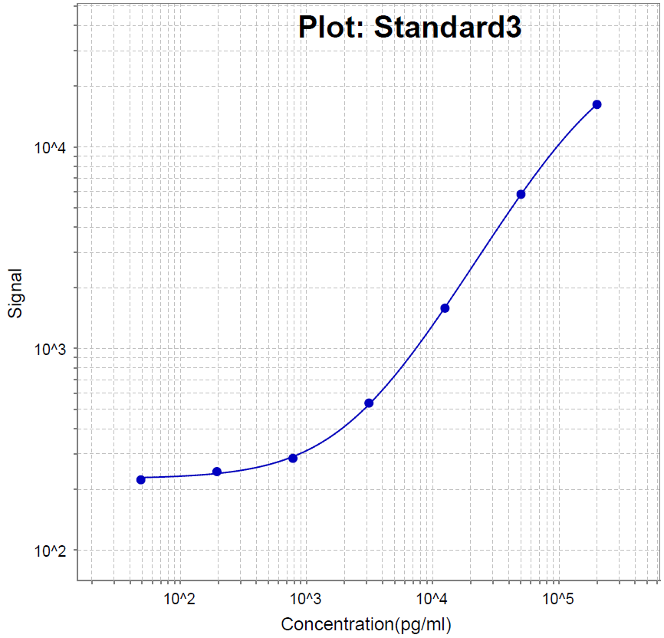
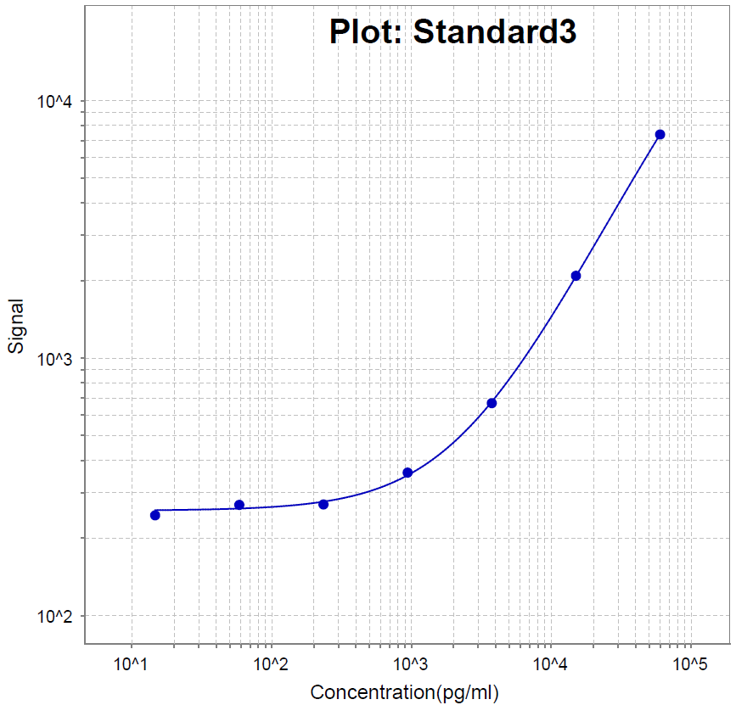
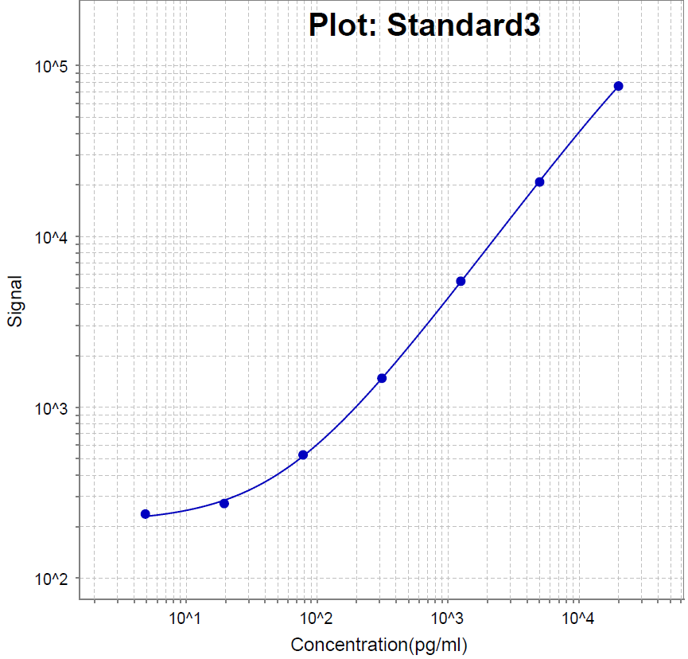
4-Plex
CA125
HE4
SPON1
FOLR1

Slide 13
Ovarian Validation Study – Early Detection
Modified design
Using parallel process with multiple plasma sample sets at Dx
3 high probability ovarian cancer candidates from over 9,000 antibodies
ASU developed 3 antibody candidate assays on MSD platform
+ 3 NAPPA (ASU)

Slide 14
Ovarian Validation Study – Early Detection
Modified design
Evaluated 11 protein and autoantibody candidates on plasma at Dx from:
100 serous ovarian cancer
100 serous benign ovarian disease
Cases vs. Benigns at Diagnosis – rule out (FHCRC – CEVC)

Slide 15
Ovarian Validation Study – Early Detection
Modified design
Evaluate up to 11 candidates in pre-diagnostic plasma samples from
Cases identified during screening study
Controls – age at study entry and time matched to cases – 5 controls per case
Blood draw goal was every 3 months – averaged 3 times per year
98% specificity per year set by variation within controls over time
Sensitivity estimated for 6 mths, 1yr, 2yrs prior to Dx at 98% specificity
11 candidates x Longitudinal samples (MGH/Broad)

Slide 16
Ovarian Validation Study – Early Detection
Modified design
Per Candidate: Systematic evaluation through hierarchical longitudinal mixture model estimates probability of change-point in candidate
Panel: hierarchical longitudinal multivariate mixture model estimates probability of change-point in any candidate
Evaluate each candidate and panel with sample sets from independent studies
If candidate has significant sensitivity prior to Dx at high specificity –
Early Detection Biomarker
Early Detection Classifier..
Early Detection Biomarkers
11 candidates x Longitudinal samples (MGH/Broad)

Slide 17
Known Cancer Biomarkers in Cancer Screening Trials
Screening: Measure early detection biomarker at regular intervals
Change-point: Rises above each case’s baseline before detection
Stable over time in controls
case
CA125 HE4 PSA
Dx
Pre-diagnostic samples
control
Time

Slide 18
Ovarian Validation Study – Early Detection
Modified design
150+ ovarian cancer candidates discovered in previous round of funding
Diamandis
Godwin
LaBaer
Li
Lokshin
Marks
Skates
Bioinformatics (in silico) mRNA filter (Toronto)
Accurate Inclusion
Mass Screening (Broad)
50 SRM Assays
PNNL (BRL)
8 high throughput assays
JHU (BRL)
+ 3 NAPPA (ASU)
Cases vs. Benigns at Diagnosis – rule out (FHCRC – CEVC)
Early Detection Biomarkers
11 candidates x Longitudinal samples (MGH/Broad)

