Slide 1
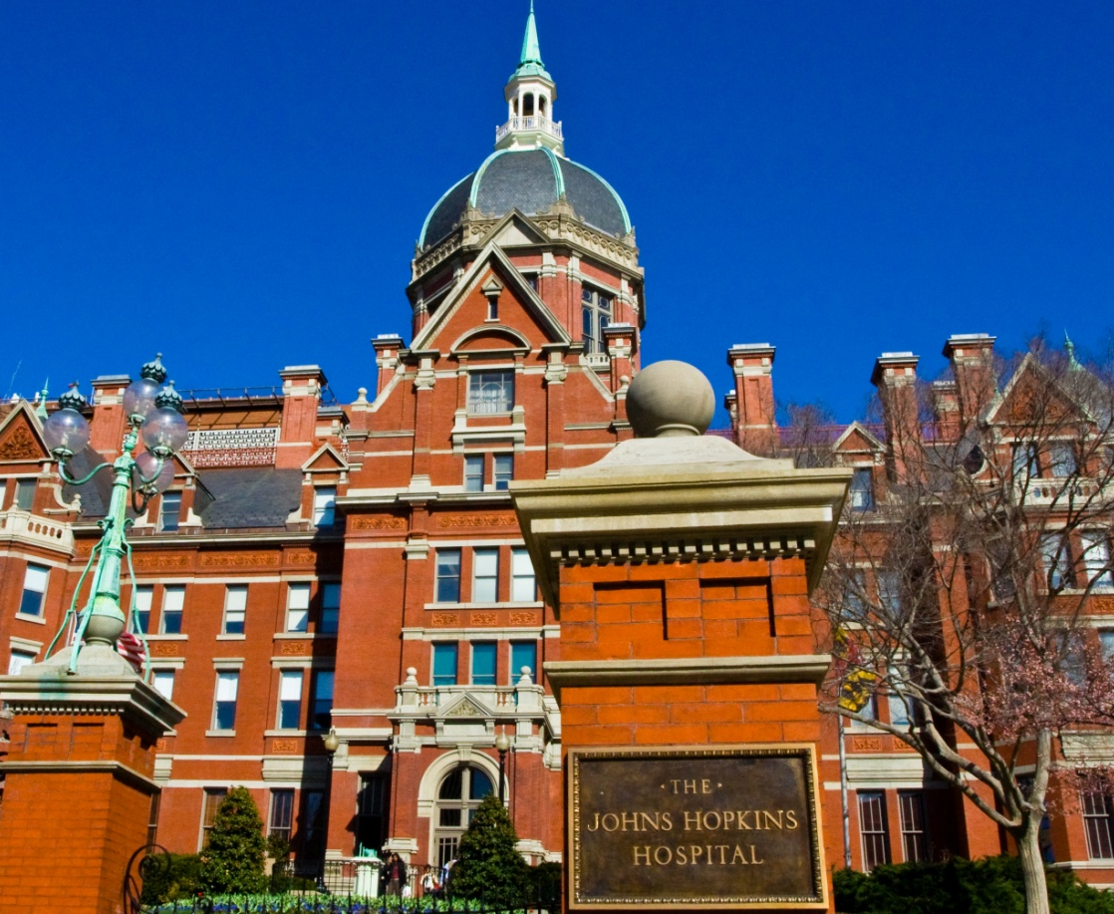



Liquid Biopsy for the Earlier Detection of Cancer
10th EDRN Workshop March 6, 2018
UPMC/JHU BDL (Schoen) &
The Ludwig Center at Johns Hopkins

Slide 2
Types of Released Tumor DNA (rtDNA)
Urine (utDNA)
Bladder Tumors
Stool (stDNA)
Colorectal Tumors
Blood (ctDNA)
Variety of Cancers
Pap Smear
Ovarian Cancers
Endometrial Cancers
Cyst Fluids
Ovarian Neoplasia
Pancreatic Neoplasia
Saliva
Head & Neck Cancers
Cerebrospinal Fluid
Brain Tumors
Spinal tumors
Pancreatic Juice
Pancreatic Neoplasia

Slide 3
Challenge #1: Distinguishing Tumor from Normal DNA
Small Intragenic Somatic Mutations
Methylated DNA
Translocations/Rearrangements

Slide 4
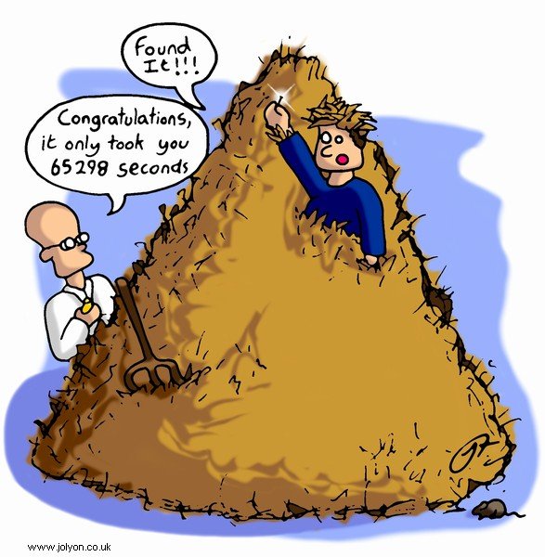
Challenge #2: Finding a Needle in a Haystack

Slide 5
Digital Genomics
Assessment of biologically significant variations in nucleic acid by assessing individual molecules.

Slide 6
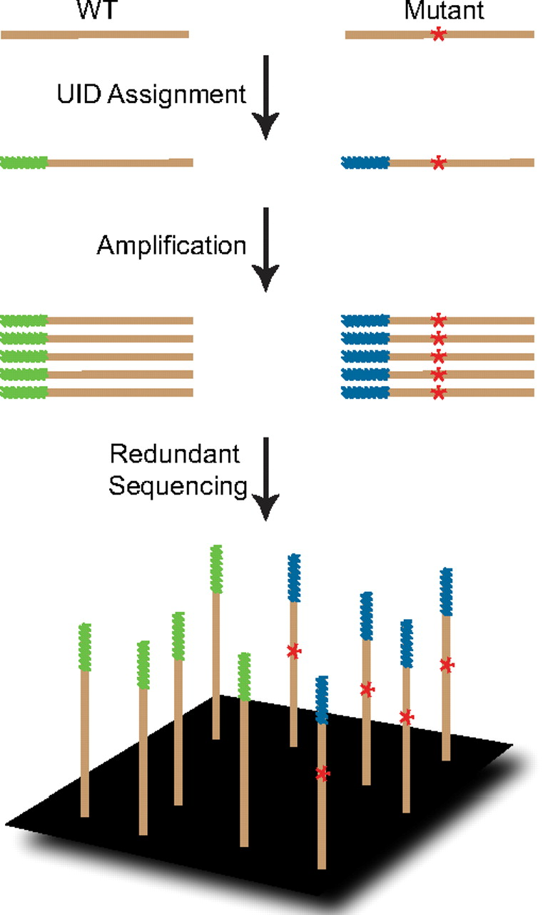
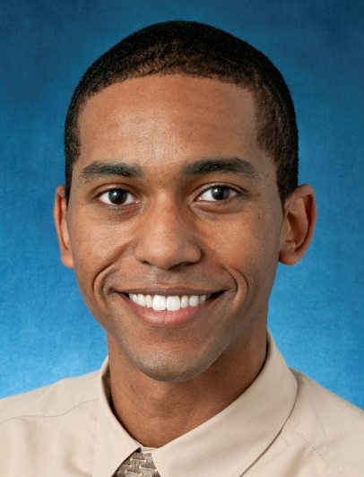
Safe-SeqS (Kinde I et al. PNAS 108:9530-9535, 2011)
Safe
Sequencing
System
Method for detection and quantification of rare mutations with massively parallel sequencing.
Isaac Kinde

Slide 7
Liquid Biopsy for the Earlier Detection of Cancer
Minimum Residual Disease
Screening

Slide 8
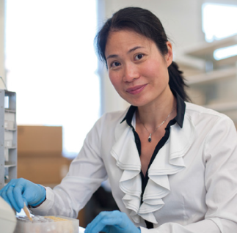
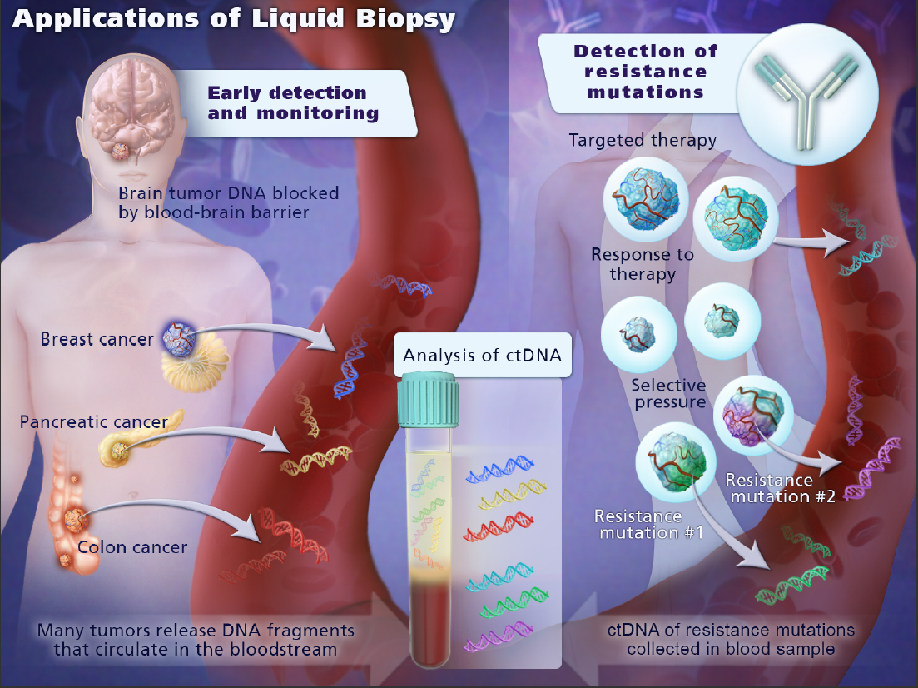


ctDNA Predicts Recurrence in Stage II Colon Cancer
Jeanne Tie
Tie et al., Sci Transl Med. 8(346):346ra92 2016.
Peter Gibbs
Tie et al., Ann Oncol, 2015.
Tie et al., Gut 2018.

Slide 9
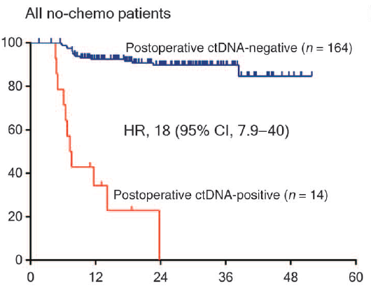
Post-op ctDNA, Time-to-Recurrence (All no-chemo patients)
ctDNA Predicts Detects Recurrence Earlier in Stage II Colon Cancer
ctDNA recurrence was 167 days earlier than radiologic recurrence (median, IQR 81 to 179)
Recurrence Free (%)
Months since surgery

Slide 10
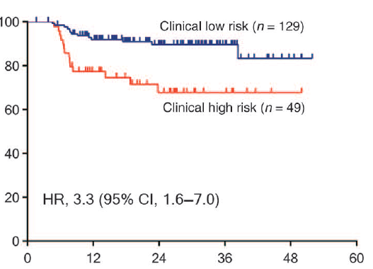
Clinical Risk, Time-to-Recurrence (All no-chemo patients)
Recurrence Free (%)
Months since surgery

Slide 11
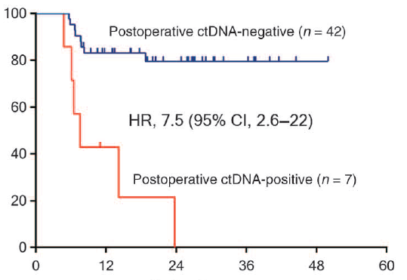
ctDNA vs. Clinical Risk “Clinical High Risk”
Recurrence Free (%)
Months since surgery

Slide 12
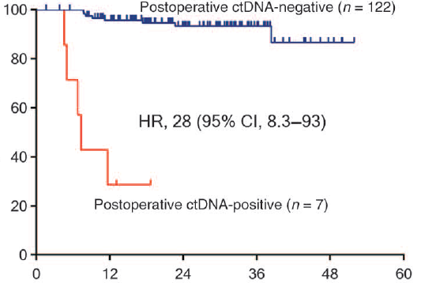
ctDNA vs. Clinical Risk “Clinical Low Risk”
Recurrence Free (%)
Months since surgery

Slide 13
Liquid Biopsy for the Earlier Detection of Cancer
Minimum Residual Disease
Screening

Slide 14
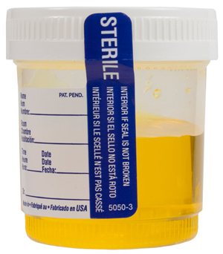
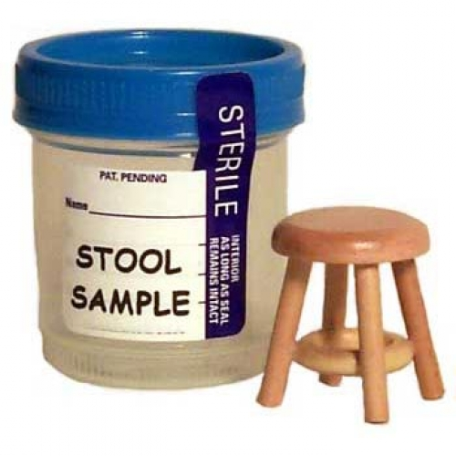
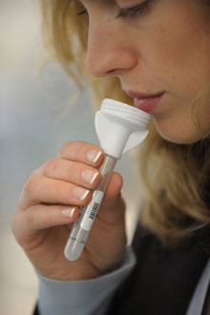
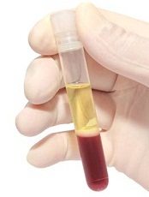
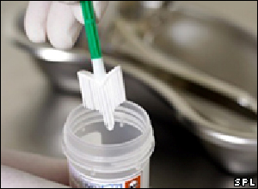
Future of Screening
NGS-bases detection of
rtDNA

Slide 15
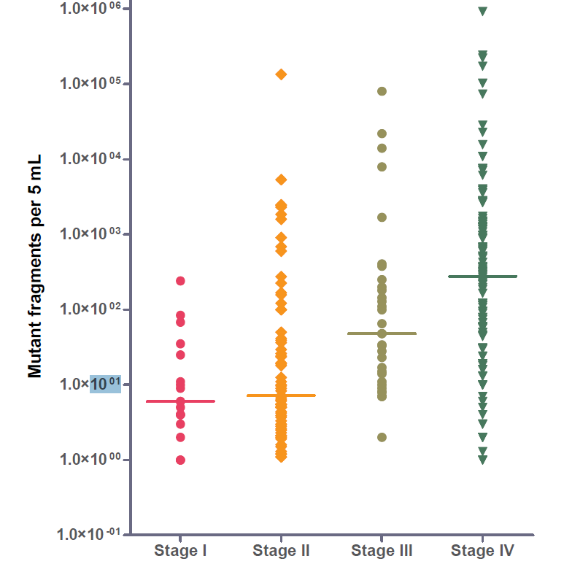
Challenge #3 Limited Molecules
ctDNA versus Stage
PCR-based target enrichment
7.5 ml of plasma
For Early
Detection,
“Every Molecule is Sacred”
Bettegowda et al.
Sci Transl Med. 2014

Slide 16
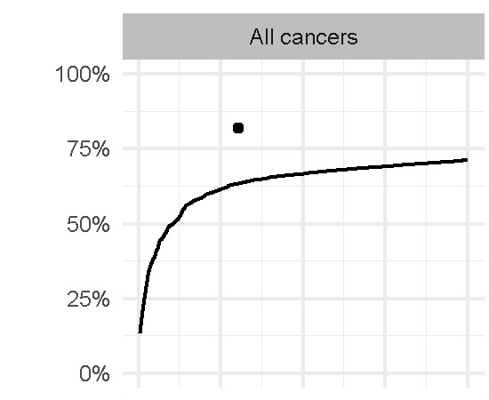
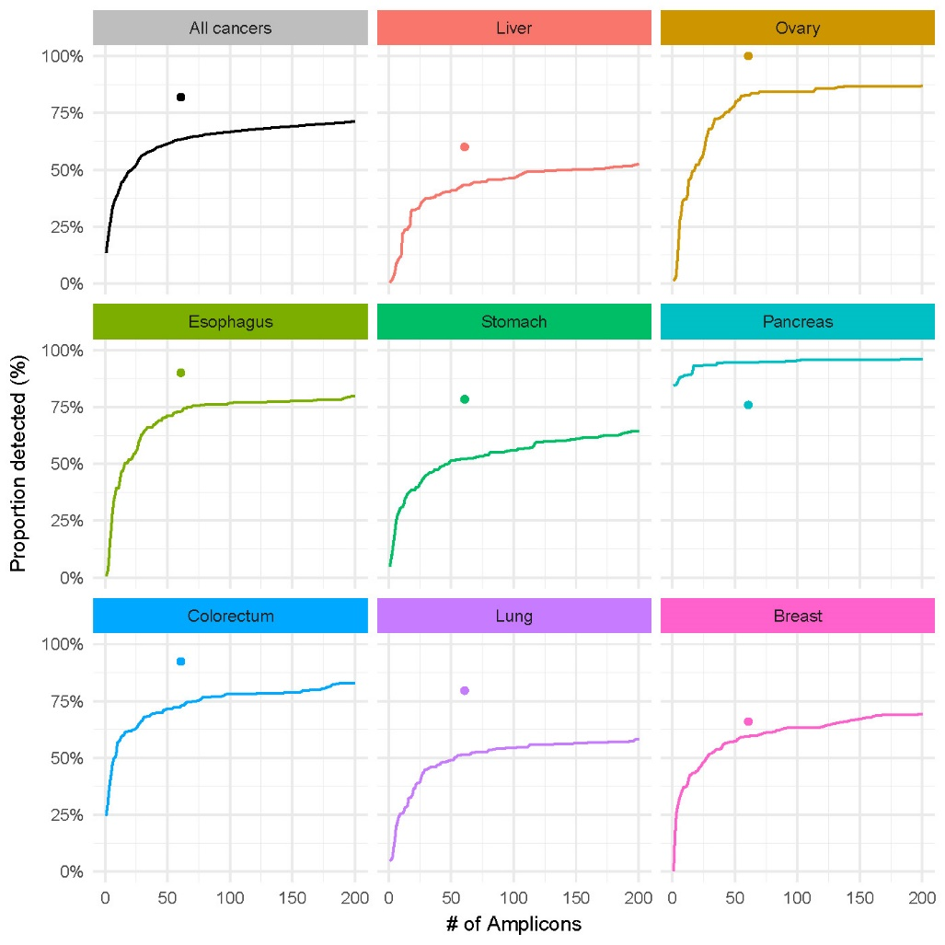
Challenge #4 Where to hunt for mutations?
61 amplicons
16 genes, 2,001 queried positions (bp)
Proportion Detected (%)
Number of Amplicons

Slide 17
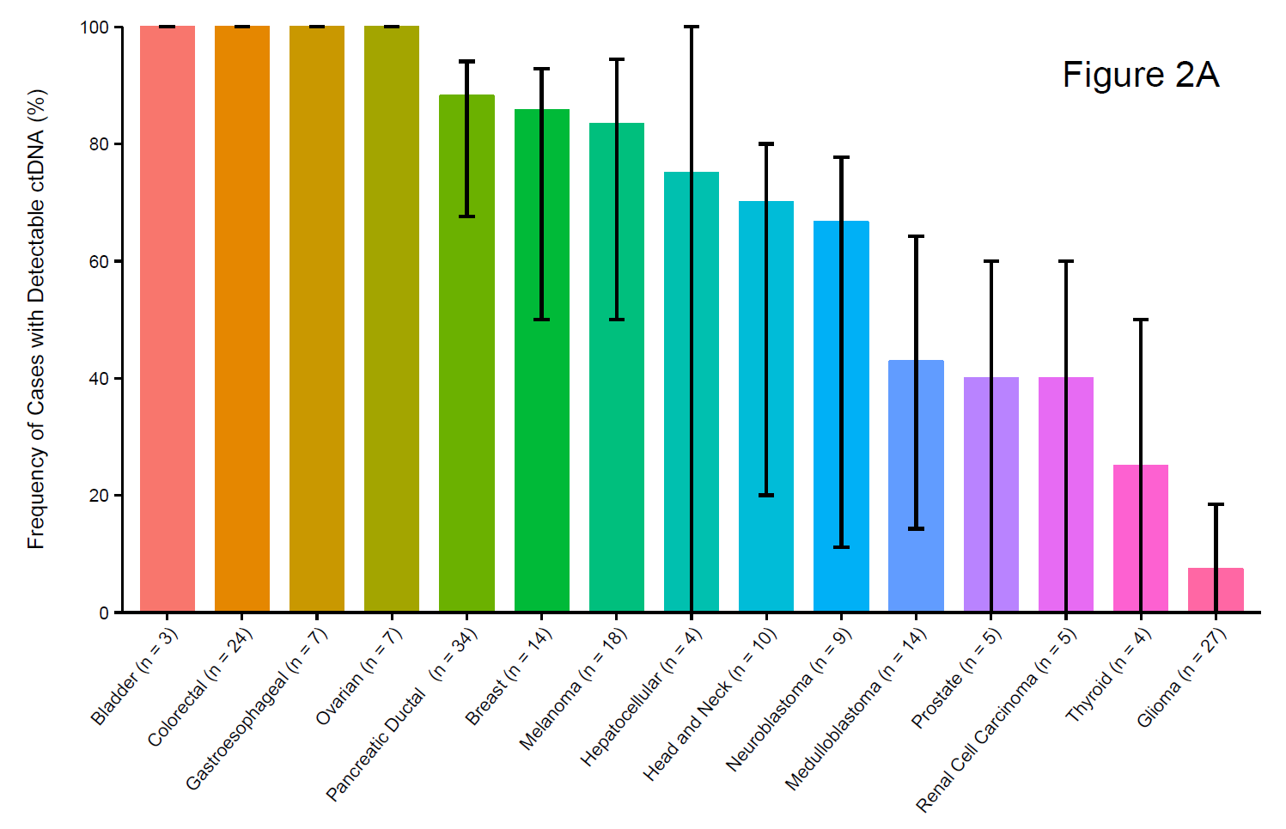
Challenge #5 Not Every Cancer has Detectable ctDNA
Frequency of Stage 4 Cancer and Brain Tumors
With Detectable ctDNA (%)
Bettegowda et al.
Sci Transl Med. 2014 Feb 19;6(224):224ra24.
Notes:
Across 15 cancer Types

Slide 18
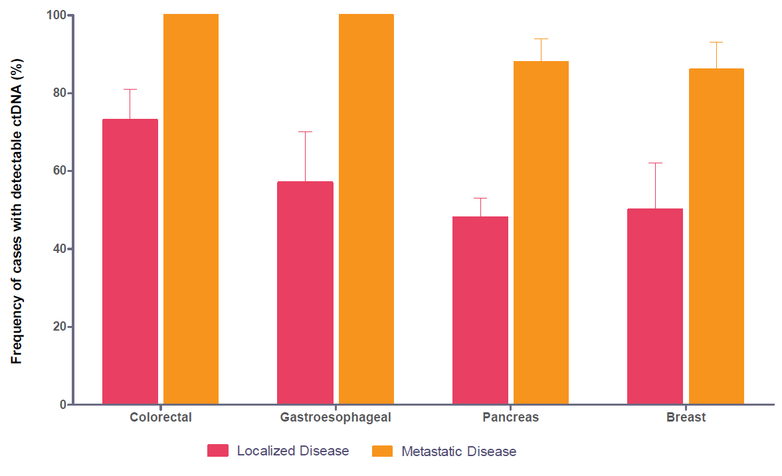
Survey of ctDNA in Human Cancer ctDNA vs Stage (n=273)
Multi-Analyte Blood Test
Include Protein Biomarkers
Sci Transl Med. 2014 Feb 19;6(224):224ra24.
Localized disease ranged from 49% to 78%
Bettegowda et al.
Sci Transl Med. 2014 Feb 19;6(224):224ra24.
Metastatic disease ranged from 86% to 100%

Slide 19
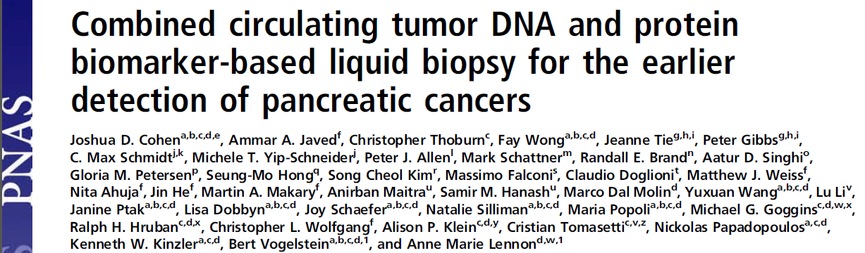
Combining ctDNA and protein markers
Proc Natl Acad Sci U S A. 2017 Sep 19;114(38):10202-10207.
Allows using thresholds with near-perfect specificity.
Sensitivity of a single marker is less demanding.
Sensitivity for a specific tumor type is not required.

Slide 20
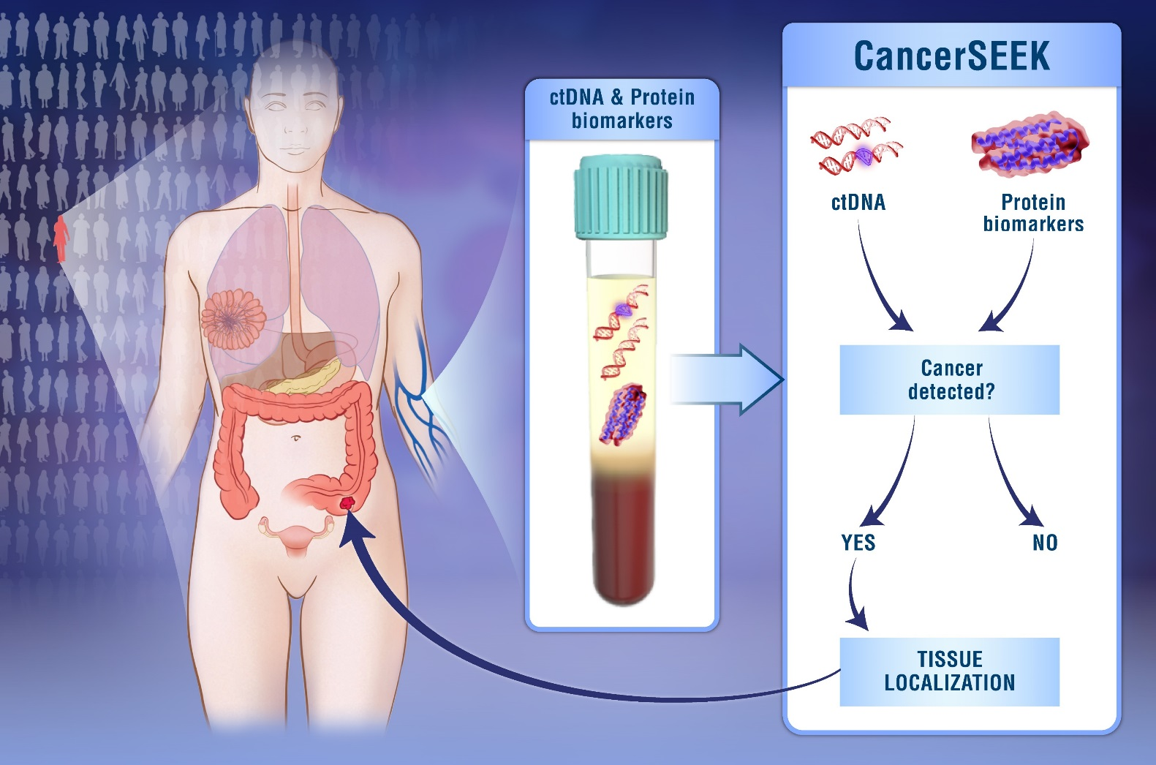
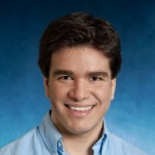
CancerSEEK Blood Test
Josh Cohen
Cohen et al., Science in press, 2018

Slide 21
The Cancer Seek Study
1,005 Cancer Patients
209 Breast
288 Colorectal
45 Esophageal
44 Liver
104 Lung
54 Ovarian
93 Pancreatic
68 Stomach
812 Healthy Controls
The CancerSeek Test
ctDNA
61amplicons in 16 genes covering 2,001 positions in the genome
39 Protein Markers
No Distant Metastases
20% Stage I
49% Stage II
31% Stage III
Median Age 64 years
Notes:
Selected 41 markers that were elevated in > 10% of at least one of the 8 cancer types with > 99% specfiicty. 39 could be reproducibly assayed in a multiplexed assay with Luminex Bead based assays on a Bioprad Bioplex 200 instrument.

Slide 22
ctDNA Panel Performance in Tumors
82% of Tumors had at least one detectable mutations
Proportion Detected (%)

Slide 23
Multi-analyte screening test (ctDNA and 39 protein markers)
Tumor Detection
ctDNA
8 Protein Markers
CA-125
CEA
CA19-9
PRL
HGF
OPN
MPO
TIMP-1
ctDNA
Logistics Regression
Cancers
Normals
Notes:
We used log ratios to evaluate mutations (omega scores) and incorporated them into Logistics Regression algorithm that incorporated the mutation data and the 8 protein markers indicated. Specificity and sensitivity we evaluated using 10 iterations of a 10-fold cross validation.

Slide 24
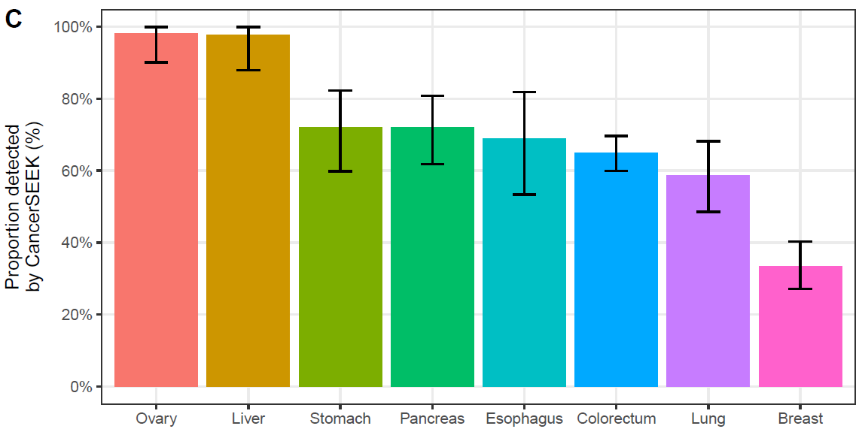
CancerSEEK Sensitivity (Blood)
69% to 98%
70% Median Sensitivity (p < 10⁻⁹⁶ one-sided binominal)
>99% Specificity (7 of 812 Healthy Controls)
Range (33% to 98%)
Ovary
Liver
Stomach
Pancreas
Eso
Colon
Lung
Breast
Notes:
62% average
55% when adjusted for tumor distributions in populations.

Slide 25
Positive test—then what next?
YES

Slide 26
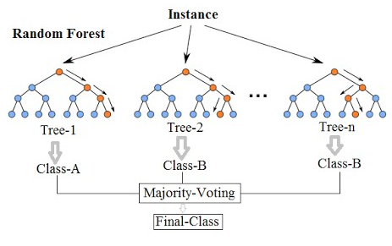
CancerSEEK Localization
Machine Learning (Random Forest)
ctDNA data (gene level)
Protein data (all 39 protein markers)
Gender
Notes:
Trees and Forests. The random forest starts with a standard machine learning technique called a “decision tree” which, in ensemble terms, corresponds to our weak learner. In a decision tree, an input is entered at the top and as it traverses down the tree the data gets bucketed into smaller and smaller sets.
Why is it called random then?
Say our dataset has 1,000 rows and 30 columns. There are two levels of randomness in this algorithm:
At row level: Each of these decision trees gets a random sample of the training data (say 10%) i.e. each of these trees will be trained independently on 100 randomly chosen rows out of 1,000 rows of data. Keep in mind that each of these decision trees is getting trained on 100 randomly chosen rows from the dataset i.e they are different from each other in terms of predictions.
At column level: The second level of randomness is introduced at the column level. Not all the columns are passed into training each of the decision trees. Say we want only 10% of columns to be sent to each tree. This means a randomly selected 3 column will be sent to each tree. So for the first decision tree, may be column C1, C2 and C4 were chosen. The next DT will have C4, C5, C10 as chosen columns and so on.

Slide 27
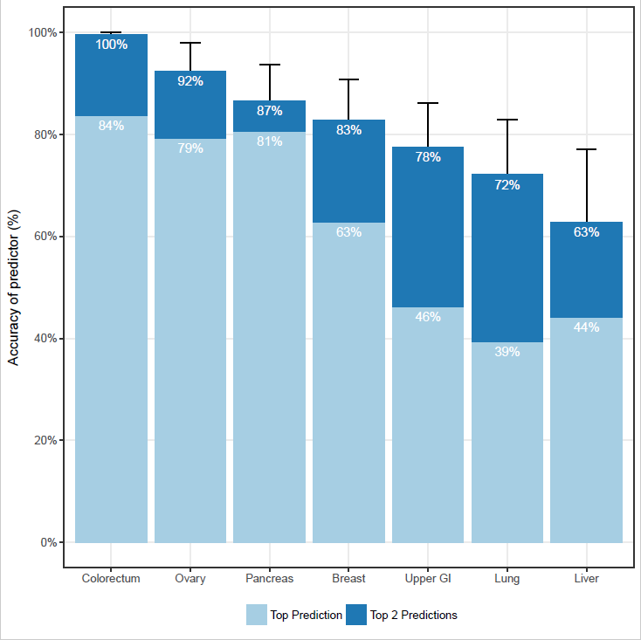
CancerSEEK Localization Accuracy
Accuracy of Prediction (%)
Top Prediction was correct in a median of 63% of the cases.
(p < 10⁻⁴⁷ one-sided binomial test)
Top 2 Prediction identified the site in a median of 83% of the cases.
(p < 10⁻⁷⁷ one-sided binomial test)
Top Prediction
Top 2 Predictions
Colon
Ovary
Panc
Breast
Upper
GI
Lung
Liver
Notes:
626 patients who tested positive
Used all 39 Protein Markers, ctDNA and gender
Grouped Gastric and esophageal together

Slide 28
Limitations of the CancerSeek Study
Most patients in this study were diagnosed on the basis of symptoms of disease.
Controls for this study were limited to healthy individuals.
Ten-fold cross-validation was used for developing the algorithms in the paper.
The proportion of cancers types was not representative of those in the United States.
Establishing the clinical utility of CancerSEEK will require multiple prospective studies.

Slide 29
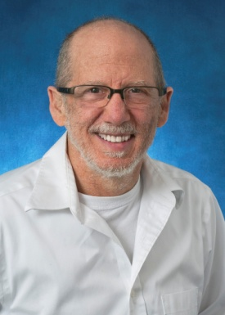
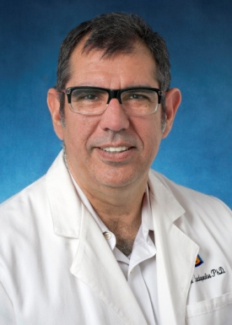
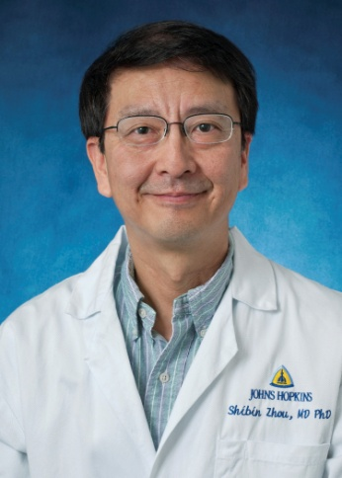
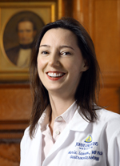
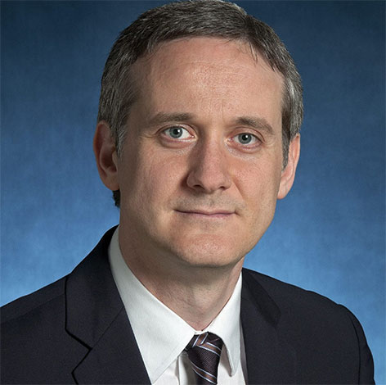
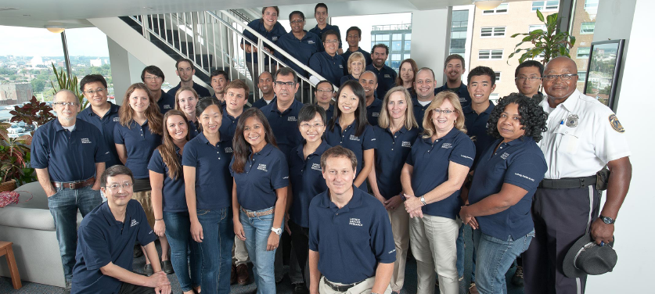
Acknowledgements
Anne Marie O'Broin Lennon
Bert
Vogelstein
Nick
Papadopoulos
Shibin
Zhou
Cristian Tomasetti
EDRN
The Marcus Foundation
The Lustgarten Foundation‎
Ludwig Cancer Research

Slide 30
Disclosure
“Under licensing agreements and the Johns Hopkins University, Dr. Kinzler ,is entitled to a share of royalty and milestone payments received by the University on sales of products related to previous and ongoing research in the lab. He also has ownership interest in PapGene Inc.and PGDx. The terms of these arrangements are being managed by the Johns Hopkins University in accordance with its conflict of interest policies.”
PapGene Inc.
Sysmex Inostics
PGDx
Exact Sciences Corporation
LabCorp
Genzyme Corporation
Agencourt
GMP Companies
Morphotek
Calbiochem Novabiochem
Wyeth
Amgen
Merck
OncoMethylome Sciences
GanyMed
Bayer Corporation
454 Life Sciences
Corixa Corp
Q-Biogene
Smithkline-Beecham
Stratagene
Yamanouchi Pharmaceuticals
Zymogenetics
Qbiogene
Quantum Biotech
Zymogenetics

Slide 31
END – Thank you

Slide 32
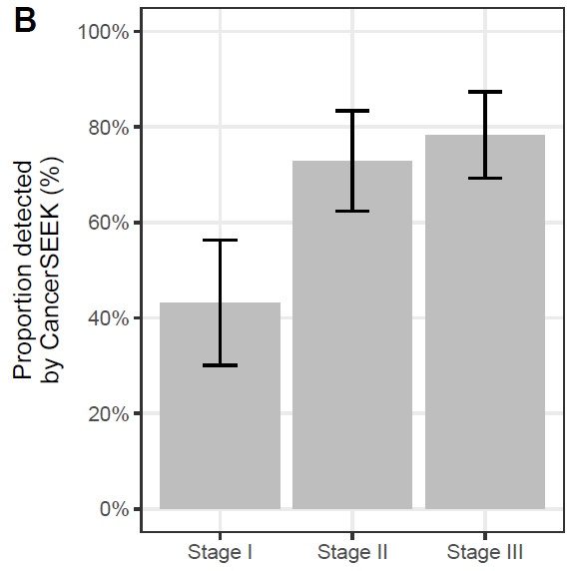
CancerSEEK Sensitivity by Stage
78%
73%
43%
Notes:
Stage 1 ranged from 20% for Eso to 100% for Liver
No independent test group
Most patients presented with symptoms
Need a prospective trial

Slide 33
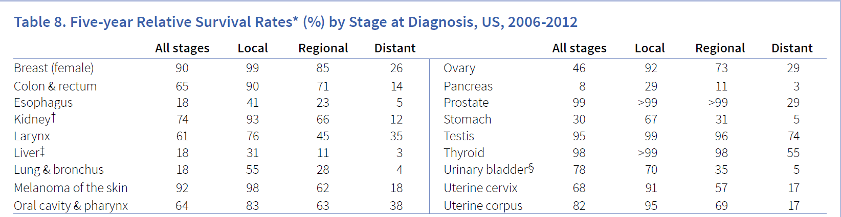
Earlier Detection Now is a Great Start
Type | Distant (Stage 4) | Regional | Local
Colon & Rectum | 14 | 71 | 90
Ovary | 29 | 73 | 92
Stomach | 5 | 31 | 67
Lung | 4 | 28 | 55
Source: ACS Cancer Facts and Figures 2017

Slide 34

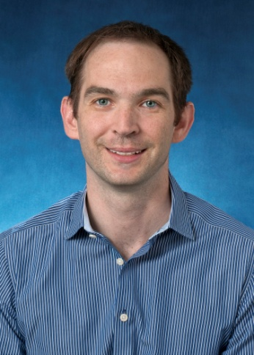
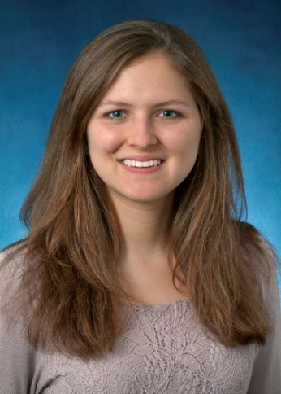
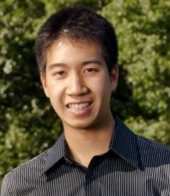
Expanding Immuno-Targets
Skora et al., PNAS 112:9967-72 2015.
Andrew Skora
Jackie Douglas
Michael Hwang
Shibin Zhou

Slide 35
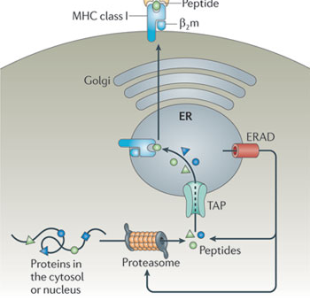
Intracellular Oncogene Mutations can be Extracellularly Presented
Common HLA alleles include:
HLA-A2 (~30-50% of the US population)
HLA-A3 (~10-15% of the US population)
HLA-B7 (~10-15% of the US population)
Run predictions on most commonly mutated Oncogenes
Develop Antibodies against the HLA-epitope complex
-Must be specific to mutated epitope and not its wild type counterpart
KRAS
HLA-A2
Neefjes J et al., Nature Reviews Immunology 11:823 (2011)
Notes:
Highlight specificity

Slide 36
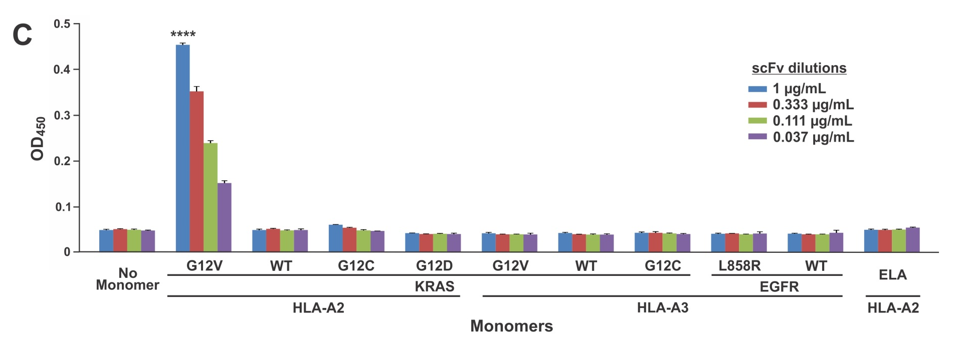
Recombinant D10 scFv Specifically Recognizes KRAS Mutant Sequence in HLA-A2

Slide 37
Recombinant D10 scFv Specifically Recognizes KRAS Mutant Sequence in HLA-A2

Slide 38
Recombinant D10 scFv Specifically Recognizes KRAS Mutant Sequence in HLA-A2

Slide 39
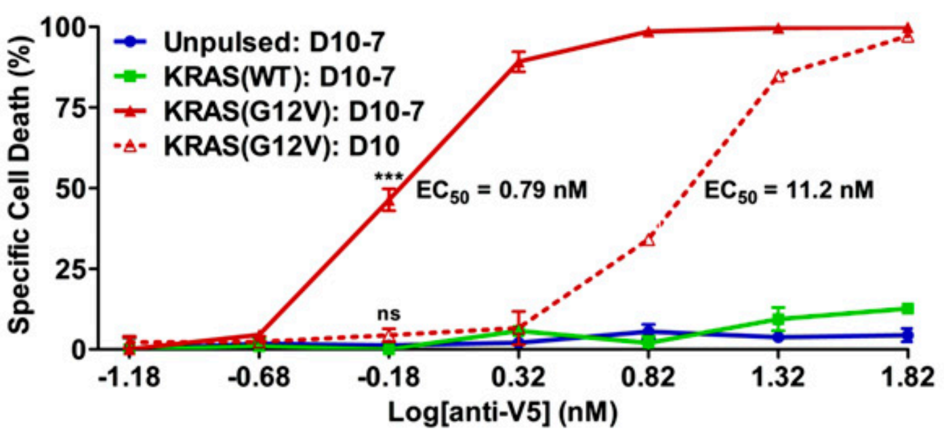
D10 Successfully Kills KRAS G12V Pulsed T2 cells
-D10: V5-tagged scFv specific to KRAS(G12V)-HLA-A2
-D10-7: V5-tagged, affinity-matured scFv variant of D10
Incubate with T2 cells in the presence of Complement

Slide 40
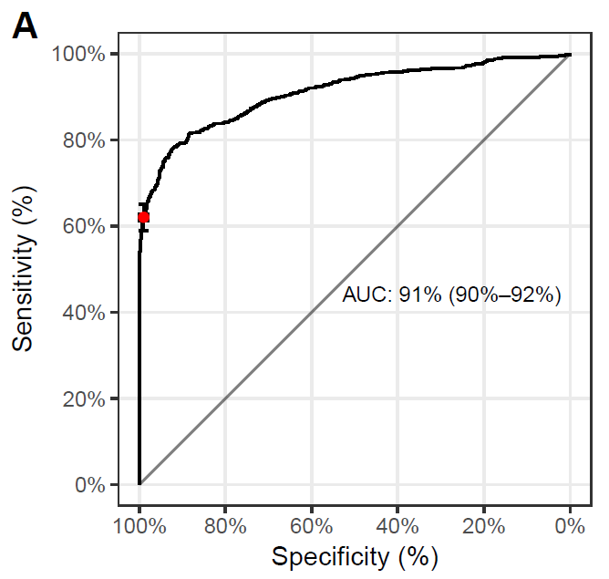
CancerSEEK Sensitivity/Specificity
62% Sensitivity
>99% Specificity

Slide 41
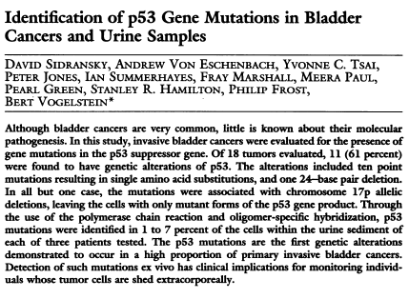
An Overnight Success 25 years in the Making
“Detection of such mutations ex vivo has clinical implications for monitoring individuals whose tumor cells are shed extracorporeally.”
Science 252:706 1991

Slide 42
Exploiting the Cancer Genome: Early Detection to Therapy
Early Detection
Released tumor DNA (rtDNA)
Released tumor DNA (rtDNA) is tumor DNA recovered from samples distinct from overtly neoplastic tissue.
rtDNA can be found in variety of clinically accessible samples.

Slide 43
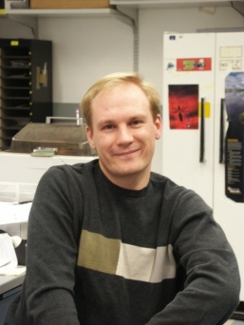

BEAMing
Beads
Emulsion
Amplification
Magnetic
Devin Dressman
A method to perform tens of thousands of digital PCR reactions in a single tube and quickly analyze the products.
Dressman et al. PNAS 100(15):8817 2003
Notes:
Coolest tools of all.

Slide 44
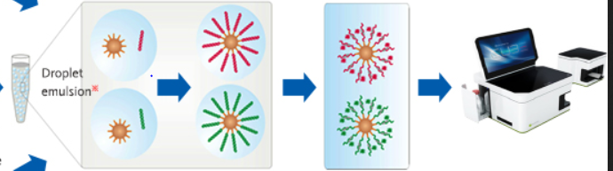
BEAMing: Single molecule amplification on beads in water-in-oil emulsions
Emulsion
PCR
Mutation
Discrimination
Detection
PNAS 100: 8817 (2001)
Nat Methods 3: 551 (2006)
Graphic Credit: Symex Inostics

Slide 45
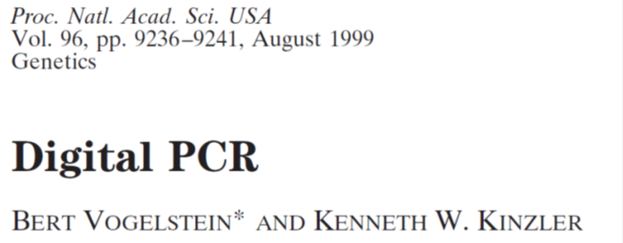
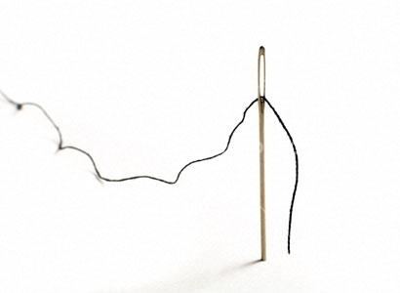


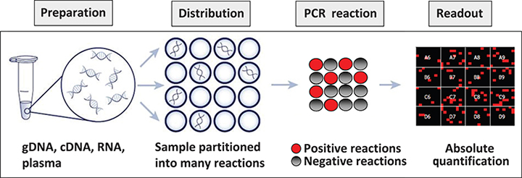
Technical Challenge: Finding the Needle in the Haystack

Slide 46
Adapting massively parallel sequencing to detection of mutations in clinical samples
Advantages
Digital
High-throughput
Automatable
Disadvantages
Error rate is too high for early detection (~1%)

Slide 47
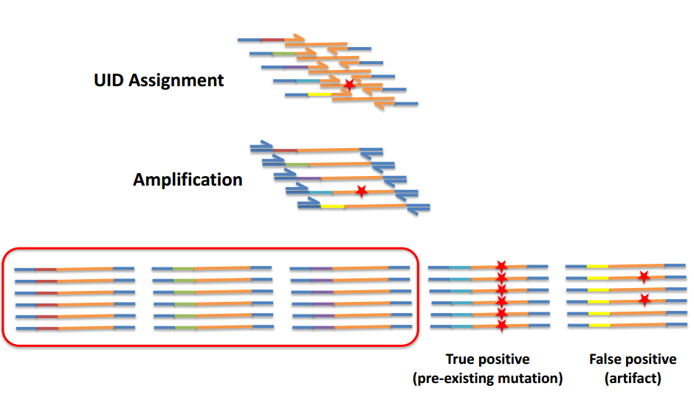
Safe-Sequencing System (Safe-SeqS): Detection of low frequency mutations

Slide 48
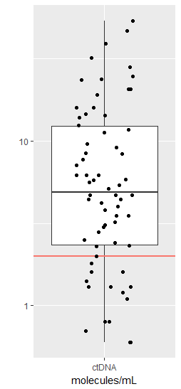
ctDNA is present in extremely low quantities in early stage patients
66/221 (30%) PDAC patients contained detectable KRAS mutation
< 2 molecules/mL in 15/66 (23%) patients
How can we improve sensitivity?
Combine ctDNA with protein markers (e.g. CA19-9, CA-125, etc.)
Cohen, et al. PNAS (2017)

Slide 49
Putting it all together…
Accept
Logistic function
Reject
Income ($)

Slide 50
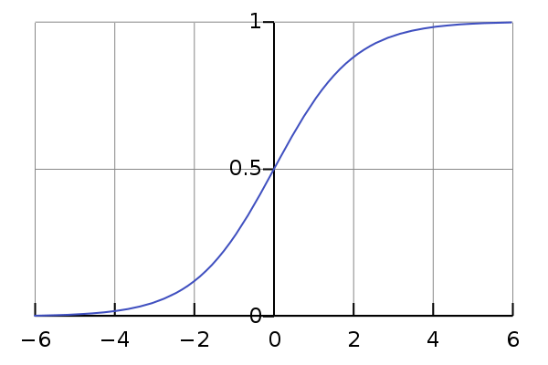



Logistic Regression
$$σ\left(t\right)=\frac{e^{t}}{e^{t}+1}=\frac{1}{1+e^{−t}}$$
$$t= β_{0}+\sum_{i=1}^{m}{β_{i}x_{i}}$$
$$F\left(x\right)=\frac{1}{1+e^{−\left(β_{0}+\sum_{i=1}^{m}{β_{i}x_{i}}\right)}}$$

Slide 51


Theoretical sensitivity
Assume n = 10 ng DNA = 3,080 hGEs
Let m = # observed DNA molecules containing a particular mutation
Let d = ctDNA fraction/limit of detection
But if have k mutations, then:
m$\sim Poisson\left(λ\right)$
$$λ=n∗d$$
$$x=P\left(m ≥1\right)=1−e^{−nd}$$
$$P\left(m ≥1\right)=1−{\left(1−x\right)}^{k}=1−e^{−ndk}$$

Slide 52

Multiple mutation detection

Slide 53




PD-1 Blockade in Tumors with DNA Mismatch Repair Deficiency
Dung Le
Le et al., N Engl J Med 372:2509-20 (2015)
November 2015
The FDA granted a breakthrough therapy designation to pembrolizumab (Keytruda) as a potential therapy for patients with MSI-H metastatic colorectal cancer (mCRC).
Luis Diaz
Notes:
The FDA’s Breakthrough Therapy Designation is intended to expedite the development and review of a candidate that is planned for use, alone or in combination, to treat a serious or life-threatening disease or condition when preliminary clinical evidence indicates that the drug may demonstrate substantial improvement over existing therapies on one or more clinically significant endpoints. KEYTRUDA was previously granted breakthrough status for advanced melanoma and advanced non-small cell lung cancer (NSCLC).

Slide 54


Pembrolizumab for All MMRd Cancers
Le et al., Science 357:409 (2017)
Dung Le
86 Consecutive Patients
12 Different Tumor Types
Mismatch Repair Deficient
Progressive Disease
Luis Diaz
Notes:
86 Consecutive Patients
12 Different Tumor Types
Mismatch Repair Deficient
Progressive Disease
All patients had PCR or immunohistochemisitry (MLH1, MSH2, MSH6 and
PMS2) evidence for Mismatch Repair Deficiency
All patients had received at least one prior treatment and had evidenc eof progression at time of enrollment
48% of the patients had germline mutation in MMR genes suggestive of Lynch syndrome

Slide 55

Mutated Oncogenes per Tumor
100% have 1 or fewer
~79% have 1 or fewer
~86% have 1 or fewer
~73% have 1 or fewer
~58% have 1 or fewer
Notes:
Classic epidemiology studies have suggested that 5-8 hits are required for a tumor
Trivial Explanations
Missed mutations
Some passengers may be drivers in specific micro environments

Slide 56
Targeting Oncogenes in CRC
APC/β-catenin
FAP
TP53
PIK3CA
RAS
Notes:
The two major oncogenes in CRC, in fact the two major oncogenes across all cancers have yet to be targeted.
PIKCCA
KRAS
More over, Not only have KRAS not been targeted in CRC, they predict lack of response to EGFR blockade and convey that secondary resistance we talked about before!

Slide 57
Mutation Associated NeoAntigens (MANA)
HLA-A*0201 epitopes per sample
Colorectal cancers
Average = 7
Breast cancers
Average = 10
Segal et al., Cancer Research, 2008.

Slide 58
The Expanding Clinical Utility of Cancer Genomes
The Inherited Genome
The Somatic Genome
The Trace Genome
Notes:
Today I like to share some of the insights that we have accumulated at the Ludwig Center over 35 years of cancer research. Specifically I want to talk about ways to exploit the cancer genome. When I say exploit, I am largely talking utility beyond basic biological insights but focusing mainly on clinical utility. By Cancer
Genome, I actually am referring to 3 distinct types of genomic analysis pertinent to cancer.
Introduce the three genomes…
I talk about these in the order seen hear as the follow the timeline in which both basic discovery and clinical application developed. Finally I will often use CRC as a model to illustrate points.

Slide 59
Familial Adenomatous Polyposis (FAP)
Affects about 1 in 10,000 individuals
Develop 100s to 1,000s of benign polyps
Average age at Cancer Dx is 39
Due to truncating a mutation in the APC gene
FAP patients accounts for <1% of all CRC patients
Pathway mutated in >95% of sporadic CRC
Gatekeepers
Normal
FAP
Notes:
-Tracy is Unit Head of Cell Biology at Children's Medical Research Institute Associate Professor Sydney Medical School, Sub-dean of postgraduate research at Sydney Medical School.
-The first convincing case of familial adenomatous polyposis was published 130 years ago, and in the first half of this period the disease was primarily described and managed by surgeons and pathologists. Modified from Familial Cancer September 2006, Volume 5, Issue 3, pp 213–220 The history of familial adenomatous polyposis.
-The reported incidence of familial adenomatous polyposis varies from 1 in 7,000 to 1 in 22,000 individuals.
https://ghr.nlm.nih.gov/condition/familial-adenomatous-polyposis#statistics
-The average age of adenoma development is 16 years, whereas the average age of colon cancer is 39 years.
Versus For sporadic colon cancer, the average age at the time of diagnosis for men is 68 and for women is 72.

Slide 60
Hereditary NonPolyposis Colorectal Cancer (HNPCC, Lunch Syndrome)
Affects about 1 in 1,000 individuals
No striking excess of benign precursors
Average age at cancer Dx (CRC, EC) is 44
Due to mutations in DNA MisMatch Repair genes
(MMR: MLH1 [50%], MSH2 [40%], MSH6 [10%], PMS2 )
HNPCC patients accounts for about 3% of all CRC patients
Sporadic defects in MMR occur in ~15% of CRC and EC
Caretakers

Slide 61
Applications of the Inherited Genome
Biological Insights
Two – hits
Gatekeeper Tumor Suppressor Genes
Caretaker Genes
Presymptomatic Diagnosis of Individuals with Inherited Predispositions to Cancer
Prophylactic procedures and treatments
Enhanced surveillances for early detection
Gene Editing or Genetic Intervention

Slide 62
The Expanding Clinical Utility of Cancer Genomes
The Inherited Genome
The Somatic Genome
The Cancer Specific Genome
The Trace Genome
Notes:
Today I like to share some of the insights that we have accumulated at the Ludwig Center over 35 years of cancer research. Specifically I want to talk about ways to exploit the cancer genome. When I say exploit, I am largely talking utility beyond basic biological insights but focusing mainly on clinical utility. By Cancer
Genome, I actually am referring to 3 distinct types of genomic analysis pertinent to cancer.
Introduce the three genomes…
I talk about these in the order seen hear as the follow the timeline in which both basic discovery and clinical application developed. Finally I will often use CRC as a model to illustrate points.

Slide 63
Exploiting the Somatic Genome Advancing Technology
32,514 Cancer Whole Genomes
5,366,273 Mutations Identified
COSMIC November 2017
RAS
1987
p53
1989
APC
1992
PIK3CA
2004
Exome
2006
Exome
2010
Genome
2014
Notes:
APC 8529 0.250000 Tracy Bryan university of Sydney
Each line is two orders of magnitude
RAS 16 50.000000
P53 1179 21.204411
APC 8529 0.250000
PIK3CA 24000 0.020000
Exome 21,000,000 0.010000
NGS Exome 38,000,000 0.000040
NGS Genome 3,000,000,000 0.000000035

Slide 64
Applications of the Somatic Genome
Identifying Mutagenic Cancer Causing Agents
Diagnosis
Prognosis
Prediction of Therapeutic Response
Oncogene Targeted Therapies
Far fewer oncogene targets than hoped
Major oncogenes difficult to target
Resistance to single targeted drug
Immunotherapy

Slide 65



Cancer Genetics meets Cancer Immunology
+
Genetics
Immunology
=

Slide 66

Immune Checkpoint Blockade
Notes:
Ipilimumab (trade name Yervoy, Bristol-Myers Squibb) is a monoclonal antibody that works to activate the immune system by targeting CTLA-4, a protein receptor that downregulates the immune system. Ipilimumab was approved by the U.S. FDA in 2011 for the treatment of melanoma, a type of skin cancer.[5][6]
Pembrolizumab (Keytruda, Merck) had been granted breakthrough therapy, priority review, and orphan drug status. It was the first agent blocking the PD-1 cellular pathway to secure U.S. approval.
On December 22, 2014, the FDA approved nivolumab (Opdivo, Bristol-Myers Squibb) for advanced melanoma.¹² In March 2015, the agency added treatment of advanced squamous NSCLC to nivolumab’s indications, based on a gain of 3.2 months in OS compared with docetaxel among 272 patients.¹

Slide 67
Genome Wide Sequencing Studies
Will these patients respond similarly or better?
FDA approved Immune Checkpoint Inhibitors target tumors with high mutational loads
Anti CTLA-4: Melanoma (2011)
Anti-PD-1: Lung and Melanoma
Science 339, 2013

Slide 68
PD-1 Blockade in Tumors with DNA Mismatch Repair Deficiency
Dung Le
Le et al., N Engl J Med 2015, 372:2509-20 2015
Phase 2 Clinical Trial
(Pembrolizumab)
Cohort A – MMR deficient CRC
Cohort B – MMR proficient CRC
Cohort C – MMR deficient nonCRC
Luis Diaz
Notes:
Phase 2 study with primary endpoint being immune-related objective response rate and PFS at 20 weeks.
Patients had treatment refractory progressive disease
CRC MSI n=11, CDC MSS n=22, nonCRC n=11
MSI had a mean of 1782 mutations whereas MSS had a mean of 73

Slide 69

Immune Checkpoint Blockade (Pembrolizumab in MMRp and MMRd CRC)
(High Mutation Load)
Hypermutated
(N=11)
Median PFS = 2.2 months
Progression Free Survival
Median PFS never reached
(N=21)

Slide 70

Immune Checkpoint Blockade (Pembrolizumab in MMRp and MMRd CRC)
(High Mutation Load)
Hypermutated
(N=11)
Most patients still alive at
12 month study end
Overall Survival
Median OS = 5.0 months
(N=21)

Slide 71


Pembrolizumab in 12 Different Types of MMRd Cancers
53% objective response rate
21% complete response rate
Median OS never reached
Median PFS never reached
Stefanie Joho
A Woman’s 2017
Notes:
As we can see here most patients are still alive at 3 years
86 Consecutive Patients
12 Different Tumor Types
Mismatch Repair Deficient
Progressive Disease
All patients had PCR or immunohistochemisitry (MLH1, MSH2, MSH6 and
PMS2) evidence for Mismatch Repair Deficiency
All patients had received at least one prior treatment and had evidenc eof progression at time of enrollment
48% of the patients had germline mutation in MMR genes suggestive of Lynch syndrome

Slide 72
Pembrolizumab for All MMRd Cancers
Le et al., Science 357:409 (2017)
Dung Le
May 23, 2017
FDA Approves Keytruda (pembrolizumab) as First Cancer Treatment for any Solid Tumor with a Specific Genetic Feature (MMRd) using the Accelerated Approval Pathway
Luis Diaz
Notes:
86 Consecutive Patients
12 Different Tumor Types
Mismatch Repair Deficient
Progressive Disease
53% objective response rate
21% complete response rate
Median OS never reached
Median PFS never reached
All patients had PCR or immunohistochemisitry (MLH1, MSH2, MSH6 and
PMS2) evidence for Mismatch Repair Deficiency
All patients had received at least one prior treatment and had evidenc eof progression at time of enrollment
48% of the patients had germline mutation in MMR genes suggestive of Lynch syndrome

Slide 73


The Future of Oncology
Elysium (2013 Science fiction film)
Part of the storyline portrayed Medicine in the future (2159)
Preventive Medicine
Designed to protect, promote, and maintain health and well-being and to prevent disease, disability, and death.
Notes:
Many movies have portrayed the future of medicine, Take for example the famed tricorder from Star Trek. Here we see images from the 2013 Science fiction movie Elysium starring Matt Damon and Jodie Foster. In this movie, we see a future where the elite class live disease-free due to daily health scans that detect problems when they are easily cured. No movie or person can claim to predict the future of medicine for they will surely do a lousy job. However, there are certain things that will almost certainly be true. One is that Preventive medicine will play a major role and two in the case of cancer, they will wonder why we focused so much effort on therapy rather than prevention.
We are challenging you to deliver the future now!

Slide 74
Cancer Prevention
Primary Prevention – Interventions intended to keep a cancerous process from ever developing (e.g. smoking cessation, sun screen use initiatives, vaccination)
Secondary Prevention – Interventions intended to discover and control cancerous or precancerous lesions while localized and curable
Primary Prevention can not stop all cancer
Early Detection is Prevention

Slide 75


Prevention
“An ounce of prevention is worth a pound of cure”
Cure
Prevention
Benjamin Franklin

Slide 76
Examples of Successful Prevention even when Therapies are Ineffective
Coronary Infarct
Polio Paralysis
Cervical Cancer
Between 1955 and 1992, the rate of cervical cancer deaths in the U.S. declined by nearly 70%.
Notes:
Use exposure to tobacco and Lung cancer as successful examples of prevention and signatures and lead way into AA.
HPV Vaccines: Virtually all (99.7%) cervical cancers are caused by persistent infection with high-risk type of human papilomavirus (HPV). Two FDA-approved vaccines (Gardasil and Cervarix) are currently in use.

Slide 77
Challenges to Early Detection
Psychosocial – Society and individual tend to give priority to reactive rather than proactive solutions.
Economical – Needs to be cost effective to administer across the population.
Practical – Needs to be readily deliverable across the population.
Technical – Test must detect curable disease with high specificity (>99%).
The journey must begin with an
Excellent Cancer Biomarker

Slide 78

Developing a Blood Test for Cancer
circulating tumor DNA (ctDNA)
cfDNA (Plasma vs. Serum)
Degraded (<150 bp)
Short Half-life: ~30 minutes
Limited number of molecules
The vast majority of DNA in the circulation is not tumor DNA.

Slide 79
The Expanding Clinical Utility of Cancer Genomes
The Inherited Genome
The Somatic Genome
The Cancer Specific Genome
The Trace Genome
Notes:
Today I like to share some of the insights that we have accumulated at the Ludwig Center over 35 years of cancer research. Specifically I want to talk about ways to exploit the cancer genome. When I say exploit, I am largely talking utility beyond basic biological insights but focusing mainly on clinical utility. By Cancer
Genome, I actually am referring to 3 distinct types of genomic analysis pertinent to cancer.
Introduce the three genomes…
I talk about these in the order seen hear as the follow the timeline in which both basic discovery and clinical application developed. Finally I will often use CRC as a model to illustrate points.

Slide 80
Applications of the Trace Genome
Released tumor DNA (rtDNA) is tumor DNA recovered from samples distinct from overtly tumor tissue.
Genetic alterations in tumor DNA are causatively related to cancer and are present from the initiating steps.
rtDNA can be found in variety of clinically accessible samples at low levels.

Slide 81
Released Tumor DNA (rtDNA) as a Clinical Biomarker
Monitoring
Detection of minimal residual disease
Detection of resistance mutations
Diagnosis in the absence of biopsy
Identification of actionable mutations
Identification of resistance mutations
Early Detection

Slide 82
Digital PCR (Vogelstein & Kinzler, Proc. Natl. Acad. Sci., USA 96: 9236-9240, 1999)
Wild type
Mutant
Analog
Digital

Slide 83


Next Generation Sequencing is Inherently Digital
NGS-tumor
G

Slide 84
Essential elements of Safe-SeqS
Tag starting molecules with endogenous or exogenous unique identifiers (UIDs)
Sequencing or Replication Error
Legitimate
Change
*
This strategy can decrese error rates by >70-fold.
Kinde et al. PNAS 108:9530 2011

Slide 85

Survey of ctDNA in Human Cancer (N= 640 Patients)
Chetan
Bettegowda
Bettegowda et al.
Sci Transl Med. 2014 Feb 19;6(224):224ra24.
Notes:
Having addressed these technical challenges, what about biological challenges?

Slide 86
ctDNA Predicts Recurrence in Stage II Colon Cancer
Recurrence Free (%)
Jeanne Tie
Months since surgery
Tie et al., Sci Transl Med. 8(346):346ra92 2016.
Peter Gibbs
Tie et al., Ann Oncol, 2015.
Tie et al., Gut 2018.
Notes:
The Walter and Eliza Hall Institute of Medical Research and University of Melbourne
Shown is the clinically defined low risk patients with no chemo.
HR was 18 for all patients.
HR was 7.5 for clinically defined high risk patients.
HR was 3.3 using standard clinical data.

Slide 87
Study Rationale
Use of adjuvant chemotherapy in stage II colon cancer remains controversial.
Guidelines suggest consideration of presence of high-risk prognostic features and patient preferences
mismatch repair/microsatellite instability status
High-risk prognostic factors
T4, tumor perforation, bowel obstruction, poorly differentiated tumor, venous invasion, or < 10 examined nodes
Can post-op ctDNA identify high risk patients?

Slide 88
Collection of clinical samples
and follow-up data
250 patients with Stage II colon cancer
Tumor Tissue
4-10 weeks post-op blood samples
- Use of adjuvant chemo at clinician’s discretion
- 3-monthly clinical review
- 6-monthly restaging CT
Mutations identified in 230 of 231 eligible patients
Target sequencing of 15 genes
3-monthly follow-up blood draw in a subset of patients*
Mutations identified in tumors
- ctDNA quantification with Safe-SeqS
- CEA analysis
Recurrence and survival data
*Results of follow-up bloods are not reported here.

