Slide 1
Development of Early Cancer Detection Tests Based on Sequencing of Cell-Free Nucleic Acids
Elizabeth Mansfield, PhD

Slide 2



GRAIL was formed in 2016 - following discoveries in the NIPT space
illumina
G R A I L
Early detection team formed
Formation
STRIVE
2015
2016
2017
2018
Noninvasive prenatal testing and incidental detection of occult maternal malignancies
Notes:
Overview of timeline
March 2015 Initial work for an early detection cancer tests starts at Illumina
July 2015 JAMA publication from Illumina finds cancer cases amongst NIPT testing population (10 cancer cases found among 125K samples)
Jan 2016 Illumina announced formation of GRAIL and initial series A funding
March 7, 2016 Initial 40 employees of GRAIL start for their first official day “GRAIL DAY” at 3 different locations
Dec 2016 CCGA Study initiated
Apr 2017 STRIVE Study initiated
June 2017 ASCO presented two publications

Slide 3



GRAIL’s Vision for Early Cancer Detection
Comprehensive test to detect many types of early-stage cancer
More effective use of x-ray and other invasive procedures
Minimal false positive results, as cell-free nucleic acids (cfNAs) are a direct measurement of cancer
Potential for global reach

Slide 4



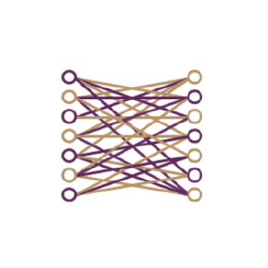
The GRAIL Approach
High-intensity sequencing to detect cell-free nucleic acids shed by tumor cells into blood
A large clinical trial program to generate scientifically rigorous evidence of clinical utility
Rigorous data science to classify patients by presence, type, and severity of cancer from a large and complex dataset
Notes:
Key points:
Tumors are genomically heterogenous (<1% of cfDNA in blood,), so you have to look “broadly” across the genome to see most cancers.
Signal in early stage can be low, so you need to look “deeply” at regions of interest in the genome.
Going broad X deep = ultra deep sequencing.
The three pillars of our approach -- What I’d like to focus on today is the first two.
High intensity sequencing: Reliably detect cfNAs shed by tumors in early stage disease by looking broadly across the entire genome, and at extraordinary depth to detect faint signals. Platform agnostic to get vast amounts of genomic data.
Large-scale clinical studies: Confirm clinical utility and validity of tests through one of the largest clinical study programs ever conducted in genomic medicine
Can the test distinguish cancer from non-cancer?
Can the test anticipate a future diagnosis?
Does this result in a stage shift and mortality benefit?
Prospective -- We have to build our own cohorts.
building the clinical evidence and tests pre specified hypotheses
State of the art computer science and data science: Apply the latest tools of data science to classify patients according to the presence, type, and severity of cancer
Unlike most companies that have an IT dept that are supportive - building and managing databases
Technology is a cornerstone. - - e.g. Pipelines and infrastructure that are learning systems, rather than heuristically driven. -- SWE department that come from Twitter, Facebook, Google, to ask the questions that we don’t know to ask. To re-architect Genomic data computing.

Slide 5




GRAIL Assay Portfolio
Leverages complementary features of genetic alterations in cancer
Targeted sequencing of cfDNA, WBCs
Detects:
Somatic mutations in 507 genes, including exons
Whole-genome sequencing of cfDNA, WBCs
Detects:
Somatic copy number alterations, rearrangements, fusions
Targeted and whole-genome bisulfite sequencing of cfDNA
Detects:
Global and gene-specific hypo- and hypermethylation
Whole-transcriptome sequencing of cfRNA
Detects:
Degraded mRNA, exosomal RNA, miRNA

Slide 6







GRAIL’s Clinical Research Program
Enrolling more than 130,000 people, including a study enrolling a cohort of 120,000 women
Cascading strategy to discover, evaluate, and validate features
Collaborating with leading community and academic medical centers
Developing detailed atlas of cfNA profiles in people with and without cancer to support product development
Develop classifiers to determine cancer status and type
Discovery Platform for Future Products

Slide 7
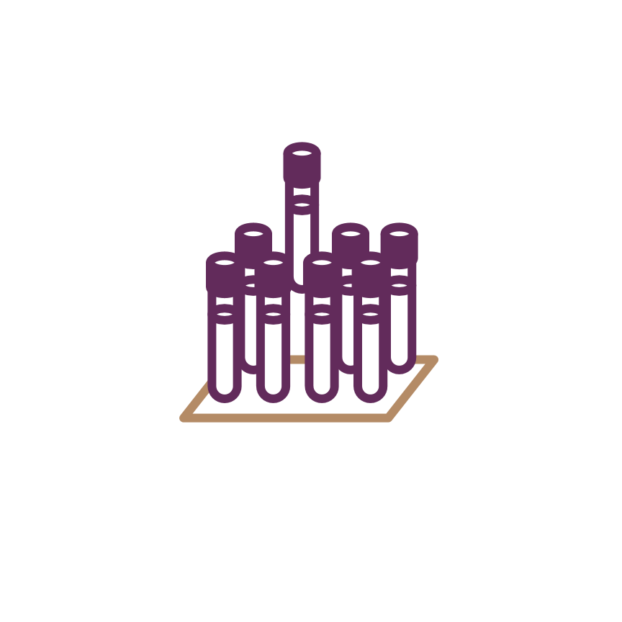



Circulating Cell-Free Genome Atlas (CCGA) Study
Targeted sequencing cfDNA, WBCs
Blood samples
(from all participants)
Whole-genome sequencing cfDNA, WBCs
Targeted & whole-genome bisulfite sequencing cfDNA
Whole transcriptome sequencing cfRNA
15,000+ participants
70% with cancer
30% without
Tissue samples
(cancer only)
Whole Genome Sequencing of tumor tissue
People with cancer: Data on treatment, recurrence, mortality
Follow-up for 5 yrs
Vital status & cancer status
People without cancer: Data on cancer diagnosis + treatment, recurrence, mortality; or remain cancer-free
FPI: 08/2016 Target: Complete Enrollment of all 15,000 Participants in 2018
Notes:
GRAIL’s foundational study to understand cfNA heterogeneity in cancer and establish a comprehensive cancer cfNA “reference library”
we are really pleased to work with our partners who have enrolled … in just 17 months

Slide 8

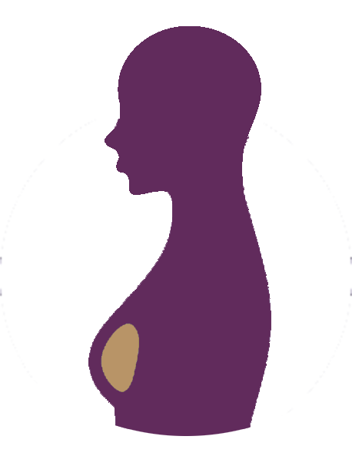
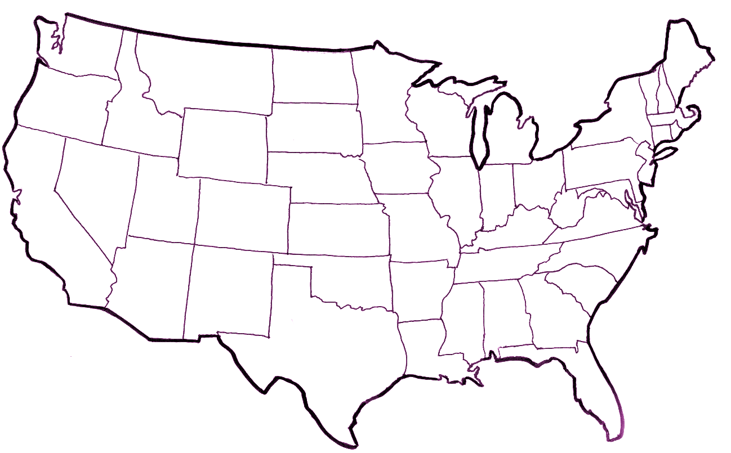
The STRIVE Study: Women’s Cohort
Longitudinal, prospective, observational cohort study
Blood collected at time of mammogram
Follow-up for vital status & cancer status yearly for 5 years
Evaluating early breast cancer detection product
Also collecting data on other cancers developed in the cohort to train a multi-cancer product
+
120,000 Asymptomatic Women
(mammogram & blood)
Multi-site study
Pan-imager model and make
Notes:
Multi-site, multi-network, multi-vendor
STRIVE Study - Breast Cancer
Blood test given during mammogram
Several study partners, Sutter Health locations, Mayo Clinic locations, Scottsdale Medical Imaging, Sarah Cannon
Women are incentivized to participate

Slide 9
STRIVE: Validation for cfNA test for Multi Cancer and Invasive Breast Cancer
Prospective, longitudinal, observational cohort study - 120,000 women undergoing screening mammography
120,000
Screening Mammograms
108,000
Normal/Benign
(BI-RADS 1, 2)
12,000
Abnormal
(NON-BI-RADS 1 & 2)
Return to routine annual mammo
Addl diagnostic workup/biopsy
90
Invasive cancers & DCIS missed
650
Non-breast cancers per year
~550
Invasive cancers & DCIS
11,400
Short interval or routine f/u
~50
cancers missed by diagnostic imaging
Up to 5 yrs of follow-up
Notes:
Study description: A prospective, multicenter, observational cohort study of women undergoing screening mammography to train and validate a test for detection of invasive breast cancer
Sample size and recruitment timeline: 120,000 women at the time of mammographic screening from clinical centers over 15 months, collect imaging data for at least 30 months and outcomes data for at least five years
Partnering Institutions: Sutter Health and Mayo Clinic actively enrolling participants. Additional institutions will be added by the end
End Points: Invasive breast cancer diagnosis within the first year. Secondary endpoints include cancer-specific mortality and diagnosis of non-breast cancers.

Slide 10








Acknowledgements
Participants
Clinical Partners

Slide 11
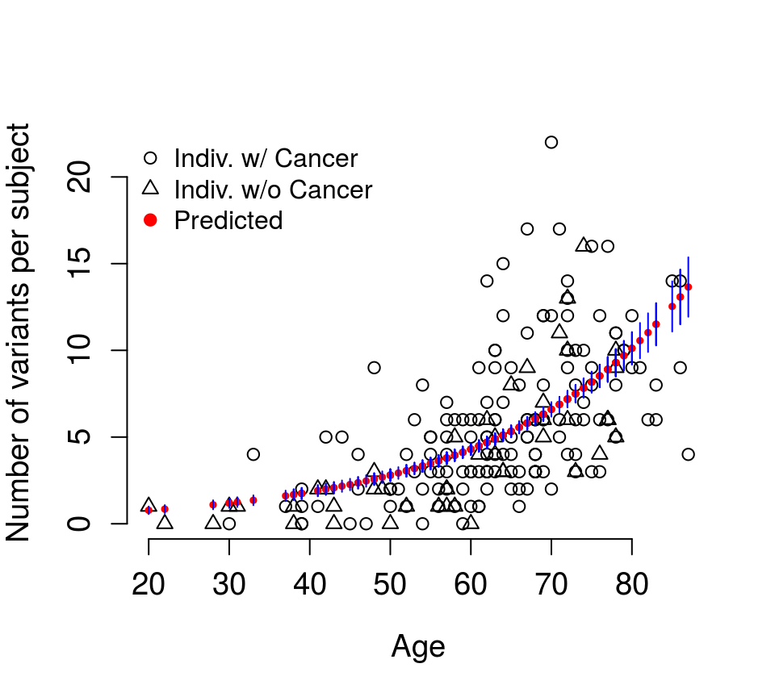
Biological Confounders
cfDNA variants originating from WBC clonal hematopoiesis
Matched variants in cfDNA and WBC Per Subject (after Quality Filtering)
White blood cells contribute somatic variants to plasma cfDNA
In healthy screening population and cancer patients
Number of variants alone shows no significant difference
Patients with cancer and participants without cancer
Modeling with age shown here
Razavi P, Li BT, Hou C, Shen R, Venn O, Lim RS, Hubbell E, De Bruijn I, Liu Q, Vijaya Satya R, Xu H. Cell-free DNA (cfDNA) mutations from clonal hematopoiesis: Implications for interpretation of liquid biopsy tests. Journal of Clinical Oncology: ASCO Annual Meeting Proceedings online supplement: 2017; LBA 11526.

Slide 12
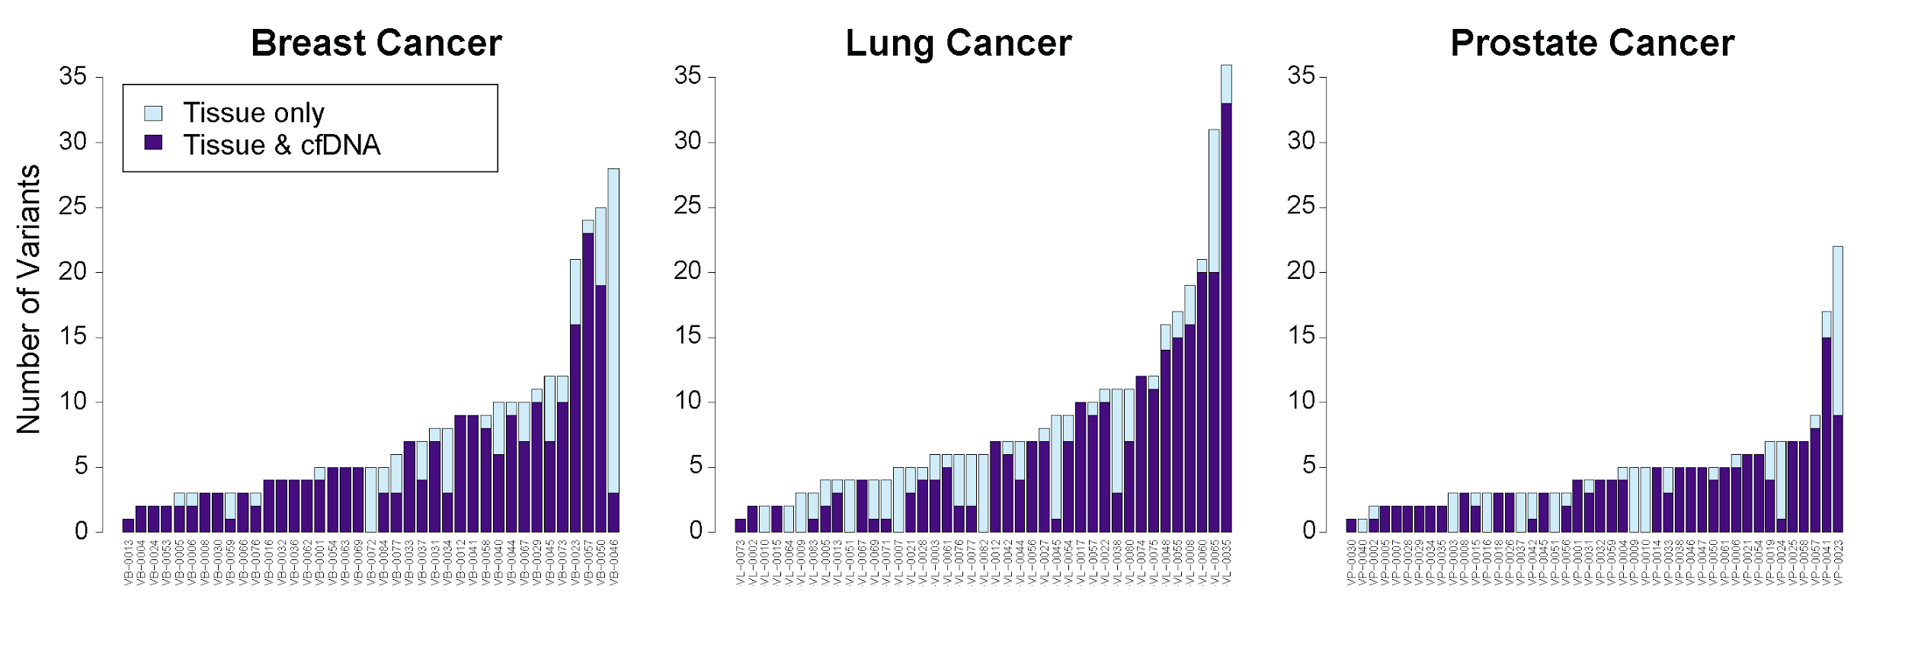
Supporting data - Concordance of genomic variants cfDNA vs. tissue
110/124 patients 89% (95% CI: [82%; 94%]) had at least one tumor tissue-detected variant independently detected in cfDNA
Breast Cancer
38/39 patients 97% ([87%-100%])
with at least 1 tumor tissue
variant detected in cfDNA
Lung Cancer
35/41 patients 85% ([71%-94%])
with at least 1 tumor tissue
variant detected in cfDNA
Prostate Cancer
37/44 patients 84% ([70%-93%])
with at least 1 tumor tissue variant detected in cfDNA
 | All Variants (SNV, indels, CNA, Fusions) |  | Clinically Actionable Variants
 | cfDNA / tissue | PPA (95% CI) | cfDNA /tissue | PPA (95% CI)
Breast Cancer | 221 / 300 | 74% (68, 79) | 24 / 27 | 89% (71, 98)
Lung Cancer | 256 / 355 | 72% (67, 77) | 11 / 18 | 61% (36, 83)
Prostate Cancer | 150 / 209 | 72% (65, 78) | 19 / 26 | 73% (52, 88)
All Patients | 627 / 864 | 73% (69, 76) | 54 / 71 | 76% (64, 85)
Razavi P, Li BT, Abida W, Aravanis A, Jung B, Shen R, Hou C, De Bruijn I, Gnerre S, Lim RS, Reales D. Performance of a high-intensity 508-gene circulating-tumor DNA (ctDNA) assay in patients with metastatic breast, lung, and prostate cancer. Journal of Clinical Oncology: ASCO Annual Meeting Proceedings online supplement: 2017; LBA 11516.
Notes:
In 89% of the patients at least one variant identified in tissue was also detected in cfDNA, including 38/39 or 97% of breast cancer patients, 85% of lung cancer patients and 84% of patients with prostate cancer.
The table shows the cfDNA detection rate when we look broadly across all variants detected in tissue, including mutations that were present in low levels.
Overall, 73% of the variants called in tissue were also detected in cfDNA without any prior knowledge of tumor genomic profile.
When we limited our analysis to actionable alterations, our detection rate was 76%.

