Slide 1


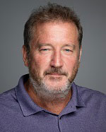



Radiomic models distinguish indolent versus aggressive lung cancers
Joint EDRN-MCL Meeting – Bethesda, MD – March 8, 2018
Matt Schabath, Ph.D
Associate Member
Department of Cancer Epidemiology
Department of Thoracic Oncology
Bob Gillies, Ph.D
Senior Member and Chair
Department of Cancer Physiology
Vice Chair of Radiology
John Heine, Ph.D
Senior Member
Department of Cancer Epidemiology
Pierre Massion, M.D
Cornelius Vanderbilt Chair in Medicine
Professor of Medicine

Slide 2
Disclosures
I have no financial disclosures to declare

Slide 3
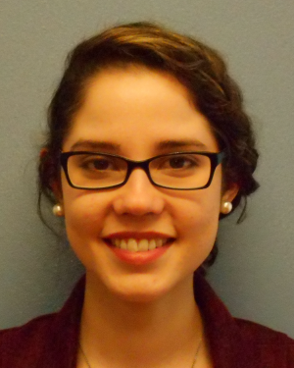


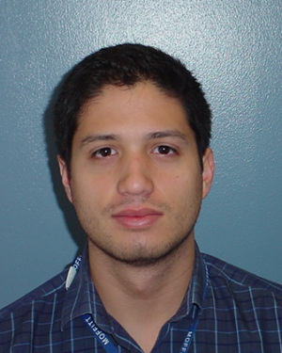
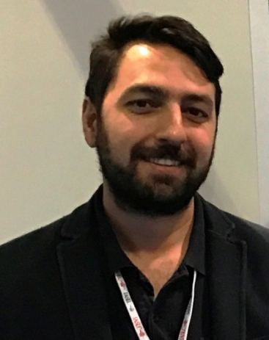
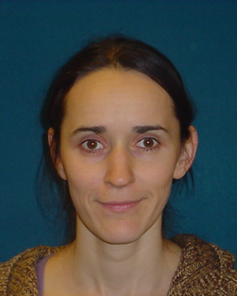
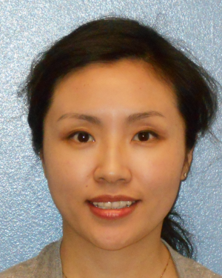
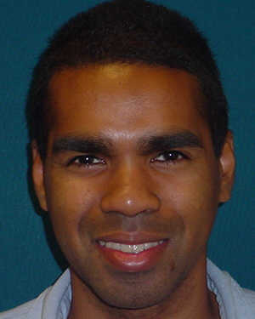
Lung Cancer Team
Ada Sulbaran
Study Coordinator
Iffat Alam
Study Coordinator
Shamanie Tirbene
Data Manager
Alberto Garcia
Imaging Data Coordinator
Ilke Tunali
PhD Candidate
Olya Stringfield, PhD
Imaging Scientist
Jin Qi, MD
Research Radiologist
Trevor Rose, MD
Clinical Radiologist

Slide 4
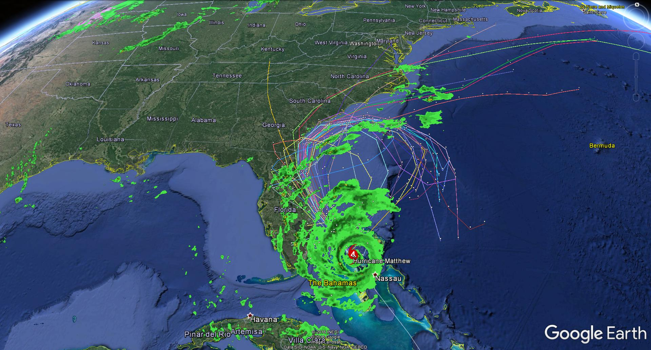
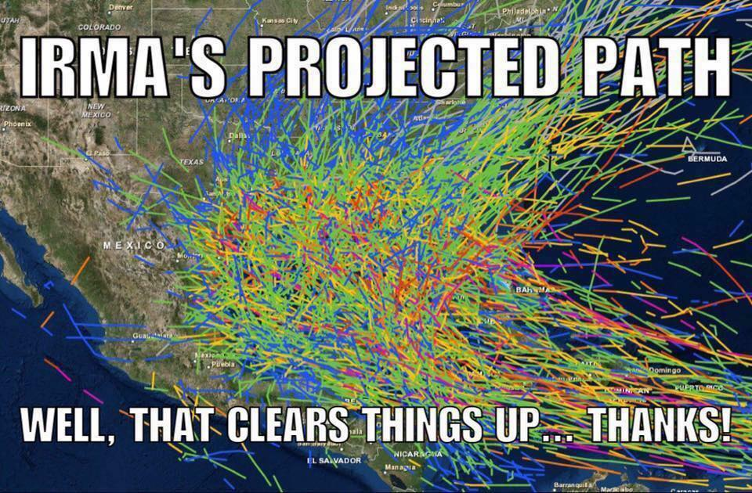
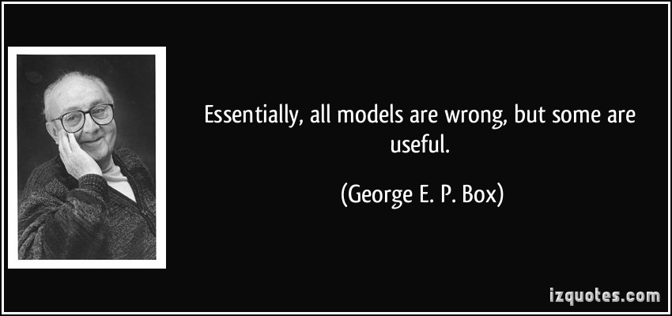
Despite over 60 years of hurricane modeling, there is still substantial imprecision…

Slide 5
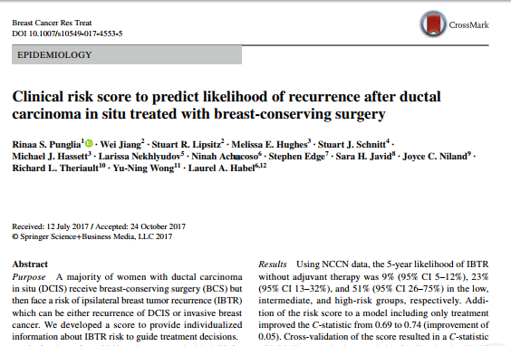
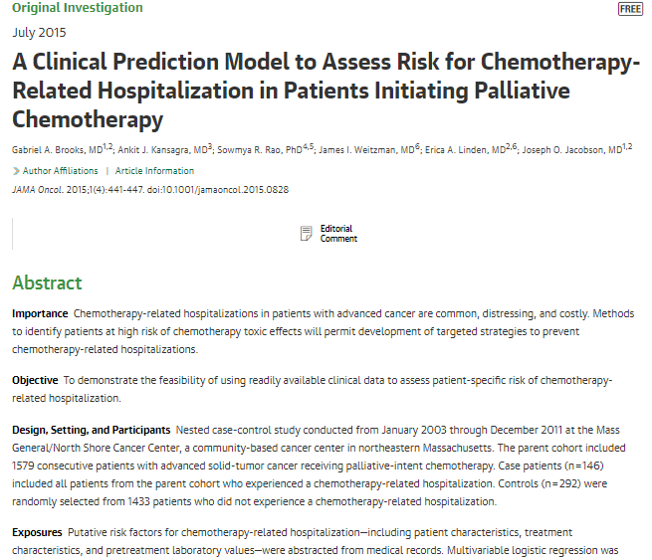
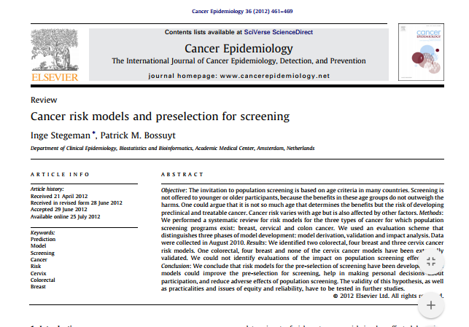
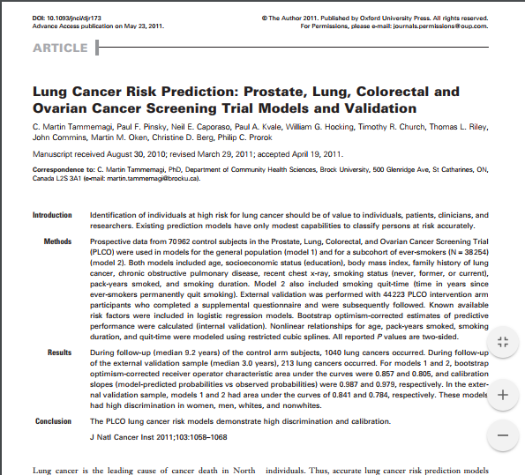
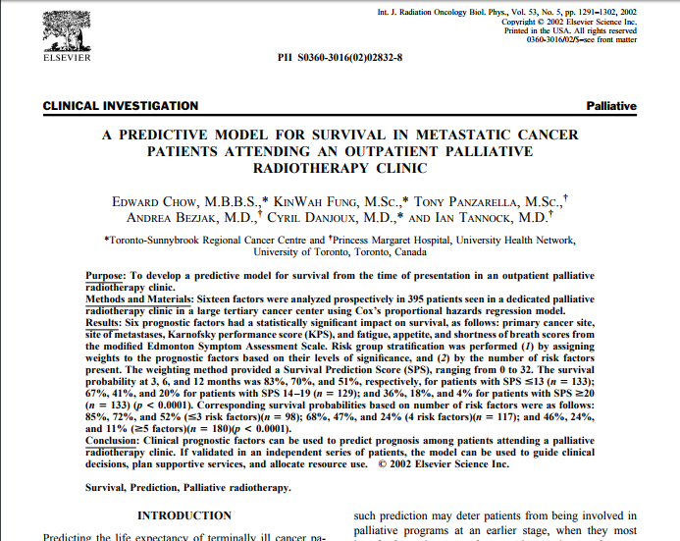
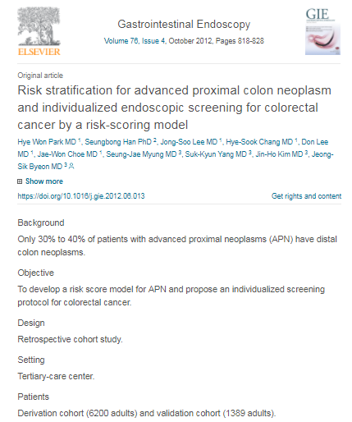
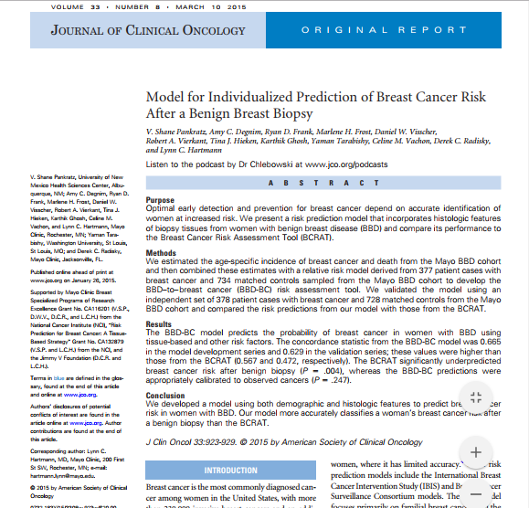
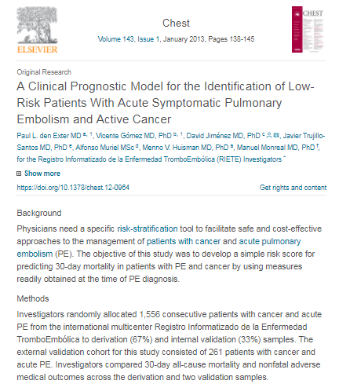
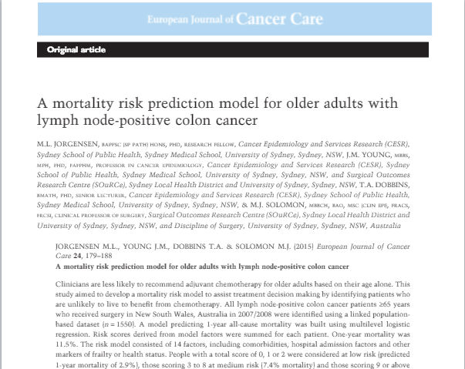
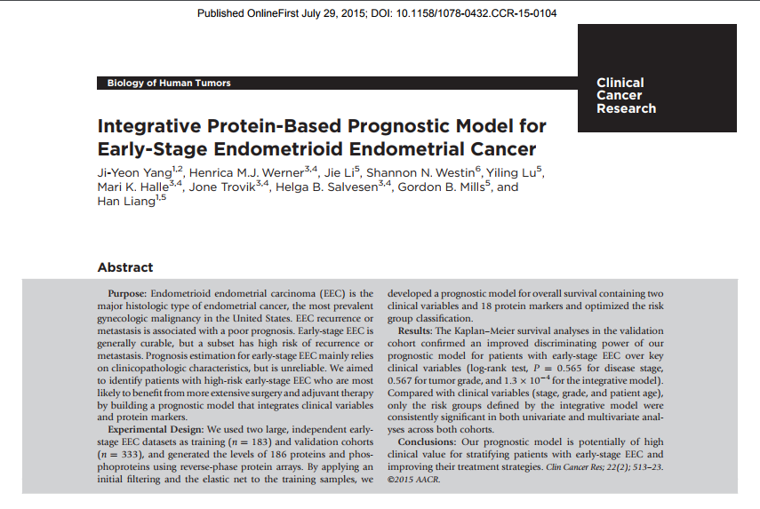

Slide 6
Many reasons attributed to statistical imprecision
Inadequacies and study design issues:
  Small sample size/over fit models
  Small effect sizes
  Not generalizable
  Not validated/independently replicated
  Poor data quality/imprecise data
  Cancer is a heterogeneous disease

Slide 7
Tumor Heterogeneity
Radiomics quantifies microenvironments and heterogeneity of entire region(s) of interest, i.e., IPNs, lung tumors, whole lung
As such, inclusion of Radiomics into models can improve performance/prediction

Slide 8
Indolent vs. Aggressive Lung Cancers
Detection of indolent cancer is a potential harm of screening, i.e., over-diagnosis
  Indolent cancers grow slowly, longer preclinical and screening window, prolonged lifespan
Characterizing behavior of non-screen detected cancers is still unmet and critical need
Aggressive cancers
Less aggressive cancers
Lethal
Indolent cancer initiation
Symptoms
and Dx
Death
Symptomatic
Goal: Utilize radiomics to classify aggressive, less aggressive, and indolent cancers
Detectable
preclinical phase
Detectable
Aggressive cancer initiation
Symptoms
and Dx
Death
Indolent cancers
Tumor burden
Time
Figures adapted from Detterbeck (2012 ) and Bevers et al (2015)

Slide 9
Developing Radiomic-Inclusive Models
Tunali et al (2018) In preparation
Gillies et al (2016) Radiology

Slide 10
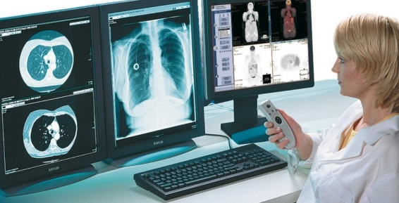




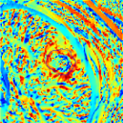
Radiomic Features
Quantitative Features
(300 to >1000s)
Semantic/Radiologic Features (~40)
Intensity
Location
Shape
Size
Texture
Margin characteristics
Wavelet
Shape characteristics
Radial Deviation and Gradient
Attenuation

Slide 11
Tumor Behavior of Non-Screen Detected Lung Cancers

Slide 12
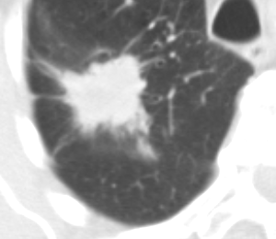
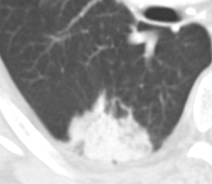
Semantic Feature: Pleural attachment
Tumor attaches to the pleura other than fissure, tumor's margin is obscured by the pleura
Present vs. not present
Pt 1
Pt 2
Notes:
(not spatial randomness!)
- unless specifically imposed
Both filters suffer from the limitation – lack of spatial information. Sub-dividing into core/bndry helps address some of that.
Need two values to better describe and differentiate the spectrum of bad vs good.
Diff between E(Bdry) and E(Core)
1 row: low difference, consistent ‘density’
2 row: high diff: lower in the middle, more pronounced edge
For each pixel, compute local entropy of the NxN neighborhood.
Entropy is a statistical measure of randomness (not spatial randomness!)
Entropy is calculated from the histogram of the image
Entropy is defined as -sum(p.*log2(p))
where p contains the histogram counts, with 256 bins
12

Slide 13
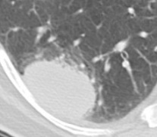
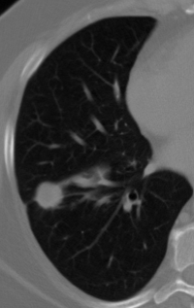
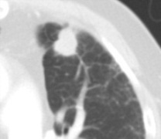
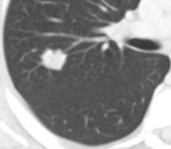
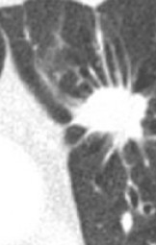
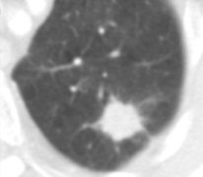
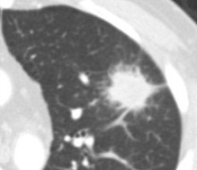
Semantic Feature: Spiculation
Linear strands radiating from the margins of the tumor
No spiculation
Pt 1
Pt 2
Pt 3
Pt 4
Pt 5
High spiculation
Notes:
(not spatial randomness!)
- unless specifically imposed
Both filters suffer from the limitation – lack of spatial information. Sub-dividing into core/bndry helps address some of that.
Need two values to better describe and differentiate the spectrum of bad vs good.
Diff between E(Bdry) and E(Core)
1 row: low difference, consistent ‘density’
2 row: high diff: lower in the middle, more pronounced edge
For each pixel, compute local entropy of the NxN neighborhood.
Entropy is a statistical measure of randomness (not spatial randomness!)
Entropy is calculated from the histogram of the image
Entropy is defined as -sum(p.*log2(p))
where p contains the histogram counts, with 256 bins
13

Slide 14
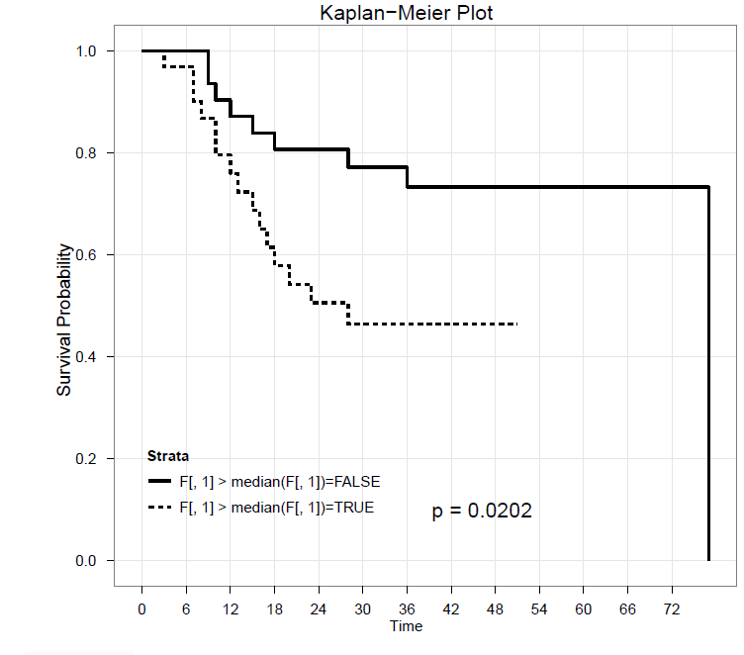
Quantitative Feature: Entropy
A measure of the uniformity or randomness of the pixel intensities
↑ Entropy Difference (boundary – core) is a Negative Prognostic Marker
Grove et al., PLoS One, 2015
Notes:
(not spatial randomness!)
- unless specifically imposed
Both filters suffer from the limitation – lack of spatial information. Sub-dividing into core/bndry helps address some of that.
Need two values to better describe and differentiate the spectrum of bad vs good.
Diff between E(Bdry) and E(Core)
1 row: low difference, consistent ‘density’
2 row: high diff: lower in the middle, more pronounced edge
For each pixel, compute local entropy of the NxN neighborhood.
Entropy is a statistical measure of randomness (not spatial randomness!)
Entropy is calculated from the histogram of the image
Entropy is defined as -sum(p.log2(p))
where p contains the histogram counts, with 256 bins
14

Slide 15
Radial Deviation and Radial Gradient (RD/RG) Features
CT Radial Deviation Map Radial Gradient Map
Patient 1
Patient 2
Patient 3

Slide 16
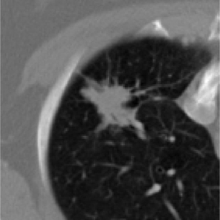
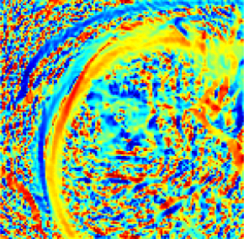
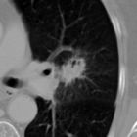
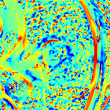
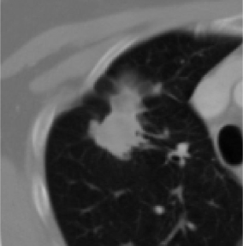
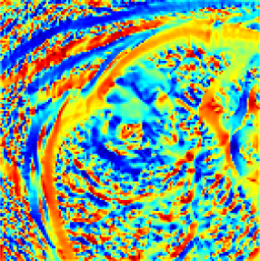
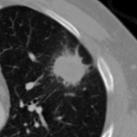
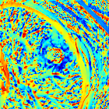
Radial Deviation and Radial Gradient (RD/RG) Features
160
140
74 year old patient w/ Stage IIIa
120
100
Patient deceased at 10 months
80
60
40
20
CT
RD Map
0
160
77 year old patient w/ Stage IIIb
140
120
Patient still alive after 60 months
100
80
60
40
20
0
RD/RG features are capturing textural characteristics and radiologic differences
Tunali et al. Oncotarget (2017)
Notes:
Here we see a cartoon of a tumor with the center of mass x,y. The RD of a pixel (k,l) is the angle between the gradient vector the vector that is towards the center of mass x,y.
And RG of a pixel k,l is the magnitude of the gradient vector along this same green vector that is towards to center of mass.

Slide 17
Combinatorial effects of the two predictive features
      HH patients exhibited significantly improved survival compared to LL
Training cohort
Test cohort
Tunali et al. Oncotarget (2017)

Slide 18
Tumor Behavior of Screen Detected Lung Cancers

Slide 19
Screening History Alone is Highly Prognostic
Positive Screen
1-2 years follow-up
Incident Lung Cancers
N =
7,191
T0 (Baseline)
CT Screen
Negative Screen
1-2 years follow-up
Incident Lung Cancers
N =
19,118
Incident LCs diagnosed following a T0 positive screen
Incident LCs diagnosed following a T0 negative screen
Schabath et al. (2016) PLOS ONE

Slide 20
Screen-Detected Lung Cancers in the NLST
52 significant features narrowed to a model of 4 features
CART generated three patient groups from 2 of the 4 features
As these were all stages of lung cancers, stage was very predictive in the multivariable model
1.00
Log-rank P < 0.001
0.75
PFS Probability
0.50
0.25
Orientation mHR = 0.33 (0.15 – 0.70)
Laws mHR = 4.44 (0.81 – 2.25)
0.00
0
12
24
36
48
60
72
Months
High Orientation
Low Orientation/Low Laws
Low Orientation/High Laws
Schabath et al. (2018) In preparation

Slide 21
Early Stage Lung Cancers in the NLST
26 significant features narrowed down to a model of 5 features
CART generated three patient groups from 3 of the 5 features
1.00
Log-rank P < 0.001
0.75
PFS Probability
0.50
0.25
RGRD mHR = 8.53 (1.64 – 44.3)
Orientation mHR = 0.20 (0.07 – 0.57)
Laws mHR = 4.01 (1.44 – 11.4)
RGRD mHR = 8.53 (1.64 – 44.3)
Orientation mHR = 0.20 (0.07 – 0.57)
Laws mHR = 4.01 (1.44 – 11.4)
0.00
0
12
24
36
48
60
72
Months
Low RDRG
High RDRG/High Orientation
High RDRG/Low Orientation/Low Laws
High RDRG/Low Orientation/High Laws
Schabath et al. (2018) In preparation

Slide 22
Impact of Screening History on Early Stage Model
Baseline screening result (+ vs -): consistently significant in every multivariable model
Among patients with baseline positive screens
Incident LCs diagnosed following a T0 positive screen
Among patients with baseline negative screens
Incident LCs diagnosed following a T0 negative screen
Schabath et al. (2018) In preparation

Slide 23
Combinatorial Effects of Screening History and Radiomics
Interplay of radiomics model and screening history
Accounting for screening history into a Clinical-Radiomics model can better discriminate aggressive vs. indolent/non-aggressive LCs
Low-risk radiomics
Low-risk radiomics
High-risk radiomics
Schabath et al. (2018) In preparation

Slide 24
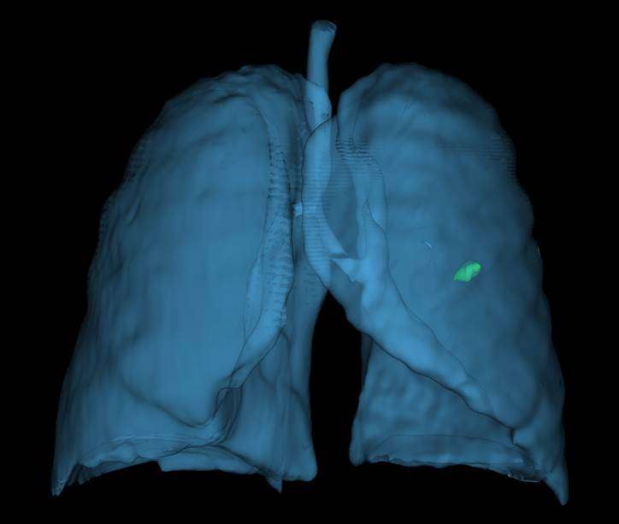
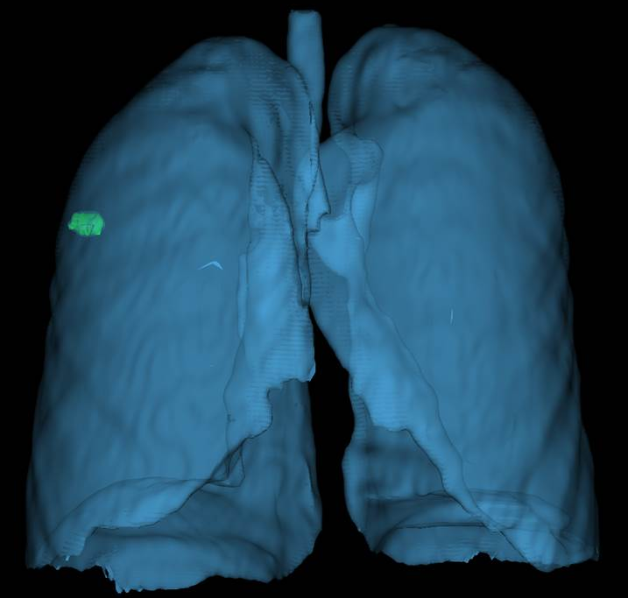
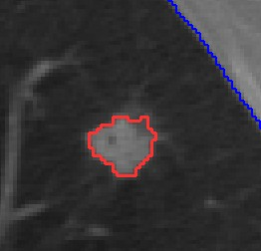
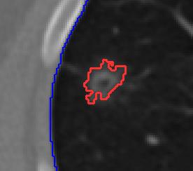
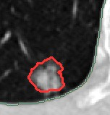
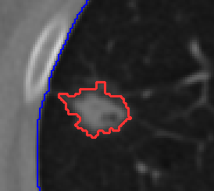
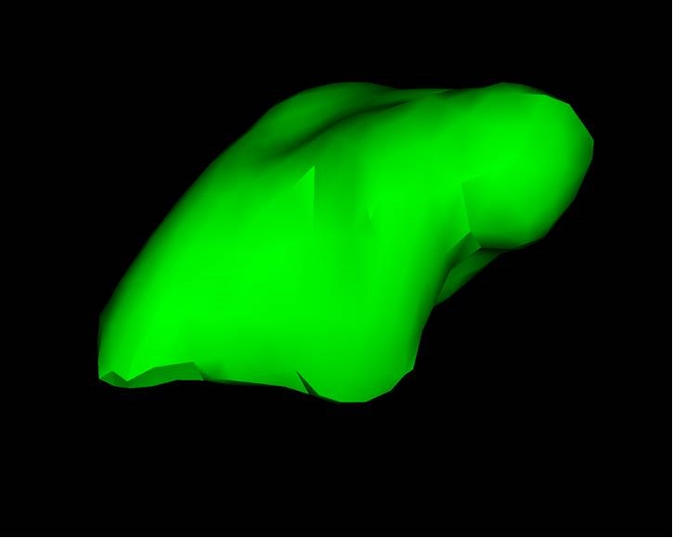
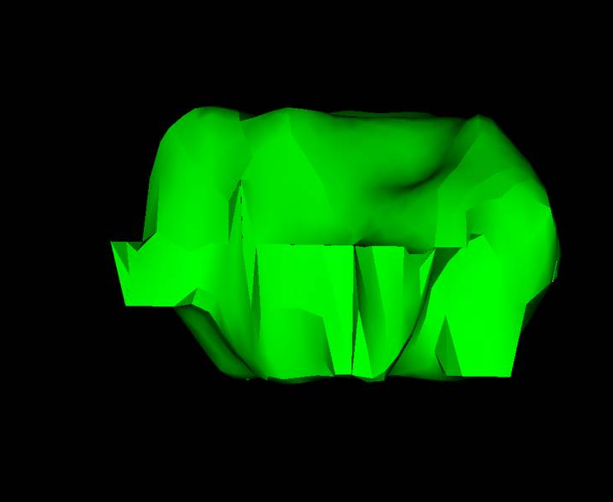
Orientation feature
2-D feature; captures the angle between the x-axis and the major axis of the ellipse
In essence, may be capturing shape, i.e., Roundness vs. Elongated/Elliptical…?
Low orientation (poor PFS)
High orientation (Good PFS)

Slide 25
Tumor Behavior of IO Treated
Lung Cancers

Slide 26
Clinical-Radiomic Models to Predict Rapid Disease Progression
Tunali et al. (2018) In preparation

Slide 27
Clinical-Radiomic Models to Predict Rapid Disease Progression
TTP < 2 months (24%) vs TTP ≥ 2 months (76%)
  Number of previous treatments
  Presence of hepatic mets
  Presence of bone mets
  Neutrophil-to-lymphocyte ratio
  3D Laws feature E5L5E5
  Border 3D Laws features E5E5L5
  Border quartile coefficient of dispersion
  Radial gradient border SD
TTP < 2 months (47%) vs TTP ≥ 12 months (53%)
  History of systemic treatment
  Number of metastatic sites
  Serum albumin levels
  3D Laws feature E5L5E5
HPD (8%) vs non-HPD (92%)
  RMH prognostic score (Serum albumin, LDH, Number of metastatic sites)
  Border NGTDM strength
Tunali et al. (2018) In preparation

Slide 28
Clinical-Radiomic Models and PFS
TTP < 2 months vs TTP ≥ 2 months
TTP < 2 months vs TTP ≥ 12 months

Slide 29
Summary and Take Home Messages
Radiomic-inclusive models improve ability to define tumor behavior
Semantic radiologic features are highly predictive
  Require manual radiology scoring
  Concerns about intra and inter-observer agreement
Quantitative features are computer-generated, i.e., reduces agreement concerns
  Segmentation: Manual vs. semi-automated
  No standard radiomic toolbox or pipeline
Impact of clinical/patient data should not ignored
  Be careful of the “hammer and nail” approach

Slide 30



Acknowledgments and Funding
Moffitt Cancer Center
Iffat Alam, BS
Yoga Balagurunathan, PhD
Alberto Garcia, BS
Bob Gillies, PhD
Qian Li, MD
Ying Liu, MD
Jin Qi, MD
Olya Stringfield, PhD
Ada Sulbaran, BS
Shamanie Tirbene
Ilke Tunali, PhD-Candidate
Hua Wang, MD
UCLA
Deni Aberle, MD
University of South Florida
Dmitry Cherezov, PhD-Candidate
Dmitry Goldgof, PhD
Larry Hall, PhD
Sam Hawkins, PhD
Vanderbilt
Pierre Massion, MD
Quantitative Imaging Network
Florida Department of Health
James and Esther King Biomedical Research Program

Slide 31
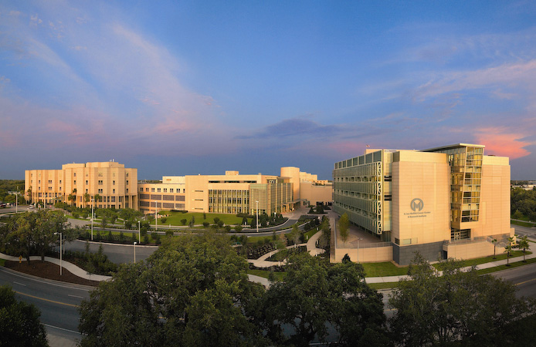


Thank you!
matthew.schabath@moffitt.org
@matthewschabath
H. Lee Moffitt Cancer Center & Research Institute, Tampa, FL

