Slide 1


A Targeted Proteomics Strategy for the Development of Prostate Cancer Liquid-Biopsies
O. John Semmes, PhD
Anthem Distinguished Professor
Director, Leroy T. Canoles, Jr. Cancer Research Center Eastern Virginia Medical School | Norfolk VA | USA

Slide 2
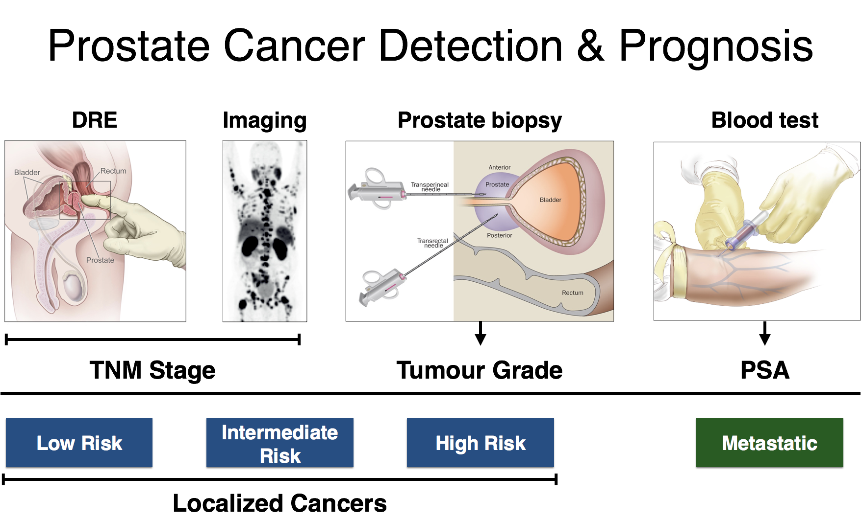
Current Diagnostic Tools Prostate Cancer

Slide 3
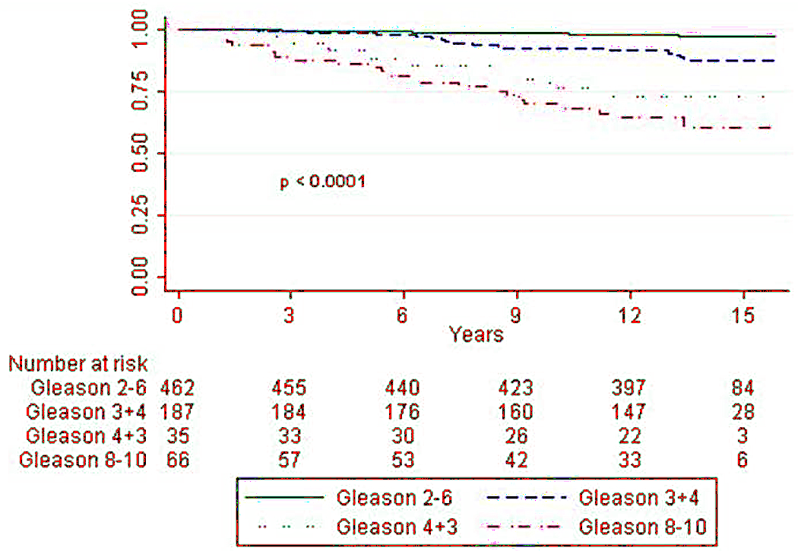
Gleason Score Upon Radical Prostatectomy Improves Risk Stratification
Wright et al 2009, J. Urology
Indolent Disease
>10% of RP reveal indolent disease
60% of men age 80 harbor indolent disease
Assigning Risk
PGS=4+3 has 3X risk of PGS=6; Stark 2009 JCO
Meta-analysis of SEER showed 40% low-risk men upgraded at surgery; Dinh 2015 JU
Overall NCCN Intermediate Disease tracked with PGS, volume, PSA; Reese 2012 Urology

Slide 4
Early Detection Goals EVMS-Toronto Biomarker Discovery Laboratory
Early Detection of Aggressive Disease
Detection of Invasive disease in an OC cohort
Detection of Upgrading especially from CGS=6
Determining patient status with Non-invasive Pathology surrogate. Contributing to Risk Assessment Tools

Slide 5
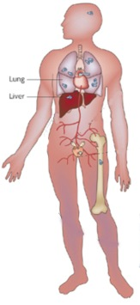
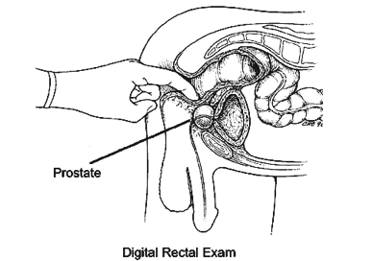
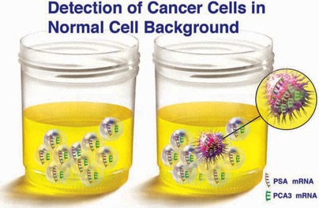
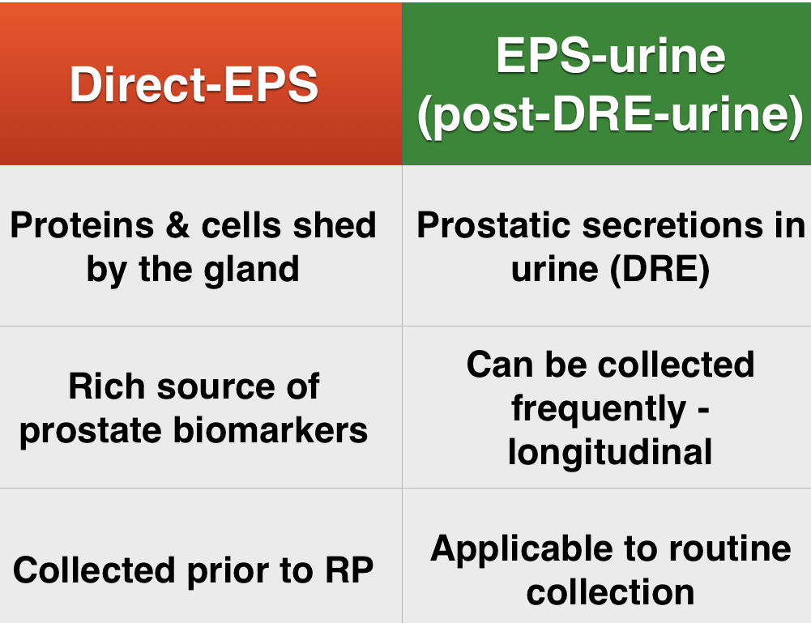
Prostate-Proximal Fluids: post-DRE Urine

Slide 6
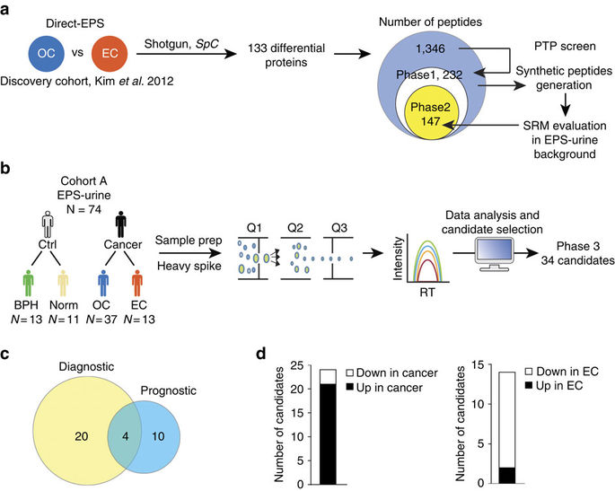
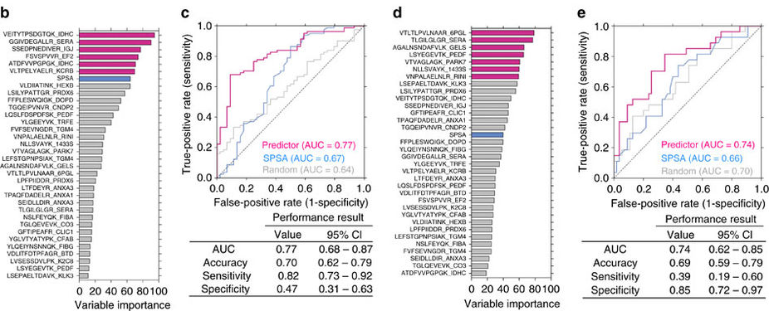
Targeted Proteomics Identifies Liquid-Biopsy for Extracapsular Prostate Cancer
Kim et al. 2016. Nature Comm.
Notes:
Generalize this figure to represent our new proteomics strategy

Slide 7




Expanded Biomarker Discovery
Discovery
Candidate Selection
Direct-EPS
EPS-urine
50
B
BPH
vs
SRM/PRM
Ctrl
Norm
50
N
vs
50
Integration into Assay Development
50
vs
Data analysis and candidate generation
CGS
61
50
76
50
EDRN Upgrading Study
50
7
30
2

Slide 8

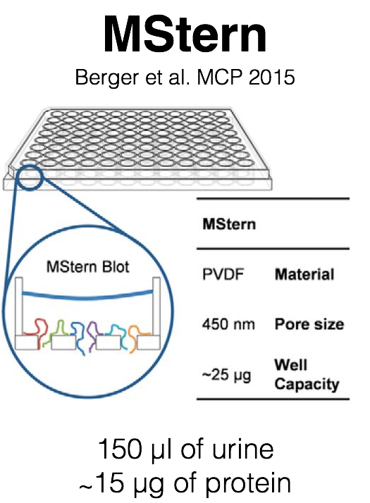
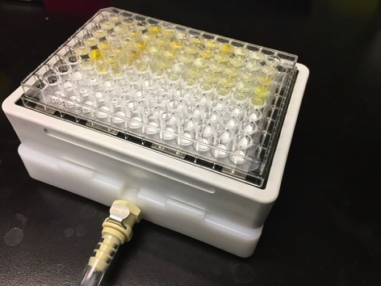
Assay Optimization Strategies
200µL Urine
Reduced and Alkylated
Trypsin-Lys-C Digestion:
50µL buffer volume
2x digestion buffer passes
4hr incubation
1µg enzyme
5% AcN
Peptide Collection, desalting and quantitation

Slide 9


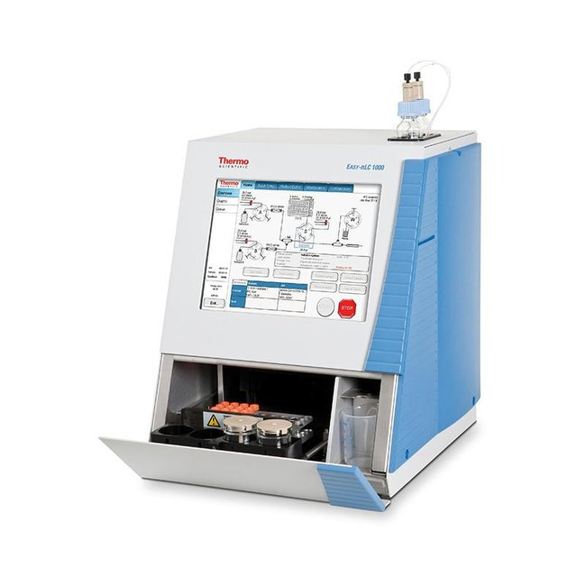

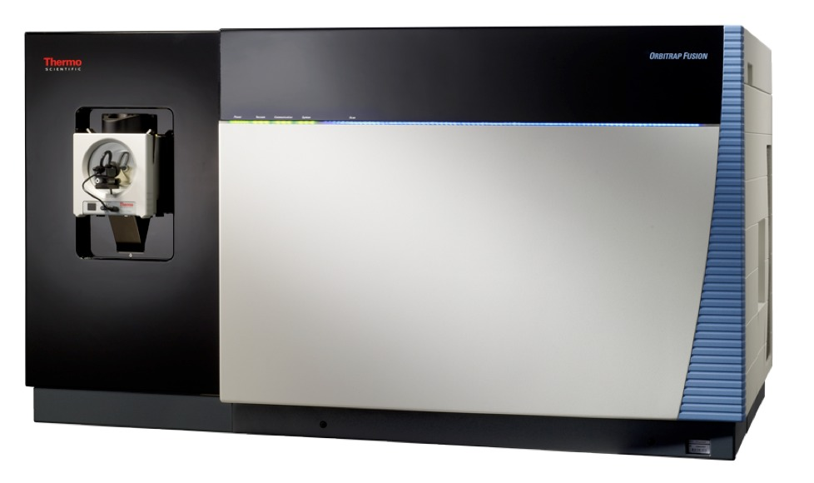
Assessment of Systematic Reproducibility
Randomized
MStern + LC-MS in Processing Duplicate
Notes:
Consolidate this slide with new data. Large picture.

Slide 10
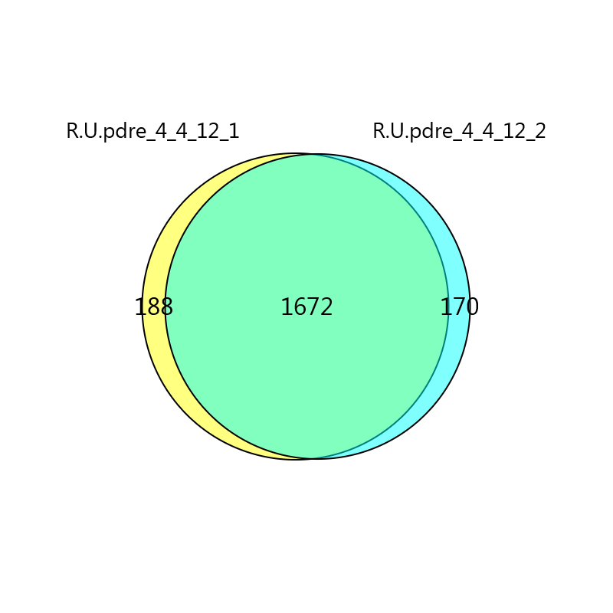
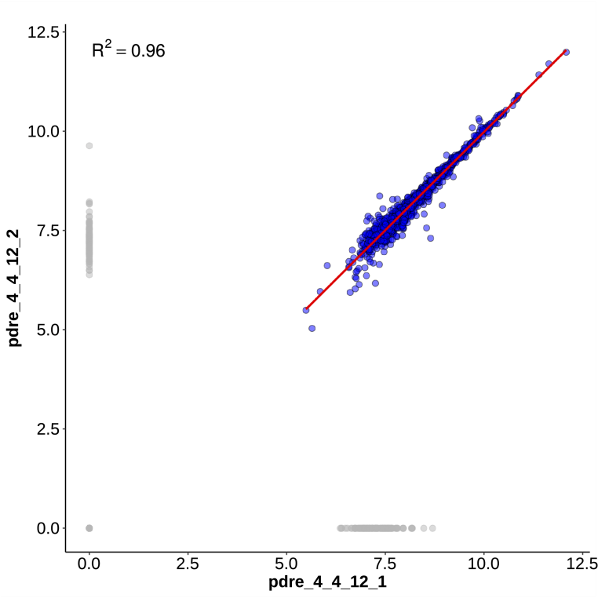
Assessment of Systematic Reproducibility
Notes:
Consolidate this slide with new data. Large picture.

Slide 11
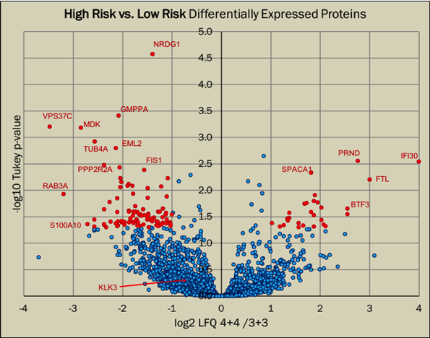
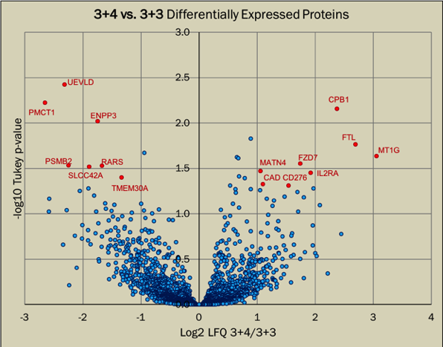
Identification of Differentially Expressed Proteins
Notes:
Consolidate this slide with new data. Large picture.

Slide 12
Parallel Discovery
Surface Expression CDCP1
In-depth proteomic analyses of exosomes isolated from expressed prostatic secretions in urine
Proteomics 2013
Dysregulated expression of cell surface glycoprotein CDCP1 in prostate cancer
Oncotarget 2015
Standardized Protocol for High-Purity EV Isolation
Notes:
Consolidate this slide with new data. Large picture. CDCP1 Basigin

Slide 13
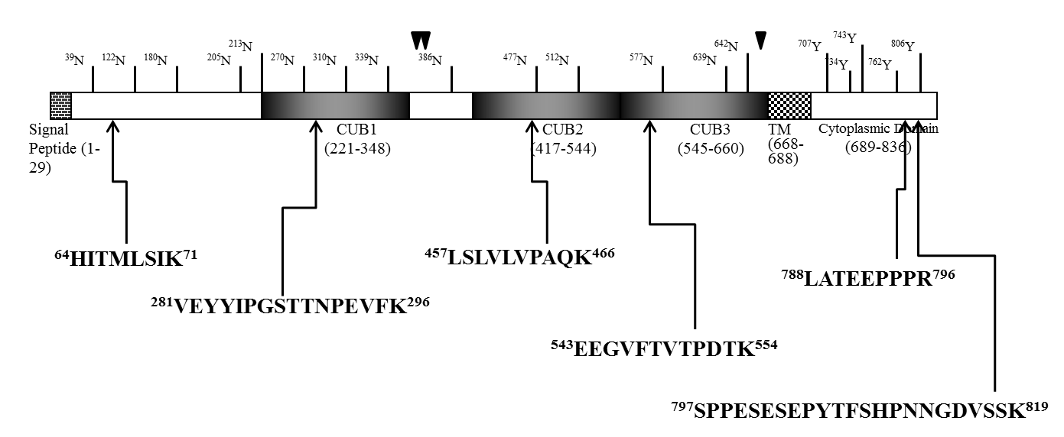
Development of PRM-MS Quantitative Assay for CDCP1

Slide 14
PRM-MS Analysis of Patient Samples for CDCP1
Detected in Post-DRE Urine from pooled GS=7
Injected equivalent to exosomes in 1ml sample
PRM-MS

Slide 15
Development of Non-invasive Molecular Assays that Integrate into Personalized Medicine Clinical Workflow
Imaging/Molecular-assisted Pathology
SOPs for Through Processing
Prot-PDU
RNA-PDU
Prot-PDU-EV
RNA-PDU-EV
CTC-PDU
Directed Biomarker Development

Slide 16

Thank You
NCI EDRN BDL
Leroy T. Canoles Cancer Research Center
John Semmes, PhD & Julius Nyalwidhe, PhD
Princess Margaret Cancer Center
Thomas Kislinger, PhD
Ontario Institute for Cancer Research
Paul Boutros, PhD
Collaborators
Eastern Virginia Medical School
Dean Troyer, MD
Michael Fabrizio, MD
E
V
MS

