Slide 1
How to get biomarkers for cancer screening into clinical practice: Use of banked samples from cohorts
David F. Ransohoff MD
Department of Medicine (gastroenterology)
Department of Epidemiology
Lineberger Comprehensive Cancer Center
University of North Carolina at Chapel Hill

Slide 2
Disclosure
Consulting:
Exact Sciences
GRAIL

Slide 3
How to get biomarkers for cancer screening into clinical practice: Use of banked samples from cohorts
NCI/EDRN Goal
“[Can] EDRN and FDA… provide guidelines for using banked samples [emphasis added] from large cohorts for FDA registry trials… will greatly speed up the process of getting good biomarkers into clinical use.”

Slide 4
How to get biomarkers for cancer screening into clinical practice: Use of banked samples from cohorts
TOPICS:
Who ‘approves’ markers, and what do they want?
•FDA
•Others (USPSTF, ACS, HEDIS, other guidelines-makers, payors, etc)
To get approval, what is role of banked specimens from cohort?
•PLCO, WHI
•other cohorts, like HMO
•present and future

Slide 5
Who ‘approves’, and what do they want?
Slide from Gene Pennello (FDA)
FDA will explain, to an applicant, details of each evaluation.
’Evaluation’ can involve different questions.
1. Does test accurately measure analyte?
2. Does test discriminate disease vs not?
3. Does test and intervention improve outcome?

Slide 6
Who ‘approves’, and what do they want?
USPSTF, other
•USPSTF
Metric: ‘Benefit > harm’ re outcome of cancer-specific mortality reduction
Reason: High burden of proof needed to intervene on healthy people
Evidence required:
•’High quality’ (RCT) demonstration of benefit>harm.
•If is a positive RCT, then demonstrating improved discrimination is ok.
(e.g.,for CRC screening, after RCT of gFOBT, FIT was ok’d - no RCT)
Process: Formal ‘evidence synthesis’; ‘quantitative conceptual framework’
Historical impact: USPSTF influences payors; needs to be considered.
•ACS, BC/BS, HEDIS (a performance measure), other
•Comment
-FDA approval is important for labeling/marketing; perhaps less for payors. Some laboratory developed tests (LDT) can get to market without approval.

Slide 7
How to get biomarkers for cancer screening into clinical practice: Use of banked samples from cohorts
TOPICS:
Who ‘approves’ markers, and what do they want?
•FDA
•Others (USPSTF, ACS, HEDIS, other guidelines-makers, payors, etc)
To get approval, what is role of banked specimens from cohort?
•PLCO, WHI
•other cohorts, like HMO
•present and future

Slide 8
To get approval, what is role of banked specimens from cohort?
Definition of a ‘cohort’ isn’t helpful
•a demographic group, like an age group
•a group you follow forward in time
Definition has no detail about what makes a study strong.
Lesson
•What makes a study strong is details of cohort design. A study must
look like it was designed on purpose re:
-persons enrolled
-steps to avoid bias in specimen collection, storage; follow-up re true
state; in lab analysis; data analysis; etc, etc. (many biases; big literature)
One bias, if large, can be fatal.
Next: Examples of strong answer from banked specimens/data from cohort.

Slide 9
Example 1: PLCO cohort to assess whether OvCa markers discriminate disease vs not.
BACKGROUND
•By 2008, 5 panels of proteomcs tests claimed strong discrimination
GOAL OF NCI-organized study (Zhu 2011)
•To assess panels, in blinded hypothesis test
METHOD:
•PLCO RCT had features of a strong cohort for evaluating screening test discrimination, including:
-bloods collected ~6 times so that, among persons later found to have
OvCa, a blood prior and near diagnosis might be available;
-bloods were handled equally, avoiding one important kind of bias;
-other kinds of bias also addressed.

Slide 10
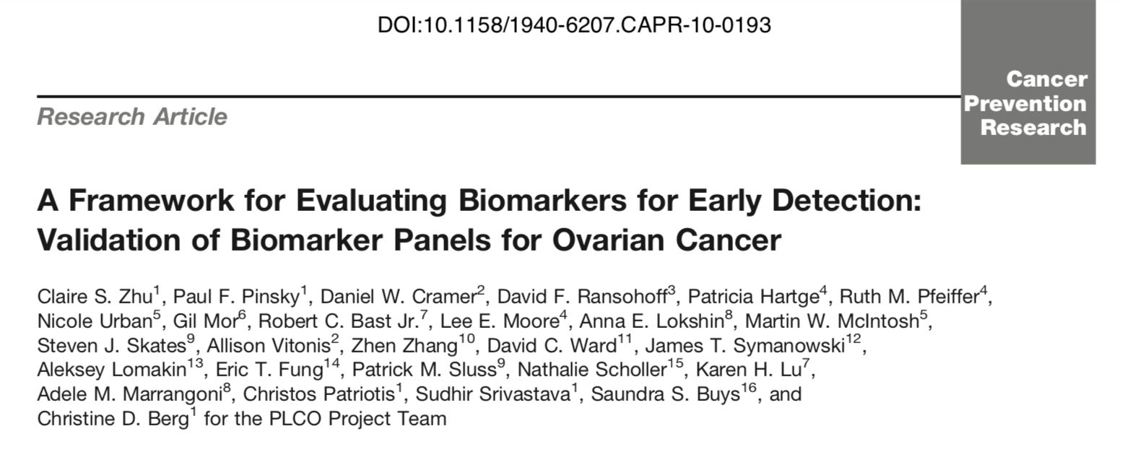
Cancer Prev Res 2011;4:375-383

Slide 11
We call the design used PRoBE (Pepe. JNCI 2008). The ‘nested case-control’ (C-C nested in cohort) design has been used since 1980s.
Design: PRoBE (prospective specimen collection; retrospective blinded eval.)
•Cohort prospectively collects specimens and data over time; avoids ‘bias’ by ‘equal’/blinded collection of specimens and data, including outcome.
I.e., Cohort can have many features as if study designed ‘prospectively’.
•Then, later (‘retrospectively’) blood specimens are evaluated near time of dx.
••One cannot take for granted that any cohort has design that avoids important bias(es). If RCT is source, design is likely to be ‘strong’. If HMO, maybe less.
••There were many challenges in ‘designing’ this study of discrimination, even though was from RCT.

Slide 12
We call the design used PRoBE (Pepe. JNCI 2008). The ‘nested case-control’ (C-C nested in cohort) design has been used since 1980s.
Design: PRoBE (prospective specimen collection; retrospective blinded eval.)
•Cohort prospectively collects specimens and data over time; avoids ‘bias’ by ‘equal’/blinded collection of specimens and data, including outcome.
I.e., Cohort can have many features as if study designed ‘prospectively’.
•Then, later (‘retrospectively’) blood specimens are evaluated near time of dx.
••One cannot take for granted that any cohort has design that avoids important bias(es). If RCT is source, design is likely to be ‘strong’. If HMO, maybe less.
••There were many challenges in ‘designing’ this study of discrimination, even though was from RCT.
A clinical study must be presumed guilty (of bias) until proven innocent.
Even a RCT. The devils are in the details.
Ransohoff J Clin Epi 2007;60:1205

Slide 13
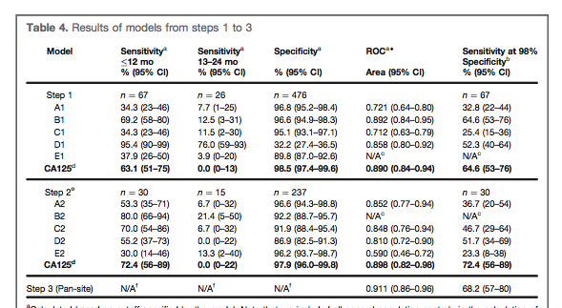
Result: 5 new assays no better than Ca125

Slide 14
To get approval, what is the role of banked specimens from cohort?
Question for FDA re PLCO OvCa study (Zhu 2011):
•If PLCO evaluation showed new panel(s) discriminated better than CA125;
•And if PLCO RCT (pub’d JAMA 2011) showed mortality reduction;
•Then could FDA approve the new OvCa panels?
Comment:
•This example shows potential of banked specimens from cohort to get reliable result about discrimination.

Slide 15
To get approval, what is the role of banked specimens from cohort?
Lessons from PLCO and WHI RCTs:
Strength
-Uses RCT design (even if ‘intervention’ is ignored), so avoids many biases
Limitations
-RCTs are very expensive
-PLCO was large, but numbers were ~small re cancers, specimens, volume
Implications
-for current research: PLCO, WHI specimens are: aging out; can’t be used for many analytes; have insufficient amounts for ‘discovery’
-for future research: How to cultivate cohorts that are strong, economical, useful: formal cohorts (All of Us, other NIH)? HMOs? EU countries?

Slide 16
Example #2: A (hypothetical) colon cancer screening blood test could be assessed in PLCO
Background
•PLCO RCT showed that sigmoidoscopy reduced CRC mortality.
Purpose, Design, Result (hypothetical study)
•Assess a blood-based test for CRC in PLCO bloods drawn right before sigmoidoscopy.
•If test was highly sensitive for CRC, then a negative result says sig is not needed. Low specificity (e.g., 40%) not a problem.
Question for FDA
•Could such a test, studied in banked specimens in a cohort, be approved by FDA?

Slide 17
Who ‘approves’, and what do they want?
Slide from Gene Pennello (FDA)
FDA will explain, to an applicant, details of each evaluation.
’Evaluation’ can involve different questions.
1. Does test accurately measure analyte?
2. Does test discriminate disease vs not?
3. Does test and intervention improve outcome?
i.e., Can an efficacy question be addressed
by cohort (non-RCT) design?

Slide 18
Example 3: Sigmoidoscopy screening efficacy study uses banked data from HMO (K-P NC) cohort.
BACKGROUND
•In early 1990s there was no published RCT re CRC screening.
•In 1992, a case control study, nested in a cohort, reported (NEJM) that sigmoidoscopy screening reduces CRC mortality
Sigmoidoscopy was an intervention.
But a blood marker, followed by intervention, could have been assessed.

Slide 19
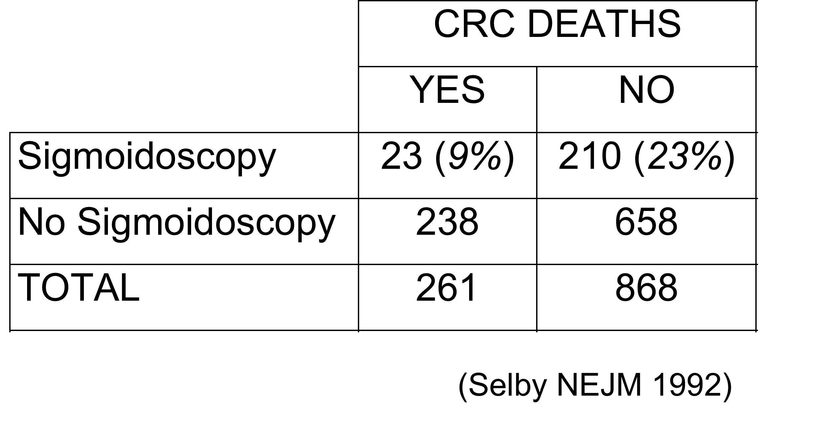
Example 3: Sigmoidoscopy screening efficacy study uses banked data from HMO (K-P NC) cohort.

Slide 20
Example 3: Sigmoidoscopy screening efficacy study uses banked data from HMO (K-P NC) cohort.
Strength of study:
•nested case-control study, within Kaiser-Permanente HMO cohort
•reason for ‘exposure’was known (because special sites used for screening)
•had unusual‘internal control’group (L vs R colon)
•other
The USPSTF’s 1996 decision to accept cohort (non RCT) evidence was a major milestone in ‘evidence-based-medicine’.
Lesson: Sometimes ‘cohort studies’ can provide strong evidence of efficacy. (i.e., not just of discrimination).

Slide 21
How to get biomarkers for cancer screening into clinical practice: Use of banked samples from cohorts
TOPICS:
Who ‘approves’ markers, and what do they want?
•FDA
•Others (USPSTF, ACS, HEDIS, other guidelines-makers, clinicians, etc)
To get approval, what is role of banked specimens from cohort?
•PLCO, WHI, in present
•other cohorts in future (e.g. new RCTs; HMOs; etc)

Slide 22
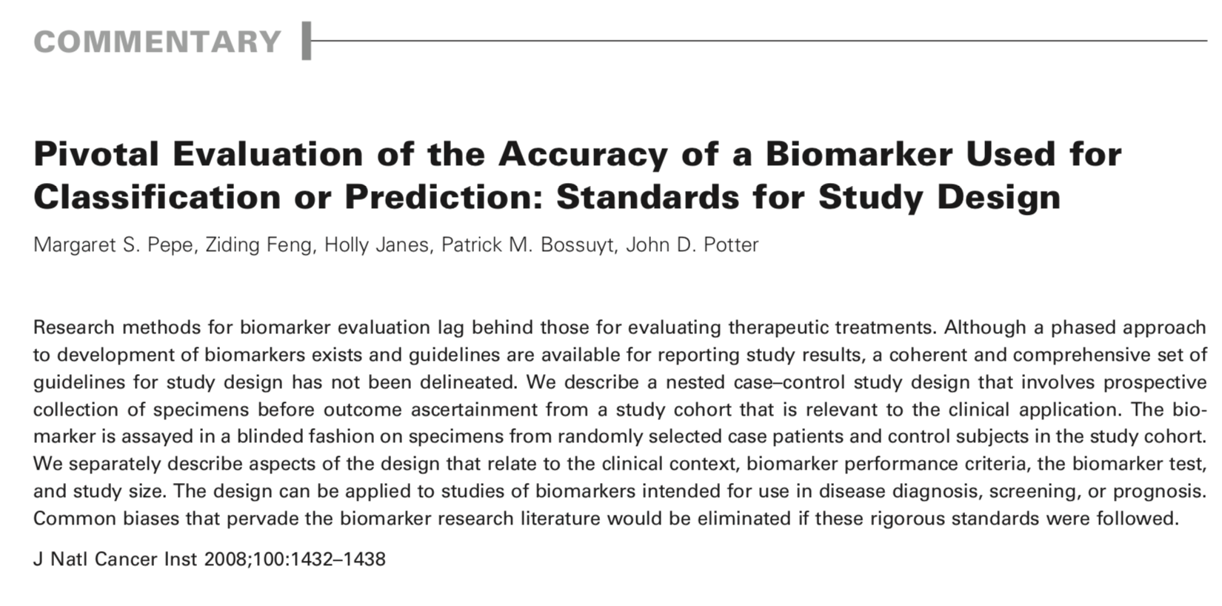
To get approval, what is role of banked specimens from cohort in future?
Principles have been discussed

Slide 23
To get approval, what is role of banked specimens from cohort in future?
Tactics to cultivate cohorts have been discussed
Many details of ‘design’ must be considered.

Slide 24
How to get biomarkers for cancer screening into clinical practice: Use of banked samples from cohorts
TOPICS:
Who ‘approves’ markers, and what do they want?
•FDA
•Others (USPSTF, ACS, HEDIS, other guidelines-makers, payors, etc)
To get approval, what is role of banked specimens from cohort?
•PLCO, WHI
•other cohorts, like HMO
•present and future

Slide 25
To get approval, what is the role of banked specimens from cohort?
Two Questions for FDA
re PLCO OvCa study (Zhu 2011):
•IF PLCO evaluation showed new panel(s) discriminated better than CA125;
•AND IF PLCO RCT (pub’d JAMA 2011) showed mortality reduction;
•Then could FDA approve the new OvCa panel(s)?
re PLCO CRC triage test (hypothetical)
•Could FDA approve, as a triage test, a blood test drawn before sigmoidoscopy that showed high sensitivity for CRC?

Slide 26
Acknowledgements
Support
National Cancer Institute
•Division of Cancer Prevention
•Division of Cancer Control and Population Sciences
•Division of Cancer Epidemiology and Genetics
•CPTAC (Clinical Proteomic Tumor Analysis Consortium)
Colleagues
•Steven Skates, Massachusetts General Hospital
•Lisa McShane, National Cancer Institute
•Keith Baggerly, MD Anderson Cancer Center
•Christine Berg, National Cancer Institute
•Ziding Feng, MD Anderson Cancer Center

