Slide 1
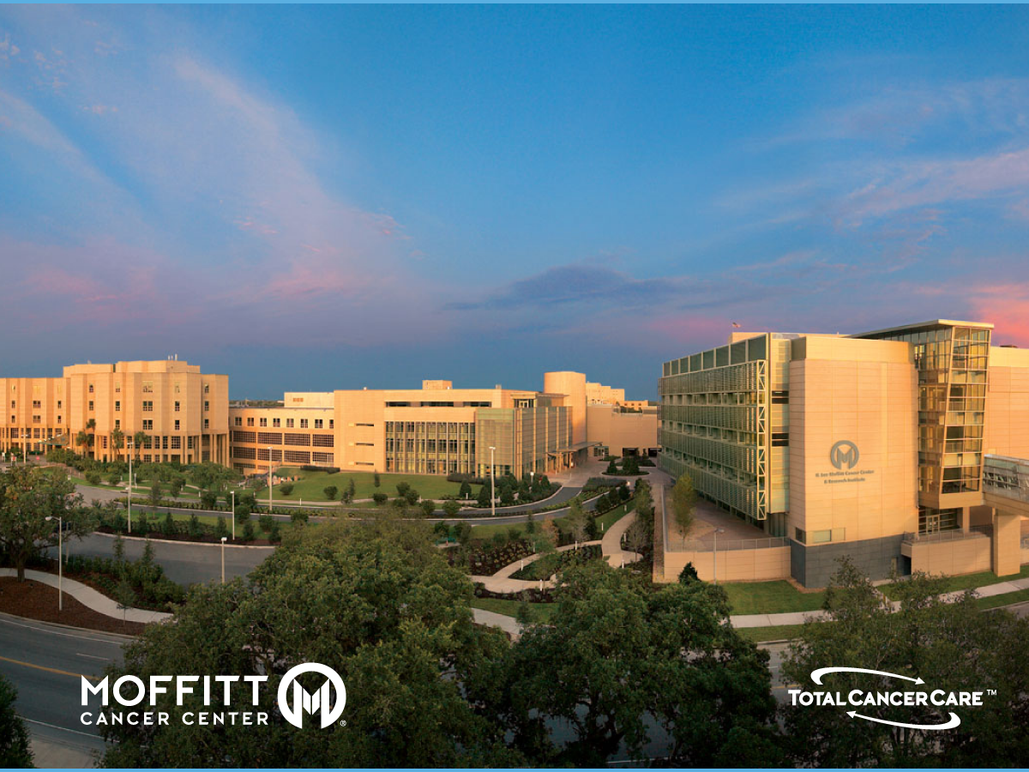
Radiomics in Early Detection of Lung Cancers
Robert Gillies and Matt Schabath
H. Lee Moffitt Cancer Center and Research Institute; Tampa FL USA; Robert.Gillies@Moffitt.org
EDRN/MCL 3/2018

Slide 2
CoI
RJG is BOD and investor of Healthmyne, Inc.

Slide 3
Moffitt Imaging Biomarker Validation Center
John Heine → qantiative mammography
Bob Gillies, Matt Schabath → IPMNs
Bob Gillies, Yoga Balagurunathan → Prostate
Jenny Permuth, Yoga → Pancreatic (nascent)

Slide 4




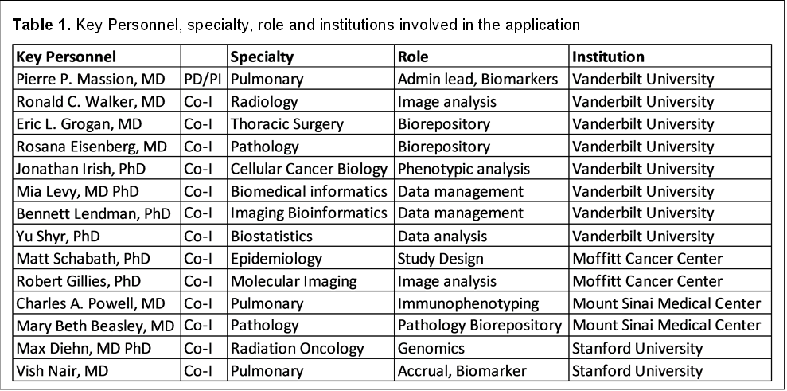
The MCL consortium team

Slide 5
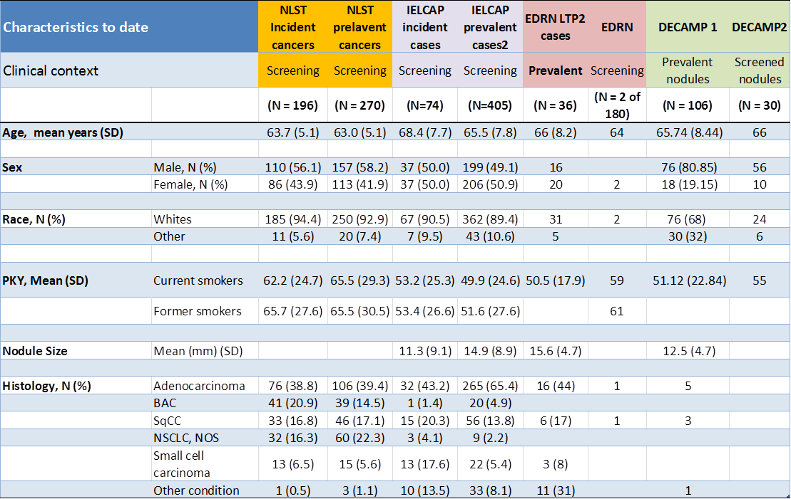
MCL Patient Populations

Slide 6
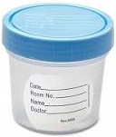
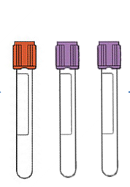

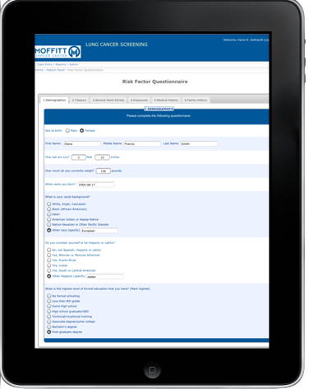
Establishing new (prospective) screening and incidental IPMN cohorts
Prospective Patient Recruitment Workflow
3 tubes of blood
1 oral gargle
Pending: Nasal swab
Incidental Pulmonary Nodule Patients
Total pts: 2,660 (32 prospective)
CT scans curated: 1,210 (3000+ pending)
Pts w/ blood draws: 14
Pts w/ oral gargle: 3
Lung cancer Dx: ~40%
Lung Cancer Screening Patients
Total pts: 278
CT scans curated: 732
Pts w/ blood draws: 186
Pts w/ oral gargle: 15
Lung cancer Dx: ~4%
LabVantage
Patient EMR
Database
Dashboard
Electronic
Consent
Radiology Report & Healthmyne
(Feature Extraction)
Cancer
Registry
Radiology

Slide 7

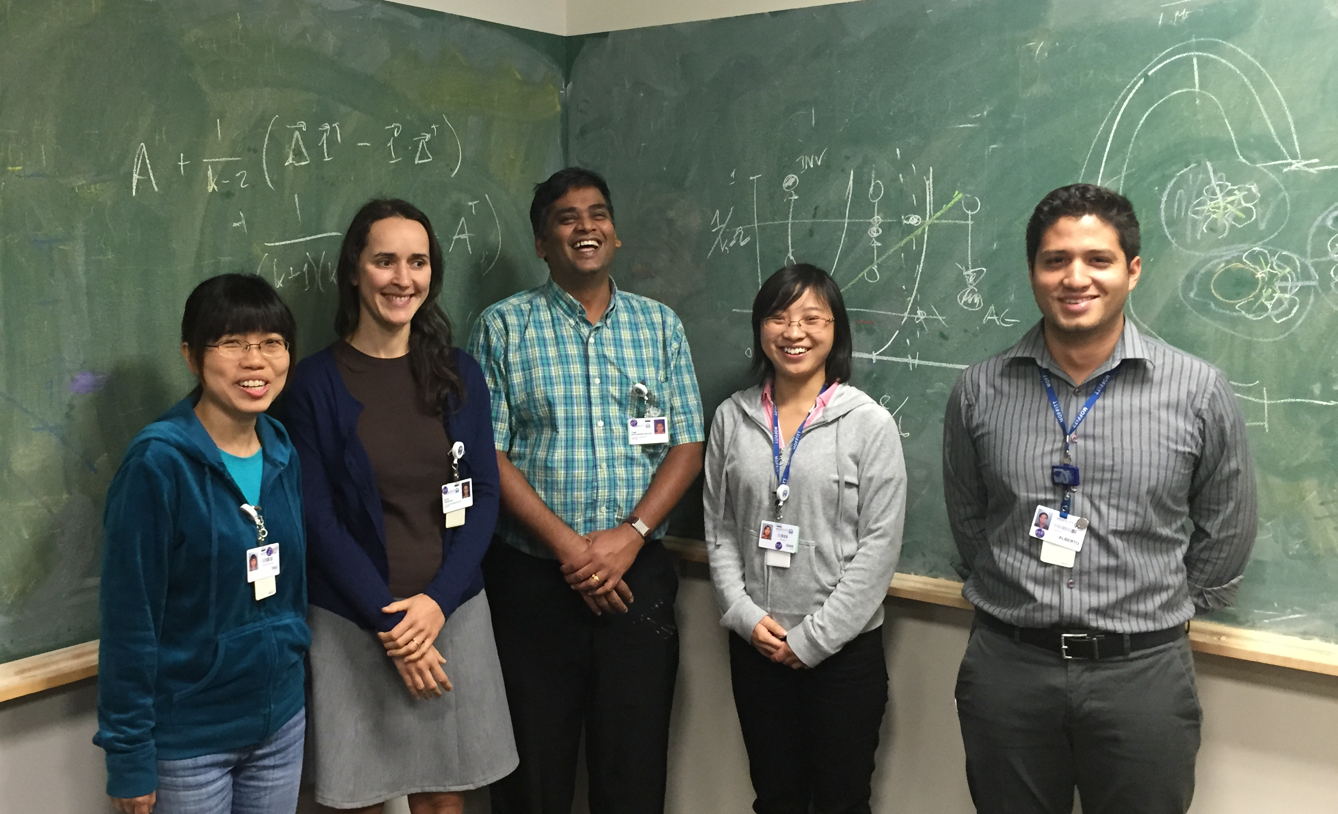
Radiomics:convert images to mineable data
Gillies, Kinahan, Hrickah. Radiology, 2016
Ying, Olya, Yoga, Kelly, Alberto

Slide 8
Radiomics: Images are data
N.B. Features can be Agnostic (Computed) or Semantic (Radiologist scored)
Gillies, Kinahan, Hrickah. Radiology 278(2), 563-77 , 2016
See also: Napel et al. 2018 “Quantitative Imaging of Cancer in the Post-genomic Era: Radio(geno)mics, Deep Learning and Habitats. CANCER (invited review..192 refs)

Slide 9

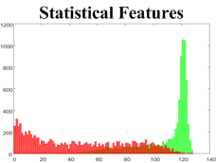
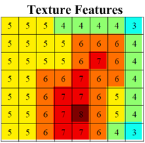
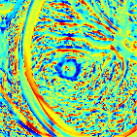
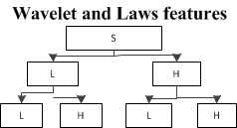
Radiomics Features
Morphological
  Volume, Surface area, Compactness, Sphericity, Location, Shape
  Central Necrosis, Spiculation, lobulation, border contrast……
Statistical Features
  Mean, Variance, Skewness, Kurtosis, Median,
  Coefficient of variation, Energy, Root mean square…
Textural Features
  Gray level co-occurrence matrix, Grey level size zone
  matrix, Grey level run length matrix, neighborhood gray
  level difference matrix, texture spectrum…
Wavelets
Radial Gradients
Laplacian Transforms
160
140
120
100
80
60
40
20
0

Slide 10
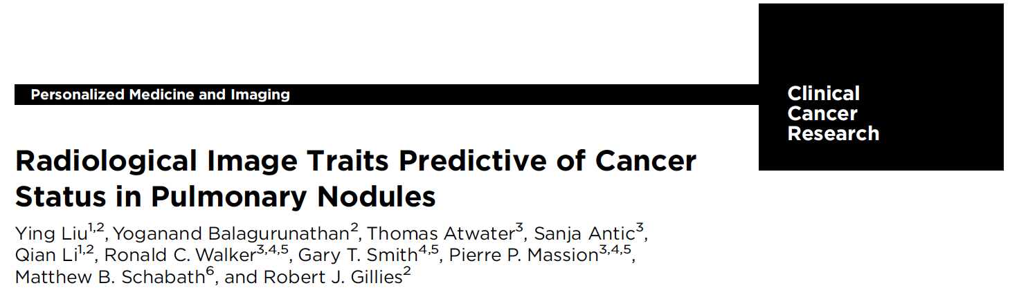
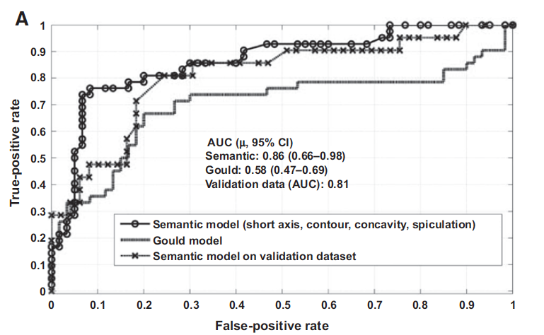
Incidental Nodules (VUMC) with Semantic features
AUROC to distinguish benign (122) from malig-nant (84) using only 4 features:
Short axis (cm),
contour,
concavity,
spiculation

Slide 11
Cohorts in NLST
(591 screen-detected cancers out of 26,309 patients: 2.2%)
Schabath et al., PLoS One, 2016

Slide 12
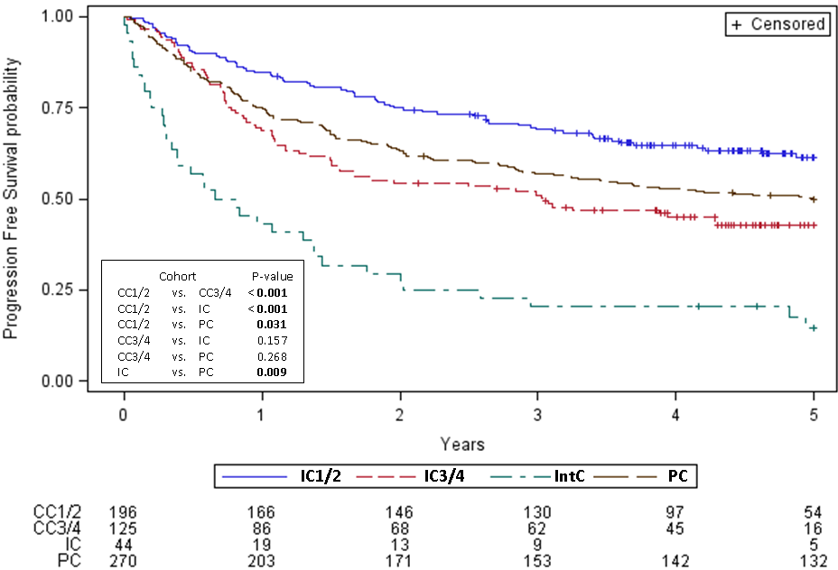
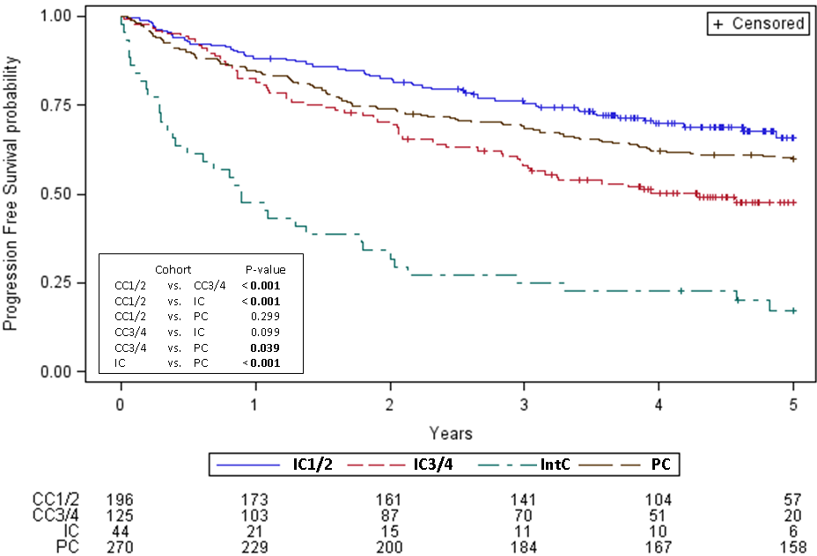
Behavior of cohorts
PFS
OS

Slide 13
Study 1: Prediction
(can baseline nodules predict subsequent cancer?)

Slide 14
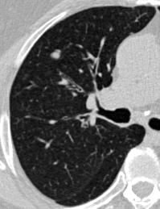
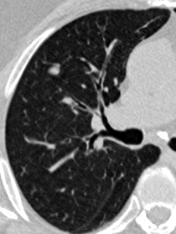
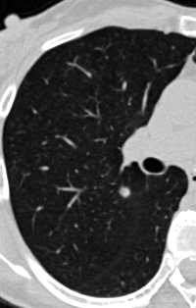
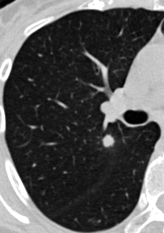
Agnostic Radiomics at Baseline
Hawkins et al. JTO 2016
Volume= 1.51cc
3D wavelet= 49.96
Entropy=4.89
Kurtosis=3.23
3D laws=0.02
Benign
Volume=0.2cc
3D wavelet= 0.02
Entropy=0.0001
Kurtosis=0.01
3D laws=0.0009
Cancer
Radiomics report at initial screening
Initial screening
Follow-up

Slide 15
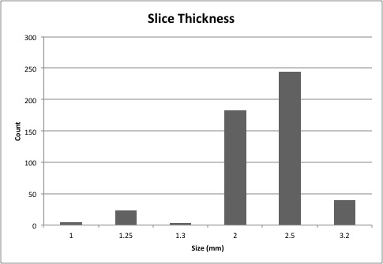
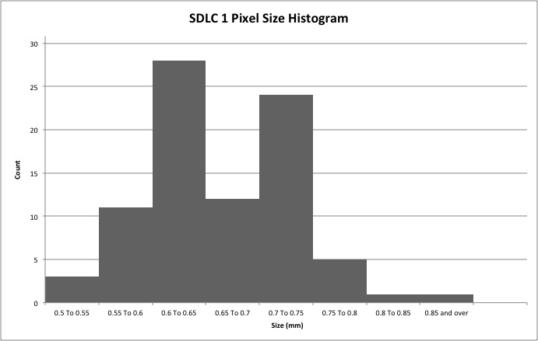
Study 1: Prediction
CT Images
NLST
Lung
Segmentation
Nodule
Segmentation
Image curation
and preprocessing
Nodule identification and matching
Feature
Extraction
Features:
Nodule Size
Nodule Attenuation
Nodule Shape
Nodule Location
Texture: Laws
Texture: Wavelets
Cancer
Feature
Subsets
Predictive
Model
Feature
Selection
Benign
nodule

Slide 16
Baseline Features to predict subsequent cancer @ 1 or 2 years
(10 non-redundant and stable features were used for model)
Hawkins et al., JTO, 2016

Slide 17
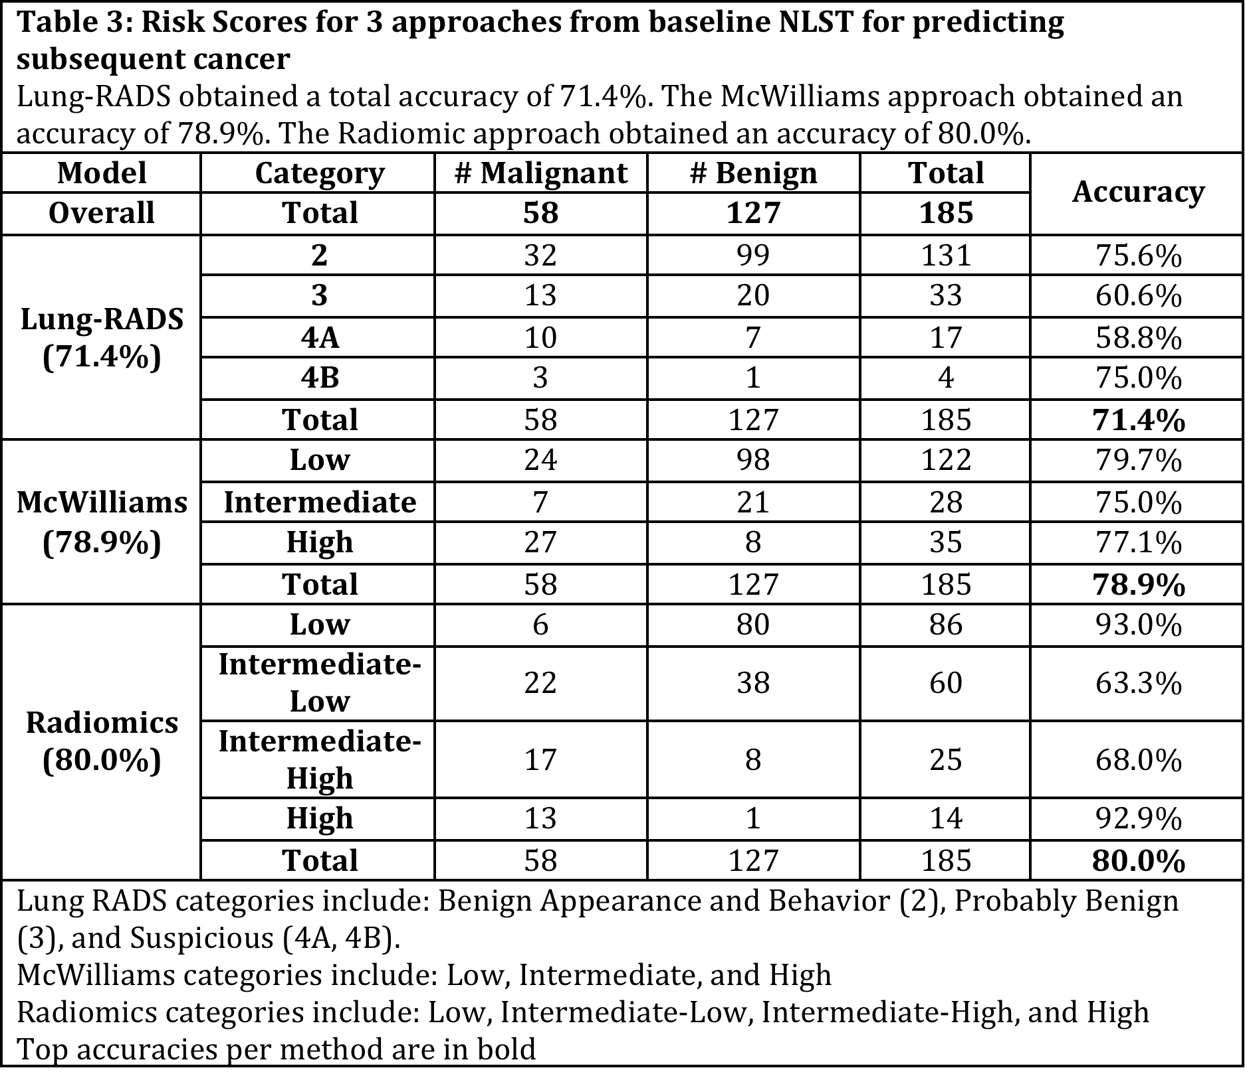
Radiomics Risk Score
N.B. Radiomics is 93% accurate for 100/185 low and high risk pts.
Hawkins et al., JTO, 2016

Slide 18
Study 2: Diagnosis
(can radiomics distinguish cancer from benign nodules?)
Balagurunathan et al., CCR, in revision

Slide 19
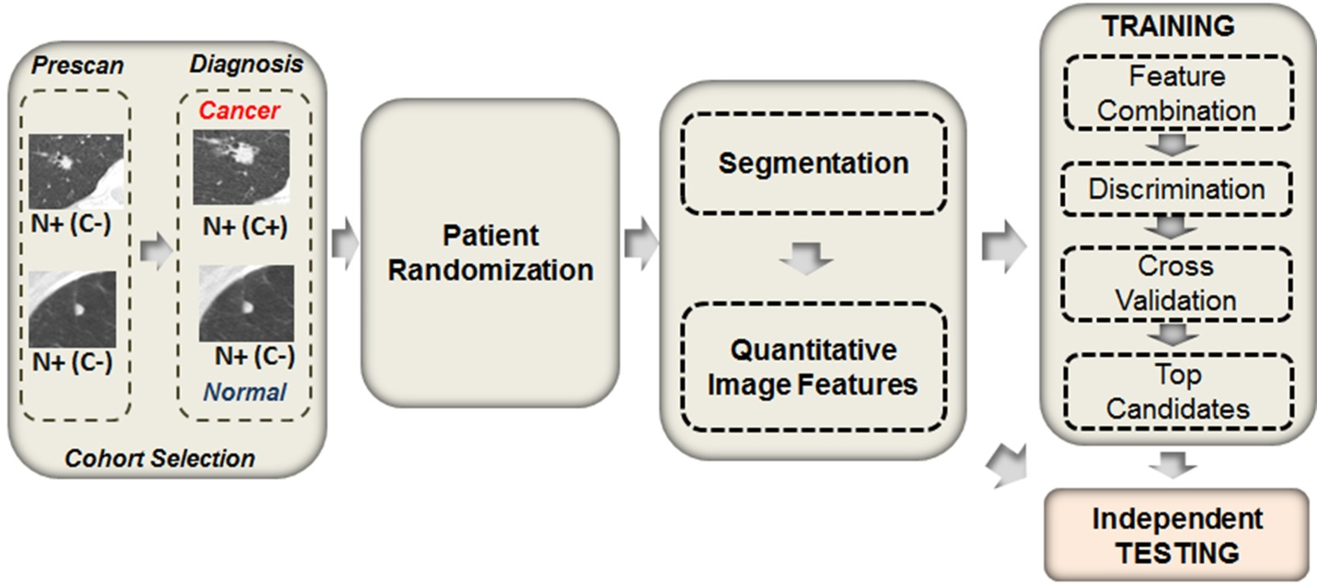
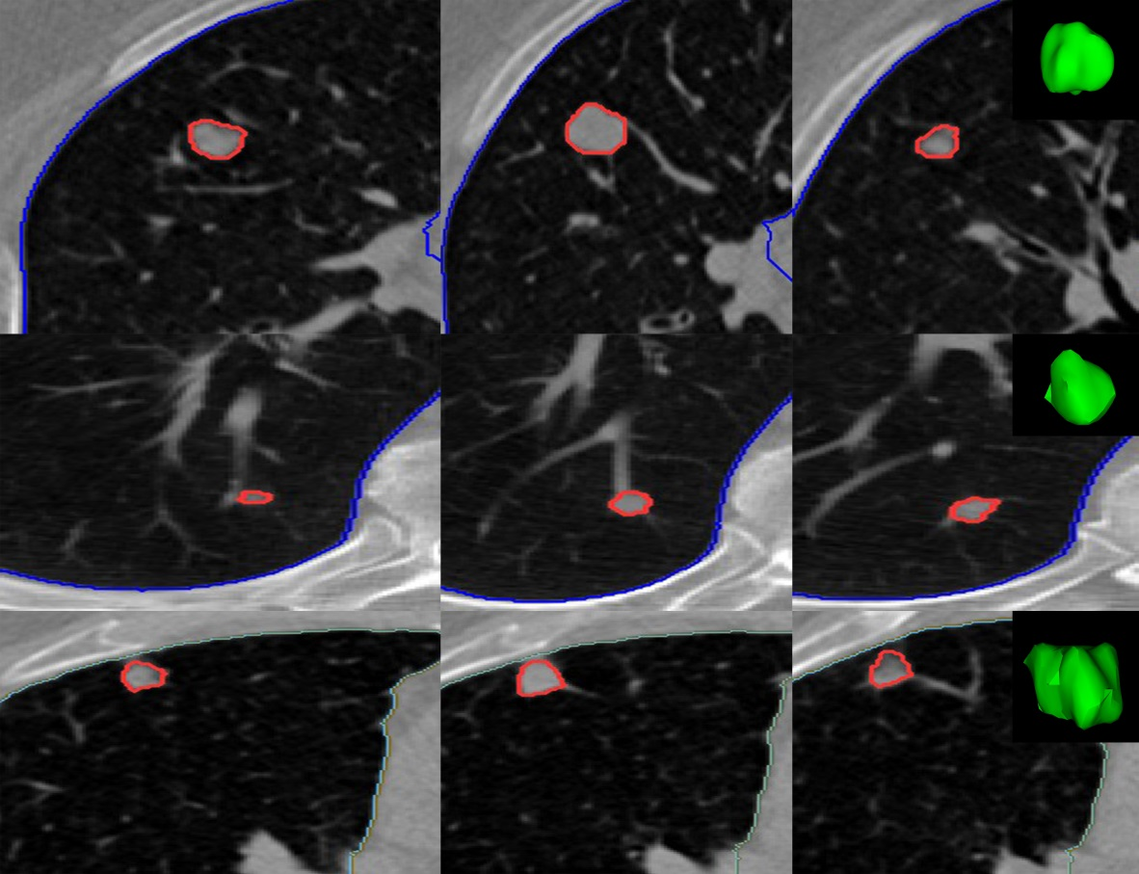
Study Design
Benign
Malignant

Slide 20
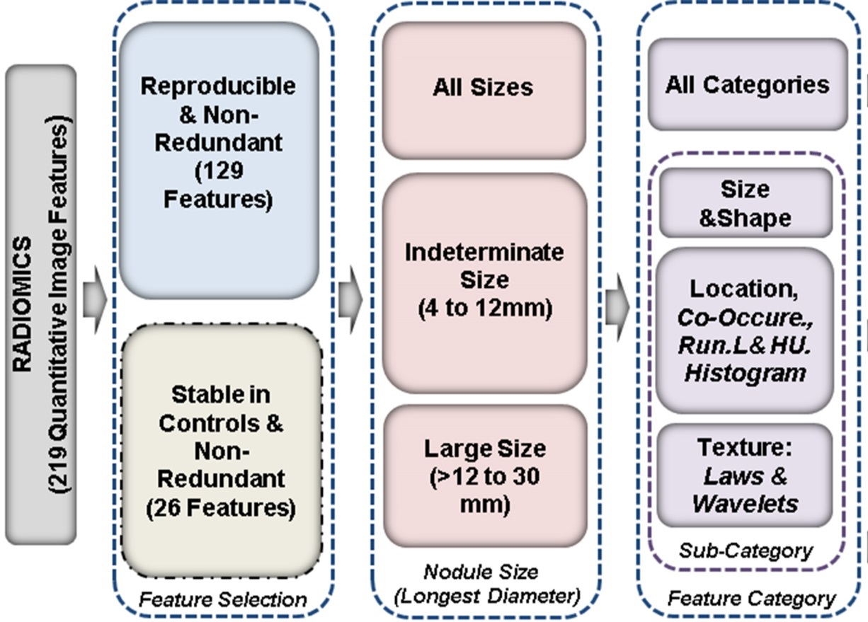
Indolent vs. Cancer Nodules

Slide 21
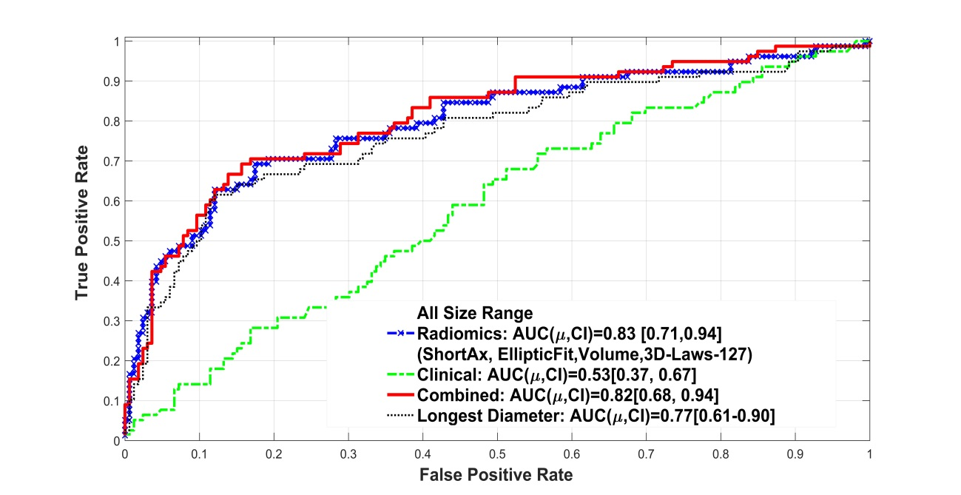
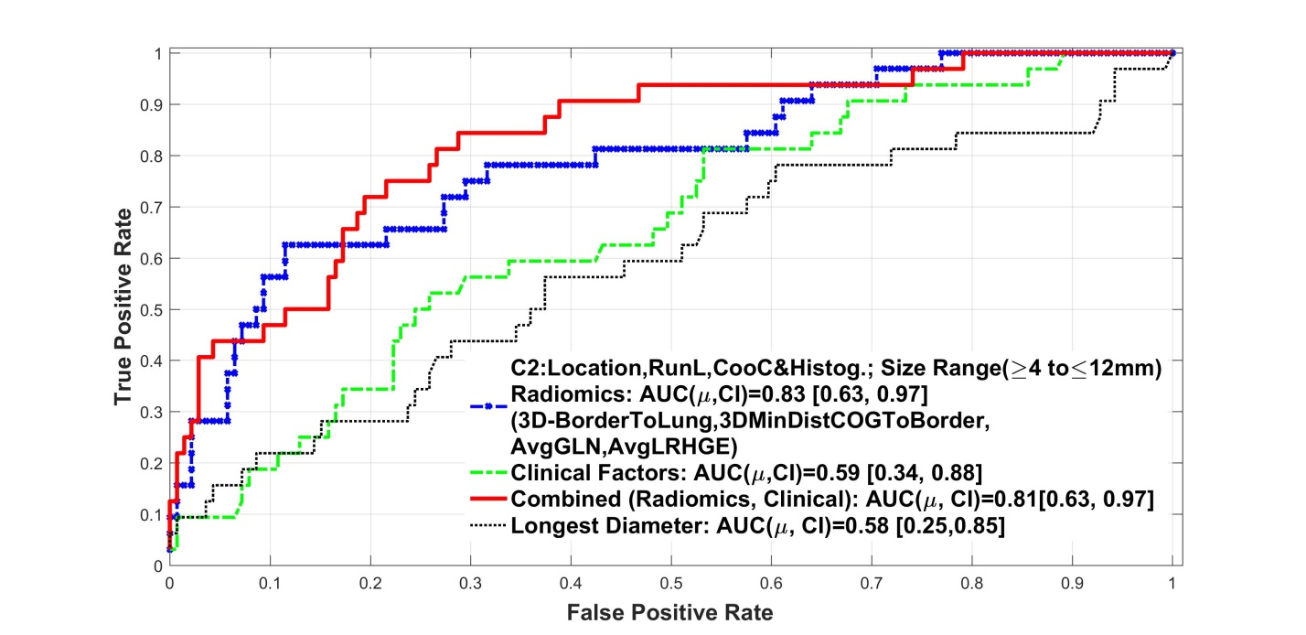

IPN classifier models
Full Model all sizes
Parsimonious Model 4-12 mm
AUROC 0.82
AUROC 0.81

Slide 22
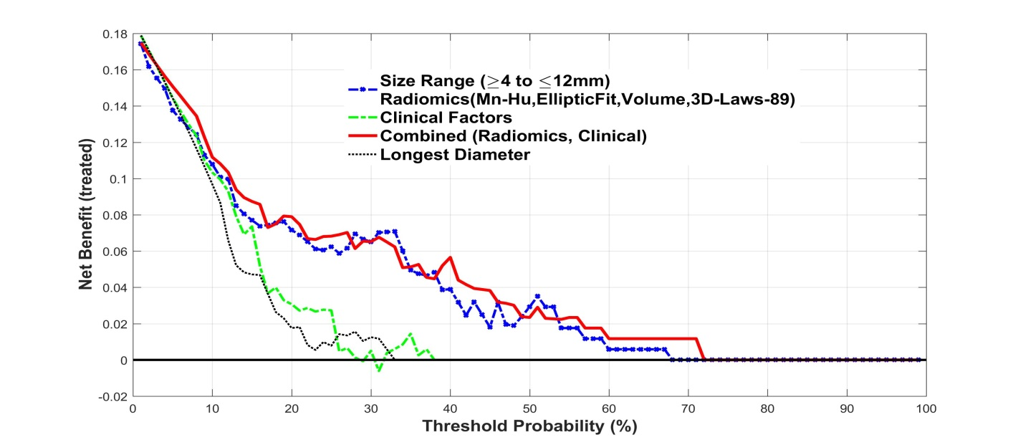
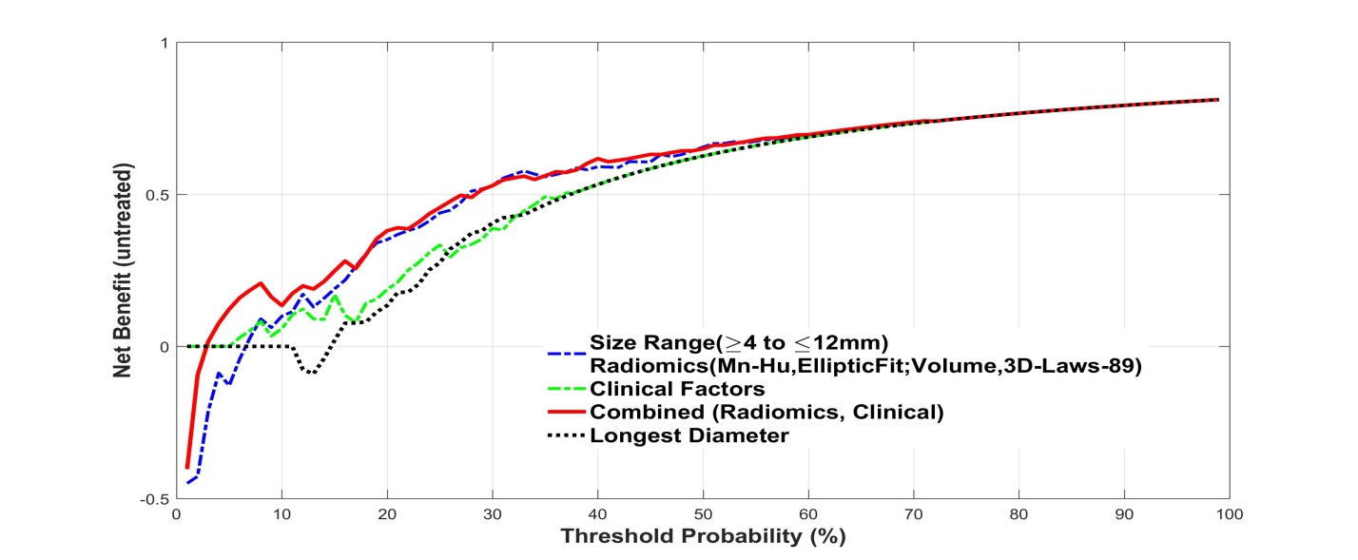
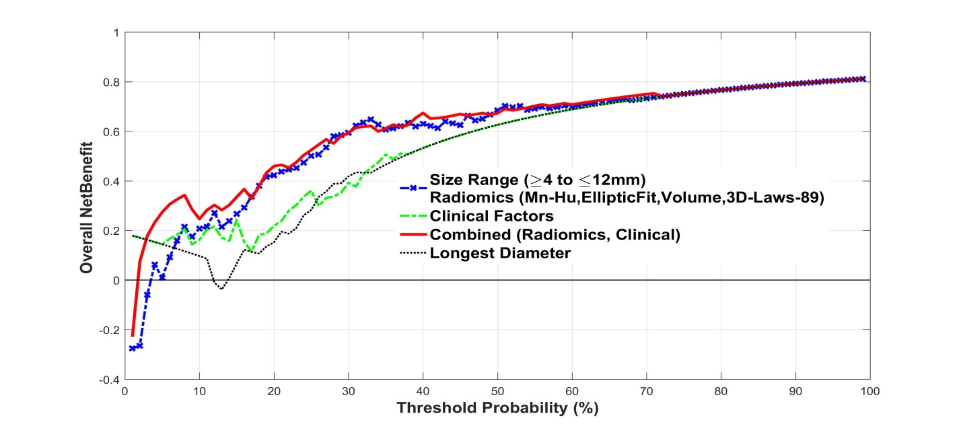
Clinical Benefit Calculations
Decision to treat
Decision to not treat
Net Clinical Benefit
Rousson V, Zumbrunn T. Decision curve analysis revisited: overall net benefit, relationships to ROC curve analysis, and application to case-control studies. BMC medical informatics and decision making. 2011;11:45

Slide 23
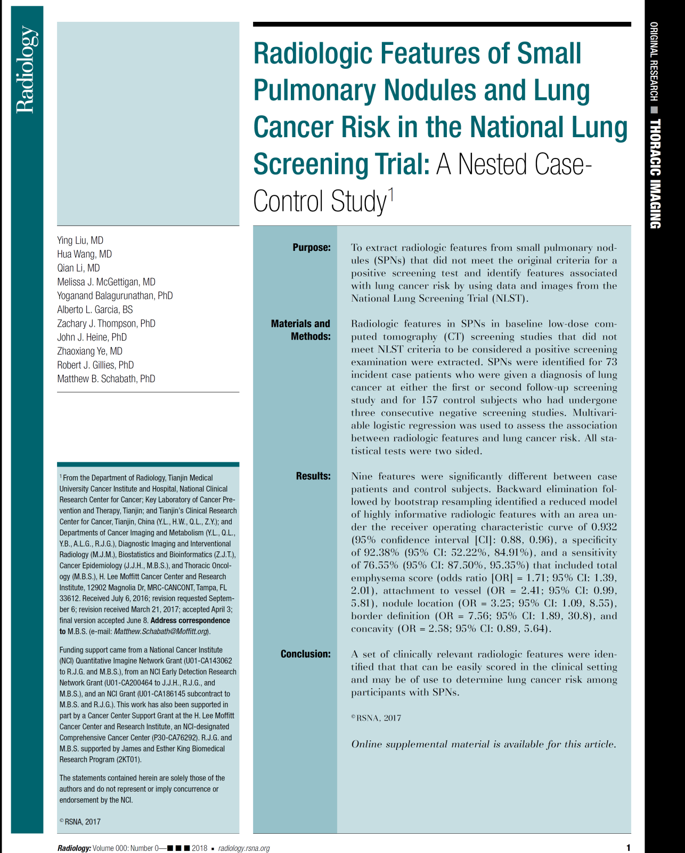
Semantic (Radiologist scoring) Features
1.00
0.75
Comparing this study with the previous, semantic features (AUROC = 0.93) outperformed computer-extracted features (AUROC = 0.83).
> Emphasizes need to develop computer features to capture radiologist scored features.
1.00
Sensitivity
0.50
0.75
1.00
Demographics Only
Area under ROC curve = 0.613
0.25
Sensitivity
0.75
Elevated emphysema score,
attachment to vessel,
upper lung nodule location,
poor border definition, and
presence of concavity (lobulation)
0.50
Demographics Only
Area under ROC curve = 0.613
0.00
Features Only
Area under ROC curve = 0.928
Sensitivity
0.00
0.25
0.25
0.50
0.50
0.75
1.00
Demographics Only
Area under ROC curve = 0.613
1 - Specificity
0.25
Features Only
Area under ROC curve = 0.928
0.00
0.00
0.25
0.50
0.75
Features and Demographics
Area under ROC curve = 0.936
1 - Specificity
1.00
0.00
0.00
0.25
0.50
0.75
1.00
1 - Specificity
Features only Sensitivity 75.3%
Specificity 92.4%
Accuracy 86.9%

Slide 24
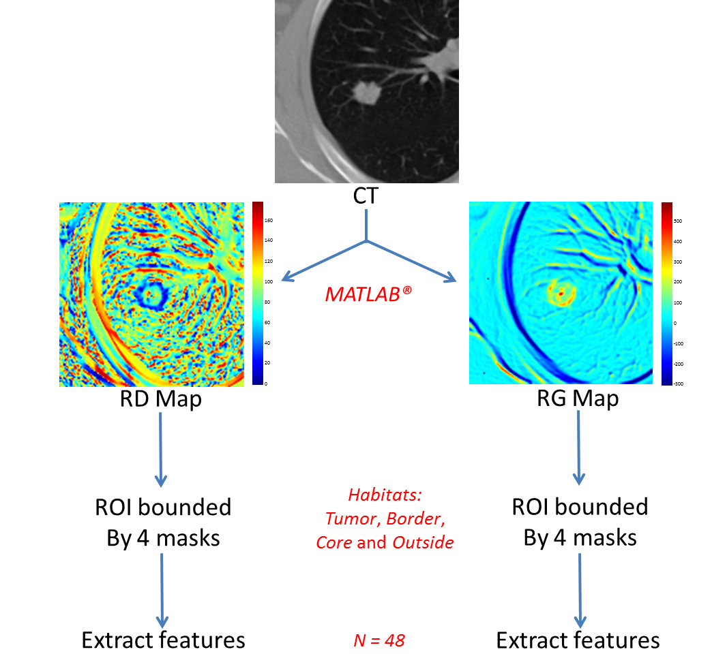
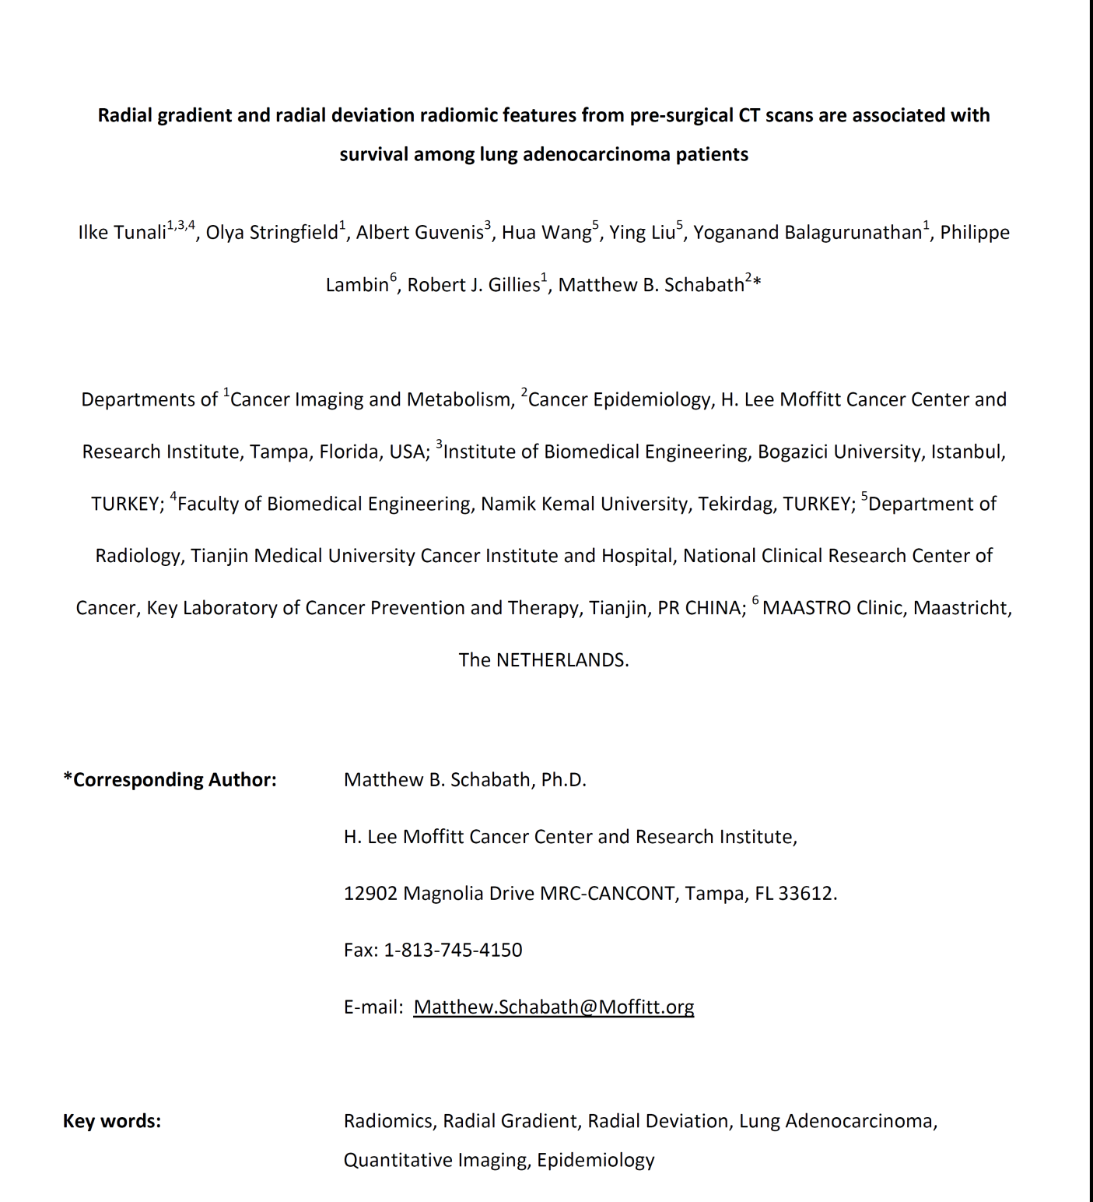
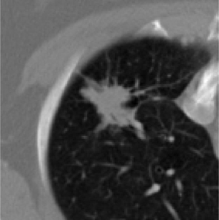
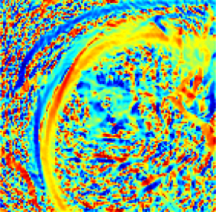
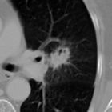
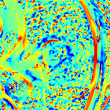
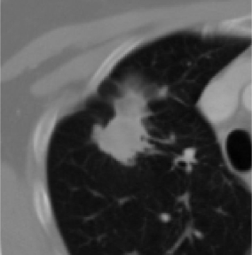
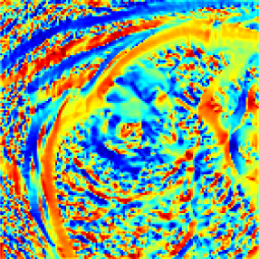
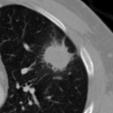
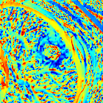
New Features: Radial gradients and Radial Deviation (semantic feature?)
Oncotarget
www.impactjournals.com/oncotarget/
160
140
Patient deceased
at
10
months
120
100
Sta
ge 3A
80
A
ge 74
60
40
20
CT
RD Map
0
160
140
Patient still alive after 60 months
120
100
Stage 3B
80
A
ge 77
60
40
20
0
www.impactjournals.com/oncotarget Oncotarget
Tunali et al., Oncotarget 2017

Slide 25
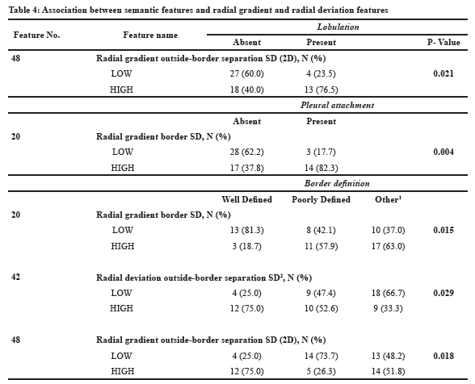
Radial gradients and Radial Deviation correspond to semantic features
Tunali et al., Oncotarget 2017 (in press)

Slide 26
Conclusions and Challenges
Conclusion 1: Quantitative Image Analytics of CT scans improve diagnostic, prognostic and predictive accuracy of indeterminate pulmonary nodules.
Conclusion 2: Both computerized and radiologist-derived features add value.
Challenge 1: Image harmonization through post-processing.
Challenge 2: Addition of serum/sputum biomarkers for additional power.
Challenge 3: Parsimony
Challenge 4: Numbers are King, Quality is Queen. The NLST, with >26,000 patients, was underpowered.

Slide 27
Conclusions and Challenges
Conclusion 1: Quantitative Image Analytics of CT scans improve diagnostic, prognostic and predictive accuracy of indeterminate pulmonary nodules.
Conclusion 2: Both computerized and radiologist-derived features add value.
Challenge 1: Image harmonization through post-processing.
Challenge 2: Addition of serum/sputum biomarkers for additional power.
Challenge 3: Parsimony
Challenge 4: Numbers are King, Quality is Queen. The NLST, with >26,000 patients, was underpowered. Need for large multi-institutional databases!

Slide 28
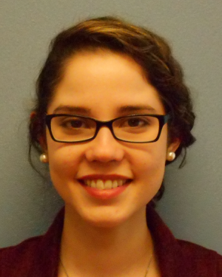

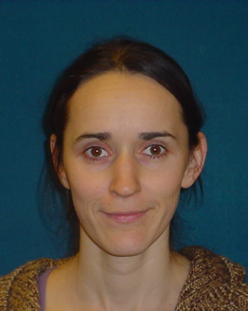
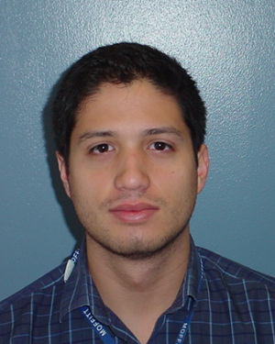
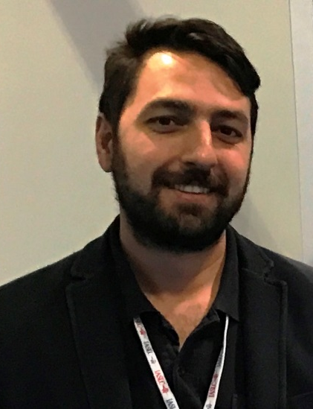
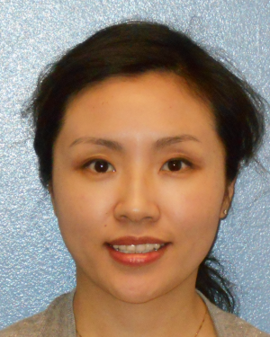
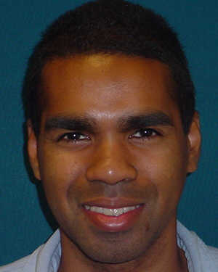


Moffitt Lung and Prostate Cancer Team
Ada Sulbaran Shamanie Tirbene Olya Stringfield, PhD Alberto Garcia Ilke Tunali
Study Coordinator Data Manager Imaging Scientist Imaging Coordinator Student
Jin Qi, MD Trevor Rose, MD Yoganand Balagurunathan Matt Schabath, PhD
Research Radiologist Radiologist Image Informatics Epidemiology, co-PI

