Slide 1

Proteomic and Genomic Ovarian Cancer Biomarker Discovery and Validation
Massachusetts General Hospital and Broad Institute
Michael J. Birrer, Michael Gillette, Eric Kuhn, Dustin Rabideau, Steven J. Skates

Slide 2
MGH/Broad/DFCI Ovarian Biomarker Pipeline
Global Proteomic Discovery
Ovarian Cyst Fluid: malignant vs. benign (LC/MS)
Gillette - Broad
Genomic Biomarker Discovery
Tissue lysate: ovarian cancer vs. fallopian tube epithelium filtered by secretome, TCGA
Birrer - MGH
Proteomics of Conditioned Media Discovery
Tubal Fimbria vs Ovarian Cancer
Drapkin - DFCI
Integrative Candidate Selection
Team
Targeted MS Qualification via immuno-SRM in plasma from pelvic mass pts, then in longitudinal screening samples
Gillette - Broad
Longitudinal Targeted Algorithm for Lead Time & Sensitivity
Skates - MGH

Slide 3
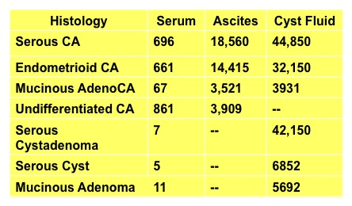
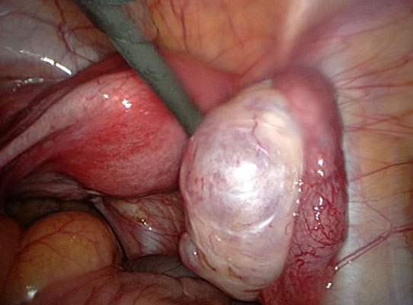
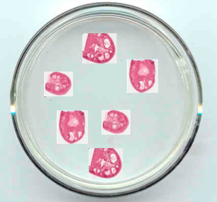
Ovarian Cyst Fluid (OCF) and Tissue Interstitial Fluid (TIF)
Increasing signal: Candidates enriched in proximal fluids
Decreasing noise: Patient unaffected tissue as control
Sedlaczek et al., CANCER 95: 2002
CANCER November 1, 2002 / Volume 95 / Number 9
Tissue interstital fluid (TIF)
Vibratome sections from fresh resections
Notes:
Strategy: Boost Signal via “Proximal Fluids” NAF (Breast) ~ BALF (Lung) CSF (CNS) ~ Pancreatic ductal fluid (Pancreas)
Fig. 4. Comparison between bronchoalveolar lavage fluid and plasma proteomes. Several proteins are present in BALF and not in plasma, suggesting that they are specifically produced in the airways. These proteins are, therefore, good candidates for becoming lung-specific biomarkers. Lung-specific proteins, such as surfactant protein A (SP-A) and clara cell protein 16 (CC16) are elevated in BALF proteome. Concentration of both proteins is indicated in different physiological fluids.

Slide 4
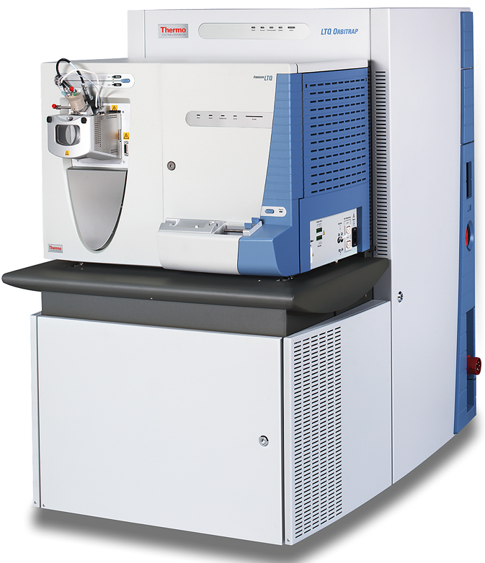
Tagged proteomic workflow allows robust and
deep discovery
IgY14
Immunoaffinity
Depletion
denature
reduce/alkylate
buffer exchange
concentrate
aliquot
freeze
Malignant and
Benign OCF or TIF
and common reference sample
proteolytic
digestion
LC-MS/MS
30 Fractions
(BRP)
Case and control samples processed in parallel
“True” pairs partnered at all stages of preparation and analysis
Randomized run order not practical at fraction level

Slide 5
Tagged mass spec with reference channel (blue)

Slide 6
Tagged mass spec with reference channel (blue)
Normalize by reference sample

Slide 7
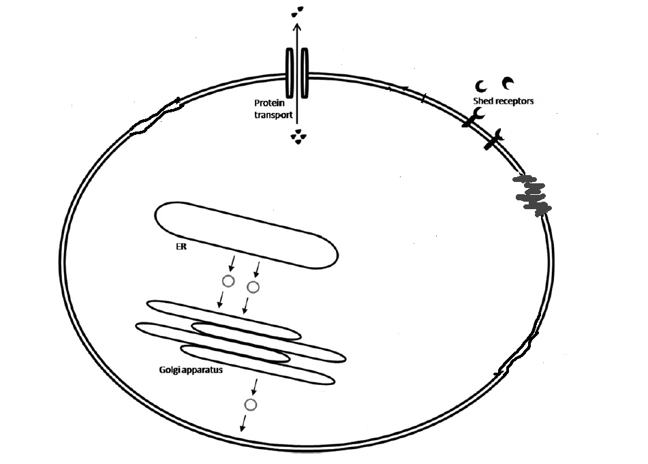
FOCUS ON SECRETED PROTEINS / GENES
Secreted Proteins
G protein-coupled receptors
Organ damage
CN Proteins
Signal Peptide
“Extra Cellular”
“Membrane”
Classical secretory pathway

Slide 8
FOCUS ON SECRETED PROTEINS / GENES
Secreted Proteins
Database for G protein-coupled receptors
http://www.gpcr.org/
Secreted Protein Database
http://spd.cbi.pku.edu.cn/
G protein-coupled receptors
Diehn et al. (PLoS Genet 2006; 2:e11)4
Gene Ontology:
“Membrane”
Organ damage
CN Proteins
Signal Peptide
“Extra Cellular”
Diehn et al. (PLoS Genet 2006; 2:e11)
Gene Ontology
“Extra Cellular”
Signal Peptide Website
http://www.signalpeptide.de
“Membrane”
Gene Ontology:
“Membrane”
Classical secretory pathway
Clark (Genome Res. 2003; 13:2265-70)
Secreted Protein Database
http://spd.cbi.pku.edu.cn/
SPdb (signal peptide database)
http://proline.bic.nus.edu.sg/spdb/
UniProt
http://www.uniprot.org

Slide 9
Ovarian Tissue Samples
OSE Study: n = 53 cases: micro-dissected ovarian tumor
n = 10 controls: ovarian surface epithelium
FTE Study: n = 10 cases: micro-dissected ovarian tumor
n = 10 paired controls: fallopian tube epithelium
n = 10 unpaired controls: fallopian tube epithelium

Slide 10
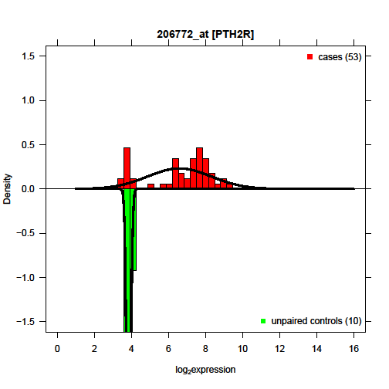
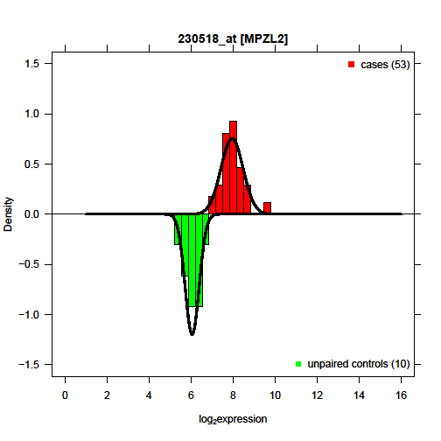
Lack of fit with Normal Distribution
Good fit
Bad fit
1 2
Cases seem to come from 2 distributions

Slide 11
Mixture model
A “mixture” of two normal (or t5) distributions
Additional parameter – the mixing proportion (Θ).
Controls follow t5 distribution
t5(µ₁,σ₁)
Cases follow mixture distribution:
Θ * t5(µ₁,σ₁) + (1- Θ) * t5(µ₂,σ₂)
  Proportion of Θ cases who express like controls
  Proportion of (1- Θ) cases who over (or under) express
Notes:
Mention similarity between t5 and normal (location and scale)

Slide 12
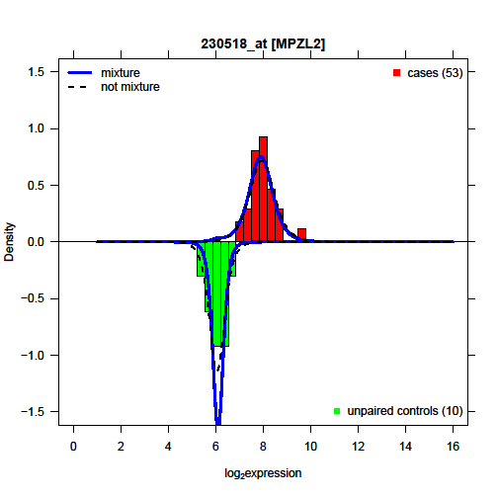
Mixture model – Mok samples
Similar fit to non-mixture
Mixture leads to better fit

Slide 13
Mixture model – FTE samples
Like OSE, we have cases and controls
  BUT we also have paired controls (matched fallopian tube epithelium)
Cases/paired controls = bivariate t5 mixture
Unpaired controls = univariate t5 (no mixture)
Cases
Paired controls
Unpaired controls
FTE mixture model

Slide 14
Integrative Candidate Selection
150 Candidates identified through 3 discovery streams
  TIF
  OSE/FTE
  OCF
Top 50 plasma proteins selected for potential relevance to ovarian cancer through consideration of human protein atlas, cBio, uniprot, and other sources

Slide 15
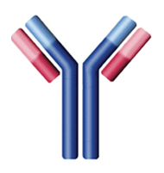
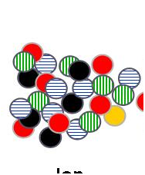
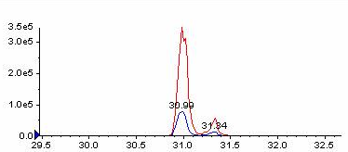
SID-MRM-MS with Ab-capture of peptides decreases assay complexity and increases robustness (SISCAPA¹⁼ - iMRM)
Peptides in digested sample
Native (¹²C) peptide
Heavy Stnd (¹³C) peptide
Add ¹³C-labeled
signature peptide
Capture on Ab-coated magnetic beads
Wash; elute peptides
Advantages of SISCAPA/ iMRM
Simpler sample handling prior to LC-MS/MS to reach ng/mL
Only requires 1 Ab
Easy to obtain useful anti-peptide Abs (≈ 95% success)
Can be highly multiplexed
Sensitivity increases with sample volume
Supports automation
MRM-MS
*
*
*
*
Ratio ¹³C-peptide to
¹²C-peptide by MRM-MS
¹²C-peptide
Abundance
¹³C₆-peptide
1. Anderson et al. (2004) J. Prot. Res.
Time, minutes
Notes:
Success rate for obtaining an IP-capable anti-peptide Ab is MUCH greater than for an anti-protein Ab using a
Peptide antigen.

Slide 16
MS Targeted Mass Spec Assay Development
50 candidates selected for targeted plasma protein assay development (iMRM)
5 peptides per candidate protein
252 synthesized peptides injected into rabbits
2 pAbs per target selected
100 MS targeted assays developed

Slide 17
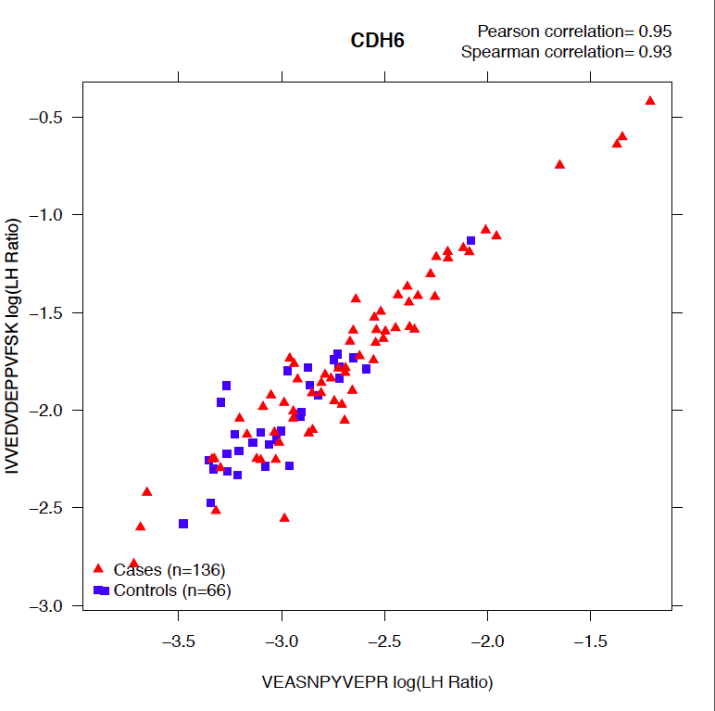

Slide 18
Summary of iMRM Assays developed for 50 EDRN selected proteins
Discovery from Sequencing and Proteomic Data
50 proteins
Selection of peptides for iMRM polyclonal Ab generation in rabbits
100 anti-peptide antibodies
Determination of pAbs generation success rate
83 working Abs
2 Ab/protein = 35 proteins
1 Ab/protein = 13 proteins
0 Ab/protein = 2 proteins
(BCL2L1, VANGL1)
18

Slide 19
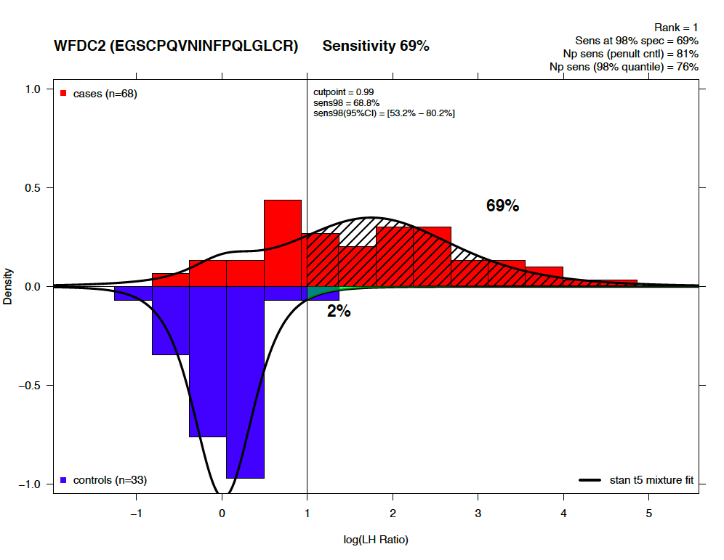

Slide 20
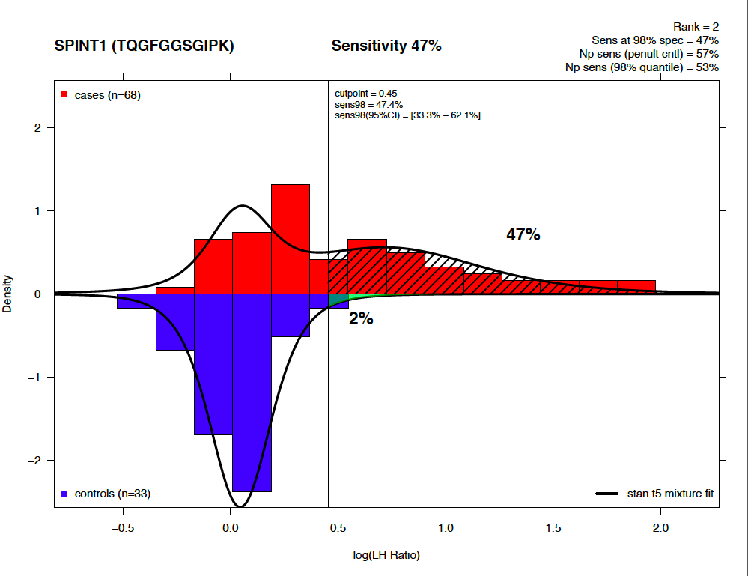

Slide 21
Targeted Mass Spec Assay
Next Steps
Evaluate in longitudinal plasma samples from screening study (CGN-GOG0199)
Determine fraction cases with change-point for each candidate
Determine earliest point of detection following change-point (@98% spec)
Combine candidates with positive longitudinal signal into a longitudinal classifier
Evaluate on independent longitudinal sample set

