Slide 1
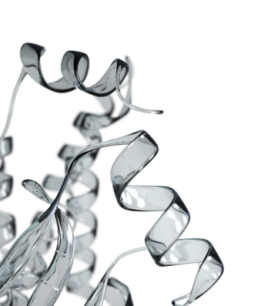
Multiplex screening and evaluation of plasma protein biomarkers for early detection of colorectal cancer using Proximity Extension Assay Ida Grundberg, PhD 10th EDRN Scientific Workshop Cancer Biomarkers in Precision Medicine March 6, 2018

Slide 2
Disclosure information
Employee at Olink Proteomics, Inc.

Slide 3
Plasma protein biomarkers for CRC
Current gold standards (colonoscopy and sigmoidoscopy) have limitations, e.g. costs, resources and low compliance
Non-invasive screening stool tests have limitations with sensitivity and adherence → blood-based screening tests are strongly desirable
Compare and evaluate Proximity Extension Assay (PEA) for analysis of 92 tumor-associated proteins in 1uL of plasma
Samples were collected from the BliTz cohort with 5,516 screening colonoscopy participants
Notes:
CRC is the 3rd most commonly diagnosed cancer and the 4th most common cancer cause of death worldwide with 1.2 million new CRC cases and 600,000 deaths yearly
Current gold standards for detection are colonoscopy and sigmoidoscopy but have limitations e.g. costs, resources and low compliance
Non-invasive screening tests based on stool (gFOBT and FIT) have limitations with sensitivity and adherence → blood-based screening tests are strongly desirable
Study aimed to compare and evaluate Proximity Extension Assay (PEA) for analysis of 92 tumor-associated proteins in only 1uL of plasma
Samples were collected from the BliTz cohort with 5,516 screening colonoscopy participants
The aim of the BliTz-study is to evaluate new stool-based screening methods fo the early detection of colorectal neoplasia. Blood and stool samples from approx. 3000 persons will be collected before colonoscopy to evaluate biomarkers for early detection of colorectal cancer. The new stool- and blood-based screening methods will then be compared to colonoscopy, the gold-standard method of early detection of colorectal cancer.

Slide 4
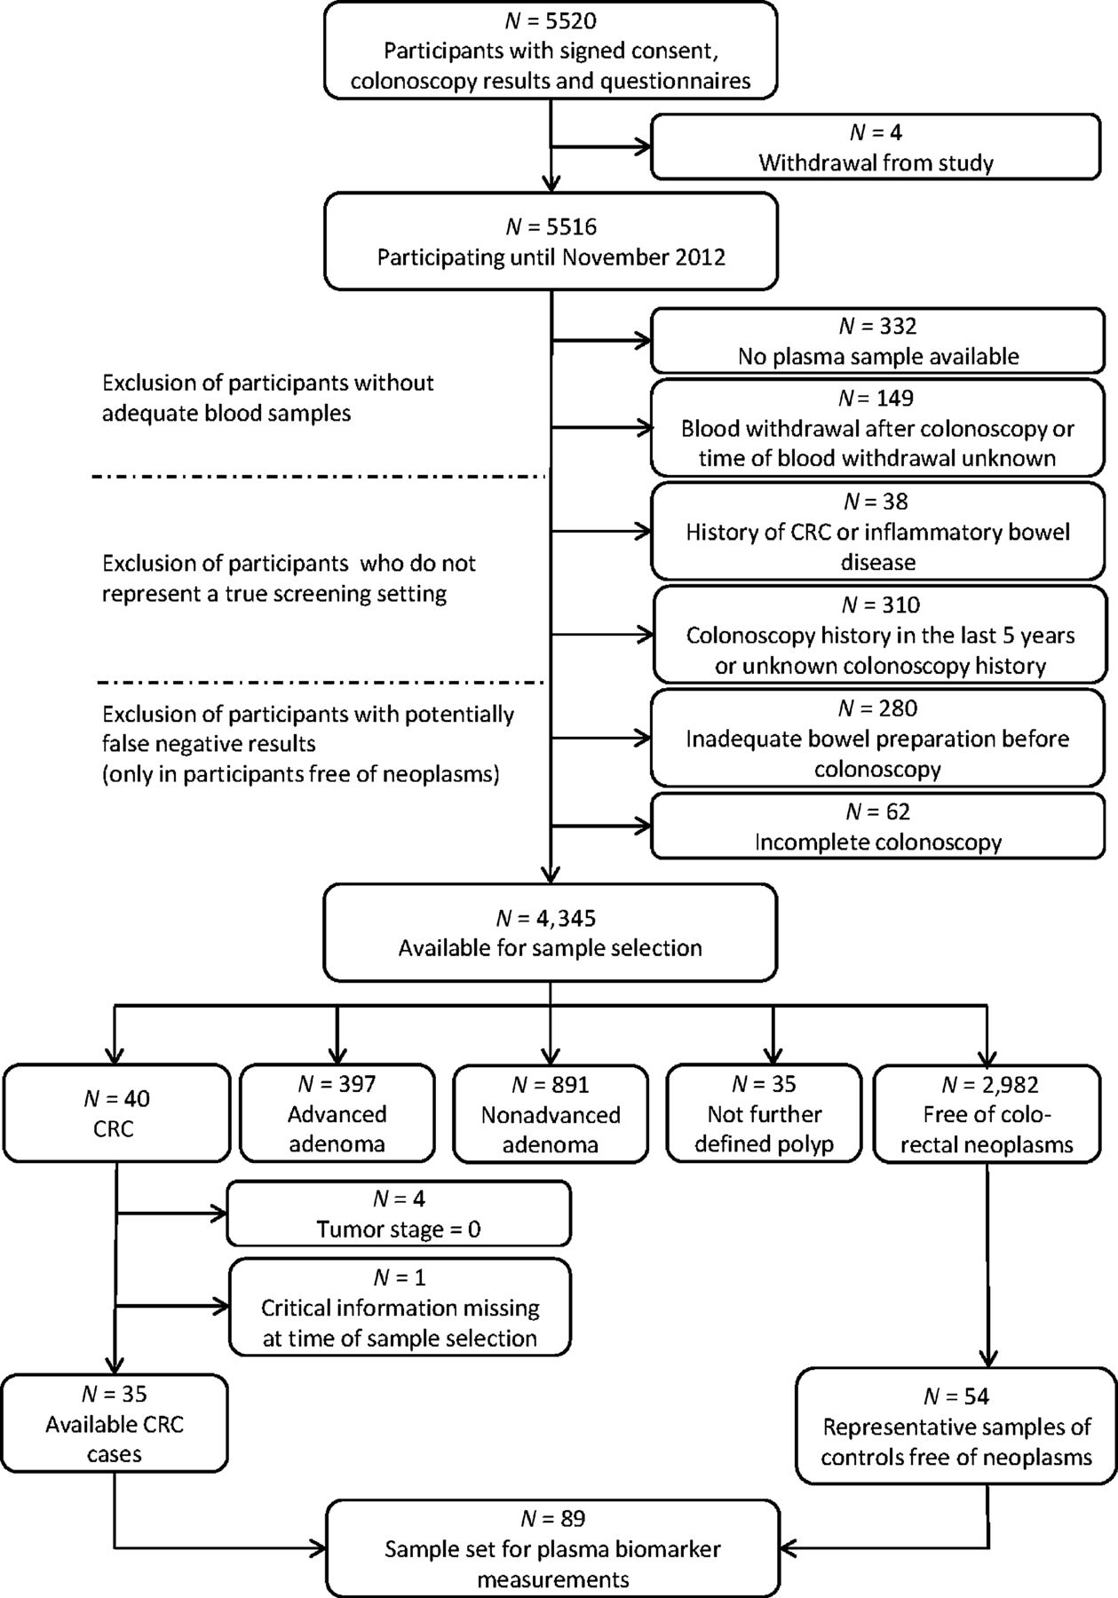

Study design and population: BliTz study
Discovery
All 35 BliTz-cases with newly detected CRC were included in the analysis
54 controls free of colorectal neoplasms
N=89 plasma samples
Validation
54 additional CRC cases from hospitals in Heidelberg
38 additional controls free of colorectal neoplasms
N=92 plasma samples
Notes:
BliTz:
20 gastroenterology practices in South-western Germany since November 2005
aims to evaluate novel promising biomarkers for early detection of colorectal
cancer.
blood samples taken one week before the screening colonoscopy.
all 35 available cases with newly detected colorectal cancer
representative sample of 54 controls free of colorectal neoplasms.
For an independent validation
54 additional colorectal cancer cases (four hospitals after diagnosis but before initiation of treatment)
38 additional randomly selected controls free of neoplasm from the BliTz study.

Slide 5

Technology: Proximity Extension Assay (PEA)

Slide 6
Technology: Proximity Extension Assay (PEA)
92 proteins/panel
Immune
Response
Cardiometabolic
Cardiovascular II
Cardiovascular III
Cell Regulation
Development
Immuno-Oncology
Inflammation
Metabolism
Neurology
Oncology II
Organ Damage

Slide 7
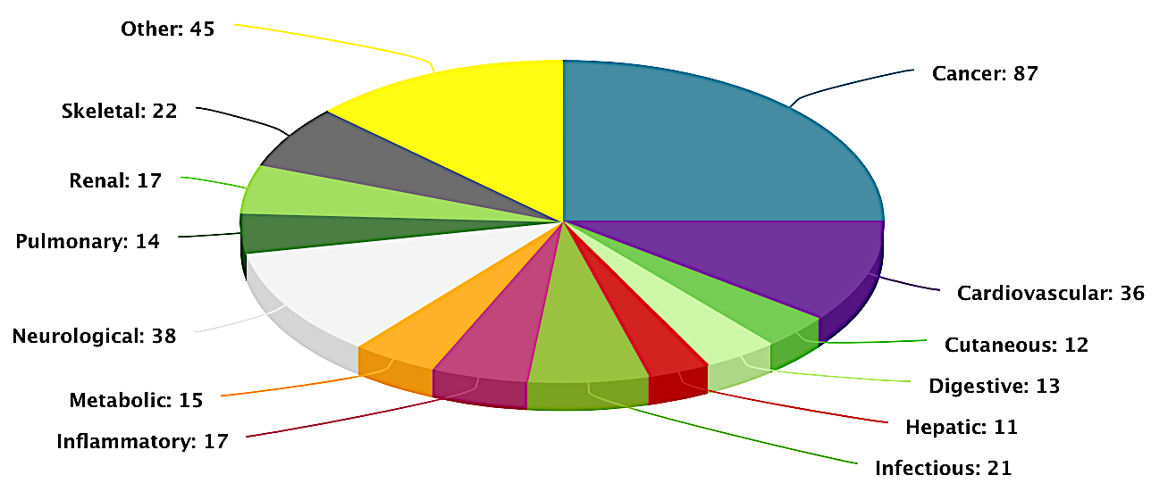
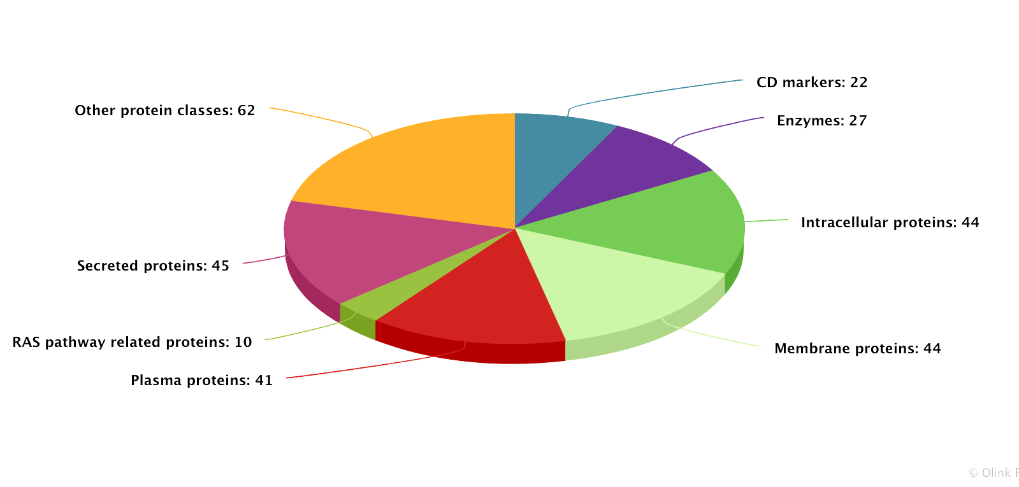
Oncology panel
Disease area
92 tumor-associated proteins
1 uL sample required
Plasma, serum, tumor biopsies, microvesicles, cell lysates, microdialysis fluids, cervical smear on filter paper, etc.
Built-in quality control and data normalization
Open-access validation data
Protein class

Slide 8
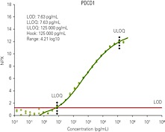
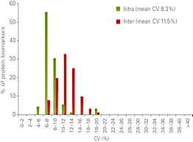
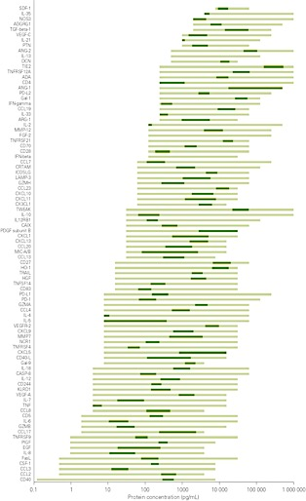
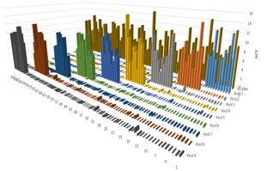

Validation PEA
1. Sensitivity (<pg/ml)
2. Precision (intra-CV <10%, inter-CV <20%)
5. Broad dynamic range (library spans 13 logs)
3. Scalable (multiplex to smallplex)
4. Specificity from dual-recognition & DNA-barcoding
Notes:
1. Ssensitivity. Each of our assay offers a sensitivity similar to ELISA (if required for that assay) and we generate calibrator curves using recombinant antigens.
2. All assays are validated for precision and in the case for the new I/O panel we have an average intra%CV of about 8% and inter%CV of under 12% .
3. Scalability. In other words we confirm that our performance remains when scaling up from 1-plex → 96-plex
4. Specificity which we test in several ways by for example by making up ”samples” with spiked-in antigens to control that we only get signals when correct antigens are present
5. Broad dynamic range that cover both elevated disease levels as well as normal levels of proteins.

Slide 9
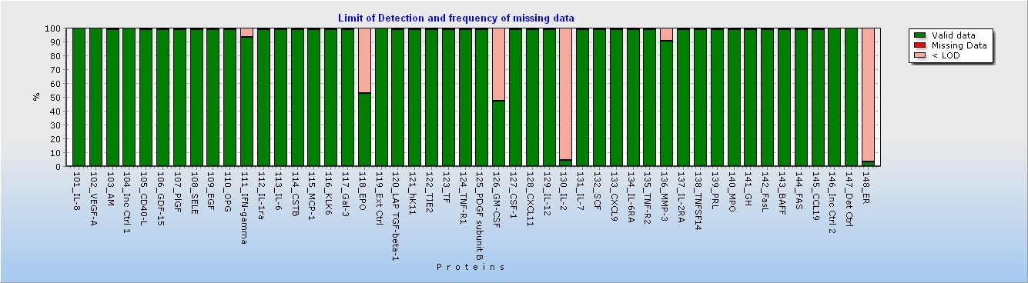
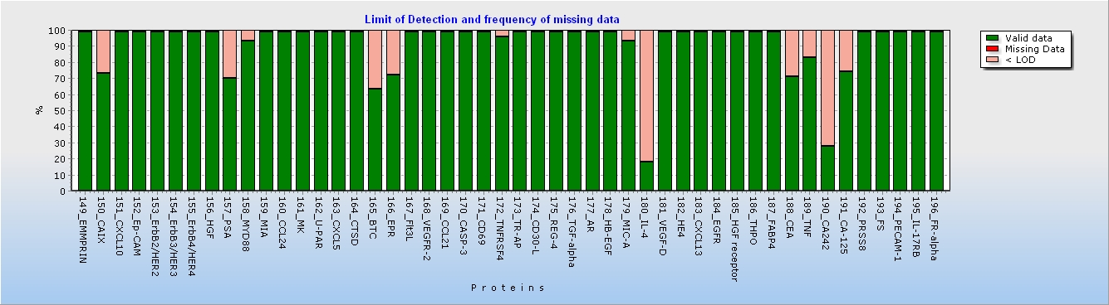
Protein detectability and plasma level differences
Protein detectability and missing data
Controls vs. CRC
Stage I/II vs. III/IV
Notes:
The percentage of limit of detection (LOD) and missing data for each of 92 protein biomarkers in all the tested plasma samples.
Box plots of plasma levels for most significant protein biomarkers: (a) between CRC cases and controls; (b) early stages (I/II) and advanced stage (III/IV) CRC. The bottom and top of the box indicate the first (Q1) and third (Q3) quartiles, and the middle line in the box is the median; the upper-limit equals Q3 plus 1.5 times interquartile range (IQR), and the lower-limit equals Q1 minus 1.5 times IQR.
Seven protein markers
(IL6, CXCL9, CXCL10, PSA, cathepsin-D, caspase-3, and AREG)
showed higher levels in early tumor stages than in advanced ones.
However, only the result for IL6 was statistically significant (P
value < 0.05)

Slide 10
Protein biomarkers with significant differences between CRC vs. controls
Over-expressed in CRC
Down-regulated in CRC
Only CEA, GDF-15, AREG met an FDR threshold of 5%
Apart from PSA, no biomarkers showed relationship to sex nor age
Adjusted AUC ranged from 0.55-0.7
80% specificity, CEA highest sensitivity 52%.
90% specificity, AREG highest sensitivity 36%
Notes:
The plasma protein levels were first compared between CRC and controls using the Wilcoxon Test, and the Benjamini and Hochberg method was additionally employed for multiple testing. The following diagnosis-related indicators were used for evaluating the diagnostic performance of
each protein biomarker: sensitivity (true positive rate), specificity (true negative rate), ROC curve, and area under the ROC curve (AUC).
For each individual protein biomarker, a logistic regression model was used to construct the prediction model. Based on the predicted possibilities from the prediction model, the AUCs and their 95% confidence intervals were derived. Moreover, sensitivities of each individual biomarker at cutoffs yielding 80% and 90% specificity were calculated. In addition to direct estimates of the diagnosis-related indicators, the .632.bootstrap method was applied to adjust for potential overestimation of diagnostic performance. Furthermore, for the biomarkers which were identified to have significantly
different plasma levels between colorectal cancer cases and controls, stage-specific AUCs (apparent and .632. adjusted AUCs) were also calculated, and the Delong test (22) was employed to compare the differences of apparent AUCs between early stages (i.e., tumor stage I/II) and advanced stages (i.e., tumor stage III/IV).
When using 25% false positive rate (FDR) as the cutoff level for multiple testing, all the 17 biomarkers were still statistically significant. However, only carcinoembryonic antigen (CEA), growth differentiation factor 15 (GDF-15), and amphiregulin (AREG) met an FDR threshold of 5%. Apart from prostate-specific antigen (PSA), for which statistically
significantly higher plasma levels in men than in women were found, all the other 16 biomarkers did not show any statistically significant relationship with sex or age within the
group of controls free of colorectal neoplasms (P values >0.05, data not shown). In addition, sensitivity analyses excluding four participants reporting to have had any cancer diagnosis in the past in self-administrated questionnaires were also conducted, and yielded almost identical results (data not shown).
The adjusted AUC for these 17 markers ranged from 0.55-0.7 and four markers (AREG, CEA, GDF-15 and IL-6) showed substanitally better diagnostic performance than the others

Slide 11
Protein biomarkers with significant differences between tumor stages
13/17 had higher adjusted AUCs in early tumor stages than at advanced
AREG, IL6, and GDF-15, adjusted AUCs for early tumor stage colorectal cancer were higher than 0.70
CEA showed the highest adjusted AUC for advanced stage colorectal cancer (0.75).
Notes:
Table 3 shows the comparison of ROC analysis for these 17 markers between colorectal cancer patients at early and advanced stages. Most markers (13/17) showed higher adjusted AUCs in colorectal cancer patients at early tumor stages than at advanced ones. However, none of the differences was statistically significant. For three markers (AREG, IL6, and GDF-15), the .632. adjusted AUCs for early tumor stage colorectal cancer were higher than 0.70 (i.e., 0.76, 0.74, and 0.72, respectively). By contrast, CEA showed the highest .632. adjusted AUC for advanced stage colorectal cancer (0.75).
Seven protein markers
(IL6, CXCL9, CXCL10, PSA, cathepsin-D, caspase-3, and AREG)
showed higher levels in early tumor stages than in advanced ones.
Estimated sensitivities at two specificities in an independent validation set
rigorous adjustment for potential overoptimism resulting from overfitting
A multimarker algorithm was derived by applying the Lasso
logistic regression model based on all 92 protein markers. With
the purpose of adjusting for potential overfitting of the prediction
algorithm, a ".632. bootstrap subsampling approach" (23) was
conducted in the following way: (i) generate 1000 bootstrap
samples (subsampling method, bootstrap without replacement);
(ii) for each bootstrap sample set, apply the Lasso logistic regression
procedure to select variables and to construct a prediction
algorithm; (iii) apply this algorithm on those patients not included
in the bootstrap sample to obtain bootstrap estimates of
prediction errors for each bootstrap sample; (iv) further adjust
these results using the .632. method to obtain a nearly unbiased
estimate of the prognostic AUC of the original algorithm. Construction
of the algorithm was done including all colorectal cancer
cases. Evaluation was likewise performed for all colorectal cancer
cases and, in addition, separately for colorectal cancer cases at
early and advanced tumor stages. Finally, AUC and sensitivity at
cutoffs yielding 80% and 90% specificity, respectively, and their
95% CIs of the multimarker algorithm were determined in the
independent validation sample.

Slide 12
Eight marker prediction algorithm
Logistic regression model for multimarker prediction algorithm based on all 92 proteins
8 markers: IFNg, EMMPRIN, ERBB4, PSA, CD69, AREG, HGF receptor, CEA
Adjusted AUC in training set: 0.77
AUC in validation set: 0.76 (0.72 for Stage I/II and 0.84 in Stage III/IV)
Notes:
We used the Lasso Logistic regression model to construct a multimarker prediction algorithm based on all 92 protein biomarkers. The following 8 markers were selected for inclusion in the algorithm: IFNg, EMMPRIN, ERBB4, PSA, CD69, AREG, HGF receptor, and CEA). The apparent AUC was 0.88 (95% CI, 0.81–0.95). Through
the ".632. bootstrap subsampling approach," the adjusted AUC of this algorithm was 0.77 (95% CI, 0.59–0.91). Of note, this algorithm showed a similar diagnostic value for early stage colorectal cancer and advanced stage colorectal cancer (.632. adjusted AUC: 0.79 vs. 0.75, respectively).
Finally, we also validated this eight-marker algorithm in the independent validation set, which included 54 colorectal cancer cases and 38 controls free of colorectal neoplasms
diagnostic performance of the eight-marker algorithm for colorectal cancer prediction in the independent validation set. The AUC was 0.76 (95% CI, 0.65–0.85), and
sensitivities at cutoffs yielding 80% and 90% specificities were 65% (95% CI, 41%–80%) and 44% (95% CI, 24%–72%), respectively. In this independent validation set, diagnostic performance was better for advanced stage than for early stage disease (AUC, 0.84 vs. 0.72, respectively).

Slide 13
Top candidate biomarkers
AREG: best performance for CRC detection (comparable with gFOBT)
Competes with EGF to bind EGFR, HER2, HER3, and HER4 (all downregulated for CRC in the study)
GDF-15 and IL6 also good performance for CRC
CEA had higher plasma levels in CRC at advanced stages compared with early ones
Notes:
Among all 92 biomarkers, AREG showed the best diagnostic performance for colorectal cancer detection, with an adjusted AUC and adjusted sensitivities at cutoffs yielding 80% and 90% specificity of 0.70 (95% CI, 0.57–0.86), 46%, and 36%, respectively. The diagnostic efficacy of AREG was thus comparable with the gFOBT, for which a sensitivity of 33% along with a specificity of 95% has recently been reported in a partly overlapping sample set selected from the BliTz study (8). AREG belongs to the EGF family, which has been suggested to have proneoplastic effects in tissues of a wide variety of organs, such as colon, lung, and stomach, through proinflammatory mechanisms
(29, 30). Our study is the first to show its promising diagnostic potential as a biomarker for early detection of colorectal cancer. However, to our knowledge, no studies
have reported the diagnostic efficacy of GDF-15 and IL6 as single markers for colorectal cancer detection.
In our analyses, CEA was found to have higher plasma levels in colorectal cancer patients at advanced stages compared with early ones, which is consistent with previous
evidence (39). Nevertheless, although CEA is limited by its poor diagnostic efficacy as a single biomarker, it could still be used in a multimarker panel to enhance the diagnostic performance, which was also seen in other studies (40, 41).
AREG: best performance for CRC detection (comparable with gFOBT)
Belongs to the EGF family and have proneoplastic effects through pro-inflammatory mechanisms

Slide 14
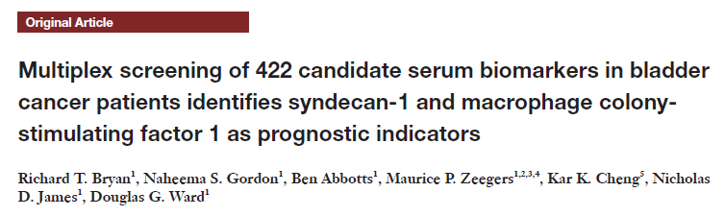
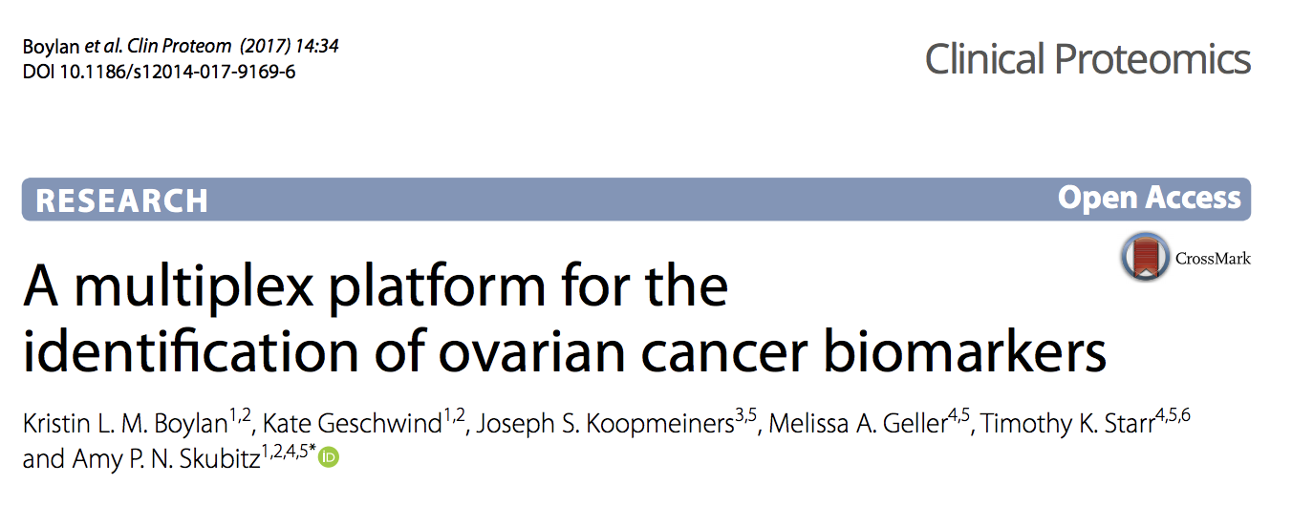
Other related publications using Olink’s platform
Aim: Validate blood-based protein markers for early detection of CRC. Samples: Discovery with 226 CRC and 118 controls and validation of 41 CRC, 106 with advanced adenomas and 107 controls
Findings: Five-marker algorithm with most promising biomarkers GDF-15, AREG, FasL, Flt3L and TP53 autoantibody for detection of CRC.
Aim: Non-invasive protein markers urothelial bladder cancer.
Samples: 90 UBC and control serum
Findings: Analysis of 422 proteins. 5 proteins significantly association to UBC (SYND1, PVRL4, HAVCR1, CSF-1, MMP7)
Aim: Colorectal cancer risk in pre-diagnostic samples
Samples: 138 patients with repeated sampling occasions, 10 years apart.
Findings: Analysis of 178 cancer and inflammation-related protein markers. 12 proteins associated with at least one metabolic risk factor and the most significant ones were: IL6, TNFSF10, SEZ6L, FGF-BP1, FGF-21, HGF , ERBB2, SGF and Furin.
Aim: Early detection of protein biomarkers for ovarian cancer
Samples: 21 early stage, 21 late stage, 18, benign disease, 21 controls.
Findings: The 12 most significant proteins were CA125, HE4, MK, KLK6, hK11, CXCL13, FR-alpha, IL-6, TNFSF14, FADD, PRSS8, FUR. The 12-protein biomarker signature had a specificity of 95.2%.

Slide 15
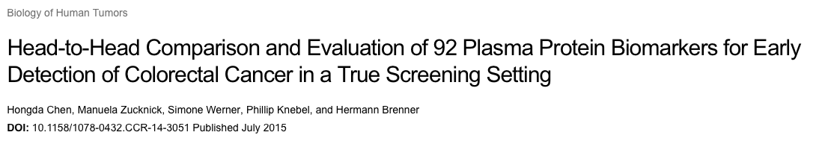
Conclusions
Multiple markers are promising to achieve the necessary sensitivity and specificity for application in mass screening
Relatively small number of samples and analysis with only one protein panel
Algorithm comparable/better than gFOBT, but still inferior to FIT
Additional biomarkers might contribute to the development of a powerful multimarker blood-based test for early detection of CRC
Ongoing studies focusing on larger screens in longitudinal cohorts, genetically predisposed patients for CRC, and screening with more Olink protein panels
Notes:
The combination of multiple markers might be a more promising approach to achieve the necessary sensitivity and specificity for application in mass screening
Limitations of our study include the relatively small number of colorectal cancer cases despite the very large screening population recruited, which reflects the very low prevalence of colorectal cancer in a true screening population. Future studies should also address the potential to enhance diagnostic performance by combination of the identified markers with additional informative blood markers. In summary, blood-based tumor-associated protein biomarkers appear to be potentially useful tools for early detection of colorectal cancer. Specific single biomarkers and the eight-protein algorithm exhibited diagnostic performance comparable or superior to diagnostic performance of gFOBT (8). In order to
match performance of FITs (8) and to be useful for population based colorectal cancer screening, further improvement is desirable and should be explored in future research. The combination of the most promising biomarkers identified in our study with additional biomarkers might contribute to the development of a powerful multimarker blood-based test for early detection of colorectal cancer.

Slide 16
Thank you!

