Slide 1
FDA Recommendations for Platform Approval/Clearance, with a Focus on Proteomics and Mass Spectrometry
EDRN Meeting
March 6, 2018
Doug Jeffery
doug.jeffery@fda.hhs.gov
240-402-6648

Slide 2

Disclaimer
This presentation is intended for informational purposes only and does not constitute legal or regulatory advice. Please see the Federal Food, Drug, and Cosmetic Act and 21 CFR Subchapter H for a full list of requirements by FDA

Slide 3
Outline
Regulatory pathways for LC-MS devices
Analytical studies for Vitamin D: comparison of LC-MS and immunoassay

Slide 4
Regulatory Classification of HPLCs and Mass Spectrometers
862.2860: Mass spectrometer for clinical use
A mass spectrometer for clinical use is a device intended to identify inorganic or organic compounds (e.g., lead, mercury, and drugs) in human specimens by ionizing the compound under investigation and separating the resulting ions by means of an electrical and magnetic field according to their mass.
862.2260: High pressure liquid chromatography system for clinical use
A high pressure liquid chromatography system for clinical use is a device intended to separate one or more drugs or compounds from a solution by processing the mixture of compounds (solutes) through a column packed with materials of uniform size (stationary phase) under the influence of a high pressure liquid (mobile phase). Separation of the solutes occurs either by absorption, sieving, partition, or selective affinity.
These instruments are Class I exempt
Manufacturers of HPLCs and Mass Spectrometers do not need to make a submission to the FDA prior to selling these instruments as medical devices

Slide 5
Not All HPLCs and Mass Spectrometers are Sold as Medical Devices
FDA Registration and Listing Database
https://www.accessdata.fda.gov/scripts/cdrh/cfdocs/cfrl/rl.cfm
Class I exempt devices listed here must conform to general requirements (general controls) including:
Facility registration (21 CFR 807.20)
Device listing (21 CFR 807.20)
Labeling requirements (21 CFR 801 or 809)
Maintaining records and reporting on recalls and adverse events (21 CFR 806 or 810)
Some HPLCs and Mass Spectrometers are sold for research use only (RUO)
You may use an RUO instrument for your test, but please come and talk to us about the best regulatory path for your assay and instrument

Slide 6
What to Do if You Want to Change Your Instrument
We work with test manufacturers all the time who make changes to their test or instrument
If the change is likely to affect the performance of the test (like changing to a completely different instrument), we will likely need to see new validation data
BUT, please come and talk to us about what changes you plan to make and we can discuss what new studies we would expect to see
FDA Guidance Document: Deciding When to Submit a 510(k) for a Change to an Existing Device: https://www.fda.gov/downloads/medicaldevices/deviceregulationandguidance/guidancedocuments/ucm514771.pdf

Slide 7
The Intended Use for Vitamin D Assay
The Vitamin D 200M Assay for the Topaz System is intended for in vitro diagnostic use in the quantitative determination of total 25-hydroxyvitamin D (25-OH-D) through the measurement of 25-hydroxyvitamin D3 (25-OH-D3) and 25-hydroxyvitamin D2 (25-OH-D2) in human serum using LC-MS/MS technology by a trained laboratory professional in a clinical laboratory. The Assay is intended for use with the Topaz System. The Vitamin D 200M Assay for the Topaz System is intended to be used in conjunction with other clinical or laboratory data to assist the clinician in making individual patient management decisions in an adult population in the assessment of vitamin D sufficiency.
Analyte(s)
Matrix
Intended Population
Indication for Use

Slide 8

Analytical Performance Testing
Precision
Linearity/assay reportable range
Detection Limit/Analytical Sensitivity
Cross reactivity/ Interfering substances
Method comparison (to the predicate or reference method)
Matrix comparison
Traceability, Stability, Expected values
Controls and calibrators

Slide 9
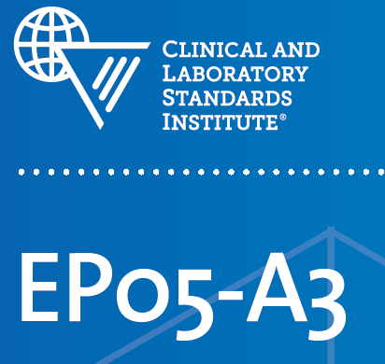
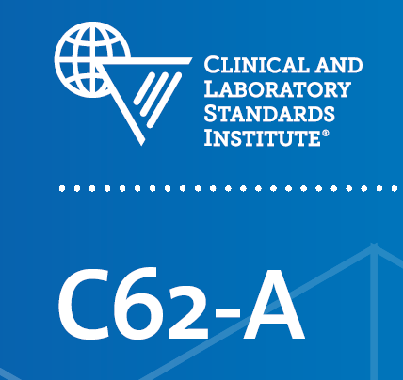
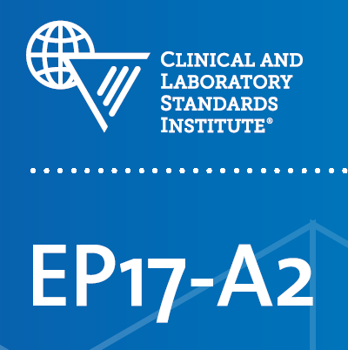
CDRH-Recognizes Guidelines for IVDs
Clinical and Laboratory Standards Institute (CLSI)
Analytical Sensitivity
Precision
Liquid Chromatography-Mass Spectrometry Methods
AND MANY MORE!
http://www.accessdata.fda.gov/scripts/cdrh/cfdocs/cfStandards/search.cfm
Use of CDRH-recognized guidelines can make performance testing and submission review faster and more efficient

Slide 10
Use the Final Finished Device for All Performance Testing
Sample Processing
LC-MS Analysis
Data Processing
Final Output

Slide 11
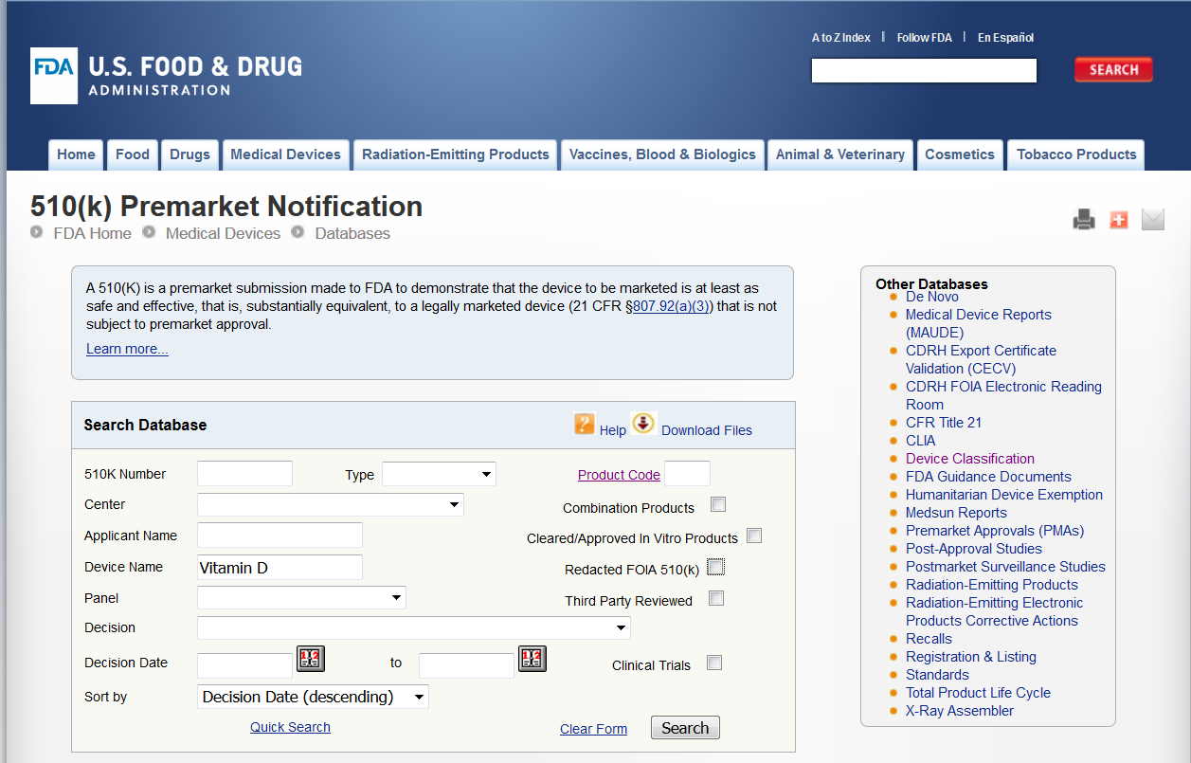
The 510k database https://www.accessdata.fda.gov/scripts/cdrh/cfdocs/cfpmn/pmn.cfm
Where to Find Information on Analytical Testing Performed for Cleared Devices

Slide 12
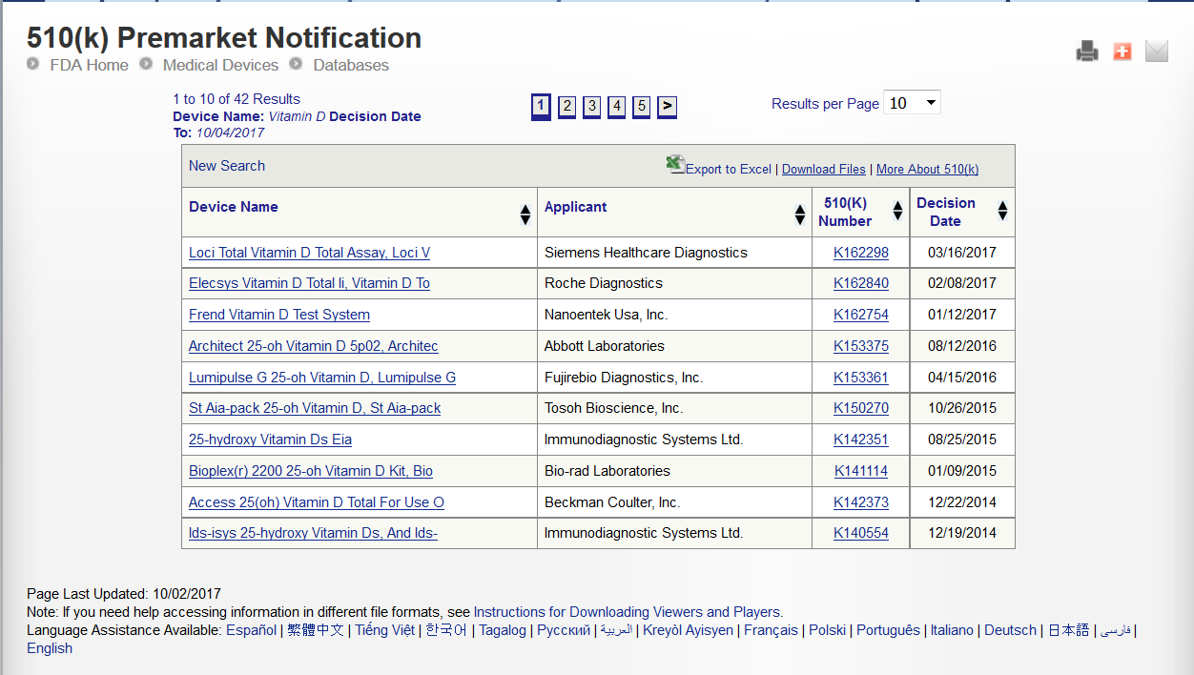
510(k)s for IVDs That Measure Vitamin D

Slide 13
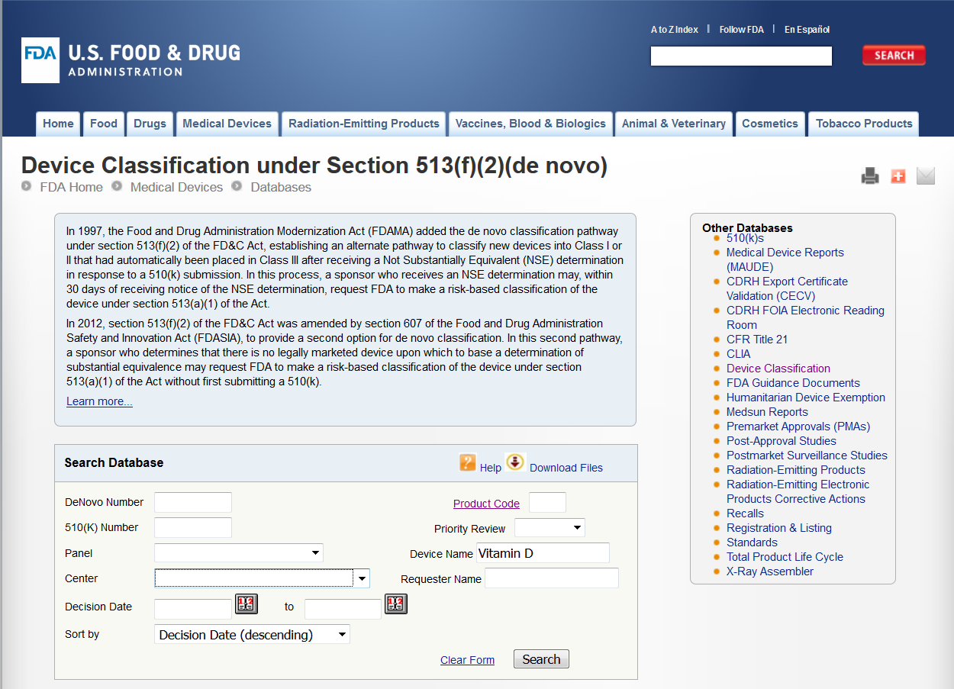
Where to Find Information on Analytical Testing Performed for Cleared Devices
The De Novo database

Slide 14
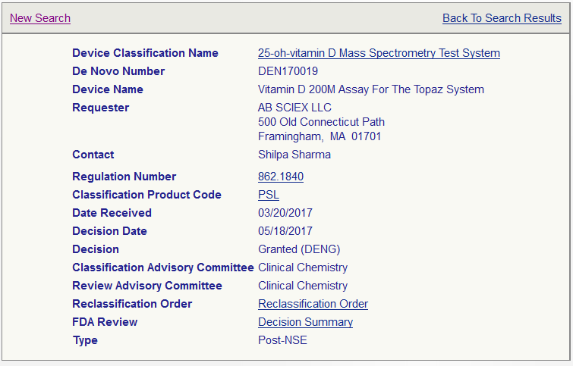
The First LC-MS Device for Vitamin D Granted by FDA

Slide 15
Intended Use/Indications for Use
DEN170019 (LC-MS)
K162298 (Immunoassay)
The Vitamin D 200M Assay for the Topaz System is intended for in vitro diagnostic use in the quantitative determination of total 25-hydroxyvitamin D (25-OH-D) through the measurement of 25-hydroxyvitamin D3 (25-OH-D3) and 25-hydroxyvitamin D2 (25-OH-D2) in human serum using LC-MS/MS technology by a trained laboratory professional in a clinical laboratory. The Assay is intended for use with the Topaz System. The Vitamin D 200M Assay for the Topaz System is intended to be used in conjunction with other clinical or laboratory data to assist the clinician in making individual patient management decisions in an adult population in the assessment of vitamin D sufficiency.
The LOCI Vitamin D Total Assay is an in vitro diagnostic test for the quantitative measurement of total 25-hydroxyvitamin D (25-OH-D) in human serum and plasma on the Dimension® EXL™integrated chemistry system with LOCI® Module. Measurements of vitamin D are used in the assessment of vitamin D sufficiency.

Slide 16
Precision (CLSI EP05-A3)
DEN170019 (LC-MS)
K162298 (Immunoassay)

Slide 17
Linearity (CLSI EP06-A)
DEN170019 (LC-MS)
K162298 (Immunoassay)
A serum sample with a high concentration of vitamin D was serially diluted with a low concentration serum sample to generate nine samples with vitamin D concentration values of 3.4, 47.7, 91.9, 136, 180, 225, 269, 313, 357 ng/mL, respectively.
The results of the linear regression analyses are summarized below:
y = 0.9974x + 1.1737 R² = 0.998
A serum sample with a high concentration of vitamin D was serially diluted with a low concentration serum sample to generate nine samples with vitamin D concentration values of 4.4, 24.7, 44.9, 65.1, 85.4, 105.6, 125.8, 146.1 and 163.3 ng/mL respectively.
The results of the linear regression analyses are summarized below:
y = 1.0222x + 1.3862, R² = 0.998

Slide 18
Traceability
DEN170019 (LC-MS)
K162298 (Immunoassay)
The assigned 25-hydroxyvitamin D of the Vitamin D 200M Assay for the Topaz System is certified with the CDC Vitamin D Standardization-Certification Program (VDSCP)
The assay is standardized through the Vitamin D Standardization Program (VDSP).

Slide 19
Analytical Sensitivity (CLSI EP17-A2)
DEN170019 (LC-MS)
K162298 (Immunoassay)
LoQ/LLMI Only
The lower limit of the measuring interval (LLMI) for each lot was determined to be the lowest concentration of analyte that achieved both the bias and precision goals (<20% bias and <20% CV)
LoB, LoD, and LoQ
The Limit of Blank (LoB), Limit of Detection (LoD) and Limit of Quantitation (LoQ) studies were performed according to the CLSI EP-17-A2 guideline
LoQ was determined to be 5.0 ng/mL based on total precision (≤20%) using all measurements observed on the low serum samples

Slide 20
Analytical Specificity/Interference Testing/Cross-Reactivity (CLSI EP07-A2)
DEN170019 (LC-MS)
K162298 (Immunoassay)
The design of the analytical specificity study was based on CLSI EP07-A2 guideline.
Interference testing was performed according to CLSI EP07-A2
Similar endogenous and exogenous interferents and cross-reactants were tested for both devices, including Vitamin D metabolites.
More interferents were tested in the LC-MS assay to demonstrate that non-Vitamin D metabolites with similar m/z did not interfere with the output of the device

Slide 21
Method Comparison (CLSI EP09-A3) (This is different for LC-MS vs Immunoassay for Vitamin D)
DEN170019 (LC-MS)
K162298 (Immunoassay)
The sponsor performed an accuracy study to the CDC Vitamin D Standardization-Certification Program (VDSCP).
A method comparison study was performed in accordance to CLSI EP09-A3 to evaluate the accuracy between LOCI Vitamin D Total Assay on the Dimension EXL with LOCI® Module system against the reference method procedure (RMP), University of Ghent’s ID-LC-MS/MS. The results were analyzed by standard Passing Bablok regression
From the Special Controls for DEN170019:
“The device must have initial and annual standardization verification by a certifying vitamin D standardization organization deemed acceptable by FDA.”

Slide 22
Summary
Analytical performance testing for most analytical studies in Vitamin D submissions are the same for LC-MS and immunoassay IVDs
Interference testing for LC-MS included unrelated metabolites with similar m/z to the Vitamin D analyte
LC-MS IVDs must have initial and annual standardization verification by a certifying vitamin D standardization organization deemed acceptable by FDA

