Slide 1

Genomic and proteomic studies of prostate cancer evolution
James Brooks, MD & Robert West, MD, PhD
NIH MCL/EDRN joint meeting
Washington DC
March 8-9, 2018

Slide 2
Hypothesis
That early prostate cancer arises from definable molecular alterations in precursor lesions and progresses as a result of acquired lesions that confer aggressive features in a subpopulation of cells in precursor lesions and/or early tumors
That at each step, there are downstream molecular alterations that confer, in a probabilistic sense, the ability for some lesions to grow and spread and in others an indolent phenotype (dead end lesions).
As such, defining the earliest genomic events, the evolutionary pathways to invasive carcinoma, the final constellation of genomic alterations, and the resultant extent of genomic heterogeneity (the building blocks for evolution), should illuminate the key genomic features distinguishing good and bad outcome prostate cancer

Slide 3
Aims
Aim 1. Investigate the early genomic evolution of good and adverse outcome prostate cancer.
Aim 1A. Delineate genomic and gene-expression changes early in the development of prostate cancer, by profiling FFPE tissues comprising low grade prostate intraepithelial neoplasia (PIN), high grade PIN, and invasive carcinoma in each of 100 patients with known favorable or adverse outcomes.
Aim 1B. Define the genomic evolution of early prostate cancer, by using the above genomic changes to reconstruct lineage relationships and phylogenetic trees in good and bad outcome prostate cancer.
Aim 1C. Evaluate candidate prognostic genomic features in a separate cohort of 225 prostate cancer patients with known favorable and adverse outcomes.
Aim 2. Define the genomic and glycoproteomic heterogeneity of good and adverse outcome prostate cancer.
Aim 2A: Determine the heterogeneity of genomic and gene-expression changes in localized prostate cancer, by profiling 3-6 separate regions from 40 cancers, half that recurred after radical prostatectomy.
Aim 2B. Define the protein expression and glycoproteomic alterations in localized prostate cancers and their intralesional heterogeneity from patients with and without subsequent recurrence.
Aim 2C: Integrate genomic alterations with transcript, protein and glycoprotein changes in localized prostate cancers, and investigate correlations with clinical outcomes.

Slide 4
Aims
Aim 1. Investigate the early genomic evolution of good and adverse outcome prostate cancer.
Aim 1A. Delineate genomic and gene-expression changes early in the development of prostate cancer, by profiling FFPE tissues comprising low grade prostate intraepithelial neoplasia (PIN), high grade PIN, and invasive carcinoma in each of 100 patients with known favorable or adverse outcomes.
Aim 1B. Define the genomic evolution of early prostate cancer, by using the above genomic changes to reconstruct lineage relationships and phylogenetic trees in good and bad outcome prostate cancer.
Aim 1C. Evaluate candidate prognostic genomic features in a separate cohort of 225 prostate cancer patients with known favorable and adverse outcomes.
Aim 2. Define the genomic and glycoproteomic heterogeneity of good and adverse outcome prostate cancer.
Aim 2A: Determine the heterogeneity of genomic and gene-expression changes in localized prostate cancer, by profiling 3-6 separate regions from 40 cancers, half that recurred after radical prostatectomy.
Aim 2B. Define the protein expression and glycoproteomic alterations in localized prostate cancers and their intralesional heterogeneity from patients with and without subsequent recurrence.
Aim 2C: Integrate genomic alterations with transcript, protein and glycoprotein changes in localized prostate cancers, and investigate correlations with clinical outcomes.

Slide 5

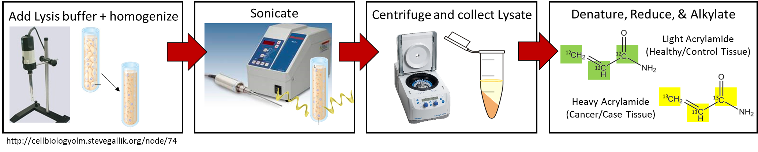
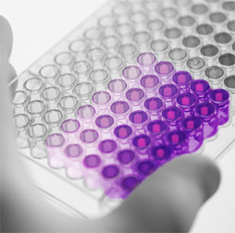
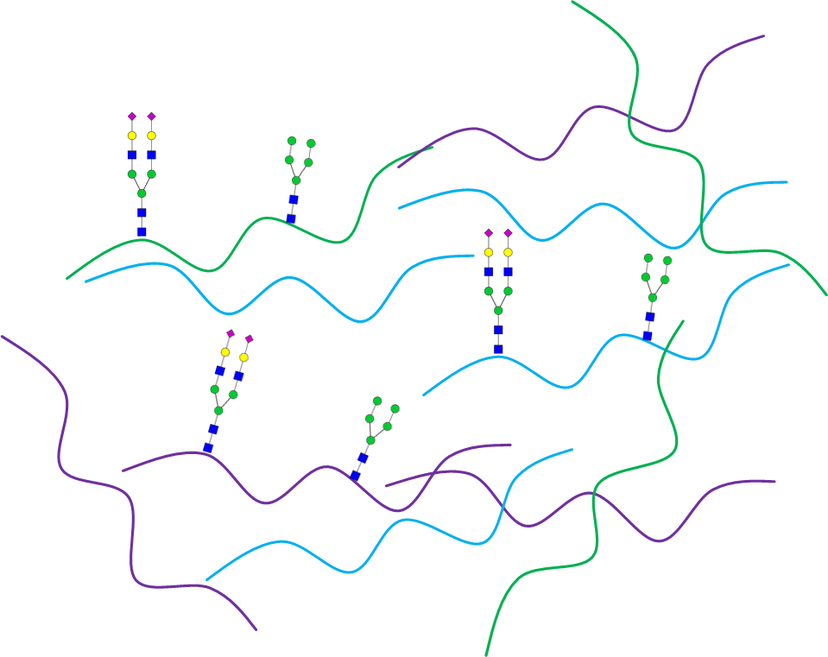
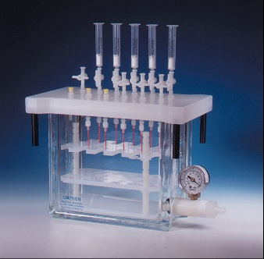
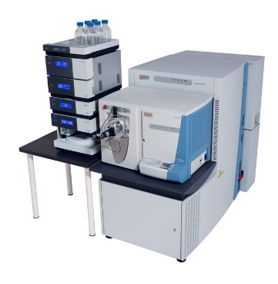

Glycosylation Site Mapping of Tissue-Derived Glycoproteins
Sharon Pitteri
Sarah Totten
Protein Extraction From Prostate Tissue
BCA Assay
Intact Glycopeptide Analysis
Trypsin Digestion
SAX-ERLIC SPE
LC-MS/MS
Byonic Search
Notes:
We have developed a methodology to analyze intact glycopeptides to retain protein- and site-specific information in order to map the glycan microgeterogeneity on tissue-derived glycoproteins. To do this we use a series of glycopeptide enrichment techniques followed by targeted tandem mass spectrometry.

Slide 6
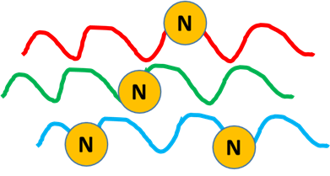
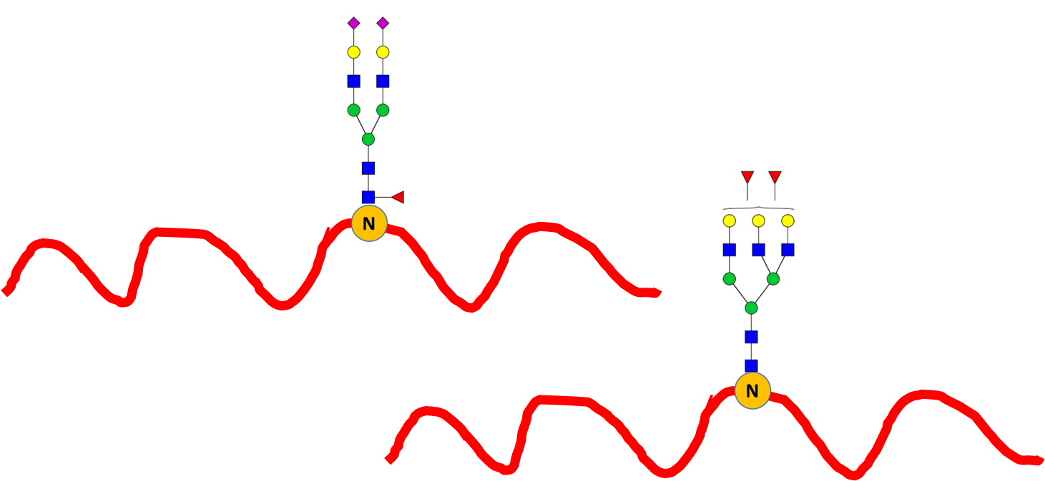
Glycosylation Site Mapping of Tissue-Derived Glycoproteins
Total Glycosylation Identification in
Cancer and Matched Normal Prostate Tissue (N=10 Pairs)
Unique Glycopeptide Overlap
Cancer vs. Normal Prostate Tissue
Unique Glycoprotein
207
257
439
347
Unique Glycosylation Sites
319
Unique Glycopeptides
1,043
Notes:
Using this approach, we compared the site-specific glycosylation between 10 pairs of cancer and matched normal prostate tissue. Preliminary data shows we have identified 1,043 unique glycopeptides across 319 glycosylation sites among 207 unique glycoproteins across the entire data set. Initial analysis shows that the majority of the identified glycopeptides were found in both cancer and normal tissue, however, there is a significant amount of glycopeptides unique to each group.

Slide 7
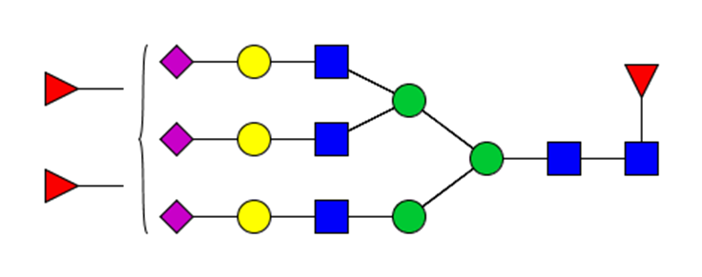
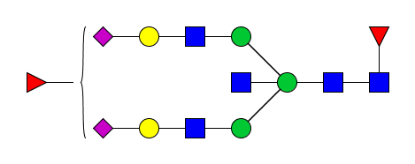
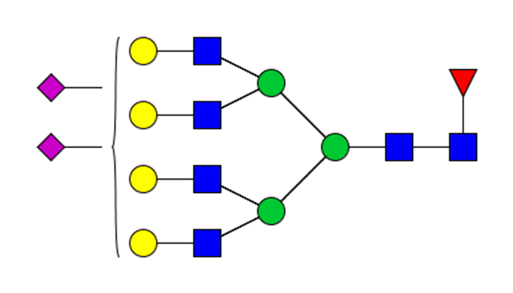
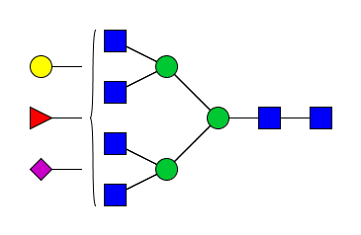
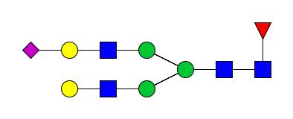
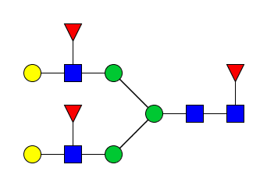
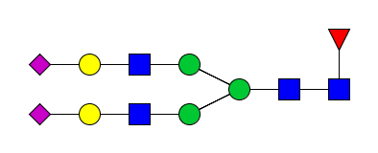
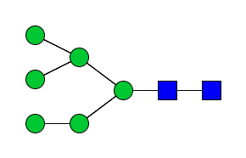
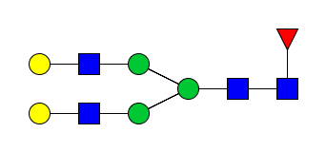
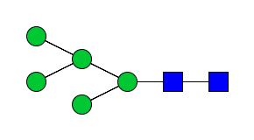
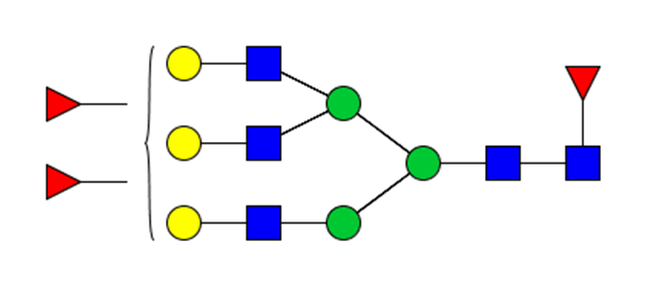
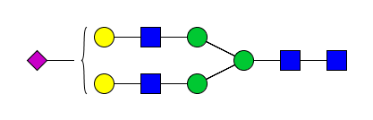
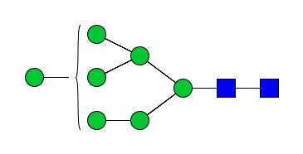
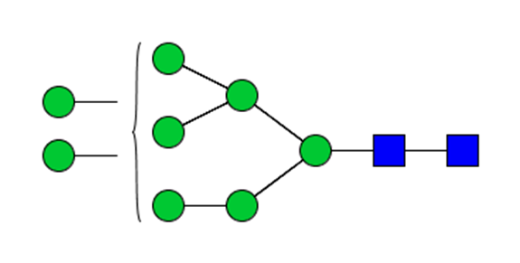
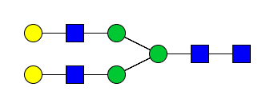
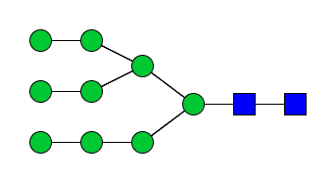
Glycosylation Site Mapping of Tissue-Derived Glycoproteins
Integrin alpha-1
...N₇₄R…
...QTQVGIVQYGEN₂₁₇VTHEFNLNK…
...N₄₁₈TTFNVESTK…
...YN₄₆₀HTGQVIIYR…
...N₇₄₈ITVR…
...SQNDKFN₈₄₀VSLTVK…
...DSCESNHN₈₈₃ITCK…
Notes:
To take a closer look, here is an example, in this case integrin alpha-1, of how we are able to map the glycan microheterogeneity at specific glycosylation sites on specific glycoproteins. This describes the protein glycosylation status in an unprecedented detail. We are able to identify multiple glycoforms at many of the glycosylation sites of integrin alpha-1

Slide 8
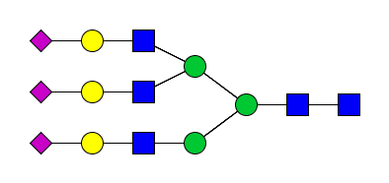
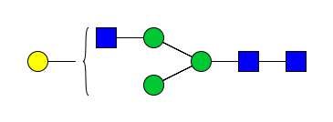
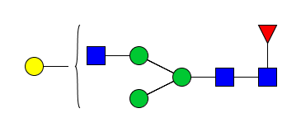
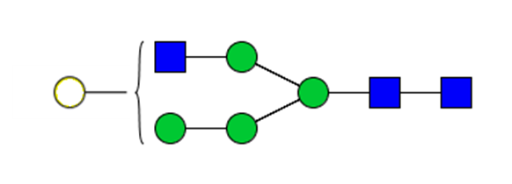
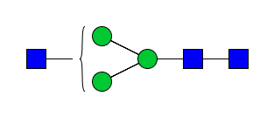
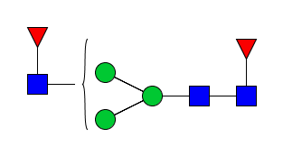
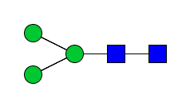
Glycosylation Site Mapping of Tissue-Derived Glycoproteins
Prostatic Acid Phosphatase (ACPP)
Tryptic Peptides
Tryptic Glycopeptides
A.) Cancer Tissue
MR
N₉₄
N₂₂₀
N₃₃₃
B.) Matched Normal Tissue
MR
N₉₄
N₂₂₀
N₃₃₃
Notes:
And we can start to tease apart the difference between cancer and normal. For example, in prostatic acid phosphatase, we are able to annotate a variety of glycans at each of the three sites, and our initial analysis shows greater amount of heterogeneity in the cancer tissue compared to the normal. This work is ongoing, and we are working on mapping the 317 glycosylation sites of the 207 glycoproteins identified so far.

Slide 9

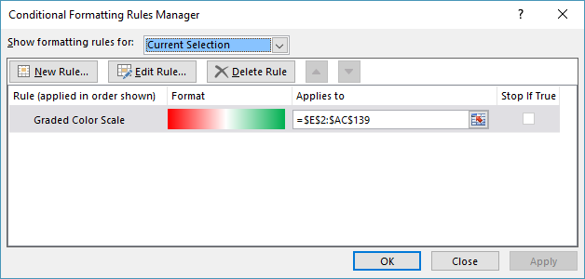
p-value < 0.001
> 50% of the cases
P4 | P5 | P6 | P7 | P10 | P11 | P12 | P14 | P15 | P16 | P20 | P21 | P22 | P23 | P1 | P2 | P3 | P8 | P9 | P13 | P17 | P18 | P19 | P24 | P25
Statistically Significant Protein Level Changes
Prostate Cancer vs Matched Normal Tissue
Parag Mallick
Radiology
Canary Center
-4
0
4
Standardized log₂ ratio

Slide 10
Gene Symbol | NON-RECURRENT |  |  |  |  |  |  |  |  |  |  |  |  |  | RECURRENT
 | 4+3 | 4+3 | 4+3 | 4+4 | 4+3 | 3+4 | 4+3 | 3+4 | 4+3 | 3+4 | 3+4 | 3+4 | 3+4 | 4+3 | 4+3 | 4+4 | 4+4 | 4+4 | 4+4 | 4+4 | 4+3 | 4+4 | 4+3 | 4+3 | 4+4
 | P4 | P5 | P6 | P7 | P10 | P11 | P12 | P14 | P15 | P16 | P20 | P21 | P22 | P23 | P1 | P2 | P3 | P8 | P9 | P13 | P17 | P18 | P19 | P24 | P25
COMMD6
PAPLN
MBD1
HCLS1
CRYZ
NAP1L1
SMC1A
MVP
AEBP1
LZIC
MIEN1
ZFR
TARS
TNRC6B
PDCD6IP
HOOK1
FDX1
GSTM2
PDHB
SMARCC2
RPS28
ANXA11
HPRT1
ASRGL1
RBM14
RHOC
NUDCD2
TFPI2
SGSH
AKAP13
BUB3
TNFRSF14
NAA10
EIF3G
DAZAP1
ANG
RNASE1
CTSL
7_SEP
PACSIN2
HNRNPK
NUP153
SCAF11
HNRNPH1
TMPRSS2
CPD
MRPS18A
Statistically Significant Protein Level Changes
Recurrent vs.
Non-Recurrent
-2
0
2
p-value < 0.05
> 50% of the cases
Standardized log₂ ratio

Slide 11

DNAseq
Laser-microdissected FFPE sections (≤ 500 cells)
Targeted DNAseq
  165 recurrently mutated prostate cancer genes
  Introns from TMPRSS2-ERG rearrangements
  CNA/LOH markers every 1Mb
CNA calls by CNVkit
  Uses both on/off target reads (≤ 100Kb resolution)
Jon Pollack
Pathology
Notes:
Targeted DNAseq uses NimbleGen custom baits. (Analysis of mutations, LOH, ongoing)

Slide 12
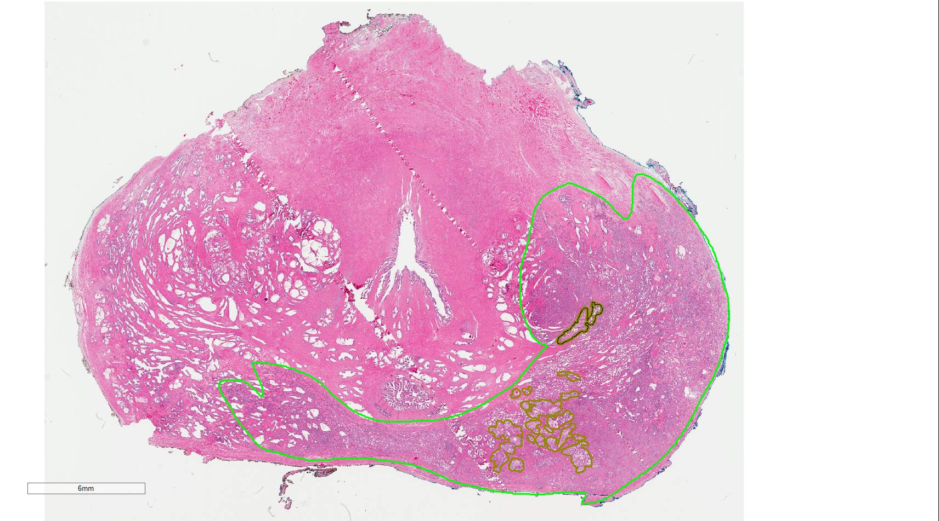

Christian Kunder, MD, PhD
Gleason grade 3
Intraductal carcinoma

Slide 13

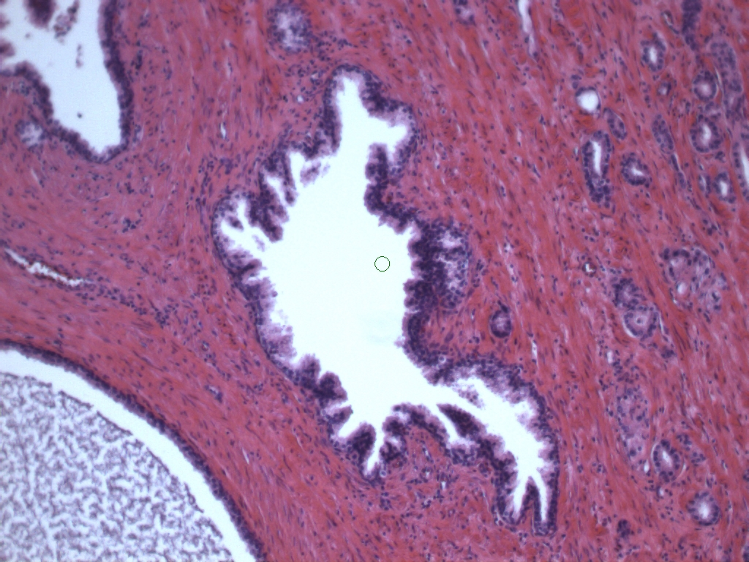
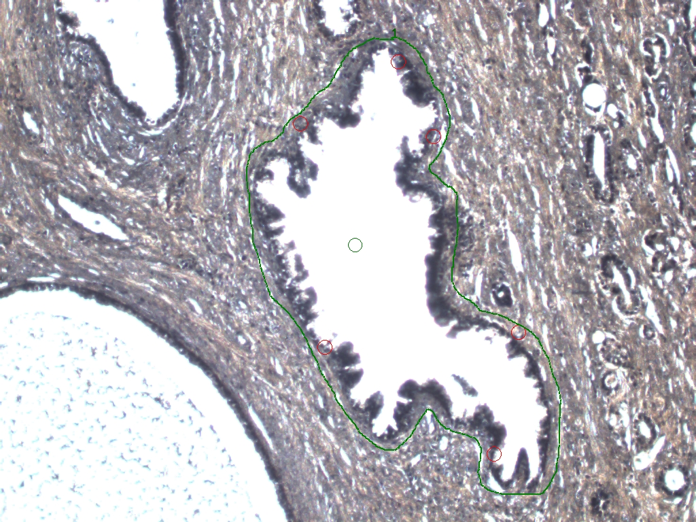
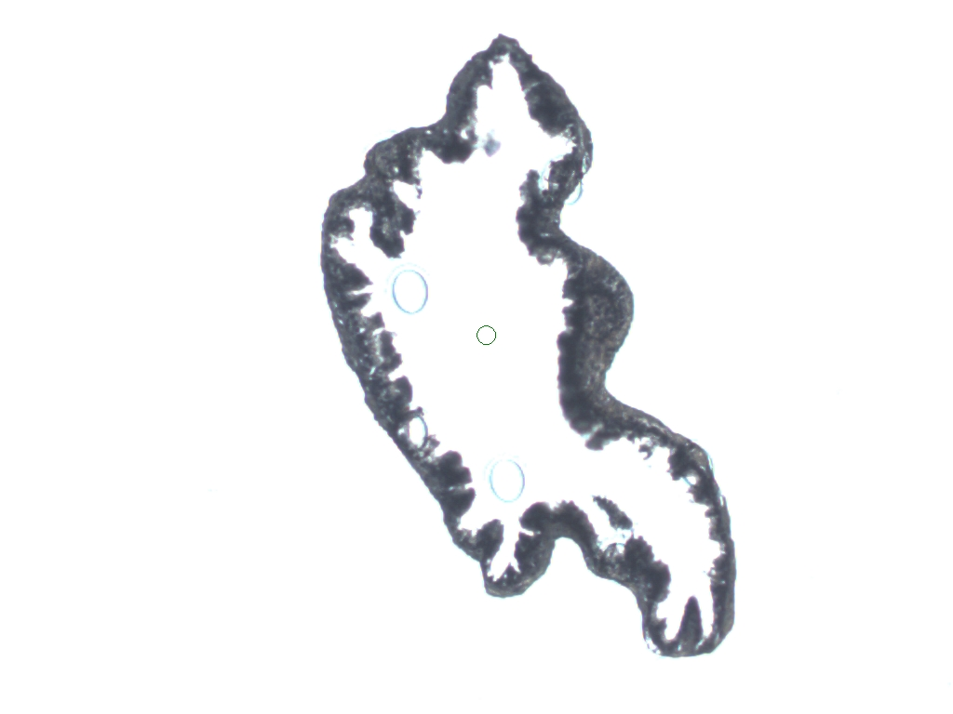
Laser capture microdissection
Okyaz Eminaga, MD
Low grade Prostatic Intraepithelial Neoplasia

Slide 14
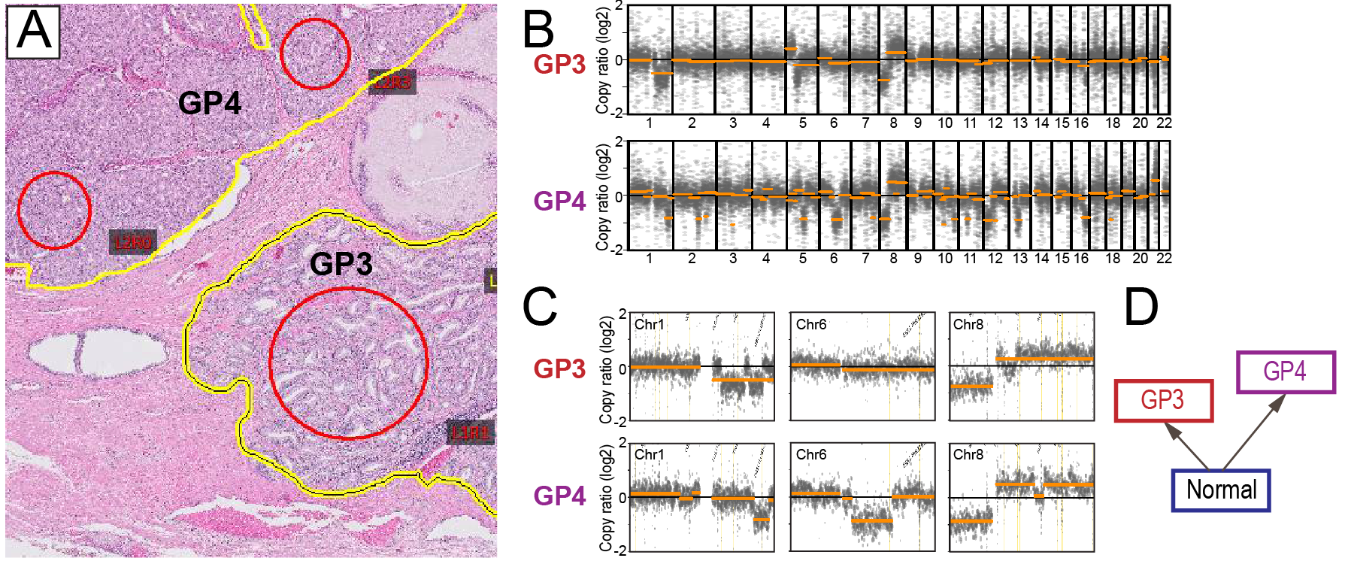
DNAseq defines relationships among cancer lesions
Case 1
Notes:
Though the GP3 and GP4 lesions are adjacent, and their overall CNA profiles look somewhat related (e.g. chr 8), on closer inspection (chr 1, 6, 8 shown), the CNA breakpoints are at distinct locations, implying that these are 2 independent cancers.

Slide 15
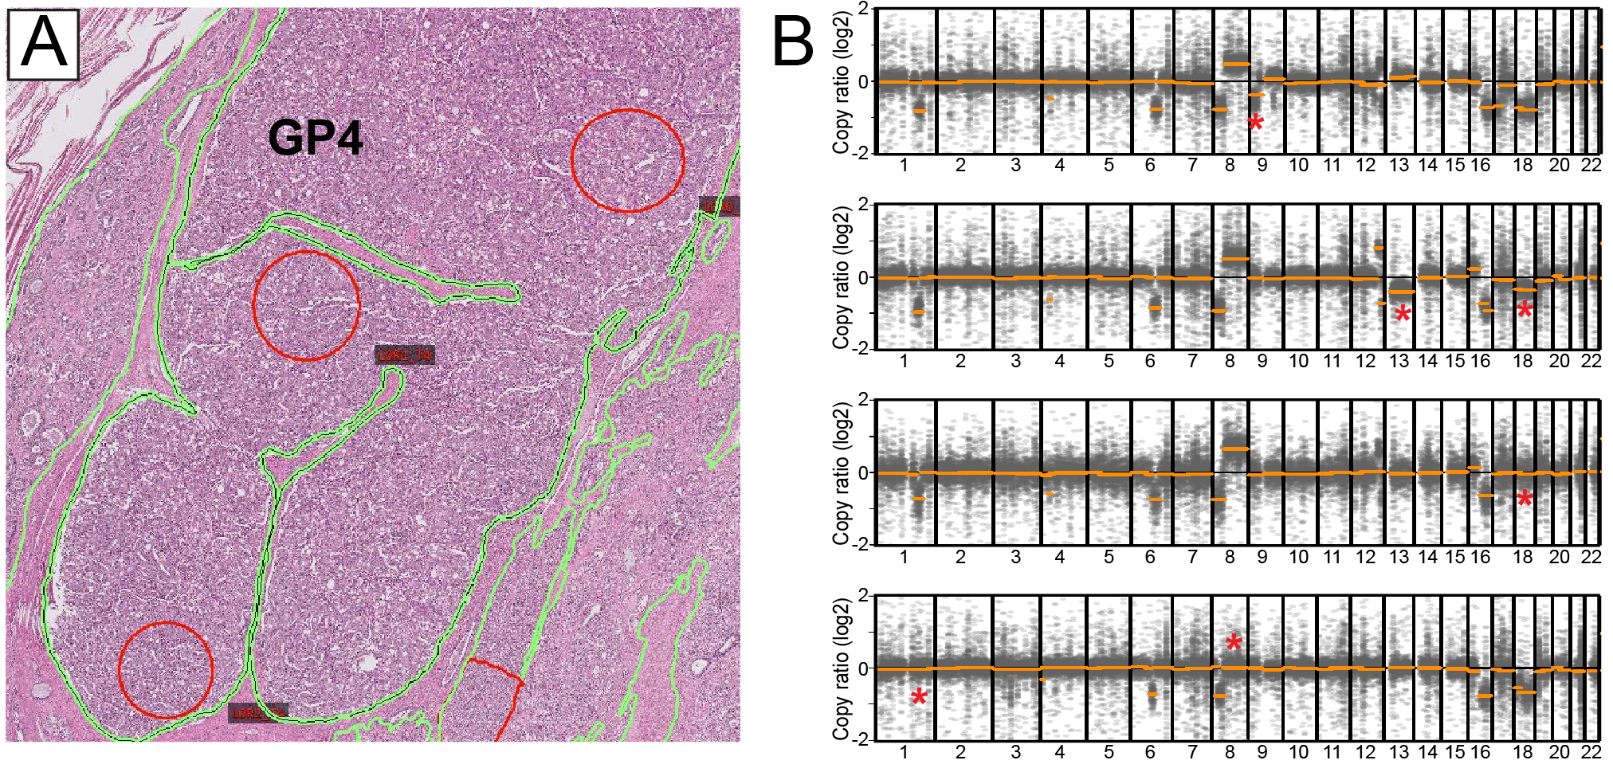
DNAseq reveals intratumor heterogeneity
Case 13
Notes:
DNAseq done from different loci within this GP4 cancer reveals overall very similar profiles, but with several differences, highlighted by asterisks. Top, has 9p deletion. Second from top, has 13q deletion, and note amplitude of 13q and 18q deletion about half that of others, suggesting present in only half the cells. Third, from top, no 18p deletion. Bottom, No 1q deletion or 8q gain.

Slide 16
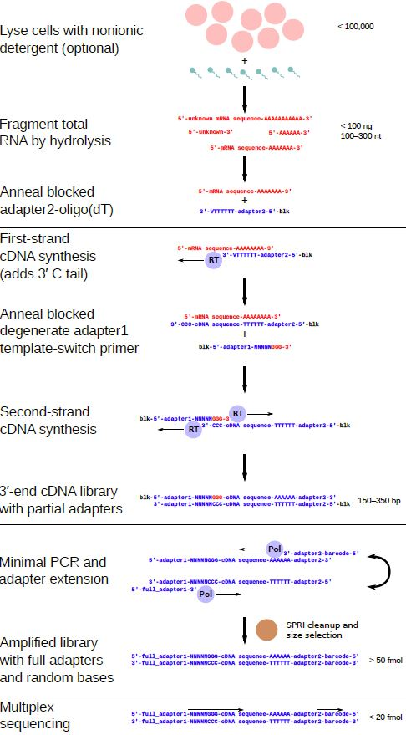
SMART-3SEQ
template switching

Slide 17
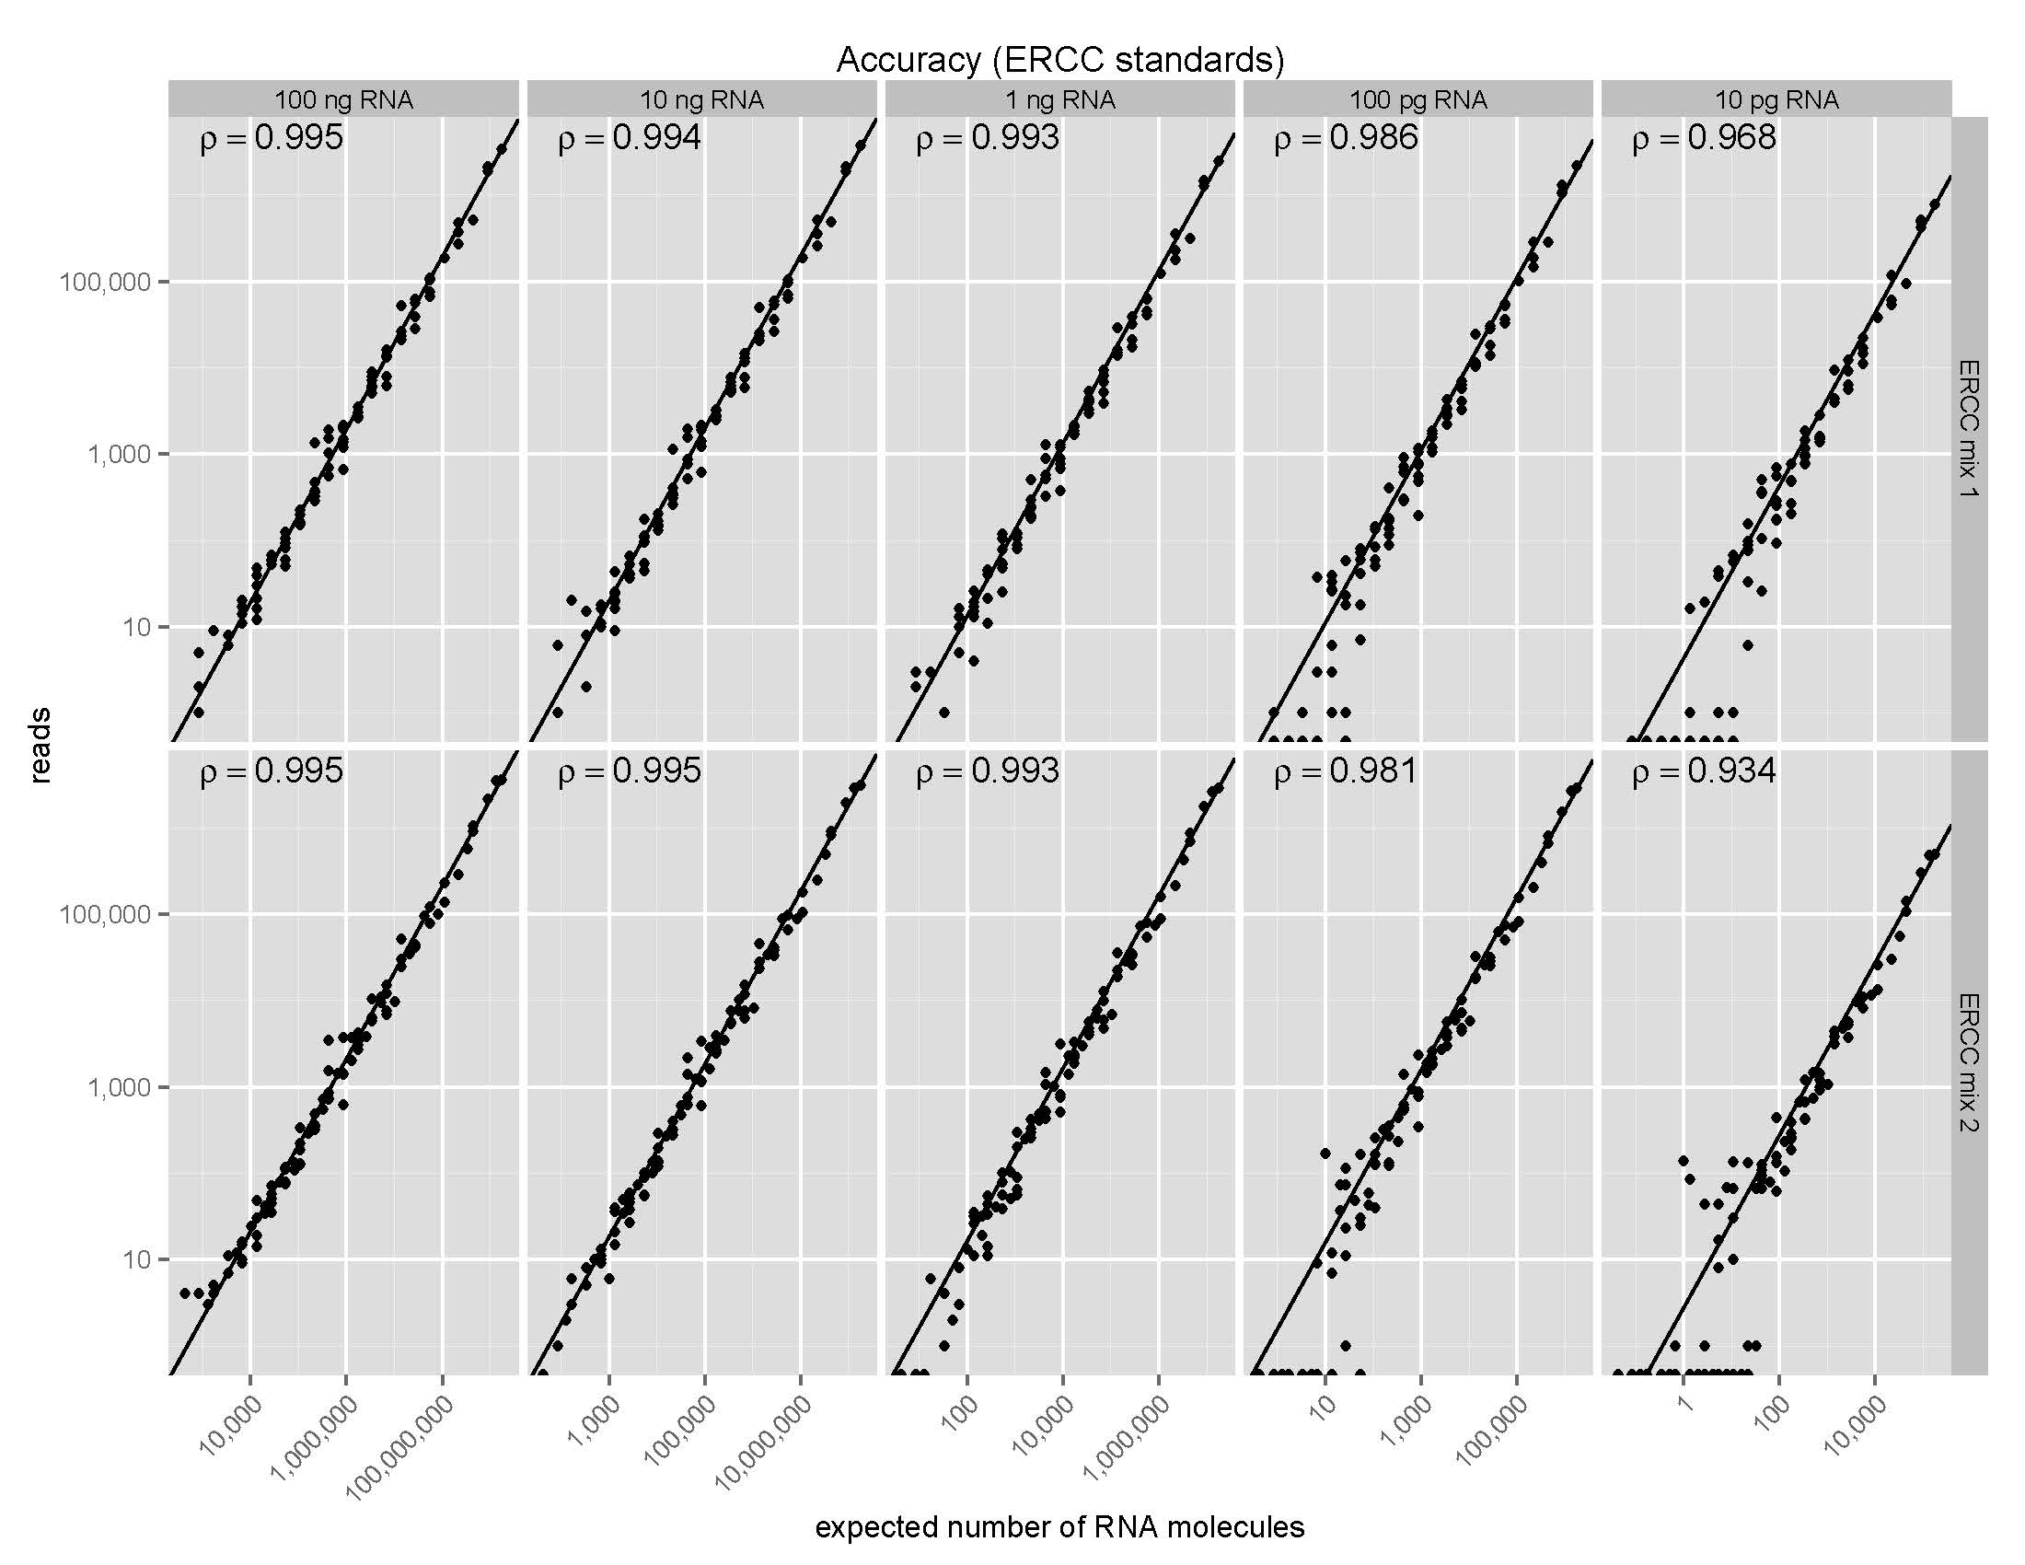
SMART-3SEQ accuracy at low RNA input
100 ng
10 ng
1 ng
100 pg
10 pg

Slide 18
Laser capture microdissection

Slide 19
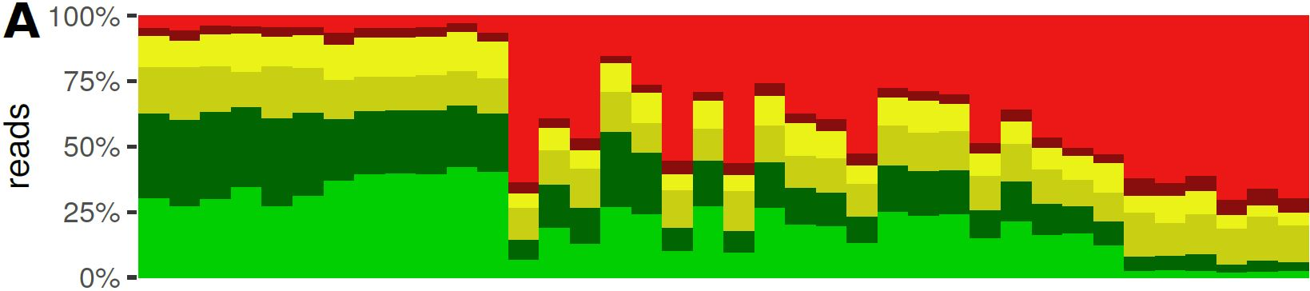
Read counts of “bulk” vs single cell libraries

Slide 20

“Bulk” vs single cell gene expression profiles

Slide 21
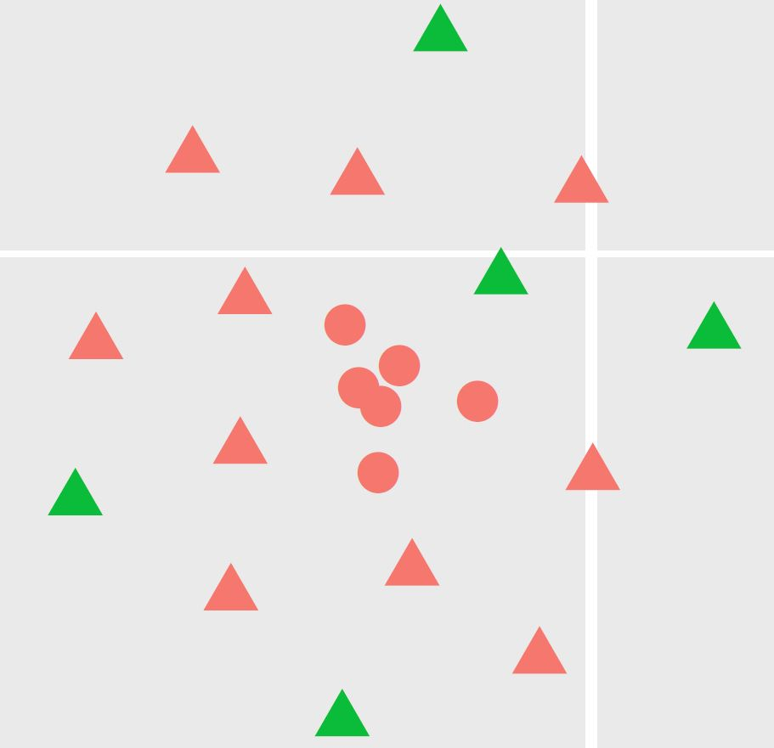
t-SNE

Slide 22
CD163 – marker of macrophages
CD163

Slide 23
Detection of HER amplification in single cells

Slide 24
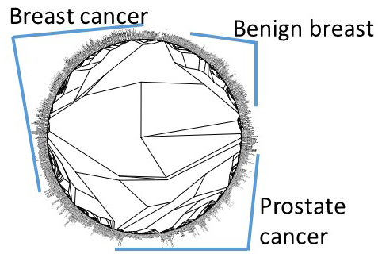

Slide 25
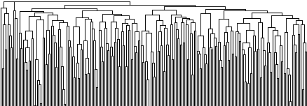
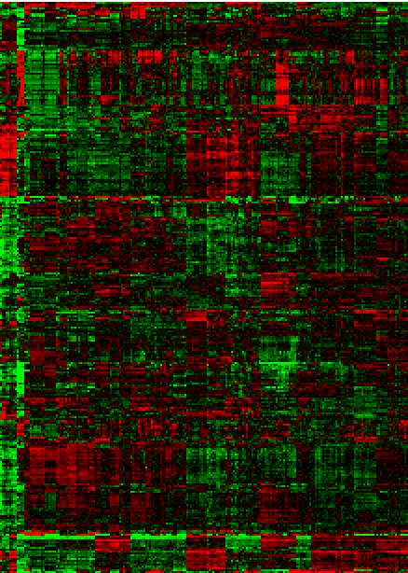
225 samples from 14 patients
39 samples of LGPIN and HGPIN

Slide 26
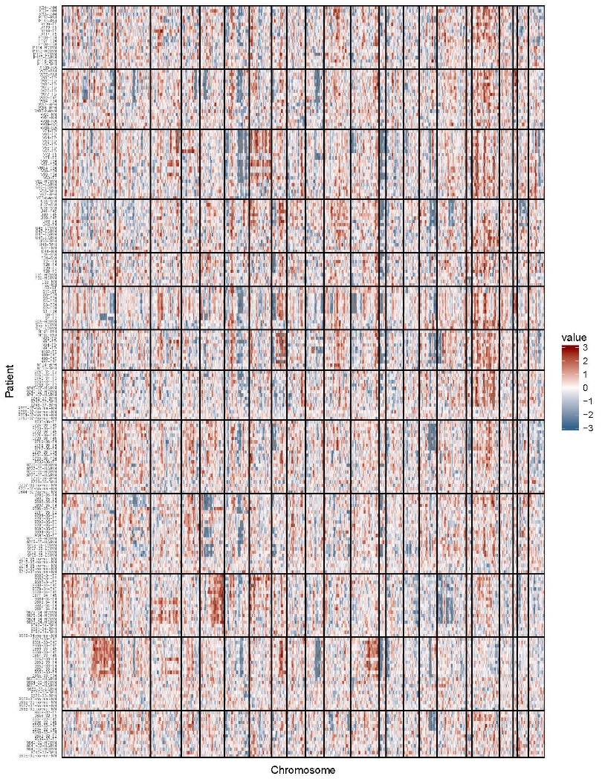
DNA copy number prediction

Slide 27
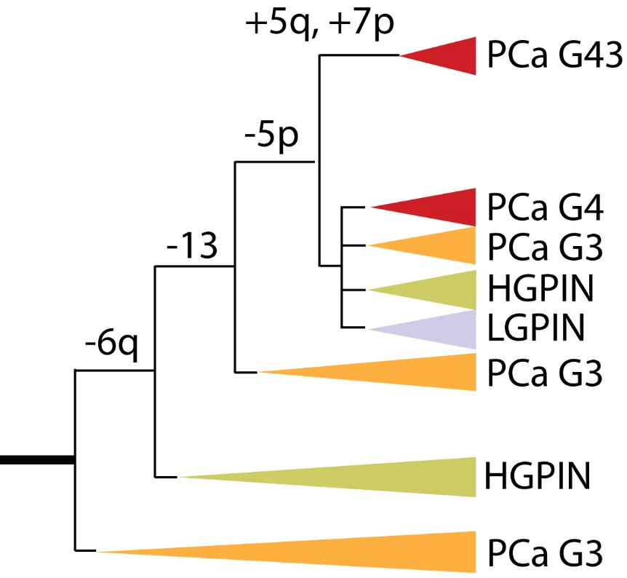
Sample lineage relationship for pt 35

