Slide 1
Whole Blood Gene Expression Can Accurately Distinguish Benign From Malignant Lung Nodules; Transitioning From Microarrays To The NanoString™ Platform.
Andrew V. Kossenkov, Rehman Qureshi, Noor B. Dawany, Jayamanna Wickramasinghe, Qin Liu, Jun-Chieh J.Tsay , Harvey Pass, Sai Yendamuri, Anil Vachani, Thomas Bauer, Brian Nam, William Rom, Michael K. Showe
Louise C. Showe
EDRN BDL 2016
wistar.org 3601 Spruce Street Philadelphia, PA 19104

Slide 2
Disclosure
This work was supported in part by PA DOH Tobacco Settlement Grants, and a subsidized research agreement with Oncocyte Corporation. Oncocyte has licensed the NSCLC NanoString classification platform we have developed.
Scientific Disclosure
We are not looking at tumor derived cells DNA or RNA but trying to detect a signal in the peripheral immune cells that can tell us whether a nodule in the lung is malignant or benign and to do that

Slide 3

“A PIMPLE WOULD HAVE A BIGGER EFFECT ON THE IMMUNE SYSTEM THAN A CANCER”
Biomarker study section ~2004

Slide 4
Previous Studies
Showe, et.al, Gene expression profiles in peripheral blood mononuclear cells can distinguish patients with non-small cell lung cancer from patients with nonmalignant lung disease. Cancer Res 69, 9202-9210 (2009). (ROC-AUC) of 0.866 (95% CI: 0.824-0.910).
Kossenkov et al, Resection of non-small cell lung cancers reverses tumor-induced gene expression changes in the peripheral immune system. Clin Cancer Res 17, 5867-5877 (2011).
Kossenkov et al., Peripheral immune cell gene expression predicts survival of patients with non-small cell lung cancer. PLoS One 7, e34392 (2012).

Slide 5
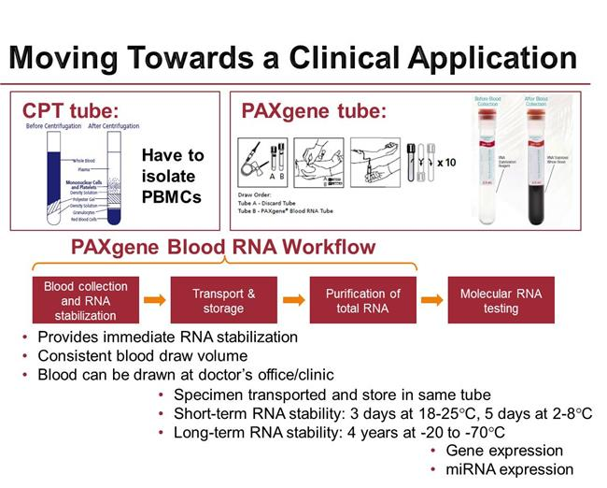
CPT vs PAXgene Tubes
Notes:
CPT (PBMC) isolation must be timely so needs to be done at collection site
PAXgene system simple blood draw
Switched to PAXgene and decided to combine mRNA and miRNA expression based on some preliminary PBMC results and the hypothesis that a multi-analyte classifier might be more robust.
As in our previous studies our controls were pulmonary patients with smoking histories approximately ½? with lung nodules

Slide 6
The Next Steps
(i) Demonstrate whether RNA from whole blood in PAXgene can be mined for gene expression information that can distinguish malignant from benign lung nodules
(ii) Determine whether a diagnostic signature developed on Illumina microarrays could be transitioned to the NanoString nCounter platform already FDA approved for the Prosigna™ Breast Cancer prognosis assay.

Slide 7
Classifier Development Platform
Gene expression on Illumina arrays (45,000 probes)
Analysis by Support Vector Machine with Recursive Feature Elimination (SVM-RFE).
Positive score=cancer, Negative score=benign
Each feature is ranked according to its contribution to the classification
Samples collected @ 4 different sites
  >20 pack years, >55 years, no previous cancer in past 10 years, All LDCT
  EDRN Lung cancer screening NYU/ Harvey Pass
  Incidental cases and controls at 3 other sites with a 5th site added to the NanoString validation studies.

Slide 8
Selecting Probes for A Custom NanoString Panel
Training Set: Cancer (n=131) vs. Benign Nodules (n=133)
  Classes were matched by age, gender, race
  Cancers were stage 1 and 2
  Benign nodules ranged 5-16mm
Independent validation set Cancers (n=175) Benign Nodule (n=90 )
  Malignant and Benign nodules were more closely matched by size.

Slide 9
 | Illumina Training set |  |  | Illumina Validation
Category | Malignant nodules | Benign nodules | p-value | Malignant nodules | Benign nodules | p-value
Total N | 131 | 133 |  | 33 | 18
Gender
Female | 73 | 68 | 0.454 | 24 | 11 | 0.529
Male | 58 | 65 |  | 9 | 7
Age | 67 ± 7 | 65 ± 7 | 0.029 | 72 ± 7 | 64 ± 7 | 0.0057
Race
Black | 19 | 17 | 0.121 | 3 | 2
White | 107 | 108 |  | 30 | 15 | 0.375
Other | 5 | 8 |  | 0 | 1
Smoking Status
Current | 33 | 47 |  | 8 | 6
Former | 90 | 81 | 0.165 | 23 | 10 | 0.466
Never | 8 | 5 |  | 2 | 1
Unknown | 0 | 0 |  | 0 | 1
Pack Years | 40 ± 21 | 38 ± 14 | 0.725 | 36 ± 19 | 41 ± 21 | 0.962
Lesion Size, mm. | 22 ± 8 | 8 ± 4 | 1x10⁻¹³ | 17 ± 4 | 15 ± 4 | 0.327
Cancer stage
I | 87 (66%) |  |  | 33 (100%)
II | 23 (18%) |  |  | 0
III | 7 (5%) |  |  | 0
IV | 9 (7%) |  |  | 0
Unknown | 5 (4%) |  |  | 0
Clinical site*
HFGCC | 68 | 22 | 8x10⁻¹³ | 14 | 1 | 0.0062
NYU | 22 | 73 |  | 15 | 8
Temple | 2 | 11 |  | 0 | 1
UPenn | 39 | 27 |  | 4 | 8
Nodules were confirmed as benign by pathology or by ≥ 4 years of follow up for 69% of BNs and 2-3 years of follow up for the remainder.

Slide 10
Performance Microarray classifier based on expression of 300 top ranked genes

Slide 11
Transitioning To The NanoString Platform
Why NanoString
  No enzymatic reactions: No RT, NO PCR amplification
    Sample preparation is minimal and cost is minimal
    Simple hybridization, maximum 800 genes
  NanoString is forgiving of RNA quality: RIN numbers of 2-3 meet all quality control metrics.
    FFPE samples can be used
  Assay is technically simple

Slide 12
Probe selection
Set name | Description | Selected Probes | Designed Probes
Illumina Microarrays
ILL-SVM | SVM-RFE genes producing the best performance based on a training set | 300 | 276
ILL-pv | Most significant by p-value between MN and BN in training subsets at (p<10⁻⁴) | 59 | 56
ILL-fold | Top significant differences between MN and BN in training subsets at p<0.01 | 79 | 53
HK | Housekeeping genes with the least variation between samples measured on microarrays | 20 | 20
NanoString PanCancer Immune
PCI-SVM | Genes with the best performance on NanoString PanCancer Immune platform | 106 | 106
PBMC studies
PBMC | Genes identified in our previous PBMC studies as being associated with diagnosis, outcome and/or post resection gene expression changes | 55 | 48
TOTAL | Candidate NanoString Custom Panel Probes | 619 | 559
(

Slide 13
Correlation of classification scores between Illumina and NanoString Custom Panel. Plot shows individual sample classification scores 10-fold cross-validation resampled 10 times using 276 genes selected by SVM from the Illumina arrays

Slide 14
New Nanostring Study Samples
 | Training set |  | Validation
Category | Malignant | Benign | Malignant | Benign
 | nodules | nodules | nodules | nodules
Total N | 114 | 158 | 68 | 74
Gender
Female | 48 | 79 | 45 | 41
Male | 58 | 79 | 23 | 32
Age | 67 ± 7 | 65 ± 7 | 68 ± 5 | 66 ± 6
Race
Black | 12 | 12 | 8 | 1
White | 73 | 127 | 48 | 64
Other | 29 | 19 | 12 | 9
Smoking Status
Current | 27 | 56 | 14 | 28
Former | 72 | 95 | 50 | 42
Never | 7 | 7 | 4 | 3
Unknown | 8 | 0 | 0 | 1
Pack Years | 45 ± 16 | 40 ± 14 | 40 ± 19 | 46 ± 14
Lesion Size, mm. | 31 ± 12 | 5 ± 1 | 15 ± 3 | 10 ± 3
Cancer stage
I | 42 (37%) |  | 50 (74%)
II | 12 (11%) |  | 3 (4%)
III | 45 (39%) |  | 4 (6%)
IV | 1 (1%) |  | 0 (0%)
Unknown | 13 (11%) |  | 11 (16%)
Training: 262 samples
Validation: 142 samples
8-20mm lesions

Slide 15
Classification performance NanoString lung nodule classifier for training and validation sets for different numbers of probes used in the classification.
Training AUC = 0.813 (95% CI: 0.763-0.864), Validation AUC = 0.820 (95% CI: 0.747-0.893)
B. Training AUC = 0.812 (95% CI: 0.764-0.866), Validation AUC = 0.806 (95% CI: 0.734-0.878)
Training AUC = 0.814 (95% CI: 0.765-0.867), Validation AUC = 0.846 (95% CI: 0.782-0.910)
Training AUC = 0.830 (95% CI: 0.778-0.878), Validation AUC = 0.815 (95% CI: 0.745-0.884)
Notes:
Fig. 3. Classification performance of a new lung nodule classifier (nanostring) for training and validation sets for different numbers of probes used in the classification. A. Training AUC = 0.813 (95% CI: 0.763-0.864), Validation AUC = 0.820 (95% CI: 0.747-0.893) B. Training AUC = 0.812 (95% CI: 0.764-0.866), Validation AUC = 0.806 (95% CI: 0.734-0.878) C. Training AUC = 0.814 (95% CI: 0.765-0.867), Validation AUC = 0.846 (95% CI: 0.782-0.910) D. Training AUC = 0.830 (95% CI: 0.778-0.878), Validation AUC = 0.815 (95% CI: 0.745-0.884)

Slide 16
Comparing Clinical Models
Applied our NanoString classifier (50 genes) to 8-20 mm validation set (MN: n=69, BN: n=80)
Applied Gould, McWilliams and Mayo Clinic models to the same samples.
For Clinical Models the scores did not center around 0, so the median score was used as the cutoff to calculate sensitivity, specificity and accuracy.
NanoString Classifier outperforms all clinical models. (Higher AUC than McWilliams, p=0.045).
Notes:
For McWilliams, I used the “full model with spiculation.” It is based on age, sex, family history of lung cancer (we don’t know this, so I assumed no one had family history), emphysema, nodule size, nodule type, upper lobe location, spiculation, and number of nodules. Mayo Clinic is based on age, smoking history, other cancer history, size, spiculation, and upper lobe location.

Slide 18
Expanding Discovery Data
Cancers (n=170) vs. Nodules (n=107) both in the 8-30 mm range. (total n=277).
We evaluated the specificity at 90% sensitivity using training sets up to 75% of the samples (n=208) using 300 Illumina SVM probes
Black dot is specificity at 90% sensitivity calculated from cross-validation on all 277 samples

Slide 19
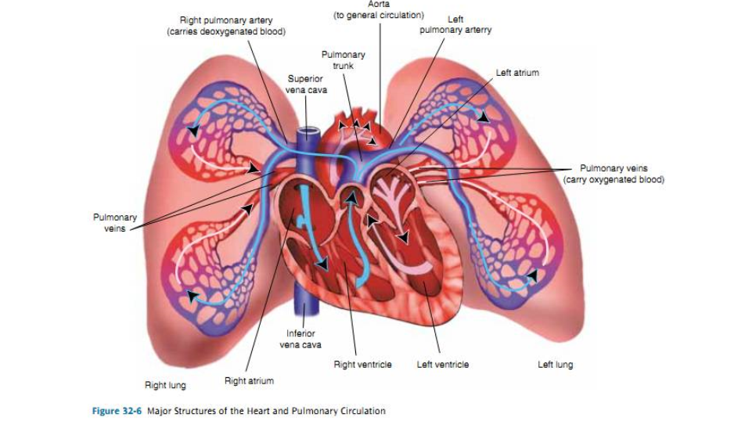
Biology

Slide 20
CIBERSORT analysis

Slide 21
PATHWAYS
Canonical Pathway | pv | n | up | dn
Oxidative Phosphorylation | 0.001 | 23 | 23 | 0
Mitochondrial Dysfunction | 0.003 | 30 | 27 | 3
VDR/RXR Activation | 0.007 | 11 | 2 | 9
PPARalpha/RXRalpha Activation | 0.008 | 23 | 6 | 17
Cellular Effects of Sildenafil (Viagra) | 0.010 | 11 | 4 | 7
**Sidenafil=Phosphodiesterase type 5 inhibitor (PDE5-Is)- widens blood vessels-increases blood flow
Notes:
Vitamin D response element (VDRE) vitamin D regulated genes

Slide 22
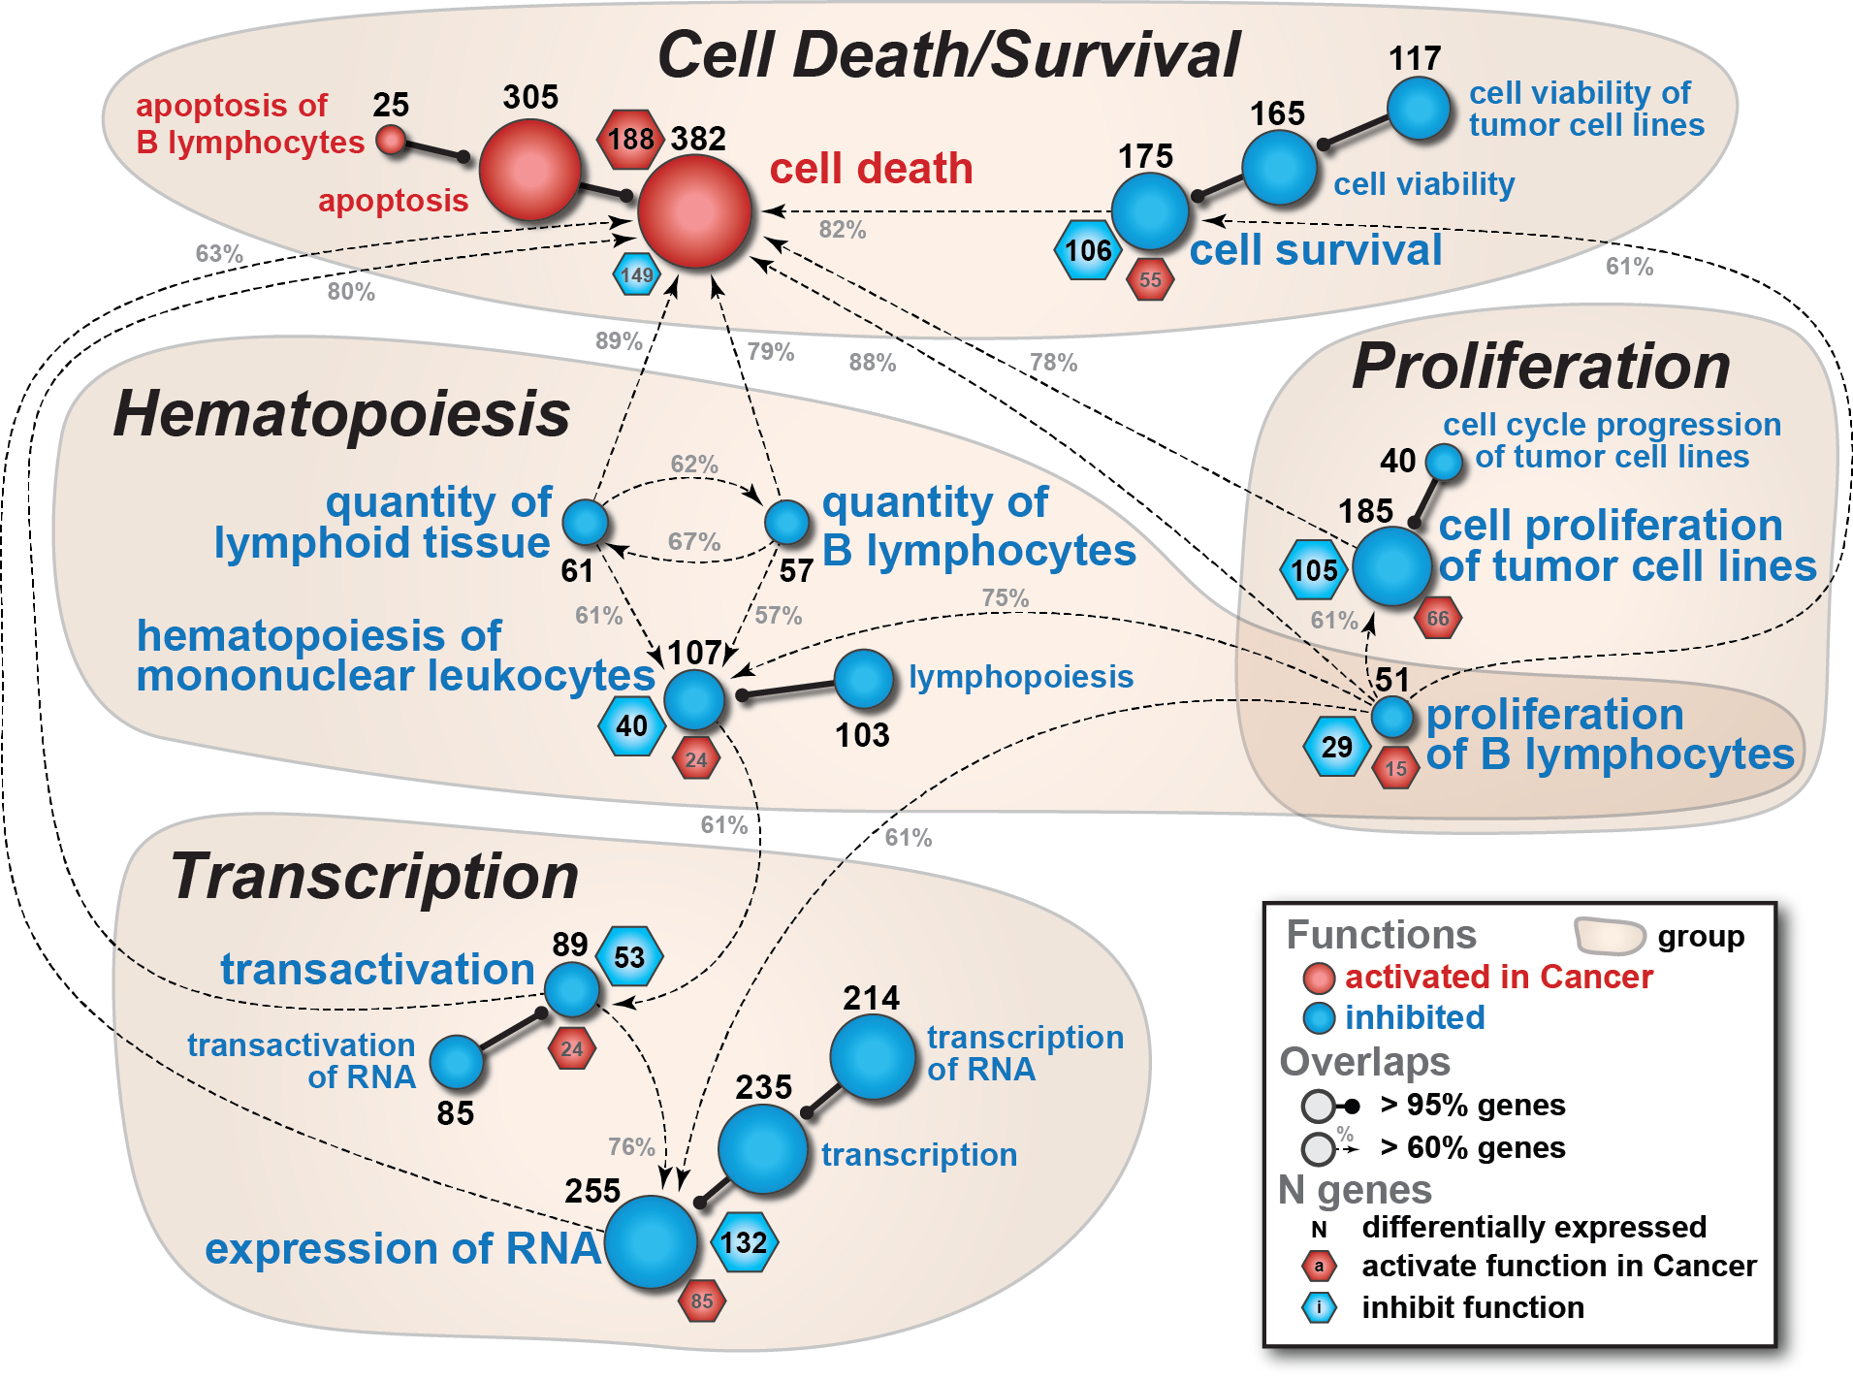

Slide 23
Summary
You can detect a cancer specific signal in whole blood of patients
with NSCLC
That signal can accurately distinguishes difficult to assess lung nodules
detected by LDCT.
Nanostring performance met and exceeded expectations.
Fewer probes required to achieve accuracies similar or better than microarrays
50 gene classifier outperformed 3 clinical models
Less stringent requirement for quality of RNA
Sample handling minimized.
No enzymatic steps to induce variability
Understanding the peripheral immune system and its interactions with
a lung tumor may be an important factor in the development of new and
effective therapies
Spitzer, M.H., et al., Systemic Immunity Is Required for Effective Cancer
Immunotherapy. Cell, 2017. 168: p. 25.

Slide 24
What’s Next
More samples from more sites.
Complete the 8-30mm study
What is different in samples that misclassify MNs and BNs
Longitudinal studies
Post resection changes in signatures

Slide 25
Acknowledgements
Michael Showe
Noor Dawany
Andrew Kossenkov
Sonali Majumder
Showe Lab
Celia Chang
Sandy Widura
Trisha Kumar
Genomics
Bioinformatics
Andrew Kossenkov
Priyankara Wickramasinghe
Rehman Qureshi
NYU: William Rom, James Tsay, Harvey Pass
HFGCC: Thomas Bauer, Brian Nam
Temple U: Gerard Criner
UPenn: Anil Vachani
Roswell Park: Sai Yendamuri
Collection sites
Support: PA DOH Tobacco Settlement CURE Funds, NCI EDRN BDL grant
EDRN 3/7/2017
Notes:
Helen F. Graham Cancer Center at Christianna, Hospital DE.

