Slide 1
Interrogating the Urinary Transcriptome To Refine Prostate Cancer Detection
Kathryn Pellegrini, PhD and Martin Sanda, MD
10th EDRN Scientific Workshop
Bethesda, MD
March 8nd 2018

Slide 2
Combining Urinary T2:Erg and PCA3 RNA Testing
Improves Specificity for Predicting Gleason > 7 PCa
Biomarker | Assay Threshold for > 95% Sensitivity To Predict Gleason > 7 | Specificity
PSA | 3.0 | 18%
PCA3 | 6.3 | 17%
T2-erg* | --- | 0%
PCA3-T2erg | 19.1, 7.6 | 39%
*T2:erg maximum sensitivity is <95% because it exists in ~60% of PCa
Sanda et al, JAMA Oncology 2017

Slide 3

Urinary T2:Erg and PCA3 Testing at Age = 55-64 Yrs Would Reduce Lifetime Health Care Costs
Scenario I: Comparison to PSA-Based Biopsy
Scenario II: Comparison to No Screening - USPSTF
Lifetime Cost Savings Per Man Undergoing PCA3-T:erg Test
Age | Change in Cost
55-64 | -$800
65-74 | -$1,200
Lifetime Cost Savings Per Man Undergoing PCA3-T:erg Test
Age | Change in Cost
55-64 | -$2,800
65-74 | +$4,500

Slide 4


Combining Serum Prostate Health Index with post-DRE Urine PCA3 and T2Erg Clinical Assays to Predict Aggressive Prostate Ca (E Huang et al, ongoing)
Serum Prostate Health Index (y axis), post-DRE Urine PCA3 (x axis), and T2Erg (z axis) clinical assay results stratified by aggressive Gleason 7+ prostate cancer (red) vs benign or indolent (blue)
Biospecimen Substrate | Biomarker Combination | Sensitivity | Specificity
Blood (serum) | Prostate Health Index (phi) | 95 | 27
Urine (post-DRE) | PCA3 + T2Erg | 92 | 36
Blood and Urine | phi + PCA3 + T2erg | 97 | 41
1st Blood, then Urine | phi > PCA3 + T2erg | 97 | 45
1st Urine, then Blood | PCA3 + T2erg > phi | 96 | 46
Notes:
PCA3 has limited use as a stand-alone marker
We began our studies by optimizing the conditions required for RNA isolation from urine

Slide 5
Strategy for Further Refinement:
Target prostate cancer-derived RNA in urinary microvesicles to improve aggressive Pca detection
Urine-derived RNA may allow a more complete sampling of the prostate
  Potential benefits during diagnosis and active surveillance
  More readily accessible for sampling
Focus areas
  Urine extracellular vesicles (EVs) as a source of prostate RNA
  Expanding the number of interrogated genes (from high throughput targeted RNA seq to whole transcriptome assays)

Slide 6
Post-DRE Urine Contains EVs of Various Size
Patient #1
Patient #2
Microvesicles (150-1000 nm)
Exosomes (<150 nm)

Slide 7
Urine EVs Provide More RNA for Analysis
200
  EVs
  Median: 36.4 ng
  IQR: 11.7-80.9 ng
  Cell Pellet
  Median: 4.8 ng
  IQR: 1.3-13.5ng
150
RNA (ng)
100
50
0
Extracellular Vesicles (EVs)
Cell Pellet
(n = 105)

Slide 8
EV RNA Yield is Significantly Higher Post-DRE
  Urine provided without prior DRE
  Median: 3.1 ng
  IQR: 1.7-4.0 ng
  Urine collected following DRE
  Median: 36.9 ng
  IQR: 11.6-79.3ng
200
100
50
20
RNA (ng)
10
5
2
1
No DRE
(n = 14)
Post-DRE
(n = 22)

Slide 9
Urine Vesicles Enriched for Prostate RNAs
Prostate-specific transcripts were detectable in post-DRE urine at higher levels than kidney/bladder-specific genes

Slide 10
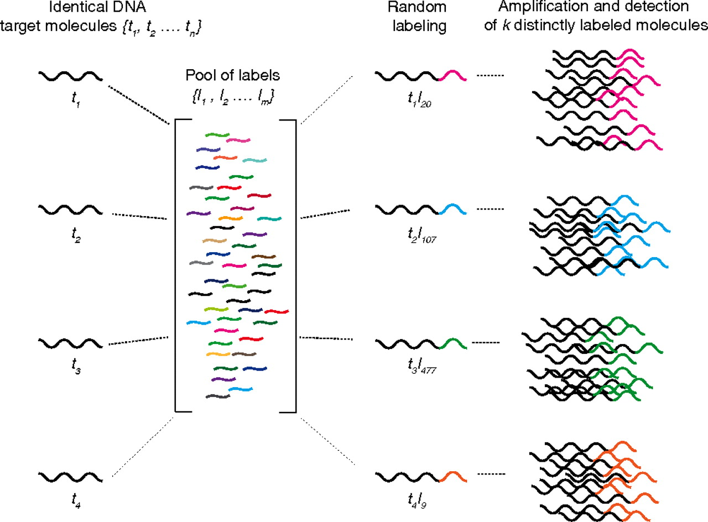
Precise Assay for Targeted RNAseq
Molecular index discerns original transcript number from PCR duplicates
  Requires 10 pg – 1 ng of RNA
Individual RNA target molecules
Random labeling
Amplification and detection of distinctly labeled molecules
Pool of labels
Figure adapted from Fu et al. PNAS 2011;108:9026-9031

Slide 11
Refinement of the Precise Assay
Target Genes
Existing prognostic panels
  GenomeDx Decipher
  Myriad Prolaris
  Genomic Health OncotypeDx
  Published (Moreno, Mucci)
Data-mining
  Increased in PCa
  Low in normal GU tissues
Control genes
  Constitutive or tissue-specific
Version 2
Non-detected transcripts removed
Highly expressed transcripts isolated onto a separate panel
Version 3
Primers re-designed using updated algorithm as recommended by BD Genomics
Control genes added across all primer panels (RAB7A, KLK2, PSMB2)

Slide 12
Target Genes Detectable in Post-DRE Urine
100
92
80
60
68
68
Number of Genes
(out of 269)
40
20
22
19
0
All samples
>50% of samples
10-50% of samples
<10% of samples
0 samples
Frequency of Detection
34% of the genes were detected in all 29 samples
19 genes were not detected in any sample

Slide 13
Known Biomarkers Higher in PCa Patients
PCA3
AMACR
SPINK1
6
6
5
4
4
Log₂ Expression
(RAB7A Normalized)
4
2
3
2
0
2
0
No PCa
GS7+ PCa
No PCa
GS7+ PCa
No PCa
GS7+ PCa
p < 0.05
p < 0.05
p < 0.05
28 genes were significantly different in EVs from prostate cancer patients – 25 upregulated, 3 downregulated

Slide 14
Potential Cancer-Specific Clustering
No PCa
GS7+ PCa
Log₂ Fold Change
-1
0
1
Fold change shown
  Compared to average of non-cancer group
  Clustered using the 28 genes that were significantly different in cancer patient EVs

Slide 15
Summary of Targeted RNA Seq
Precise Assay version 3 has been transferred to CLIA-certified genomics core here at Emory
  At least four more batches planned (30 samples/batch)
  Analysis will focus on algorithm to distinguish aggressive from indolent prostate cancer
This assay only measures selected genes
  Current selection based on analysis of tissue
  Would whole transcriptome assay identify new biomarkers?

Slide 16
Microarray Analysis of Tissue and Vesicles
Pilot evaluation of matched tumor (RP) and post-DRE urine EV specimens were collected from 15 patients at Emory
  Gene expression assessed by whole transcriptome microarray (Affymmetrix)
Analysis of this data has focused on the following:
  Comparison of transcript detection in tumor and urine specimens
  Correlation of RP and urine transcript levels

Slide 17
Many Genes Detected in Both RP and Urine
Over 9000 genes were detected in the RP tissue or post-DRE urine EV specimens for all 15 patients
  Almost 4000 of these genes were common between RP and EVs
  Over 15000 genes were not detected in any specimen tested
High degree of overlap between RP- and urine-detected genes
  Other genes may be specific to a particular specimen type
RP
Urine
Genes detected for all 15 patients
2766
3898
2351
37035

Slide 18
Summary
Targeted RNA seq of PCa-associated transcripts from urinary microvesicles
  250 taget RNA transcripts detectable with minimum frequency ~10%
  CLIA environment
Whole (genome-wide) transcriptome array/RNASeq platform(s)
  Preliminary data indicate 3898 transcript targets
  CLIA environment, industry/commercialization partner

Slide 19


Acknowledgements
Kathryn Pellegrini
Mehrdad Alemozaffar
Ella Anastasiades
Becky Arnold
Almira Catic
Kristen Douglas
Chris Filson
C Beebe
H Chang
C Cimmino
B Hershatter
A Lay
Emory EDRN CVC Team
Clinician Collaborators
Eugene Huang
Frances Kim
Kristin Larsen
Carlos Moreno
Dattatraya Patil
David Schuster
Mersiha Torlak
V Master
P Nieh
K Ogan
J Pattaras
C Ritenour
Harvard: BIDMC/DFHCC/SPH
Univ Michigan
Univ Texas SAHSC
Univ Washington
University of East Anglia
Jeremy Clark
Colin Cooper
Funding

