Slide 1
Can an In Vitro Diagnostic (IVD) Device be Validated for Early Detection on Banked Samples?
Gene Pennello, Ph.D
Division of Biostatistics, OSB/CDRH/FDA

Slide 2
Medical Device Evaluation
For indication(s) A (B, etc.), is device X
safe,
effective,
have probable benefits that outweigh the probable risks,
with reasonable assurance?

Slide 3
Diagnostic Device Evaluation
Analytical performance - does my test measure the analyte I think it does? Correctly? How reliably?
Clinical performance - does my test result correlate with target condition of interest in a clinically significant way?
Clinical Utility - does my test support clinical decisions for patient management such as effective treatment or preventive strategies?

Slide 4
Intended Use & Indications for Use
  The driving force of the FDA review
  Determine the type of review
  Determine the data requirements
  Describe what the device measures, why, and in what population(s) it should be used
Notes:
While a reviewer, the approach I used, and was endorsed by management at that time, was the use of the following definitions. Please be forewarned that to assume this was consistent with all reviewers and divisions within ODE would be incorrect.
Indication for Use = the clinical condition it is intended to diagnose, treat (devices seldom cure anything), reconstruct or improve upon.
Patient populations were considered within the review of indication for use. For example, pediatrics and adult populations were always considered separately. In addition, if a patient population was historically considered off limits and were now being considered to be part of the treatment population this too was considered (for example, to use an orthopedic implant in the osteoporotic patient population (or don’t exclude it)). In addition, claims made with respect to the treatment were also considered part of the indication for use review. For example, an laparoscopic or minimally invasive device that claimed a faster healing rate or fewer adverse events/serious complications compared to the predicate were either found not equivalent or were forced to provide clinical study evidence to support such claims (my personal preference was the latter option. Don’t believe that if a laparoscopic instrument is equivalent in all other ways that the device should be reviewed under a PMA.).
Intended Use = a device’s effect on the human body.
By effect I mean what does the device do to the human body, (e.g., cut, ablate, coagulate, replace a body part, image, inject/extract liquids/tissue, etc). During the 510k review process the technological methodology in achieving this effect was NOT part of intended use but did affect the decision as to whether the device was substantially equivalent.

Slide 5
Least Burdensome
“… the Secretary shall consider the least burdensome appropriate means necessary to demonstrate a reasonable assurance of device safety and effectiveness.”
“When clinical data are necessary, FDA and industry should consider the most efficient means of obtaining the evidence necessary to meet the regulatory need or standard”.
Section 515(c)(5)(A) of FD&C Act, FDA Modernization Act, 1997.
The Least Burdensome Provisions: Concept and Principles, Draft Guidance for Industry and FDA Staff, 2017.

Slide 6
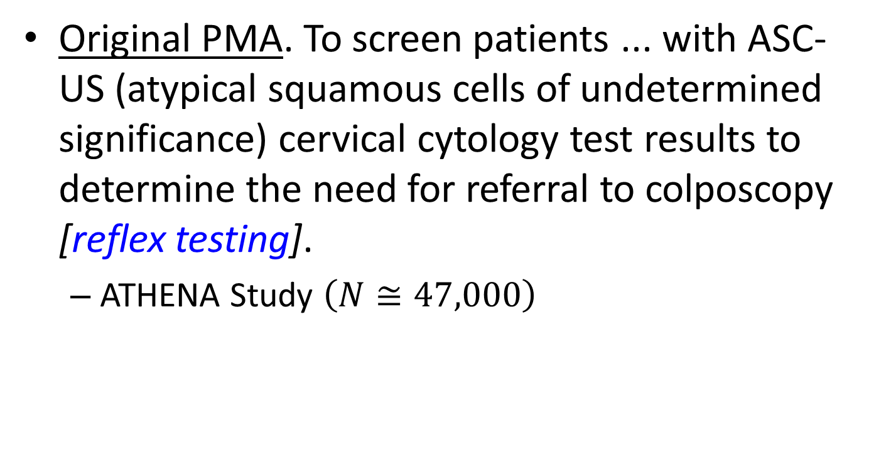
Cobas HPV Test
Original PMA. To screen patients ... with ASC-US (atypical squamous cells of undetermined significance) cervical cytology test results to determine the need for referral to colposcopy [reflex testing].
  ATHENA Study $\left(N{≅47,000}\right)$

Slide 7
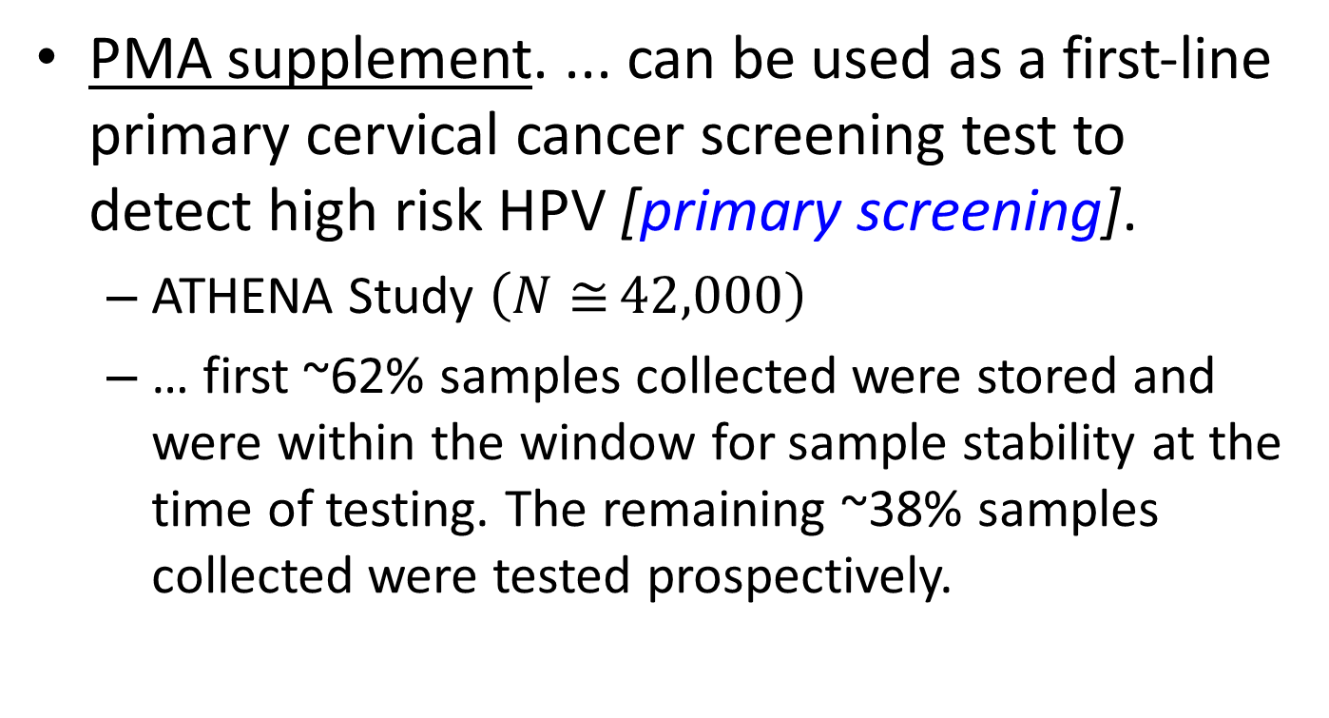
Cobas HPV Test
PMA supplement. ... can be used as a first‐line primary cervical cancer screening test to detect high risk HPV [primary screening].
  ATHENA Study $\left(N≅{42,000}\right)$
  … first ~62% samples collected were stored and were within the window for sample stability at the time of testing. The remaining ~38% samples collected were tested prospectively.

Slide 8
Diagnostic Devices, Radiology
Multiple-reader multiple-case (MRMC) study
  Multiple study readers interpret results retrospectively from both the investigational and control device modalities.
Selenia Dimensions 3D Breast Tomosynthesis generates digital mammographic images that can be used for screening and diagnosis of breast cancer.
  302 of 3521 imaged subjects were selected for study: 76 cancer, 24 recalled, 76 benign, and 126 negative.
Computer-aided detection (CAD)
  Use of specialized computer algorithms applied to medical information for improving the accuracy in detecting and/or discriminating disease by clinicians.

Slide 9
TOP2A FISH pharmDx Kit
Device output: copy number changes (normal, deletions or amplifications)
Claim: prognosis for recurrence or death
Population: breast cancer patients
Design: stored specimens from a randomized controlled trial in a retrospective analysis.
‘‘the main design risk . . . was that missing blocks created a potential for unrepresentative results due to selection-bias… The tissue was more often available when the prognostic factors were worse.” (Summary of Safety and Effectiveness)

Slide 10
Keys to Prospectively Planned, Retrospective Validation
Adequate, well-conducted study with eligibility criteria the same as the assay.
Specimens are available on a large predominance of subjects.
Analysis plan is completely pre-specified.
Assay demonstrates acceptable analytical performance on archived specimens.
Assay result is obtained on a large portion of archived specimens.
User of assay is masked to the clinical data.
Mack. Nature Biotech, 2009, 27(2), 110-2.
Subramanian, Simon. Nat Rev Clin Onc, 2010, 7, 327-34.
Simon, Paik, Hayes, JNCI, 2009; 101, 1446-52.
10
Notes:
10
(to approximate random allocation of factors not used in stratified randomization, e.g., assay marker status)

Slide 11
Endpoints / Claims
  Mortality
  Reduced incidence of late stage cancer
  Disease stage shift.
  Lead time / sensitivity of detection in preclinical disease phase.
  Diagnostic accuracy is superior to standard test or is non-inferior with other benefits (e.g., less invasive).
  Diagnostic accuracy is superior when test is used as adjunct to standard test.
  Intended use mitigates risk, e.g., OVA1:
    Patients with a pelvic mass scheduled for surgery
    Elevated risk referred to gynecologic oncologist for surgical treatment.

Slide 12
Absolute Risk
Absolute risk is the probability that a subject who is free of the disease of interest at age a will be diagnosed with that disease in a subsequent age interval (a, t].
Relative risk (RR) is less clinically relevant than absolute risk:
  RR = 10 could mean 0.1% to 1%, or 1% to 10%.

Slide 13
MammaPrint
Analytes: gene expression of 70 gene variants
Endpoint: prognosis for recurrence or death
Claim: risk of distant metastasis
Population: breast cancer patients
Study design: retrospective analysis of stored specimens from a well-defined cohort

Slide 14
Time to distant metastasis (N=302)

Slide 15
Proportion alive at 10 years
Clinical Gene N Proportion*
Signature
Low Risk Low Risk 52 0.88 (0.74 to 0.95)
Low Risk High Risk 28 0.69 (0.45 to 0.84)
High Risk Low Risk 59 0.89 (0.77 to 0.95)
High Risk High Risk 163 0.69 (0.61 to 0.76)
*Buyse et al JNCI 2006

Slide 16
Estimating Absolute Risk in
Sub-Samples of a Cohort
Nested case-control design: At each time a case develops, sample individuals from risk set.
Case-cohort design: Analyze data from subcohort selected at start of follow-up and all cases observed during follow up
  Raw data (e.g. serum samples) collected on all subjects at baseline, but analyzed only for cases and subcohort members.
Langholz and Borgan, 1997, Biometrics. v53. 767-774
Self and Prentice, 1988. Ann. Statist. v16. 64-81.
Barlow, 1994. Biometrics. v50. 1064-1072

Slide 17
Prospectively planned sample selection from a retrospective study population
(1) Study population
Intended use population
  (1) Prospective-Retrospective design (2) Case-Cohort design
  (3) Nested Case-Control design
Retrospective Study population
(3)
Matched sample of controls
(2)
Random sample of study pop
All cases
All cases

Slide 18
Nested Case Control Design
(3)
Matched sample of controls
All cases
  Woodward 2005
    For each case, a random selection of control(s) is taken from the cohort at risk at the time when the case got the disease.
  Biesheuvel et al 2008; Baker et al 2002;
    All (random subset) cases are included and a random sample of the controls is selected.
  Pepe et al, JNCI 2008
    Randomly selected case patients and
    control subjects in the study cohort

Slide 19
Case Cohort Design
(2)
Random sample of study pop
All cases
All cases and a random subcohort.
Advantages
  Subcohort can be used for
  multiple diseases
  Any time scale can be
  used
Disadvantages
  Potentially more susceptible to bias than nested case-control

Slide 20
Matched Case-Control Design
Match controls with cases on known risk factors and other covariates, including
  Specimen collection site, processing site, and storage time; calendar time; age; gender; race; treatment (if applicable), etc.

Slide 21
Matched Case-Control Designs
“With [case-control] matched designs one can determine if there is some association between the marker and the outcome but one cannot quantify how well the marker performs as a classifier”.
… impact of the new marker on model performance can be substantially underestimated
… the incremental value of the same marker added to a model with standard risk factors tends to be grossly overestimated (an AUC increment of 0.02 vs 0.17).
Pepe, Fan, Seymour et al, Clin Chem 2012; 58:8, 1242-51.
Pencina, Clin Chem 2012; 58:8, 1176-8.

Slide 22
Confounding
Odds ratio association of test result with clinical condition can be adjusted for the effects of many categorical covariates using:
  Conditional logistic regression
  Cochran-Mantel-Haenzel estimate of OR

Slide 23
Intention to Treat (ITT)
Intent to Treat (ITT): Include every subject who is randomized according to their treatment assignment, regardless of non-compliance with treatment, missing outcomes, protocol deviations, withdrawal, or anything else that happened after randomization.
ITT analysis avoids overoptimistic estimates of treatment efficacy due to the exclusion of subjects on the basis of post-randomization variables.
Notes:
Campbell, Pennello, and Yue, 2011, Missing Data in the Regulation of Medical Devices, J Biopharm Stat, 21(2), 180-195.

Slide 24
Intention to Diagnose (ITD)
Include every subject for analysis, even when data are not complete.
Address missing data
  Report number (percent) of subjects without test results (sample unavailable; test result invalid, unevaluable, equivocal, etc.).
  Impute missing data, if meaningful for analysis.
    Sensitivity analysis (worst case, NI, MAR, NMAR)
    Imputation variables
      sampling method (e.g., biopsy, resection)
      sample characteristics
      handling and processing factors
      clinical variables, outcome

Slide 25
Endpoints / Claims
  Mortality
  Reduced incidence of late stage cancer
  Disease stage shift.
  Lead time / sensitivity of detection in preclinical disease phase.
  Diagnostic accuracy is superior to standard test or is non-inferior with other benefits (e.g., less invasive).
  Diagnostic accuracy is superior when test is used as adjunct to standard test.
  Intended use mitigates risk, e.g., OVA1:
    Patients with a pelvic mass scheduled for surgery
    Elevated risk referred to gynecologic oncologist for surgical treatment.

Slide 26
Take Homes
Prospectively planned, retrospective studies have been the basis of approval of diagnostic devices for cancer screening or diagnosis.
  Enrichment designs have been considered.
Study population should be representative of IU population of the device.
  Cohort being sampled should be well-defined.
  Avoid convenience sampling.
Presubmission (q-sub) meeting with CDRH is strongly encouraged.
Before your diagnostic device is applied to stored specimens in a retrospective clinical validation study, validate its analytical performance.

Slide 27
Analytical Performance Studies
Bias, relative to a reference method for measuring analyte.
Precision. Measurement variation in repeated testing.
  repeatability of the test result taken under the same set of conditions (e.g., testing sample replicates in the same run)
  reproducibility of test result taken under different conditions (e.g., testing sample replicates in different labs)
Limit of Detection. Smallest analyte level detected reliably.
Reagent Stability. Shelf-life, in-use, and shipment.
Analytical Specificity. Measurement of a specific analyte in the presence of potential interfering substances, cross-reactivity, or cross-contamination.
Commutability of different sample types, when processed samples are used in place of clinical samples.
Reference Interval. Central XX% of test values in healthy individuals.
CLSI. A Framework for Utilizing CLSI Guidelines to Evaluate Clinical Laboratory Measurement Procedures; 2nd ed, CLSI report EP19. Wayne, PA: Clinical and Laboratory Standards Institute; 2015.

Slide 28
References: Case-Control, Case-Cohort, Nested Case-Control Designs
Rodrigues, Kirkwood. Case-control designs in the study of common disease; Updates on the demise of the rare disease assumption and the choice of sampling scheme for controls, Intern J Epidem 1990; 19(1), 205-218.
Janes H, Pepe MS. Matching in Studies of Classification Accuracy: Implications for Analysis, Efficiency, and Assessment of Incremental Value, Biometrics 2008; 64, 1-9.
Kleinbaum DG, Kupper LL, Morgenstern H. Epidemiologic Research, Van Nostrand Reinhold, 1982, Ch. 11, Selection Bias.
Barlow WE, Ichikawa L, Rosner D, Izumi S. Analysis of Case-Cohort Designs. J Clin Epidem 1999; 52(12):1165-1172.
Pepe MS, Feng Z, Janes H, Bossuyt PM, Potter JD, Pivotal Evaluation of the Accuracy of a Biomarker Used for Classification or Prediction: Standards for Study Design, J Natl Cancer Inst 2008;100: 1432-1438.
Wacholder, Practical Considerations in Choosing between the Case- Cohort and Nested Case-Control Designs, Epidemiology 1991; 2(2): 155-158.
Baker SG , Kramer BS , Srivastava S . Markers for early detection of cancer: statistical guidelines for nested case-control studies . BMC Med Res Methodol . 2002 ; 2 : 4 .

Slide 29

Acknowledgements
OIR
DBS
29

