Slide 1
FDA requirements for analyte panel and classifier approval/clearance:
Guidance and drivers in IVDMIA development
Zhen Zhang
Center for Biomarker Discovery and Translation
Johns Hopkins University School of Medicine

Slide 2
Disclosure
Through license agreements between Johns Hopkins University and Vermillion Inc., Dr. Zhen Zhang is entitled to royalty payment from OVA1 and Overa.
The two FDA cleared tests OVA1 and Overa were developed partially supported by a sponsored research agreement between Vermillion Inc. and Johns Hopkins University and funding from DOD and NCI/EDRN.
Clinical performance of the two tests will not be discussed. Only the process of development is used as an example for the presentation.

Slide 3
IVDMIA (per FDA)
A device that
combines the values of multiple variables using an interpretation function to yield a single, patient-specific result (e.g., a “classification,” “score,” “index,” etc.), that is intended for use in the diagnosis of disease or other conditions, or in the cure, mitigation, treatment or prevention of disease, and
provides a result whose derivation is non-transparent and cannot be independently derived or verified by the end user.

Slide 4
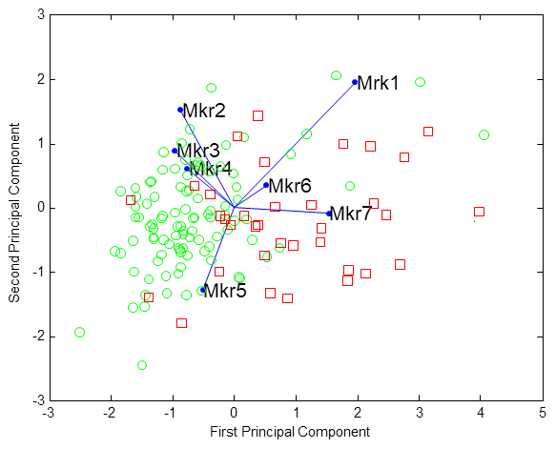
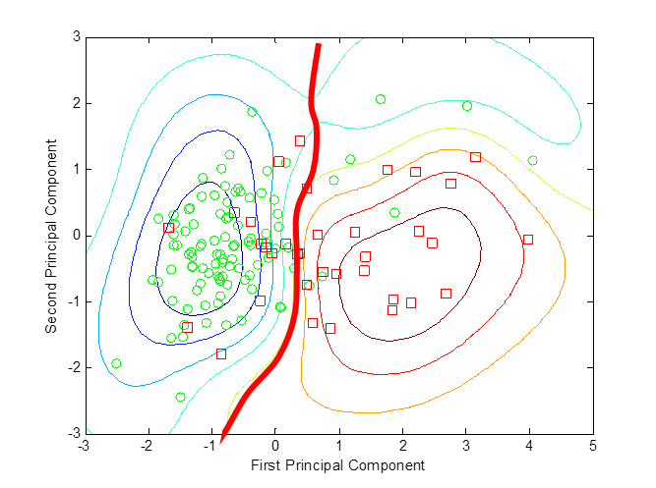
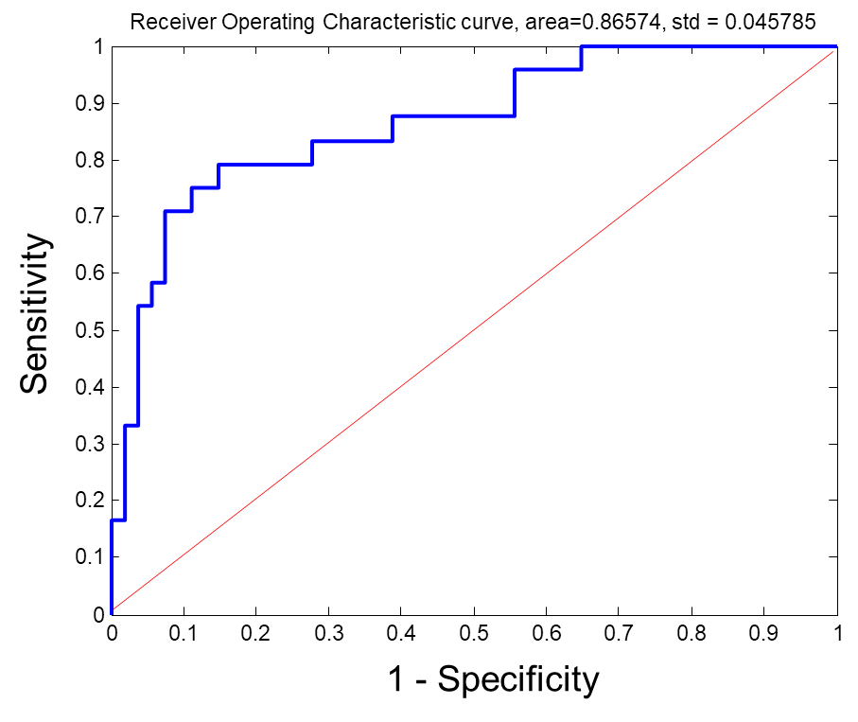

Development of IVDMIA
Biomarker data
Classification model
Clinical evaluation
… …
Study & experimental design
Model derivation via machine learning
Clinical Relevance
Statistical Soundness
Regulatory Requirements

Slide 5
Elements in regulatory requirements for safety and effectiveness drives IVDMIA development
Intended use.
Performance Characteristics
  Analytical performance
  Clinical studies: clinical sensitivity and specificity
  Clinical cutoffs.

Slide 6
A test’s intended use is defined by the time point at which it is to be used along a disease process
Early Detection
Screening
Prognosis
Predicting response to Tx
Risk Assessment
Wellness?
Monitoring

Slide 7
The time point-defined intended use in turns helps to define IVDMIA target population (inclusion/exclusion)
and consider the following:
  If test is positive, what are the options for clinical intervention? Will it likely alter patient outcomes?
  What are the consequence for test false positive/false negative?
  What are the current alternatives in testing for this intended use?
  Availability of samples at this time-point under current gold standard Dx?
  Will a meaningful size of patient population benefit from the test? (potential commercial market size)
  ……

Slide 8
Design a test’s desired performance characteristics
Zhang, Z., & Chan, D. W. (2010). Cancer epidemiology, biomarkers & prevention

Slide 9
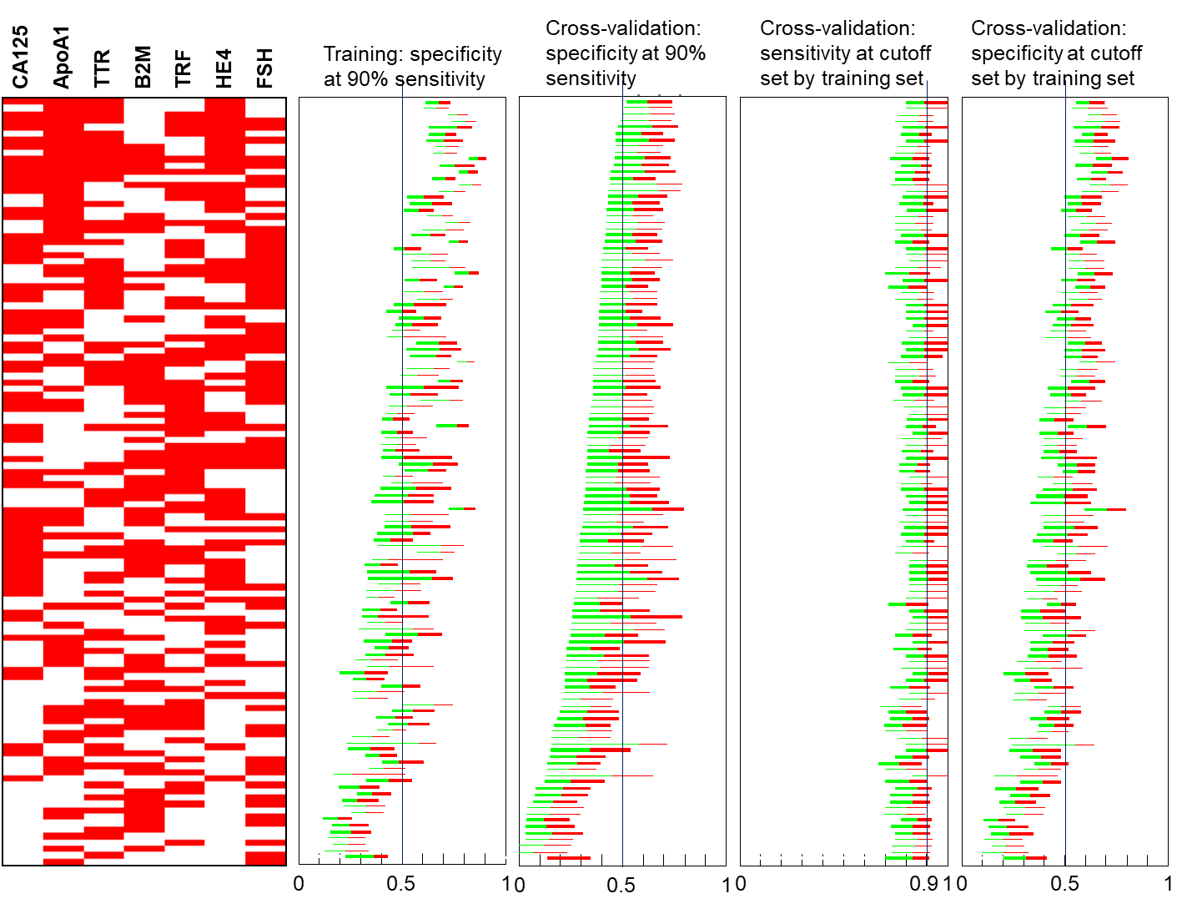
Finalize IVDMIA panel of biomarkers

Slide 10
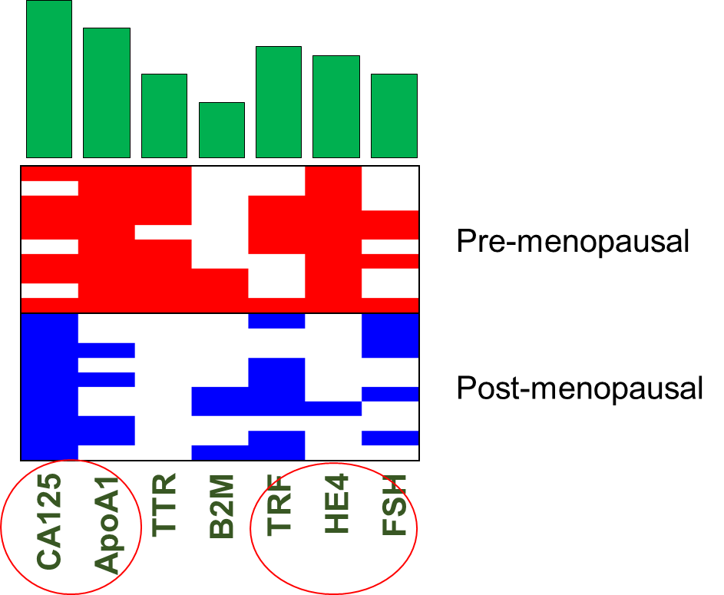
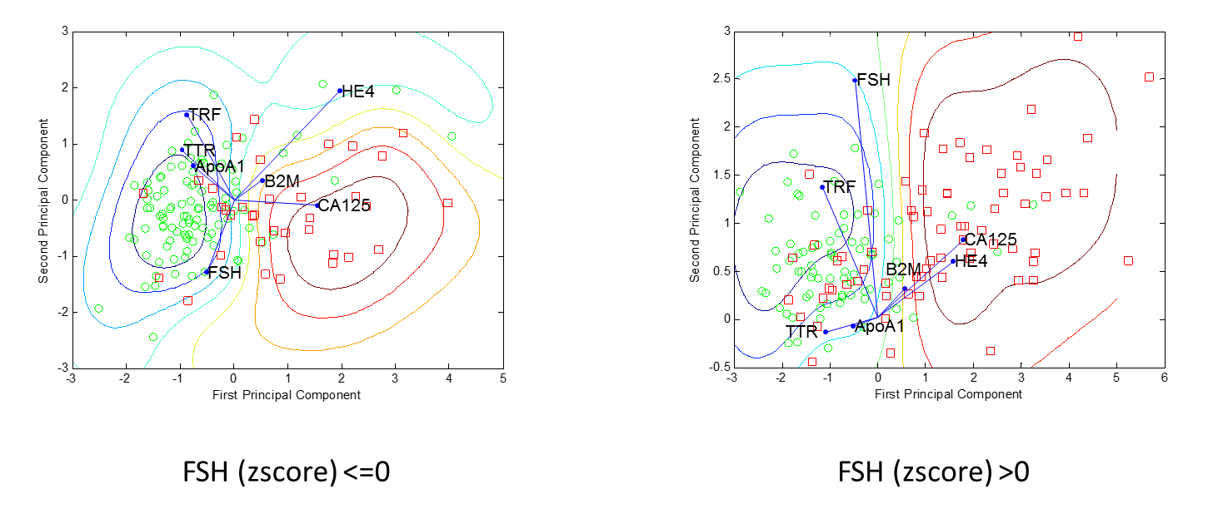
Biplot of biomarkers in training data and tentative classifier in projected 2D space

Slide 11
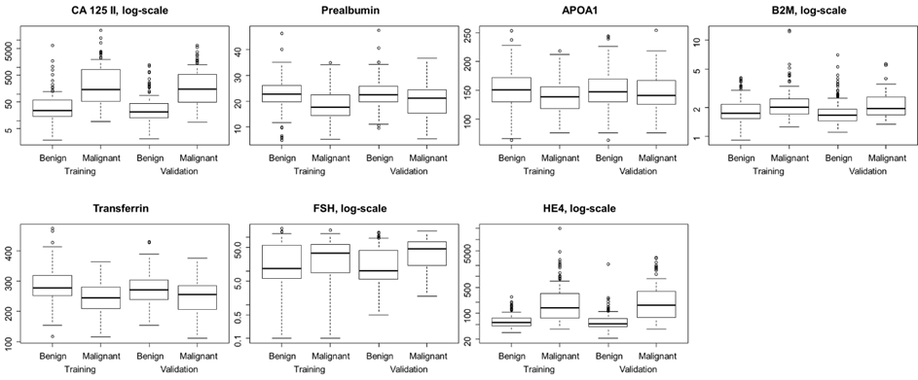
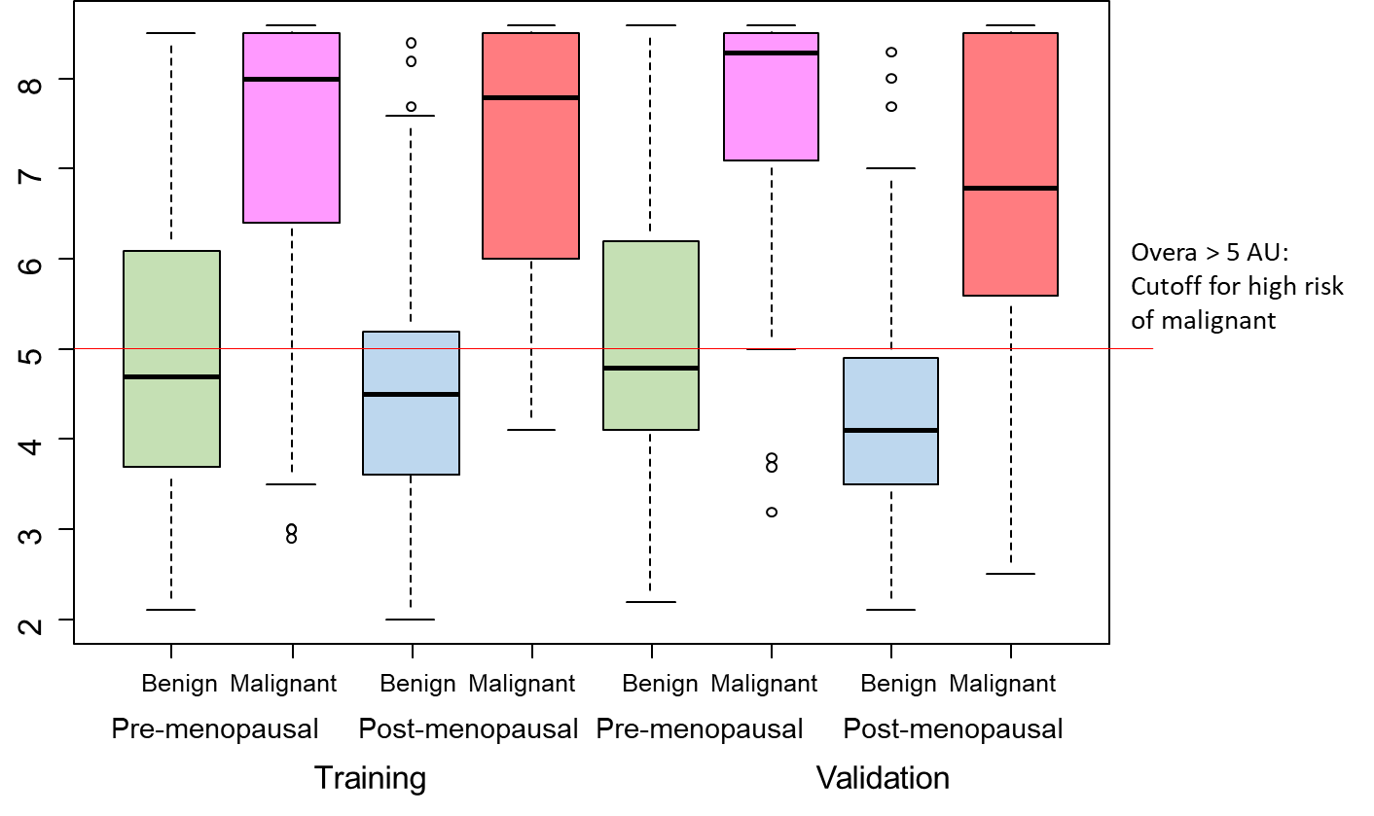
Bloxplots of individual markers and IVDMIA

Slide 12
Question:
Many of the algorithms behind an IVDMIA is nonlinear which make it difficult to attribute a final IVDMIA score to the individual markers numerically. What evidence is needed for the inclusion of individual markers in an IVDMIA panel?
Does each of the input markers need to demonstrate its own discriminatory power and if so at what level?

Slide 13
Cutoff and clinical performance characteristics
1.0
NPV
Sensitivity
(% of disease detected)
0.8
Additional cases captured
0.6
Performance Metrics
Specificity
0.4
Enriched PPV over Prevalence
PPV
0.2
Prevalence
At cutoff=5.0AU, 38.0% of premenopausal samples were positive
0.0
0.0
0.2
0.4
0.6
0.8
1.0
Proportion of Test Positives

Slide 14
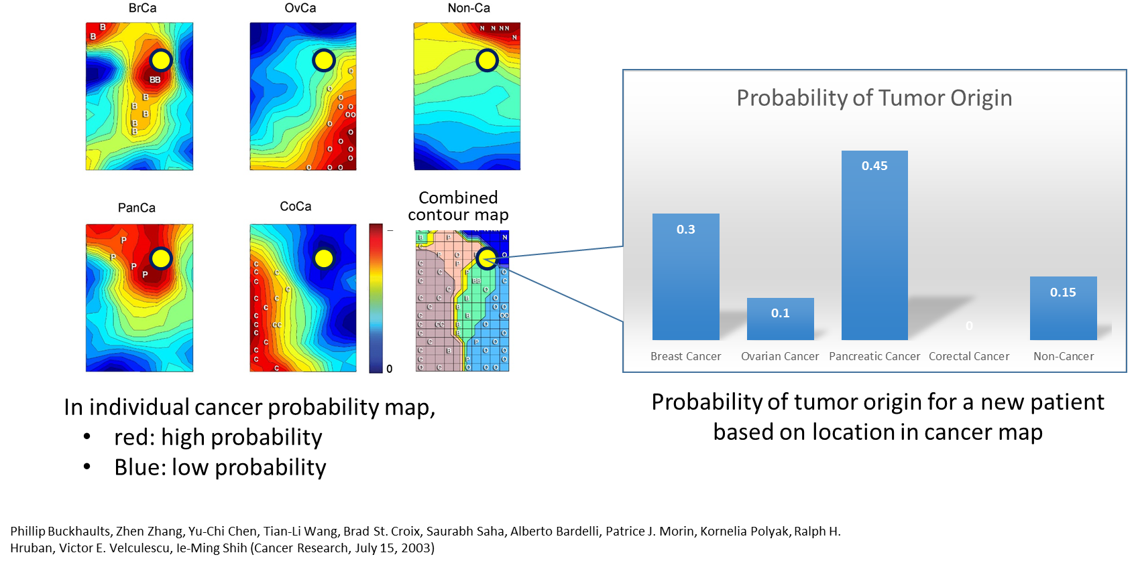
Question:
What are the factors in deciding whether a single cutoff for positive/negative results or multiple cutoffs representing different bins of estimated probability of positive conditions is more appropriate?

Slide 15
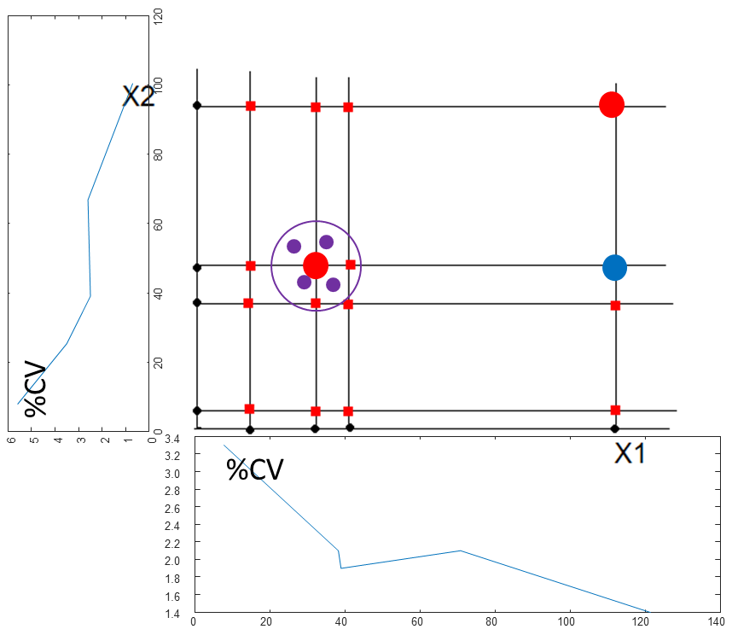
MC estimated analytical performance characteristics of IVDMIA
9
8
7
6
5
%CV of IVDMIA
4
3
2
1
0
2
3
4
5
6
7
8
9
10
Mean IVDMIA

Slide 16

Center for biomarker discovery and translation

Slide 17
Acknowledgement
JHU
  Current: Daniel W Chan, Lori Sokoll,, Hui Zhang, Jin Song.
  Past: C Nicole Rosenzweig, Jinong Li, Alex Rai, Lily Chen, Bai Zhang.
Collaborators on ovarian cancer biomarker research
  RC Bast, Jr., IJ Jacobs, A Berchuck, C Van Haaften-Day, NF Hacker, HW de Bruijn, AG van der Zee, F Ueland, R Bristow, ET Fung, D Munroe, S Skates.
Funding: NCI/EDRN BRL (D Chan), BDL (Z Zhang), CPTAC (H Zhang, Z Zhang, D Chan), DOD (Z Zhang), and Vermillion Inc.

Slide 18
Questions repeated
What evidence is needed for the inclusion of individual markers in an IVDMIA panel? Many of the algorithms behind an IVDMIA is nonlinear which make it difficult to attribute a final IVDMIA score to the individual markers numerically. Does each of the input markers need to demonstrate its own discriminatory power and if so at what level?
What are the factors in deciding whether a single cutoff for positive/negative results or multiple cutoffs representing different bins of estimated probability of positive conditions is more appropriate.
My presentation will show how our understanding of the regulatory requirement helps to shape our IVDMIA development process. We would like to hear FDA’s comments whether our understand is correct and make sense, and if we missed important factors/items.
The value of an input to a multivariate panel may be affected by factors external to an IVDMIA algorithm. How such changes could be periodically incorporated into an approved/cleared IVDMIA and what the type of evidence/data will be required.

