Slide 1


Early Detection of Pancreatic Cancer through the Evaluation of Pancreatic Cysts
Aatur D. Singhi, MD PhD
University of Pittsburgh Medical Center
Department of Pathology
singhiad@upmc.edu

Slide 2
Disclosures
I have no financial relationships to disclose.

Slide 3
























Randall Brand, MD
Marina Nikiforova, MD
N. Paul Ohori, MD
Sara Monaco, MD
Herbert Zeh, MD
Amer Zureikat, MD
Kevin McGrath, MD
Jennifer Chennat, MD
Kenneth Fasanella, MD
Asif Khalid, MD
Kenneth Lee, MD
Adam Slivka, MD PhD
Melissa Hogg, MD
Allan Tsung, MD
J. Wallis Marsh, MD
Ying Huang, PhD
Walter Park, MD
Michael Goggins, MD
Charles Craik, PhD
Koushik Das, MD
Brian Habb, PhD
Notes:
But before, I begin, I would like to acknowledge that the body of work I’ll be discussing has been a large collaborative effort that not only includes the University of Pittsburgh Medical Center,
but also, Johns Hopkins, Stanford, UCSF, Van Andel Institute, Washington University and the Fred Hutch.
In addition, none of this would be possible without generous support from the National Pancreas Foundation, PanCAN and NCI’s Early Detection Research Network.

Slide 4

Pancreatic Cancer
Notes:
Now it would be remiss of me to talk about early detection of pancreatic cancer without first reviewing the significant health impact pancreatic cancer has in the United States.

Slide 5
3rd
Leading cause of cancer deaths in the United States.
1st
Mortality rate among all major cancers.
74%
Die within the first year of diagnosis.
92%
Die within 5 years of being diagnosed.
53,670
Estimated new cases of pancreatic cancer (equivalent number of deaths).
0
Early detection methods and successful treatment options have been discovered.
Adapted from http://www.pancan.org
Notes:
So… according to American Cancer Society, pancreatic cancer is considered the 3rd leading cause of cancer deaths in the US. CLICK
It has the unfortunate honor of being ranked 1st in mortality rate among all major cancers. CLICK
Sadly, 74% of patients die within the 1st year of diagnosis. CLICK
And approximately 92% of patients with pancreatic cancer will die within 5 years of being diagnosed. CLICK
In 2017 alone, over 53,000 Americans were diagnosed with pancreatic cancer, and approximately the same number in 2017 died from this dismal disease. CLICK
And probably the most dire of these statistics is that there still remains zero early detection methodologies and zero successful treatment options. CLICK

Slide 6
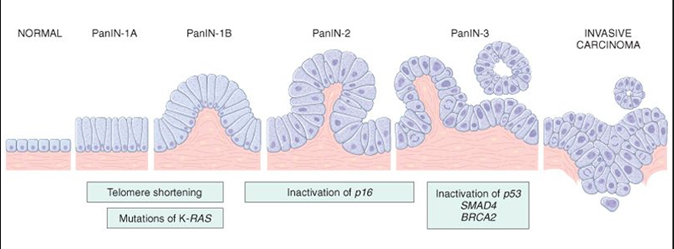
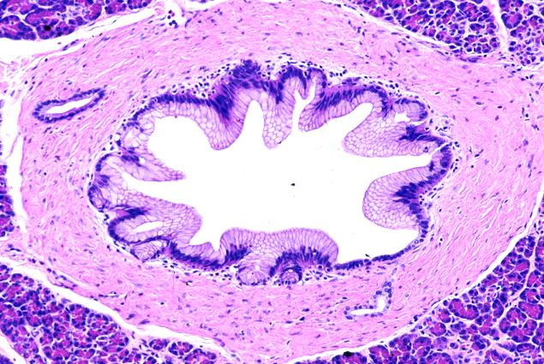
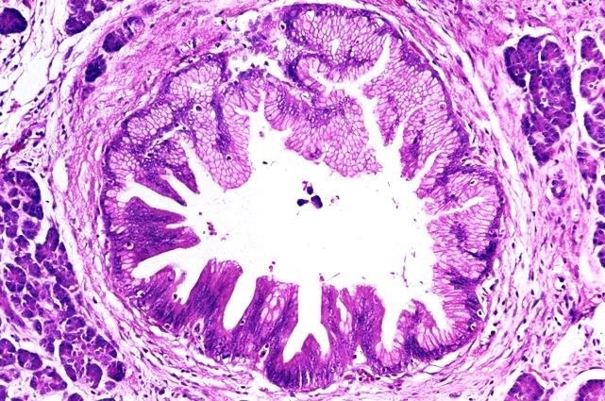
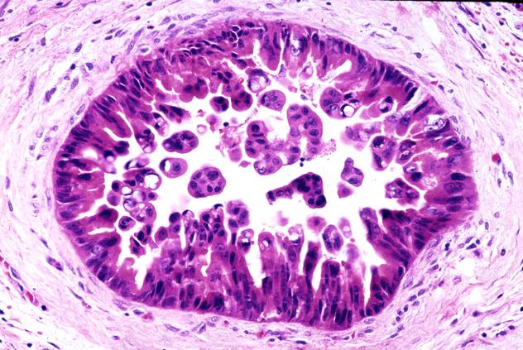
Pancreatic Cancer = Genetic Disease
Invasive Cancer
Normal Duct
KRAS
CDKN2A
TP53
Telomere Shortening
SMAD4
Notes:
But that being said, several initiatives and major advancements have been made in the last few decades that have increased our understanding of the pathobiology of these neoplasms.
For example, fundamentally, we know that pancreatic cancer is a genetic disease. CLICK
It arises from the normal ducts of the pancreas, and CLICK
evolves into pancreatic cancer through precursor neoplasms. CLICK
These precursor neoplasms progressively acquire genomic alterations that eventually gives pancreatic cancer its aggressive and destructive properties.

Slide 7
Precursors to Pancreatic Cancer
15% of Pancreatic Cancers
Invasive Cancer
Normal Duct
IPMN
MCN
Mucinous Pancreatic Cysts
IPMN = Intraductal Papillary Mucinous Neoplasm
MCN = Mucinous Cystic Neoplasm
Notes:
Although a minority, approximately 15% of pancreatic cancers are thought to arise from:
intraductal papillary mucinous neoplasms or IPMNs and
mucinous cystic neoplasms or MCNs. Both IPMNs and MCNs are collectively known as mucinous pancreatic cysts

Slide 8
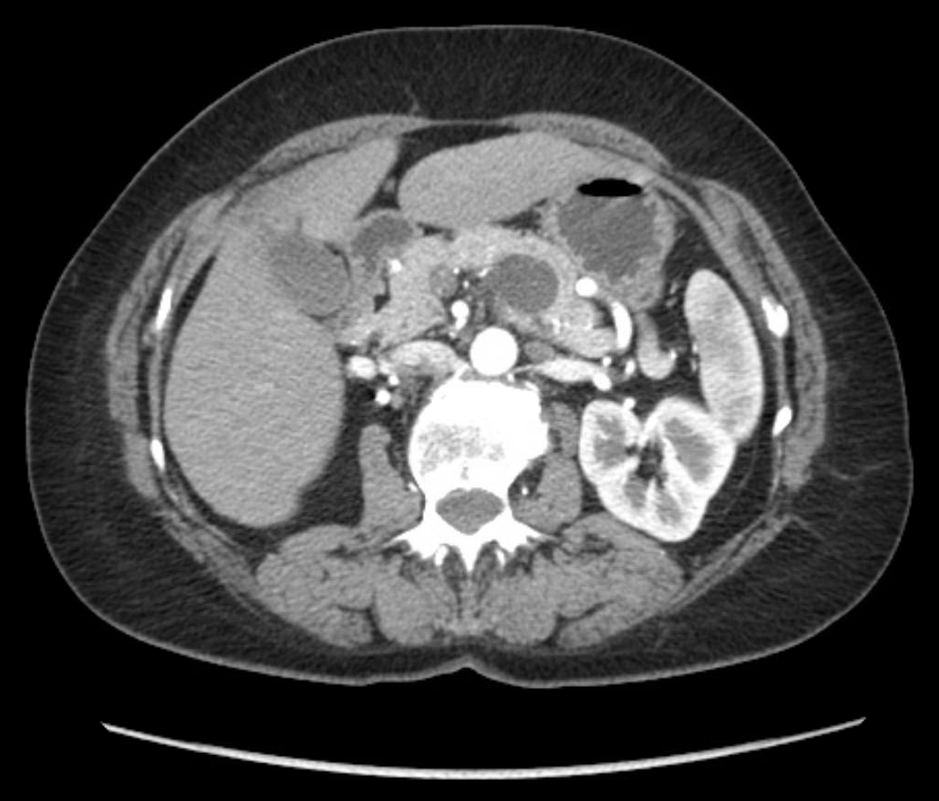
Precursors to Pancreatic Cancer
Standard CT
Invasive Cancer
Normal Duct
IPMN
MCN
IPMN = Intraductal Papillary Mucinous Neoplasm
MCN = Mucinous Cystic Neoplasm
Notes:
And are often identified by standard radiographic imaging, such CT and MRI.
Thus, they are amenable to early detection methodologies.

Slide 9
53,670
Estimated new cases of pancreatic cancer (equivalent number of deaths).
8,050
Pancreatic cancers arising from a mucinous pancreatic cyst (IPMN/MCN).
6,462,000
Number of Americans with a pancreatic cyst.
Pseudocyst
Foregut Cyst
Retention Cyst
Lymphoepithelial Cyst
Acinar Cell Cystadenoma
Squamoid Cyst
Serous Cystadenoma (SCA)
Cystic PanNET
Solid-Pseudopapillary Neoplasm
IPMN = Intraductal Papillary Mucinous Neoplasm
MCN = Mucinous Cystic Neoplasm
Notes:
In other words, among the 53,000 Americans diagnosed with pancreatic cancer each year, CLICK
for 8,000, there is the distinct possibility of detecting their pancreatic cancer at a very early stage and the potential for cure.
The issue, however, is pancreatic cysts are very common in the US population. CLICK
In fact, it is estimated over 6 million Americans have a pancreatic cyst. Further, mucinous cysts, again IPMNs and MCNs, are not the only type of pancreatic cyst, CLICK
In addition to mucinous cysts, pancreatic cysts include non-neoplastic cysts, benign neoplasms and neoplasms with very low malignant potential, all of which can mimic an IPMN and an MCN.

Slide 10
53,670
Estimated new cases of pancreatic cancer (equivalent number of deaths).
8,050
Pancreatic cancers arising from a mucinous pancreatic cyst (IPMN/MCN).
6,462,000
Number of Americans with a pancreatic cyst.
Non-Mucinous Pancreatic Cyst
Mucinous Pancreatic Cyst (IPMN/MCN)
Notes:
But!
Let’s say we do live in a perfect world where we can accurately differentiate between non-mucinous and mucinous pancreatic cysts.
And patients with an IPMN or an MCN are all sent for surgical resection as a cancer prevention protocol.
Thus, in theory, this should prevent 15% of pancreatic cancers or 8,000 Americans every year from suffering from this horrible disease.
And while in theory this may be true...

Slide 11
53,670
Estimated new cases of pancreatic cancer (equivalent number of deaths).
8,050
Pancreatic cancers arising from a mucinous pancreatic cyst (IPMN/MCN).
6,462,000
Number of Americans with a pancreatic cyst.
3,231,000
Number of Americans with a mucinous pancreatic cyst.
Not all mucinous pancreatic cysts (IPMNs and MCNs) transform into Pancreatic Cancer.
Notes:
It’s not as trivial as it sounds.
Approximately half of those 6 million patients with a pancreatic cyst actually harbor a mucinous pancreatic cyst.
Mucinous cysts are extremely common in the US population, especially IPMNs and only a rare number of IPMNs and MCNs will undergo malignant transformation into pancreatic cancer.

Slide 12
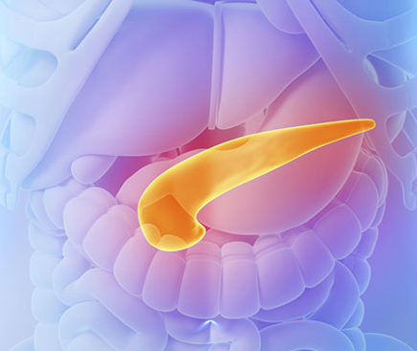

53,670
Estimated new cases of pancreatic cancer (equivalent number of deaths).
8,050
Pancreatic cancers arising from a mucinous pancreatic cyst (IPMN/MCN).
6,462,000
Number of Americans with a pancreatic cyst.
3,231,000
Number of Americans with a mucinous pancreatic cyst.
Robotic Assisted Pancreatectomy
Notes:
Moreover, surgical resection of the pancreas is not an elective procedure and, despite refinements to minimally invasive techniques, surgery is still associated with significant morbidity and mortality.
In fact, a Whipple procedure has an associated morbidity of 20% and a mortality of 3%.
Therefore, if we did resect all 3 million mucinous pancreatic cysts, we could be subjecting patients to significant and unnecessary harm.
Ideally, we need to be able to identify those mucinous cysts that will harbor or progress into pancreatic cancer with a high sensitivity and a high specificity.
Considering the numbers that I have presented, and I hate to sound like a cliché,

Slide 13

53,670
Estimated new cases of pancreatic cancer (equivalent number of deaths).
8,050
Pancreatic cancers arising from a mucinous pancreatic cyst (IPMN/MCN).
6,462,000
Number of Americans with a pancreatic cyst.
3,231,000
Number of Americans with a mucinous pancreatic cyst.
Notes:
but identifying those mucinous cysts that will transform into pancreatic cancer is like looking for the proverbial needle in a hay stack.

Slide 14
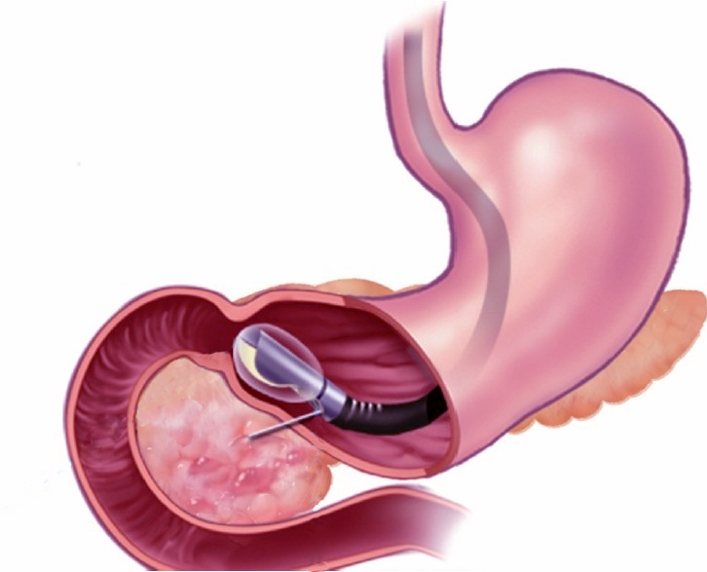

Pancreatic Cysts
Diagnostic Modalities
Endoscopic ultrasound (EUS) has variable sensitivity and specificity in pancreatic cyst classification.
Ancillary studies using aspirated cyst fluid, such as CEA (marker of mucinous cysts) and cytology, have had limited success in cyst classification and the detection of malignancy.
Endoscopic Ultrasound
Fine Needle Aspiration
Pancreatic Cyst
Adapted from Brugge WR. Endosc Ultrasound 2012 Jul; 1(2):59-60.
Notes:
Now, currently, upon identification of a pancreatic cyst, standard assessment involves endoscopic imaging through the GI tract with fine needle aspiration of the pancreatic cyst fluid for CEA, a marker of mucinous cysts, and cytology.
The purpose of these modalities is to aid in determining cyst type and presence of malignant cells.
But both assays have limited success in cyst classification and detection of malignancy.

Slide 15

Pancreatic Cysts
Endoscopic Ultrasound
Fine Needle Aspiration
Pancreatic Cyst (IPMN)
Pancreatic Cyst
Adapted from Brugge WR. Endosc Ultrasound 2012 Jul; 1(2):59-60.
Notes:
More recently, the application of molecular techniques as emerged as a promising adjunct to the evaluation of pancreatic cysts.
Although the cellular content of pancreatic cyst aspirates are often suboptimal, DNA from lysed or exfoliated epithelium shed into the fluid can be analyzed for genetic abnormalities.
In other words, an IPMN as shown here

Slide 16
Pancreatic Cysts
Endoscopic Ultrasound
Fine Needle Aspiration
Exfoliated Cyst Epithelium
Pancreatic Cyst (IPMN)
Pancreatic Cyst
Adapted from Brugge WR. Endosc Ultrasound 2012 Jul; 1(2):59-60.
Notes:
That includes exfoliated cyst epithelium

Slide 17
Pancreatic Cysts
Lysed Cyst Epithelium (DNA)
Endoscopic Ultrasound
Fine Needle Aspiration
Exfoliated Cyst Epithelium
Pancreatic Cyst (IPMN)
Pancreatic Cyst
Adapted from Brugge WR. Endosc Ultrasound 2012 Jul; 1(2):59-60.
Notes:
And lysed cyst epithelium which would contain fragmented DNA,

Slide 18

Pancreatic Cysts
Lysed Cyst Epithelium (DNA)
Endoscopic Ultrasound
Fine Needle Aspiration
Exfoliated Cyst Epithelium
Pancreatic Cyst (IPMN)
Pancreatic Cyst
Adapted from Brugge WR. Endosc Ultrasound 2012 Jul; 1(2):59-60.
Notes:
Can be aspirated (CLICK)
using a fine needle under endoscopic ultrasound guidance.
And analyzed for molecular alterations.

Slide 19
Molecular Analysis (Panc. Cyst Fluid)
 | KRAS | GNAS | VHL | CTNNB1
IPMN | + | + | - | -
MCN | + | - | - | -
SCA | - | - | + | -
SPN | - | - | - | +
Non | - | - | - | -
Intraductal papillary mucinous neoplasms (IPMN):
KRAS and GNAS
Mucinous cystic neoplasms (MCN):
KRAS
Serous cystadenomas (SCA):
VHL
Solid pseudopapillary neoplasms (SPN):
CTNNB1
Non-neoplastic cysts:
Absent
IPMN
KRAS
GNAS
MCN
KRAS
SCA
VHL
SPN
CTNNB1
Non
Notes:
Moreover, previous studies have identified distinct mutational profiles among the major pancreatic cysts that are highly specific for cyst type.
For instance, IPMNs often harbor mutations in KRAS and GNAS.
In contrast, serous cystadenomas, a benign neoplastic cyst that often mimics an IPMN, are characterized by VHL alterations.
And nonneoplastic cysts are considered to be devoid of any of the above mutations. (CLICK)
In fact, based on these findings, one could create a very specific molecular panel that can be used to assay preoperative pancreatic cyst fluid.

Slide 20
Molecular Analysis (Panc. Cyst Fluid)
 | KRAS | GNAS | VHL | CTNNB1
IPMN | + | + | - | -
MCN | + | - | - | -
Low-grade Dysplasia
High-grade Dysplasia
AdenoCA
KRAS & GNAS
Notes:
But why stop there. As I mentioned previously not all mucinous cysts will progress to adenocarcinoma.
For example, in the matter of IPMNs, despite refinements to pancreatic cyst guidelines, there are still issues with sensitivity and specificity in predicting malignancy.

Slide 21
Molecular Analysis (Panc. Cyst Fluid)
 | KRAS | GNAS | VHL | CTNNB1 | TP53 | PIK3CA | PTEN
IPMN | + | + | - | - | HR | HR | HR
MCN | + | - | - | - | HR | HR | HR
SCA | - | - | + | - | - | - | -
SPN | - | - | - | + | - | - | -
Non | - | - | - | - | - | - | -
 | KRAS | GNAS | VHL | CTNNB1
IPMN | + | + | - | -
MCN | + | - | - | -
Low-grade Dysplasia
High-grade Dysplasia
HR = High-risk of malignancy
AdenoCA
KRAS & GNAS
TP53, PIK3CA & PTEN
TP53
PIK3CA
PTEN
Notes:
Recently, candidate gene sequencing has identified recurrent mutations in various genes that are often associated with high-grade dysplasia and adenocarcinoma in mucinous cysts.
To name a few, these include the genes p53, PIK3CA and PTEN
CLICK
That can also be added to this list. Such that we now have a list of genes that can be used preoperatively to not only classify pancreatic cysts, but possibly distinguish indolent versus malignant mucinous cysts.

Slide 22
Molecular Analysis (Panc. Cyst Fluid)
 | KRAS | GNAS | VHL | CTNNB1 | TP53 | PIK3CA | PTEN
Next-generation sequencing panel (PancreaSeq) to assess preoperative EUS-FNA obtained pancreatic cyst fluid.
Exons 1 through 3 of VHL were assessed by Sanger sequencing, limit of detection 10-20%.
>1,000 hot spot mutations with over 1000x to 500x depth of coverage, corresponding to a limit of detection of 3% to 5%, respectively.
Samples below 500x were not interpreted.
Notes:
And so, we started doing just that. We took our wish list and designed a limited next gene sequencing panel within a CLIA-certified and CAP-approved clinical laboratory.
Unfortunately, due to design issues at the time, we were unable to include VHL on this panel, and instead assessed VHL by Sanger sequencing.
But, by NGS, were able to analyze over 1,000 hot spot mutations in the remaining genes with over 1000x to 500x depth of coverage.
And any samples that fell below the 500x depth of coverage were considered non-interpretable.

Slide 23
Molecular Analysis (Panc. Cyst Fluid)
 | KRAS | GNAS | VHL | CTNNB1 | TP53 | PIK3CA | PTEN
For each mutation identified, an allele frequency (AF) was calculated based on the number of reads of the mutant allele versus the total (mutant + wild type) alleles and reported as a percentage.
# of mutant allele reads
AF =
X 100%
# of total allele reads (mt + wt)
Notes:
Further, for each genetic mutation, allele frequencies were calculated based on the number of reads of the mutant allele versus the total number of reads that includes both the mutant and wild type alleles and expressed as a percentage.

Slide 24
Molecular Analysis (Panc. Cyst Fluid)
 | KRAS | GNAS | VHL | CTNNB1 | TP53 | PIK3CA | PTEN
# of mutant allele reads
AF =
X 100%
# of total allele reads (mt + wt)
250 GNAS p.R201H reads
GNAS AF =
X 100%
= 25%*
1000 GNAS (mt + wt) reads
*KRAS and GNAS are heterozygous mutations, and an AF < 50% is expected.
Notes:
For example, in the case of a GNAS mutation where 250 mutant reads were detected out of a total of 1000 reads, the allele frequency or AF would be 25%.
CLICK
Now, it is important to underscore that KRAS and GNAS mutations are typically heterozygous and, thus, a maximum AF should be around 50%, but likely less considering normal GI tract contamination during the aspiration procedure.

Slide 25
Molecular Analysis (Panc. Cyst Fluid)
 | KRAS | GNAS | VHL | CTNNB1 | TP53 | PIK3CA | PTEN
Over a 43-month period, 673 EUS-FNA pancreatic cyst fluid specimens from 642 patients were prospectively analyzed for genetic alterations.
Among the 673 specimens, 626 (93%) PCs were satisfactory for molecular analysis (PancreaSeq).
In comparison, 452 (72%) PCs were sufficient for CEA analysis.
Additionally, 251 (40%) PCs were satisfactory for cytopathologic evaluation.
Notes:
This panel was offered to our gastroenterologists as of January 2014 and over a 43-month period, we prospectively tested 673 consecutive EUS-FNA specimens as part of the routine evaluation of a pancreatic cyst.
Of the 673 specimens, 93% were satisfactory for molecular analysis. In comparison, 72% were sufficient for CEA analysis and only 40% were satisfactory for cytology.
Now, unfortunately, in the time allotted, I cannot discuss all of our data, but I would like to highlight a couple of key findings.
Principally, I’d like to review the mucinous cysts – IPMNs and MCNs within our cohort.

Slide 26
Molecular Analysis
KRAS/GNAS
KRAS/GNAS
Mutant
(n = 308)
KRAS/GNAS
Wild type
(n = 318)
49%
51%
Notes:
First, mutations in KRAS and GNAS are markers of mucinous cysts, specifically IPMNs and MCNs. CLICK
Prospective clinical testing of 626 pancreatic cysts revealed about half harbored mutations in KRAS, GNAS or both genes.
To be honest at first, this seemed high, approximately 49% of pancreatic cysts were likely mucinous cysts or potential precursors to pancreatic cancer.

Slide 27
6,462,000
Number of Americans with a pancreatic cyst.
3,231,000
Number of Americans with a mucinous pancreatic cyst.
KRAS/GNAS
Mutant
(n = 308)
KRAS/GNAS
Wild type
(n = 318)
49%
51%
Notes:
But this isn’t all too surprising.
Once again, half of all pancreatic cysts are considered to be mucinous cysts and the presence of KRAS and/or GNAS mutations within our study cohort supports this finding.

Slide 28
Molecular Analysis
TP53/PIK3CA/PTEN
TP53/PIK3CA/PTEN
Mutant (n = 35)
6%
94%
TP53/PIK3CA/PTEN
Wild type (n = 591)
Notes:
Looking at the other side of our panel composed of the genes p53, PIK3CA and PTEN that are associated with high-grade dysplasia and invasive adenocarcinoma. CLICK
Approximately 6% of pancreatic cysts harbored mutations in at least 1 of these 3 genes.

Slide 29
6,462,000
Number of Americans with a pancreatic cyst.
8,050
Pancreatic cancers arising from a mucinous pancreatic cyst (IPMN/MCN).
TP53/PIK3CA/PTEN
Mutant (n = 35)
6%
94%
TP53/PIK3CA/PTEN
Wild type (n = 591)
Notes:
A prevalence of 6% is certainly unexpected.
Based on the numbers I quoted before, we would only expect 0.1% of all pancreatic cysts to contain these mutations that are associated with advanced neoplasia.
PAUSE
However, a true assessment of this data cannot be done by clinical impression alone, it needs to be correlated with diagnostic clinical outcome.

Slide 30
Molecular Analysis (Panc. Cyst Fluid)
Surgical Resection Dx | Total, n = 102 (18%)
AdenoCA arising in an IPMN | 13
IPMN with HGD | 4
MCN with HGD | 2
IPMN with LGD | 39
MCN with LGD | 8
Serous cystadenoma | 3
Cystic PanNET | 9
Acinar cell cystadenoma | 1
Pseudocyst | 17
Retention cyst | 2
Lymphoepithelial cyst | 2
Epidermoid cyst | 1
Squamoid cyst | 1
Notes:
So among the 626 pancreatic cysts tested over 4 years, 102 or 18% of patients have come to surgical resection.

Slide 31
Molecular Analysis (Panc. Cyst Fluid)
Surgical Resection Dx | Total, n = 102 (18%)
AdenoCA arising in an IPMN | 13
IPMN with HGD | 4
MCN with HGD | 2
IPMN with LGD | 39
MCN with LGD | 8
Serous cystadenoma | 3
Cystic PanNET | 9
Acinar cell cystadenoma | 1
Pseudocyst | 17
Retention cyst | 2
Lymphoepithelial cyst | 2
Epidermoid cyst | 1
Squamoid cyst | 1
66 Mucinous Cysts:
56 IPMNs
10 MCNs
Notes:
This cohort includes 66 patients with a mucinous cyst and consisted of 56 IPMNs and 10 MCNs

Slide 32
Molecular Analysis (Panc. Cyst Fluid)
Surgical Resection Dx | Total, n = 102 (18%)
AdenoCA arising in an IPMN | 13
IPMN with HGD | 4
MCN with HGD | 2
IPMN with LGD | 39
MCN with LGD | 8
Serous cystadenoma | 3
Cystic PanNET | 9
Acinar cell cystadenoma | 1
Pseudocyst | 17
Retention cyst | 2
Lymphoepithelial cyst | 2
Epidermoid cyst | 1
Squamoid cyst | 1
66 Mucinous Cysts:
56 IPMNs
10 MCNs
36 Non-Mucinous Cysts
Notes:
As well as 36 patients with non-mucinous pancreatic cysts that were resected for a variety of indications.

Slide 33
Molecular Analysis (Panc. Cyst Fluid)
Surgical Resection Dx | Total, n = 102 (18%)
AdenoCA arising in an IPMN | 13
IPMN with HGD | 4
MCN with HGD | 2
IPMN with LGD | 39
MCN with LGD | 8
Serous cystadenoma | 3
Cystic PanNET | 9
Acinar cell cystadenoma | 1
Pseudocyst | 17
Retention cyst | 2
Lymphoepithelial cyst | 2
Epidermoid cyst | 1
Squamoid cyst | 1
IPMNs & MCNs
KRAS &/or GNAS mutations
Sensitivity: 89%
Specificity: 100%
Elevated CEA*
Sensitivity: 57%
Specificity: 80%
Notes:
Correlating the resected IPMNs and MCNs, KRAS and GNAS mutations had 89% sensitivity and 100% specificity. In other words, when a mutation in KRAS and/or GNAS was identified preoperatively in pancreatic cyst fluid it always correlated with a mucinous cyst on resection.
In comparison, elevated CEA, again a widely used marker for mucinous cysts had only a 57% sensitivity and 80% specificity.

Slide 34
Molecular Analysis (Panc. Cyst Fluid)
Surgical Resection Dx | Total, n = 102 (18%)
AdenoCA arising in an IPMN | 13
IPMN with HGD | 4
MCN with HGD | 2
IPMN with LGD | 39
MCN with LGD | 8
Serous cystadenoma | 3
Cystic PanNET | 9
Acinar cell cystadenoma | 1
Pseudocyst | 17
Retention cyst | 2
Lymphoepithelial cyst | 2
Epidermoid cyst | 1
Squamoid cyst | 1
IPMNs & MCNs
KRAS &/or GNAS mutations
Sensitivity: 89%
Specificity: 100%
Elevated CEA*
Sensitivity: 57%
Specificity: 80%
IPMNs
KRAS &/or GNAS mutations
Sensitivity: 100%
MCNs
KRAS mutations
Sensitivity: 20%
Notes:
Delving deeper into the data based on mucinous cyst type, the inability to reach a perfect sensitivity with KRAS and GNAS is primarily due to the lack of detectable KRAS mutations in MCNs.
In contrast, all 56 IPMNs were preoperatively identified using KRAS and GNAS, and thus far these genes have had a perfect sensitivity for predicting an IPMN.

Slide 35
Molecular Analysis (Panc. Cyst Fluid)
Surgical Resection Dx | Total, n = 102 (18%)
AdenoCA arising in an IPMN | 13
IPMN with HGD | 4
MCN with HGD | 2
IPMN with LGD | 39
MCN with LGD | 8
Serous cystadenoma | 3
Cystic PanNET | 9
Acinar cell cystadenoma | 1
Pseudocyst | 17
Retention cyst | 2
Lymphoepithelial cyst | 2
Epidermoid cyst | 1
Squamoid cyst | 1
Surgical Resection Dx | Total, n = 102 (18%)
AdenoCA arising in an IPMN | 13
IPMN with HGD | 4
MCN with HGD | 2
IPMN with LGD | 39
MCN with LGD | 8
Serous cystadenoma | 3
Cystic PanNET | 9
Acinar cell cystadenoma | 1
Pseudocyst | 17
Retention cyst | 2
Lymphoepithelial cyst | 2
Epidermoid cyst | 1
Squamoid cyst | 1
Notes:
Next, examining the pancreatic cysts with advanced neoplasia

Slide 36
Molecular Analysis (Panc. Cyst Fluid)
Surgical Resection Dx | Total, n = 102 (18%)
AdenoCA arising in an IPMN | 13
IPMN with HGD | 4
MCN with HGD | 2
IPMN with LGD | 39
MCN with LGD | 8
Serous cystadenoma | 3
Cystic PanNET | 9
Acinar cell cystadenoma | 1
Pseudocyst | 17
Retention cyst | 2
Lymphoepithelial cyst | 2
Epidermoid cyst | 1
Squamoid cyst | 1
Adenocarcinoma or High-grade Dysplasia: 19 Cysts
Notes:
That consisted of 19 cases of either adenocarcinoma or high-grade dysplasia arising in a mucinous cyst

Slide 37
Molecular Analysis (Panc. Cyst Fluid)
Surgical Resection Dx | Total, n = 102 (18%)
AdenoCA arising in an IPMN | 13
IPMN with HGD | 4
MCN with HGD | 2
IPMN with LGD | 39
MCN with LGD | 8
Serous cystadenoma | 3
Cystic PanNET | 9
Acinar cell cystadenoma | 1
Pseudocyst | 17
Retention cyst | 2
Lymphoepithelial cyst | 2
Epidermoid cyst | 1
Squamoid cyst | 1
Adenocarcinoma or High-grade Dysplasia: 19 Cysts
Low-grade Dysplasia or No Dysplasia:
83 Cysts
Surgical Resection Dx | Total, n = 102 (18%)
AdenoCA arising in an IPMN | 13
IPMN with HGD | 4
MCN with HGD | 2
IPMN with LGD | 39
MCN with LGD | 8
Serous cystadenoma | 3
Cystic PanNET | 9
Acinar cell cystadenoma | 1
Pseudocyst | 17
Retention cyst | 2
Lymphoepithelial cyst | 2
Epidermoid cyst | 1
Squamoid cyst | 1
Notes:
And 83 cysts that either harbored low-grade dysplasia or no dysplasia at all.

Slide 38
Molecular Analysis (Panc. Cyst Fluid)
Surgical Resection Dx | Total, n = 102 (18%)
AdenoCA arising in an IPMN | 13
IPMN with HGD | 4
MCN with HGD | 2
IPMN with LGD | 39
MCN with LGD | 8
Serous cystadenoma | 3
Cystic PanNET | 9
Acinar cell cystadenoma | 1
Pseudocyst | 17
Retention cyst | 2
Lymphoepithelial cyst | 2
Epidermoid cyst | 1
Squamoid cyst | 1
Advanced Neoplasia
KRAS and/or GNAS and TP53, PIK3CA, and/or PTEN
Sensitivity: 79%
Specificity: 96%
Cytology
Sensitivity: 32%
Specificity: 98%
Advanced Neoplasia
KRAS and/or GNAS and TP53, PIK3CA, and/or PTEN
Sensitivity: 89%
Specificity: 100%
Malignant cytopathology
Sensitivity: 57%
Specificity: 80%
Surgical Resection Dx | Total, n = 102 (18%)
AdenoCA arising in an IPMN | 13
IPMN with HGD | 4
MCN with HGD | 2
IPMN with LGD | 39
MCN with LGD | 8
Serous cystadenoma | 3
Cystic PanNET | 9
Acinar cell cystadenoma | 1
Pseudocyst | 17
Retention cyst | 2
Lymphoepithelial cyst | 2
Epidermoid cyst | 1
Squamoid cyst | 1
Notes:
The inclusion of p53, PIK3CA and PTEN had a modest sensitivity of 79% and a specificity of 96% for advanced neoplasia.
In comparison, cytology at our institution had a poor sensitivity of 32% and a slightly higher specificity of 98%.

Slide 39
Molecular Analysis (Panc. Cyst Fluid)
Surgical Resection Dx | Total, n = 102 (18%)
AdenoCA arising in an IPMN | 13
IPMN with HGD | 4
MCN with HGD | 2
IPMN with LGD | 39
MCN with LGD | 8
Serous cystadenoma | 3
Cystic PanNET | 9
Acinar cell cystadenoma | 1
Pseudocyst | 17
Retention cyst | 2
Lymphoepithelial cyst | 2
Epidermoid cyst | 1
Squamoid cyst | 1
Advanced Neoplasia
KRAS and/or GNAS and TP53, PIK3CA, and/or PTEN
Sensitivity: 79%
Specificity: 96%
Cytology
Sensitivity: 32%
Specificity: 98%
IPMNs w/ Advanced Neoplasia
KRAS and/or GNAS and TP53, PIK3CA, and/or PTEN
Sensitivity: 88%
Specificity: 97%
Surgical Resection Dx | Total, n = 102 (18%)
AdenoCA arising in an IPMN | 13
IPMN with HGD | 4
MCN with HGD | 2
IPMN with LGD | 39
MCN with LGD | 8
Serous cystadenoma | 3
Cystic PanNET | 9
Acinar cell cystadenoma | 1
Pseudocyst | 17
Retention cyst | 2
Lymphoepithelial cyst | 2
Epidermoid cyst | 1
Squamoid cyst | 1
Notes:
Considering MCNs were an issue before, we subdivided the IPMNs and MCNs with advanced neoplasia.
The sensitivity of p53, PIK3CA and PTEN increased to 88% in IPMNs with advanced neoplasia, but the specificity was still not quite perfect.

Slide 40
Molecular Analysis (Panc. Cyst Fluid)
Surgical Resection Dx | Total, n = 102 (18%) | TP53/PIK3CA/PTEN-mut, n = 18 (19%) | TP53/PIK3CA/PTEN-wt, n = 84 (81%)
AdenoCA arising in an IPMN | 13 | 13 (100%) | 0 (0%)
IPMN with HGD | 4 | 2 (50%) | 2 (50%)
MCN with HGD | 2 | 0 (0%) | 2 (100%)
IPMN with LGD | 39 | 3 (8%) | 36 (92%)
MCN with LGD | 8 | 0 (0%) | 8 (100%)
Serous cystadenoma | 3 | 0 (0%) | 3 (100%)
Cystic PanNET | 9 | 0 (0%) | 9 (100%)
Acinar cell cystadenoma | 1 | 0 (0%) | 1 (100%)
Pseudocyst | 17 | 0 (0%) | 17 (100%)
Retention cyst | 2 | 0 (0%) | 2 (100%)
Lymphoepithelial cyst | 2 | 0 (0%) | 2 (100%)
Epidermoid cyst | 1 | 0 (0%) | 1 (100%)
Squamoid cyst | 1 | 0 (0%) | 1 (100%)
Notes:
In an effort to identify the cause of these inaccuracies, CLICK
we retrospectively reviewed the preoperative molecular data for p53, PIK3CA and PTEN.

Slide 41
Molecular Analysis (Panc. Cyst Fluid)
Surgical Resection Dx | Total, n = 102 (18%) | TP53/PIK3CA/PTEN-mut, n = 18 (19%) | TP53/PIK3CA/PTEN-wt, n = 84 (81%)
AdenoCA arising in an IPMN | 13 | 13 (100%) | 0 (0%)
IPMN with HGD | 4 | 2 (50%) | 2 (50%)
MCN with HGD | 2 | 0 (0%) | 2 (100%)
IPMN with LGD | 39 | 3 (8%) | 36 (92%)
MCN with LGD | 8 | 0 (0%) | 8 (100%)
Serous cystadenoma | 3 | 0 (0%) | 3 (100%)
Cystic PanNET | 9 | 0 (0%) | 9 (100%)
Acinar cell cystadenoma | 1 | 0 (0%) | 1 (100%)
Pseudocyst | 17 | 0 (0%) | 17 (100%)
Retention cyst | 2 | 0 (0%) | 2 (100%)
Lymphoepithelial cyst | 2 | 0 (0%) | 2 (100%)
Epidermoid cyst | 1 | 0 (0%) | 1 (100%)
Squamoid cyst | 1 | 0 (0%) | 1 (100%)
Alterations in TP53/PIK3CA/PTEN were preoperatively found in all 13 (100%) adenocarcinomas
Notes:
As expected alterations were identified in all 13 early stage pancreatic cancers, all of which were arising in an IPMN.

Slide 42
Molecular Analysis (Panc. Cyst Fluid)
Surgical Resection Dx | Total, n = 102 (18%) | TP53/PIK3CA/PTEN-mut, n = 18 (19%) | TP53/PIK3CA/PTEN-wt, n = 84 (81%)
AdenoCA arising in an IPMN | 13 | 13 (100%) | 0 (0%)
IPMN with HGD | 4 | 2 (50%) | 2 (50%)
MCN with HGD | 2 | 0 (0%) | 2 (100%)
IPMN with LGD | 39 | 3 (8%) | 36 (92%)
MCN with LGD | 8 | 0 (0%) | 8 (100%)
Serous cystadenoma | 3 | 0 (0%) | 3 (100%)
Cystic PanNET | 9 | 0 (0%) | 9 (100%)
Acinar cell cystadenoma | 1 | 0 (0%) | 1 (100%)
Pseudocyst | 17 | 0 (0%) | 17 (100%)
Retention cyst | 2 | 0 (0%) | 2 (100%)
Lymphoepithelial cyst | 2 | 0 (0%) | 2 (100%)
Epidermoid cyst | 1 | 0 (0%) | 1 (100%)
Squamoid cyst | 1 | 0 (0%) | 1 (100%)
Alterations in TP53/PIK3CA/PTEN were detected in 2 (50%) IPMNs with HGD and 3 (8%) IPMNs with LGD
Notes:
In addition, mutations in the 3 genes were detected in IPMNs with high-grade dysplasia, BUT only 2 of the 4 cases or 50%.

Slide 43
Molecular Analysis (Panc. Cyst Fluid)
Surgical Resection Dx | Total, n = 102 (18%) | TP53/PIK3CA/PTEN-mut, n = 18 (19%) | TP53/PIK3CA/PTEN-wt, n = 84 (81%)
AdenoCA arising in an IPMN | 13 | 13 (100%) | 0 (0%)
IPMN with HGD | 4 | 2 (50%) | 2 (50%)
MCN with HGD | 2 | 0 (0%) | 2 (100%)
IPMN with LGD | 39 | 3 (8%) | 36 (92%)
MCN with LGD | 8 | 0 (0%) | 8 (100%)
Serous cystadenoma | 3 | 0 (0%) | 3 (100%)
Cystic PanNET | 9 | 0 (0%) | 9 (100%)
Acinar cell cystadenoma | 1 | 0 (0%) | 1 (100%)
Pseudocyst | 17 | 0 (0%) | 17 (100%)
Retention cyst | 2 | 0 (0%) | 2 (100%)
Lymphoepithelial cyst | 2 | 0 (0%) | 2 (100%)
Epidermoid cyst | 1 | 0 (0%) | 1 (100%)
Squamoid cyst | 1 | 0 (0%) | 1 (100%)
Alterations in TP53/PIK3CA/PTEN were detected in 2 (50%) IPMNs with HGD and 3 (8%) IPMNs with LGD
Notes:
Further, 3 of 39 IPMNs with low-grade dysplasia were also found to harbor alterations in these 3 genes.
PAUSE
I think this goes without saying, but an important aspect of any early detection technique for pancreatic cancer is to not only identify high-grade lesions and early cancers, but also exclude low-grade lesions.
Thus, if the molecular assay cannot clearly detect IPMNs with advanced neoplasia and discriminate them from IPMNs with low-grade dysplasia, its utility in clinical practice will be limited.

Slide 44
Surgical Dx | KRAS | GNAS | TP53 | PIK3CA | PTEN | KRAS/GNAS to TP53/PIK3CA/PTEN
AdenoCA in IPMN | 40% | 48% | H Deletion | - | H Deletion
AdenoCA in IPMN | 29%, 7% | - | 38%, 18% | 28% | -
AdenoCA in IPMN | 40% | 43% | H Deletion | - | -
AdenoCA in IPMN | 19% | 15% | 16% | - | -
AdenoCA in IPMN | 21% | - | 21% | - | -
AdenoCA in IPMN | 15% | - | 16% | - | -
AdenoCA in IPMN | 33% | - | - | 29% | -
AdenoCA in IPMN | 11% | - | 19% | - | -
AdenoCA in IPMN | 18% | - | 23% | - | -
AdenoCA in IPMN | - | 51% | - | 50% | -
AdenoCA in IPMN | 41% | - | 43% | - | -
AdenoCA in IPMN | 26% | - | 29% | - | -
AdenoCA in IPMN | 7% | - | - | 5% | -
IPMN with HGD | - | 30% | 34% | - | -
IPMN with HGD | - | 39% | 42% | - | -
IPMN with HGD | 45% | 92% | - | - | -
IPMN with HGD | 41% | 88% | - | - | -
Notes:
However, a number of findings did stand out when we reviewed the allele frequency data for each gene among the IPMNs with advanced neoplasia that included, once again, 13 pancreatic adenocarcinomas and 4 IPMNs with high-grade dysplasia.

Slide 45
Surgical Dx | KRAS | GNAS | TP53 | PIK3CA | PTEN | KRAS/GNAS to TP53/PIK3CA/PTEN
AdenoCA in IPMN | 40% | 48% | H Deletion | - | H Deletion
AdenoCA in IPMN | 29%, 7% | - | 38%, 18% | 28% | -
AdenoCA in IPMN | 40% | 43% | H Deletion | - | -
AdenoCA in IPMN | 19% | 15% | 16% | - | -
AdenoCA in IPMN | 21% | - | 21% | - | -
AdenoCA in IPMN | 15% | - | 16% | - | -
AdenoCA in IPMN | 33% | - | - | 29% | -
AdenoCA in IPMN | 11% | - | 19% | - | -
AdenoCA in IPMN | 18% | - | 23% | - | -
AdenoCA in IPMN | - | 51% | - | 50% | -
AdenoCA in IPMN | 41% | - | 43% | - | -
AdenoCA in IPMN | 26% | - | 29% | - | -
AdenoCA in IPMN | 7% | - | - | 5% | -
IPMN with HGD | - | 30% | 34% | - | -
IPMN with HGD | - | 39% | 42% | - | -
IPMN with HGD | 45% | 92% | - | - | -
IPMN with HGD | 41% | 88% | - | - | -
Notes:
As we would expect, mutations in KRAS and GNAS, which are in red, were characterized by an AF of less than 50%.
Again, these are heterozygous mutations and it’s unlikely to reach 50% considering GI contamination during the aspiration procedure.

Slide 46
Surgical Dx | KRAS | GNAS | TP53 | PIK3CA | PTEN | KRAS/GNAS to TP53/PIK3CA/PTEN
AdenoCA in IPMN | 40% | 48% | H Deletion | - | H Deletion
AdenoCA in IPMN | 29%, 7% | - | 38%, 18% | 28% | -
AdenoCA in IPMN | 40% | 43% | H Deletion | - | -
AdenoCA in IPMN | 19% | 15% | 16% | - | -
AdenoCA in IPMN | 21% | - | 21% | - | -
AdenoCA in IPMN | 15% | - | 16% | - | -
AdenoCA in IPMN | 33% | - | - | 29% | -
AdenoCA in IPMN | 11% | - | 19% | - | -
AdenoCA in IPMN | 18% | - | 23% | - | -
AdenoCA in IPMN | - | 51% | - | 50% | -
AdenoCA in IPMN | 41% | - | 43% | - | -
AdenoCA in IPMN | 26% | - | 29% | - | -
AdenoCA in IPMN | 7% | - | - | 5% | -
IPMN with HGD | - | 30% | 34% | - | -
IPMN with HGD | - | 39% | 42% | - | -
IPMN with HGD | 45% | 92% | - | - | -
IPMN with HGD | 41% | 88% | - | - | -
Notes:
Alterations in TP53, PIK3CA and PTEN are highlighted in green and had a similar allele frequency to KRAS and GNAS.

Slide 47
Surgical Dx | KRAS | GNAS | TP53 | PIK3CA | PTEN | KRAS/GNAS to TP53/PIK3CA/PTEN
AdenoCA in IPMN | 40% | 48% | H Deletion | - | H Deletion | Equivalent AF
AdenoCA in IPMN | 29%, 7% | - | 38%, 18% | 28% | -
AdenoCA in IPMN | 40% | 43% | H Deletion | - | -
AdenoCA in IPMN | 19% | 15% | 16% | - | -
AdenoCA in IPMN | 21% | - | 21% | - | -
AdenoCA in IPMN | 15% | - | 16% | - | -
AdenoCA in IPMN | 33% | - | - | 29% | -
AdenoCA in IPMN | 11% | - | 19% | - | -
AdenoCA in IPMN | 18% | - | 23% | - | -
AdenoCA in IPMN | - | 51% | - | 50% | -
AdenoCA in IPMN | 41% | - | 43% | - | -
AdenoCA in IPMN | 26% | - | 29% | - | -
AdenoCA in IPMN | 7% | - | - | 5% | -
IPMN with HGD | - | 30% | 34% | - | -
IPMN with HGD | - | 39% | 42% | - | -
IPMN with HGD | 45% | 92% | - | - | -
IPMN with HGD | 41% | 88% | - | - | -
Notes:
In fact the AFs for KRAS and GNAS were nearly identical to the AFs for p53, PIK3CA and PTEN.

Slide 48
Surgical Dx | KRAS | GNAS | TP53 | PIK3CA | PTEN | KRAS/GNAS to TP53/PIK3CA/PTEN
AdenoCA in IPMN | 40% | 48% | H Deletion | - | H Deletion | Equivalent AF
AdenoCA in IPMN | 29%, 7% | - | 38%, 18% | 28% | -
AdenoCA in IPMN | 40% | 43% | H Deletion | - | -
AdenoCA in IPMN | 19% | 15% | 16% | - | -
AdenoCA in IPMN | 21% | - | 21% | - | -
AdenoCA in IPMN | 15% | - | 16% | - | -
AdenoCA in IPMN | 33% | - | - | 29% | -
AdenoCA in IPMN | 11% | - | 19% | - | -
AdenoCA in IPMN | 18% | - | 23% | - | -
AdenoCA in IPMN | - | 51% | - | 50% | -
AdenoCA in IPMN | 41% | - | 43% | - | -
AdenoCA in IPMN | 26% | - | 29% | - | -
AdenoCA in IPMN | 7% | - | - | 5% | -
IPMN with HGD | - | 30% | 34% | - | -
IPMN with HGD | - | 39% | 42% | - | -
IPMN with HGD | 45% | 92% | - | - | -
IPMN with HGD | 41% | 88% | - | - | -
Notes:
For the 2 IPMNs with high-grade dysplasia that were negative for p53, PIK3CA and PTEN, the AFs for GNAS

Slide 49
Surgical Dx | KRAS | GNAS | TP53 | PIK3CA | PTEN | KRAS/GNAS to TP53/PIK3CA/PTEN
AdenoCA in IPMN | 40% | 48% | H Deletion | - | H Deletion | Equivalent AF
AdenoCA in IPMN | 29%, 7% | - | 38%, 18% | 28% | -
AdenoCA in IPMN | 40% | 43% | H Deletion | - | -
AdenoCA in IPMN | 19% | 15% | 16% | - | -
AdenoCA in IPMN | 21% | - | 21% | - | -
AdenoCA in IPMN | 15% | - | 16% | - | -
AdenoCA in IPMN | 33% | - | - | 29% | -
AdenoCA in IPMN | 11% | - | 19% | - | -
AdenoCA in IPMN | 18% | - | 23% | - | -
AdenoCA in IPMN | - | 51% | - | 50% | -
AdenoCA in IPMN | 41% | - | 43% | - | -
AdenoCA in IPMN | 26% | - | 29% | - | -
AdenoCA in IPMN | 7% | - | - | 5% | -
IPMN with HGD | - | 30% | 34% | - | -
IPMN with HGD | - | 39% | 42% | - | -
IPMN with HGD | 45% | 92% | - | - | - | GNAS AF > 55%
IPMN with HGD | 41% | 88% | - | - | -
Notes:
Were over 50%. As I discussed before, the allele frequencies for KRAS and GNAS should max out at 50%.
The presence of a GNAS AF greater than 55% indicates the presence of mutant allele-specific imbalance or MASI and reflects increased dosage of the mutant allele, either by copy-neutral LOH or gene amplification.
KRAS MASI has been documented before for IPMNs with high-grade dysplasia. But to date, GNAS MASI has not been well-described, but may have a similar association.

Slide 50
Surgical Dx | KRAS | GNAS | TP53 | PIK3CA | PTEN | KRAS/GNAS to TP53/PIK3CA/PTEN
AdenoCA in IPMN | 40% | 48% | H Deletion | - | H Deletion | Equivalent AF
AdenoCA in IPMN | 29%, 7% | - | 38%, 18% | 28% | -
AdenoCA in IPMN | 40% | 43% | H Deletion | - | -
AdenoCA in IPMN | 19% | 15% | 16% | - | -
AdenoCA in IPMN | 21% | - | 21% | - | -
AdenoCA in IPMN | 15% | - | 16% | - | -
AdenoCA in IPMN | 33% | - | - | 29% | -
AdenoCA in IPMN | 11% | - | 19% | - | -
AdenoCA in IPMN | 18% | - | 23% | - | -
AdenoCA in IPMN | - | 51% | - | 50% | -
AdenoCA in IPMN | 41% | - | 43% | - | -
AdenoCA in IPMN | 26% | - | 29% | - | -
AdenoCA in IPMN | 7% | - | - | 5% | -
IPMN with HGD | - | 30% | 34% | - | -
IPMN with HGD | - | 39% | 42% | - | -
IPMN with HGD | 45% | 92% | - | - | - | GNAS AF > 55%
IPMN with HGD | 41% | 88% | - | - | -
IPMN with LGD | 47% | 45% | - | 3% | -
IPMN with LGD | 41% | 42% | - | 3% | -
IPMN with LGD | - | 39% | - | 3% | -
Notes:
Lastly, examining the 3 IPMNs with low-grade dysplasia that harbored PIK3CA mutations.

Slide 51
Surgical Dx | KRAS | GNAS | TP53 | PIK3CA | PTEN | KRAS/GNAS to TP53/PIK3CA/PTEN
AdenoCA in IPMN | 40% | 48% | H Deletion | - | H Deletion | Equivalent AF
AdenoCA in IPMN | 29%, 7% | - | 38%, 18% | 28% | -
AdenoCA in IPMN | 40% | 43% | H Deletion | - | -
AdenoCA in IPMN | 19% | 15% | 16% | - | -
AdenoCA in IPMN | 21% | - | 21% | - | -
AdenoCA in IPMN | 15% | - | 16% | - | -
AdenoCA in IPMN | 33% | - | - | 29% | -
AdenoCA in IPMN | 11% | - | 19% | - | -
AdenoCA in IPMN | 18% | - | 23% | - | -
AdenoCA in IPMN | - | 51% | - | 50% | -
AdenoCA in IPMN | 41% | - | 43% | - | -
AdenoCA in IPMN | 26% | - | 29% | - | -
AdenoCA in IPMN | 7% | - | - | 5% | -
IPMN with HGD | - | 30% | 34% | - | -
IPMN with HGD | - | 39% | 42% | - | -
IPMN with HGD | 45% | 92% | - | - | - | GNAS AF > 55%
IPMN with HGD | 41% | 88% | - | - | -
IPMN with LGD | 47% | 45% | - | 3% | -
IPMN with LGD | 41% | 42% | - | 3% | -
IPMN with LGD | - | 39% | - | 3% | -
Notes:
The AFs for KRAS and GNAS were on the order of 40%

Slide 52
Surgical Dx | KRAS | GNAS | TP53 | PIK3CA | PTEN | KRAS/GNAS to TP53/PIK3CA/PTEN
AdenoCA in IPMN | 40% | 48% | H Deletion | - | H Deletion | Equivalent AF
AdenoCA in IPMN | 29%, 7% | - | 38%, 18% | 28% | -
AdenoCA in IPMN | 40% | 43% | H Deletion | - | -
AdenoCA in IPMN | 19% | 15% | 16% | - | -
AdenoCA in IPMN | 21% | - | 21% | - | -
AdenoCA in IPMN | 15% | - | 16% | - | -
AdenoCA in IPMN | 33% | - | - | 29% | -
AdenoCA in IPMN | 11% | - | 19% | - | -
AdenoCA in IPMN | 18% | - | 23% | - | -
AdenoCA in IPMN | - | 51% | - | 50% | -
AdenoCA in IPMN | 41% | - | 43% | - | -
AdenoCA in IPMN | 26% | - | 29% | - | -
AdenoCA in IPMN | 7% | - | - | 5% | -
IPMN with HGD | - | 30% | 34% | - | -
IPMN with HGD | - | 39% | 42% | - | -
IPMN with HGD | 45% | 92% | - | - | - | GNAS AF > 55%
IPMN with HGD | 41% | 88% | - | - | -
IPMN with LGD | 47% | 45% | - | 3% | -
IPMN with LGD | 41% | 42% | - | 3% | -
IPMN with LGD | - | 39% | - | 3% | -
Notes:
But PIK3CA was ONLY at 3%.

Slide 53
Surgical Dx | KRAS | GNAS | TP53 | PIK3CA | PTEN | KRAS/GNAS to TP53/PIK3CA/PTEN
AdenoCA in IPMN | 40% | 48% | H Deletion | - | H Deletion | Equivalent AF
AdenoCA in IPMN | 29%, 7% | - | 38%, 18% | 28% | -
AdenoCA in IPMN | 40% | 43% | H Deletion | - | -
AdenoCA in IPMN | 19% | 15% | 16% | - | -
AdenoCA in IPMN | 21% | - | 21% | - | -
AdenoCA in IPMN | 15% | - | 16% | - | -
AdenoCA in IPMN | 33% | - | - | 29% | -
AdenoCA in IPMN | 11% | - | 19% | - | -
AdenoCA in IPMN | 18% | - | 23% | - | -
AdenoCA in IPMN | - | 51% | - | 50% | -
AdenoCA in IPMN | 41% | - | 43% | - | -
AdenoCA in IPMN | 26% | - | 29% | - | -
AdenoCA in IPMN | 7% | - | - | 5% | -
IPMN with HGD | - | 30% | 34% | - | -
IPMN with HGD | - | 39% | 42% | - | -
IPMN with HGD | 45% | 92% | - | - | - | GNAS AF > 55%
IPMN with HGD | 41% | 88% | - | - | -
IPMN with LGD | 47% | 45% | - | 3% | - | Not Equivalent
IPMN with LGD | 41% | 42% | - | 3% | -
IPMN with LGD | - | 39% | - | 3% | -
Notes:
And thus, there is a discordance between the allele frequencies for KRAS and GNAS versus PIK3CA.
Based on these findings, we believe the PIK3CA mutations within these 3 IPMNs with low-grade dysplasia are subclonal and the low AF may serve as a discriminating factor between low-grade dysplasia and advanced neoplasia in an IPMN.

Slide 54
Molecular Analysis (Panc. Cyst Fluid)
Surgical Resection Dx | Total, n = 102 (18%)
AdenoCA arising in an IPMN | 13
IPMN with HGD | 4
MCN with HGD | 2
IPMN with LGD | 39
MCN with LGD | 8
Serous cystadenoma | 3
Cystic PanNET | 9
Acinar cell cystadenoma | 1
Pseudocyst | 17
Retention cyst | 2
Lymphoepithelial cyst | 2
Epidermoid cyst | 1
Squamoid cyst | 1
IPMNs w/ Advanced Neoplasia
GNAS AF >55% or KRAS and/or GNAS AF = TP53, PIK3CA, and/or PTEN AF
Sensitivity: 100%
Specificity: 100%
Surgical Resection Dx | Total, n = 102 (18%)
AdenoCA arising in an IPMN | 13
IPMN with HGD | 4
MCN with HGD | 2
IPMN with LGD | 39
MCN with LGD | 8
Serous cystadenoma | 3
Cystic PanNET | 9
Acinar cell cystadenoma | 1
Pseudocyst | 17
Retention cyst | 2
Lymphoepithelial cyst | 2
Epidermoid cyst | 1
Squamoid cyst | 1
Notes:
Therefore, modifying our selection criteria for IPMNs with advanced neoplasia to include an AF for GNAS over 55% or an equivalent AF between KRAS/GNAS versus p53, PIK3CA and PTEN would yield a 100% sensitivity and 100% specificity.

Slide 55
Molecular Analysis (Panc. Cyst Fluid)
Surgical Resection Dx | Total, n = 102 (18%)
AdenoCA arising in an IPMN | 13
IPMN with HGD | 4
MCN with HGD | 2
IPMN with LGD | 39
MCN with LGD | 8
Serous cystadenoma | 3
Cystic PanNET | 9
Acinar cell cystadenoma | 1
Pseudocyst | 17
Retention cyst | 2
Lymphoepithelial cyst | 2
Epidermoid cyst | 1
Squamoid cyst | 1
IPMNs w/ Advanced Neoplasia
GNAS AF >55% or KRAS and/or GNAS AF = TP53, PIK3CA, and/or PTEN AF
Sensitivity: 100%
Specificity: 100%
IPMNs & MCNs w/ Advanced Neoplasia
GNAS AF >55% or KRAS and/or GNAS AF = TP53, PIK3CA, and/or PTEN AF
Sensitivity: 89%
Specificity: 100%
Surgical Resection Dx | Total, n = 102 (18%)
AdenoCA arising in an IPMN | 13
IPMN with HGD | 4
MCN with HGD | 2
IPMN with LGD | 39
MCN with LGD | 8
Serous cystadenoma | 3
Cystic PanNET | 9
Acinar cell cystadenoma | 1
Pseudocyst | 17
Retention cyst | 2
Lymphoepithelial cyst | 2
Epidermoid cyst | 1
Squamoid cyst | 1
Notes:
When we tried to expand this to all mucinous cysts, again we identified a problem with MCNs.
Unfortunately, we just don’t have the right markers in the panel to accurately detect advanced neoplasia in MCNs.

Slide 56
Summary
Integrating molecular testing to pancreatic cyst fluid analysis using next generation sequencing is a useful adjunct in the evaluation of pancreatic cysts.
Among IPMNs, preoperative mutations in KRAS and/or GNAS were identified in all resected IPMNs (n = 56).
Mutations in TP53, PIK3CA and PTEN were detected in all pancreatic adenocarcinomas.
Notes:
So, in summary, I hope I have demonstrated that integrating NGS testing to pancreatic cyst fluid analysis is a useful tool in the evaluation of pancreatic cysts.
Among IPMNs, preoperative mutations in KRAS and GNAS had 100% sensitivity for IPMNs.
I do have to admit there is an element of surgical bias to this evaluation and so it’s difficult to gauge the true sensitivity of this assay.
As more and more cases are surgically resected, we should arrive at an accurate number. Of course, diagnostic sampling, and preservation and handling of the specimen are also issues that will eventually come into play.
Regardless, mutations in p53, PIK3CA and PTEN were found in every IPMN with adenocarcinoma.

Slide 57
Summary
No genetic alterations were detected in TP53, PIK3CA and PTEN in 2 of 4 (50%) IPMNs with high-grade dysplasia.
Three IPMNs with low-grade dysplasia harbored mutations in PIK3CA.
Incorporation of allele frequency (AF) improved the detection of IPMNs with advanced neoplasia (100%):
GNAS AF > 55%
KRAS/GNAS AF = TP53/PIK3CA/PTEN AF
Notes:
However, genetic alterations in these 3 genes were absent in 2 of 4 IPMNs with high-grade dysplasia.
Moreover, 3 IPMNs with low-grade dysplasia were also positive for mutations in PIK3CA.
But, modifying our selection criteria based on allele frequency by requiring a GNAS AF greater than 55% or KRAS / GNAS AFs to be equivalent to those for p53, PIK3CA and PTEN, we would achieve a perfect sensitivity and specificity for detecting IPMNs with at least high-grade dysplasia.
This certainly adds to the overall complexity of molecular diagnostics for pancreatic cysts and, of course, no one want to have to break out a calculator to do the math

Slide 58
Future Directions
Surveillance protocol for molecularly profiled pancreatic cysts (risk vs. early detection).
Notes:
but these findings give us an interesting look at the biology of these neoplasms and possibly surveillance.

Slide 59
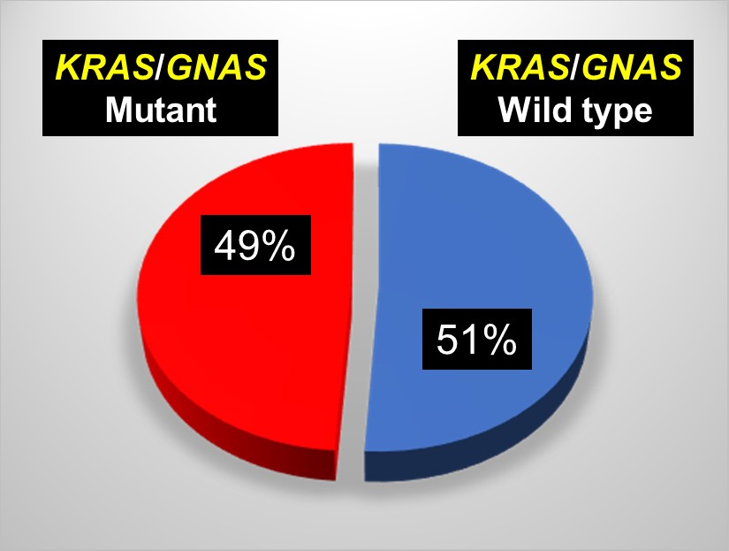
Future Directions
Surveillance protocol for molecularly profiled pancreatic cysts (risk vs. early detection).
3,231,000
Number of Americans with a mucinous pancreatic cyst.
Notes:
One of the key issues with pancreatic cysts is that approximately half are mucinous cysts, as supported by the presence of KRAS and/or GNAS mutations within our study cohort.
In other words, approximately 50% of our patients are at risk for developing pancreatic cancer.
But very few will truly progress and, therefore, a more rationale and cost-effective approach to surveillance is needed.

Slide 60
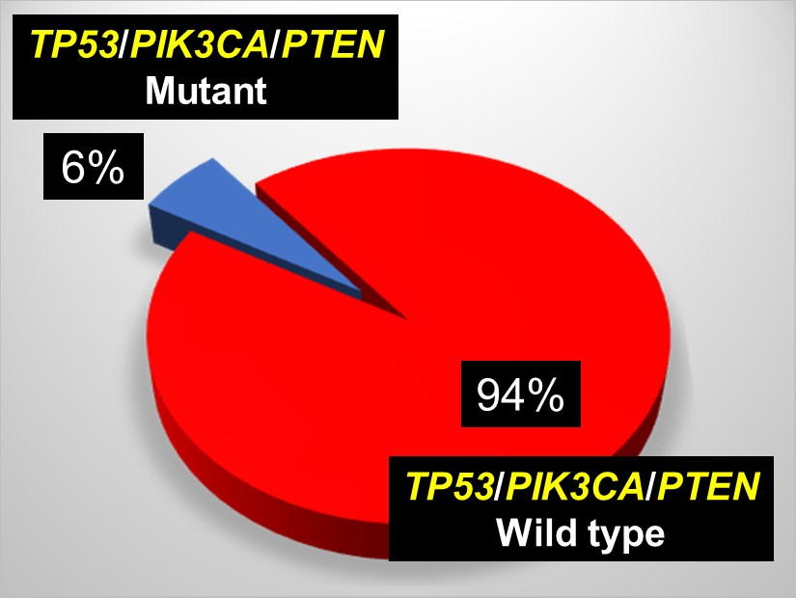
Future Directions
Surveillance protocol for molecularly profiled pancreatic cysts (risk vs. early detection).
387,720
Notes:
Mutations in p53, PIK3CA and PTEN were detected in 6% of pancreatic cysts and may represent a subset of pancreatic cysts that truly require follow-up as opposed to wild type cysts.
Rather than surveilling 3 million patients, it’s much more amenable to screen 400,000.

Slide 61
Future Directions
Surveillance protocol for molecularly profiled pancreatic cysts (risk vs. early detection).
Expansion and optimization of the multigene panel (PancreaSeqV2).
Integration of other testing modalities.
Creation of the Pancreatic Cyst Biomarker Alliance (PCBA).
Supported by the EDRN: Pancreatic Cyst Biomarker Validation Study.
Notes:
Certainly, improvements to our gene sequencing panel need to be made, especially with regards to MCNs and other cyst types.
The second version of this panel is slated to be released for clinical use in the next month and our hope is that it will demonstrate significant improvements over our first version.
But, to be honest, it’s unlikely that a single assay will truly succeed in making a dent in pancreatic cysts and pancreatic cancer.
And hence, the creation of the Pancreatic Cyst Biomarker Alliance or the PCBA, which is funded by the EDRN under the titled project: Pancreatic Cyst Biomarker Validation Study.

Slide 62








Pancreatic Cyst Biomarker Validation Study
Pancreatic Cyst Biomarker Alliance
Notes:
Briefly, the PCBA is composed of multiple investigators from 8 different academic institutions that either have access to large cohorts of pancreatic cyst fluid or

Slide 63
Pancreatic Cyst Biomarker Validation Study
Telomerase
Glucose
DNA Methylation Markers
PancreaSeq
Amphiregulin
Glycoproteins
Gastricsin
Das-1
Data Management Coordinating Center
Cathepsin E
Notes:
promising pancreatic cyst biomarkers that have been tested on over 100 specimens and show a sensitivity and specificity superior to standard CEA or cytology.

Slide 64
Pancreatic Cyst Biomarker Validation Study
Mucinous vs. Non-Mucinous Cysts
PancreaSeq
Glycoproteins
Amphiregulin
Glucose
Gastricsin
Cathepsin E
Presence vs. Absence of Advanced Neoplasia
PancreaSeq
DNA Methylation Markers
Das-1
Telomerase
Telomerase
Glucose
PancreaSeq
DNA Methylation Markers
PancreaSeq
Amphiregulin
Glycoproteins
Gastricsin
Das-1
Cathepsin E
>350 Pancreatic Cysts (w/ Dx Path)
Notes:
These markers can be subdivided into two types: CLICK
The first set are those that distinguish between mucinous versus non-mucinous pancreatic cysts. Once again, the importance of this distinction is that mucinous cysts have malignant potential while non-mucinous cysts do not.
And the 2nd set of markers are those that detect advanced neoplasia.
Certainly, there are biomarkers that can do both, but typically pancreatic cyst biomarkers have the ability to do one or the other. CLICK
Among cases to be tested, a total of over 350 pancreatic cyst fluid specimens have been contributed to this endeavor from the participating institutions – all with confirmed diagnostic pathology.

Slide 65
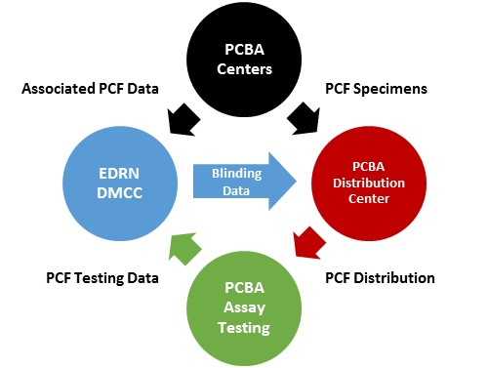
Pancreatic Cyst Biomarker Validation Study
Ying Huang, PhD
Randall Brand, MD
Jackie Dahlgren, PhD
Notes:
The overall scheme of this project is quite simple.
The PCBA centers submit pancreatic cyst fluid specimens to the designated distribution center, which is under the direction of Dr. Randall Brand at UPMC.
Separately the corresponding diagnoses are sent to the EDRN Data Management and Coordinating Center under the direction both Drs. Ying Huang and Jackie Dahlgren.
All specimens prior to distribution to the individual PCBA investigator labs for testing will be blinded.
And, all attempts have also been made to minimize resending specimens to the PCBA investigator that were originally contributed by the PCBA investigator’s home institution.
Finally, upon completion of assay analysis, the PBCA investigator lab will submit both binary prediction results and raw data to the EDRN DMCC to assess performance characteristics of individuals assays.

Slide 66
Pancreatic Cyst Biomarker Validation Study: Phase 2
Phase 1
Preclinical Exploratory
(Exploratory studies to identify biomarkers)
Phase 2
Clinical Assay and Validation
(Determine capacity of discriminating biomarkers))
Phase 3
Retrospective Longitudinal
(Testing of longitudinally collected cohorts)
Accrue additional biomarkers and sites.
Future specimen types: pancreatic juice, serum, urine and stool.
Notes:
The purpose of this study is to move past the preclinical exploratory phase of biomarker development CLICK
And into a true phase 2 clinical validation study CLICK
With the eventual goal of moving on to a phase 3 study with those markers that demonstrate solid performance over current routine clinical assays. CLICK
Lastly, I’d like to end by underscoring that this is a very open and collegial group with the intent to accrue additional sites, investigators, biomarkers and not only cyst fluid but eventually other specimen types, such as serum, urine and stool.

Slide 67
Randall Brand, MD
Marina Nikiforova, MD
N. Paul Ohori, MD
Sara Monaco, MD
Herbert Zeh, MD
Amer Zureikat, MD
Kevin McGrath, MD
Jennifer Chennat, MD
Kenneth Fasanella, MD
Asif Khalid, MD
Kenneth Lee, MD
Adam Slivka, MD PhD
Melissa Hogg, MD
Allan Tsung, MD
J. Wallis Marsh, MD
Ying Huang, PhD
Walter Park, MD
Michael Goggins, MD
Charles Craik, PhD
Koushik Das, MD
Brian Habb, PhD
Notes:
and on that note, I’m happy to take any questions.

Slide 68
Randall Brand, MD
Marina Nikiforova, MD
N. Paul Ohori, MD
Sara Monaco, MD
Herbert Zeh, MD
Amer Zureikat, MD
Kevin McGrath, MD
Jennifer Chennat, MD
Kenneth Fasanella, MD
Asif Khalid, MD
Kenneth Lee, MD
Adam Slivka, MD PhD
Melissa Hogg, MD
Allan Tsung, MD
J. Wallis Marsh, MD
Ying Huang, PhD
Walter Park, MD
Michael Goggins, MD
Charles Craik, PhD
Koushik Das, MD
Brian Habb, PhD

