Slide 1
Approaches to Improving DNA Methylation Detection
Meeting the Requirements for Early Detection
Team:
James G. Herman, MD PI (University of Pittsburgh)
Jeff T.H. Wang, PhD Co-PI (Johns Hopkins University)
David Wilson, MD Clinical Co-I (University of Pittsburgh)
Jian-Min Yuan, MD, PhD Population Based Co-I (University of Pittsburgh)
Benda Diergaarde, PhD Epidemiology Co-I (University of Pittsburgh)
Sanja Dacic, MD Pathology Co-I (University of Pittsburgh)
Tom Pisanic, PhD Biomedical Engineering Co-I (Johns Hopkins)
Notes:
1

Slide 2
DNA Methylation contributes to the progression of carcinogenesis
by silencing of tumor suppressor genes
DNA Methylation As a Cancer Biomarker
Pros: Cons:
Stability of DNA
Frequency of Changes ? Drivers of malignancy
Timing of alteration Cancer vs. Tissue Specificity
Ease of Detection Requires Modification
Sensitivity of Detection DNA Degradation
Heterochromatin Meth Heterogeneity
Enrichment
2
2
Notes:
vas
2

Slide 3
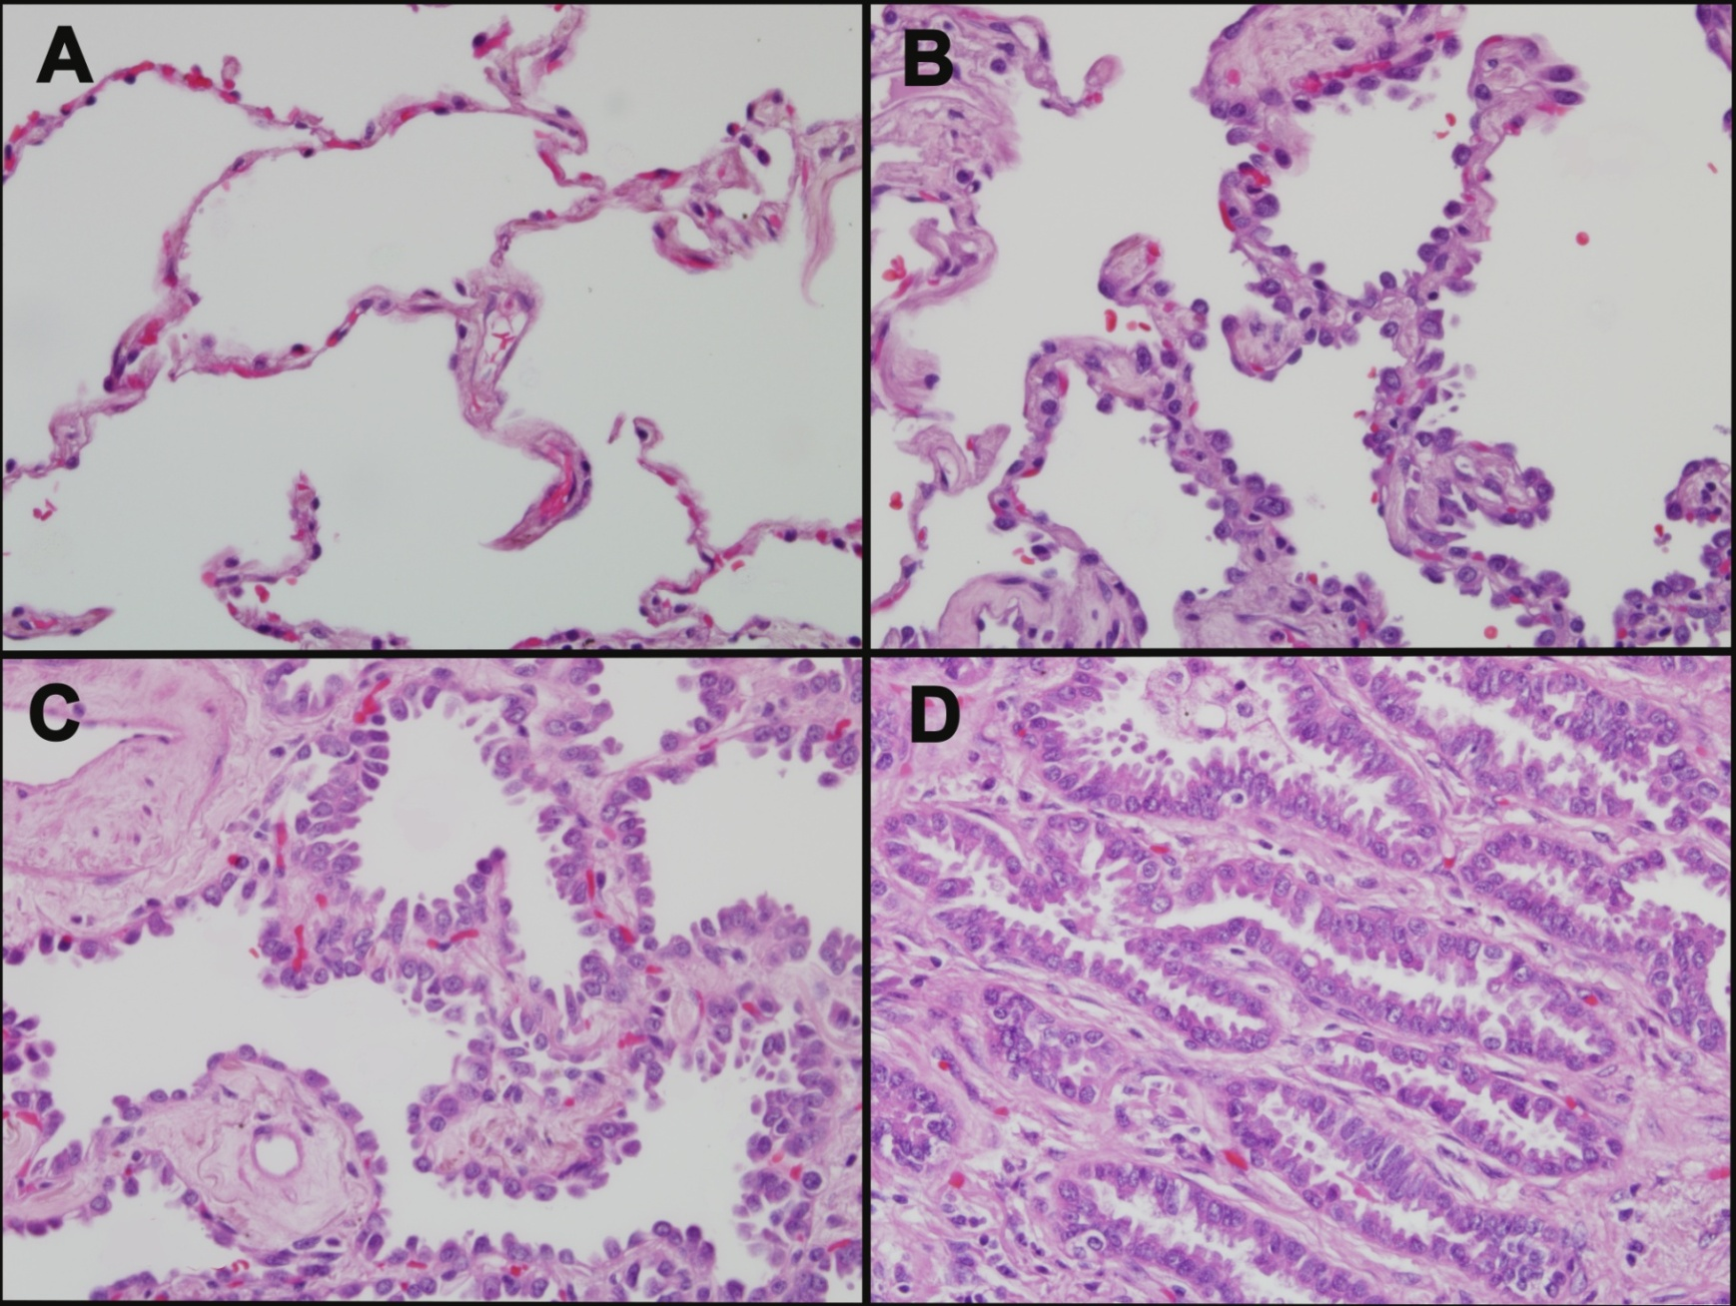
Epigenetic Changes underlie Cancer Progression
Normal Lung
Low Grade AAH
High Grade AAH
Adenocarcinoma
Methylation
events
RARβ1
Tert
DapK
p16
ASC
RassF1a
MGMT
APC
RUNX3
LKB1
WIF1 DKK1 DKK3
SFRP2 SFRP 1, 4, 5
(Licchesi et al, Clinical Cancer Research, 2008)
(Licchesi et al, Oncogene, 2008)

Slide 4
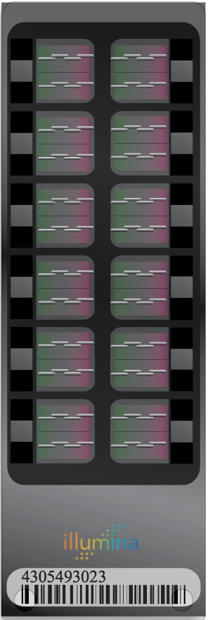
Methods of Determining Methylation Patterns Following Bisulfite Modification
CTGACGATTCCGGCTGAGA
UTGAUGATTUUGGUTGAGA
NaHSO4
CTGA^{m}CGATTC^{m}CGGCTGAGA
UTGA^{m}CGATTU^{m}CGGUTGAGA
PCR
with primers specific for
methylation changes
Unmethylated
Methylated
C T A G
C T A G
Amplification and
Array detection
(Illumina)
Amplification and
Sequencing
Unmethylated/modified
template
Methylated/modified
template
TTGATGATTTTGGTTGAGA
TCGATGATTTCGGTTGAGA
Unmodified
template
U M U M U M

Slide 5
Detection of aberrant promoter methylation in tumor and serum from resectable NSCLC patients
Nor: Normal
Tum: Tumor
Ser: Serum
U: Unmethylated
M:Methylatyed
(Esteller et al, Cancer Research, 1999)
Aberrant methylation of at least one gene was detected in 15 of 22 (68%) NSCLS tumors
Abnormal methylated DNA was detected in 11 of 22 (50%) in serum samples.
Challenges: sensitives reach a plateau of detection, typically at best of 60%
Analytical sensitivity of MSP is ~ 0.1% of detecting methylated among otherwise unmethylated DNA.
Single gene/assay sensitivities are often lower given the lack of presence of individual loci in some patients

Slide 6
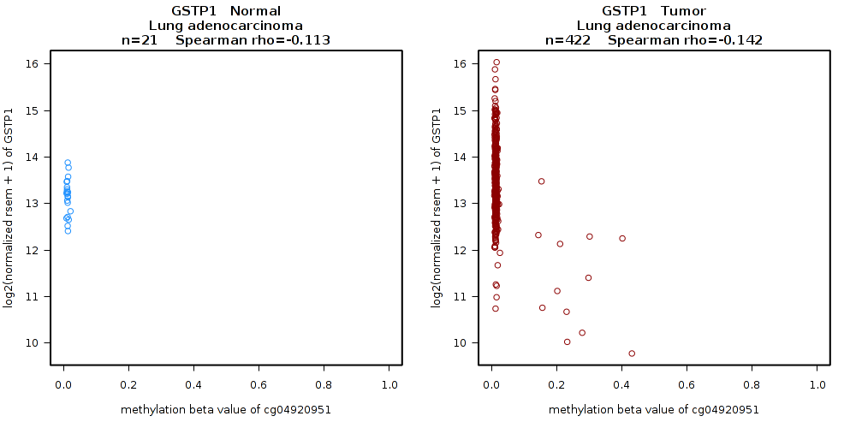
GSTP1 Promoter Hypermethylation
in Prostate and Lung Adenocarcinoma

Slide 7
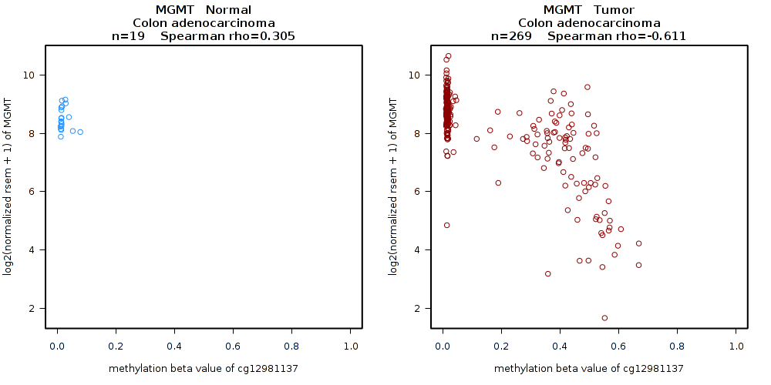
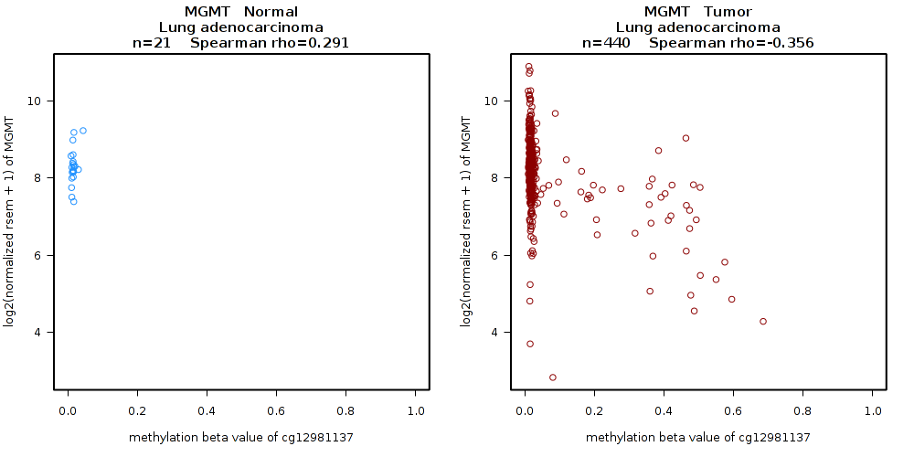
MGMT Promoter Hypermethylation
in Colon and Lung Adenocarcinoma

Slide 8
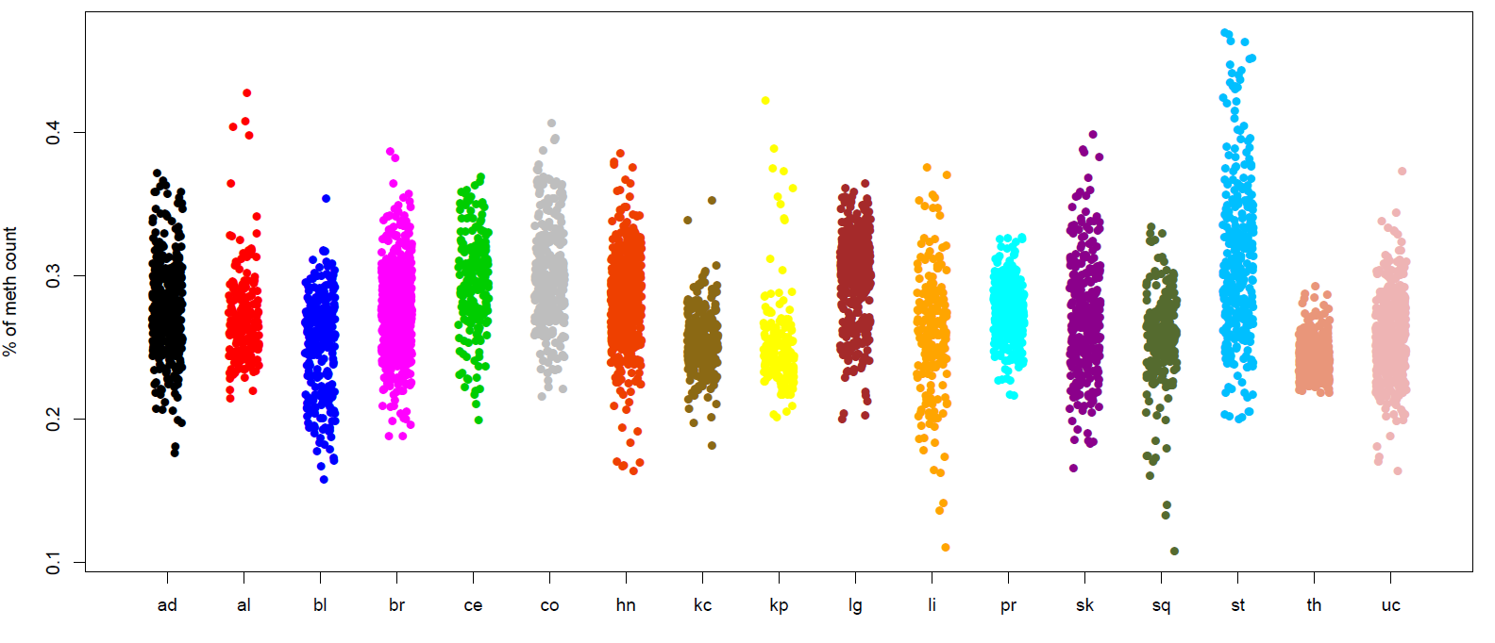
Promoter region Methylation Silencing events
According to tumor type
2900 Genes with Silencing among 17 tumor types

Slide 9
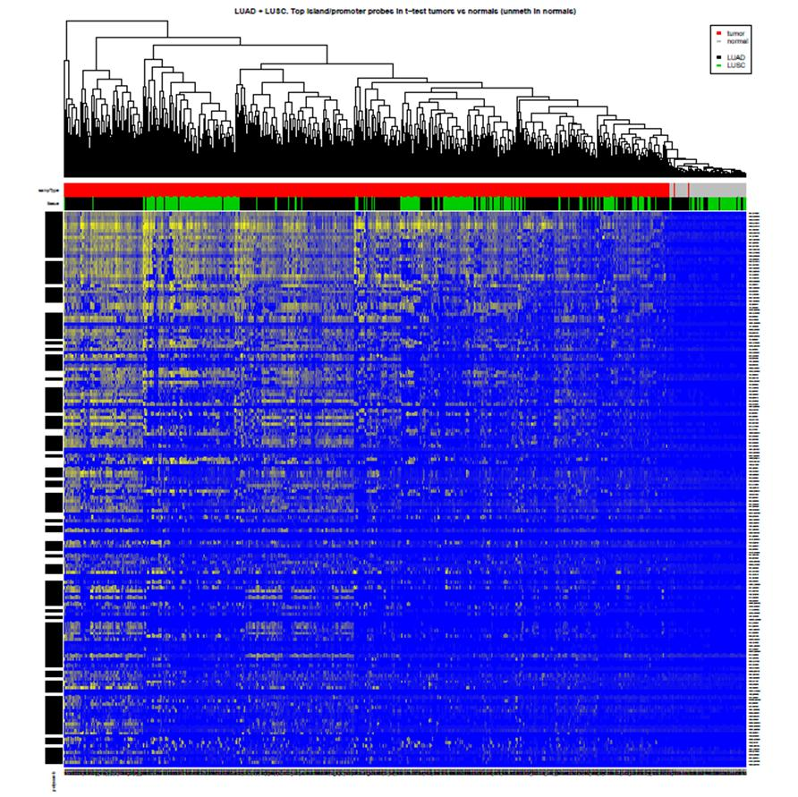
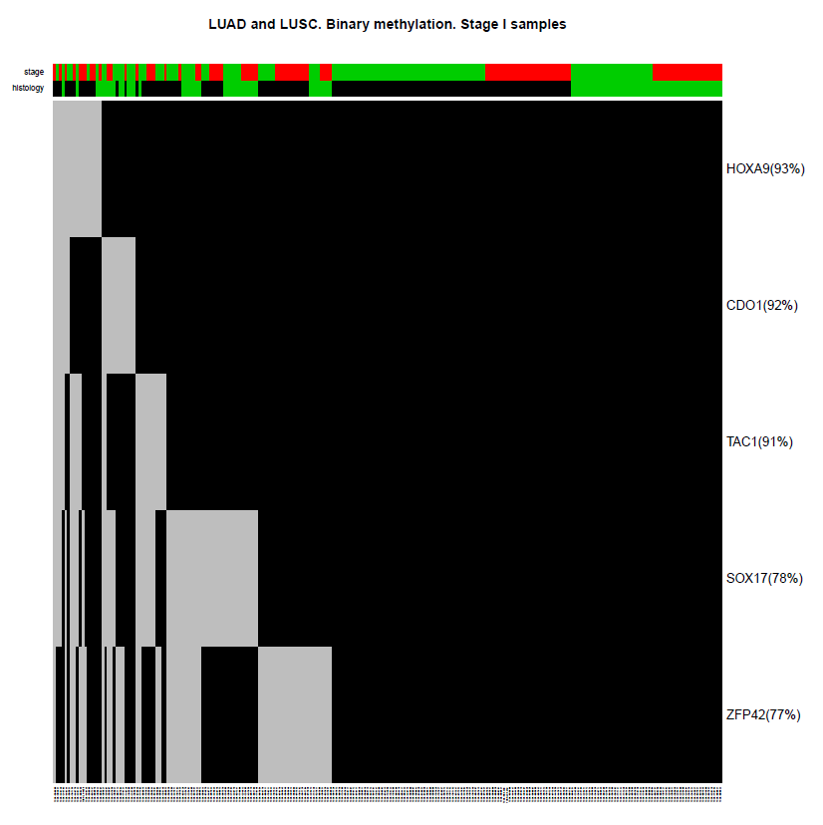
Highly Prevalent Tumor Specific Methylation in Lung CA:
TCGA Tumors and Normal
Sample
Histology
Methylation status
Sample
Histology
Methylation status
Tumor
Normal
Adenocarcinoma
Squamous carcinoma
IA
IB
Adenocarcinoma
Squamous carcinoma
Methylated
Unmethylated
0
1
HOXA9(93%)
CDO1(92%)
TAC1(91%)
SOX17(78%)
ZFP42(77%)
tumor
normal
(Wrangle et al, Clinical Cancer Research, 2014)
Notes:
-

Slide 10
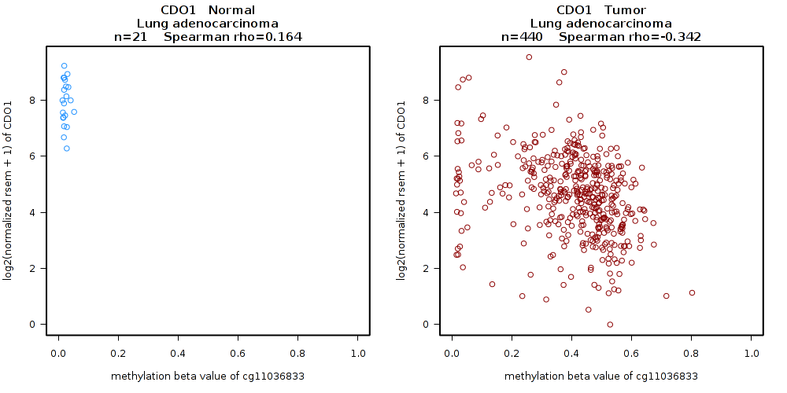
CDO1 Methylation: Cancer Specific Silencing in Lung Cancer
Potential Driver Methylation

Slide 11
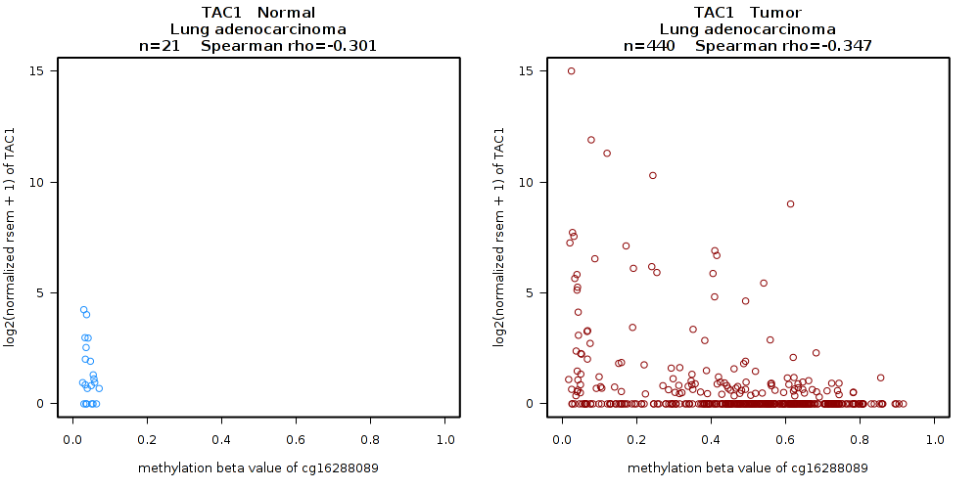
TAC1 Methylation: Cancer Specific DNA Methylation
Baseline inactive gene in Lung Cancer
Passenger Methylation
Still potential Detection Biomarker
Tumor Specific Methylation

Slide 12
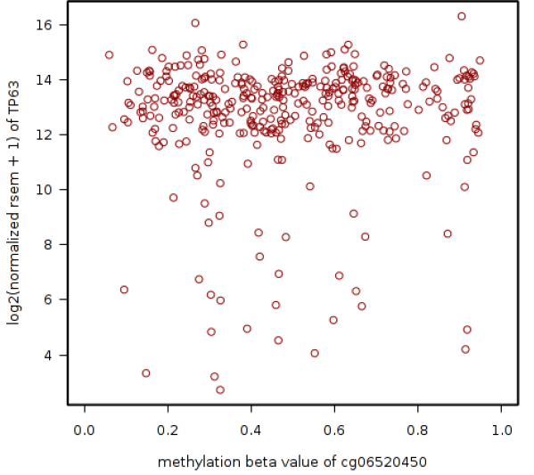
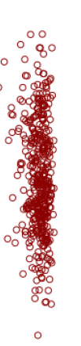
Methylation of p40 (p63) promoter---Tissue Specificity
Cell of Origin Epigenetic Determinant
Squamous
Adeno
Cell of Origin Methylation
Not a Detection Biomarker

Slide 13
Innovations Necessary for Ultrasensitive DNA Methylation Detection
Highly Prevalent Tumor Specific Methylation Defined for Lung CA
6 gene panel with individual 77-93% prevalence in stage I lung cancer
Wrangle et al, Clinical Cancer Research, 2014
Improved Sensitivity using Integrated Methylation Analysis
Problems of small DNA quantities, fragmentation and damage in processing
Net Result is ~25-100 fold improvement in amplifiable DNA
0.5-2 ml plasma
VJ Bailey et al, Clinical Chem, 2010, B Keeley et al, Clinical Chim Acta, 2013
Improved Methods for Detection
Next generation methylation detection
Bailey VJ et al, Genome Res, 2009, Pisanic II TR et al, NAR, 2015,

Slide 14
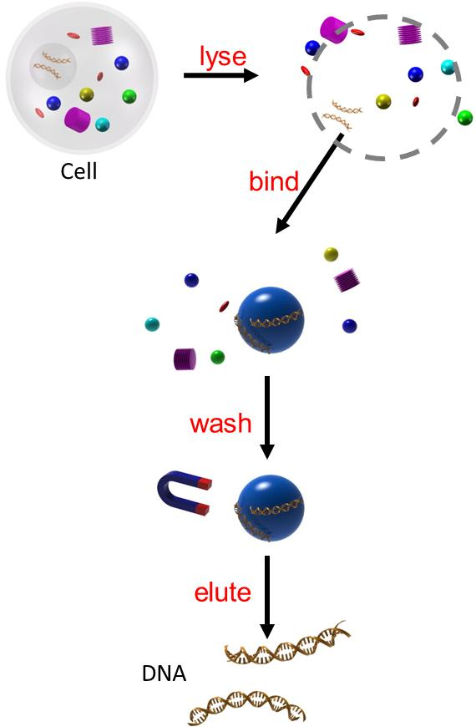
Integrate DNA Isolation and Bisulfite Conversion in a Single Tube Process Using Silica Superparamagnetic Particles
(Efforts funded through NCI CCNE)
Induced magnetic property in a magnetic field, easy for manipulation
Reversible DNA binding and desorption by tuning the buffer condition
Small size provides large surface area for DNA binding
Size varies from 10 nm to 1000 nm

Slide 15
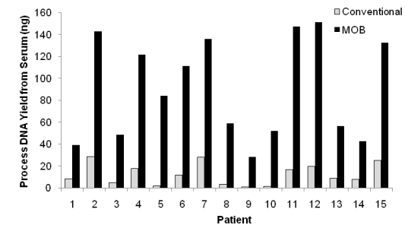
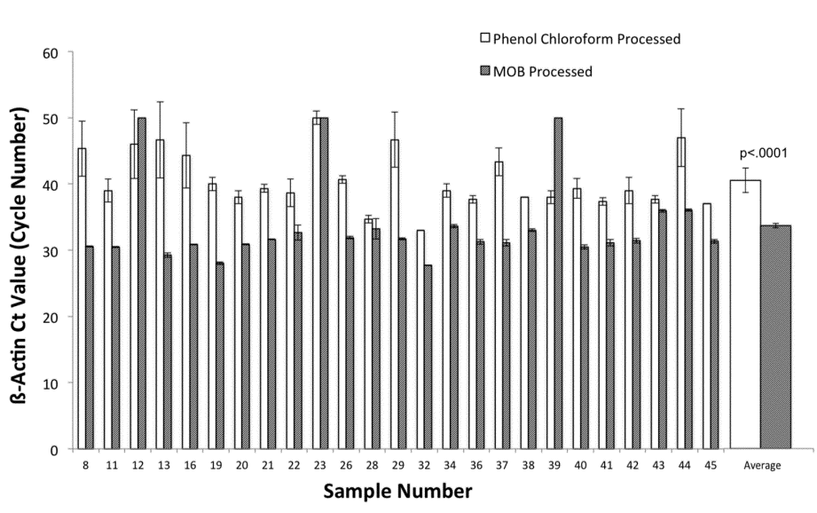
MOB Increases DNA Content Obtained from Serum in Cancer Patients
Scale up to 2 mL
Direct Measure of DNA Content
Bisulfite Modified Template Measured by Real-Time PCR
(VJ Bailey et al, Clinical Chem, 2010)
(B Keeley et al, Clinical Chim Acta, 2013)
Avg. Ct : 33.8 vs. 40.6 cycles (6.8 cycles)
Std Dev: 0.3 vs. 1.9 cycles
Net Result is ~100 fold improvement in amplifiable DNA

Slide 16
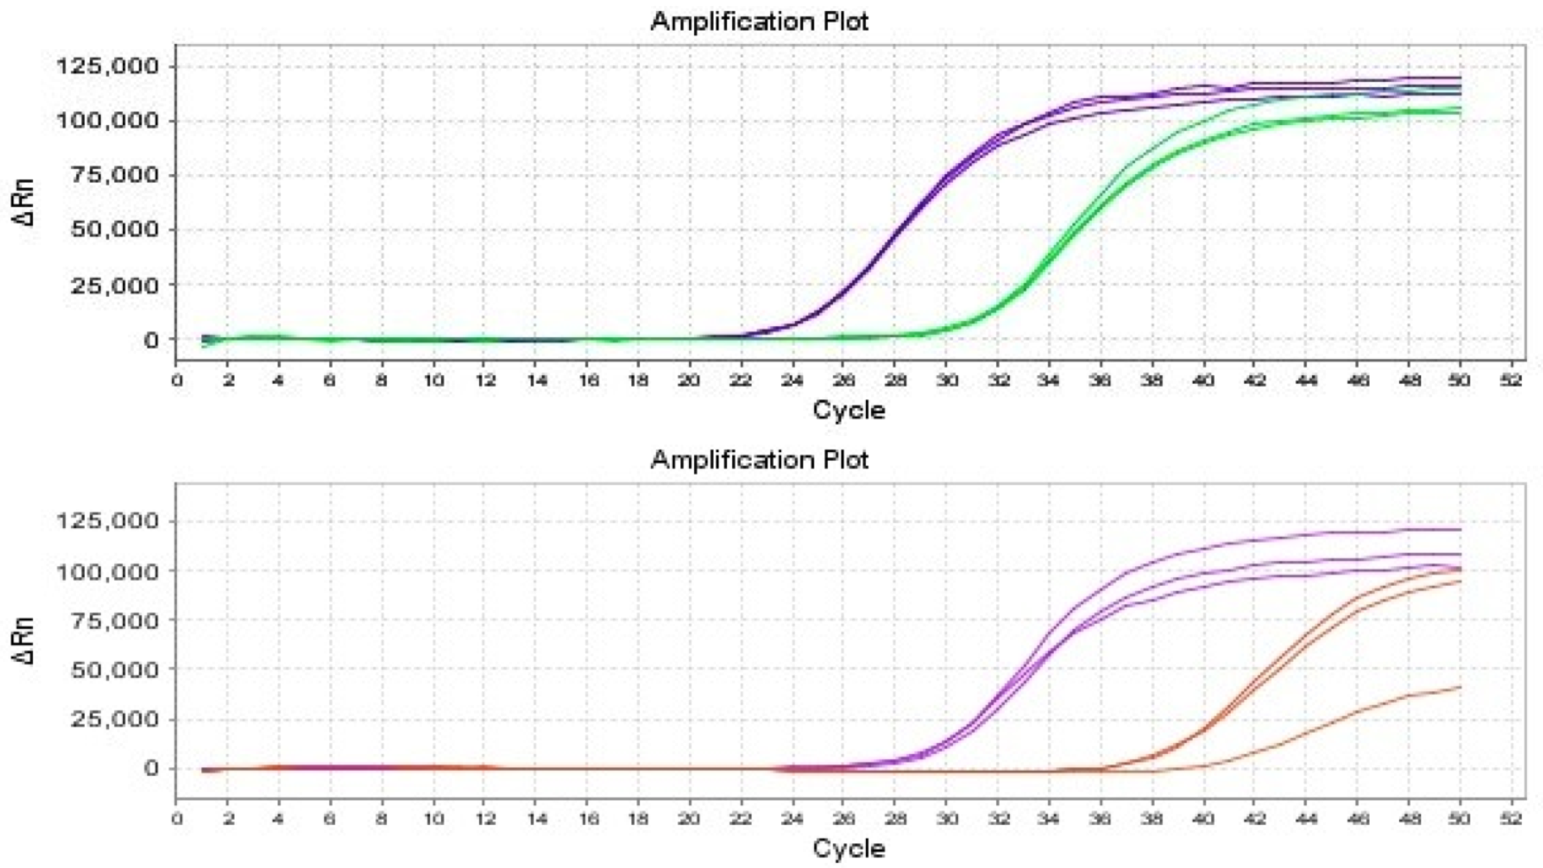
Methylation Detection in Plasma Samples
Pushing to the Limits of Detection
β-actin
SOX17
β-actin
CDO1

Slide 17
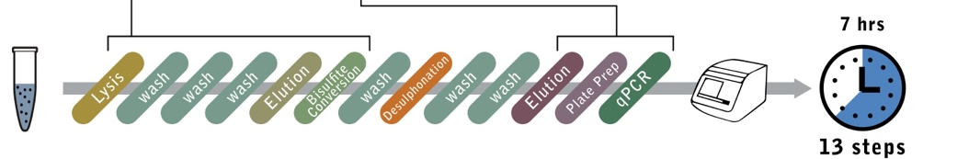
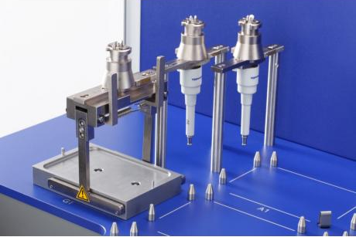
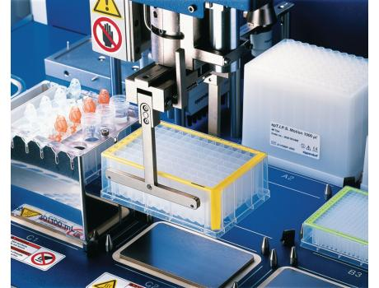
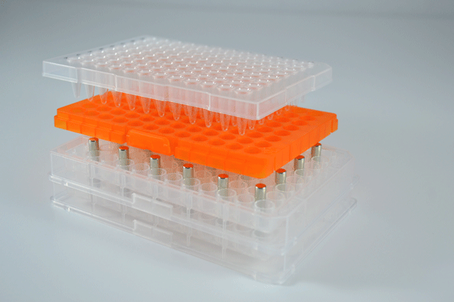
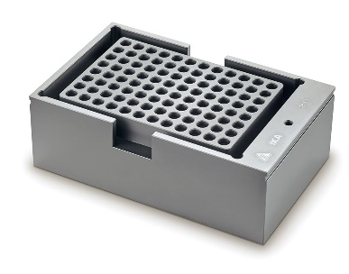
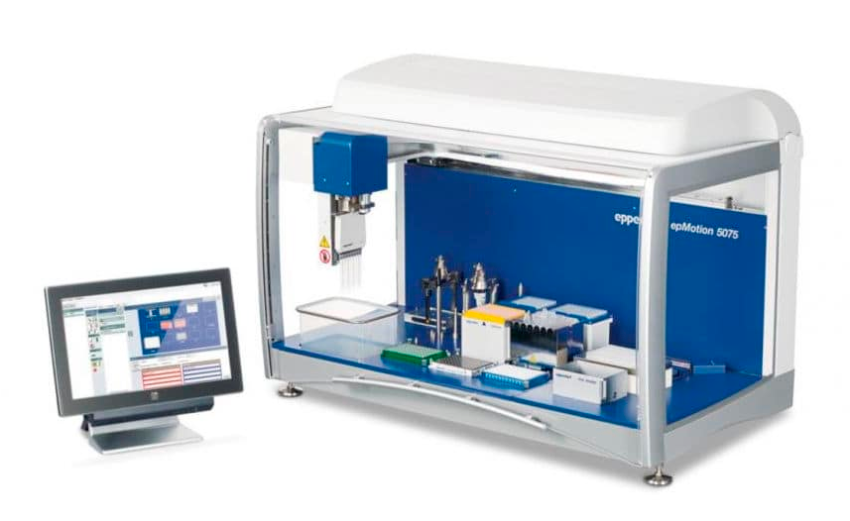
Implement MOB in a Robotic System
Streamlined DNA processing based on MOB
High-throughput, automated DNA processing
Liquid Handling:
Buffer addition and removal
PCR plate preparation
Gripper – transfer samples to:
Heater
Magnetic holder
Magnetic separation
Heater / shaker:
Incubation
Particle dispersion
Reagent mixing
Faster, user-free processing (7 hours)
Minimal contamination risk
Improved reproducibility

Slide 18
Methylation Detection in Plasma and Sputum
Early Stage (node negative, 91% stage 1)
Controls with surgically resected pulmonary noduleas
Blood | Sensitivity | Specificity | PPV | NPV | AUC | 95% CI
CDO1 | 65% | 74% | 86% | 46% | 0.68 | (0.58 - 0.77)
TAC1 | 76% | 78% | 90% | 57% | 0.78 | (0.70 - 0.86)
HOXA7 | 33% | 94% | 93% | 36% | 0.60 | (0.51 - 0.69)
HOXA9 | 81% | 52% | 81% | 52% | 0.62 | (0.52 - 0.73)
SOX17 | 71% | 86% | 93% | 54% | 0.78 | (0.70 - 0.86)
ZFP42 | 81% | 58% | 83% | 55% | 0.66 | (0.56 - 0.75)
CD01, TAC1, SOX17 | 91% | 64% | 86% | 74% | 0.77 | (0.68 - 0.86)
Sputum | Sensitivity | Specificity | PPV | NPV | AUC | 95% CI
CDO1 | 78% | 67% | 90% | 45% | 0.70 | (0.57 - 0.84)
TAC1 | 84% | 79% | 94% | 57% | 0.84 | (0.74 - 0.94)
HOXA7 | 63% | 92% | 97% | 40% | 0.77 | (0.67 - 0.86)
HOXA9 | 77% | 42% | 83% | 32% | 0.56 | (0.41 - 0.69)
SOX17 | 84% | 88% | 96% | 59% | 0.84 | (0.75 -0.94)
ZFP42 | 88% | 62% | 90% | 58% | 0.73 | (0.60 - 0.87)
TAC1, HOXA7, SOX17 | 93% | 79% | 94% | 75% | 0.89 | (0.80 - 0.98)

Slide 19
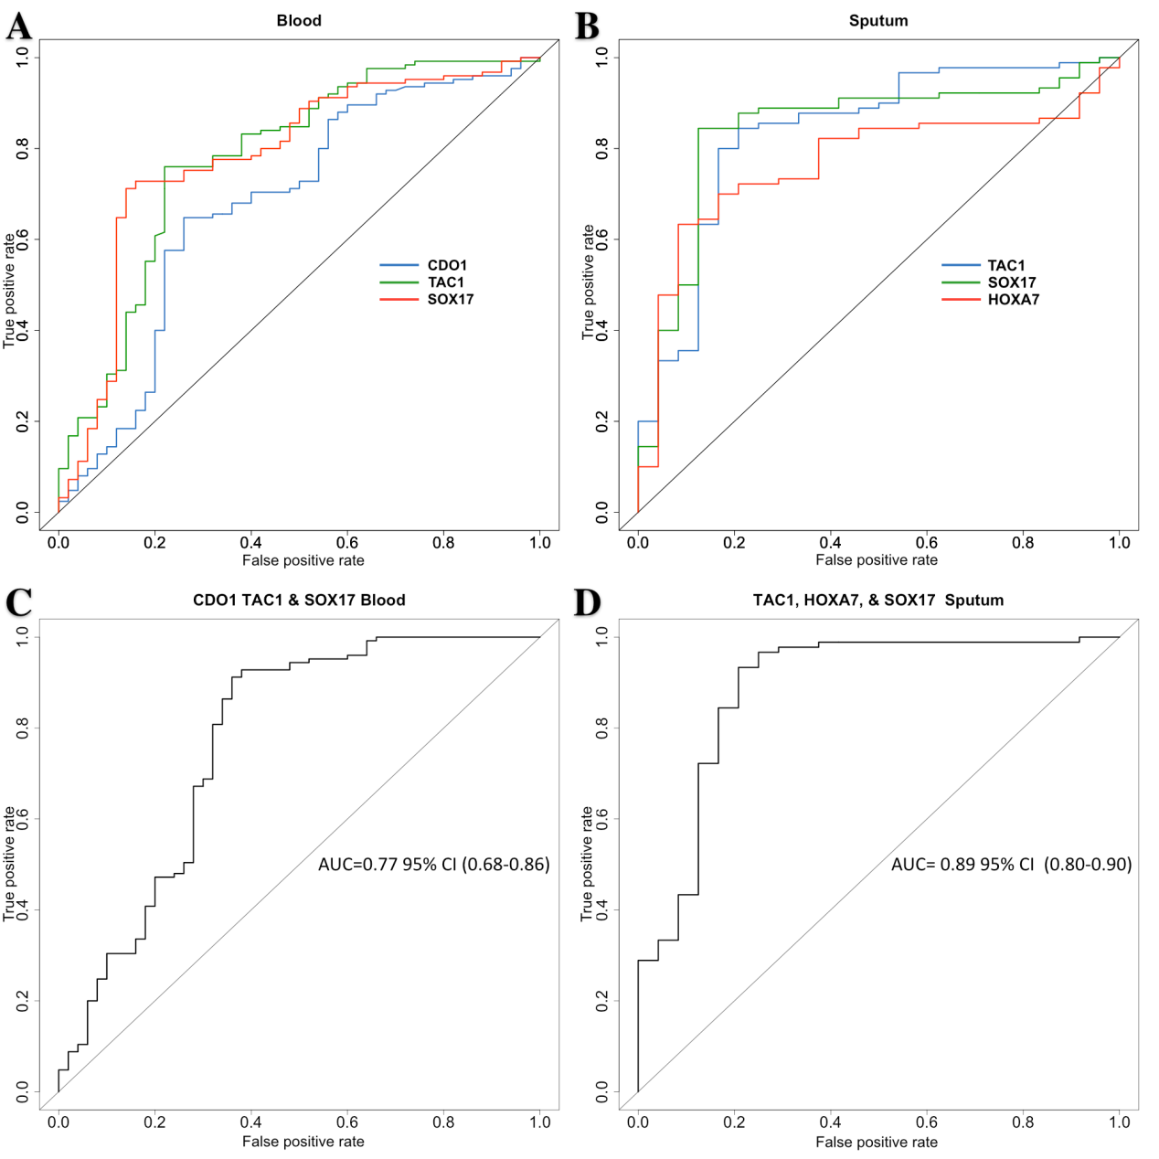
ROC curves for Methylation Detection in Plasma and Sputum

Slide 20
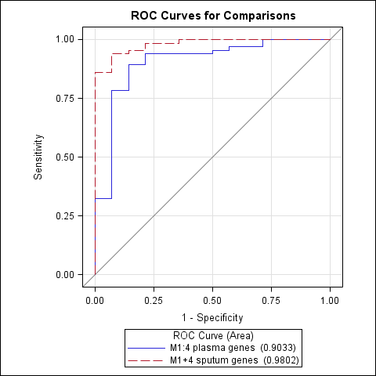
ROC Curves
Methylation Detection in Plasma and Sputum
Clinical AUC 0.64

Slide 21
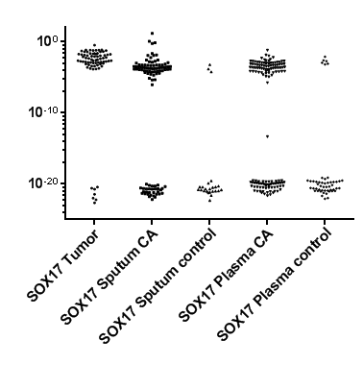
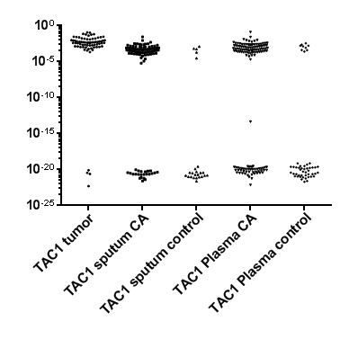
SOX17 and TAC1 Methylation Detection in
Tumor and Fluid Samples

Slide 22
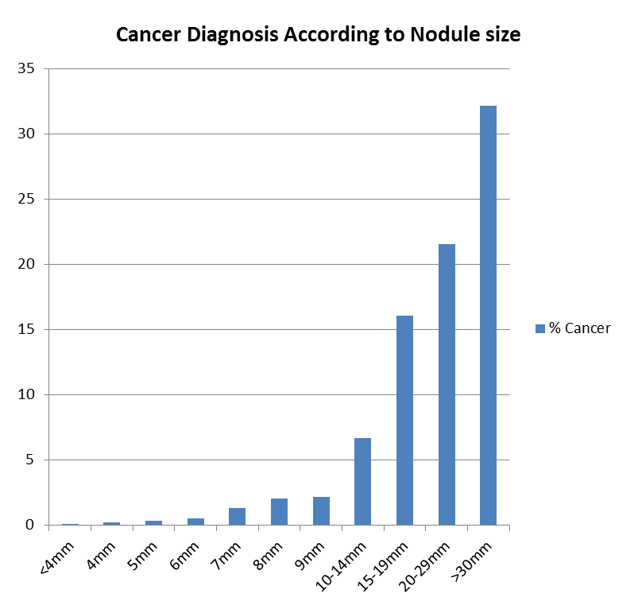
Problem of Intermediate Nodules
Cancer Risk
Data from Gierada et al, JNCI 2014

Slide 23
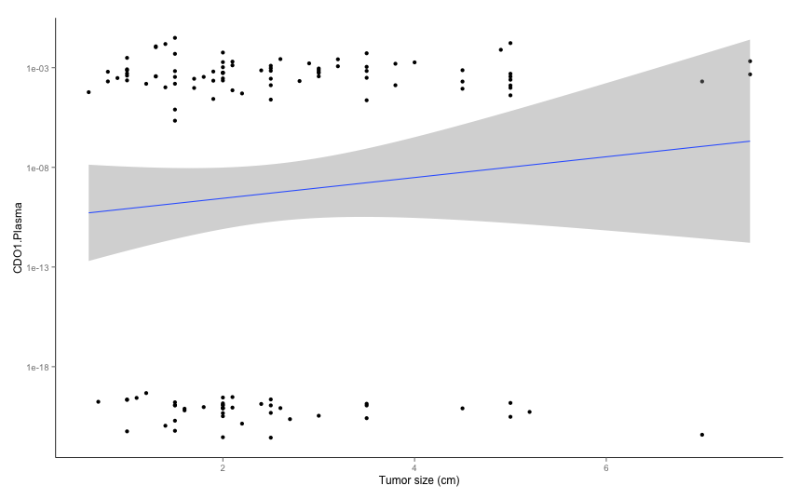
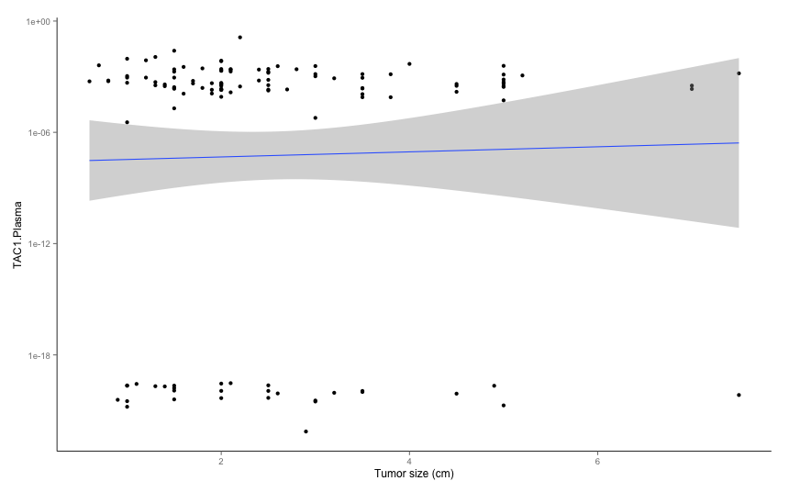
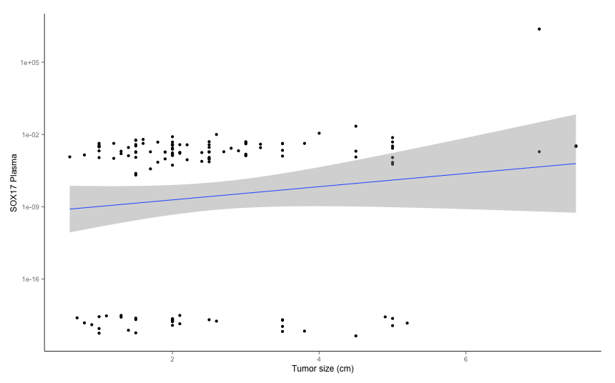
Quantity of Methylation Detection in Plasma According to Nodule/Tumor Size

Slide 24
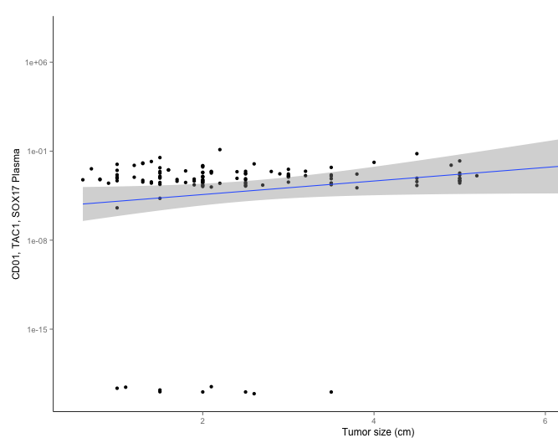
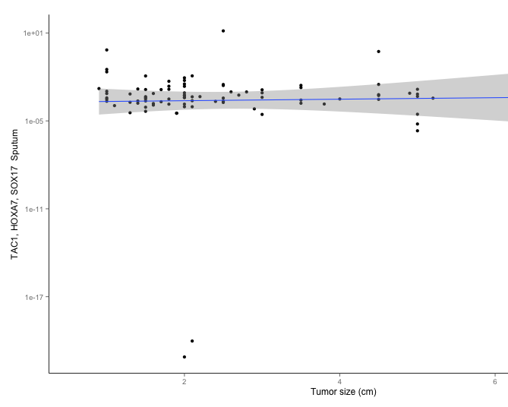
Methylation Detection According to Nodule/Tumor Size

Slide 25
Methods of Determining Methylation Patterns Following Bisulfite Modification
CTGACGATTCCGGCTGAGA
UTGAUGATTUUGGUTGAGA
NaHSO4
CTGA^{m}CGATTC^{m}CGGCTGAGA
UTGA^{m}CGATTU^{m}CGGUTGAGA
PCR
with primers specific for
methylation changes
Unmethylated
Methylated
C T A G
C T A G
Amplification and
Array detection
(Illumina)
Amplification and
Sequencing
Unmethylated/modified
template
Methylated/modified
template
TTGATGATTTTGGTTGAGA
TCGATGATTTCGGTTGAGA
Unmodified
template
U M U M U M

Slide 26
Methylation Detection
Methylation Specific PCR (MSP)
Primer
Primer
Methylated Specific
Probe
Unmethylated Specific
Probe

Slide 27
Methylation Detection
Methylation Specific PCR (MSP)
Primer
Primer
Methylated Specific
Methylated Specific
Probe
Unmethylated Specific
Probes

Slide 28
Methylation Detection Approaches to Heterogeneity
Methylation Specific PCR (MSP)
Methylation Sensitive HRM (MSHRM)
Methylated Specific
Methylation Preferred
Notes:
One of the main advantages of MS-HRM is the design and use of “methylation preferred” primers. By carefully optimizing primer design and assay parameters, DREAMing assays amplify all methylation patterns, including those that would otherwise be missed with MSP primers. This results is significantly improved analytic sensitivity to allow for the detection of individual epialleles.

Slide 29
Epigenetic Changes underlie Cancer Progression
Normal Lung
Low Grade AAH
High Grade AAH
Adenocarcinoma
Gene A
Gene B
Gene C

Slide 30
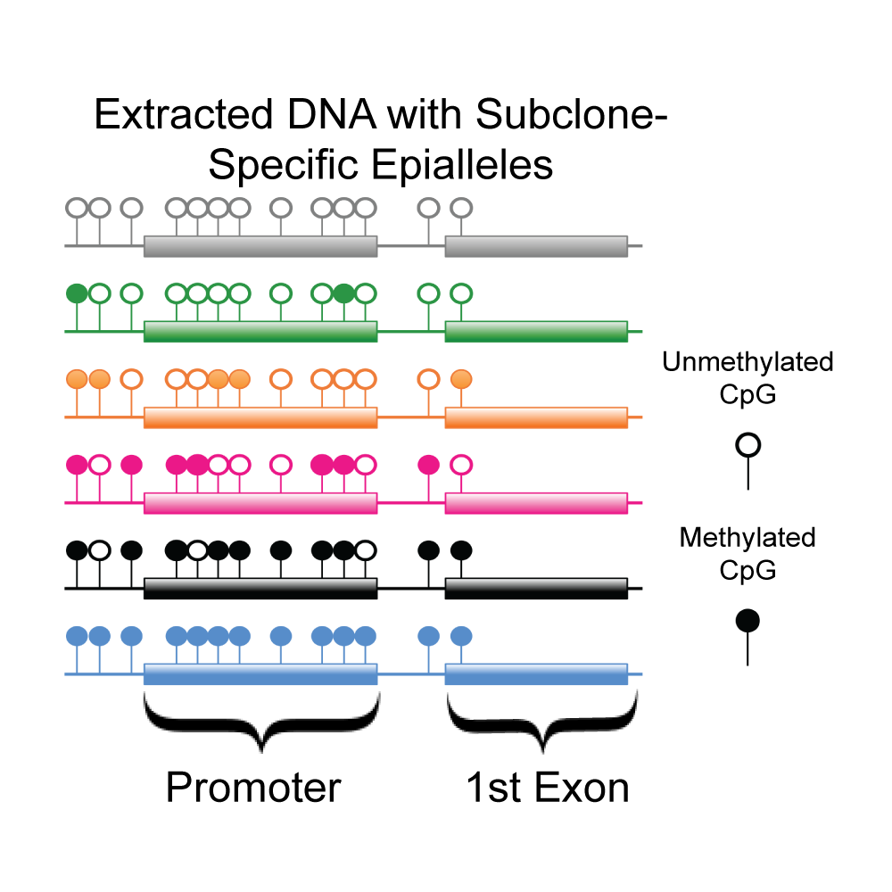
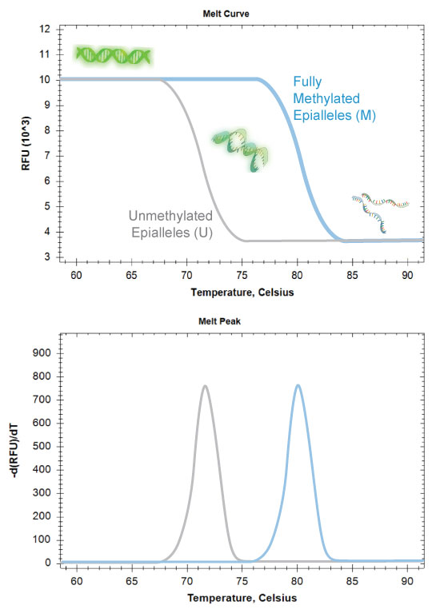
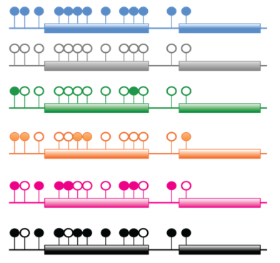
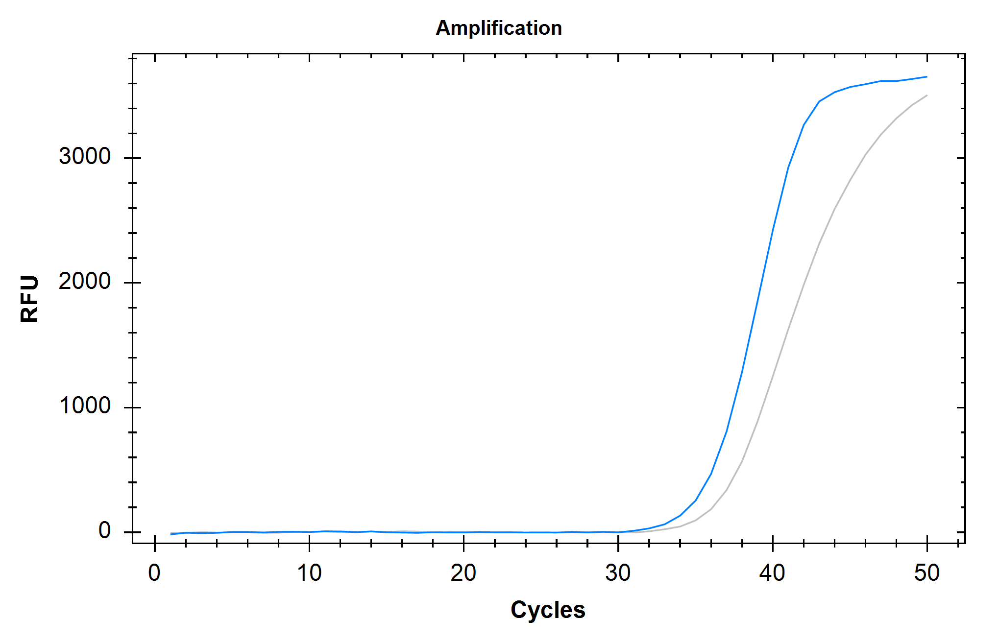
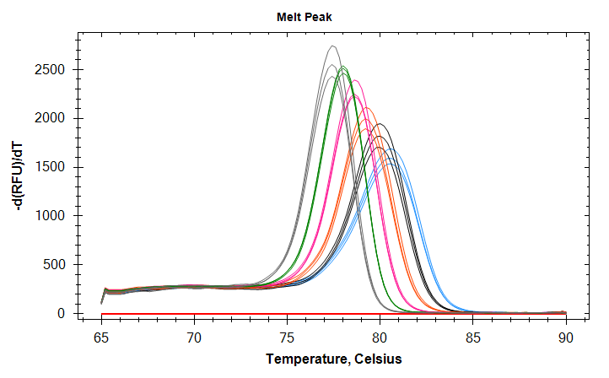
DREAMing Fundamentals
Methylation Preferred
Methylated DNA
Unmethylated DNA
ΔT_{m}
BRCA1
Pisanic II, et.al. Nucl. Acids Res. (2015)

Slide 31
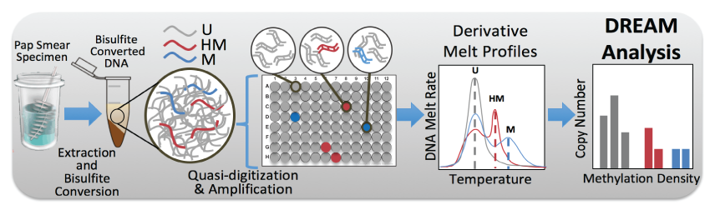
DREAMing Discrimination of Rare EpiAlleles by Melt

Slide 32
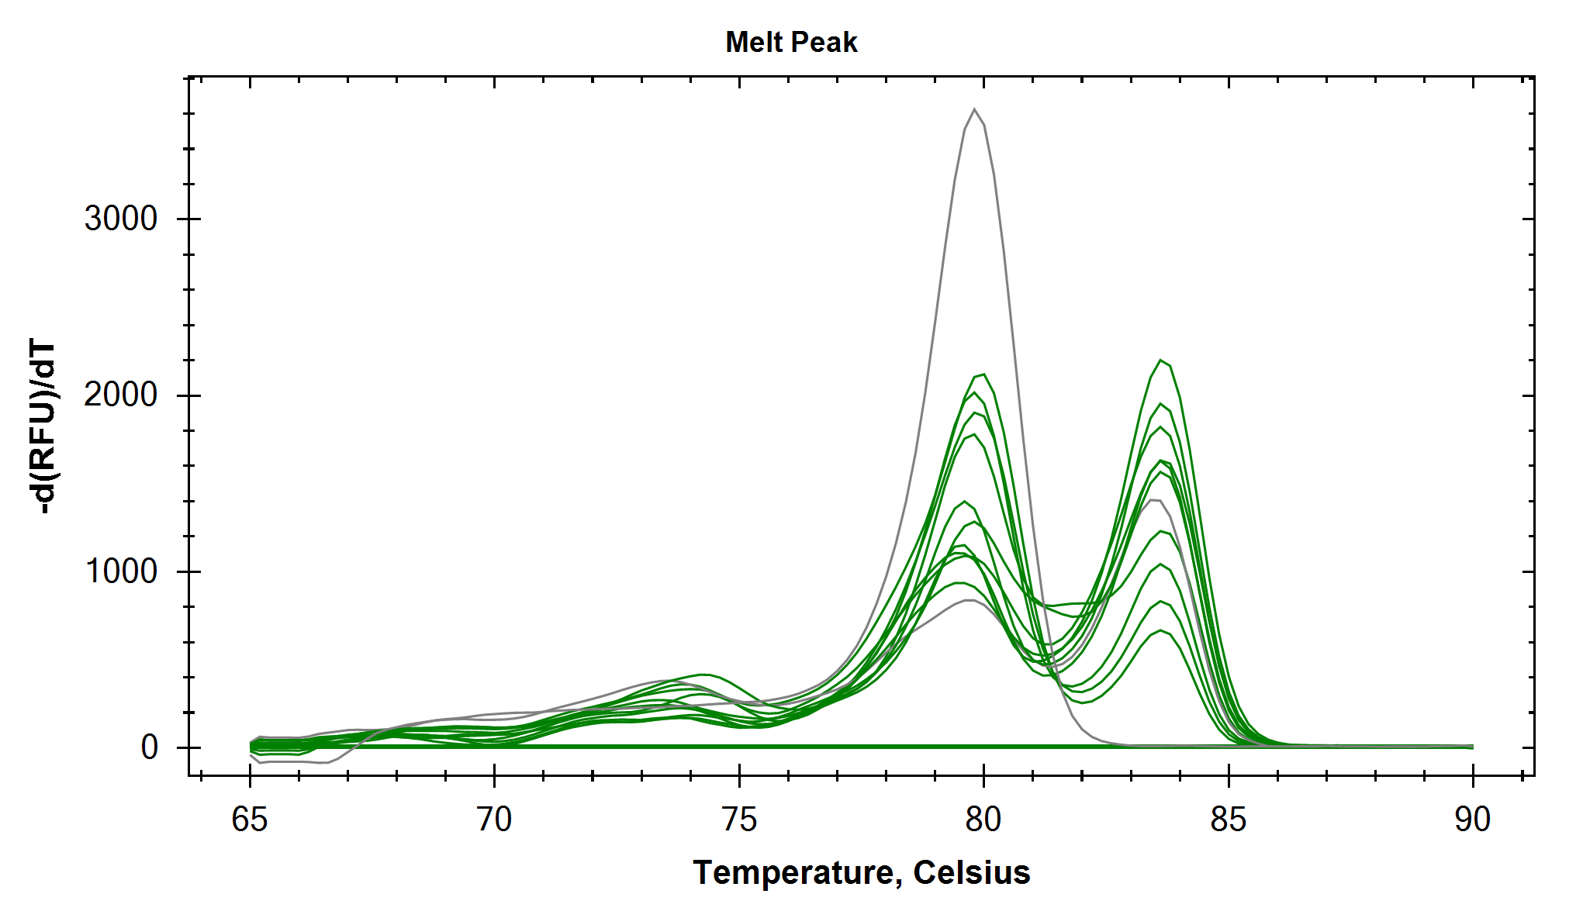
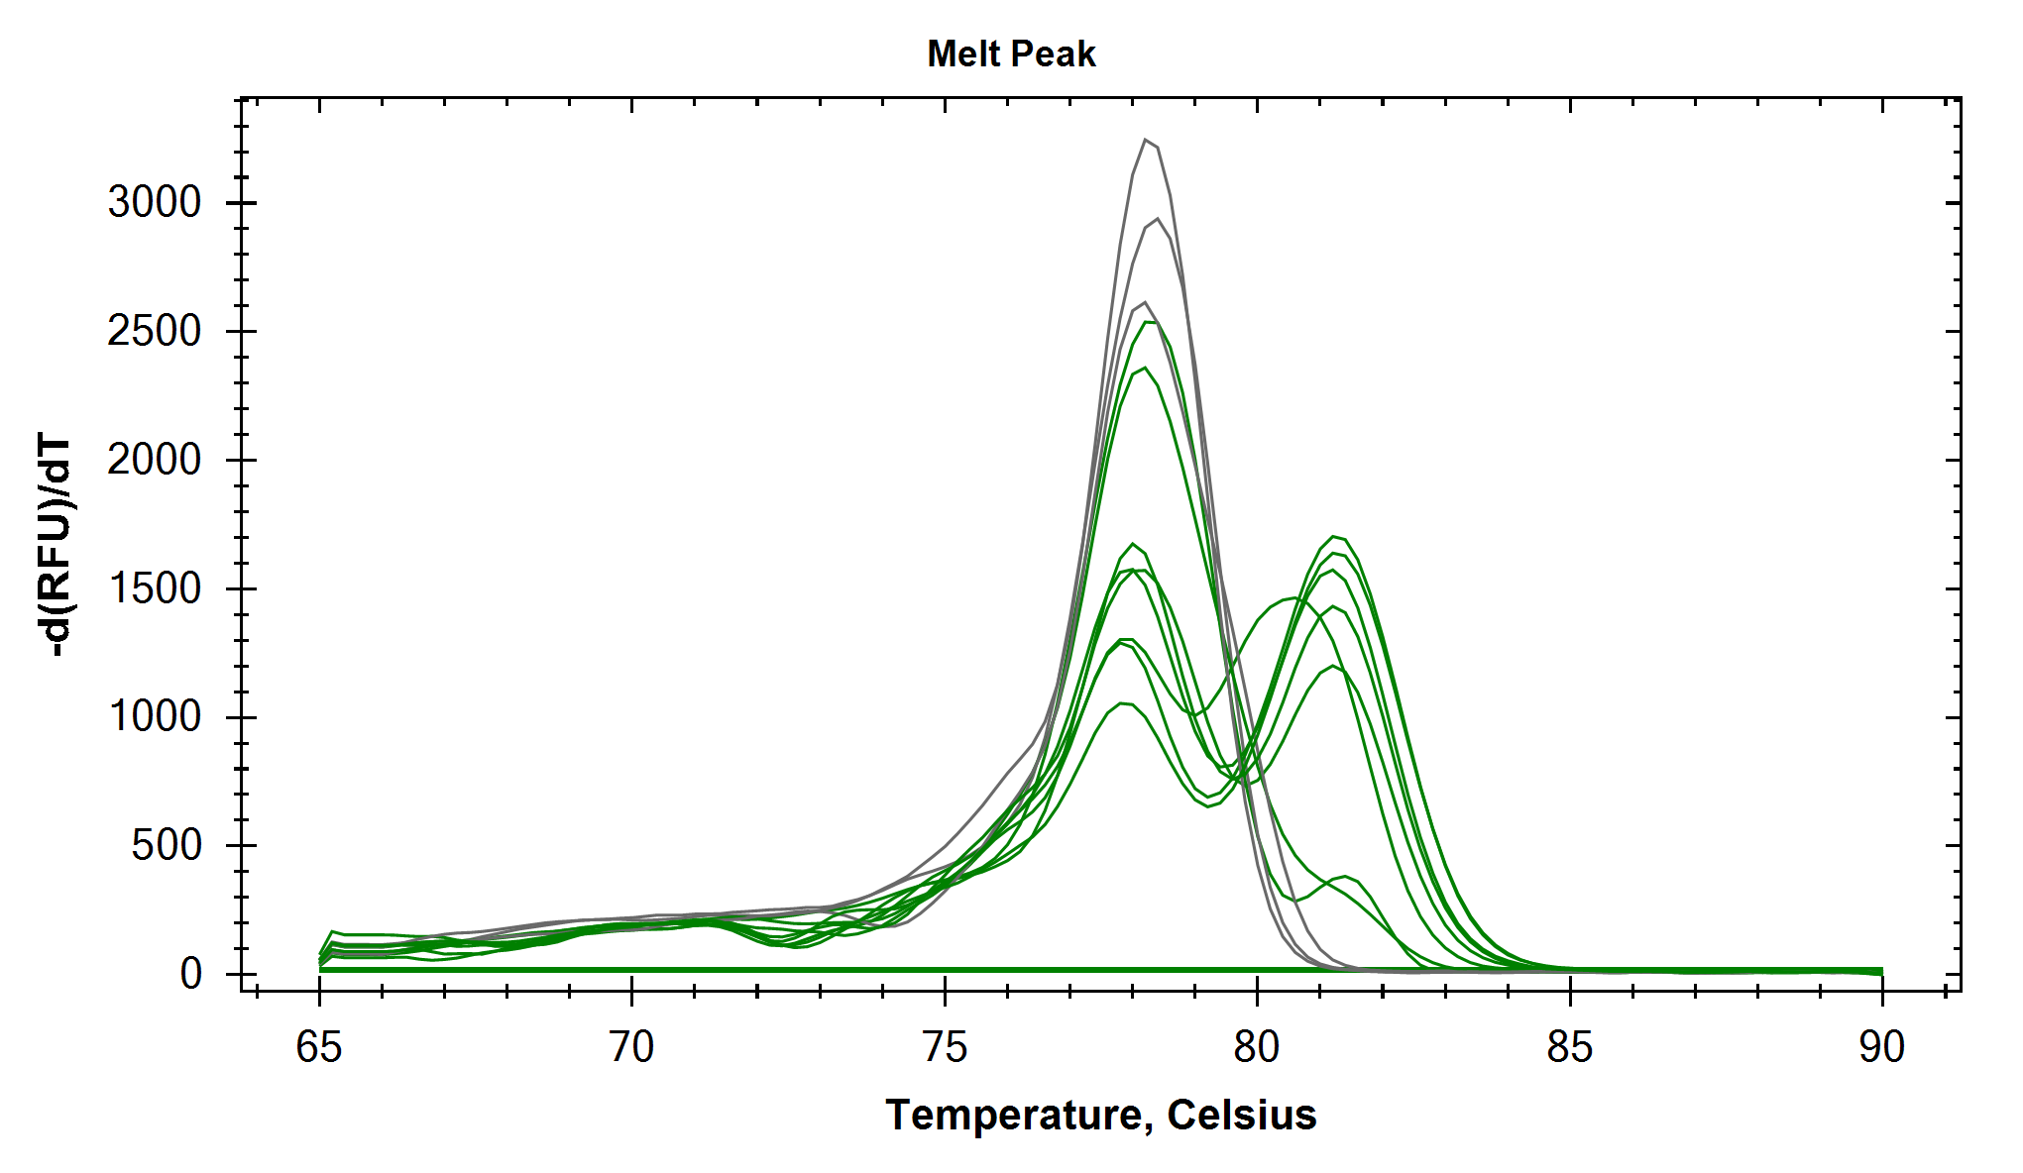
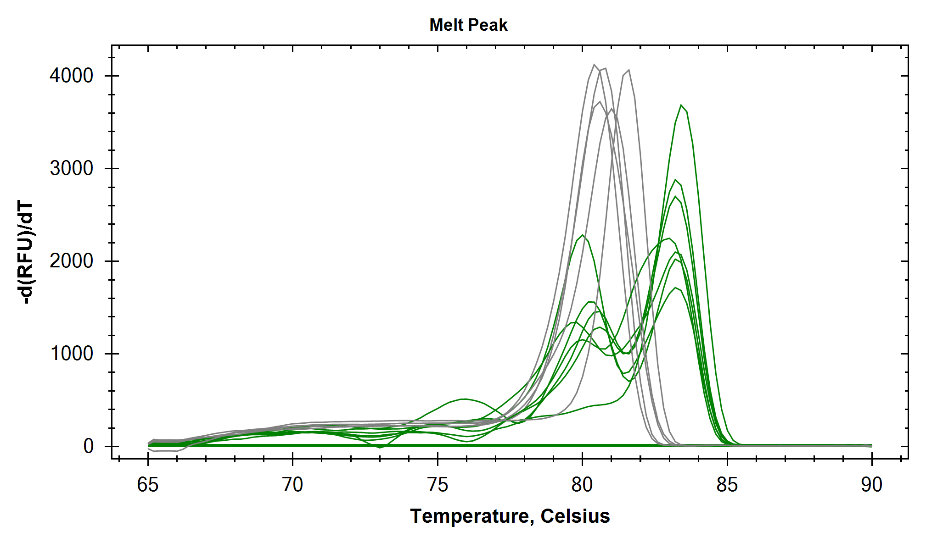
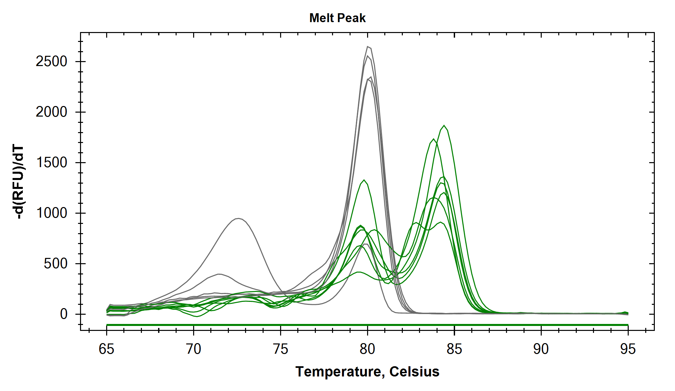
Lung Cancer DREAMing Assays
CDO1
10 of 6-10 estimated.
400 unmethylated genomes per well
SOX17
8 of 6-10 estimated.
400 unmethylated genomes per well
TAC1
7 of 6-10 estimated.
500 unmethylated genomes per well
HOXA9
7 of 6-10 estimated.
500 unmethylated genomes per well
Notes:
These plots demonstrate single molecule sensitivity for each of the target, showing detection of individual synthetic targets amongst 400-500 unmethylated bisulfite-treated genomic equivalents per well (12 wells total).

Slide 33
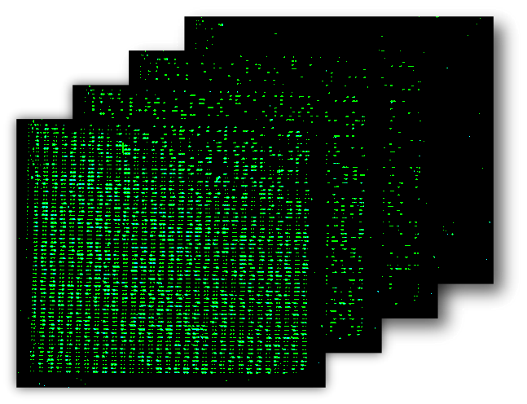
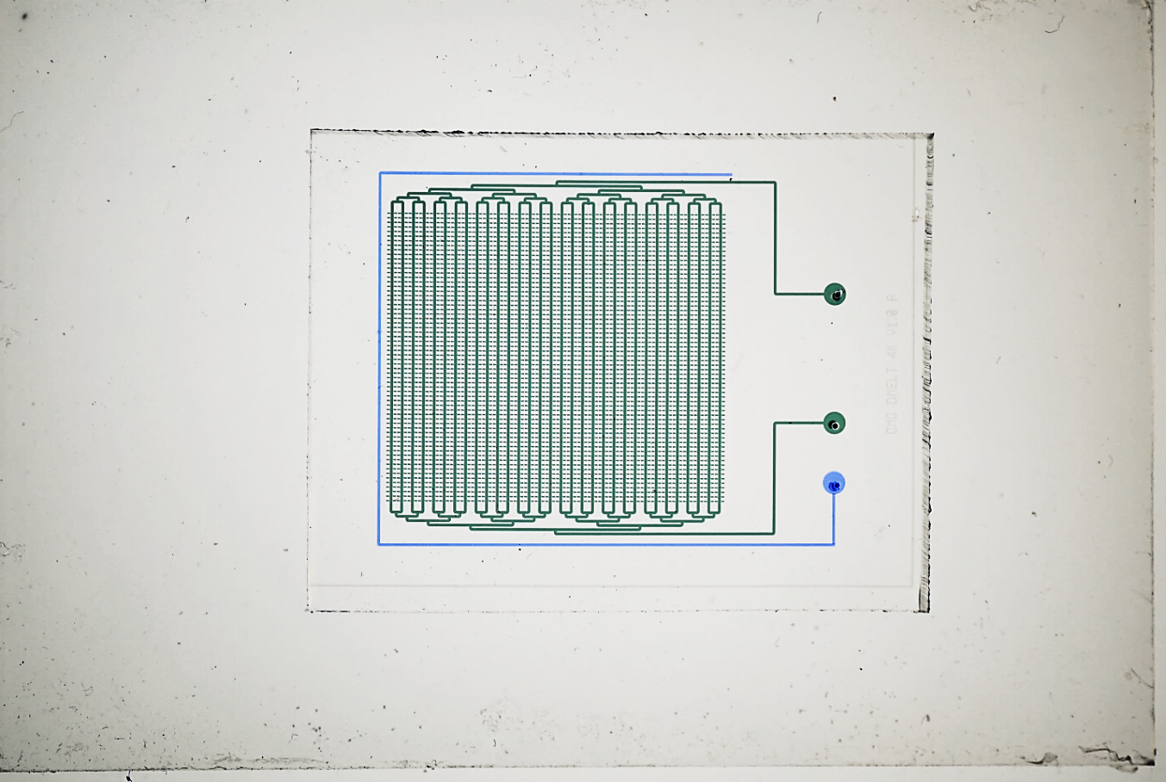
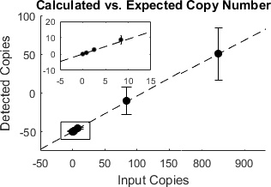
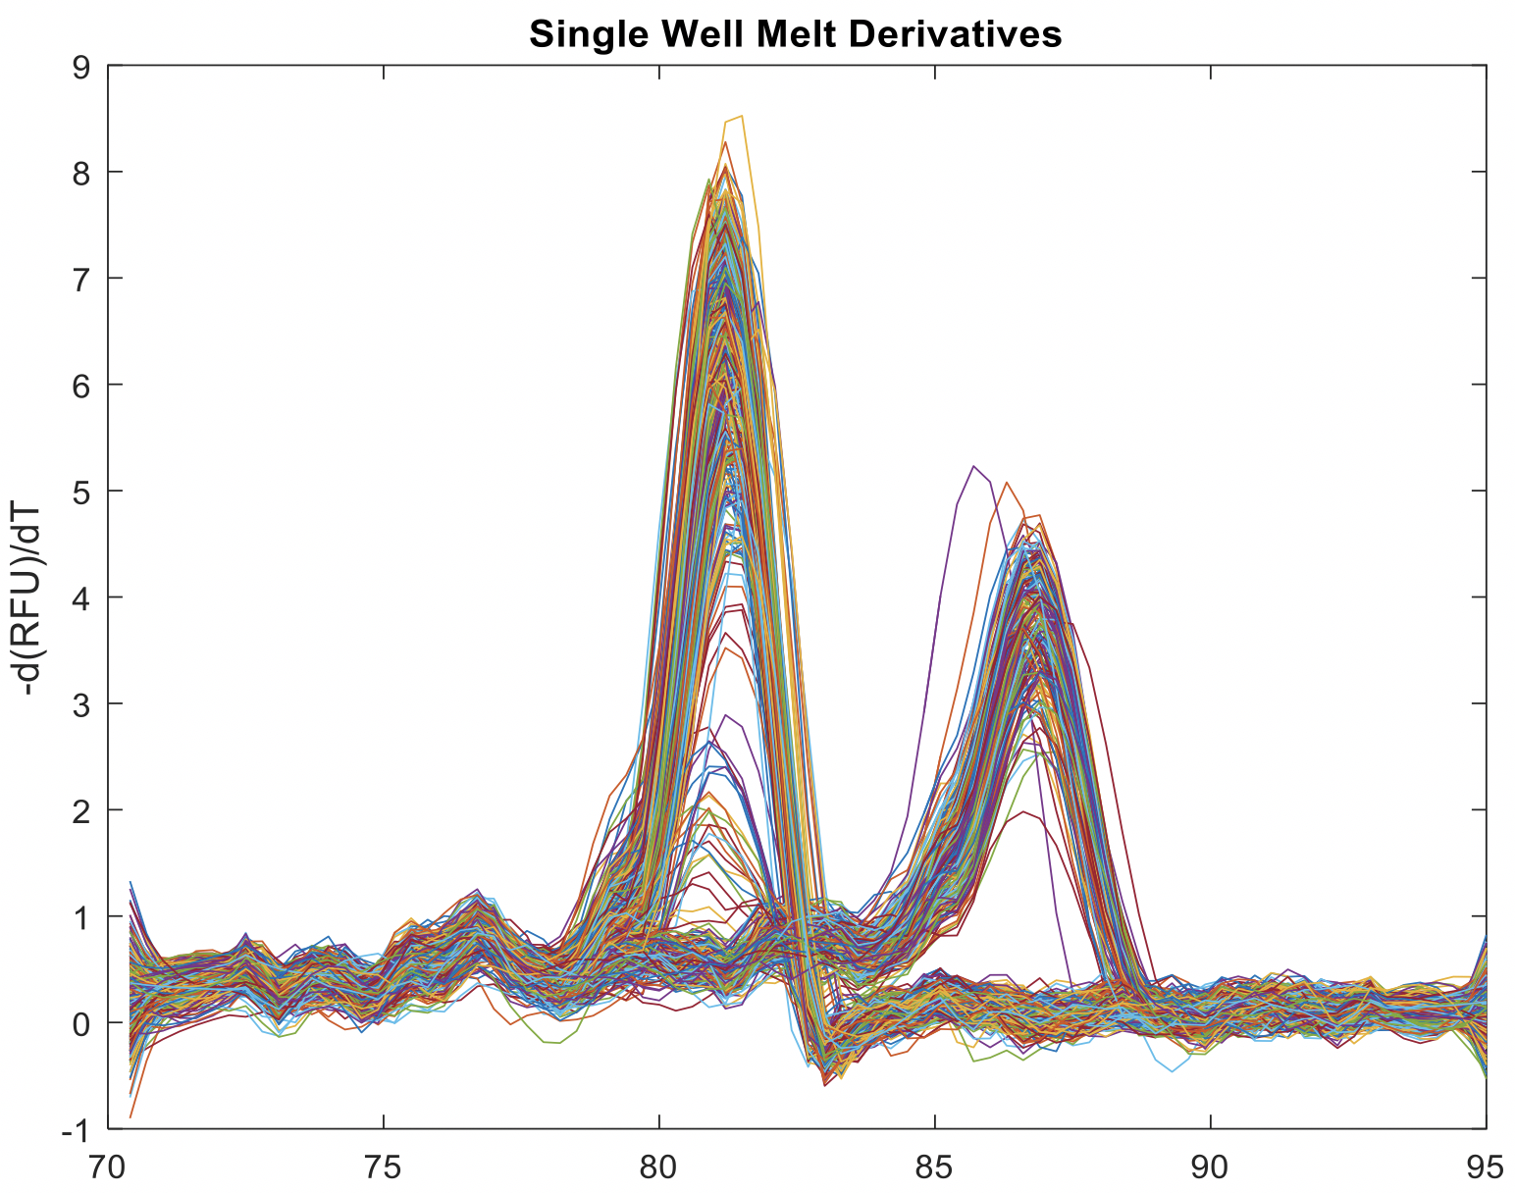
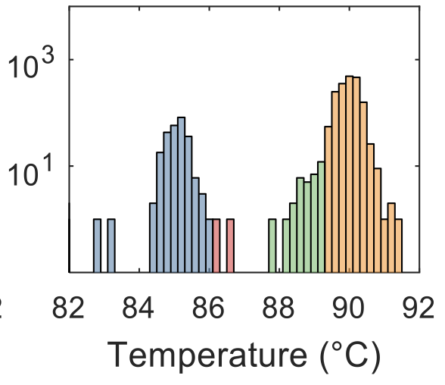
Microfluidics to Increase DREAMing sensitivity
(A)
(B)
Prototype 4096-well device
Inlet
Outlet
Increasing T
Hydration channel
(C)
(D)
Methylation (cfDNA)
Temperature

Slide 34
Approaches to Improving DNA Methylation Detection
Meeting the Requirements for Early Detection
Team:
James G. Herman, MD PI (University of Pittsburgh)
Jeff T.H. Wang, PhD Co-PI (Johns Hopkins University)
David Wilson, MD Clinical Co-I (University of Pittsburgh)
Jian-Min Yuan, MD, PhD Population Based Co-I (University of Pittsburgh)
Benda Diergaarde, PhD Epidemiology Co-I (University of Pittsburgh)
Sanja Dacic, MD Pathology Co-I (University of Pittsburgh)
Tom Pisanic, PhD Biomedical Engineering Co-I (Johns Hopkins)
Notes:
34

