Slide 1
Understanding the Landscape of DCIS
Laura J. Esserman, MD, MBA
Michael Campbell, PhD
CONFIDENTIAL
DRAFT

Slide 2
Lessons Learned from Invasive Cancer

Slide 3
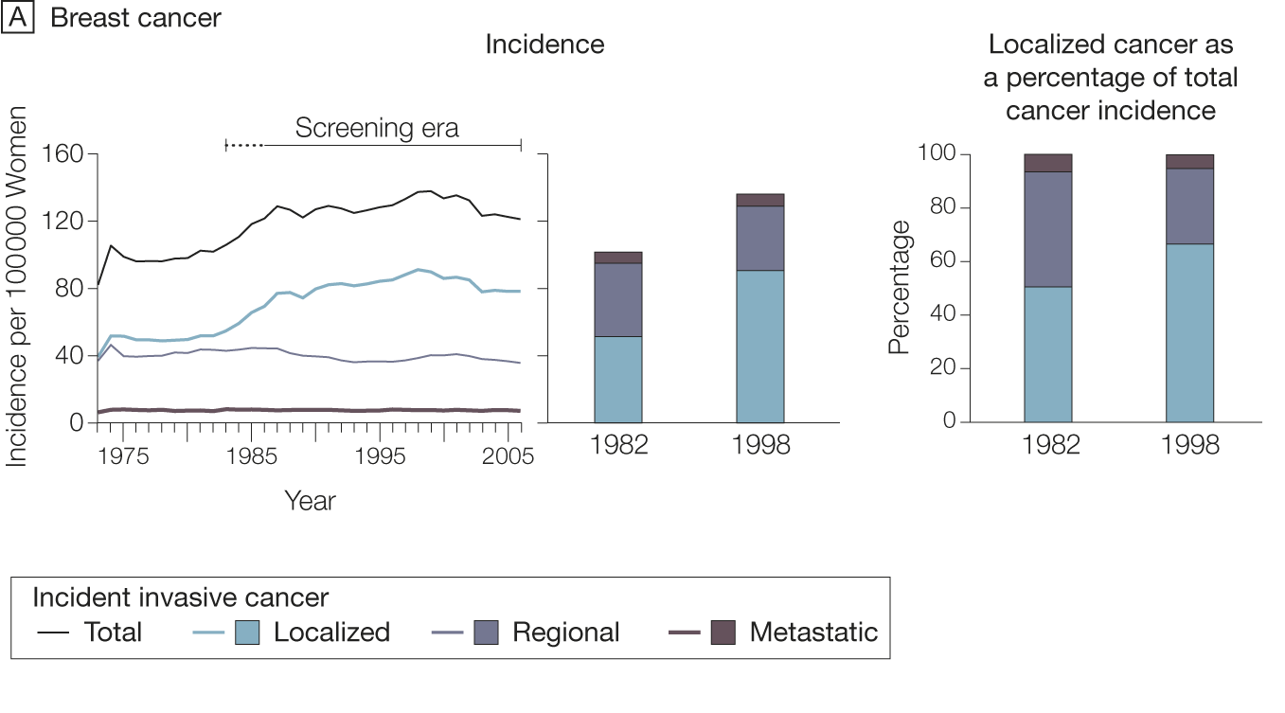
Increase in breast cancer rates driven by detection of early (localized) cancers
Esserman JAMA 2009
Notes:
Keeping in mind that schematic, it is easy to understand what is happening with screening and BC rates
Here I’m showing BC broken down by stage at dx
Increase in localized cancers driving increase, without proportial decline in regional cancers, and no change in metastatic
Its highly plausible that you’re detecting more of the slow-growing cancers – snails/turtles from the previous slide

Slide 4
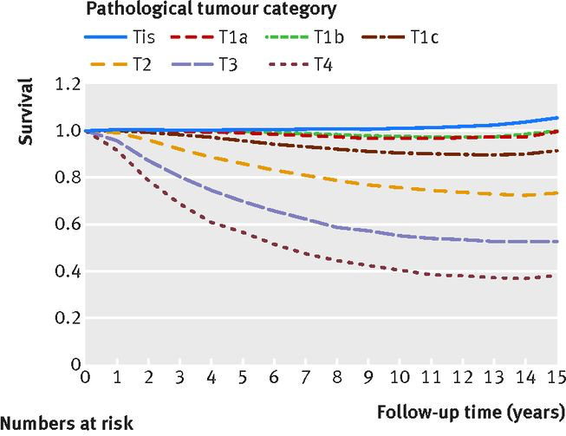
Old Paradigm: inexorable progression
Normal
Cell
“cancer” is one disease . . .
Atypical
Cell
Carcinoma
In Situ
Stage 1
Cancer
Stage 2-3
Cancer
Detectable Metastases
Early Detection Will Reduce Mortality
Cancer
death
Esserman et al, Lancet Oncology May 2014

Slide 5
New Paradigm: Variable Progression
INDOLENT LESIONS
SLOW PROGRESSION
RAPID PROGRESSION
RISK
ULTRA-LOW
LOW/MEDIUM
HIGH RISK
Normal
Cell
Normal
Cell
Normal
Cell
Atypical
Cell/CIS
Atypical
Cell/CIS
Stage 1-3
Cancer
Stage 1
Cancer
Stage 1-3
Cancer
Detectable
Metastasis
DIAGNOSIS
Detectable Metastasis
Cancer
death
Cancer
death
SCREENING
IMPACT
NONE
Reduces Mortality
Little
PREVENTION
NONE
Endocrine
Risk Reduction
???

Slide 6
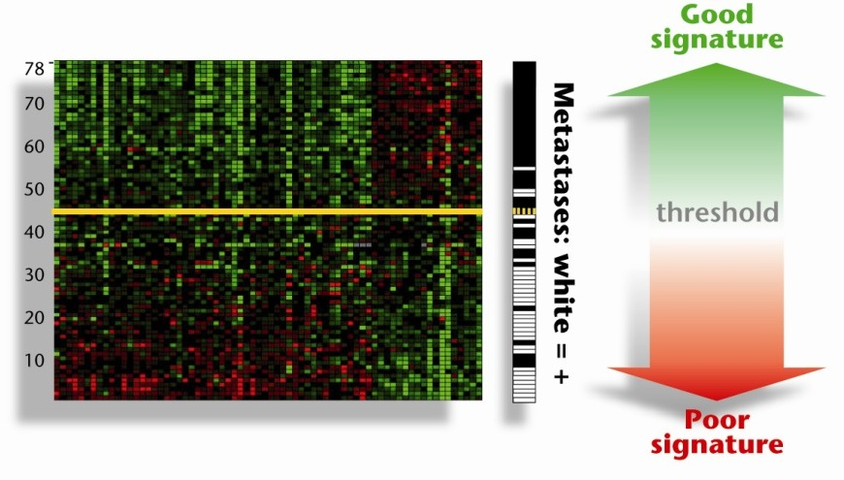
Defining indolent breast cancers using gene expression profiling
70 significant prognosis genes
Ultralow
Threshold
Vant Veer Nature 2002
Esserman, Vant Veer BCRT 2012

Slide 7
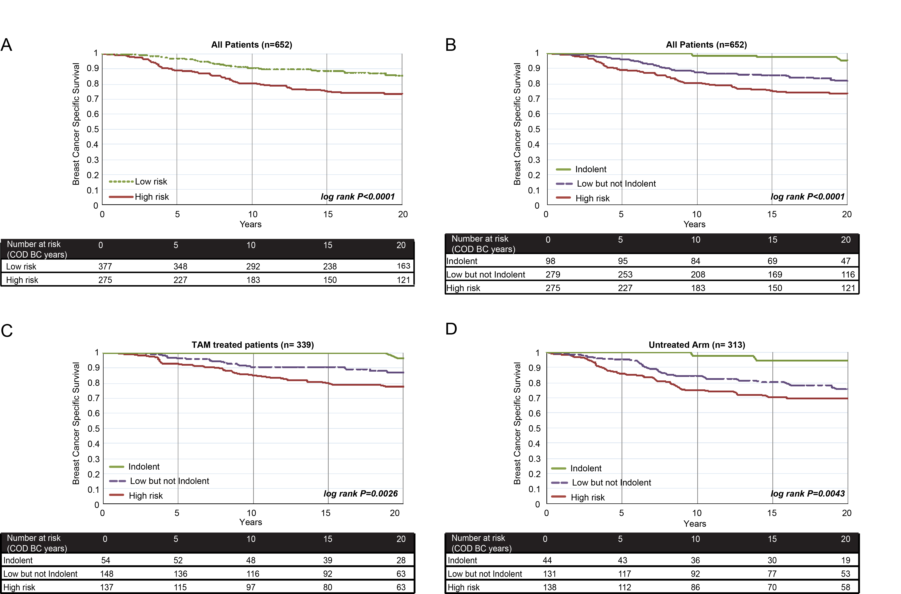
STO 3 population
DCIS Dx
70 Gene Indolent vs. Low but not Indolent vs. High Risk
20-30% of mammagraphically detected cancers
Redefine Cancer 2018: what are the common features of ultralow risk cancer across organ types
. . . .and we certainly. . don’t need to find their DCIS precursors .
Esserman et al JAMA Onc 2017

Slide 8
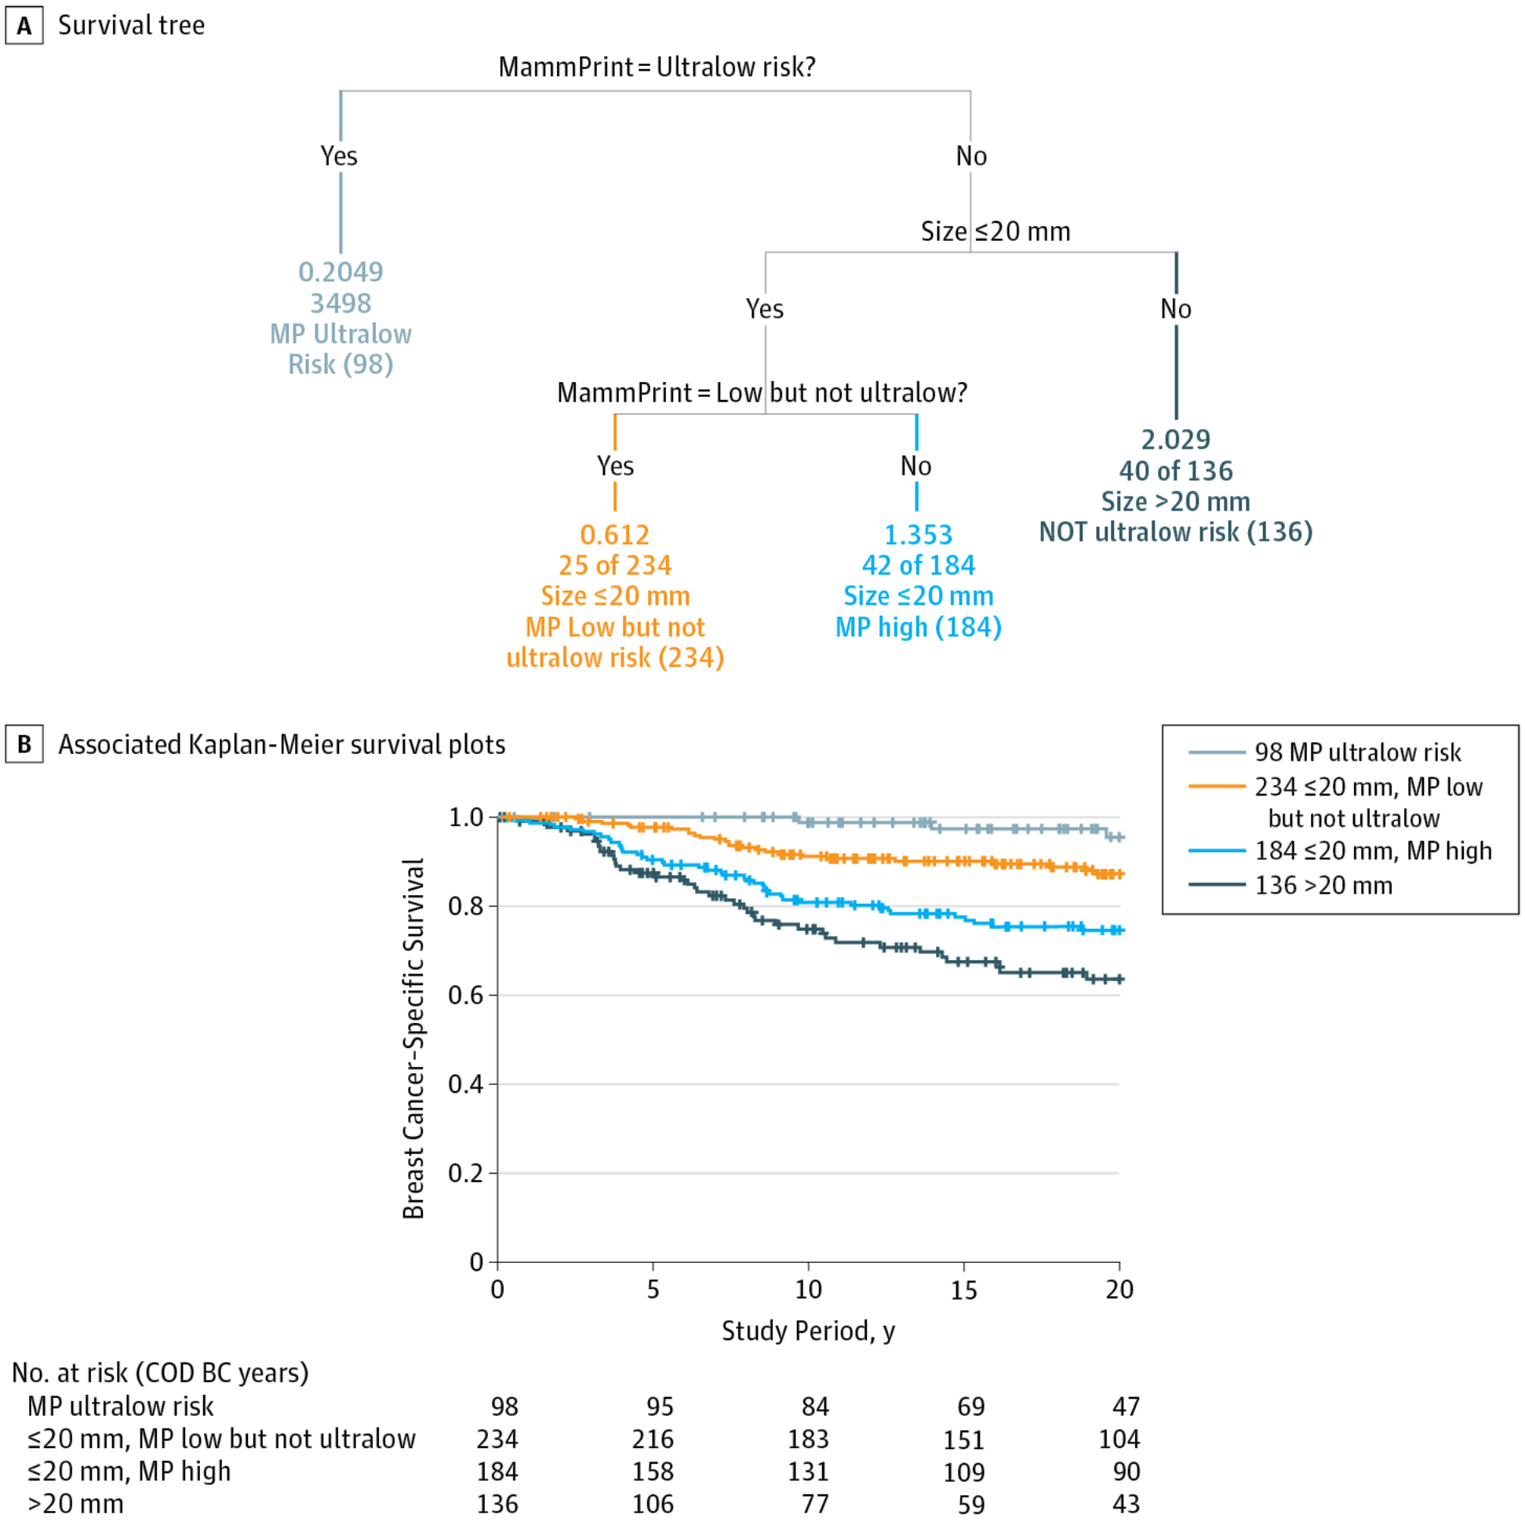
Cleaning up the Denominator
Brings Insight
Earlier recurrence

Slide 9
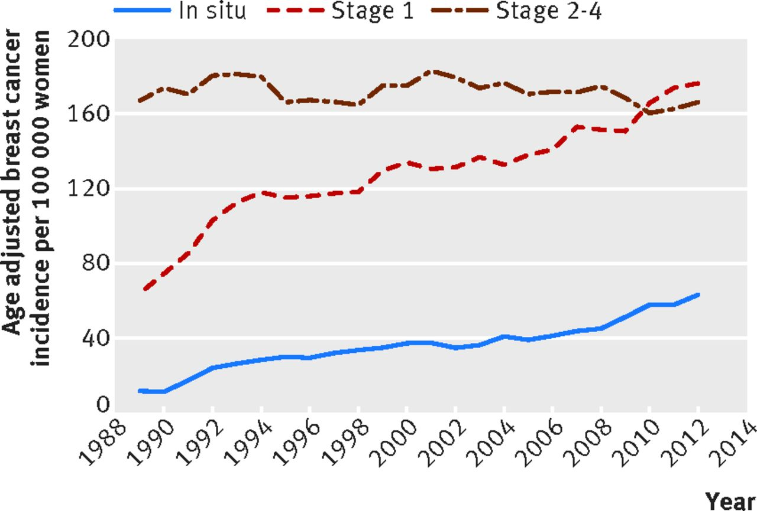

Stage 2-4 disease has not decreased concomitantly
Trends in age adjusted breast cancer incidence by stage in women aged 50 or more in the Netherlands, 1989 to 2012.
Philippe Autier et al. BMJ 2017;359:bmj.j5224
©2017 by British Medical Journal Publishing Group
Notes:
Trends in age adjusted breast cancer incidence by stage in women aged 50 or more in the Netherlands, 1989 to 2012

Slide 10
Better outcomes for all patients
Early endpoints should drive early adaptation
Better Agents
Immune modulation
Check point inhibitors
DNA damaging agents
Antibody conjugates
Better Early Endpoints
Imaging
Liquid biopsies
Pathologic response

Slide 11
I SPY 2: Adaptive Trial Testing Novel Agents (Stage 2/3)
11 agent combinations
Included in
this analysis, including control
Yee et al SABCS 2017
Notes:
Unlike other neoadjuvant trials where few experimental arms are incorporated into the trial, I-SPY2 is a platform trial designed to accommodate multiple agents in the neoadjuvant setting. This graph shows the timeline of agent inclusion in the trial. For this analysis, we considered all patients in completed arms, up through the graduation of Pembrolizumab (which occurred in 10/2016 and was reported at ASCO 2017). 10 agents and the control arm of paclitaxel are included in this analysis.

Slide 12
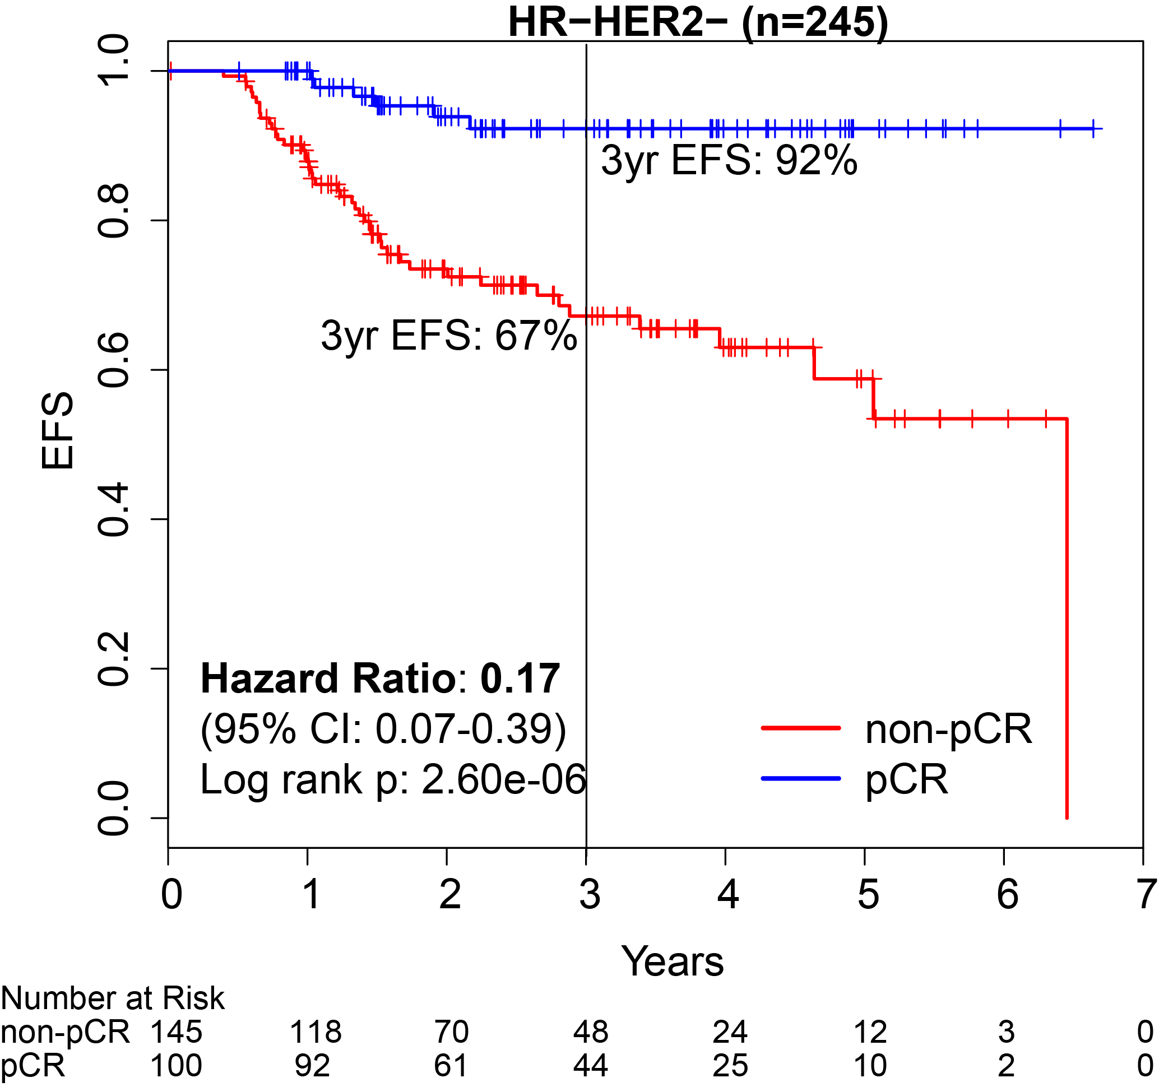
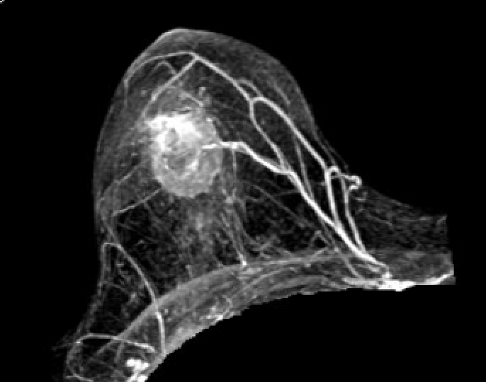
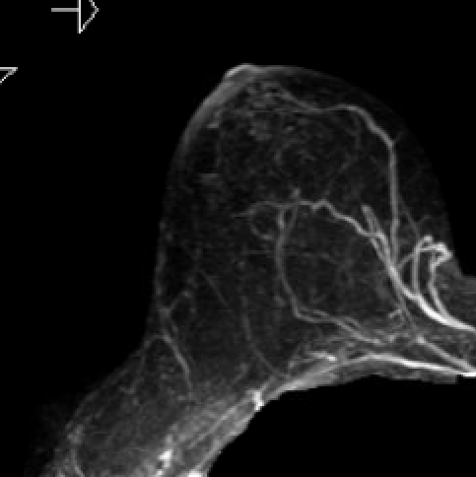
I-SPY2: Pembrolizumab
Signature | Estimated pCR rate (95% probabilty interval) |  | Probability pembro is superior to control | Predictive probability of success in phase 3
 | Pembro | Control
All HER2- | 0.44 (0.33 – 0.55) | 0.17 (0.11 – 0.23) | >99.9% | 98.5%
TN | 0.60 (0.44 – 0.75) | 0.22 (0.13 – 0.30) | >99.9% | >99%
HR+/HER2- | 0.30 (0.17 – 0.43) | 0.13 (0.07 – 0.19) | >99.6% | 83.4%

Slide 13
Defining breast cancers using gene expression profiling
70 significant prognosis genes
Ultralow
Threshold
Low, not
Ultralow
Hi 1
Hi 2
Vant Veer Nature 2002
Esserman, Vant Veer BCRT 2012
Esserman et al JAMA Oncology 2017

Slide 14
Associating Biology with Receptor Subtypes

Slide 15
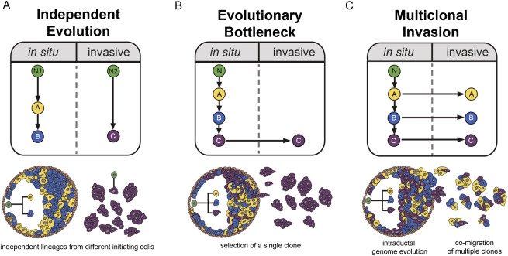


DCIS lesions reflect the type of subsequent Invasive Cancer that might arise
Casasent Cell Jan 2018
Edgerton/Navin

Slide 16
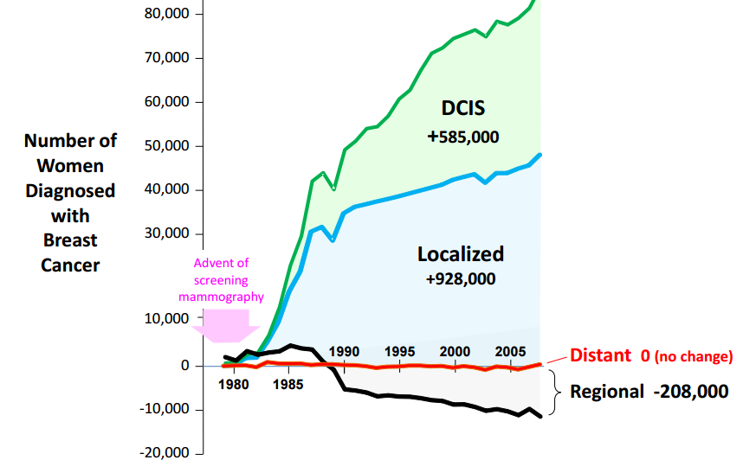
Reducing the Overtreatment of Ductal Carcinoma In Situ.
What proportion of DCIS is really “pre-cancer”?
  Which reflect risk for consequential cancers?
Can some DCIS be watched?
  Ultralow or low risk biology?
Can DCIS be treated medically?
  Changing the ecosystem?

Slide 17
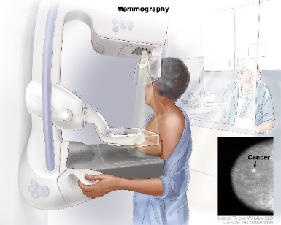
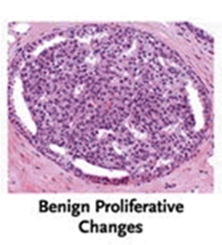
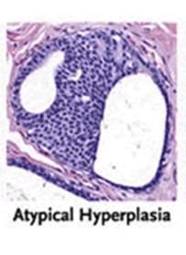
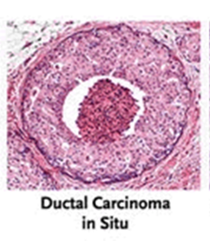
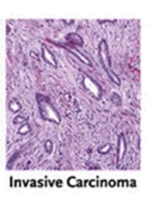
A 21^{st century} Approach to Breast Cancer Management
NO screening
Benefit
Screening Benefit
? screening
Benefit
Finding earlier-
WHO is at greatest risk?
Comedo/TIME compromised
Risk of Recurrence for invasive Ca of consequence
Non-Invasive
WHO
can we safely ignore?
INCREASING RISK
Indolent
Late Recurrence Risk
Early Recurrence
Risk
Interval cancers
Invasive
Luminal A
Luminal B
HR-
HER2+
TNBC
Eg –ISPY2
MP UltraLow
NOT UltraLow
Early indicators of response to hormonal therapy

Slide 18
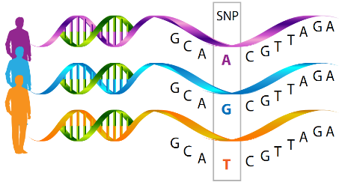
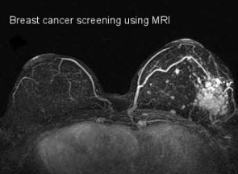
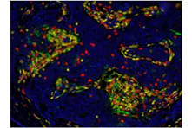
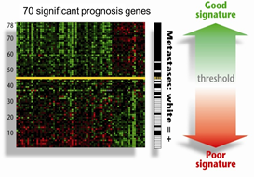
A 21^{st century} Approach to Breast Cancer Management
NO screening
Benefit
MCL DCIS Studies
Retrospective Cohort
Screening Benefit
? screening
Benefit
Imaging features, biology of precursors
Eliminate as a target for screening
Comedo/TIME compromised
Risk of Recurrence for IBC of consequence
Non-Invasive
High Risk DCIS Local Pembrolizu-mab Trial
Prospective Registry
Targeted SNP and mutation profiling
INCREASING RISK
Indolent
Late Distant Recurrence Risk
Immune Multiplex IHC
Early Recurrence
Risk
Interval cancers
Profiling
Imaging
6 month time /exposure
ΔBPE
ΔDensity
Invasive
Luminal A
Luminal B
HR-
HER2+
TNBC
Eg –ISPY2
MP UltraLow
NOT MP UltraLow
Expression Profiling- STO-3 Trial
MINDACT

Slide 19


Women Informed to Screen Depending On Measures of risk

Slide 20
WISDOM Study Design: Pragmatic Trial
Eligible
Patients
Consent
Observational Cohort
Randomized Cohort
Randomize
Annual
Screening
Annual
Screening
Personalized
Screening
Personalized
Screening
MCL
Who is at risk for which cancer?
Profile cancers, DCIS that arise
Determine if personalized screening
(as compared to annual screening):
Is as safe
Is less morbid
Is more accepted by women
Enables prevention
Has greater health care value
adapts over time

Slide 21
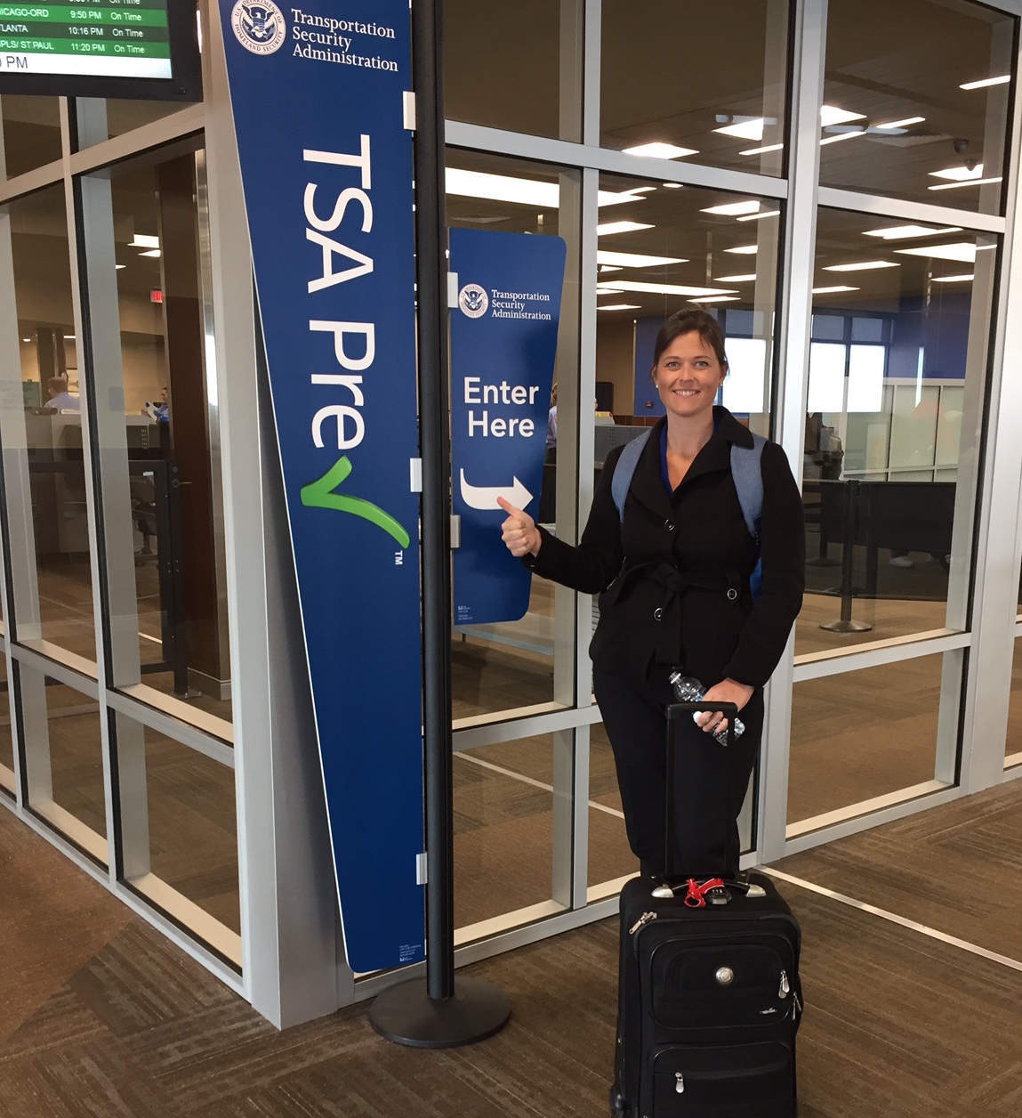
Screening Keyed to Risk is Good!

Slide 22
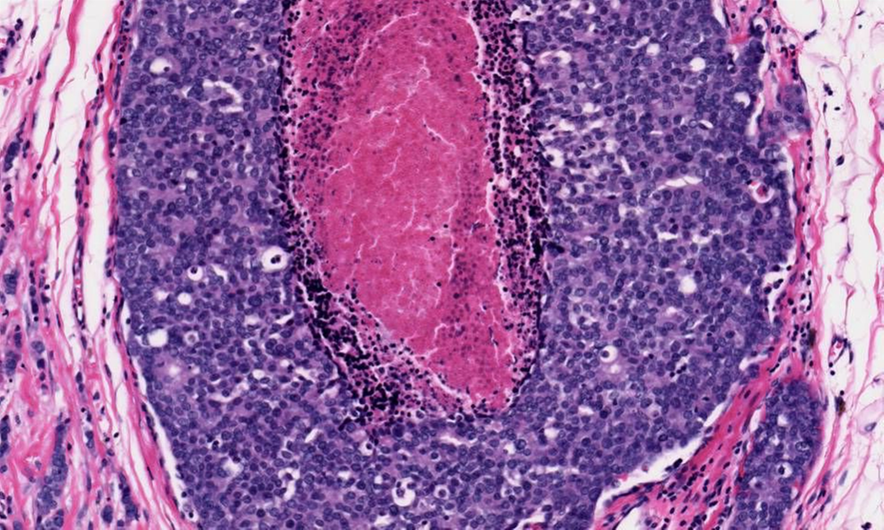
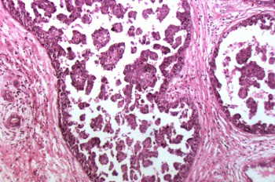
DCIS: Cohorts Assembled to Understand what Modulates Risk
(set asides)
Surveillance n=40
Progression
Resolved
Stable
Retrospective Cohort (n=2912/2043)
Subsequent events (220/152)
  Invasive only→ Profiling
  DCIS only
120 highly characterized (Hi/Low risk)
Immune Modulation (n=9)
Window study
Context
Imaging (MRI, mammo): focal vs diffuse, BPE
Genomics: Oncotype DCIS, T cell repertoire, RNA seq
Germline genetics: mutations/SNPs
Breast Density: A→D
Immune Profile: multiplex immunoflouresence, expression

Slide 23
UC DCIS Treated Cohort (n=831)
No Subsequent Event (n=679)
Subsequent Event
(n=152)
Subsequent Event
(n=152)
Invasive
(n=94)
Invasive Subsequent Event (n=94)
DCIS Only
(n=58)
contralateral (n=45)
Global Risk factor as much as focal risk marker
Ipsilateral (n=49)

Slide 24
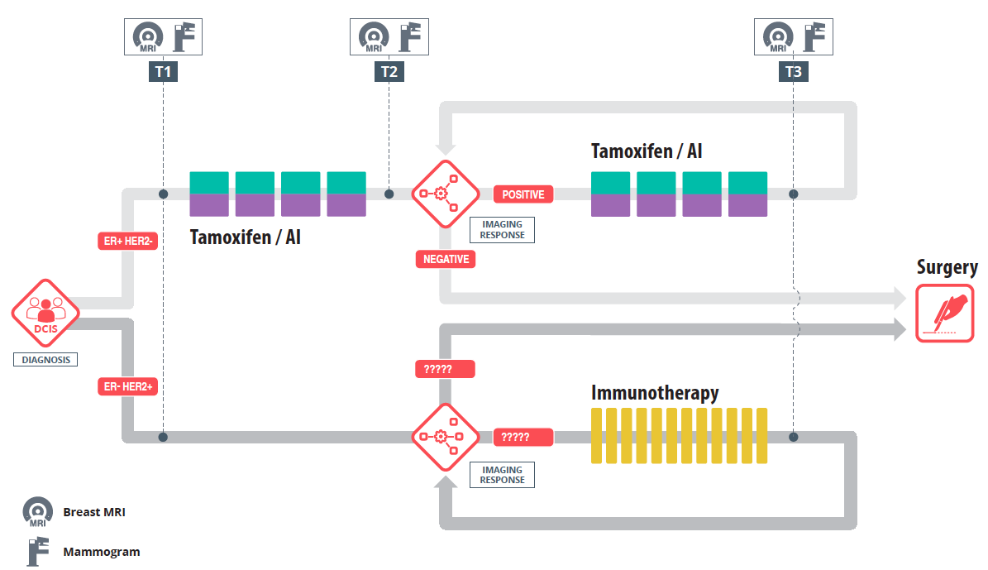
Schema for prospective DCIS Management
Active Surveillance
Immune Modulation Trial

Slide 25
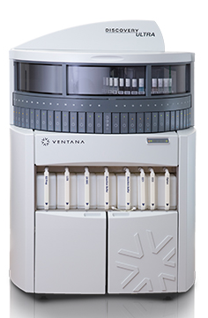
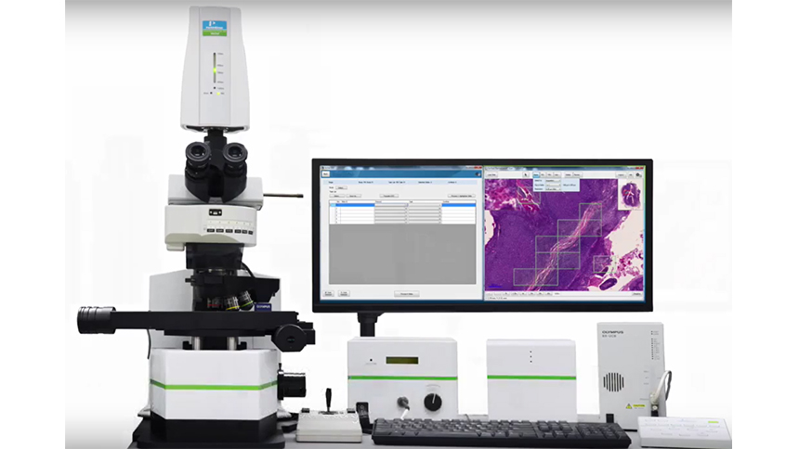
Immune Biomarkers Multiplex Panels
Immune Profiling DCIS
Ventana Discovery System
Vectra 3.0 Automated Quantitative Pathology Imaging System
Scott VandenBerg
Jennifer Bolen
Cliff Hoyt
Panel 1 | Cell populations
CD3 | T cell co-receptor T cells
CD20 | Surface molecule (calcium channel?) B cells
FoxP3 | Forkhead box P3 transcription factor Treg cells
CD117 | c-kit mast cells, some breast epithelial/cancer cells
Ki67 | nuclear proliferation marker
panCK | Cytokeratins
Panel 2 | Cell populations
CD3 | T cell co-receptor T cells
CD8 | TCR co-receptor cytotoxic T cells (Tc); (also on some NK cells and dendritic cells)
CD68 | Glycoprotein, binds LDL macrophages
PD-1 | Immune checkpoint receptor T cells; pro-B cells
PD-L1 | Immunosuppressive PD-1 ligand cancer cells; macrophages; vascular endothelial cells
panCK+Ki67 | Cytokeratins (CK); nuclear proliferation marker (Ki67)

Slide 26
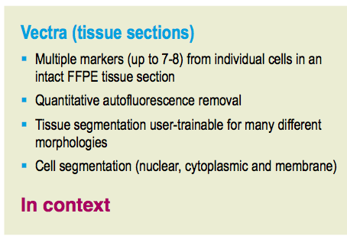
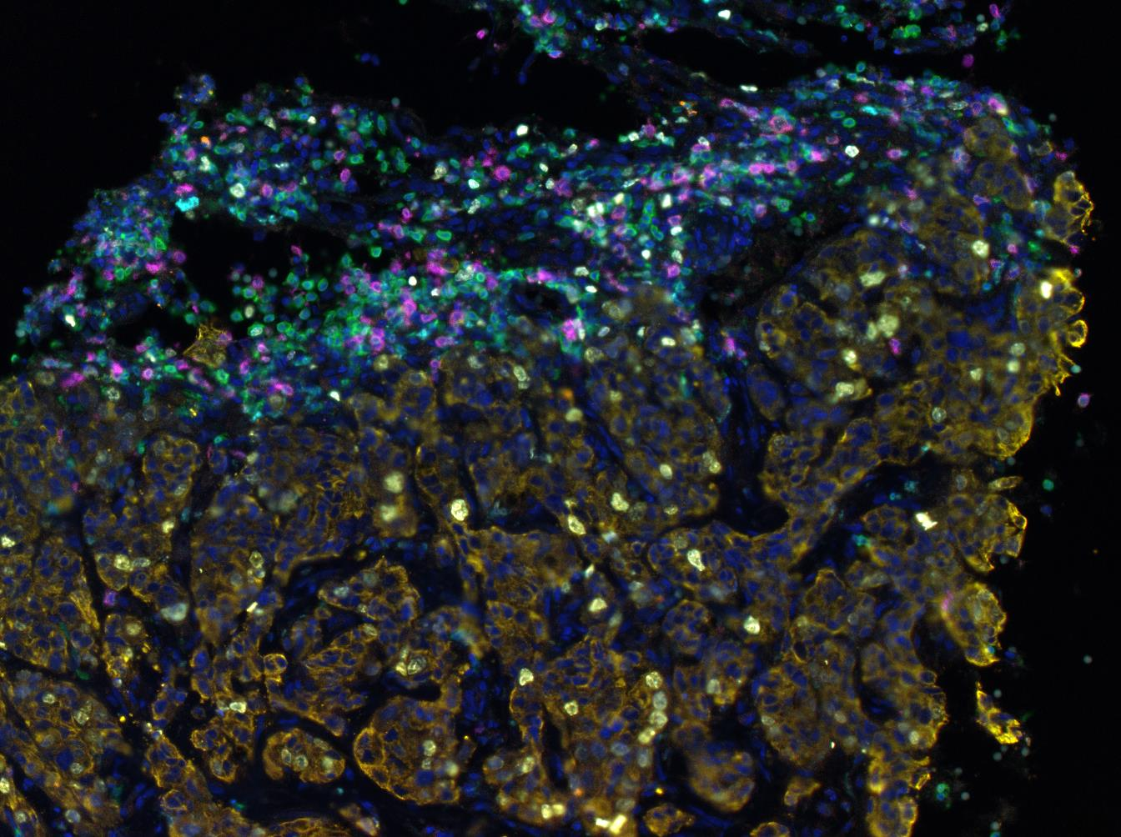
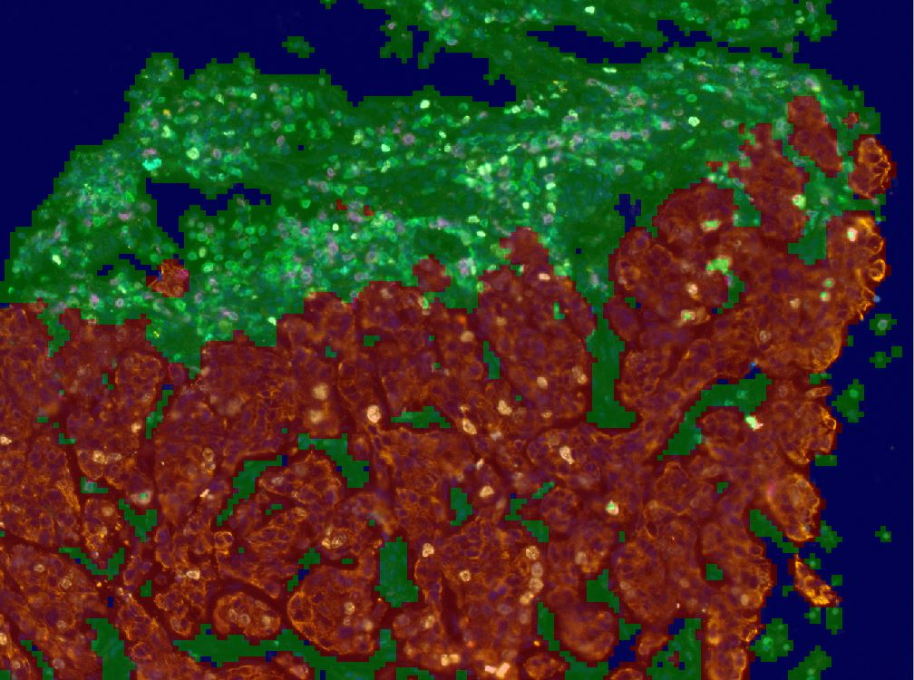
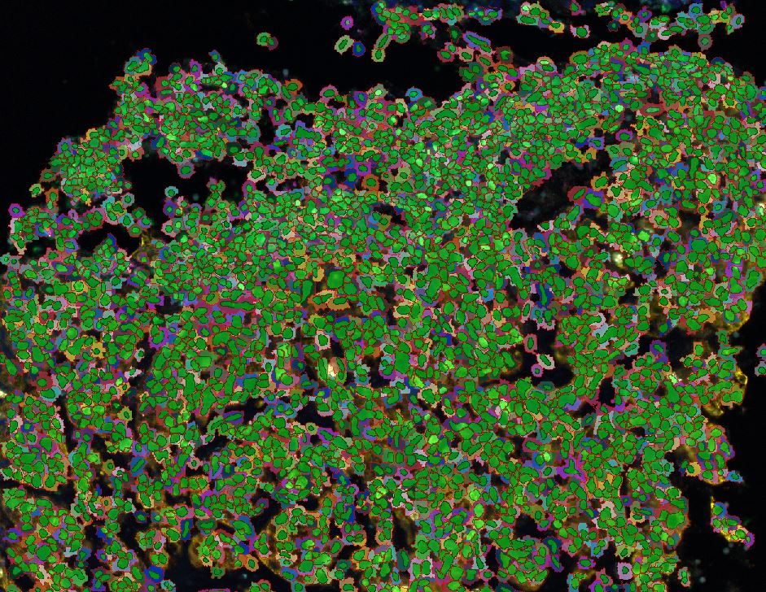
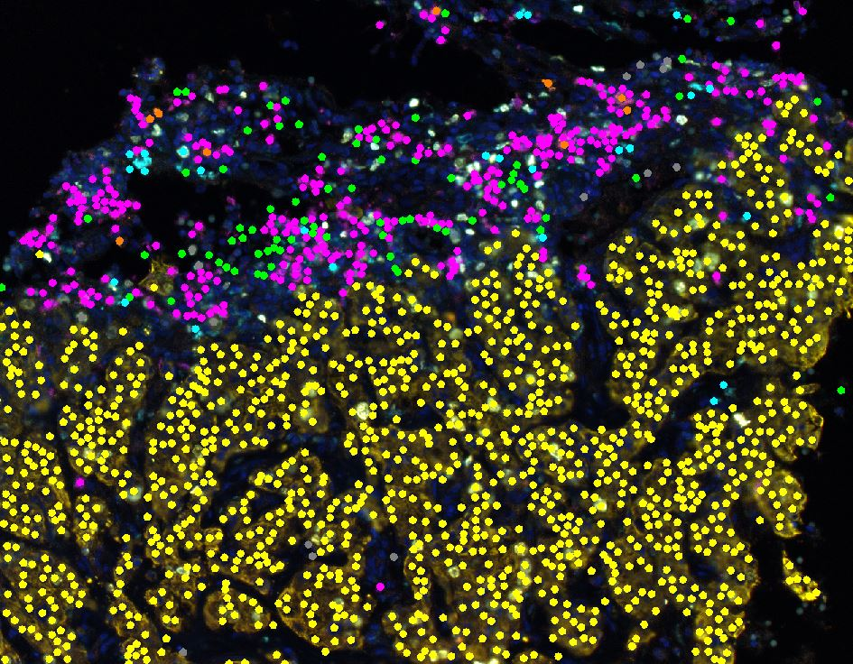
Immune Profiling DCIS
Multiplex Immunofluorescence and Multispectral Imaging
Vectra and inForm software
Composite Image
Tissue Segmentation
Stroma
Tumor
Cell Segmentation
Cell Phenotype Map
CD3⁺CD8⁻
CD3⁺CD8⁺
CD3⁺PD-1⁺
CD68⁺
Tumor Cell
DCIS Cohort
103 cases
  Luminal A: 38 (37%)
  Luminal B: 33 (32%)
  HER2⁺: 26 (25%)
  Triple Negative: 6 (6%)
  Grade 1: 11 (11%)
  Grade 2: 44 (43%)
  Grade 3: 48 (46%)

Slide 27
Immune Landscapes in DCIS (panel 2)
CD3
CD8
PD-1
CD68
DClS

Slide 28
Tertiary Lymphoid Structures in DCIS
CD3
CD8
PD-1
CD68
DClS
Notes:
Spearman
counts

Slide 29

Correlations Between Immune Cell Populations
and Clinicopathologic Characteristics
VNPI
Age
Size
Palpable
Grade
Comedonecrosis
HER2 status
HR status
Breast Density
T cells
CD3⁺CD8⁺
CD3⁺CD8⁻
CD68⁺
T cells (S)
CD3⁺CD8⁺ (S)
CD3⁺CD8⁻ (S)
CD68⁺(S)
Ki67⁺ TILs (S)
PDL1 (S)
T cells (D)
CD3⁺CD8⁺ (D)
CD3⁺CD8⁻ (D)
CD68⁺ (D)
Dot color relates to the direction of the correlation (red negative, blue positive)
Color intensity and size of dots relates to the strength of the correlation
Only significant correlations are shown (Spearman’s p < 0.05)
Notes:
Spearman
counts

Slide 30
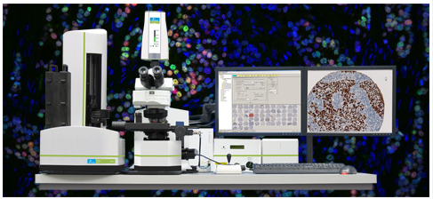
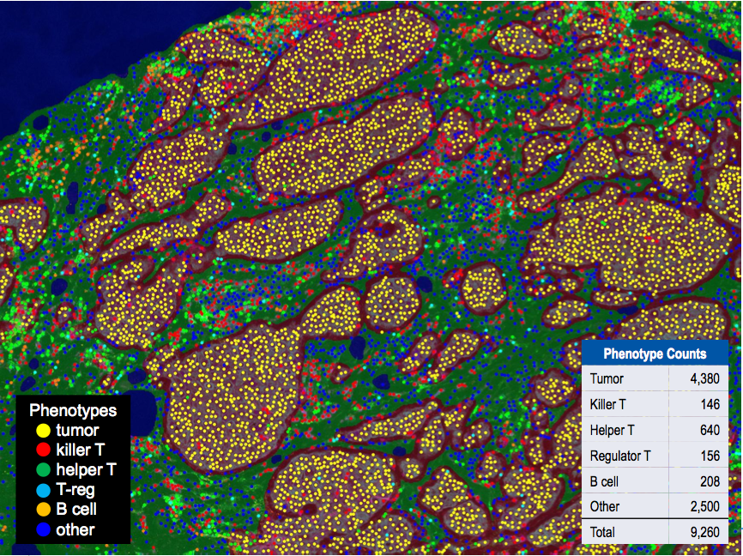
Modulating the Immune Microenvironment in DCIS
Agent: Pembrolizumab
Administration: Intralesional injection directly into DCIS
How often: Two doses, three weeks apart
Patients must have at least 2 of the following high risk features:
High-grade
Palpable mass
Her2 positive
Hormone receptor negative (less than 1%)
Young age (less than 45 years old)
Large size (greater than 5 cm)
Biopsy proven high-risk DCIS
Intralesional injection of pembrolizumab x 2
(9-18 patients)
Surgery
core biopsy
surgical specimen
Tissue sections prepared for immunologic assays
Notes:
Spearman
counts

Slide 31
Intralesional injection of pembrolizumab (anti-PD-1)
induces increase in immune infiltrates
Pre-Tx: Panel 1
Post-Tx: Panel 1
Post-Tx: Panel 2
Panel 1: CD3 (green); CD20 (red); CD117 (magenta); Ki67 (cyan); cytokeratin (yellow)
Panel 2: CD3 (green); CD8 (magenta); CK & Ki67 (yellow)
Three of five patients demonstrated a significant increase in total CD3⁺ T cells as well as CD8⁺ T cells, one patient showed a modest increase in T cell infiltrate
Well tolerated; no systemic toxicity
Notes:
DCIS Pembro slide
pre vs post

Slide 32
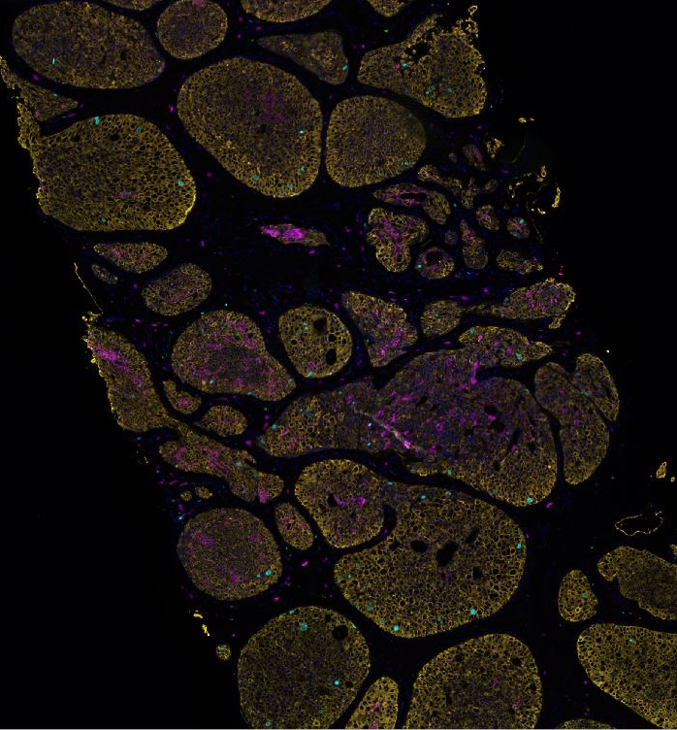
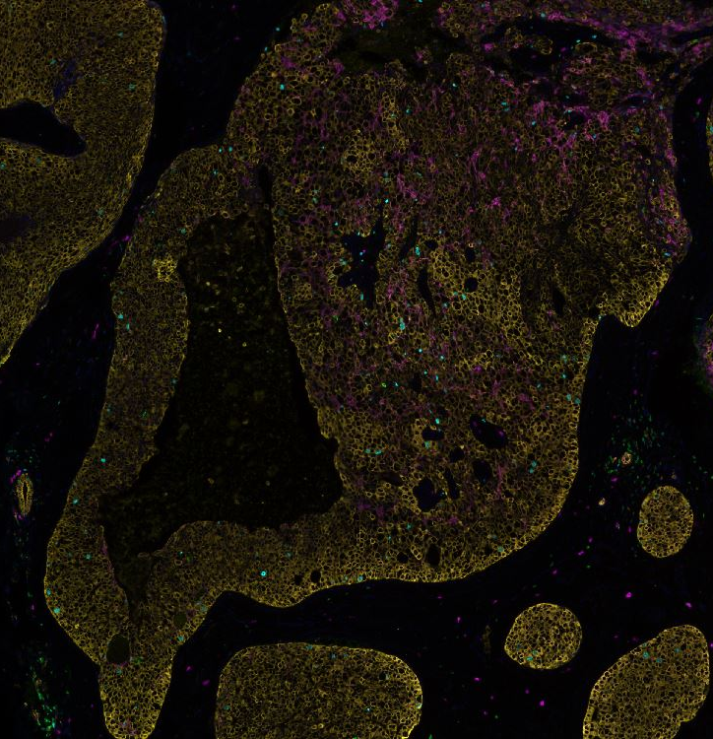
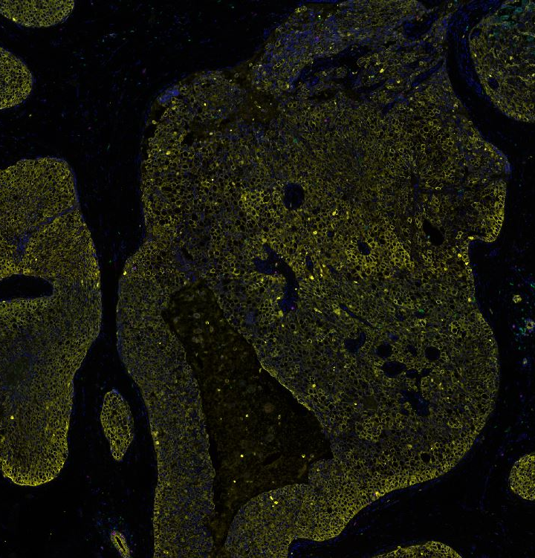
But not in all cases...
Pre-Tx: Panel 1
Post-Tx: Panel 1
Post-Tx: Panel 2
Panel 1: CD3 (green); CD20 (red); CD117 (magenta); Ki67 (cyan); cytokeratin (yellow)
Panel 2: CD3 (green); CD8 (magenta); CK & Ki67 (yellow)
POSTER #8
Notes:
DCIS Pembro slide
pre vs post

Slide 33
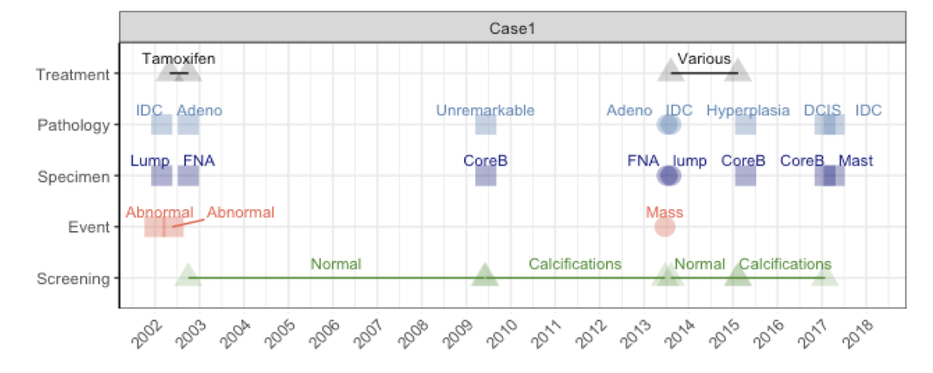
Ongoing Studies
Additional multiplex panels are being developed/optimized (eg. a myeloid/dendritic cell panel)
DCIS retrospective cohort: Panel 1 to be run soon
DCIS pembrolizumab study
  Following the dose escalation phase, a “time escalation” phase will begin in which patients are given multiple doses over time of the highest dose achieved in the dose escalation phase.
Longitudinal Studies: Most molecular studies are not designed to study progression over time
  Within patients synchronous DCIS+IDC
  Between patients pure DCIS vs. micro-invasion vs. IDC
  Between patients high-grade vs low-grade
  Multiple ipsilateral specimen over time (>5 years) offer exceptional opportunity to assess changes overtime with only a few patients.
    Multiplex immune profiling
    TCR repertoire analyses
Hisrst, Iaconetti, Harismendy
Notes:
Spearman
counts

Slide 34





U01 Team
Laura Esserman- PI
Gillian Hirst -U01 Project Manager
Laura van t Veer- Biospecimen collection, RASTER
Mike Campbell - Multiplex Immune Assays
Rick Baehner-Pathology, Genomic Health OncotypeDx
Rita Mukhtar- Co-PI DCIS ATHENA Registry- UCSF site coordinator
Elad Ziv - Lead germline genetic analysis
Jeff Tice - Risk models to predict both IDLE and interval cancers
Alexander Borowsky-Immune Pathology,
Richard Bold-Co-PI DCIS Registry
Olivier Harismendy- Immune Repertoire Profiling, Genomics
Barbara Parker-Site PI Athena Breast Health Network
Tracy Layton- ATHENA PM
Eliza Jeong-Site coordinator
Christina Yau-Biostatistician
Chris Benz- genomics
Allison Stover-Fiscallini

Slide 35





Breast Collaborative Project
DCIS Retrospective Cohort
U01 Sites
Oslo University Hospital

