Slide 1


Prostate Cancer as a Model for the Challenges of Precision Early Detection
Scott A. Tomlins M.D., Ph.D.
Associate Professor of Pathology and Urology
Michigan Center for Translational Pathology Department of Pathology
University of Michigan Medical School
March 7, 2018

Slide 2
Disclosure Information
I have the following financial relationships to disclose:
The University of Michigan has been issued a patent on ETS gene fusions on which I am a co-inventor.
The diagnostic field of use has been licensed to Hologic/Gen-Probe, Inc., which has sublicensed rights to Roche/Ventana Medical Systems
Consultant for and honoraria from Roche/Ventana Medical Systems, Jansenn, AbbVie, Almac Diagnostics and Astellas/Medivation
Sponsored research agreement with and travel support from with Compendia Biosciences/Life Technologies/ThermoFisher Scientific
Sponsored research agreement with Astellas and GenomeDX
Co-founder of, equity holder in and Laboratory Director for Strata Oncology

Slide 3
Prostate Cancer Decision Making
60 y/o man with a PSA of 4.0ng/ml
Should I undergo biopsy?
Biopsy: ASAP
Biopsy: High grade PIN involving 1 of 12 cores
What now?
Biopsy: Prostatic adenocarcinoma, Gleason score 3+3=6, 2/12 cores, maximum 40% involvement
What (if any) is the best treatment for my cancer?
RRP: Prostatic adenocarcinoma, Gleason score 3+4=7 (or 4+5=9), confined to prostate, margins free
Am I cured? Do I need treatment, if so what?
Rib, Biopsy: Metastatic prostatic adenocarcinoma
What is the best treatment for me?

Slide 4
Prostate Cancer Decision Making
60 y/o man with a PSA of 4.0ng/ml
Should I undergo biopsy?
Biopsy: ASAP
Biopsy: High grade PIN involving 1 of 12 cores
What now?
Biopsy: Prostatic adenocarcinoma, Gleason score 3+3=6, 2/12 cores, maximum 40% involvement
What (if any) is the best treatment for my cancer?
RRP: Prostatic adenocarcinoma, Gleason score 3+4=7 (or 4+5=9), confined to prostate, margins free
Am I cured? Do I need treatment, if so what?
Rib, Biopsy: Metastatic prostatic adenocarcinoma
What is the best treatment for me?

Slide 5
Why is PCa early detection so difficult?
PSA testing is widespread/need long follow-up
PCa diagnosis is blind
80-90% sensitivity of gold standard
We don’t know if good prostate cancer turns bad
PCa is extremely common
Specificity for aggressive disease is hard
PCa is multifocal
Defining/specificity for aggressive disease is hard
Clinicopathological parameters are pretty good!
Tough to market things that are free
Few recurrent hotspot early/aggressive prostate cancer genome alterations

Slide 6
Prostate Cancer Decision Making
60 y/o man with a PSA of 4.0ng/ml
Should I undergo biopsy?
Biopsy: ASAP
Biopsy: High grade PIN involving 1 of 12 cores
What now?
Biopsy: Prostatic adenocarcinoma, Gleason score 3+3=6, 2/12 cores, maximum 40% involvement
What (if any) is the best treatment for my cancer?
RRP: Prostatic adenocarcinoma, Gleason score 3+4=7 (or 4+5=9), confined to prostate, margins free
Am I cured? Do I need treatment, if so what?
Rib, Biopsy: Metastatic prostatic adenocarcinoma
What is the best treatment for me?

Slide 7
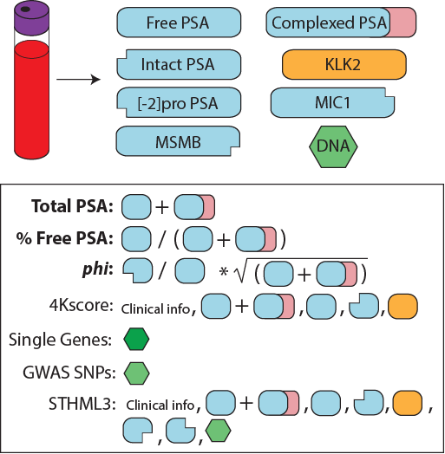
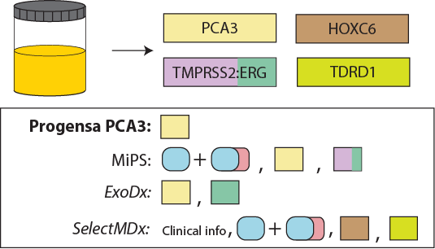
We have PCa early detection tests!

Slide 8
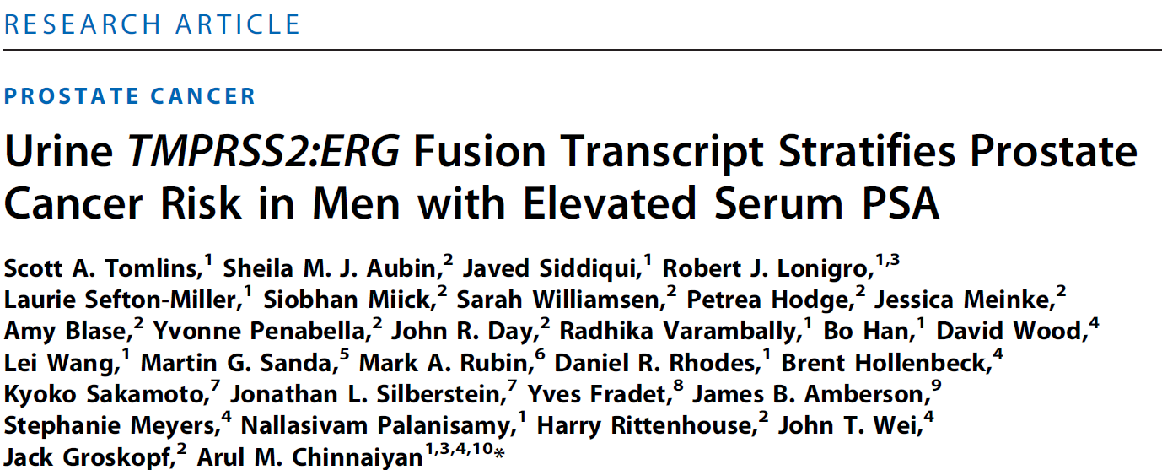
On study biopsy, >5th biopsy, 20 cores, PSA 258: BPT
Five months later, saturation 72 core biopsy, PSA 1,377: 6 distal ant cores with PCa (Gl 9)

Slide 9
Why is PCa early detection so difficult?
PSA testing is widespread/need long follow-up
PCa diagnosis is blind
80-90% sensitivity of gold standard
We don’t know if good prostate cancer turns bad
PCa is extremely common
Specificity for aggressive disease is hard
PCa is multifocal
Defining/specificity for aggressive disease is hard
Clinicopathological parameters are pretty good!
Tough to market things that are free
Few recurrent hotspot early/aggressive prostate cancer genome alterations

Slide 10
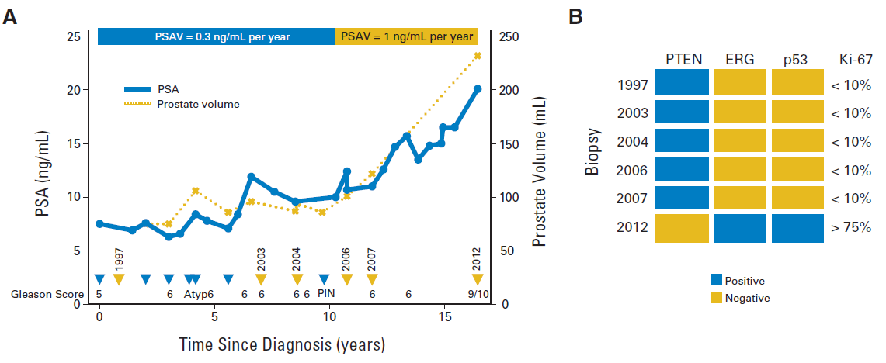

Slide 11
Why is PCa early detection so difficult?
PSA testing is widespread/need long follow-up
PCa diagnosis is blind
80-90% sensitivity of gold standard
We don’t know if good prostate cancer turns bad
PCa is extremely common
Specificity for aggressive disease is hard
PCa is multifocal
Defining/specificity for aggressive disease is hard
Clinicopathological parameters are pretty good!
Tough to market things that are free
Few recurrent hotspot early/aggressive prostate cancer genome alterations

Slide 12
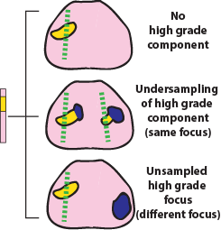
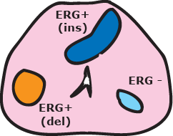
The issue of multifocality

Slide 13
The issue of multifocality

Slide 14
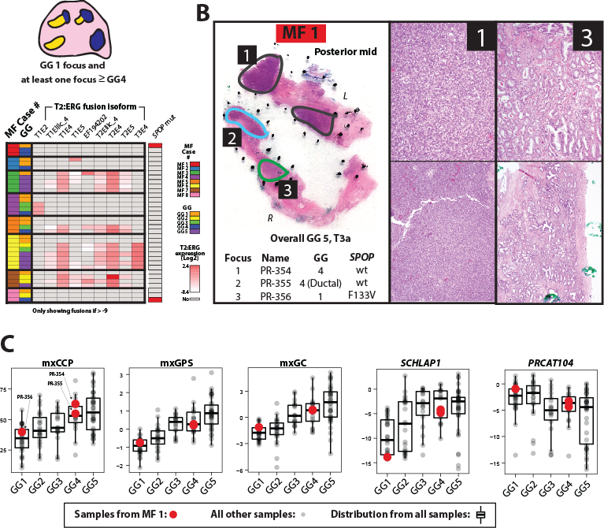

Slide 15
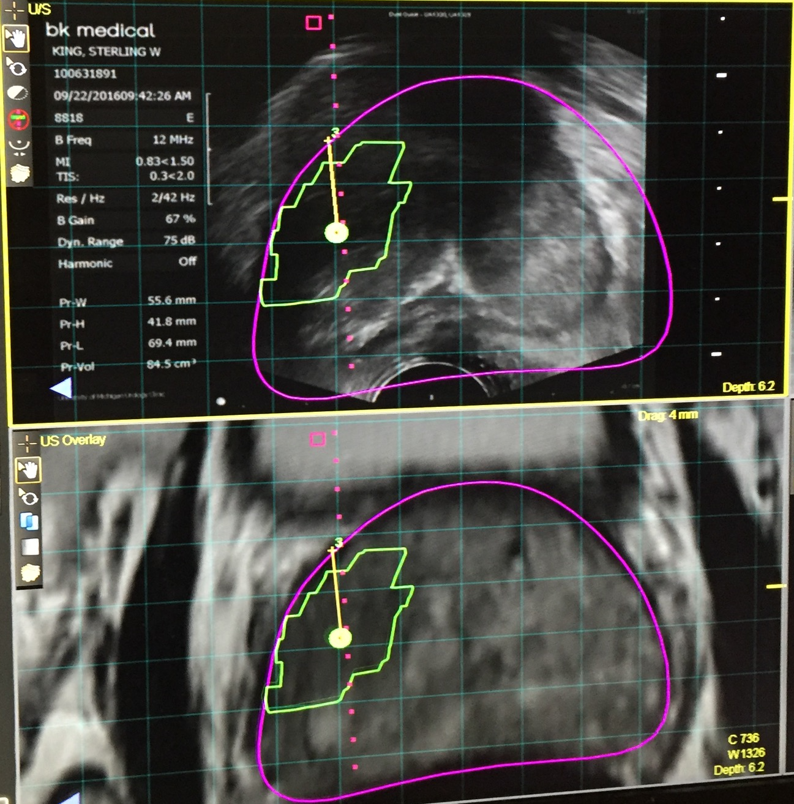
mpMRI (molecular imaging)
Enables tracking of “lesions” and biopsy cores
Patients can easily relate to imaging
Anatomic image guidance appeals to urologists
Not as likely to find insignificant PCA
Aggressive marketing of systems and availability
Urologists embrace marketable technology
(e.g. Davini Robot)

Slide 16
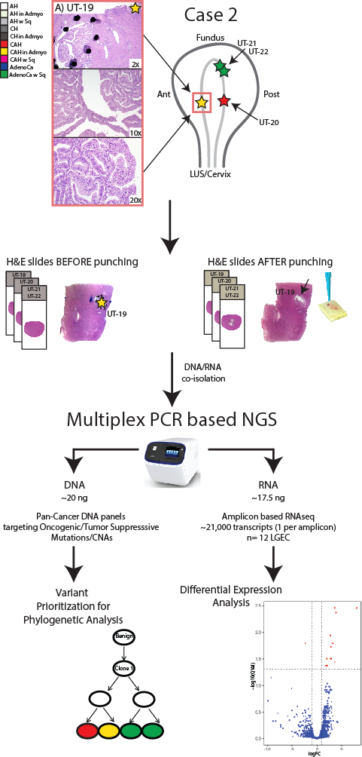
Is this unique to prostate cancer?

Slide 17
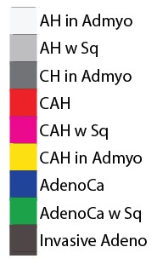
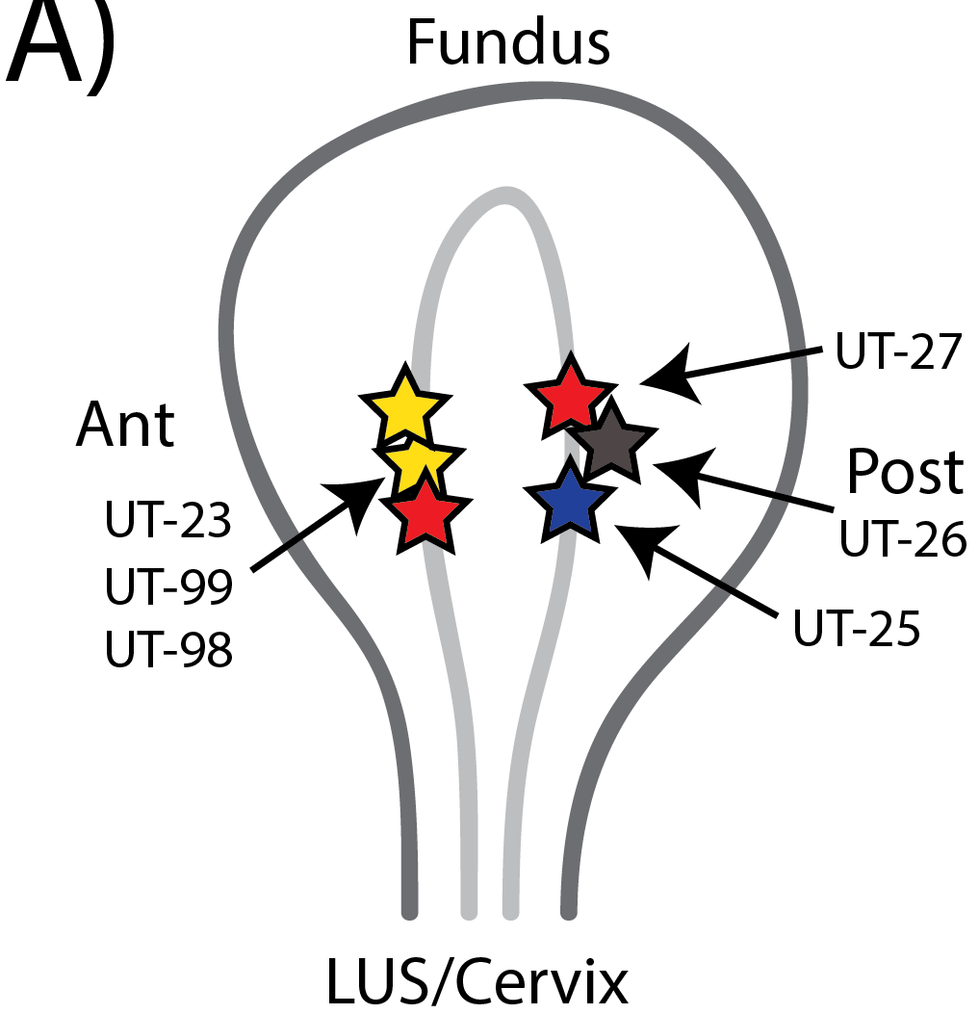
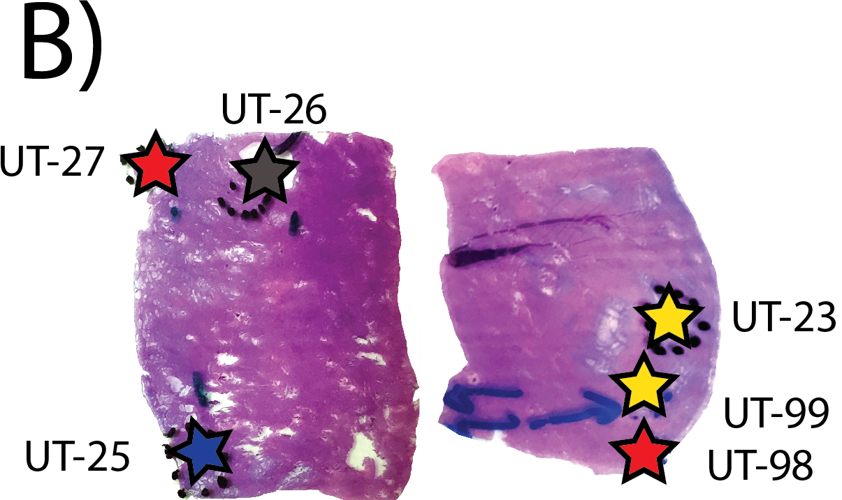
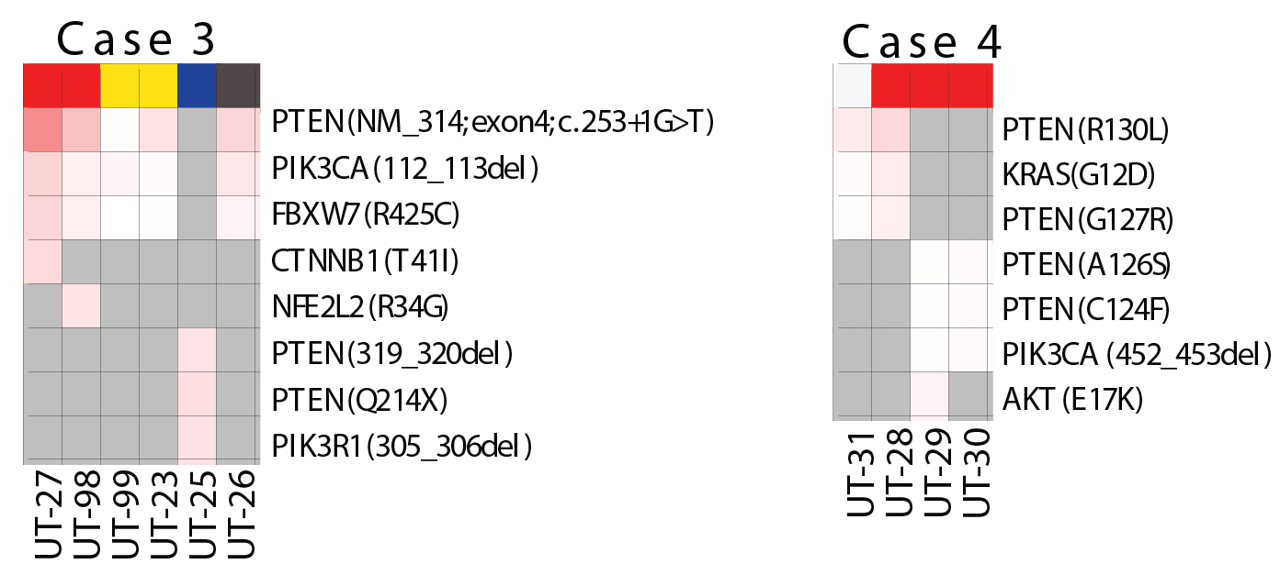
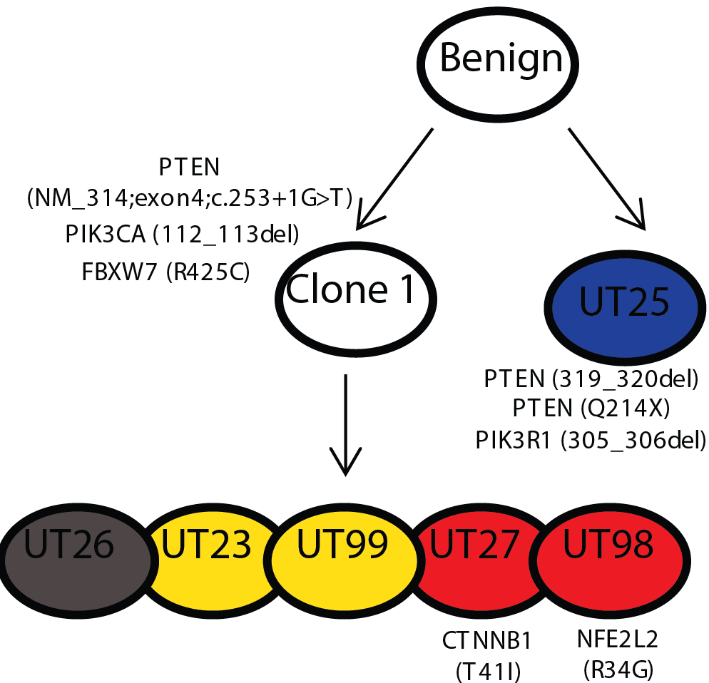
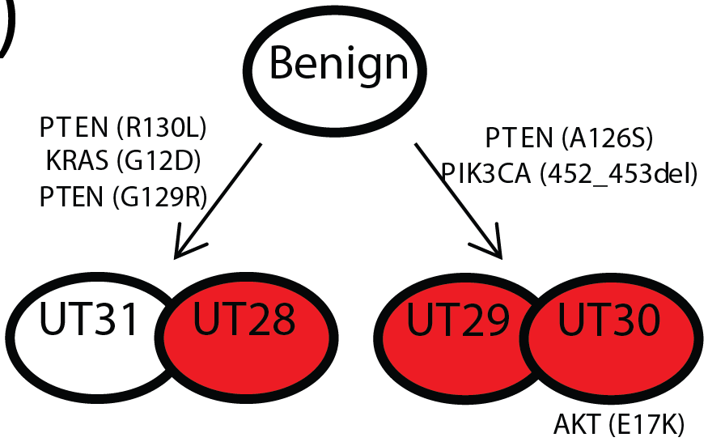
Multiclonal disease

Slide 18
Why is PCa early detection so difficult?
PSA testing is widespread/need long follow-up
PCa diagnosis is blind
80-90% sensitivity of gold standard
We don’t know if good prostate cancer turns bad
PCa is extremely common
Specificity for aggressive disease is hard
PCa is multifocal
Defining/specificity for aggressive disease is hard
Clinicopathological parameters are pretty good!
Tough to market things that are free
Few recurrent hotspot early/aggressive prostate cancer genome alterations

Slide 19
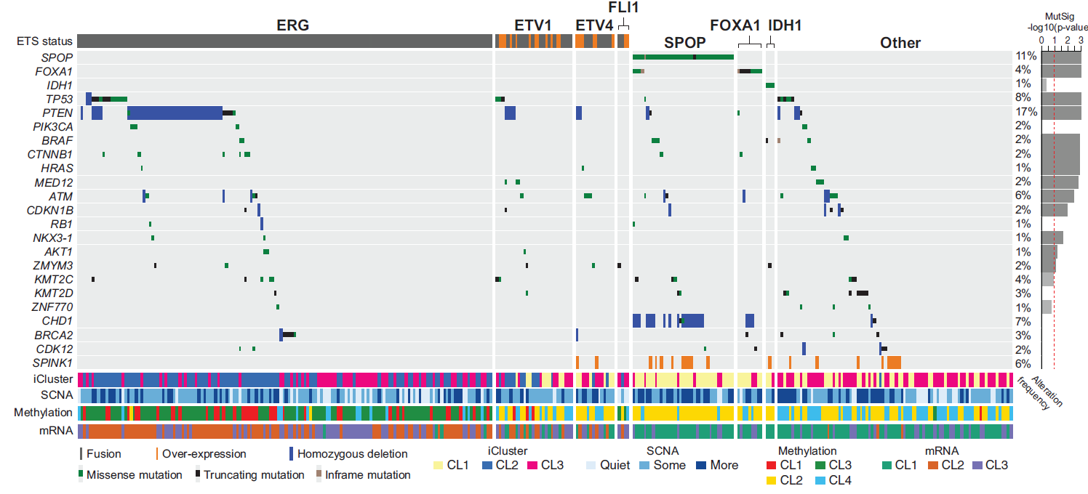
No recurrent hotspot mutations
TCGA Cell 2015

Slide 20
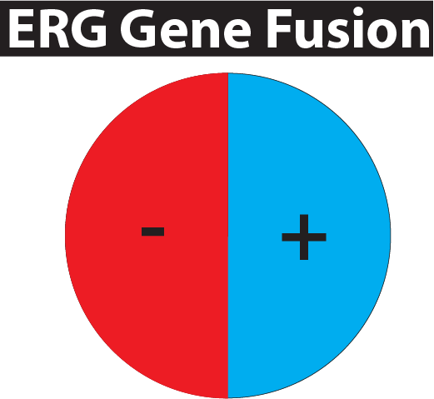
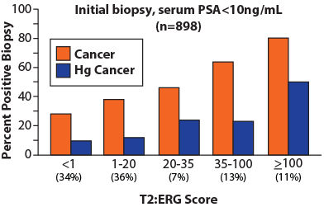
TMPRSS2:ERG gene fusions
IHC >99.99% specific
(Young et al. AJCP 2012)
(Furusato et al. PCPD 2010)
(Tomlins et al. APLM 2012)
Resolves 28% of atypical cases
~10,000 tumors
(Shah et al. Human Pathol 2013)
(Pettersson et al. Cancer Epid Bio Prev, 2012)
Tomlins et al., European Urology, 2015
Notes:
T2:ERG fusions are the most prostate cancer specific biomarker yet reported. Tissue expression, using antibodies directed against ERG, is used diagnostically and has specificity for cancer >99.99% by immunohistochemistry across multiple studies using different antibodies.
~50% of prostate cancer foci harbor T2:ERG fusions. However, ~80% of men at prostatectomy have at least 1 T2:ERG positive focus, given that most men with prostate cancer have multifocal disease.

Slide 21
What lessons can be learned from Pca?
Numerous early detection tests that all improve upon serum PSA
Limited incorporation of “aggressive” PCa markers
Hard to define aggressive disease
Multifocality
Development of 2nd cancers
Long f/u required to know if aggressive
Limited differences between aggressive/non-aggressive cancer genomes/transcriptomes
No highly recurrent point mutations for easy cfDNA testing
Small subsets can be identified at diagnosis
mpMRI/molecular imaging/liquid biopsies will drive changes in early detection
Better hit rate of biopsy
Define whether PCa progresses
In many cancers (e.g. prostate, endometrial, melanoma, colon, etc) early clonal alterations do not drive cancer aggressiveness
Can we develop cheap, aggressive disease specific tests that can be applied early/often enough, pinpoint location without resulting in “incidentalomas”, and result in intervention when morbidity/mortality can be reduced?

Slide 22
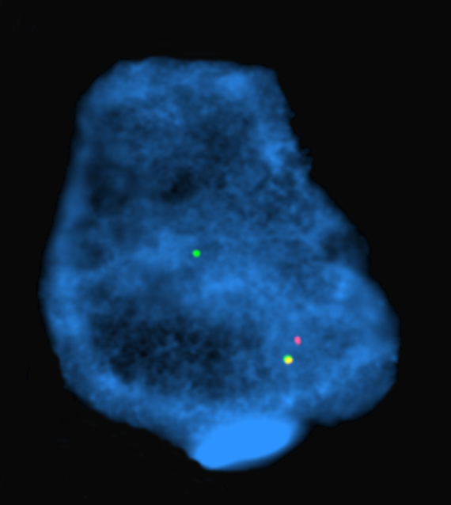







Acknowledgements
Tomlins Lab
UMHS (MCTP)
Pete Nelson (FHCRC)
Karen Knudsen (TJU )
Seth Sadis (ThermoFisher)
Ryan Dittamore (Epic Biosciences) Gert Attard (Royal Marsden)
Leonard Marks (UCLA)
Jiaoti Huang (UCLA/Duke)
Romain Mathieu (Med. Univ. of Vienna)
Martin Susani (Med. Univ. of Vienna)
Nathalie Rioux-Leclercq (Rennes Hospital)
Shahrokh Shariat (Med. Univ. of Vienna
Tamara Lotan (JHMI)
Ted Schaeffer (Northwestern)
ThermoFisher Ampliseq R&D Team
Rubicon Genomics
Collaborators
Daniel Hovelson
Andi Cani
Andrew McDaniel
Kei Omata
Albert Liu
Lorena Lazo de la Vega
Anmol Amin
Venkata Yadati
Michaela Haller
Moloy Goswami
Lucy Wang
Kelly Vandenberg
Komal Kunder
Samantha Rahrig
Jarred Bratley
Venkata Yadati
Anmol Amin
Sharath Anand
Travis Weiss
Sherin John
Bhavneet Singh
Rishika Ramireddy
Jeremy Kaplan
Catherine Grasso (UW)
Michael Quist
Arul Chinnaiyan
John Wei
Javed Siddiqui
Ganesh Palapattu
Simpa Salami
Todd Morgan
Muneesh Tewari
Felix Feng
Kathy Cooney
Maha Hussain
Xuhong Cao
Rajesh Rao
Dan Hayes

