Slide 1
Updates for the Data Management & Coordinating Center
Ziding Feng, PhD, Mark Thornquist, PhD, Margaret Pepe, PhD, Jackie Dahlgren, MS
September 5, 2018,

Slide 2
EDRN Mission
Conduct successful validation studies and move biomarkers from lab to clinics.

Slide 3
DMCC Responsibilities
Network coordination.
Data management and protocol development
Theoretical and applied statistical research (no longer in this RFA)
Validation information system and services
Core funds management (added in this RFA)

Slide 4
Highlights of DMCC Achievements
Validation studies: Supporting 9 ongoing prospective multi-center studies (lung(2), prostate(2), GI(3), breast/gyn(2)) plus NOD.
Construct and maintain 11 Clinical Reference Set (lung, prostate(2), breast(3), pancreatic, liver, bladder, colon, cancer in women), and coordinate their uses and data analyses.

Slide 5
Major Accomplishment in this funding cycle
(completed validation studies since 2016)
Sanda/Wei – prostate (PCA3 & T2-erg, JAMA-Oncology)
EDRN needs more of such studies

Slide 6
Reference Set
Lung (retrospective & prospective)
Prostate (retrospective & prospective)
Breast (retrospective & prospective)
Pancreas (retrospective & prospective)
Liver (retrospective & prospective)
Bladder (prospective)
Colon (retrospective)
Ovarian (managing an existing set)

Slide 7
Other Grants Built upon EDRN Work
PROSPR Coordinating Center (Li/Barlow/Zheng). 2018-2023.
CPDPC Coordinating Center (Feng/Maitra -2018, Yuan/Li/Maitra 2018-2020)
Liver Cancer Early Detection Consortium – DMCC (Feng, 2018-2023)

Slide 8
EDRN/DMCC
Coordination for Network Collaborative Studies

Slide 9
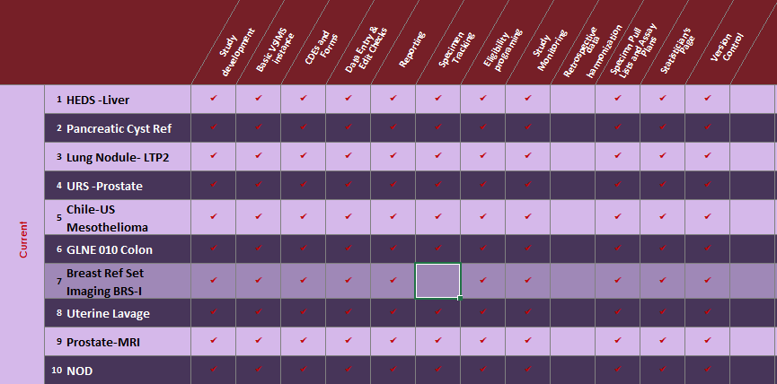
DMCC: Study Operations Overview

Slide 10
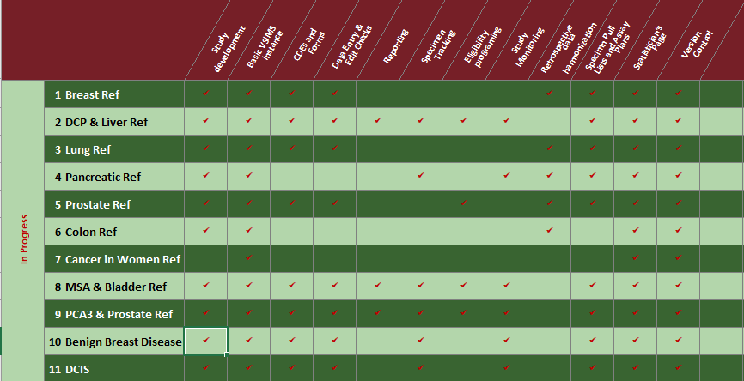
DMCC: Study Operations Overview

Slide 11
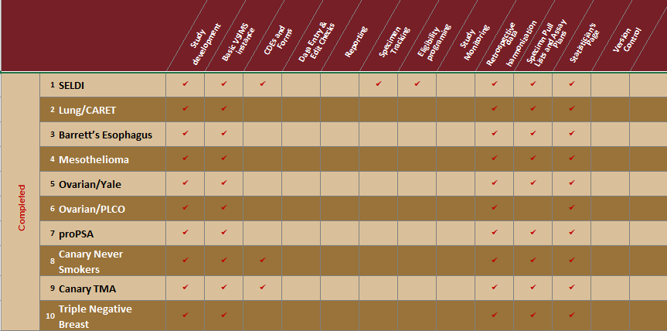
DMCC: Study Operations Overview

Slide 12
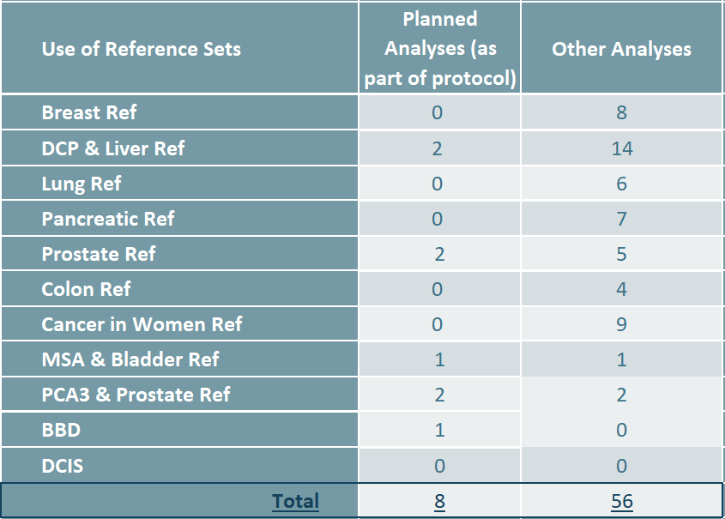
Use of Reference Sets

Slide 13
DMCC Coordination Levels
Study Name | Category A | Category B | Category C | Category D
 | Prospective/Multi-Center | Retrospective | Specimen Repositories | Statistical Consultation
 | New Collection | Data Harmonization | No Limit | No Limit
 | Maximum 6 | Maximum 4
Breast Ref |  |  | X
DCP & Liver Ref |  |  | X
Lung Ref |  |  | X
Pancreatic Ref |  |  | X
Prostate Ref |  |  | X
Colon Ref |  |  | X
Cancer in Women Ref |  |  | X
MSA & Bladder Ref |  |  | X
PCA3 & Prostate Ref |  |  | X
Benign Breast Disease (BBD) |  |  | X
DCIS |  |  | X
1 HEDS Liver | X
2 Pancreatic Cyst Ref | X
3 Lung Nodule LTP2 | X
4 URS Prostate | X
5 Chile-US Mesothelioma | X
6 GLNE 010 Colon | X
*7 Breast Ref Set Imaging BRS-I | X | X
*8 Uterine Lavage | X
*9 Prostate-MRI | X
*10 NOD | X
*Funded through carry-forward or supplement

Slide 14
Ongoing Prospective Study Facts (as of 7/31/2018)
Types of Inquiries:
Types of Requests:
Incomplete Specimen Worksheets
Specific Participant Questions
Data Updates
Protocol Questions
SOP Questions
Specific Participant Questions
Supply Requests & Questions
Entry Errors

Slide 15
How can DMCC help you?
Consultations for sites on study design, biomarker development and triage strategies, data analyses, challenges that require statistical innovations.
  The DMCC statistical team is arguably the best in developing new statistical methodology in diagnostic/screening biomarker evaluations.
When you think you may have a biomarker that is near the stage of validation study, talk to DMCC to help you appraise your data evidence, help you write validation study proposal to be submitted to EDRN EC for review/approval.
  It does not have to be your own biomarker!
Validation study: closely work with NCI and DMCC as a team.

Slide 16
Questions?

