Slide 1
National Institute of Standards and Technology
Reference Laboratory
Project UPDATEs
Anne Plant, PhD
NIST Fellow
anne.plant@nist.gov

Slide 2
Focus on Liquid Biopsy (LB)
I. Measurements of Tumor DNA in LB: reference materials / interlaboratory evaluation of measurement quality
II. Measurements of Methylated DNA in LB
III. Measurements of Gene Copy Number Variants in LB
IV. Future work with exosomes
  Graphic: Huntsman Cancer Institute, University of Utah

Slide 3
Challenge: clinical validation
First: Analytical validation
Discovery/ Preclinical
Clinical validation
Relatively easy
Hard due to biological variability
accuracy
reproducibility / repeatability / robustness
sensitivity / specificity
dynamic range / response function
Notes:
Preclinical analysis must have a high level of confidence, and level of confidence must be known, in order to compare to clinical results where there is much more uncertainty due to biological variability

Slide 4
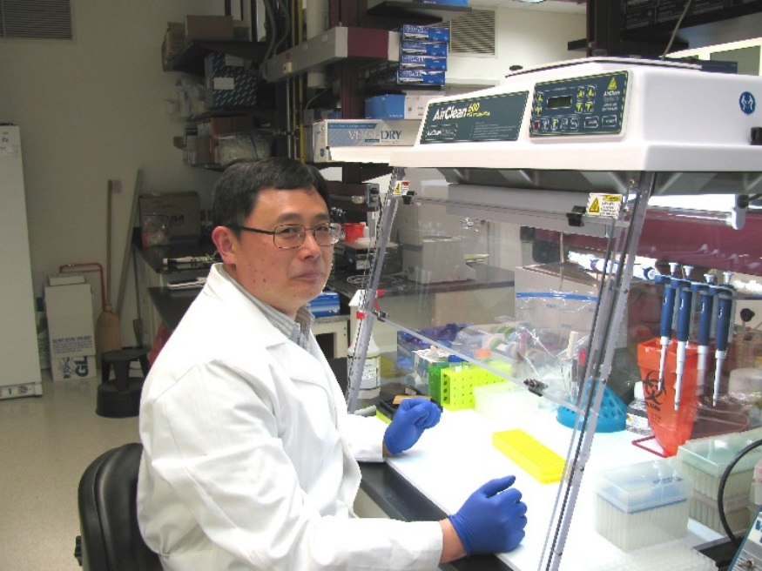
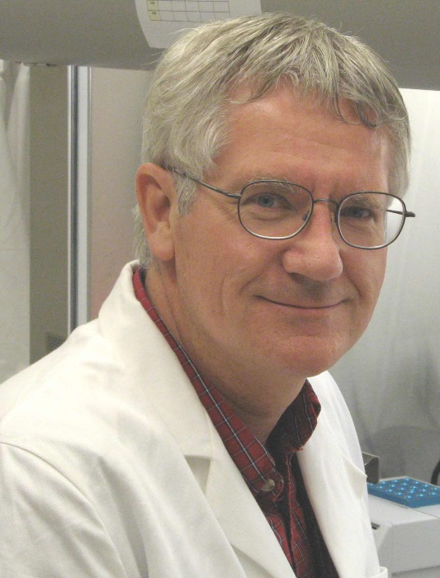

NIST Technical Experts
Hua-Jun He: Research Scientist
Kenneth Cole: Group Leader
Jamie Almeida: Research Biologist
In addition, we confer with NIST experts in statistics, gene sequencing, bioinformatics, Office of Standard Reference Materials.

Slide 5
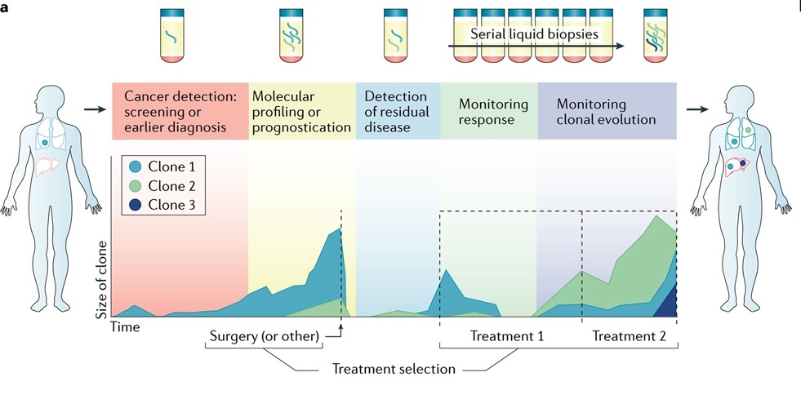
Circulating Tumor DNA (ctDNA) in LB
Clinical Applications
Wan et al. Nature Reviews Cancer (2017) doi:10.1038/nrc.2017.7
Notes:
| A schematic time course for a hypothetical patient who undergoes surgery (or other initial treatment), has a disease relapse and then receives systemic therapy. The potential applications of liquid biopsies during this patient's care are indicated. The patient starts with one single disease focus, but multiple metastases and distinct clones (depicted in different colours) emerge following treatment. b | The information extracted from circulating tumour DNA (ctDNA) may be classified, broadly, as quantitative information (that is, relating to tumour burden) or genomic information. Quantification of ctDNA at a single time point may allow disease staging and prognostication, and genomic analysis can inform the selection of targeted therapies. Therefore, longitudinal analysis allows the quantitative tracking of tumour burden to monitor treatment response, for example, and by comparing genomic profiles over time, clonal evolution may be monitored.

Slide 6
Challenges for Analytical Validation of DNA in Liquid Biopsy
Low concentration of mutations in high background of wild-type DNA
Degraded in molecular weight
Many mutations, which ones and what kinds to focus on
Measuring assay performance: limits of detection, specificity, ranges…
Process controls (pre-analytical process steps)
Calibrators (standards) that work with different methods and instruments (commutability)

Slide 7
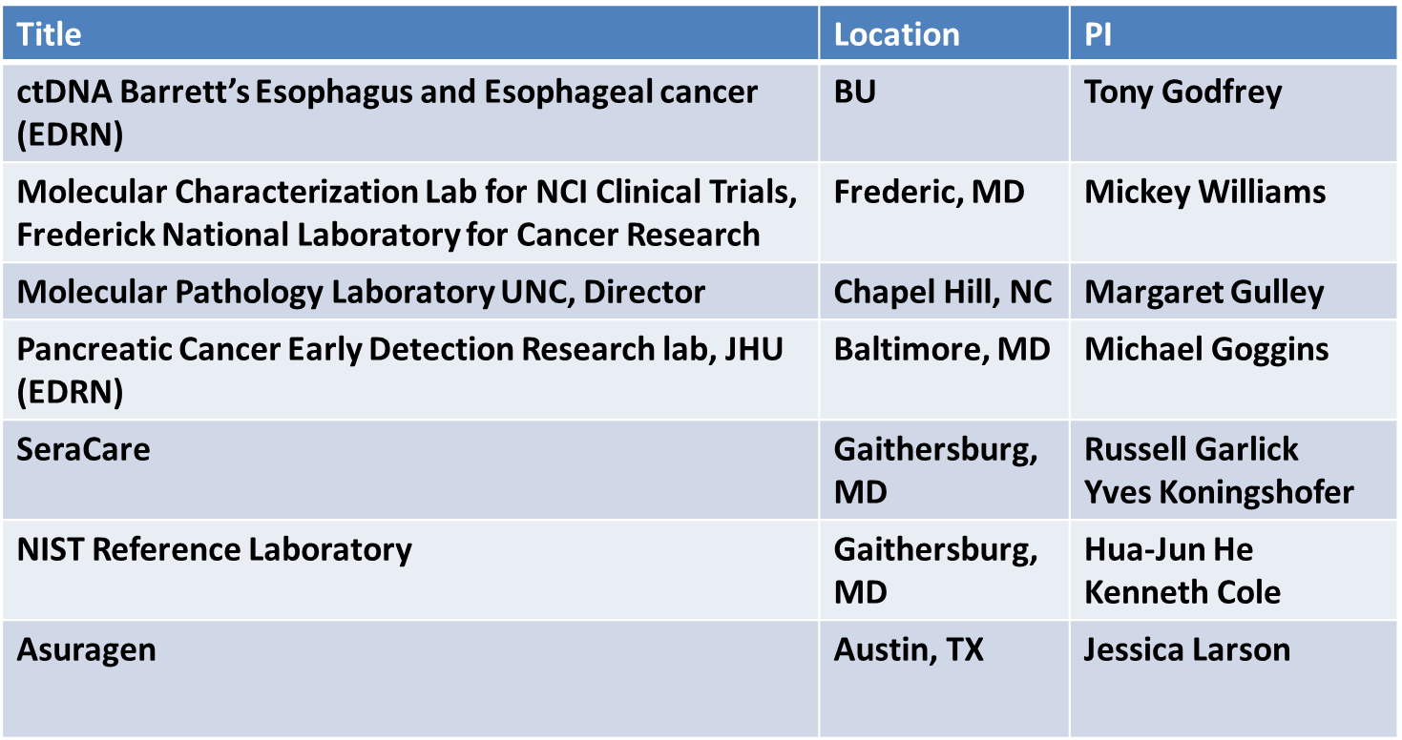
Multilab Assessment of ctDNA Measurements
Interlab Study of Commercial Circulating Tumor DNA Reference Materials with 40 Variants
*
*
Providing commercially available RM
*
Participating Labs in EDRN Sponsored Interlaboratory Evaluation (manuscript in progress)

Slide 8
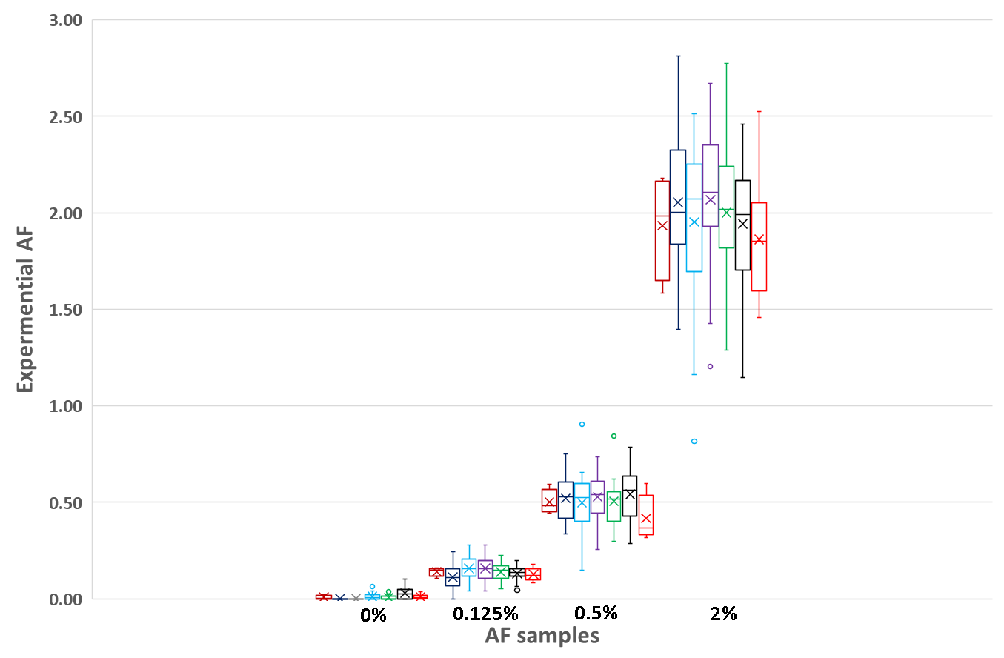
Multilab Assessment of ctDNA Measurements
Four Allele Fractions (AF) commercial 40-variant RM in plasma simulant.
Evaluated by 7 expert labs w 4 different NGS methods and different subsets of the 40.
Tested: extraction, DNA quantitation, variant measurement, and bioinformatic pipeline.
These results establish confidence that *material is robust
*coincidence in results between labs can be achieved
Notes:
Results of 7 labs

Slide 9
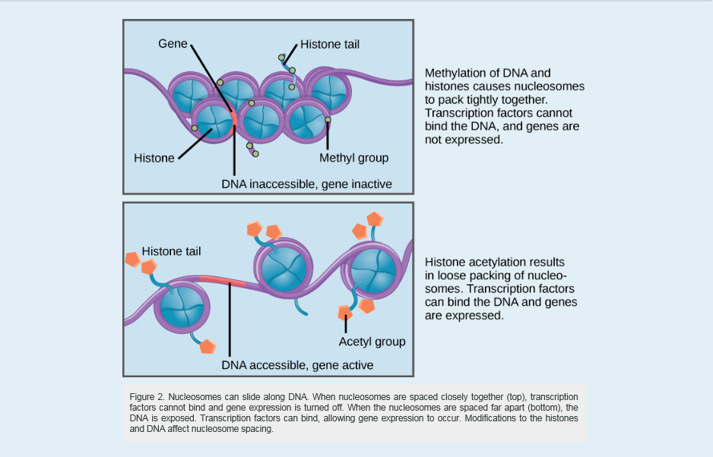
II. Epigenetic Control of Gene Expression: Markers for Early Detection of Cancer
https://courses.lumenlearning.com/wm-biology1/chapter/reading-eukaryotic-epigenetic-gene-regulation/

Slide 10
NIST Strategy for Methylation Assays and Reference Material Evaluation
Characterize existing commercial reference materials
Evaluate use of NIST Genome in a Bottle: human DNA reference materials highly annotated for sequence identity
Implementing assay MethylLight digital PCR assay for mir342/EVL (colon cancer risk, in consultation with Bill Grady and Ming Yu, Fred Hutchison Cancer Center)
Implementing assay for CCNA1 plus VIM DNA methylation Identifying DNA methylation biomarkers for non-endoscopic detection of Barrett's esophagus (in consultation with Sandy Markowitz and Helen Moinova, Case Western University)
Notes:
Sci Transl Med. 2018 Jan 17;10(424). pii: eaao5848. doi: 10.1126/scitranslmed.aao5848.
Identifying DNA methylation biomarkers for non-endoscopic detection of Barrett's esophagus.
Moinova HR1, LaFramboise T2,3, Lutterbaugh JD1, Chandar AK1, Dumot J1, Faulx A1, Brock W1, De la Cruz Cabrera O4, Guda K2, Barnholtz-Sloan JS2, Iyer PG5, Canto MI6, Wang JS7, Shaheen NJ8, Thota PN9, Willis JE10,11,12, Chak A13,2,12, Markowitz SD13,2,3,12.
Abstract
We report a biomarker-based non-endoscopic method for detecting Barrett's esophagus (BE) based on detecting methylated DNAs retrieved via a swallowable balloon-based esophageal sampling device. BE is the precursor of, and a major recognized risk factor for, developing esophageal adenocarcinoma. Endoscopy, the current standard for BE detection, is not cost-effective for population screening. We performed genome-wide screening to ascertain regions targeted for recurrent aberrant cytosine methylation in BE, identifying high-frequency methylation within the CCNA1 locus. We tested CCNA1 DNA methylation as a BE biomarker in cytology brushings of the distal esophagus from 173 individuals with or without BE. CCNA1 DNA methylation demonstrated an area under the curve of 0.95 for discriminating BE-related metaplasia and neoplasia cases versus normal individuals, performing identically to methylation of VIM DNA, an established BE biomarker. When combined, the resulting two biomarker panel was 95% sensitive and 91% specific. These results were replicated in an independent validation cohort of 149 individuals who were assayed using the same cutoff values for test positivity established in the training population. To progress toward non-endoscopic esophageal screening, we engineered a well-tolerated, swallowable, encapsulated balloon device able to selectively sample the distal esophagus within 5 min. In balloon samples from 86 individuals, tests of CCNA1 plus VIM DNA methylation detected BE metaplasia with 90.3% sensitivity and 91.7% specificity. Combining the balloon sampling device with molecular assays of CCNA1 plus VIM DNA methylation enables an efficient, well-tolerated, sensitive, and specific method of screening at-risk populations for BE.
Methods Mol Biol. 2018;1768:363-383. doi: 10.1007/978-1-4939-7778-9_21.

Slide 11
III. Gene Copy Number Measurements in Liquid Biopsy
NIST Strategy
BAC DNA Clones for the genes:
  ERBB2 (HER2)
  MET
  EGFR
  KRAS
Cell lines: breast, ovarian, gastric …
Example of NIST Reference Materials for Copy Number Measurement of Genomic DNA (see supplemental slides)
Exploring methods to simulate size of cell-free DNA in LB: nucleosomal DNA digestion

Slide 12
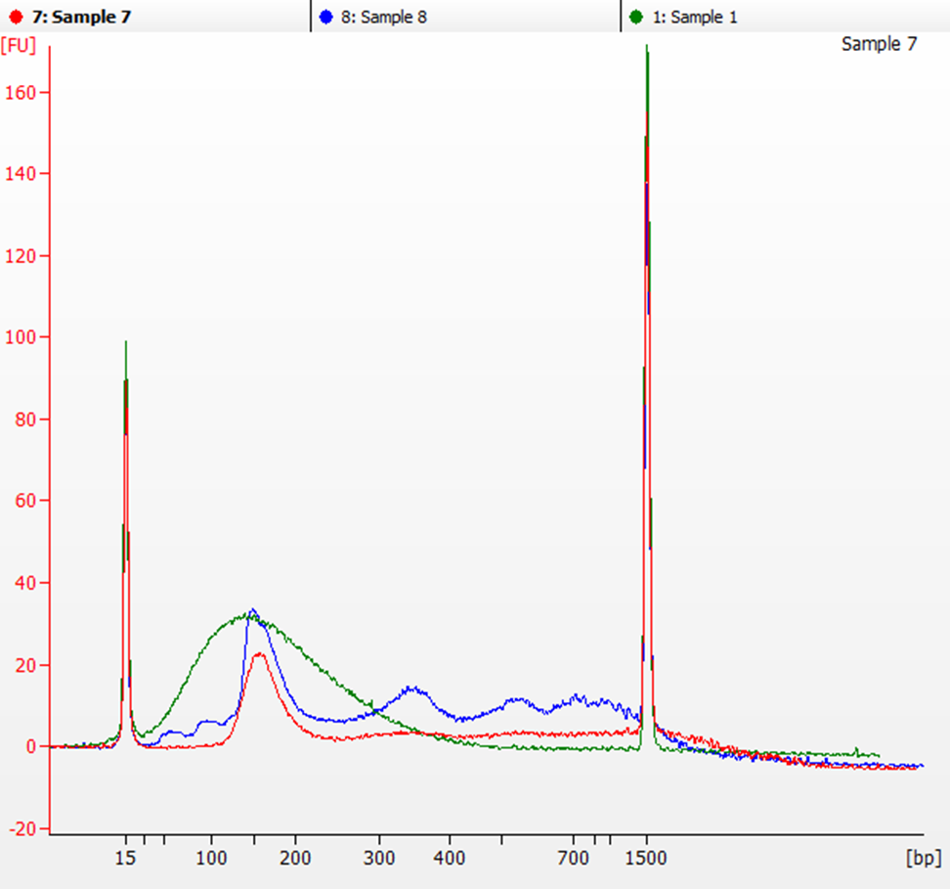
Comparison of Different Methods to Prepare Reference Materials with Size-Distribution that Simulates Patient Plasma DNA
Genome in a Bottle DNA (GM 24385)
This strategy would produce a reference material that is more relevant to a patient sample.
Bioanalyzer analysis
Covaris (physically sheared) fragmented DNA (Green);
Nucleosome DNA treated by Atlantis dsDNase (Red);
Nucleosome DNA treated by MNase (Blue)
Notes:
Source of DNA: cell line for Genome in a Bottle GM 24385

Slide 13
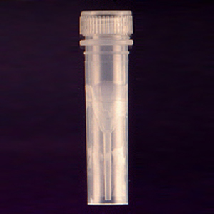

NIST Strategy for Reference Material Spike-In Mixtures for LB
Custom markers for reference materials to support discovery
~160 bp x 17 DNA fragments
BRAF (V600E)
EGFR (D770_N771insG)
EGFR (E746_A750delELREA)
EGFR (T790M)
KIT (D816V)
KRAS (G12D)
NRAS (Q61R)
PIK3CA (H1047R)
PIK3CA (N1068fs*4)
BRAF mirror sequence
AKT1 (E17K)
APC (R145O)
EGFR (L858R)
ERBB2 (L755S)
PTEN (P248fs*5)
TP53 (R175H)
TP53 (R273H)
Restriction Enzyme
Synthetic Plasmid
Plasmid Sequence
Calibrator test mixtures
Nuclease
Mix at desired ratios
and concentrations
GM24385
Size from 100 to 200 bp
Fragmented genomic DNA

Slide 14

IV. Future Work
Quantitative Flow Cytometry
  Standardization of Measurements of Exosomes for Cancer Diagnostics and Treatment
  Assays for chronic lymphocytic leukemia
  Measurement of myeloma markers during therapy
  Assays for intracellular and secreted cytokines for therapy and biomanufacturing
Lili Wang, Project Leader, Flow Cytometry

Slide 15
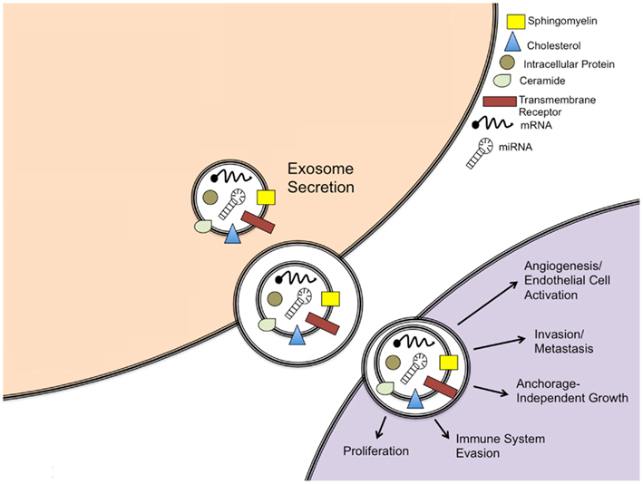
Exosomes are extracellular vesicles (EV) carrying bioactive molecules with essential roles in intercellular communication and immune system modulation
Size | Origin | Composition | Functions | Application
50-150 nm | Intraluminal multivesicular bodies released directly into extracellular space from late endosomal vesicles | microRNA mRNA Proteins lipids | Intercellular communication and immune system modulation | Cancer Diagnostics Predictor for anti-tumor adaptive treatments Therapeutics
Front. Oncol., 17 April 2012
http://dx.doi.org/10.3389/fonc.2012.00038
Nature, 16 August 2018
https://doi.org/10.1038/s41586-018-0392-8

Slide 16

Strategies for Developing Reference Materials and Procedures for Reliable Exosome Measurement Using Flow Cytometry
Size, concentration, and fluorescence intensity calibration materials for characterizing scattering and fluorescence detection sensitivity of flow cytometers:
    EVs → Refractive Index 1.37 - 1.39
    Polystyrene (PS) → Refractive Index 1.59
    Silica nanoparticles (SiO₂) → Refractive Index 1.45 – 1.54
    Liposomes → Refractive Index 1.36 - 1.39
Exosome reference materials for fit-for-purpose applications (exosomes from various cancers).
Building an ultra-sensitive quantum flow cytometer for exosome detection and enumeration.
Development of reference methods/procedures for reliable flow analysis of exosomes that incorporate cytometer calibration, counting, and exosome reference materials.

Slide 17
Summary: Focus on Liquid Biopsy (LB)
I. Measurements of Tumor DNA
II. Measurements of Methylated DNA
III. Measurements of Gene Copy Number Variants
IV. Future work with exosomes
Benefits to working with NIST to develop and test reference materials
NIST is engaged with the FDA and understands their criteria.
NIST engages industry that can produce relevant reference materials.
NIST has a well-established reputation for developing and validating materials and measurements that can lead to clinically important biomarkers.
NIST is not a regulatory agency, and we DO NOT impose standards.

Slide 18
NIST Technical Experts
Kenneth Cole
Hua-Jun He
Thank You

Slide 19
Supplemental Slides

Slide 20
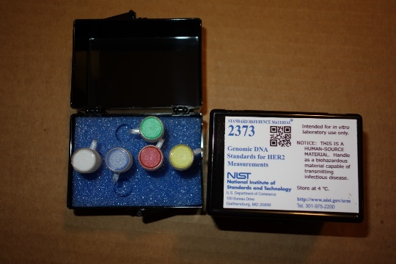
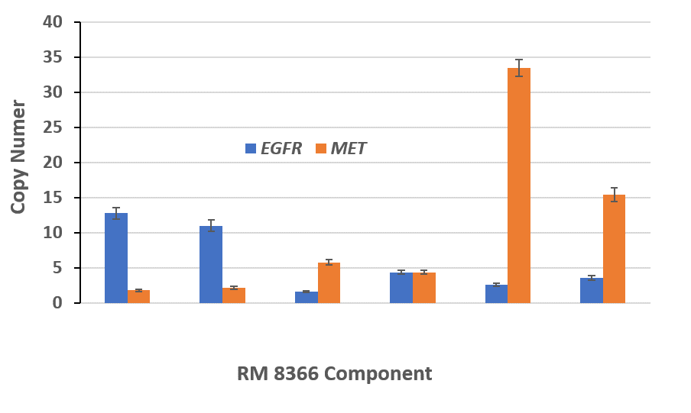

Comparability Through Reference Materials
NIST HER2 Genomic DNA Standard Reference Material, SRM® 2373: a well-characterized genomic DNA reference material that can be used to improve the confidence of the measurements of HER2 gene copy number.
NIST EGFR/MET Gene Copy Number Standards for Cancer Measurements, RM 8366: a well-characterized genomic DNA reference material that can be used to improve the confidence of the measurements EGFR and MET gene copy number.
NIST Genome in a Bottle: reference standards, reference methods, and reference data to enable translation of whole human genome sequencing to clinical practice.
Notes:
The priority of GIAB is authoritative characterization of human genomes for use in analytical validation and technology development, optimization, and demonstration.

Slide 21
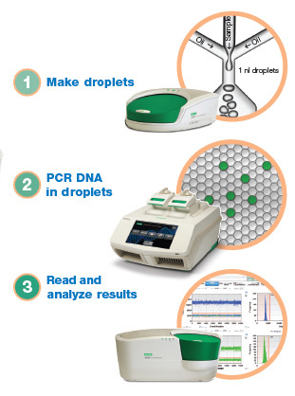
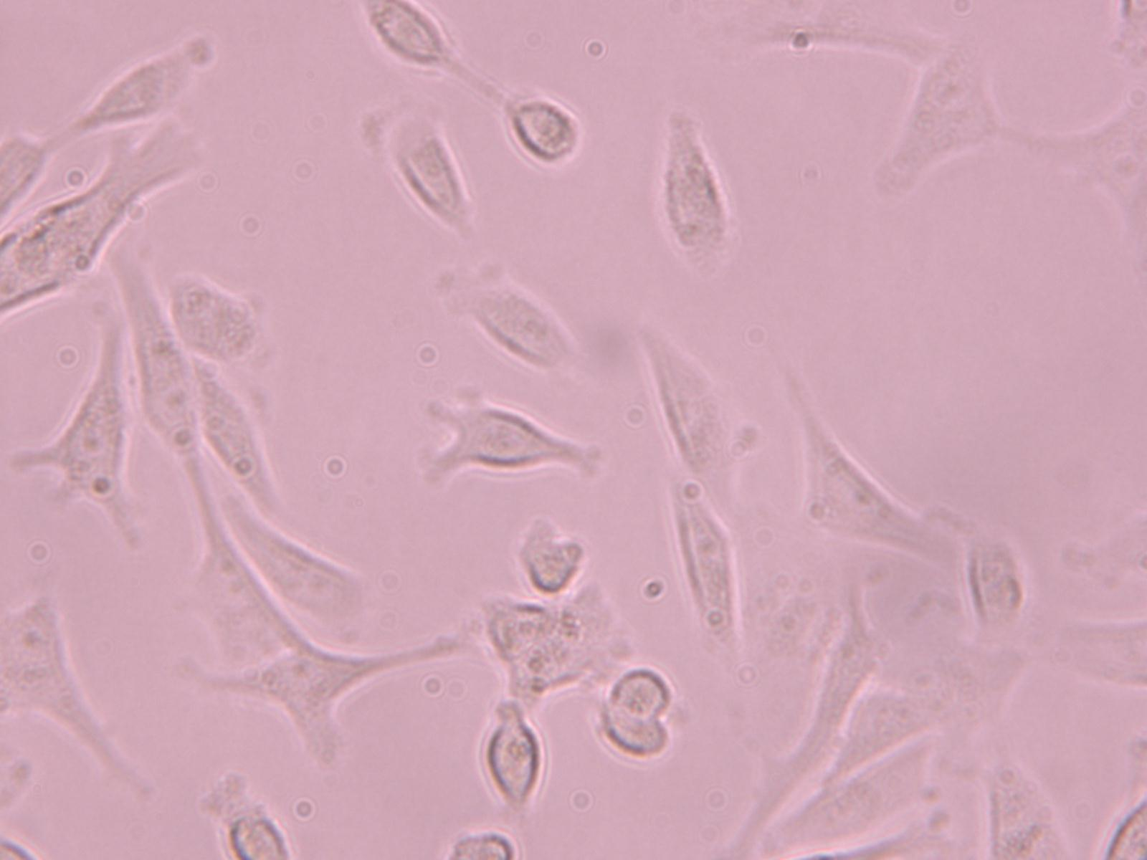
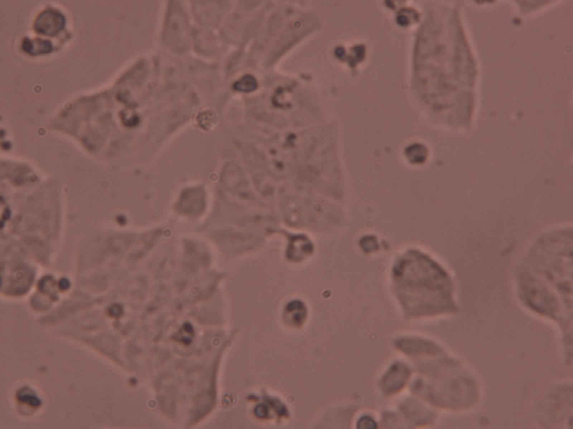
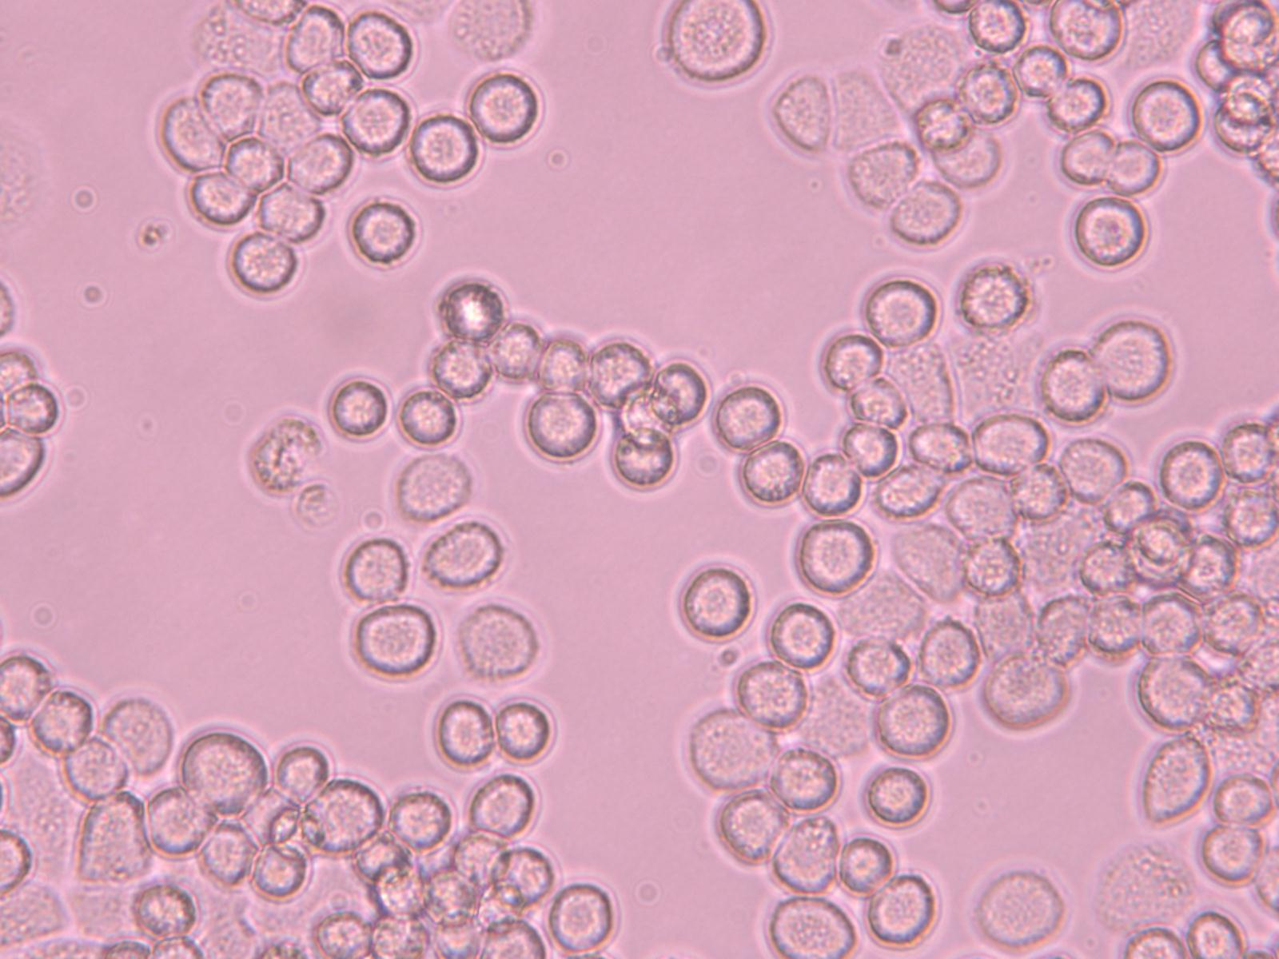
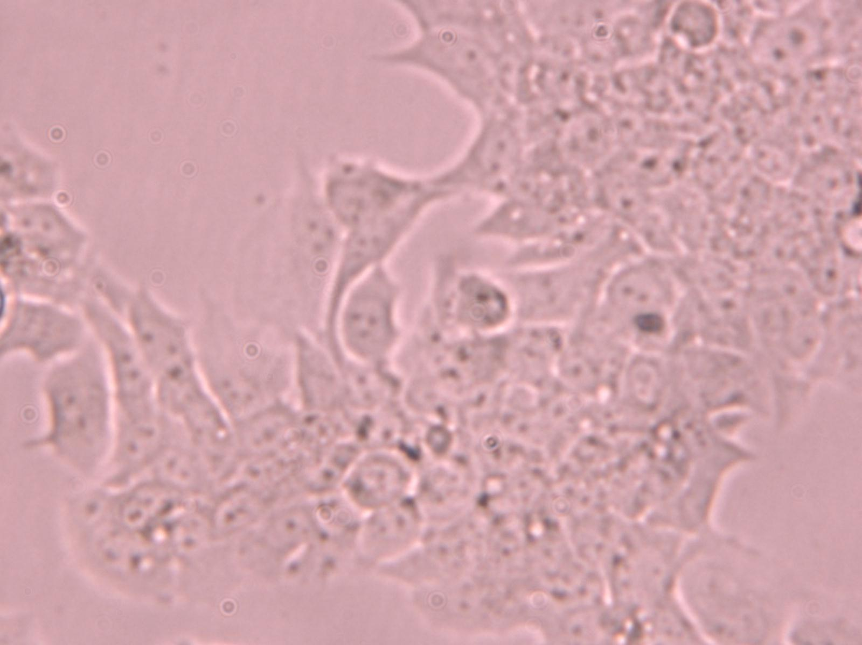
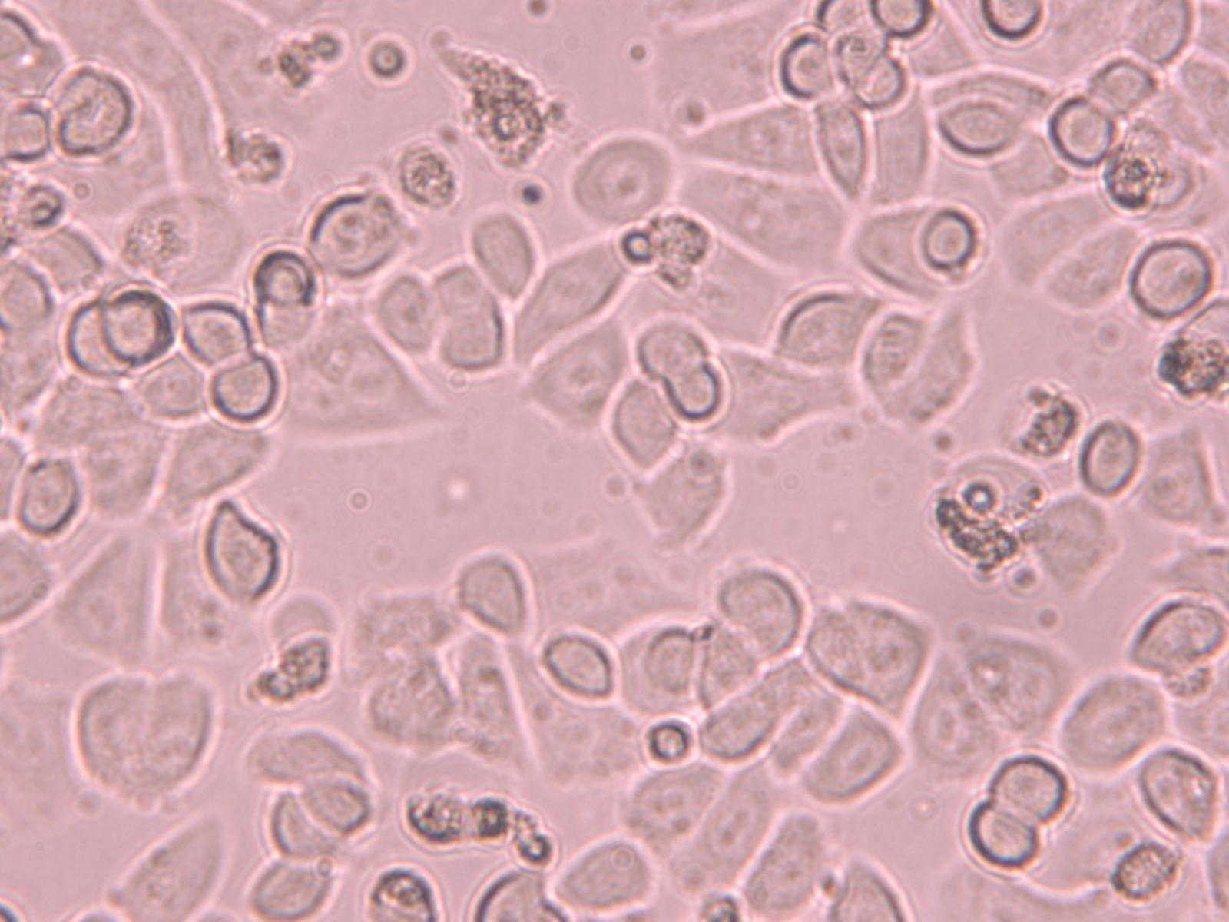
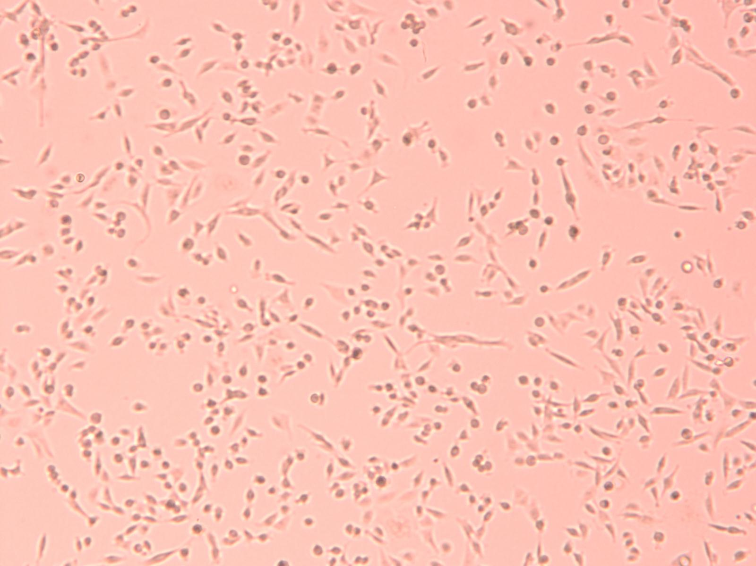
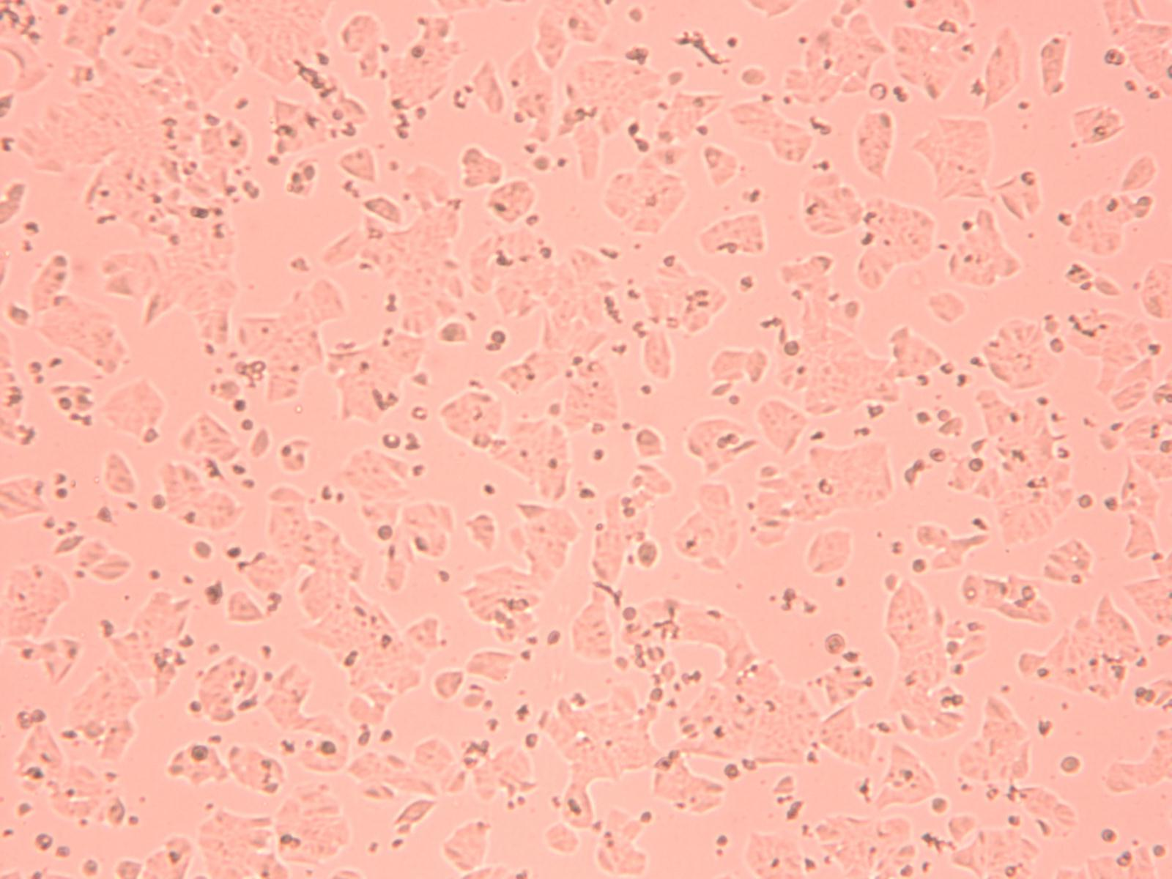
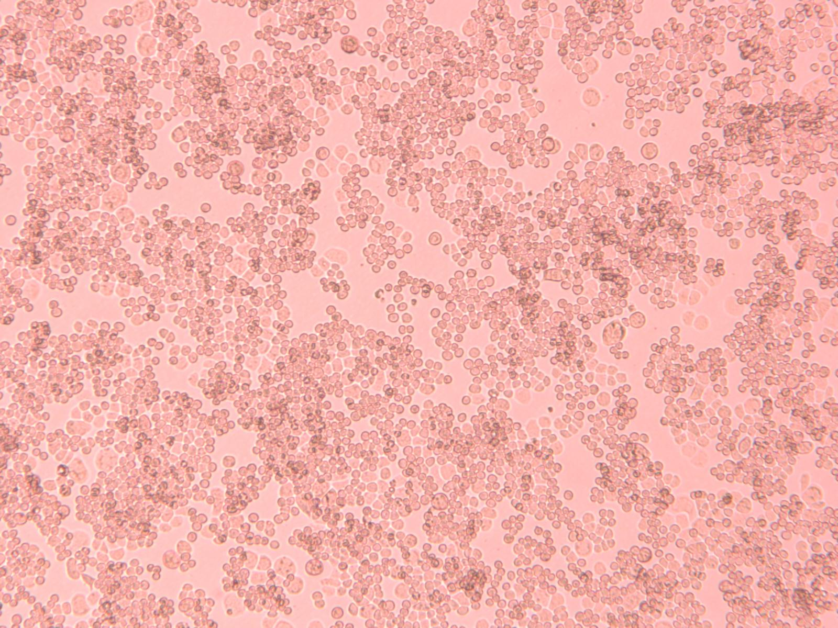
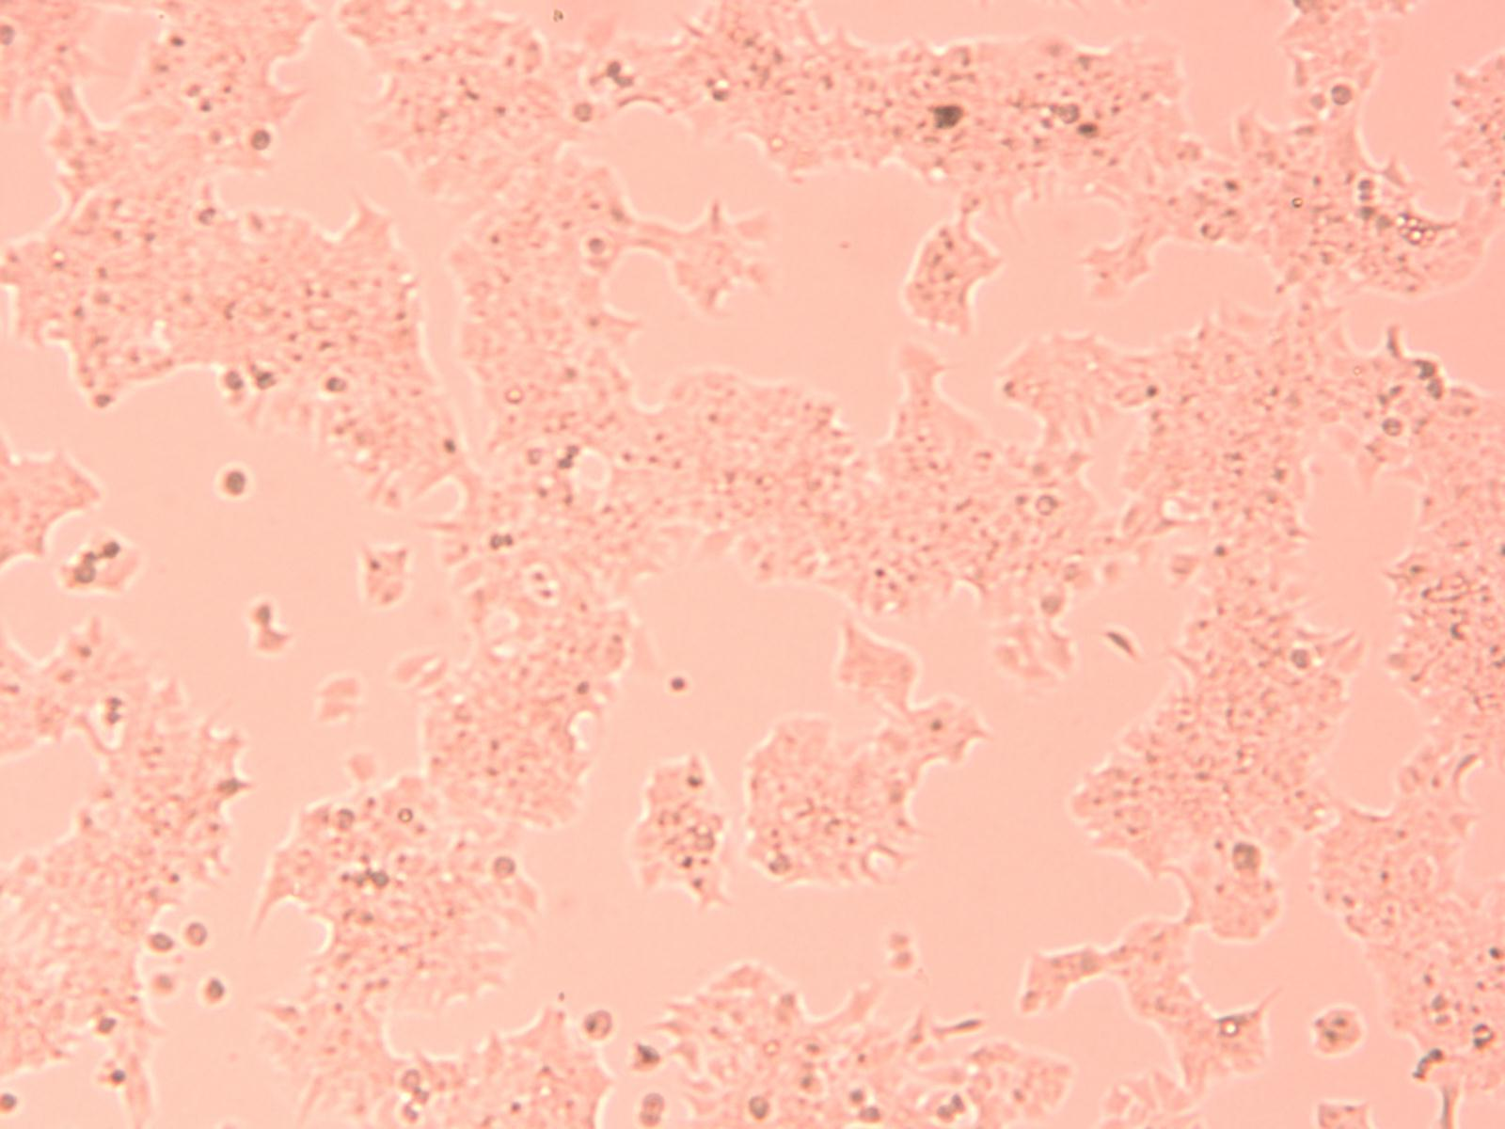
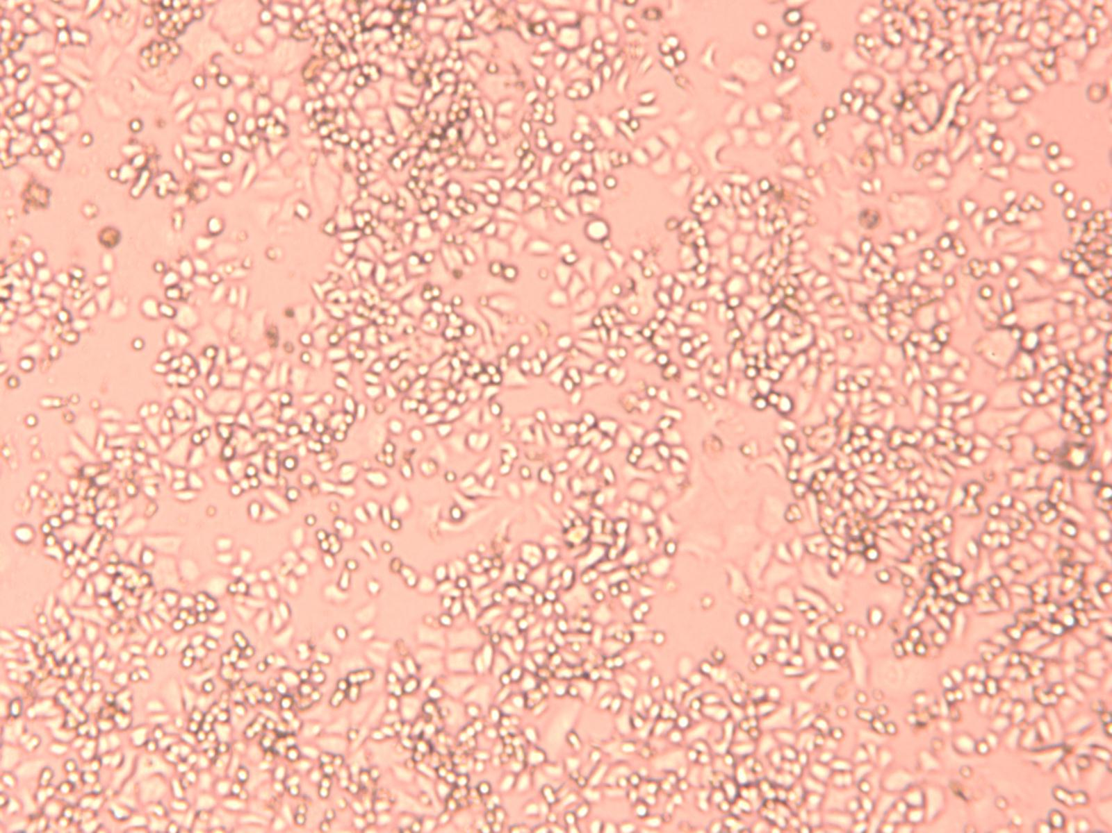
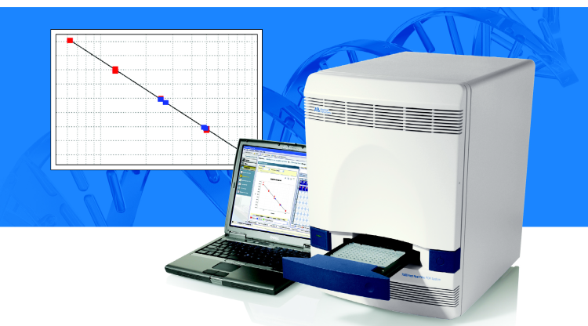
NIST SRM 2373:HER2 Copy Number Genomic DNA
Copies by dPCR
5 breast cancer cell lines
Copies by qPCR
Additional Measurements
HER2 protein expression levels on cells measured
with flow cytometry
Measurement of messenger RNA levels in cells
Notes:
We are seeking the true value of the copy number using two orthogonal techniques
Sequencing may be the third dimension

Slide 22
NIST RMs to Validate NGS Methods for Copy Number Measurements for HER2 and EGFR/MET
Notes:
NIST Developed Reference Materials for Gene copy number measurements
Used to validate Next Generation Sequencing Methods (collaboration with NCI)
Collaborators: Mickey Williams, NCI, Molecular Characterization Laboratory, Reference Lab for MATCH Clinical Trial for Precision Medicine for Cancer Treatment. J Mol Diagnostics (2016) 18, 753
WGS: whole genome sequencing
WES: whole exome sequencing

Slide 23
Breast Cancer Cell Lines for Genomic DNA Isolation
Cell Line | MDA-MB-231 | MDA-MB-361 | MDA-MB-453 | BT-474 | SK-BR-3
Source | Pleural effusion | Brain metastasis | Pericardial effusion | Invasive ductal carcinoma | Pleural effusion metastasis
Karyotype | Hypo-triploid | Hyper-diploid | Tetraploid | Hyper-triploid | Hyper-triploid (highly modified)
Type | Basal B | Luminal | Luminal | Luminal | Luminal
Hormone status | Triple negative | Triple positive | Negative ER/PR | Triple Positive | Negative ER

Slide 24
SRM 2373 to Validate HER2 Gene Copy Numbers by Various NGS and Bioinformatics Methods
Collaborators: Mickey Williams, NCI, Molecular Characterization Laboratory, Reference Lab for MATCH Clinical Trial for Precision Medicine for Cancer Treatment. J Mol Diagn (2016) 18, 753

Slide 25
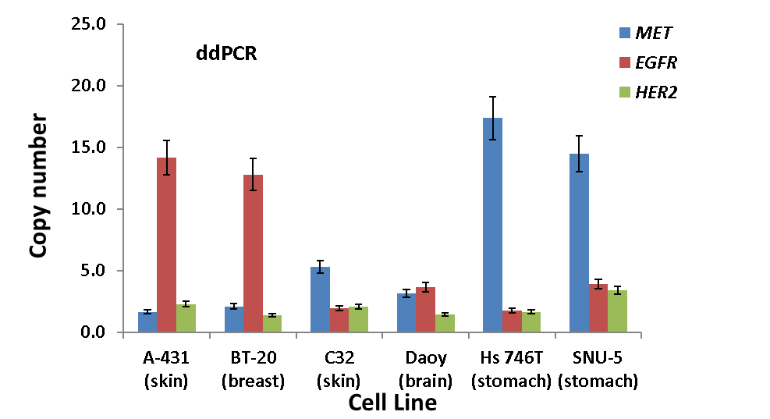
NIST RM 8366: EGFR and MET Gene Copy Number
Standards for Cancer Measurements
Collaborators:
Mickey Williams
MoCha Lab, NIH/NCI
Reference Lab for NCI MATCH clinical trial
Copy number assays for EGFR and MET developed and validated for ddPCR;
The reference genes: RSP27A, DCK, EIF5B, and PMM1 were tested in gDNA extracted from 6 cell lines.

