Slide 1


EDRN Informatics Infrastructure
EDRN Informatics Center
Capabilities and Collaborations
NASA Jet Propulsion Laboratory, Caltech
Geisel School of Medicine at Dartmouth College
Data Management and Coordinating Center
September 5, 2018

Slide 2
Agenda
Overview of knowledge system framework
Overview of public portal
Biomarker Data and Value Added Databases
Bioinformatics Applications and Data Pipelines
Wrap up

Slide 3


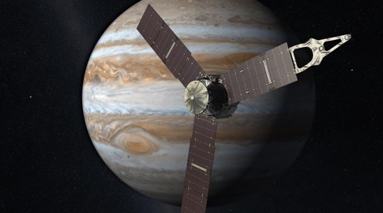
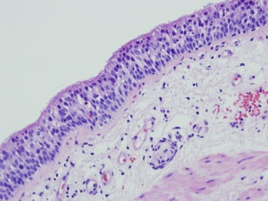

NCI/JPL Informatics Collaboration: Crossing Disciplines to Support Scientific Research
Development of an advanced Knowledge System to capture, process, share and support reproducible analysis for biomarker research
  Genomics, Proteomics, Imaging, etc data types of data
NASA-NCI partnership, leveraging informatics and data science technologies from planetary and Earth science
  Reproducible, Big Data Systems for exploring the universe
  Software and data science methodology transfer based on open source Apache Object Oriented Data Technology developed at JPL
Notes:
As Dan discussed earlier – an interagency agreement was formed between NCI and JPL allowing us to leverage the systems already developed in planetary and earth science to create an advanced knowledge system to capture and share biomarker data for EDRN.

Slide 4
Development of a Knowledge System to capture and share biomarker data results
Develop structured data collection, storage and curation for biomarker validation studies, biomarker database
Integrate data from a variety of experimental platforms and laboratories make easily accessible
Organize data so that it is searchable and informative
Build enabling informatics infrastructure for collaboration, sharing and dissemination
Biomarker DB
Science Data Archive
LabCAS
Common Data Elements
EDRN Portal
Knowledge
Environment
Goal: make data verifiable, consistent and informative to the community

Slide 5

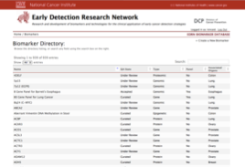
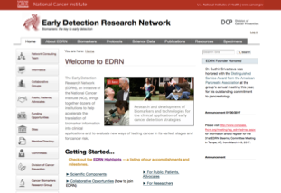
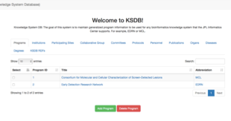
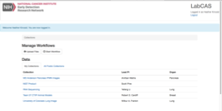
Integrated Knowledge Data Environment
Biomarker Database
BMDB
Informatics Center Knowledge Systems
KEGG
EDRN Portal
GEO
Project Databases
Science Data
Protocols
Biomarkers
Publications
Signatures
Sites
SOPs
Specimens
Etc
PubMed
eSIS
PI WebSites
KSDB
BioMuta
Laboratory Catalog and
Archive Service
eCAS
LabCAS
Canary Foundation
Amazon S3
Specimens
PI Data

Slide 6
What’s in Place Today
A national, biomarker knowledge system
A biomarker data infrastructure consisting of ~1000 biomarkers, ~200 protocols, 1500 publications, 100 TB data
Tools for laboratories to support the processing, capture, curation and sharing of data before publications
Pilot projects in imaging, scalable workflows, data integration, etc.
Support for data-driven approaches for data discovery and analysis
Common portal to access the knowledge environment

Slide 7
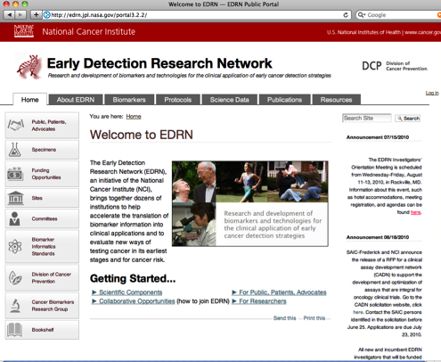
Portal: Dissemination and
Access to Biomarker Data
Gateway to information
Information managed both within and outside the knowledge system
Initial starting point for community to get to research data
Google-like search to access the wealth of data
Multi-level Security
https://edrn.nci.nih.gov

Slide 8
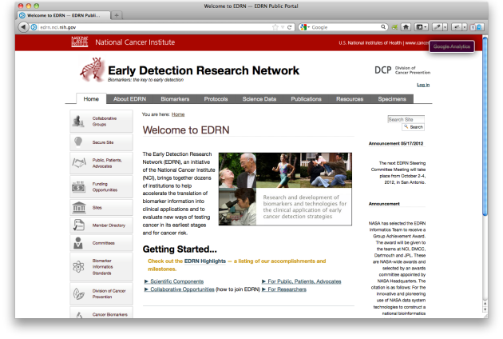
Capturing and Sharing Biomarker
Data Results
Investigator Upload
EDRN Data Curation
EDRN Public Portal
(http://edrn.nci.nih.gov)
Laboratory Data
Generation
Laboratory
Data Warehouse
(LabCAS)
EDRN Data
Warehouse
(eCAS)
Biomarker
Database
(BMDB)
External
Data
Resources
and Tools
EDRN Informatics Center
8

Slide 9
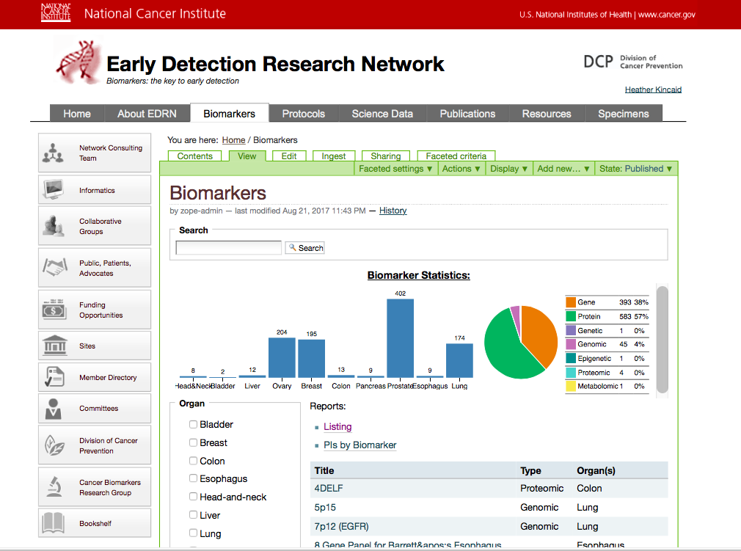
EDRN Biomarker Database (BMDB)
Content:
  940 biomarkers
  EDRN laboratories are source of information
Management:
  2 biocurators
  QC process by domain experts within EDRN
Annotation:
  Driven by metadata
  Partly automated
  Human expertise

Slide 10
Curating New Biomarkers
Ensure we are capturing all biomarker studies including positive and negative results
Extend deep curation of biomarker records
Capture related data sets
Contact us when you are ready to capture biomarkers and deposit data into the EDRN databases
Email to maureen.colbert@dartmouth.edu
  List of biomarker names (e.g., spreadsheet works well)
  Publication/PubMed ID
  Data sets to warehouse

Slide 11
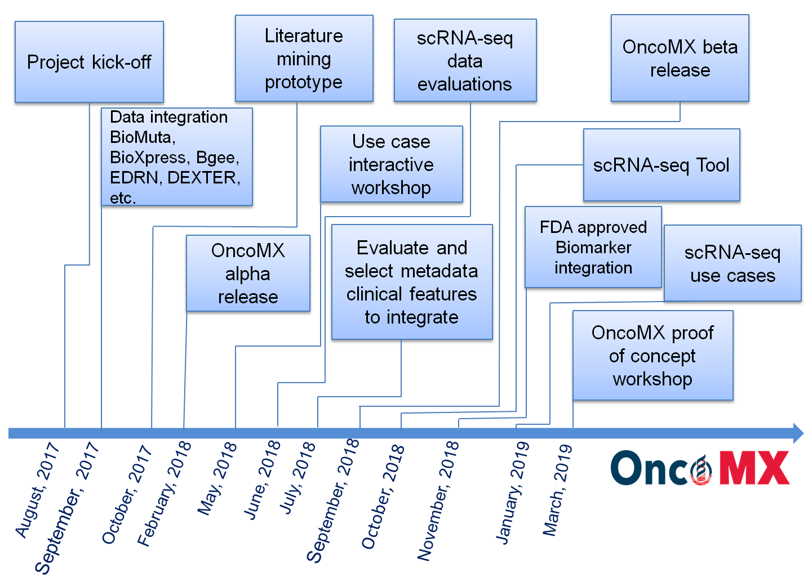
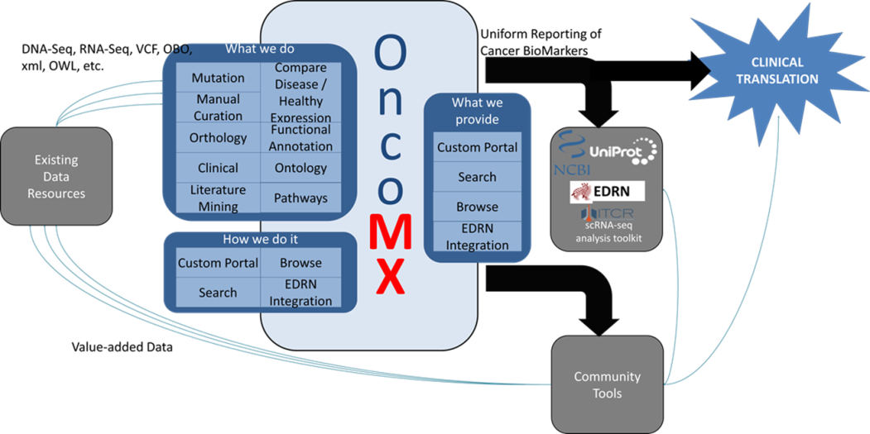





OncoMX: an integrated cancer mutation and expression resource for exploring cancer biomarkers
Integrated cancer biomarker resource that allows easy access to data from:
  BioMuta – mutations
  BioXpress – tumor expression
  Bgee – normal tissue expression
  DEXTER and DiMEX – literature mining
  EDRN - biomarkers
  and more
Integration of comprehensive cancer mutation and expression-associated data for biomarker evaluation and discovery

Slide 12
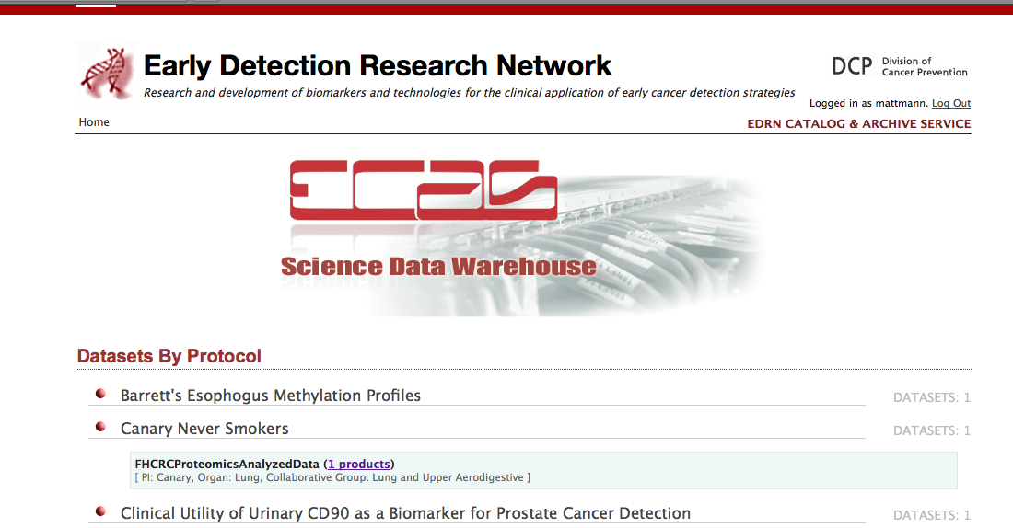
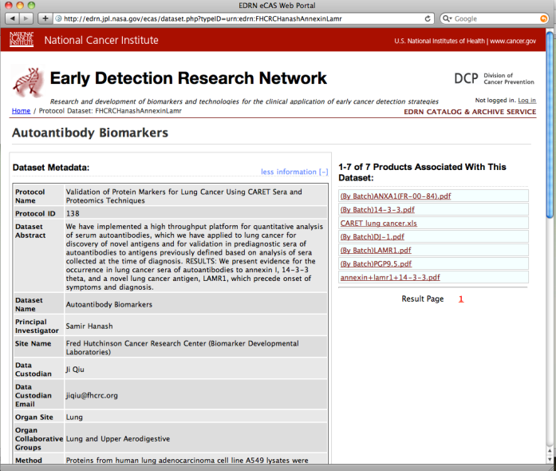
Capture and Sharing of Public Data Sets
EDRN has a warehouse of public biomarker data
  Uses the CDEs to populate a catalog describing the data sets
  Supports public release/access to the data
  Supports peer review of the data by collaborative groups prior to public release
  Integrated with the rest of the knowledge system
Provides a long term and central capture of biomarker study results for the broad community
Credit: Sam Hanash (Validation of Protein Markers for Lung Cancer Using CARET Sera and Proteomics Techniques)
12

Slide 13
Integration of multiple pipelines for data integration
“LabCAS”
Integrated Knowledge
Database
Instrument
Publish Data Sets with
Common Data Elements
Biomarkers
RNASeq
Laboratory Data Repository
Science Data
Processing Algorithm
Image Data
Pathology Data
Genomics Data
Instrument
Publish Data Sets with
Common Data Elements
Protocols
Sites
Laboratory Data Repository
Imaging
Science Data
Processing Algorithm
Instrument
Publish Data Sets with
Common Data Elements
Other Resources
NCI Imaging
Data
caBio
Other
Resources
Laboratory Data Repository
Pathology
Science Data
Processing Algorithm
Scalable computing, common data elements, computational methods
Notes:
Here’s an example of creating pipelines. This is something we are doing with EDRN and MCL programs, but the notion is towards enabling more and more data integration and interactivity with analytical tools

Slide 14
EDRN Scientific Data Pipelines
Support Image Capture for Validation Studies and link to VSIMS:
  Breast Reference Set Image Project to include mammography images (PIs:Jeffrey Marks/John Heine)
  Prostate-MRI Biopsy Project (PI: John Wei)
Pipelines:
  NIST: Facilitate submission of data from labs partaking in micro-RNA collaborative study (PI: Scott Pine)
  Biomarker Discovery: scale execution of data processing pipelines on the Cloud (PI: Marc Lenburg)
EDRN Protocol Data:
  Three EDRN Breast Protocols (PI: John Heine)

Slide 15
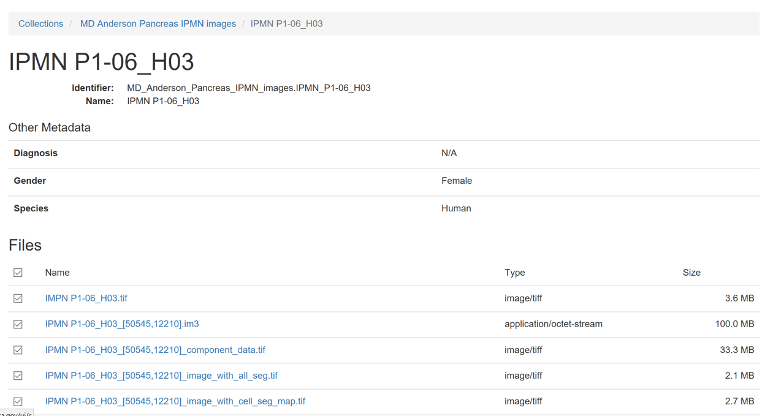
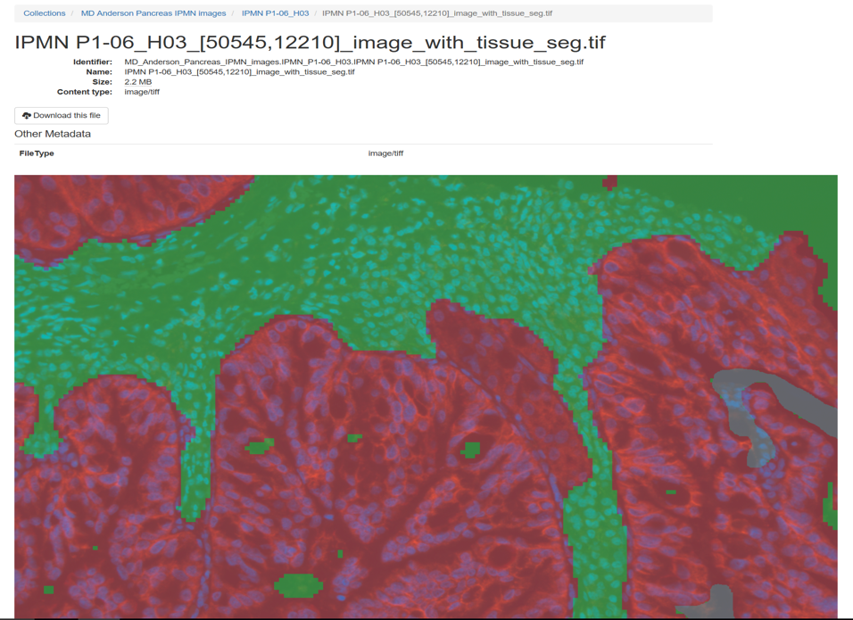
Support for Image Archiving

Slide 16
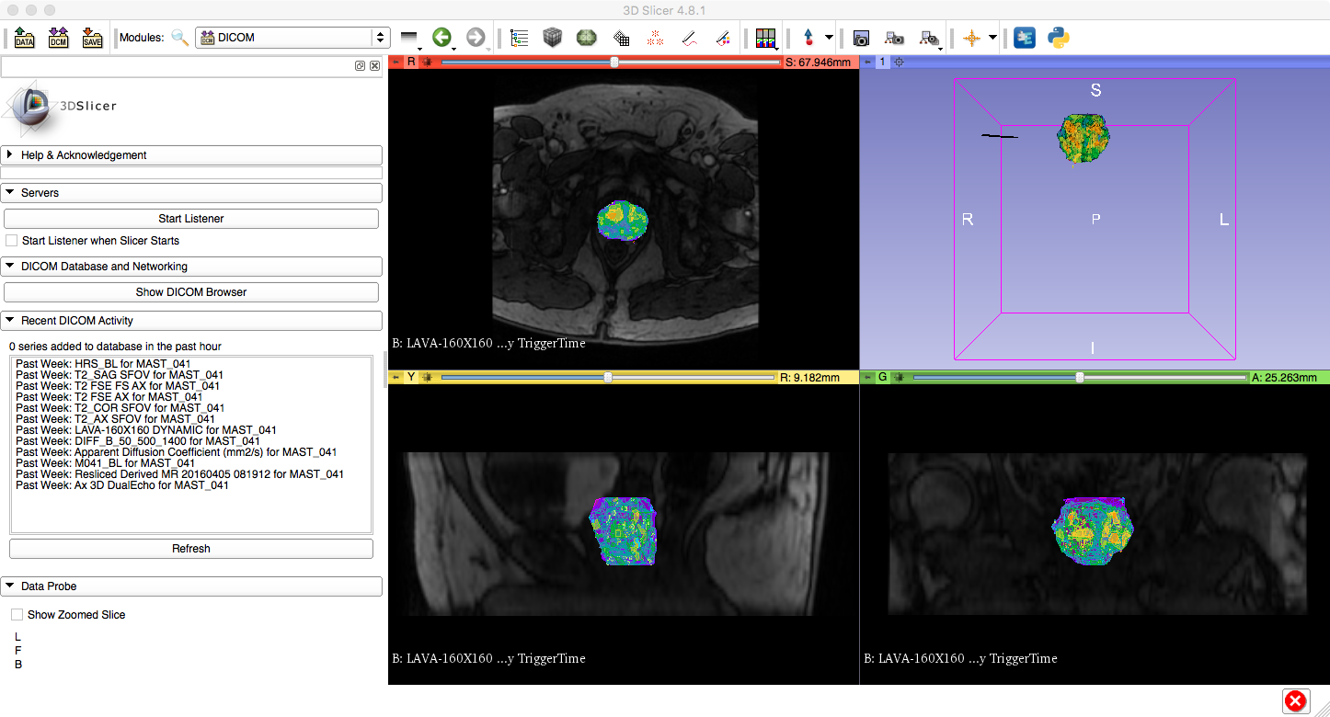
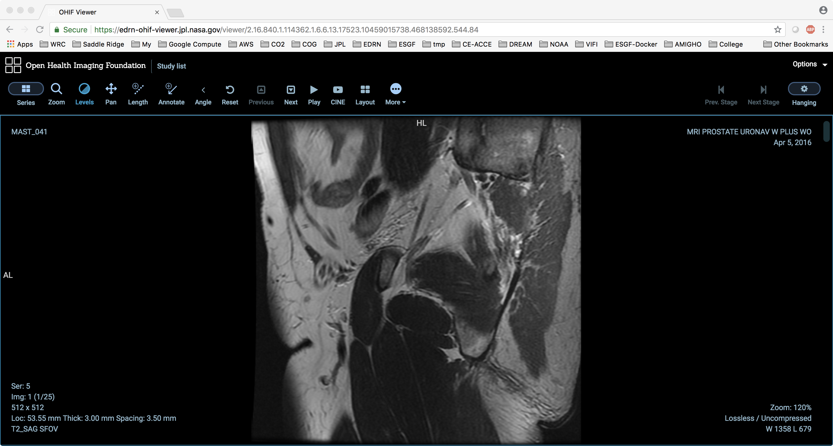
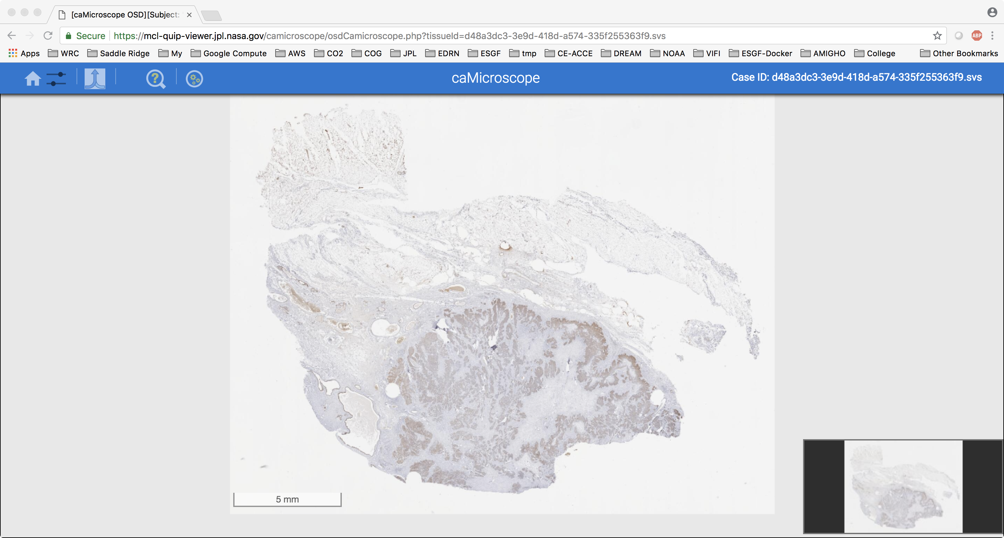
Integrate different analytical tools
Framework to plug-in many open-source viewers (client and server side)
  caMicroscope
  OHIF DICOM Viewer
  3D Slicer
Capture additional metadata
User specified organization of data
New approaches for data integration and exploitation
Notes:
This is important because our focus is on the ECOSYSTEM and not a specific tool
Those will come and go and we plug them in!

Slide 17
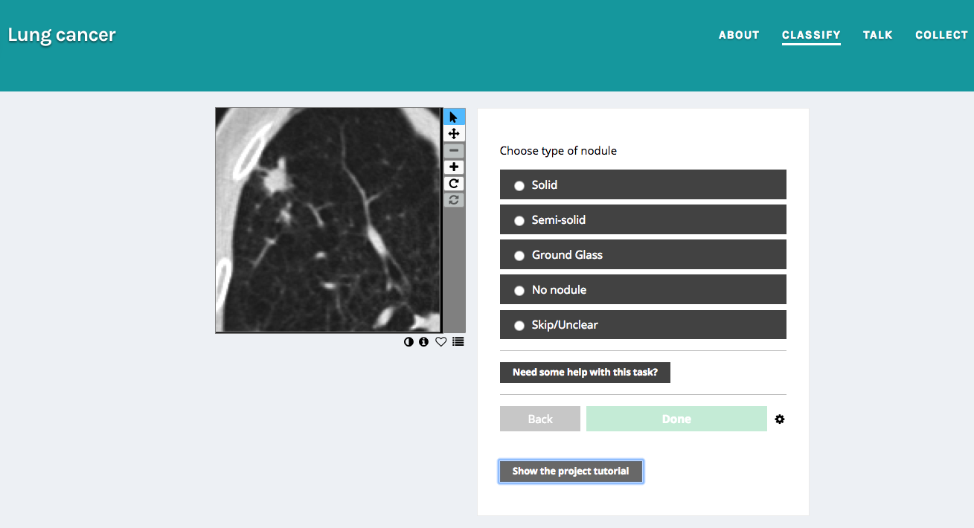
Crowd Sourcing Image Analysis
Adaptation of Zoonverse
Reduce False Positives from traditional ML
Support clustering for radiologists
Construct training sets
Notes:
Crowd sourcing inputs to deal with variations
Zoonverse

Slide 18
Conclusion: Working Together
Make sure you can access the portal for secure information (requires a login)
Capture your biomarkers and results in the database – Contact Maureen Colbert (Maureen.Colbert@dartmouth.edu)
Capture and link your public science data – Contact Maureen Colbert (Maureen.Colbert@dartmouth.edu)
Support your data processing, capture, and sharing needs for your studies
Integrate biomarker resources from your sites and work: tools, data resources, etc
Work with your informatics teams
Please contact Heather Kincaid (Heather.Kincaid@jpl.nasa.gov)

Slide 19
EDRN and MCL Acknowledgements
Marc Lenburg, Boston University
Avi Spira, Boston University
Sandy Borowsky, UC Davis
Anirban Maitra, MD Anderson
Scott Pine, NIST/Stanford
Raja Mazumber, George Washington
Steve Skates, Harvard
Michael Birrer, MGH
Joel Saltz, Stony Brook
Gordon Harris, MGH
Chris Amos, Baylor
Ziding Feng, MD Anderson

Slide 20
NCI Request for Information (RFI)
Input on Development of an NCI Cancer Biomarker Data Aggregator
A federated data system that will provide access to relevant tools, services, and information on biomarkers with potential clinical utility
Response Date: October 20, 2018
Notice Number: NOT-CA-18-095 https://grants.nih.gov/grants/guide/notice-files/NOT-CA-18-095.html
All responses must be submitted to NCIIDCRFI@mail.nih.gov by October 20, 2018

Slide 21










Informatics Center Acknowledgements
  NCI
  Dartmouth
  Caltech
  JPL
JPL Informatics Center Team:
Dan
Crichton - PI
Luca Cinquini
Sean Kelly
Heather Kincaid
David Liu
Chris Mattmann
Ashish Mahabal
Kristen Anton
(Dartmouth)
Maureen Colbert
(Dartmouth)
Thomas
Fuchs
(Sloan Kettering)
Notes:
As Dan discussed earlier – an interagency agreement was formed between NCI and JPL allowing us to leverage the systems already developed in planetary and earth science to create an advanced knowledge system to capture and share biomarker data for EDRN.

