Slide 1
Use of Novel Proteomic Approaches for Cancer Biomarker Identification and Verification
33rd Early Detection Research Network
Steering Committee Meeting
Karin D. Rodland, Ph.D.
September 5th, 2018

Slide 2
Translating Proteomic Discoveries to the Clinic: the Biomarker Problem
There is an unmet clinical need for minimally invasive biomarkers for early detection of ‘silent’ cancers, such as cancers of the ovary or pancreas
Multiple laboratories have been funded to identify potential biomarkers, generating long lists of candidates
Discovery strategies have included transcriptome profiling, next-gen sequencing of DNA, DNA methylation, and proteomic studies
There is a need to convert candidate lists to protein-based assays and prioritize for development of affinity reagents
Use of targeted proteomics can rapidly identify good-performing candidates without the need for affinity reagents
The Goal: Help Poor Performing Candidates Fail Quickly and Cheaply

Slide 3
A General Strategy for Biomarker Development
bottleneck
Rifai et al., Nat Biotechnol. 2006, 24, 971-983

Slide 4
Integrating Discovery and Verification
Broad Quantification for Discovery
Protein abundances
Multiple types of PTMs
Targeted quantification
for experimental Verification
Protein activities
PTM crosstalk and pathways/networks
Global proteomics is hypothesis generating
Targeted proteomics is hypothesis testing

Slide 5
The Sensitivity Problem in Biomarker Discovery
Global LC-MS/MS
SRM
advanced SRM
PSA
Anderson et al., Mol Cell Proteomics, 2002

Slide 6
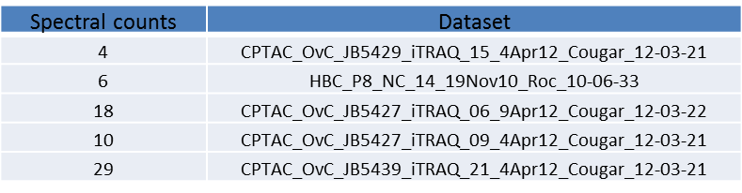
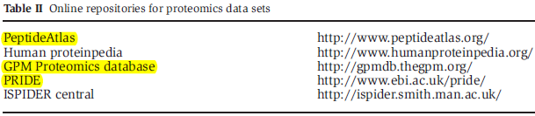

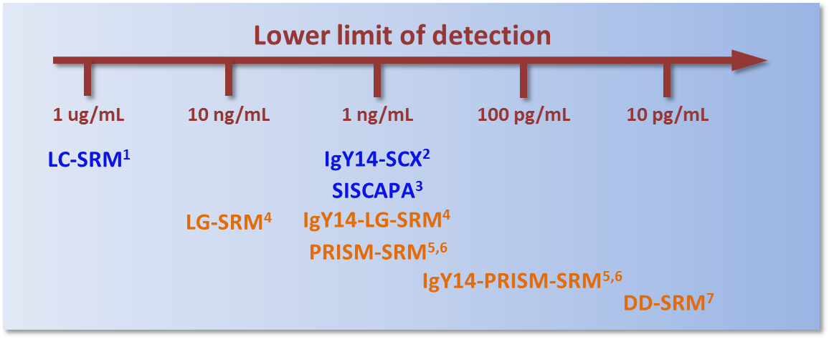
Targeted MS Assays are Specific and Sensitive
PNNL data
Online database
Prediction tools
Protein represented by 2 or more unique peptides:
Using 10-200 µL of blood plasma or serum
Other platforms
PNNL platforms (Ab-independent)
¹Anderson et al., Mol Cell Proteomics. 2006, 5, 573-588
²Keshishian et al., Mol Cell Proteomics. 2007, 6, 2212-2229
³Whiteaker et al., Mol Cell Proteomics. 2012, 11, M111.015347
⁴Shi et al., Anal Chem. 2013, 85, 9196-9203
⁵Shi et al., Proc Natl Acad Sci. 2012, 109, 15395-15400
⁶Shi et al., J Proteome Res. 2013, 12, 3353-3361
⁷Nie et al., Anal Chem. 2017, 89, 9139-9146

Slide 7
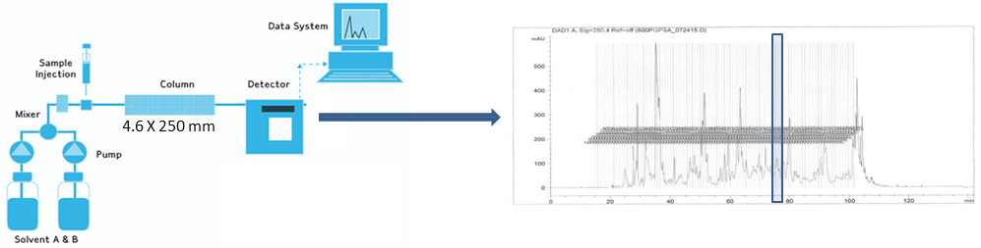
Highly Sensitive SRM Platforms at PNNL
LG-SRM
10 ng/ml
PRISM-SRM
100 pg/ml
PRISM-SRM
DD-SRM
10 pg/ml
(no need for depletion)

Slide 8
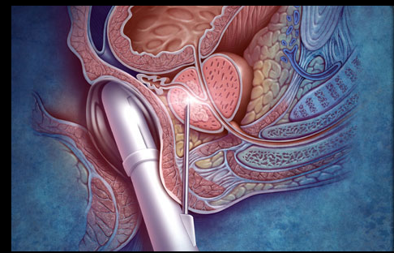
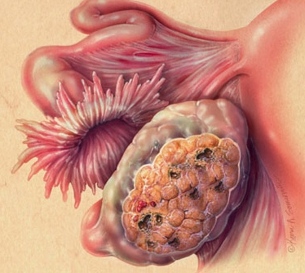

The Biomarker Verification Problem: Prioritizing Resources for Affinity Reagent Development
Differential expression studies identify scores to 100s of candidates
Clinical assays are likely to be affinity reagent based
Can targeted mass spectrometry identify panels of biomarkers with improved predictive ability?

Slide 9
Approach: Examine Prostate Cancer-associated Candidates from Genomic Studies
In collaboration with the Center for Prostate Disease Research (CPDR), we identified a list of 52 biomarker candidates for discriminating indolent from aggressive prostate cancer
Selection was based on the curated literature
genes statistically associated with prostate cancer prognosis
prostate cancer associated genes that were up-regulated in transcriptomics studies
other cancer-related genes
Sensitive, multiplexed PRISM-SRM assays were developed to the following candidates:
CaP prognosis associated genes | Other CaP associated genes | Other cancer related genes
AKT1 | AMACR | BRAF
ANXA2 | CRISP3 | CAMKK2
AR | ERG (pan) | EGFR
AURKA | ERG8 | HIF1A
CCND1 | ETV1 | HPN (TMPRSS1)
CDKN1A | FOLH1 (PSMA) | HSPB1
EZH2 | HOXC6 | MMP2
FGFR1 | KLK2 | MMP9
MUC1 | KLK3/PSA | PDGFRB
MUC6 | KLK11 | PIK3CA
MYC | MYO6 | PLA2G7
MYCN | NPY | ODC1
NCOA2 | PSGR | RAF1
PMP22 | SPARC | SERPINI1
SMAD4 | TWIST1 | STAT3
SPINK1 |  | TGFB1
SPP1 (OPN) |  | TP53
TFF3 |  | TPM2
 |  | VEGFA

Slide 10
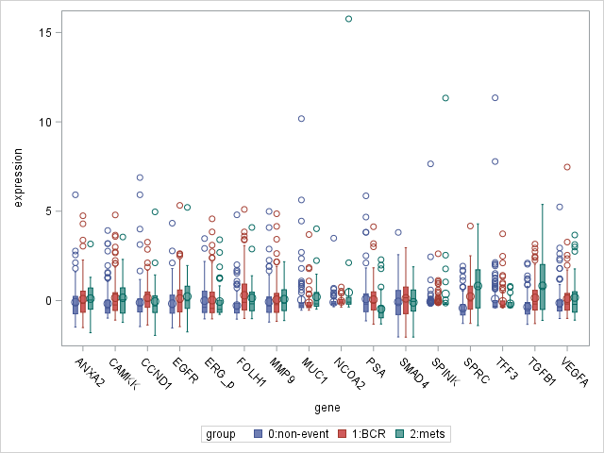
PRISM-SRM Analysis of 279 FFPE Blocks from Prostatectomies with 10 years Follow-Up
Outcome:
No progression
BCR
Metastasis
Z-score of protein level
Protein

Slide 11
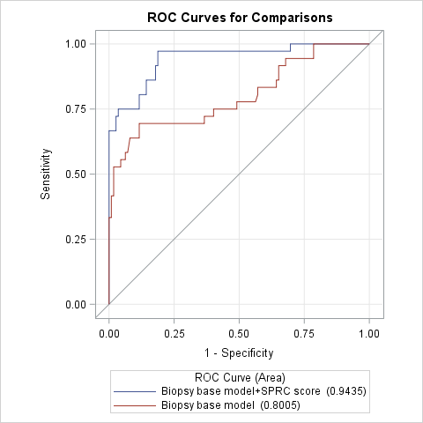
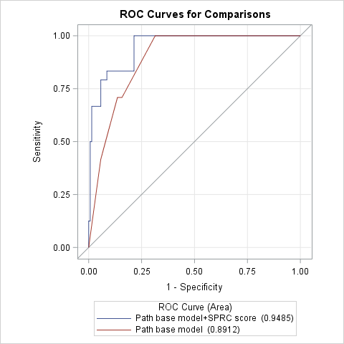

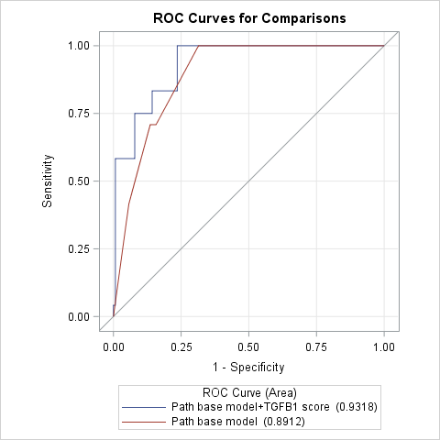
Performance of Complementary Biomarkers for Predicting Prostate Cancer Metastasis
Biopsy base model
= Age at diagnosis + Race + NCCN risk
Pathology base model
= Path T stage + GG + Surgical margin
SPARC/PSA score
SPARC/PSA score
AUC 0.94
AUC 0.95
TGFB1/PSA score
TGFB1/PSA score
AUC 0.94
AUC 0.93

Slide 12
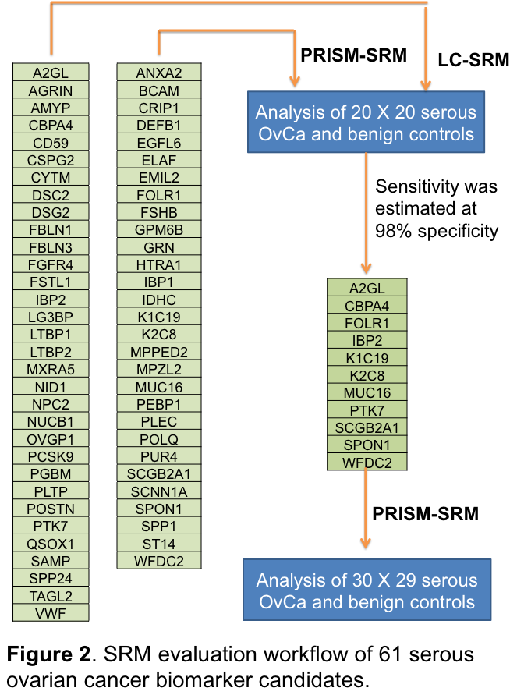
EDRN Collaborative Project: Evaluation of 61 Candidate OvCa Biomarkers
Candidate ovarian cancer biomarkers representing consensus of the ovarian cancer BDLs
Assay development
PNNL developed multiplexed SRM assays for candidates lacking antibodies
SRM assays validated on EDRN Serum Set
32 candidates validated by LC-SRM and 29 candidates by PRISM-SRM
50 ovarian cancer cases and 50 matched controls
Determined sensitivity at 98% specificity
A final set of 8 promising protein biomarker candidates submitted for Luminex analysis at JHU
K1C19
WFDC2
MUC16
A2GL
CBPA4
SPON1
FOLR1
K2C8

Slide 13
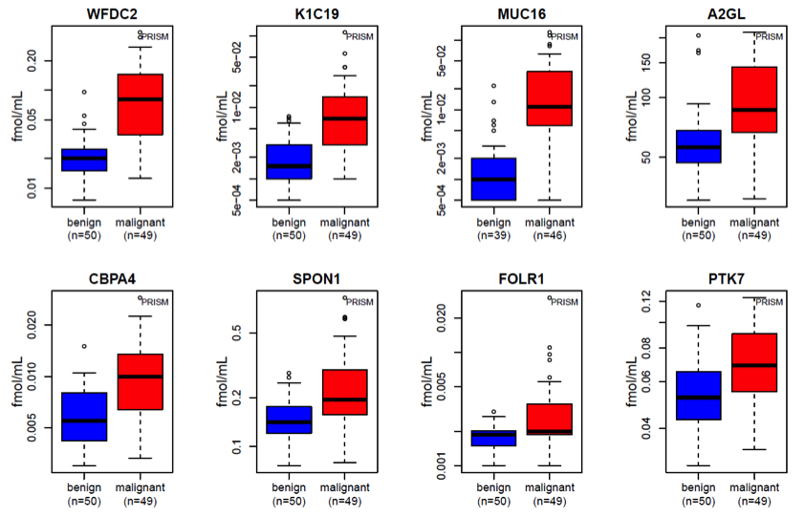
Candidate Biomarker Performance: Serous Ovarian Cancer vs. Benign Serous Disease
Notes:
PRISM-SRM analysis of candidate biomarkers in serum samples from serous ovarian cancer patients (red) and patients with serous benign ovarian disease (blue). : box-pots of the same measurements

Slide 14
Targeted Mass Spectrometry Can Identify Unique Molecular Events
Distinguishing among PSA variants to improve performance
Free versus bound PSA
PSA processing variants
Identifying specific TMPRSS2:ERG fusions
Identifying driver mutations at the protein level

Slide 15
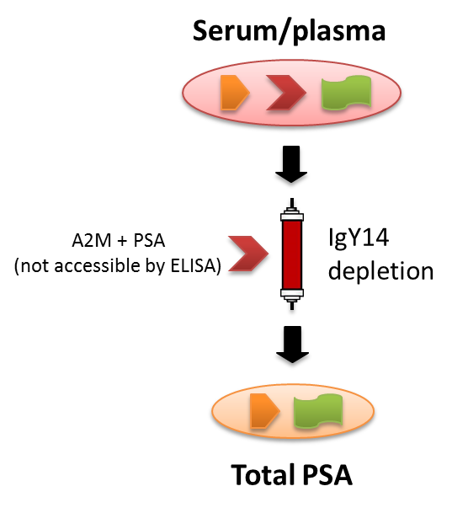
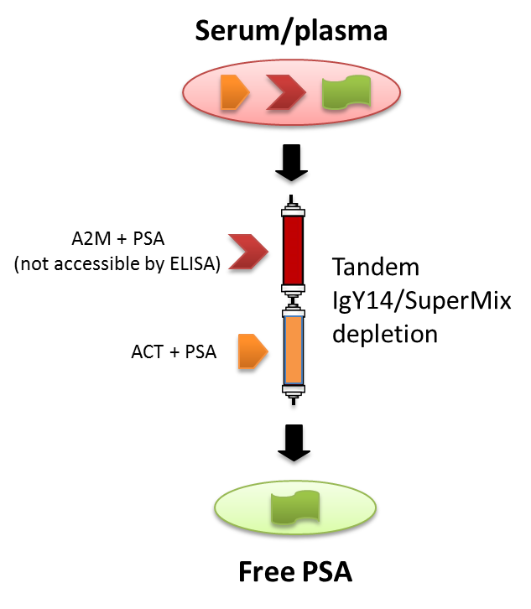
Analysis of Serum Total and Free PSA Using Immunoaffinity Depletion Coupled to LC-SRM
Low ng/mL levels were achieved for both total and free PSA analysis
Good correlation of SRM and immunoassay results of total PSA measurements for a set of 33 blinded clinical serum samples
PRISM SRM performed as well, in both sensitivity and accuracy, as a CLIA-approved ELISA for PSA
Liu et al. J Proteomics. 2012, 75, 4747-4757

Slide 16
Simultaneous Quantification of proPSA Isoforms in Prostate Patient Urine Using LG-SRM
PSA
(-2) proPSA
(-4) proPSA
(-5) proPSA
(-7) proPSA
Heavy (IS)
Light
Shi et al., unpublished results

Slide 17
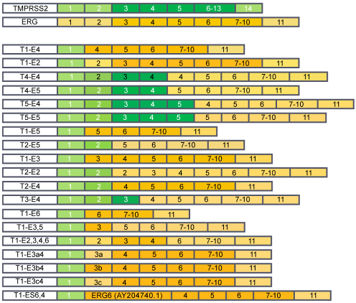
Identifying TMPRSS2:ERG fusions products
TMPRSS2:ERG fusion variants
Occurs in ~45% of prostate cancers
~100% specificity for prostate cancer
Current assays rely on PCR or FISH
Lack of good antibodies against ERG protein
John et al. J Cancer Sci Ther. 2012, 4: 94-101.
Notes:
Sets up the T2:ERG fusion protein as a target for SRM assays; illustrates multiplicity of possible isoforms

Slide 18
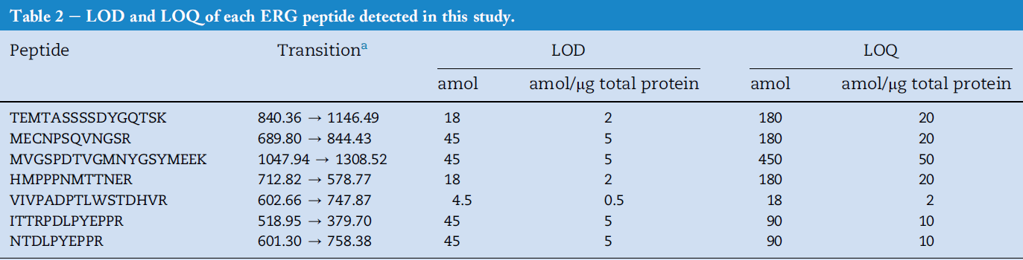
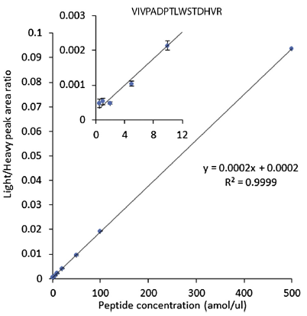
Sensitive Detection of Multiple TMPRSS2-ERG Fusion Protein Products Using PRISM-SRM
#
#
#
*
*
Range for LOD (0.5-5 amol/µg total protein) and LOQ (2-50 amol/µg total protein)
Three “shared” peptides as signature peptides for detection of T2ERG fusion
Highly correlated with T2ERG fusion status (in both patient tissues and cell lines)
For the first time, detection of two distinctive ERG protein isoforms simultaneously expressed in T2ERG-positive tissues
#
*
He et al., Mol Oncol. 2014, 8, 1169-1180

Slide 19
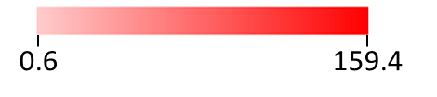
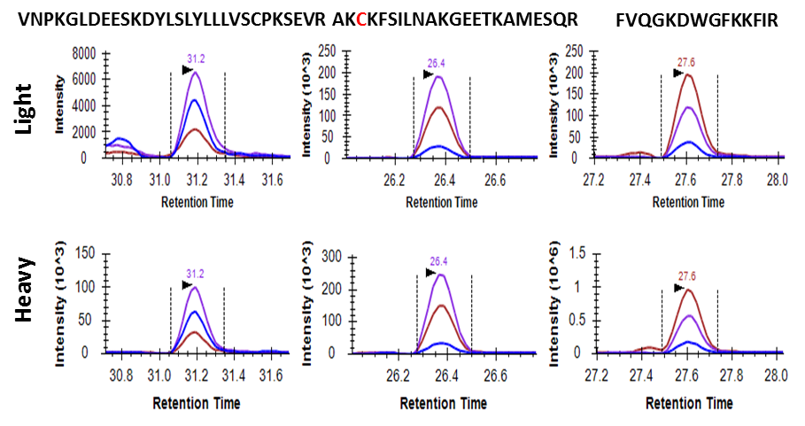
Identification of Specific SPOP Mutations
SPOP Peptide | WT | Y87N | F102C | F133V
VNPKGLDEESKDYLSLYLLLVSCPKSEVR | 0.6 |  | 10.1 | 0.8
VNPKGLDEESKDYLSLNLLLVSCPKSEVR |  | 10.3
AKFKFSILNAKGEETKAMESQR | 1.2 | 26.1 |  | 1.9
AKCKFSILNAKGEETKAMESQR |  |  | 54.2
FVQGKDWGFKKFIR | 0.7 | 12 | 15.3
FVQGKDWGVKKFIR |  |  |  | 0.9
LADELGGLWENSR | 2.2 | 26.8 | 35.4 | 2.6
SLASAQCPFLGPPR | 10.8 | 122.4 | 159.4 | 13.0
Example: F102C mutation
fmol/µg of total protein
Applying PRISM-SRM assays to analyze HEK293 cells with the expression of WT and three most frequent SPOP mutations in prostate cancer led to confident detection of all three SPOP mutations in the positive cell lines, but not in the negative cell lines.
Wang et al., J Transl Med. 2017, 15(1): 175

Slide 20

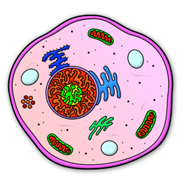
The Next Challenge: Nanoproteomics
Nanoproteomics → → →
Traditional Sample Handling
2,000,000,000 ng
500,000 ng
50,000 ng
5000 ng
500 ng
50 ng
5 ng
0.05 ng
1 x 10⁷ cells
1 x 10⁶ cells
1 x 10⁵ cells
10,000 cells
1000 cells
100 cells
Tissues
Sorted Cells
Plasma
LCM tissues
Biopsy
Embryos
Cell Culture
Primary Cultures
Exosomes
Culture Secretome
Tissue “Voxels”
Circulating Tumor Cells

Slide 21
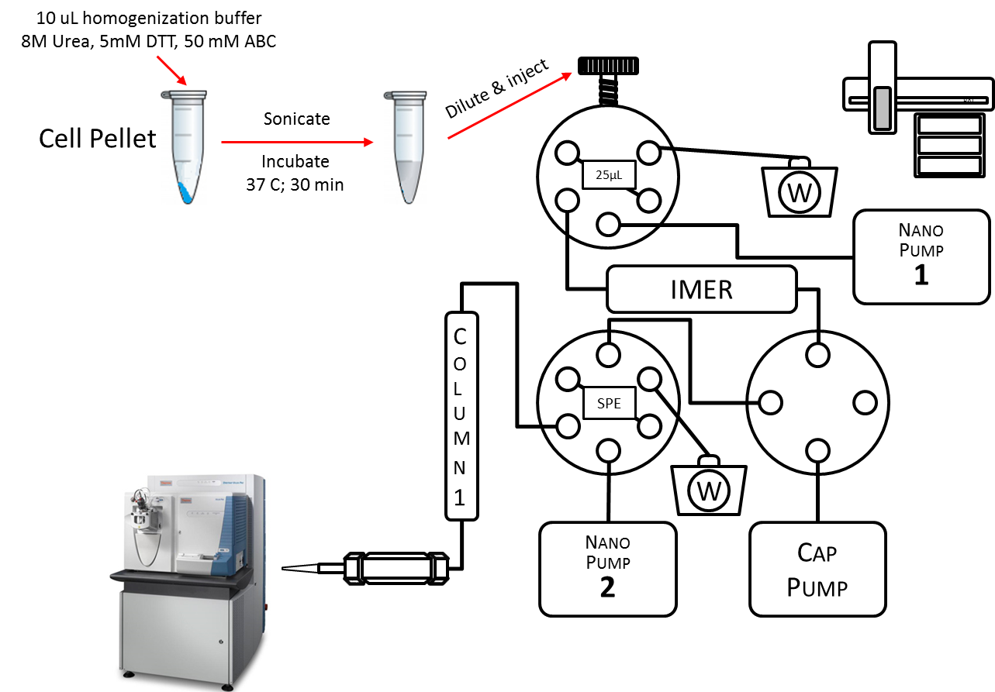
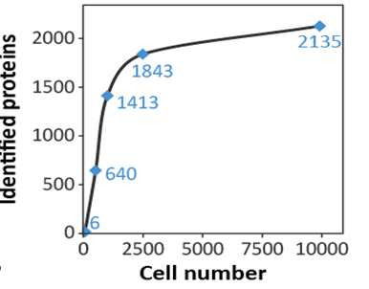
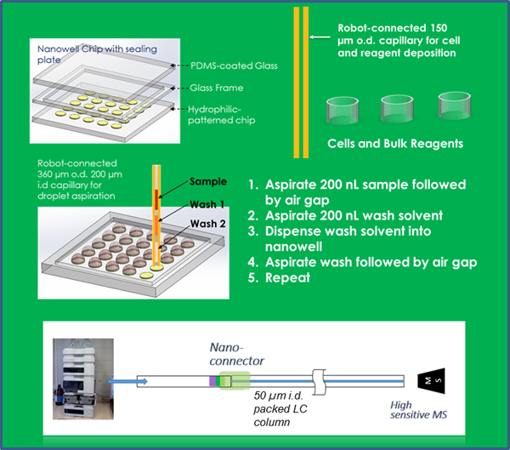
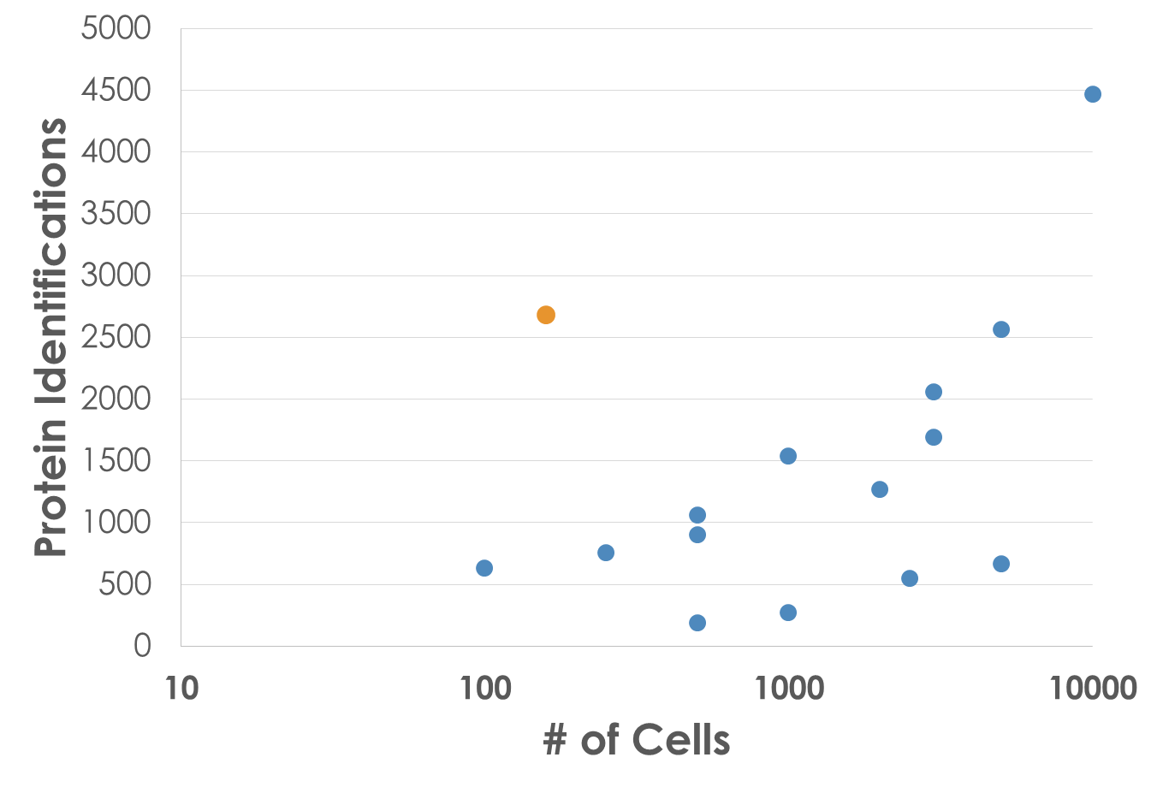
New Technologies for Nanoproteomics
SNaPP
Huang et al., Endocrinology. 2016, 157, 1307-1314
Clair et al., Sci Rep. 2016, 6: 39223
Nanowell
nanoPOTS
Zhu et al., Anal Chem. 2013, 85, 6723-6731
Zhu et al., Nat Commun. 2018, 9, 882

Slide 22





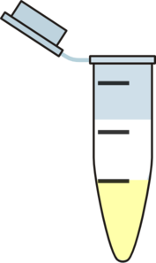



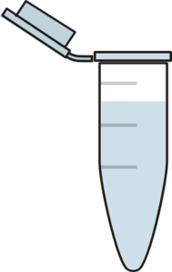
The Strategy: Minimize Sample Losses
Surface
Urea
DTT
IAA
Surface
Trypsin
Surface
Transfer
Transfer
Transfer
Surface
Desalting
Surface
Homogenization/
Extraction
Denaturation/
Reduction/
Alkylation/
Tryptic Digestion
Surface
Collection/
Concentration
Decrease surface area
Provide a protective carrier

Slide 23
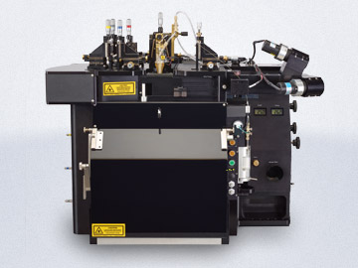
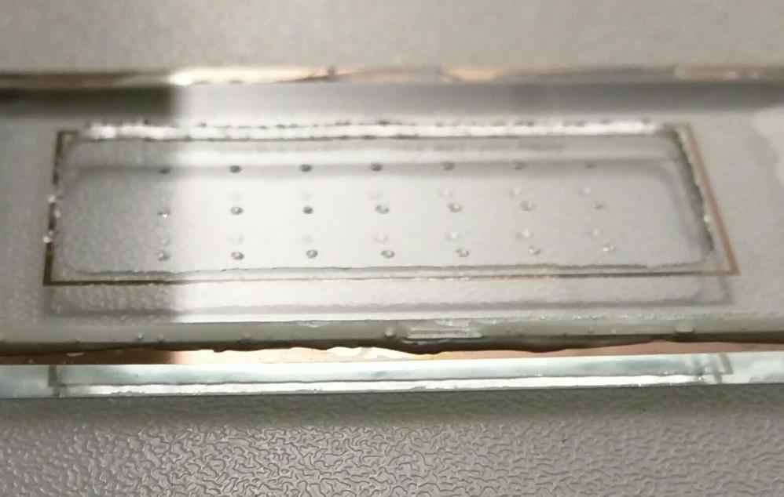
Single Cell Proteomics – Initial Results
Single cell isolation with Fluorescence-Activated Cell Sorting
500 µm
Size or fluorescence-based cell sorting
Precise cell number in each wells
100% success rate (21/21)
Zhu et al., unpublished results

Slide 24
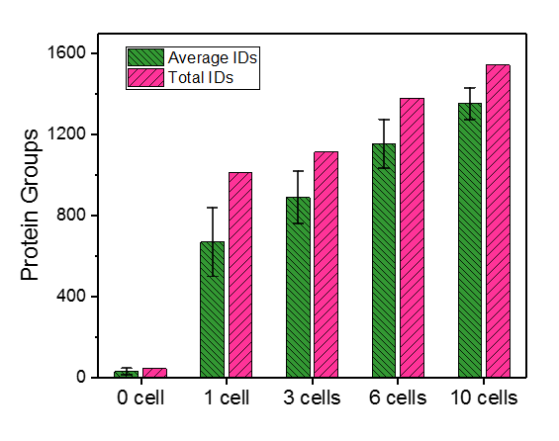
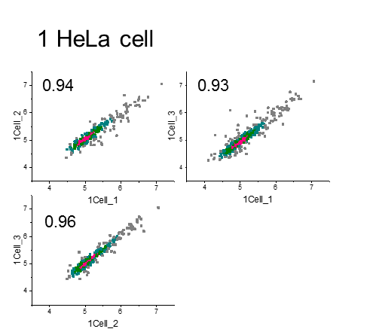
nanoPOTS: Protein Identification and Quantification
0 to 10 cells (triplicate analyses)
An average of 669 protein groups were identified for single HeLa cells
332 protein groups were quantifiable with LFQ for single cells
Single-cell Pearson correlations: 0.93-0.96
Zhu et al., unpublished results

Slide 25
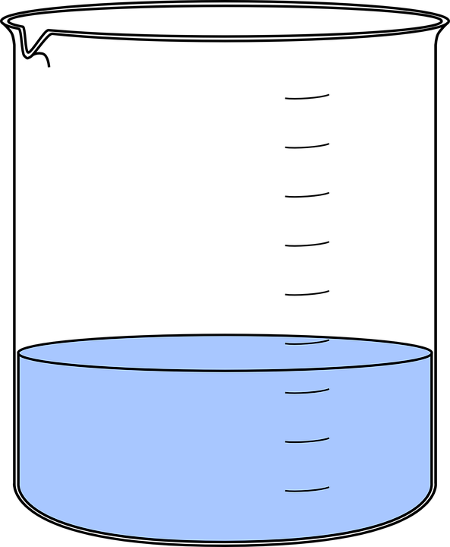



Adding Carrier for Targeted Proteomic Experiments
Carrier-assisted ‘nesting’ of sorted cells
cPRISM-SRM
Carrier
eLC-SRM
Large contact surface area
Very low concentration
Single cells of interest
RT-PCR tube
Exaggerated cartoon
Exogenous carrier proteins
Because the MS analysis is targeted at specific peptides, the presence of a vast excess of carrier does not complicate the MS

Slide 26
Platform sensitivity comparison (The lowest abundance quantifiable proteins)
MS platform | Limits of quantification (LOQs)
 | Cell number | Protein | Copies per cell
SNaPP-MS | 50 mouse cells | n/aª | n/aª
nanoPOTS-MS* | 10-14 HeLa | PARP4 | ~19,200^{b}
cPRISRM-SRM* | 10 HMEC | SHC1 | ~25,000^{c}
eLC-SRM* | 10 MCF7 | PTPN11 | ~54,100^{c}
* 30 µm i.d. × 70 cm column with 60 nL/min for nanoPTOS-MS; 100 µm i.d. × 20 cm column with 300 nL/min for both cPRISM-SRM and eLC-SRM
ª Only 6 high-abundance proteins were detected.
^{b} Bekker-Jensen et al. CellSyst 4, 587-599 (2017).
^{c} Shi et al. Sci Signal 9(436):rs6 (2016).

Slide 27
Summary
Global proteomics is a powerful technique for discovery of candidate biomarkers based on protein differential expression
Most candidates from differential expression experiments (RNA or protein) do not verify
Targeted proteomics can quickly and efficiently prioritize candidate biomarkers for affinity reagent development
Targeted proteomic methods can approach (or improve on) sensitivities achieved with antibody-based methods
Targeted proteomic methods are sequence-specific
Targeted proteomics can verify protein-level expression of cancer-associated molecular events
mutations, splicing variants, gene fusions
Current advances in nanoproteomics are approaching single cell sensitivities

Slide 28
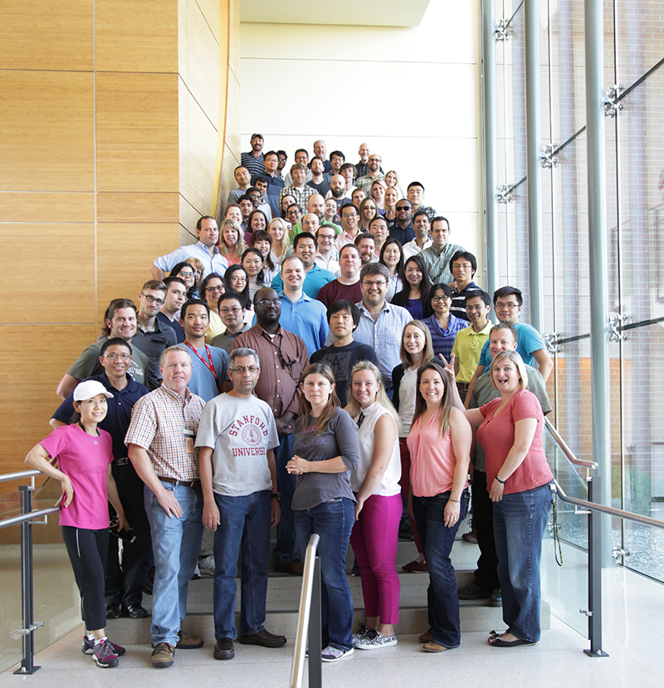

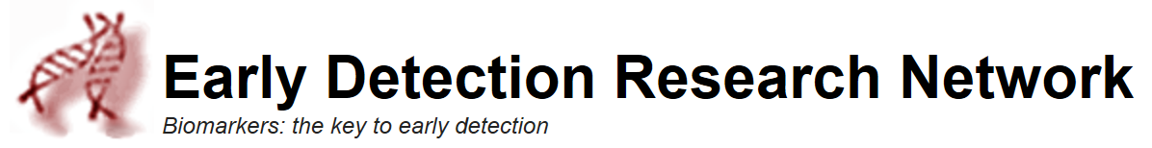
Acknowledgements
The EDRN Team (Integrative Omics Group) at PNNL
Yuqian Gao
Yi-Ting Wang
Hui Wang
Athena Schepmoes
Tujin Shi
Chia-Feng Tsai
Tom Fillmore
Ying Zhu
Paul Piehowski
Wei-Jun Qian
Richard Smith
Tao Liu
Karin Rodland
Collaborators
CPDR: Shiv Srivastava, George Petrovics, Jennifer Cullen, Yongmei Chen, Denise Young, Albert Dobi
UTHSCSA: Ian Thompson, Robin Leach, Brandy Weaver
Emory: Martin Sanda, Kathryn Pellegrini
Toronto: Thomas Kislinger, Stanley Liu
EDRN GU Collaborative Group
EDRN/NCI
Jacob Kagan, Lynn Sorbara, Sudhir Srivastava

Slide 29
Back up slides

Slide 30
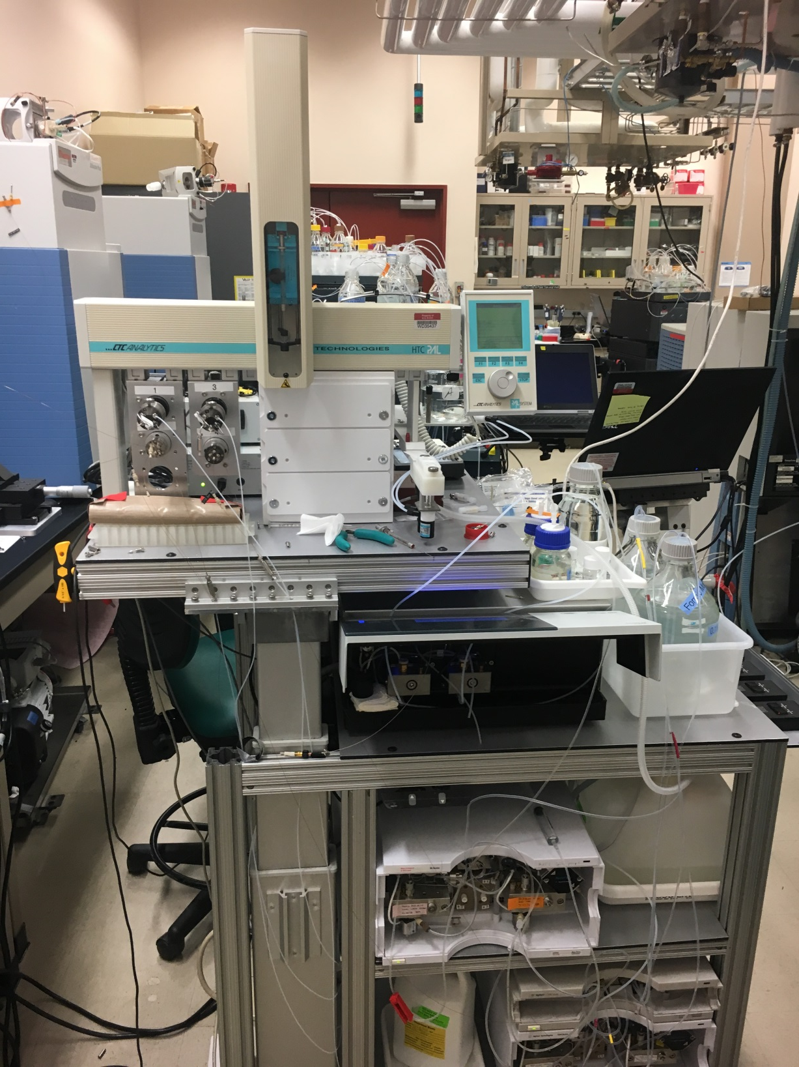
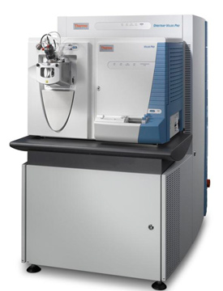
Simple NanoProteomic Platform (SNaPP)
DTT
Urea
IAA
PAL
25µL
W
Nano
Pump
1
IMER
Column
1
SPE
W
Nano
Pump
2
Cap
Pump
Huang et al. Endocrinology 157, 1307-1314 (2016).

Slide 31
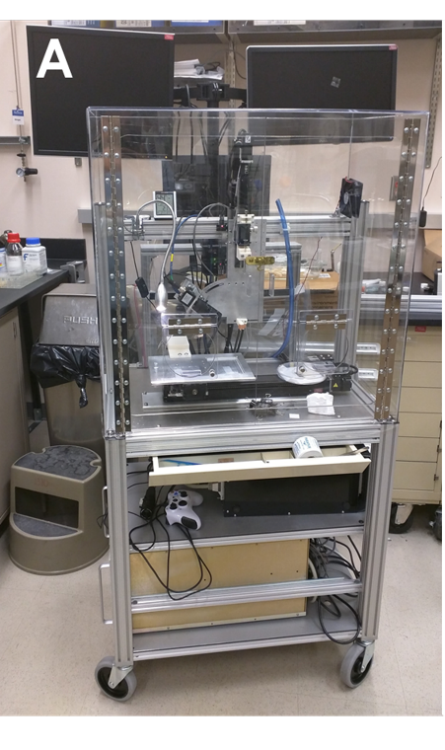
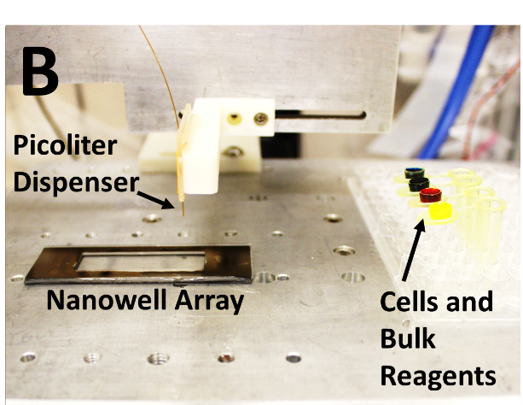
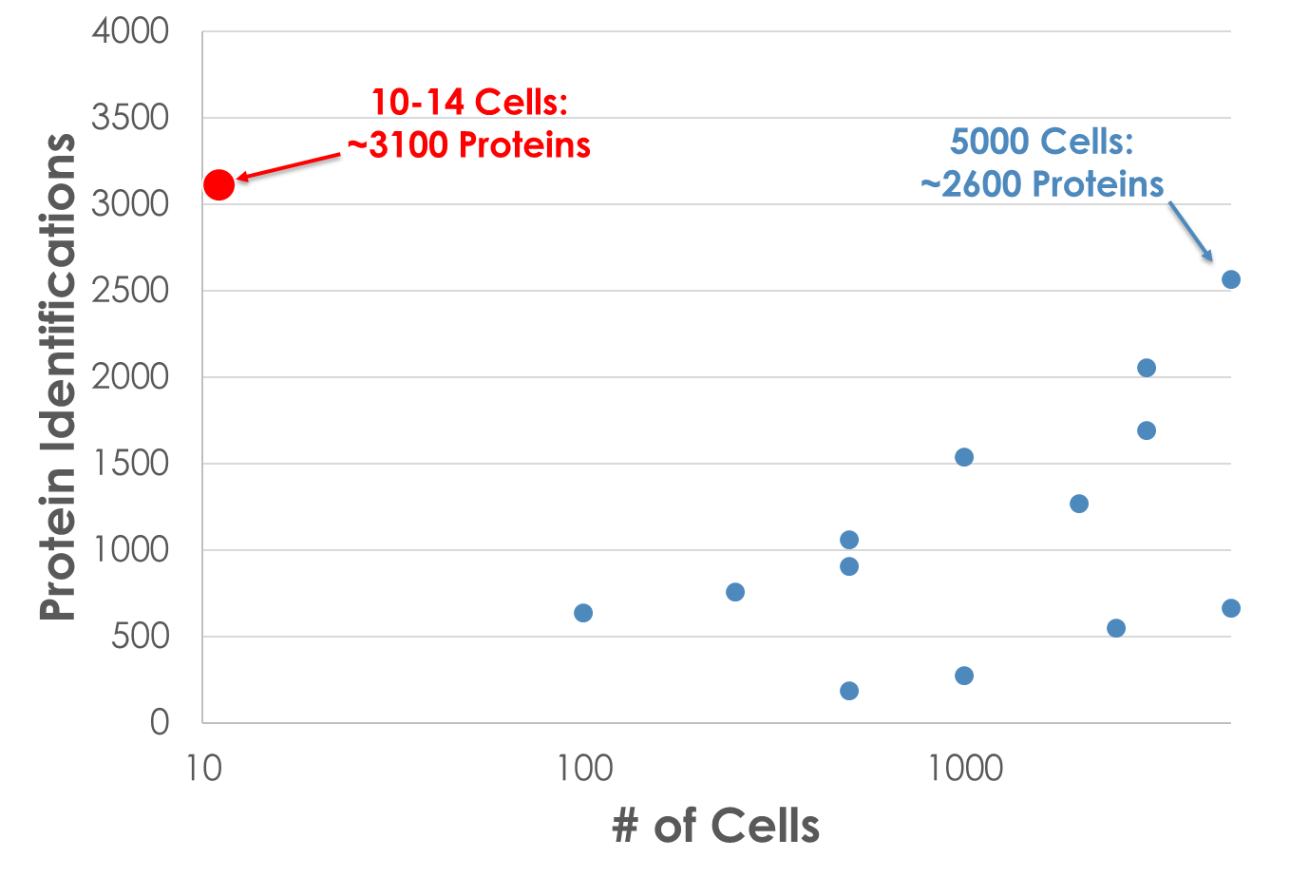
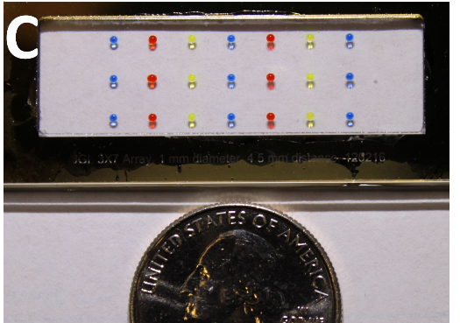
Nanoscale Sample Processing
Benchmarking
Proteome coverage achieved for ~10 HeLa cells using nanoPOTS is shown in red. Previously reported proteome coverage for small populations of mammalian cells is shown in blue.

