Slide 1


Biomarker Based
Non-Endoscopic Detection Of Barrett’s Esophagus (BE) And Esophageal Adenocarcinoma (EAC)
Sanford Markowitz
Helen Moinova
Joseph E. Willis
Amitabh Chak
Notes:
1

Slide 2
COI DISCLOSURE
Sanford Markowitz receives royalties on methylated DNA technology licensed to Exact Sciences and is a founder, board member, consultant, and inventor on patents licensed to Lucid Diagnostics. Helen Moinova is an inventor on patents licensed to Lucid Diagnostics.

Slide 3
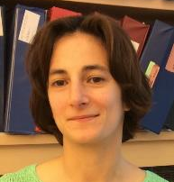
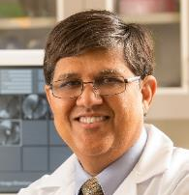
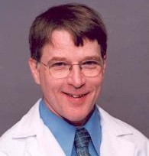
The Team
Helen Moinova
Amitabh Chak
Joe Willis
Kishore Guda
Tom LaFramboise

Slide 4
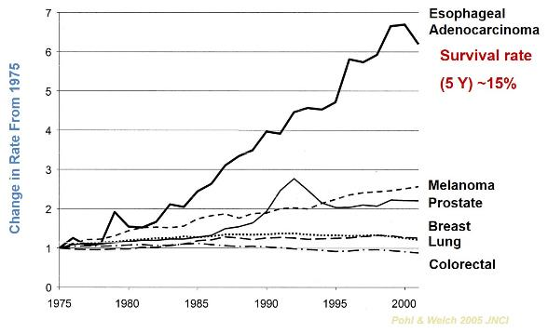
The EAC Challenge
Esophageal Cancer (EAC):
Fastest growing cancer in U.S.
5-year survival < 20%
Death toll now exceeds ovarian cancer
Seldom detected early

Slide 5
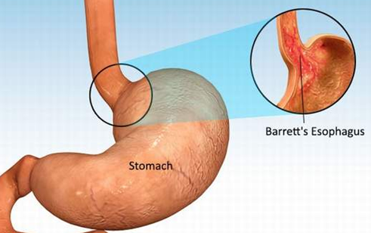
The EAC Opportunity
Barrett’s esophagus (BE)
Only known precursor to EAC
Occurs in distal esophagus in patients with GERD

Slide 6
The EAC Opportunity
Barrett’s esophagus (BE)
Only known precursor to EAC
Occurs in distal esophagus in patients with GERD
Detection of BE and ablation of dysplastic BE can prevent cancer

Slide 7

Challenges to BE Screening by EGD

Slide 8
Challenges to BE Screening by EGD
EGD is costly, requires sedation, day off work.
EGD Screening only recommended by AGA, and only in those with chronic GERD + additional risk factors.
EGD screening, even in GERD, not generally accepted by primary care physicians or patients.
Effectiveness Limited – 40% of EAC pts have no GERD symptoms.
Challenge: Antecedent BE recognized beforehand in <10% of EAC cases.

Slide 9
The Need
Needed: Non-EGD Biomarker Driven approaches that can detect BE more easily and at less expense than EGD.

Slide 10
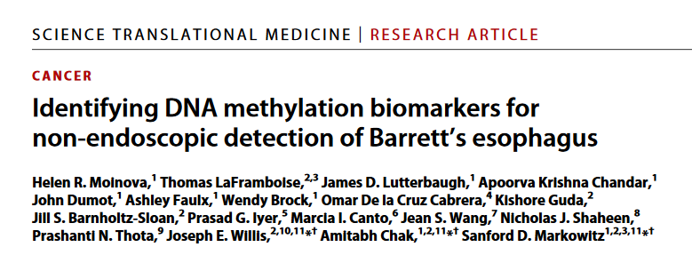
Biomarker Approach
92%
90%
Specificity
Sensitivity

Slide 11
Biomarker Approach
i) Methylated DNA Biomarker Panel
ii) Swallowable Esophageal Sampling
Device

Slide 12
Vimentin Gene Methylation (mVim) is a Colon Cancer Biomarker
ATG
Methylated in
Cancer
EXON 1
1
2
3
4
5
6
7
8
9
10
11
12
N
T
N
T
N
T
N
T
N
T
N
T
N
T
N
T
N
T
N
T
N
T
N
T
Methylated in 80% of Colon Cancer Cases
Notes:
Note within large CpG Island there is a small group of CpG that are robust in descriminating cancer from normal

Slide 13
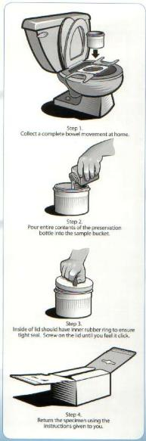
Vimentin Gene Methylation (mVim) is a Colon Cancer Biomarker
Methylated Vimentin DNA: Commercialized by Exact Sciences For Stool DNA Detection of Colon Cancer (ColoSureTM, LabCorp)
Notes:
Note within large CpG Island there is a small group of CpG that are robust in descriminating cancer from normal

Slide 14
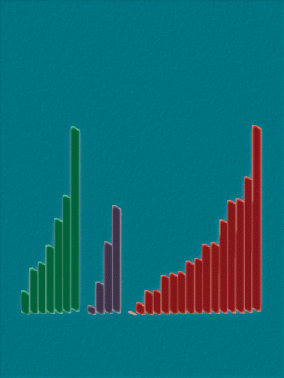
Cancer Epidemiology, Biomarkers & Prevention, April 2012
Vimentin Methylation as a Gastrointestinal Cancer Biomarker Moinova et al. ________________________________
Page 594
Vimentin Methylation in Barrett’s/EAC
(91% Sensitive)
Normal
BE
HGD
EAC
SCC
Notes:
Study lead by Helen Moinova in our EDRN team in collaboration with Case BETRNet and Case GI SPORE

Slide 15
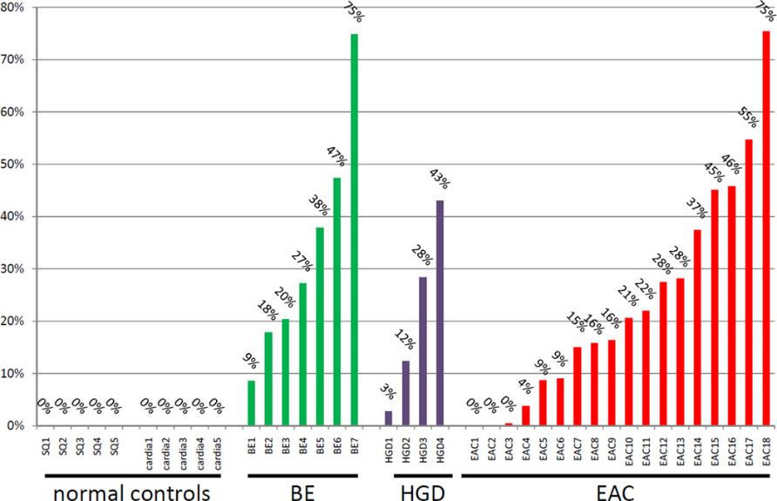
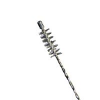
Pilot Study – Molecular Cytology: 90% of BE Detected by mVIM DNA on Esophageal Brushings

Slide 16
Molecular Cytology: mVim in Esophagus Cytology Brushings (N=310)
Training set
Validation set
mVIM
mVIM
AUC: 0.948
If >1.05%:
Sensitivity: 90.7%
Specificity: 93.2% Cases: 107; Controls 59
AUC: 0.956
If >1.05%:
Sensitivity: 91.5%
Specificity: 92.6% Cases: 117; Controls 27

Slide 17
New Complementary Methylation Marker
If One Marker is Good, Would Two Markers Be Better?

Slide 18
New Complementary Methylation Marker
If One Marker is Good, Would Two Markers Be Better?
Genome Wide RRBS in 72 Biopsies: 26 EAC/Sq pairs; 15 BE; 5 EAC Cell Lines

Slide 19
New Complementary Methylation Marker (mCCNA1)
CCNA1 locus
NGS assay 176 bp, 21 CpGs
RRBS patch, 90bp, 7 CpGs
CpG island 872 bp, 103 CpGs
RefSeq
Transcripts

Slide 20
New Complementary Methylation Marker (mCCNA1)
mCCNA1
CCNA1 locus
NGS assay 176 bp, 21 CpGs
RRBS patch, 90bp, 7 CpGs
CpG island 872 bp, 103 CpGs
RefSeq
Transcripts
Sq
NDBE
HGD
EAC

Slide 21
Molecular Cytology: mCCNA1 in Esophagus Cytology Brushings (N=313)
Training set
Validation set
mCCNA1
mCCNA1
AUC: 0.948
If >1.05%:
Sensitivity: 90.7%
Specificity: 93.2% Cases: 107; Controls 59
AUC: 0.956
If >1.05%:
Sensitivity: 91.5%
Specificity: 92.6% Cases: 117; Controls 27
AUC: 0.954
If >3.12%:
Sensitivity: 90.7%
Specificity: 98.4% Cases: 108; Controls 61
AUC: 0.952
If >3.12%:
Sensitivity: 89.6%
Specificity: 92.9% Cases: 115 Controls 28

Slide 22
Molecular Cytology: mVIM + mCCNA1 in 313 brushings
mVIM and mCCNA1 in combined esophageal brushings
from 229 cases of BE/EAC and 84 controls
mVIM
mCCNA1
AUC: 0.956
Cases: 230; Controls 86
AUC: 0.954
Cases: 229; Controls 89
Project JEDI

Slide 23
Molecular Cytology: mVIM + mCCNA1 in 313 brushings
 | mVIM (Positive if > 1.05%) |  | mCCNA1 (Positive if > 3.12%) |  | Either mVIM or mCCNA1 Positive
 | % | # | % | # | % | #
Specificity Control GEJ (GERD , EE, other) | 93% | 86 | 97% | 89 | 91% | 84
Sensitivity NDBE | 92% | 71 | 80% | 69 | 92% | 72
Sensitivity LGD | 94% | 33 | 91% | 32 | 94% | 34
Sensitivity HGD | 87% | 23 | 100% | 23 | 100% | 23
Sensitivity Cancer | 91% | 97 | 95% | 99 | 96% | 100
Notes:
Note, this is using training set cutoff
And for specificity it censors cases where have only one negative maker and other N/A
For sensitivity it counts all cases with one negative marker as negative (“allowing fails”)
For GEJ, 8 cases (+) for vim or sqbe18; 76 negative for both, 7 cases negative for one marker and other failed

Slide 24
Additional Specificity Studies
mVim and mCCNA1 tested negative on biopsy series of additional common upper GI pathologies including chronic carditis and eosinophilic esophagitis.
Notes:
Note, this is using training set cutoff
And for specificity it censors cases where have only one negative maker and other N/A
For sensitivity it counts all cases with one negative marker as negative (“allowing fails”)
For GEJ, 8 cases (+) for vim or sqbe18; 76 negative for both, 7 cases negative for one marker and other failed

Slide 25
Additional Specificity Studies
mVim and mCCNA1 tested negative on biopsy series of additional common upper GI pathologies including chronic carditis and eosinophilic esophagitis.
Tissue | False Positives | N
Control GE-Junction | 0 | 40
Control Distal Esophagus | 0 | 24
Chronic Carditis | 0 | 15
Eosinophilic Esophagitis | 0 | 15
Notes:
Note, this is using training set cutoff
And for specificity it censors cases where have only one negative maker and other N/A
For sensitivity it counts all cases with one negative marker as negative (“allowing fails”)
For GEJ, 8 cases (+) for vim or sqbe18; 76 negative for both, 7 cases negative for one marker and other failed

Slide 26
Additional Specificity Studies
Smoking associated DNA methylation in proximal esophagus brushings
Notes:
Note, this is using training set cutoff
And for specificity it censors cases where have only one negative maker and other N/A
For sensitivity it counts all cases with one negative marker as negative (“allowing fails”)
For GEJ, 8 cases (+) for vim or sqbe18; 76 negative for both, 7 cases negative for one marker and other failed

Slide 27
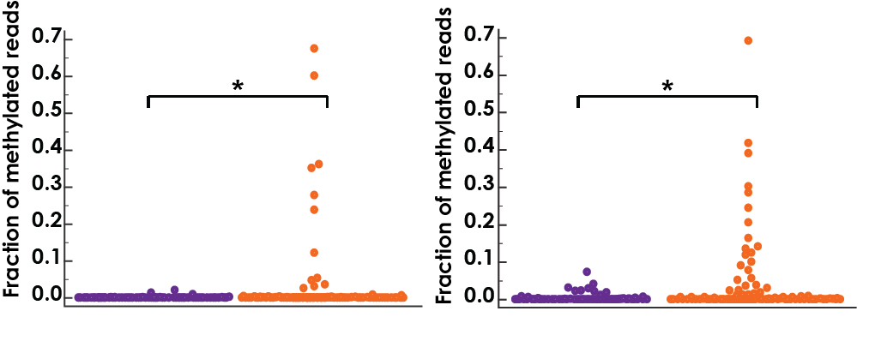
Additional Specificity Studies
Smoking associated DNA methylation in proximal esophagus brushings
mCCNA1
mVIM
p=0.0094
p=0.0155
Non-smokers
Smokers
Non-smokers
Smokers
Notes:
Note, this is using training set cutoff
And for specificity it censors cases where have only one negative maker and other N/A
For sensitivity it counts all cases with one negative marker as negative (“allowing fails”)
For GEJ, 8 cases (+) for vim or sqbe18; 76 negative for both, 7 cases negative for one marker and other failed

Slide 28
The Challenge
Comfortable Non-Endoscopic Sampling of the Distal Esophagus / GE Junction
Without Sampling the Proximal Esophagus and Throat

Slide 29
The Power of Pairs
i) Methylated DNA Biomarker Panel
ii) Swallowable Esophageal Sampling
Balloon

Slide 30
JASSS Balloon
Joe/Amitabh/Sandy’s Swallowable Sampling Balloon
Capsule sized balloon
Tethered balloon
is swallowed
Balloon with structured surface:
i) inflated in the stomach
ii) pulled back to sample distal esophagus
Balloon deflated
for retrieval
Notes:
Design incorporates proprietary features that make the balloon device inherently superior to a sponge.

Slide 31
JASSS Balloon
Joe/Amitabh/Sandy Swallowable Sampling Balloon
Capsule sized balloon
Tethered balloon
is swallowed
Balloon with structured surface:
i) inflated in the stomach
ii) pulled back to sample distal esophagus
Balloon deflated
for retrieval
FDA Review: Non-Significant Risk Device
Notes:
Design incorporates proprietary features that make the balloon device inherently superior to a sponge.

Slide 32


Demonstration
CONFIDENTIAL

Slide 33
JASSS Balloon Advantages
Small Size for Insertion and Removal Maximizes Patient Comfort
Design Maximizes Sample Quantity
Maximizes Biomarker Signal to Noise by:
Targeting Sampling to Distal Esophagus
Protecting Sample from Dilution and Contamination in Proximal Esophagus and Oropharynx

Slide 34
Study Design
Patients with BE, EAC, or GERD controls were recruited for JASSS prior to EGD at 3 hospitals
JASSS sampling was performed with sips of water and prn pharyngeal anesthesia
Balloons were placed in vials and frozen
DNA was extracted from balloons, bisulfite converted, and sequenced with NGS
A software pipeline calculated % DNA reads arising from bisulfite converted methylated versus unmethylated Vim and CCNA1 templates

Slide 35
Results
156 patients recruited from 3 hospitals.
128 (82%) successfully swallowed first generation device.
116 (91%) balloons collected > 60 ng of DNA, which was adequate for NGS analysis
86 individuals had evaluable diagnoses (Exclusions: 23 post ablation, 4 gastric IM, 3 cardia IM / IM of GEJ / Irregular Z line)

Slide 36
Results - Tolerance
Procedure took mean 3.1 minutes (range, 1 – 14 min).
72% of the 128 subjects rated overall tolerance as excellent
93% preferred JASS to EGD and were willing to repeat it again.
Scores of 1 or 2 on a 10-point Likert scale, denoting little to no anxiety, pain, or choking, were reported by 75%, 95%, and 82% of subjects, respectively.
Scores for gagging during swallowing were slightly higher, >2, in 47% of subjects.

Slide 37
Performance Equals Endoscopic Brushings
mVIM
mCCNA1
AUC: 0.91
N=36 controls, 50 cases
AUC: 0.92
N=36 controls, 50 cases

Slide 38
Performance in 86 Subjects
 | Sample # | mVIM (Positive if >1.0%) | mCCNA1 (Positive if >1.0%) | Either mVIM Or mCCNA1 Positive
Specificity on Controls | 36 | 92% | 100% | 92%
Sensitivity: Non-Dysplastic BE (>1cm) | 31 | 81% | 71% | 90%
Sensitivity: All Dysplastic BE | 11 | 73% | 73% | 82%
Sensitivity: All Cases | 50 | 80% | 72% | 88%

Slide 39
CONCLUSIONS
JASSS encapsulated balloon can sample the distal esophagus with excellent tolerability and acceptability.
Methylated Vimentin and CCNA1 can be successfully assayed on JASSS samples by NGS bisulfite sequencing.
BE and EAC detected with high sensitivity and specificity, demonstrating the feasibility of non-endoscopic unsedated BE screening.

Slide 40
Next Steps
2nd Generation JASSS Balloon with Improved Swallowability and Increased DNA Collection
Case Control Study to define optimal performance of New Balloon with Marker Panel
Multi-center BE detection study in at risk screening population.
CLIA Grade mVIM and mCCNA1 assays
Biomarker Discovery to Distinguish BE versus Dysplasias and Cancers to Allow for Nonendoscopic BE Surveillance

Slide 41
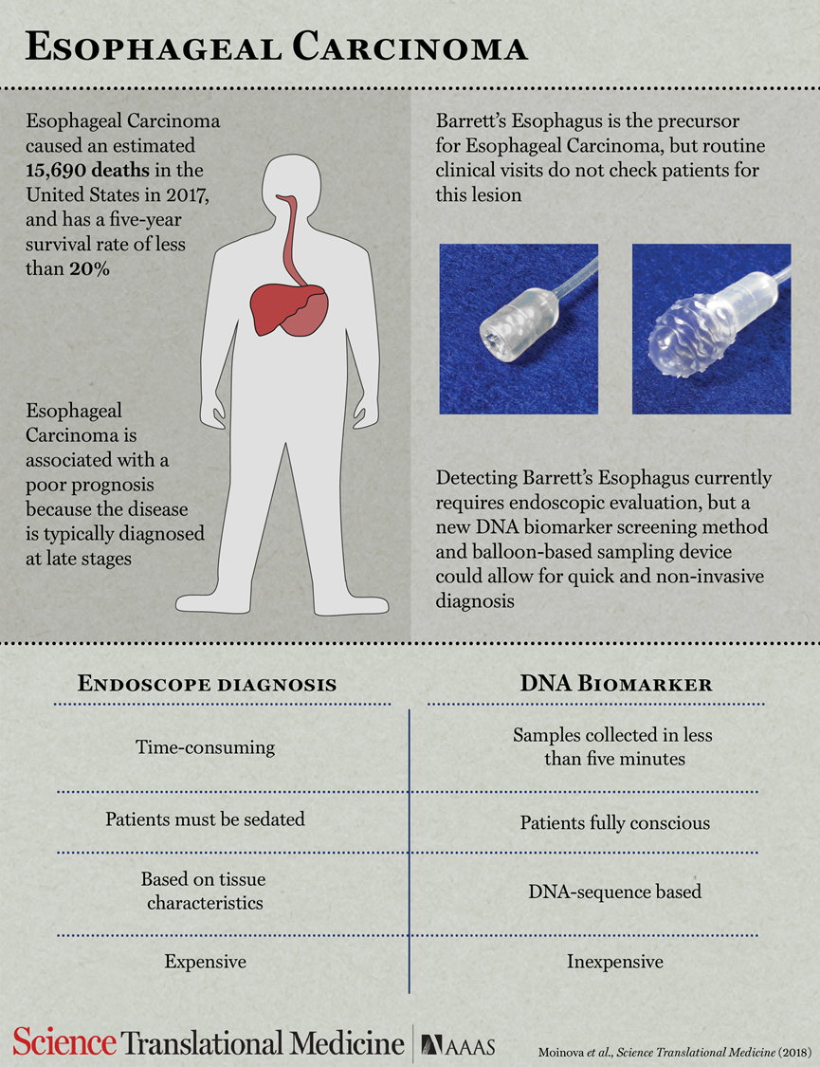
Summary

Slide 42
Gen 1 JASSS device had a 17% failure to swallow rate
Gen 1 had a 9% rate of inadequate DNA (<60 ng)

Slide 43
Gen 2 - improved design of JASSS balloon to improve swallowing and DNA sampling
Recruited 59 subjects, Only 2 failed to swallow (<4%)

Slide 44
Generation 1 Samples Collected on Frozen Balloons
Ongoing Studies – Testing Effects of Collecting Balloons in Alcohol Based Fixatives

Slide 45
Next Step – Establishing Cut Point for Assay on Samples Collected in Alcohol Based Fixatives

Slide 46
BE Progression Biomarkers-Brushings
Marker | 2 Methyl DNAs | P53 | P53 + Methyl DNAs
Specificity NDBE (Lesion) | 91.4% | 97.1% | 88.9%
Sensitivity LGD (lesion) | 25.7% | 10.3% | 30.8%
Sensitivity HGD (lesion) | 48.0% | 16.0% | 56.0%
Sensitivity All dysplasia (Lesion) | 35.0% | 12.5% | 40.6%
Sensitivity All cancers (lesion) | 57.0% | 43.4% | 73.0%

Slide 47
Summary
State of Biomarker Research
Pre-EDRN: No BE Biomarker Assay
With EDRN: National Clinical Trial of BE Biomarker
Novelty
BE Biomarkers: Methylated DNA, mVim, CCNA1,
Balloon Device for Non-Endoscopic Sampling
Biomarker Discovery, Prevalidation, and Validation
mVim, mCCNA1
Team Science
BE Biomarker Discovery, Prevalidation, Validation Collaborative with EDRN, BETRNet, GI SPOREs Program
CRC Biomarker Studies Collaborative with Schoen, Vogelstein, and GLNE (Brenner and Colleagues)

