Slide 1
Prostate Cancer Detection Collaborative Group
Ongoing refinement of validated biomarker
Blood: -2proPSA (Prostate Health Index)
Post-DRE Urine: PCA3, T2:Erg
Multiplex Biomarker Discovery/Development
Multiplex RNA (EV’s in post-DRE Urine)
Proteomics (Mass Spec, post-DRE Urine and Blood)
Imaging (Prostate MRI as a Biomarker)
Collaborative Group Studies
Initial Dx: PCA3 Trial (serum phi+urinary PCA3/T2Erg)
Detecting treatable cancers: Upgrading study (blood, urine)
MRI as biomarker: MRI trial (initial diagnosis)

Slide 2


Aim 1: Combining Serum Prostate Health Index with post-DRE Urine PCA3 and T2Erg Clinical Assays to Predict Aggressive Prostate Ca (E Huang et al)
Serum Prostate Health Index (y axis), post-DRE Urine PCA3 (x axis), and T2Erg (z axis) clinical assay results stratified by aggressive Gleason 7+ prostate cancer (red) vs benign or indolent (blue) N=512
Biospecimen Substrate | Biomarker Combination | Sensitivity | Specificity
Blood (serum) | Prostate Health Index (phi) | 95 | 27
Urine (post-DRE) | PCA3 + T2Erg | 92 | 36
Blood and Urine | phi + PCA3 + T2erg | 97 | 41
1st Blood, then Urine | phi > PCA3 + T2erg | 97 | 45
1st Urine, then Blood | PCA3 + T2erg > phi | 96 | 46
Notes:
PCA3 has limited use as a stand-alone marker
We began our studies by optimizing the conditions required for RNA isolation from urine

Slide 3
Urine Vesicles Enriched for Prostate RNAs
Prostate-specific transcripts were detectable in post-DRE urine at higher levels than kidney/bladder-specific genes

Slide 4
Many Genes Detected in Both RP and Urine
Over 9000 genes were detected in the RP tissue or post-DRE urine EV specimens for all 15 patients
Almost 4000 of these genes were common between RP and EVs
Over 15000 genes were not detected in any specimen tested
High degree of overlap between RP- and urine-detected genes
Other genes may be specific to a particular specimen type
RP
Urine
Genes detected for all 15 patients
2766
3898
2351
37035

Slide 5
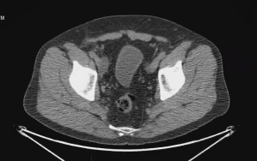
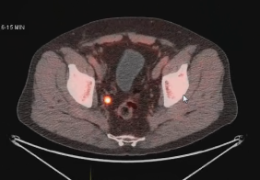
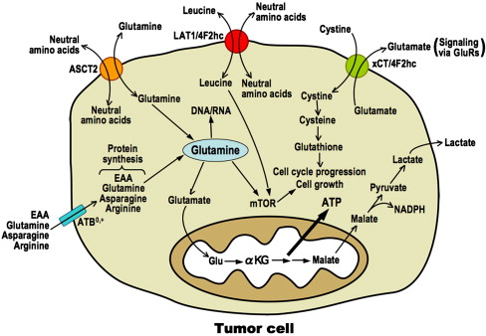
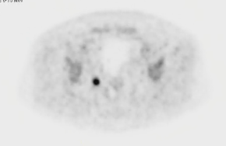
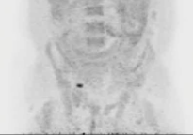
Aim 3: Detection of Prostate Cancer Micrometastatic Disease by FACBC-PET D Schuster, M Goodman, Dept of Radiology; M Alemozaffar, Dept of Urology
Detection of sub-centimeter lymph node metastases in patient with rising PSA (0.46) after prostatectomy:
FACBC fluciclovine (Axumin):
Non-natural alicyclic amino acid analogue PET radiotracer
Ganapathy et al. Pharmacology & Therapeutics 2009;121:29
Notes:
PCA3 has limited use as a stand-alone marker
We began our studies by optimizing the conditions required for RNA isolation from urine

Slide 6
Restriction Spectrum Imaging to Improve Prostate MRI
Michael A. Liss M.D., M.A.S.
EDRN Associate Member
Assistant Professor of Urology
University of Texas Health San Antonio

Slide 7
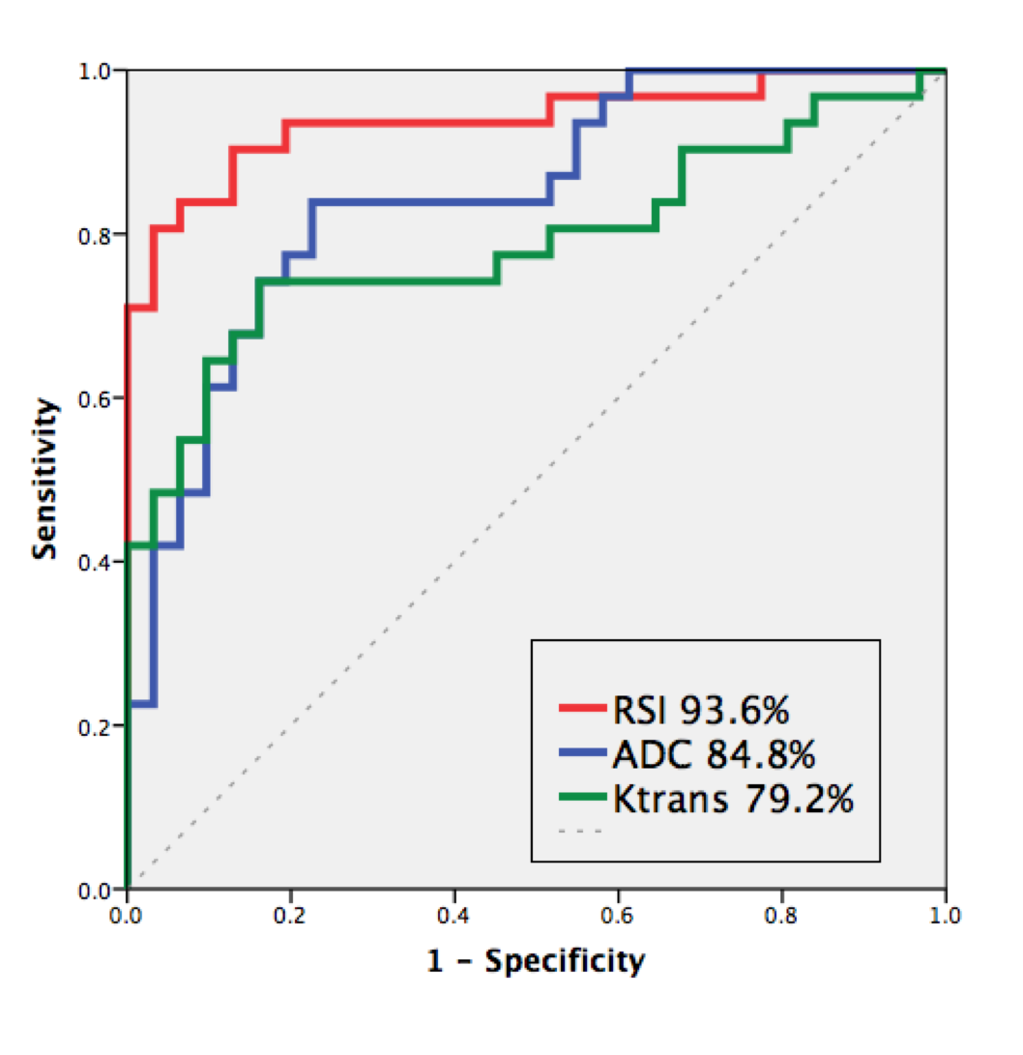
Aim 1: Improve ROC performance of Prostate MRI
McCammack, et al. PCAN 2016.
Notes:
33 UCSD patients. Tumor and normal prostate ROIs were drawn on the T2 based on the whole mount path. ROIs were copied to RSI maps, Ktrans maps and ADC maps. ROC performance was derived. RSI was acquired with B values of 1000, 375 and 125 with 15, 6 and 6 directions respectively. ADC maps were acquired from conventional DWI (B0 and B1000) without spatial distortion correction.
Example tumor (red) and normal PZ (blue) ROI assignment to the patient’s T2 image (A), subsequently reregistered to the K^{tran} map overlaid on T2 (B), conventional ADC map (C), and RSI-CM overlaid on T2 (D). ROI definitions were made on T2 images by an experienced radiologist based on the whole mount H&E section (E) tumor outlines provided by genitourinary pathology.
UCSD case. No endorectal coil.

Slide 8
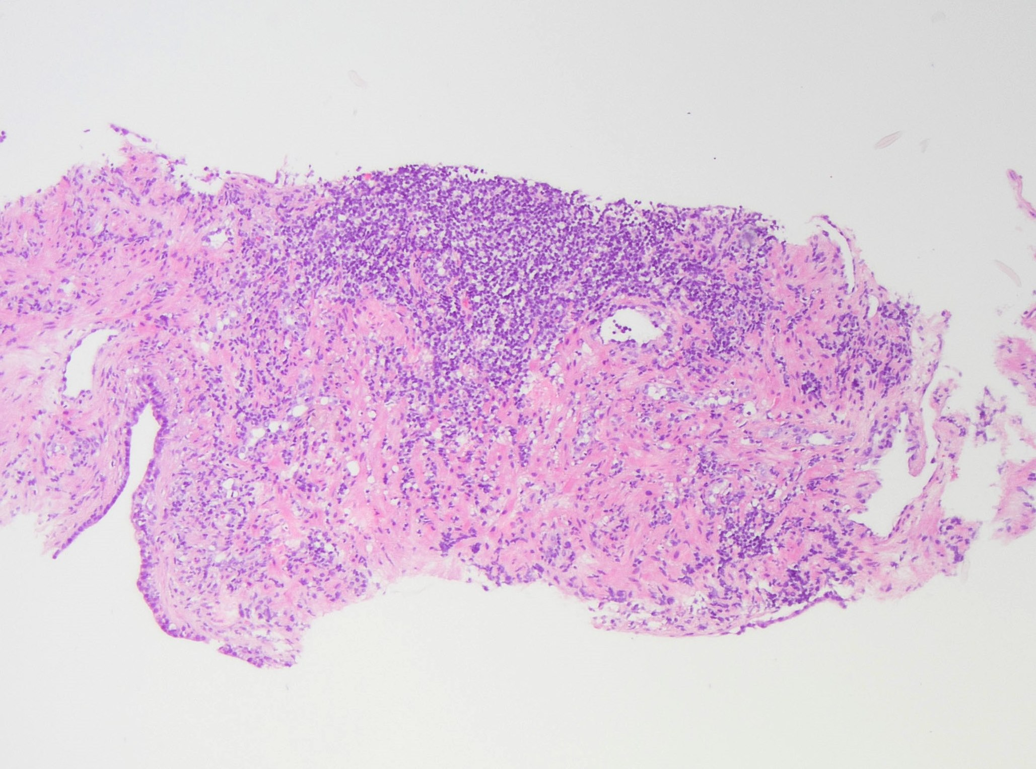
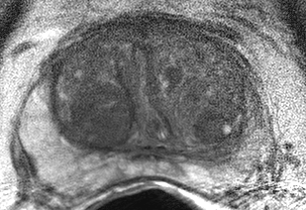
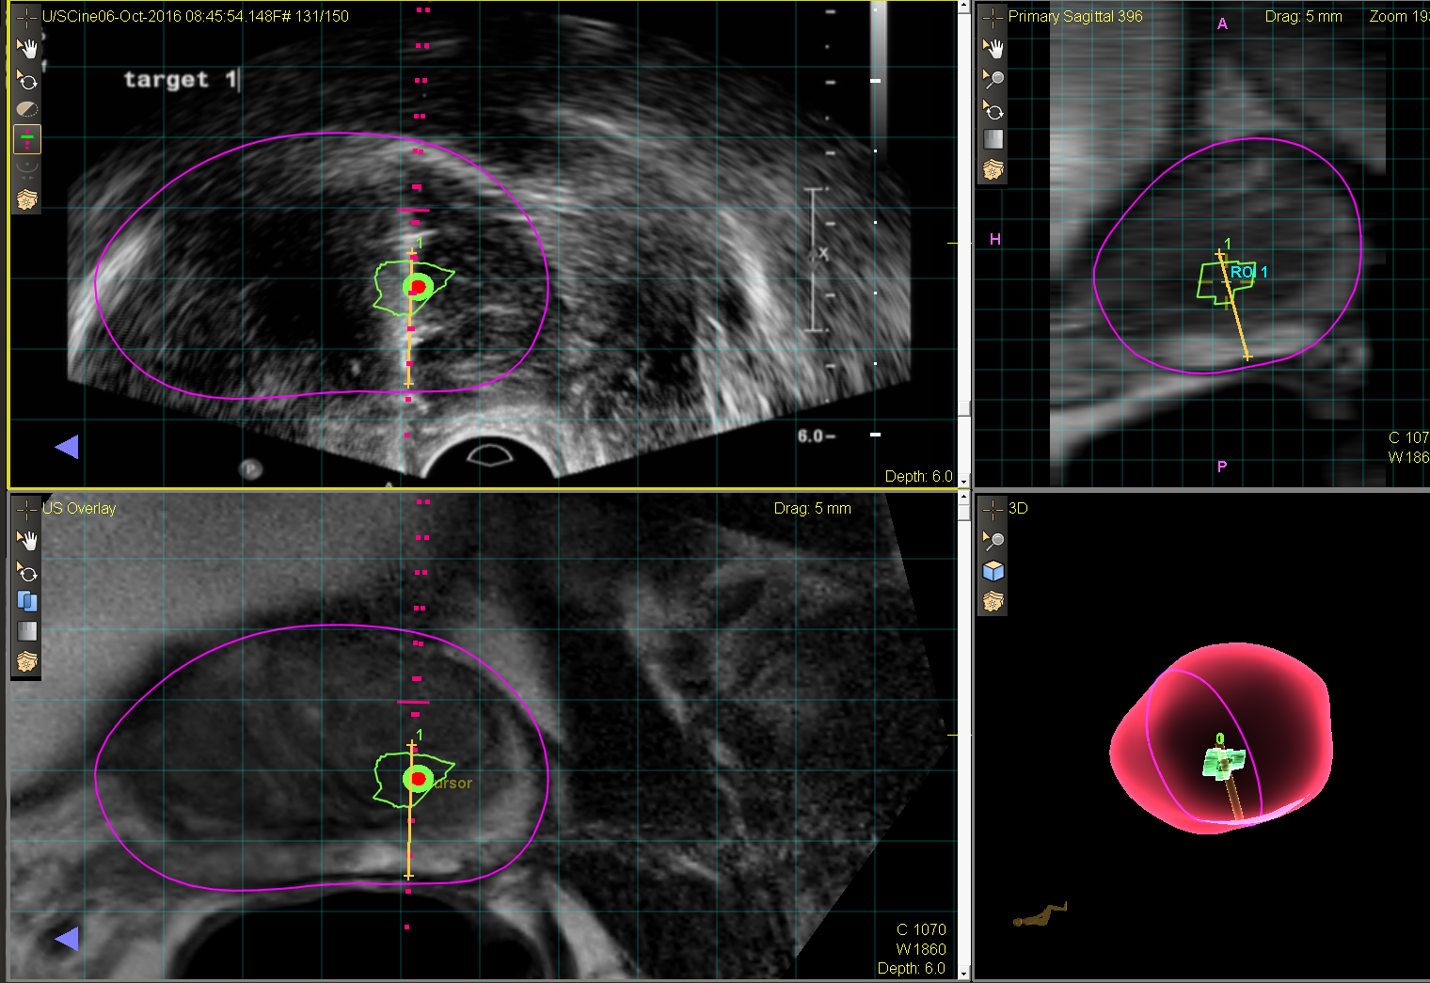
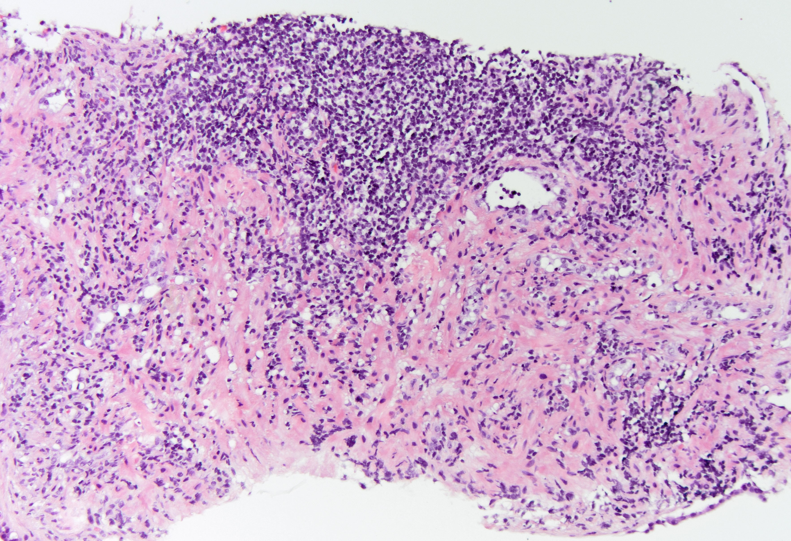
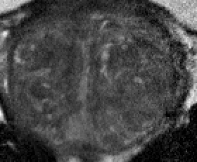
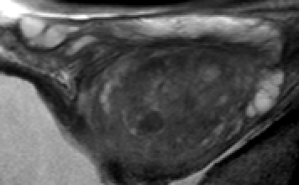
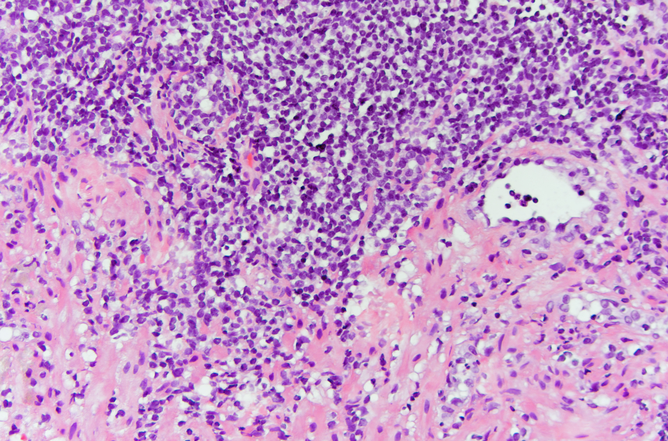
Aim 2: RSI may reduce Inflammation on Prostate MRI
Radiology - Prostate MRI
Urology - MRI Fusion Prostate Biopsy
Pathology
MRI
Phillips 3T with endorectal coil
T1,T2, DWI, DCE, B=0,700, 1400
PI-RADS = 3
Patient Demographics
Age: 67 years
PSA: 10.1 ng/mL
Prostate Size: 70 cc
Previous biopsy: one
Previous pathology: HGPIN 1/12 cores
All Cores Negative
Focal inflammation
inflammation
MRI T2 Transverse
lesion
MRI T2 Coronal
MRI T2 Sagittal

Slide 9
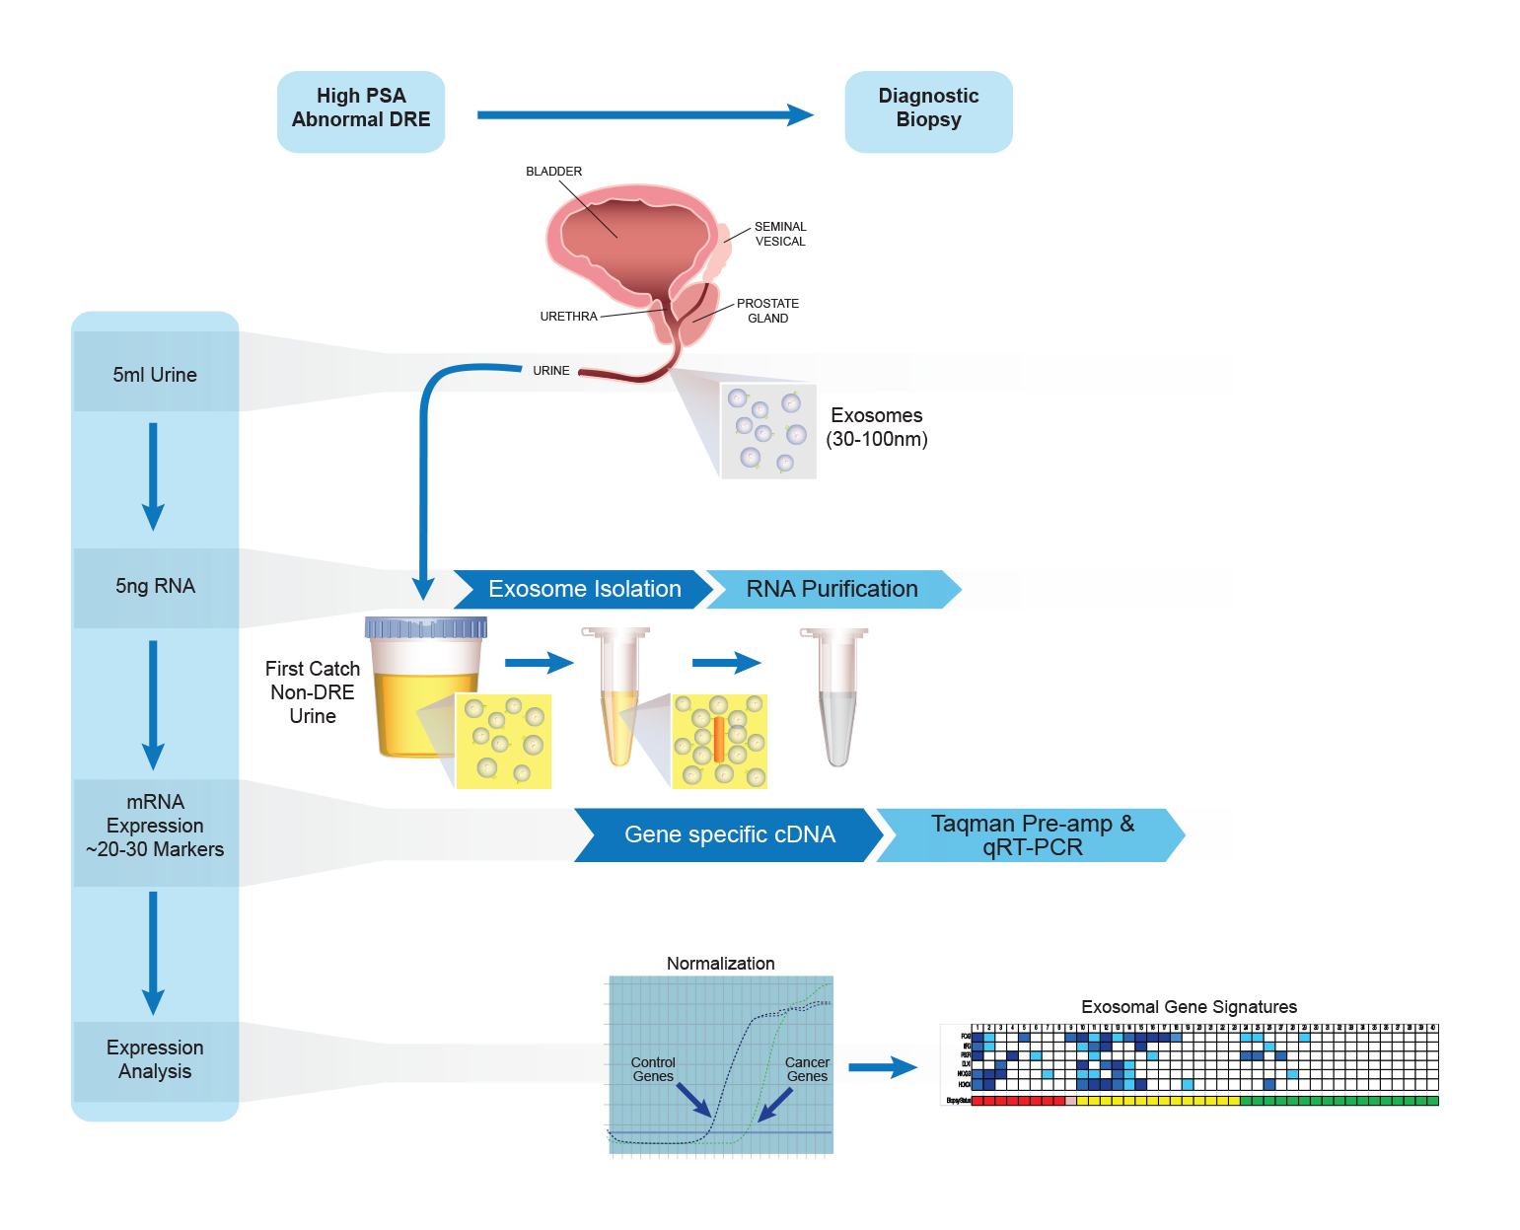
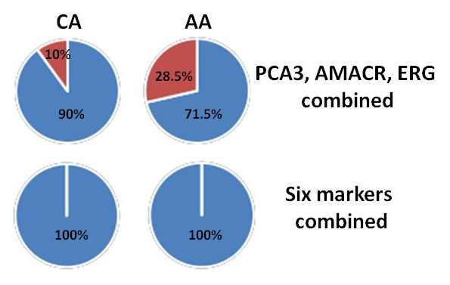
CPDR Urine Exosome Gene Expression Panel Assay to Enhance Biomarkers for African American Prostate Cancers (Shiv Shrivastava, PI)
Background/Hypothesis:
Commonly used prostate cancer gene expression markers have limited diagnostic potential in AA CaP patients.
Assays for gene expression marker panels that perform well for AA or CA CaP have been developed and evaluated in urine (non-DRE) exosomes.
Focus on Gene panel e.g., PSGR, PCGEM1, PCA3, ERG, HOXC6 and normalization control SPDEF
Kohaar et al.

Slide 10
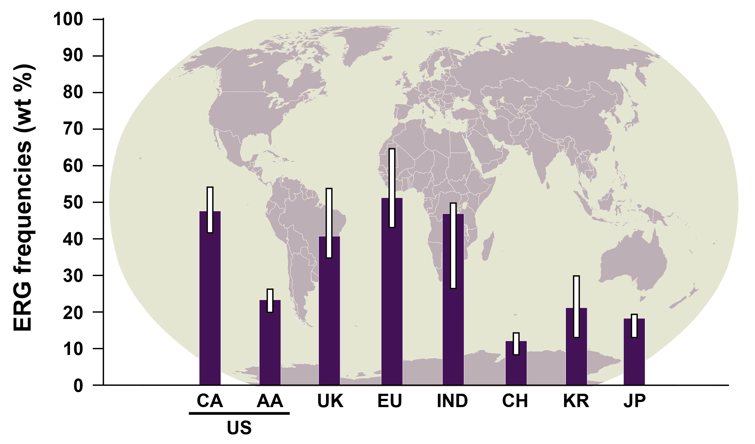
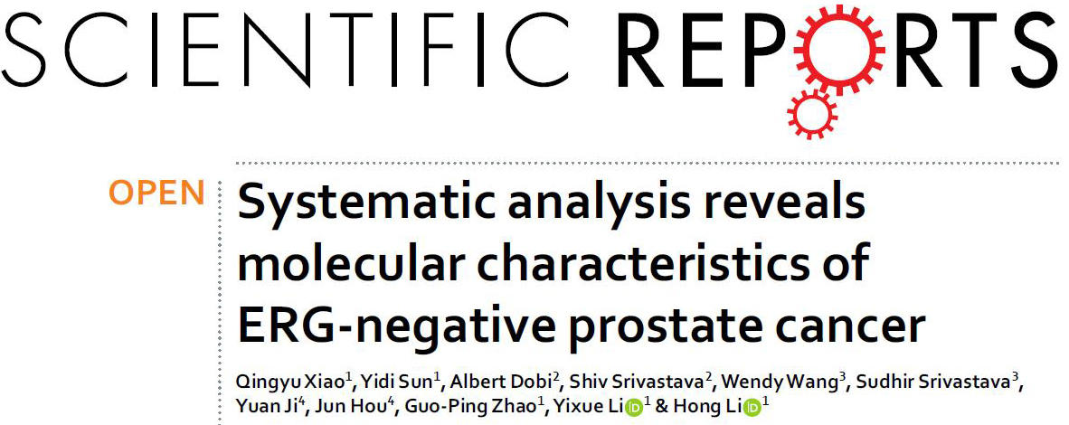
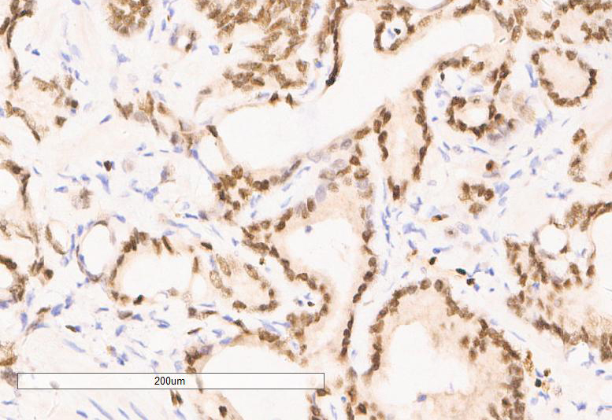
International Collaboration NCI-EDRN, USU-CPDR and Chinese Academy of Sciences-Key Laboratory of Computational Biology, Shanghai
Collaborators: Dr. Gouping Zhao, Dr. Yixue Li and Dr. Hong Li and Dr. Yuan Ji, Chinese Academy of Sciences; Max-Planck-Society Partner Institute for Computational Biology
EDRN Directions: Dr. Sudhir Srivastava, Dr. Wendy Wang
Continuing studies are addressing genomic and gene expression alterations in prostate cancer in China
An ERG IHC study has been completed assessing 100 FFPE prostate specimens indicating 22% ERG frequency
ERG frequencies worldwide
Sedarsky et al., Nature Reviews Urol 2017 (modified)
Goal: develop race/ethnicity informed biomarkers for the early detection of clinically significant prostate cancer.
Manuscript (in preparation)

Slide 11
Early Predictive Protein Markers of Metastatic Progression (EDRN GU Group-Collaboration)
CPDR: Dr. Jennifer Cullen, Dr. Gyorgy Petrovics,
Dr. Isabell A. Sesterhenn,
COL Inger Rosner and Shiv Srivastava
PNNL: Dr. Tao Liu and Dr. Karin Rodland
EDRN Directions: Dr. Jacob Kagan and
Dr. Sudhir Srivastava
Study Cohort (N=279)
Metastatic progression (N=38)
Developed BCR (N=106)
No progression after over 10 years follow-up (N=135)
Protein | AUC |  | Protein | AUC
ANXA2 | 0.5989 |  | NCOA2 | 0.6363
CAMKK2 | 0.5880 |  | PSA | 0.7271
CCND1 | 0.5103 |  | SMAD4 | 0.4848
EGFR | 0.6156 |  | SPINK1 | 0.5323
ERG_pan | 0.5331 |  | SPRC | 0.7784
FOLH1 | 0.6467 |  | TFF3 | 0.5706
MMP9 | 0.5670 |  | TGFB1 | 0.7883
MUC1 | 0.5953 |  | VEGFA | 0.5592
AUC of each protein to metastatic progression
Identified a SRM assay protein markers for detection of aggressive prostate (metastatic progression) cancer (SPRC, TGF-β and PSA)

Slide 12


Leveraging the transcriptome for the early detection of prostate cancer
Arul M Chinnaiyan, M.D., Ph.D.
Scott A. Tomlins, M.D., Ph.D.
EDRN BDL

Slide 13
Research Highlights
Established MiPS-NGS assay
Discovered/characterized novel lncRNA biomarkers (PCAT14, ARLNC1, and THOR)
Identified CDK12 a biomarker for sensitivity to immune checkpoint inhibitors
Wu, Cieslik, Robinson et al, Cell 2018

Slide 14
Challenges
Co-PI, Scott Tomlins recruited to industry (however we have maintained 5% effort at U-M)
Issues with Commercial Partner (Hologic/Gen-Probe) for urine PCA3 and T2-ERG assays
Requirement of post-DRE not ideal (need more sensitive assays)
Advent of prostate MRI
While early diagnosis is possibly with a urine test, developing a test that picks up aggressive prostate cancer is the key
Patents, Licenses, and International Collaborations
Secured PCA3 license from Hologic; T2-ERG IP returned to U-M (considering new commercial partners)
MiPS in the U-M CLIA Pathology labs as offered as urine test
U-M has secured a supply contract from Hologic for T2-ERG urine assay reagents
International collaborations with institutions in China are under discussion
Outlook/Future Plans
Establish MiPS NGS as the new urine MiPS test (will be used as part of EDRN CORE project)
Refine content of MiPS NGS
Carry out MiPS-NGS validation studies as part of the EDRN.
Identify a new commercial partner to develop and market MiPS and MiPS-NGS

Slide 15

Overview of Generated Data
Biofluid & Tissue Resources – EVMS, PMCC & SHSC
EDRN
Post-DRE Urines
Direct-EPS
Frozen Tissues
Method Optimization
524 patients
720 samples
MStern & EV isolation
Proteogenomics
185
101
228
100

Slide 16
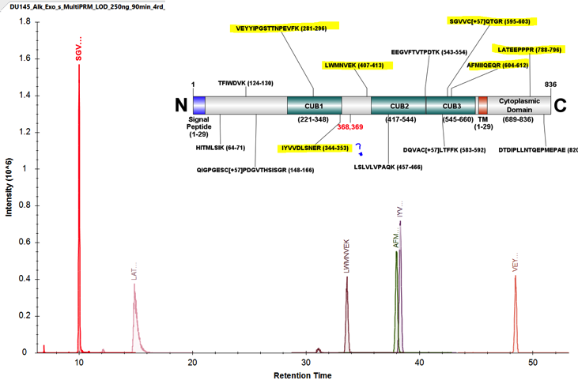
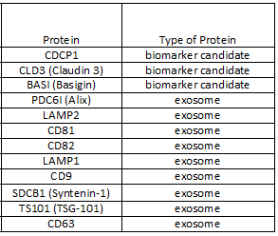
Targeted Proteomics for Exosomal Biomarkers
Targeted PRM Identification of Multiple CDCP1 Peptides
Synthesized AQUA peptides
Panel of Biomarker Candidates and Exosome Marker Proteins

Slide 17
Overview of Program Progress
Aim 1
Year 1
Year 2
Year 3
Year 4
Year 5
Assay Optimization
PRM-MS application to new pDU cohort
Novel discovery - dEPS
Novel discovery pDU
Novel discovery pDU glycol
Data mining & new PRM-MS develop.
Aim 2
Novel discovery - exosomes
Novel discovery - exosomes glyco
Data mining and HRM development
Validation of HRM assay (pDU)
Assay refinement & optimization
Aim 3
Assay performance optimization
Discovery of novel biomarkers
Integration & comparison w/o data
Examining biomarker origins

Slide 18
High Throughput Analysis of Prostate Samples Reveals Protein Modifications Associated with Cancer Aggressiveness
Hui Zhang
Johns Hopkins University
Ruedi Aebersold
Institute for Molecular Systems Biology
Notes:
20180905

Slide 19
Outlook and plans for the future
We have 145 urine specimens from Johns Hopkins Urology (50% Gleason 6 and 50 % Gleason 8 and above
Dr. Shiv Srivastava from Center for Prostate Disease Research has potentially 200 urine specimens and we have written the IRB for the collaboration and IRB was approved. We are waiting for MTA from DOD
We would like to collaborate with other institutions on analysis of urinary biomarkers
Analyze urine specimens using developed SRM and ELISA assays to validate urinary glycoproteins associated with aggressive prostate cancer
Verify the association of fucosylated glycoproteins in prostate cancer tissue and urine samples
Validate IHC assays for FUT8, periostin, PTK7, and NAAA in TMAs from AS
Work with BRL to validate fucosylated PSA assays for serum levels of fuc-PSA test
Challenges and help needed to complete the projects

Slide 20
EDRN Biomarker Reference Laboratory (BRL) at Johns Hopkins 2018 research project Updates – Daniel W. Chan, Ph.D. (PI) Research Highlights
EDRN Collaborative Group network and validation Studies.
Prospective Active Surveillance Study for prostate cancer: Emory CVC (PI Martin Sanda)
Prostate MRI Biomarker Study and Longitudinal Testing of Validated Biomarkers: Michigan BDL (PI John Wei).
Tissue Upgrading Study for prostate cancer: UT San Antonio CVC (PI Robin Leach)
Urine biomarkers for aggressive prostate cancer: JHU BDL (PI Hui Zhang)
Development of an 8 biomarker multiplexed immunoassay on the BioPlex/MSD Sector for the analysis of 200 ovarian cancer samples: Harvard BDL (PI Steve Skates).
Industrial Collaborations
Development and validation of MiCheck® - a Multianalyte Index Assay (MIA) that combines Glypican-1 (GPC-1) and additional protein biomarkers in an algorithm: Minomic Inc.
Analysis of a panel of biomarkers (AFP, PIVKA-II), GP73, HGF, DPP4, DPP4/Seprase) for hepatocellular cancer (HCC) on the Architect Immunoassay Analyzer: Abbott Labs (Associate Member).
Product Development
Development of AGPC - An in vitro diagnostic multivariate index assay (IVDMIA) for aggressive prostate cancer. The panel will include 2 biomarkers discovered and published from our EDRN BRL - fucosylated PSA and sTIE-2 (soluble angiopoietin-2) and additional biomarkers. We plan to perform clinical validation using the EDRN prostate cancer reference sets.

Slide 21
JHU BRL - Challenges and help needed to complete their projects
Timelines for collaborative projects: Uncertainties.
Reagent provided by company: Contractual delays (Beckman)
Prostate cancer specimens and reference set for validation for product development study.
Outlook and plans for the future
Continue supporting EDRN investigators with BRL activities
Continue supporting Cooperative Group Collaborative Projects: Prostate cancer and Gynecological cancer.
Continue industry collaborations
Continue product development of AGPC - An in vitro diagnostic multivariate index assay (IVDMIA) for aggressive prostate cancer.

Slide 22
Emory CVC Sample Distribution 2016-18
Year | Recipient PI / Institution | Sample | Biomarker / Project | # Subjects |  | # sample
2015 | A. Perry / Dublin, Ireland | Urine Pellets | epiCaPture | 91 |  | 91
2015 | H Whitaker/Cambridge, UK ¹ | Whole Urine | Movember GAP Study | 181 |  | 181
2015 | H Pandha/Surrey, UK ² | Whole Urine |  |  |  | 181
2015 | E. Diamandis/Toronto, Canada³ | Whole Urine |  |  |  | 179
2015 | E. Davicioni/ San Diego ⁴ | Urine EV cDNA & FFPE tissue | Comparison of urine and prostate transcriptomes | 15 |  | 30
2015 | J. Clark / Newcastle, UK ⁵ | Urine EV cDNA | Prostate Urine Risk Signature | 100 |  | 100
2015 | A. McDonald/ Penn State ⁶ | Plasma | microRNA project | 34 |  | 102
2016 | W. Catalona / Northwestern | Buffy Coat | Genomics of men on AS | 30 |  | 51
2016 |  | Saliva |  | 71 |  | 71
2016 | E. Riley / Freenome | Plasma | Genomic Analysis | 20 |  | 176
2017 | J. Codington / Emory | Serum | Diagnostic Sr. Antibody | 31 |  | 31
2017 | T. Liu / Pacific Northwest National Laboratory⁷ | Whole Urine | Proteomics of Whole Urine | 30 |  | 30
2017 | C. Moreno / Emory ⁸ | Serum | Acuray platform test | 10 |  | 10
2017 | R. Arnold / Emory | Urine Pellets | mtDNA Mutations | 45 |  | 45
2017-18 | NCI Central Repository | Serum | URS Study | 52 |  | 810
2017-18 |  | Plasma |  |  |  | 486
2017-18 |  | Whole Urine |  |  |  | 147
2017-18 |  | Supernatant |  |  |  | 48
2017-18 |  | PBS Pellet |  |  |  | 17
2017-18 |  | RNALater Pellet |  |  |  | 26
2017-18 | FHCRC Central Repository | Frozen Tissue | PASS Study | 69 |  | 38
2017-18 |  | Serum |  |  |  | 648
2017-18 |  | Plasma |  |  |  | 972
2017-18 |  | Buffy Coat |  |  |  | 44
2017-18 |  | Whole Urine |  |  |  | 226
2017-18 |  | Supernatant |  |  |  | 124
2017-18 |  | PBS Pellet |  |  |  | 22
2017-18 |  | RNALater Pellet |  |  |  | 58
2018 | R. Cummings / BIDMC ⁹ | Serum | Glycomics analysis | 50 |  | 60
2018 | E. Davicioni/ San Diego ¹⁰ | Urine EV cDNA | Urine Classifier Development | 44 |  | 44
2018 | R. Arnold / Emory | Urine EV RNA | mtDNA Mutations | 13 |  | 13
Total |  |  |  |  | 886 | 5061

Slide 23
Aims of Upgrading Cohort
Specific Aim 1: Recruitment of 340 men w/ bx Gleason 3+3 who have elected to undergo radical prostatectomy for PCA.
Preoperative blood and urine samples,
Prostate biopsy slides/blocks, RP slides/blocks
Demographic data collection collected.
Specific Aim 2: Identify clinical and demographic risk factors associated with upgrading (defined as > 3+4 at time of RP)
Biopsy and RP H&E will undergo Central Review (Cornell).
Patients will be followed to one intermediate endpoint (tumor grade and state at RP).
Patients consented for collection of follow-up data to determine adjuvant or salvage treatments and disease recurrence.
Specific Aim 3: Utilize biologics to identify biomarkers for upgrading (Phase II)

Slide 24
Status of recruitment
261 participants enrolled to date, 58 subjects are ineligible
30 subjects identified as ineligible at Round 1 for the following reasons:
10 unable to provide urine/blood sample or adequate sample
5 specimens collected outside of time or w/o DRE (newest criteria)
5 withdrew
4 not diagnosed w/in 2 years of scheduled prostatectomy
3 unwilling to contribute samples to reference set
2 did not proceed to prostatectomy or chose other treatment
1 site did not have supplies needed to collect urine
28 subjects identified as ineligible at Round 2 (Central Pathology Review did not concur w/ sites biopsy Gleason score of 3+3)
To date 193 biopsies have been sent for Central Review (UTHSCSA: 10, UW: 10, Stanford: 37, UM: 27, UC Irvine: 1, Emory: 37, Cleveland Clinic: 71, U Miami: 0)
New sites added: Johns Hopkins (Dr. Alan Partin), Eastern Virginia Medical School (Dr. John Semmes & Dr. Michael Fabrizio of Urology of Virginia), Weill Cornell Medicine-Urology (Dr. Jim Hu) and Icahn School of Medicine at Mt. Sinai (Dr. Ashutosh Tewari)

Slide 25
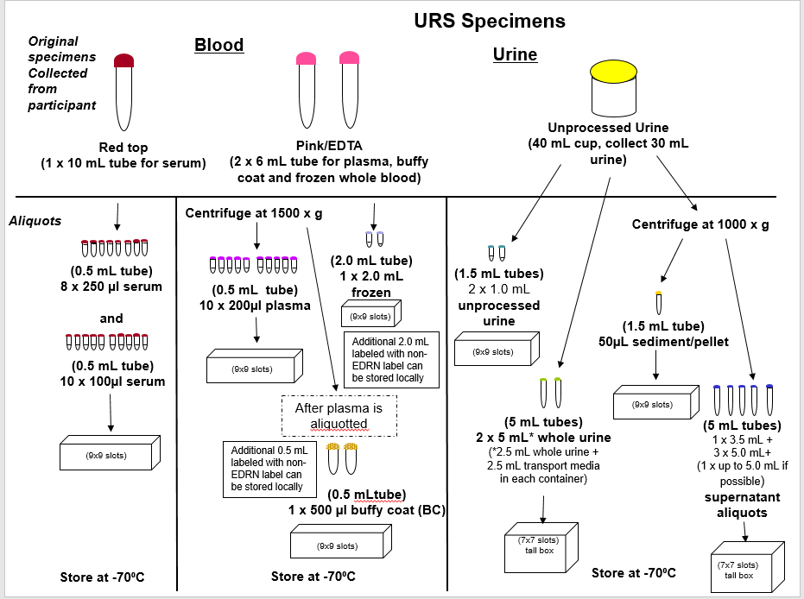

Slide 26
Biomarkers Suitable for Updated EDRN Urine Processing SOP
Biomarker | Site | Status | Analytic Plan
Prostate Health Index (phi) | Hopkins BRL (Chan, Sokoll) | FDA-approved Awaiting CPT | Optimize (train) & validate for upgrading endpoint
Urine PCA3, T2:Erg (eg MIPs) | Michigan (Tomlins, Chinnaiyan et al) | FDA (PCA3), CLIA (T2:Erg) | Optimize (train) & validate for upgrading endpoint
Tissue RNA-Seq (Targeted) | Michigan | CLIA | Optimize (train) & validate for upgrading & imaging
Urine RNA-Seq | Michigan | Laboratory | Prevalidation
Urine Transcriptome | Emory (Moreno, Pelligrini, Sanda) | CLIA | Optimize (train) & validate for upgrading & imaging
Urine RNA | CPDR (Petrovics, Srivastava) | Laboratory | Optimize (train) & validate for upgrading & imaging
Urine Proteome | Eastern Va M S, Univ Toronto (Semmes et al) | Laboratory | Optimize (train) & validate for upgrading & imaging
Urine Proteome | PNNL (Liu) | Laboratory | Prevalidation
Urine Glycomics | Hopkins (Zhang) | Laboratory | Prevalidation

Slide 27
Challenges and Opportunities for the EDRN (via Hollywood, with apologies)
“Good Will Hunting” (Robin Williams & Matt Damon…NEXT DOOR!!)
What are the computational challenges to optimizing “informative impact” of potentially effective multiplex biomarker combinations? (aka the power struggle)
“Jerry McGuire” (Show Me the Money! Tom Cruise)
What happens when payors cover invalid diagnostic tests? (haste)…or when FDA approves and payors balk (waste)?
“The Wolf of Wall Street” (Leonardo DiCaprio)
How do we stabilize the bridge over biomarker commercial partners’ chasm of fickleness?
How will the EDRN restructure to meet these challenges?

