Slide 1


The Road to Early Detection of Pancreatic Cancer
Anirban Maitra, M.B.B.S.
Professor of Pathology and Translational Molecular Pathology
University of Texas MD Anderson Cancer Center

Slide 2
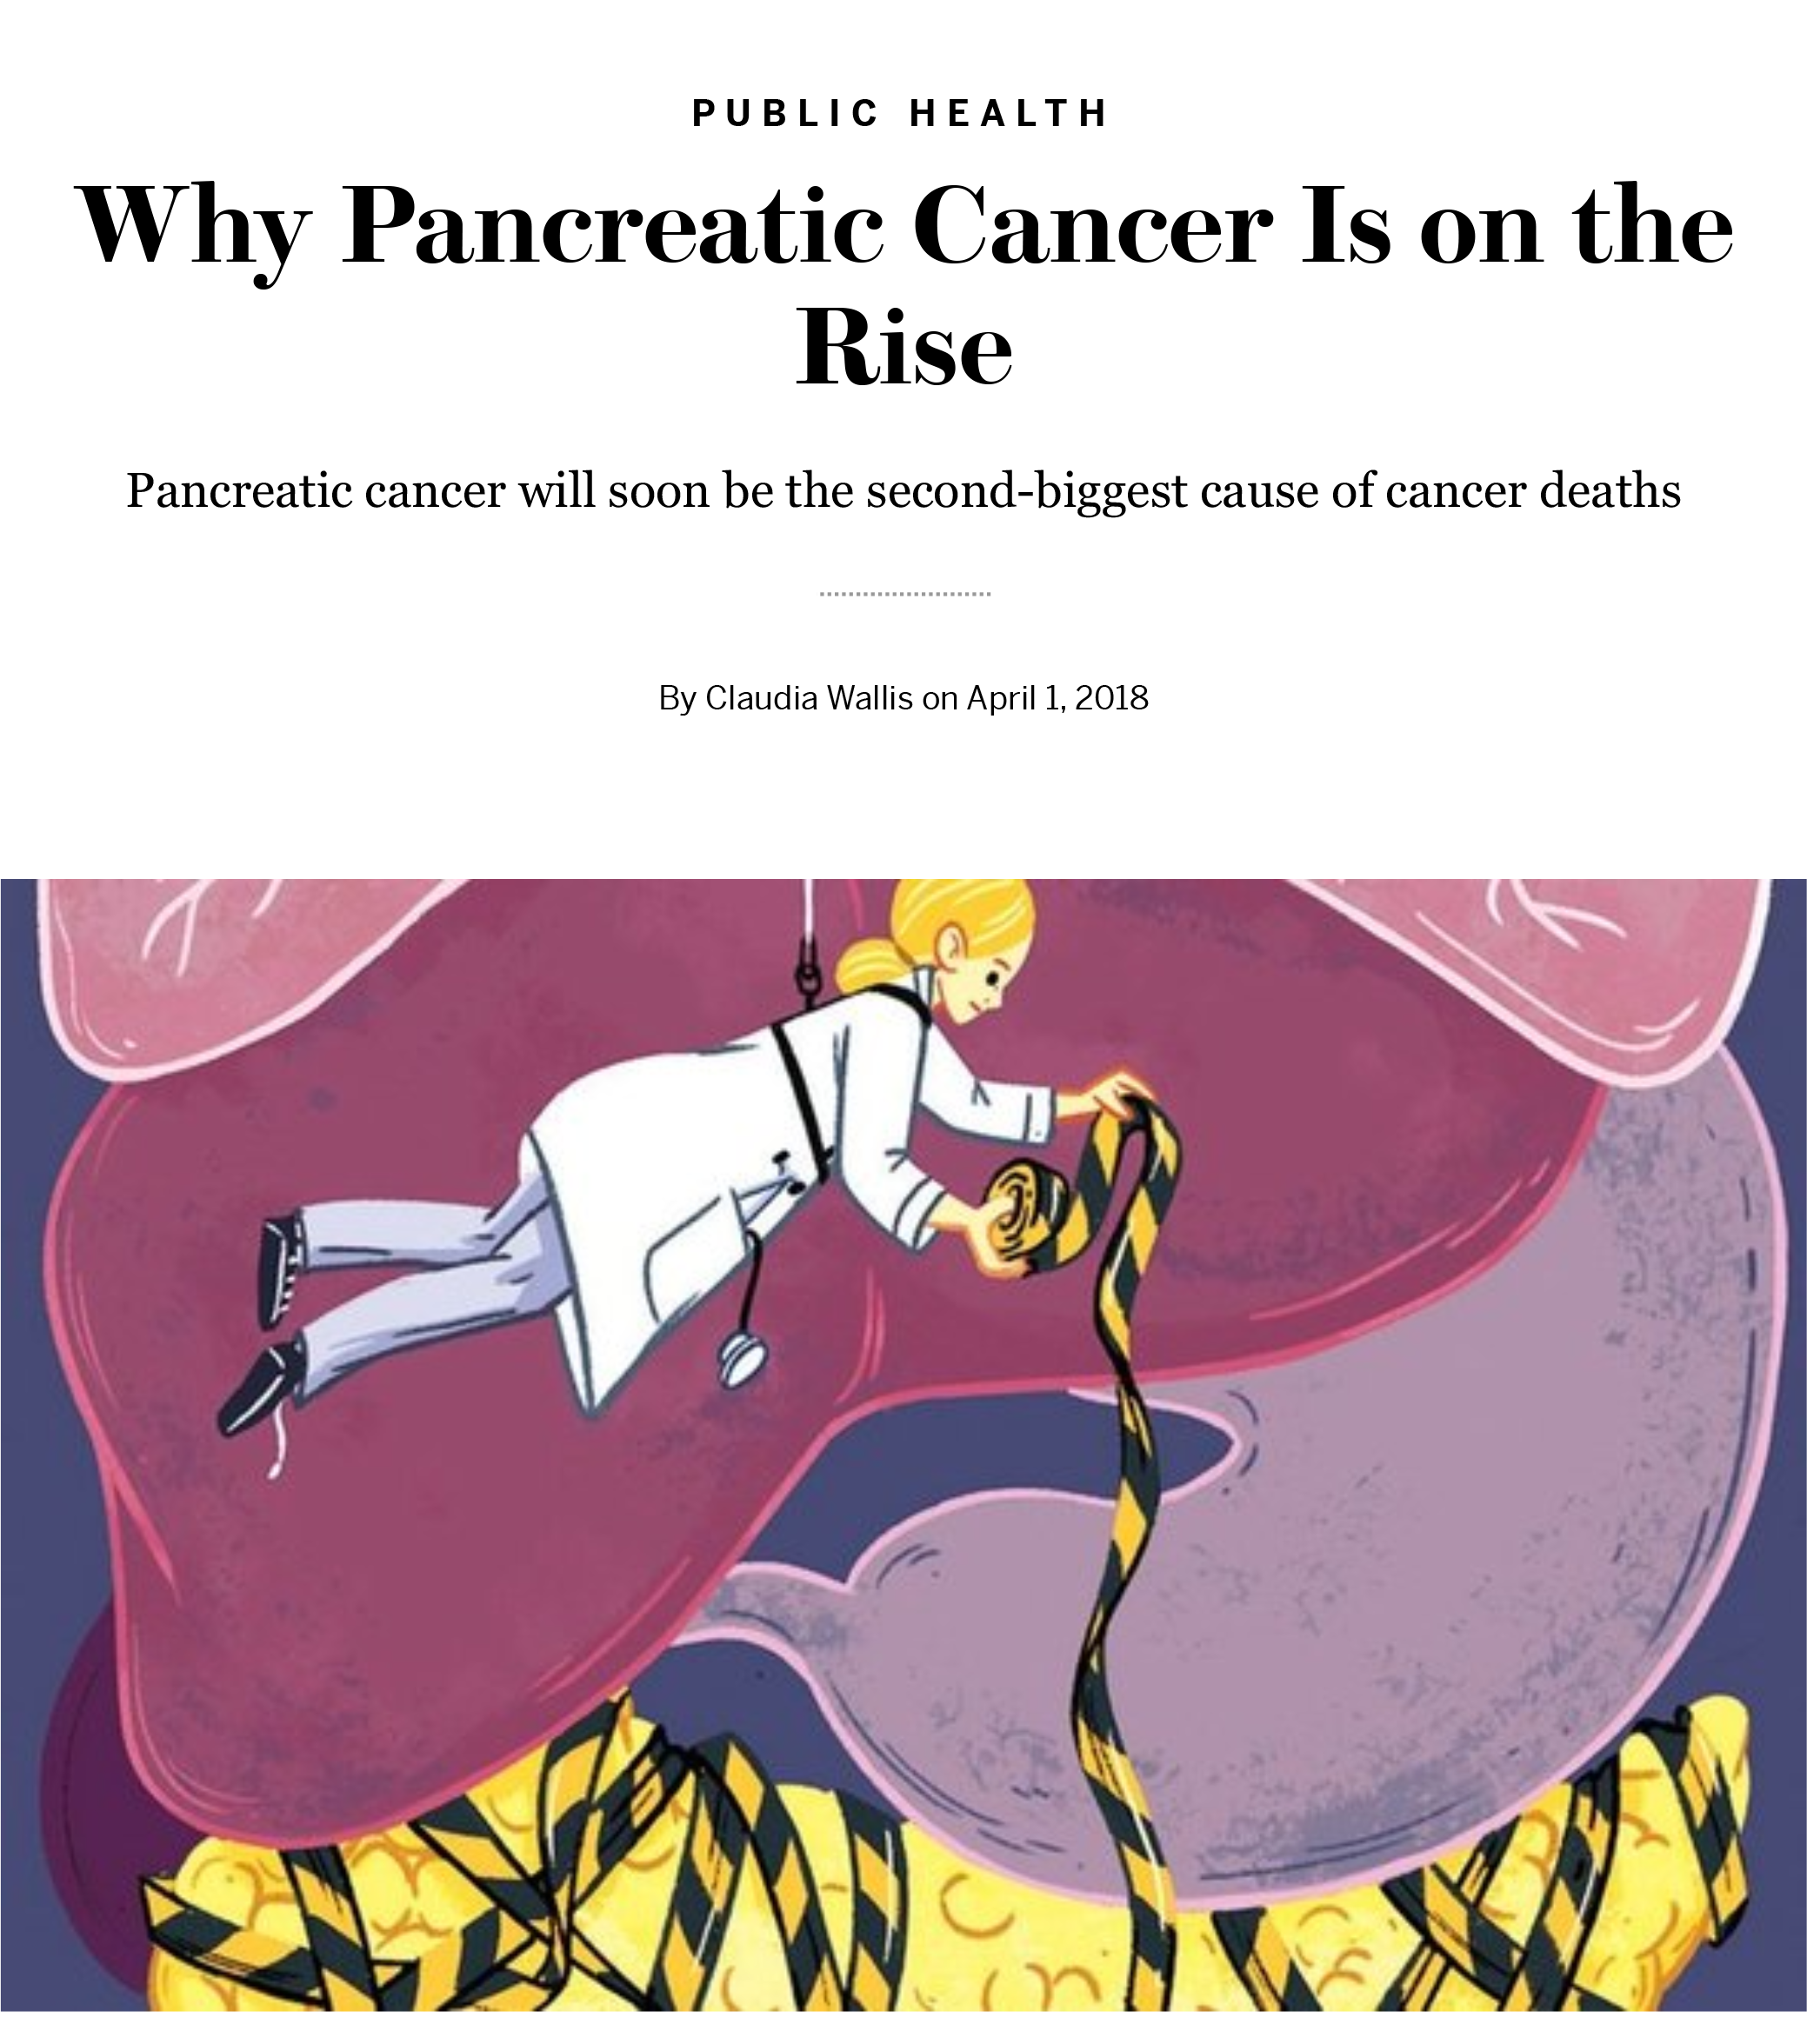
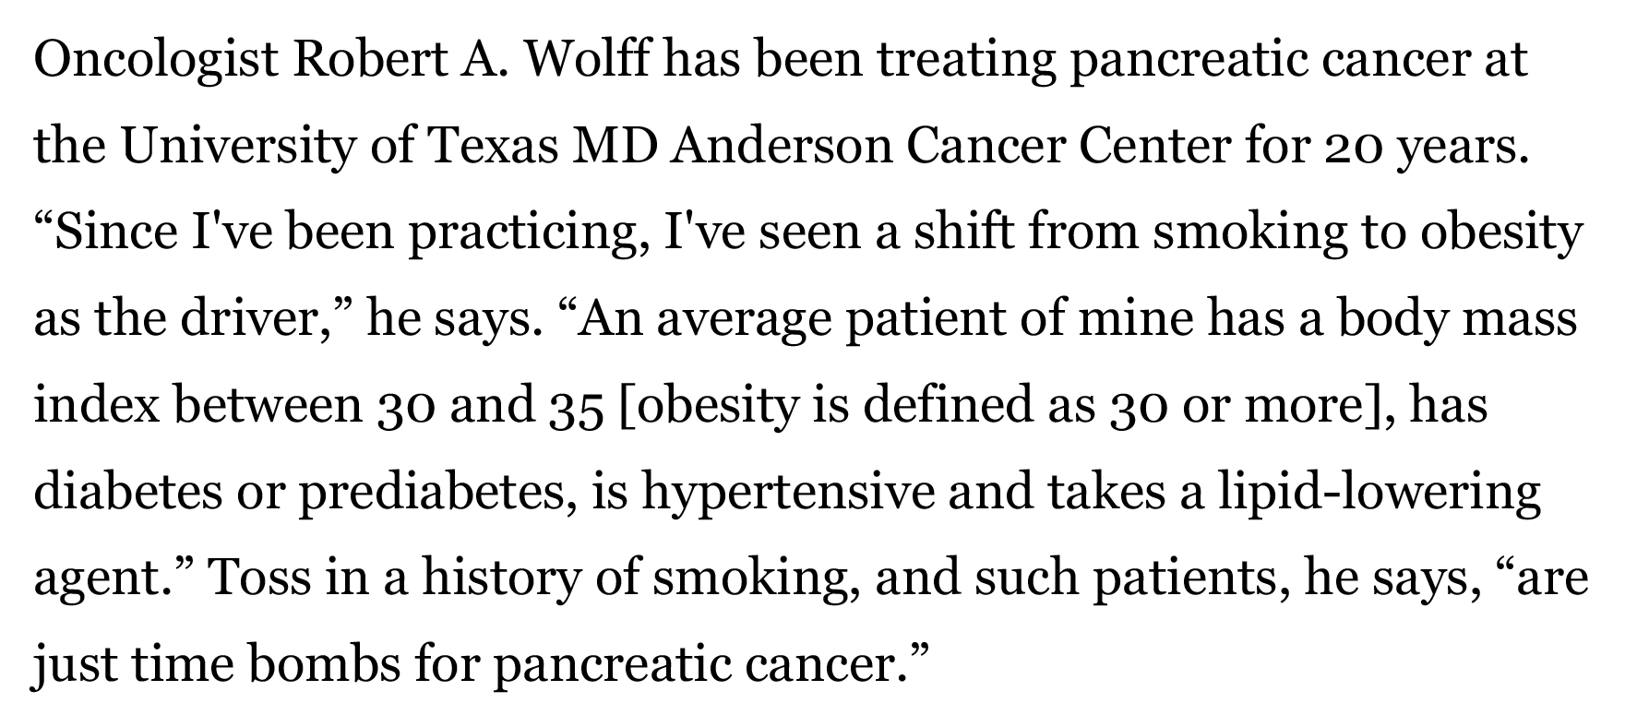
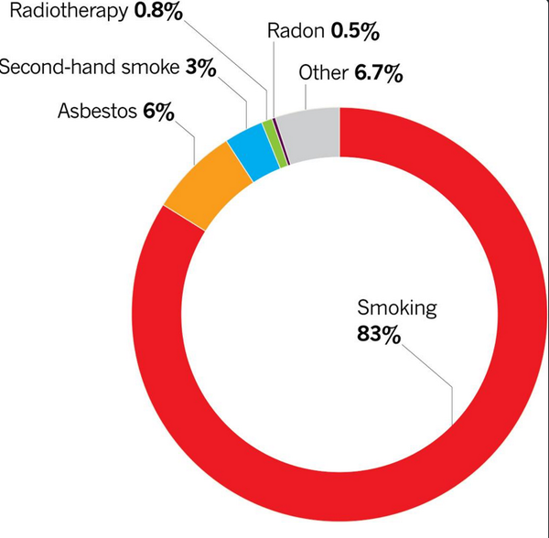
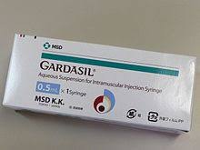
In contrast to cervical cancer or lung cancer, no single major attributable risk factor (HPV, smoking) in most patients.
Scientific American April 2018
An aging population
Better diagnostics
“Diabesity” epidemic

Slide 3
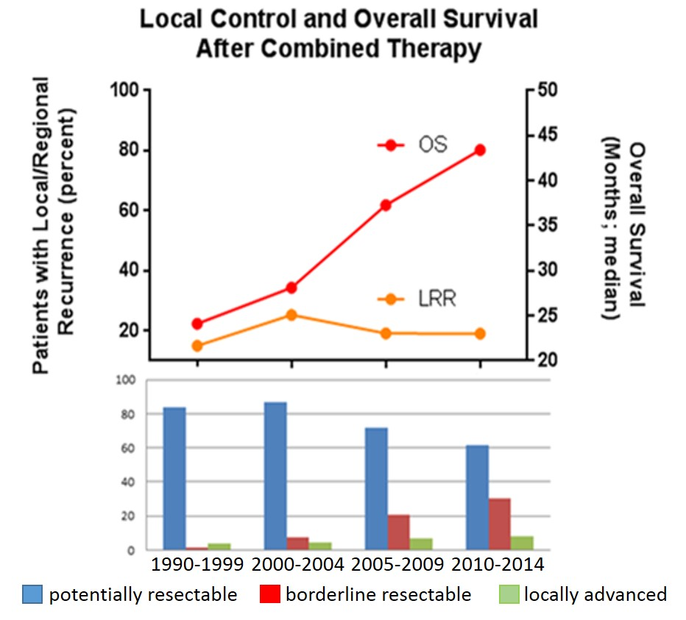
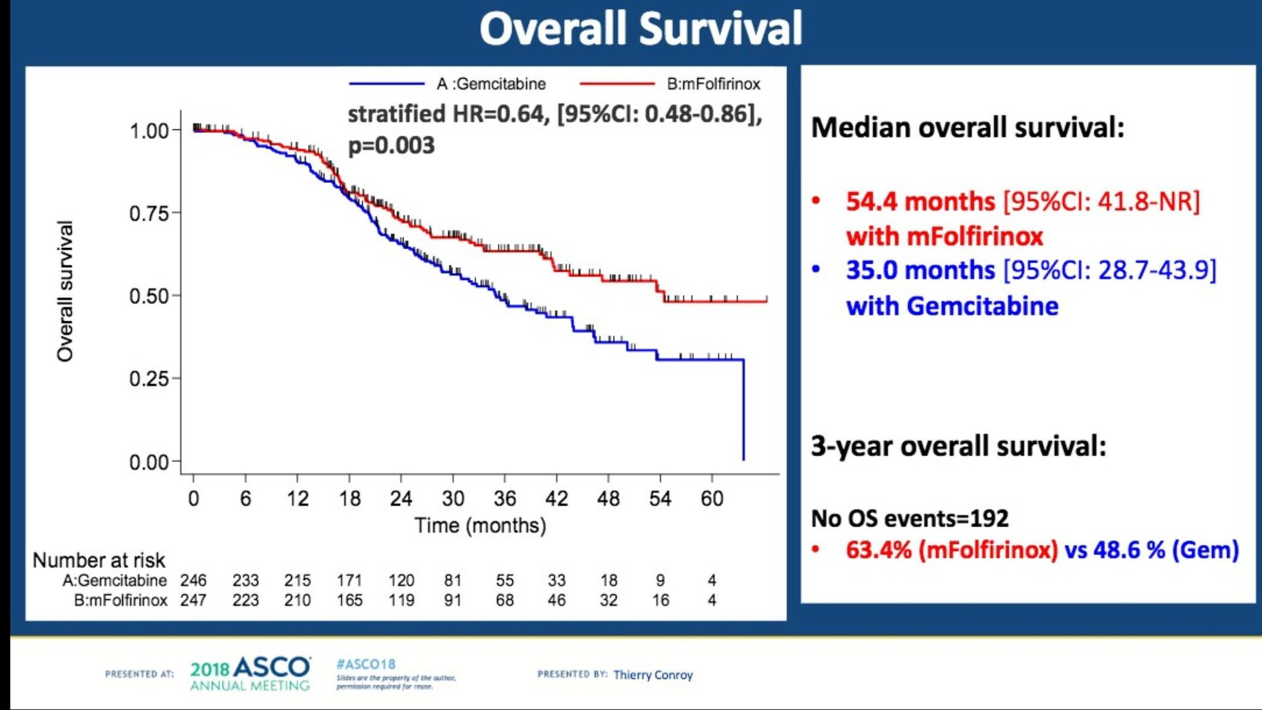
Disease specific survival is improving due to increasing adoption of neoadjuvant regimens and better adjuvant therapies
Median survival for overall resected patients at MDACC = 43 months
J Gastrointest Surg. 2017.
Exceptional survival data that requires detection at lower stage of disease (currently ~20%)
PRODIGE 24
Adjuvant mFOLFIRINOX v Gemcitabine in resected pancreatic cancer
ASCO 2018

Slide 4
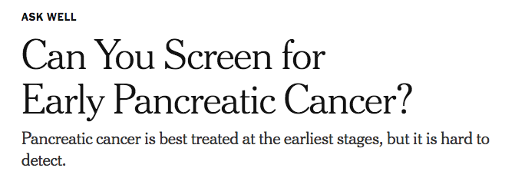
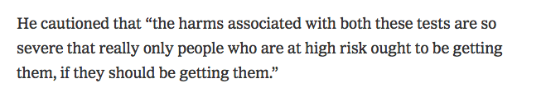
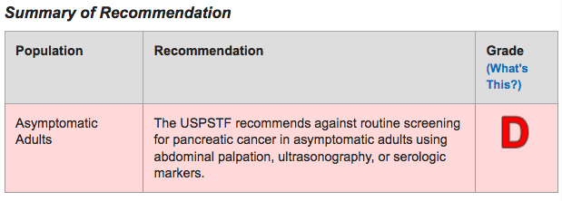
NY Times Aug 2018
Otis Brawley, ACS on CA19-9 and CT scans

Slide 5
Definition of Cancer Screening
Screening: Testing in setting of asymptomatic general population
Surveillance: Testing in asymptomatic high-risk individuals
Diagnostic: Testing in setting of symptoms
Pancreatic Cancer Screening
Surveillance

Slide 6
Can we screen the general population for Pancreatic Cancer?
Screen 100,000 asymptomatic individuals
Age-adjusted incidence rate was 12.0 per 100,000 men and women per year
Apply a biomarker with a 100% sensitivity and 99% specificity
Detect all 12 PDAC cases
~1,000 false positive studies
Not feasible to screen population, must enrich Randall Brand, UPMC

Slide 7
What about surveillance in a high risk Pancreatic Cancer population?
Screen enriched population of 10,000 asymptomatic individuals
Age-adjusted incidence rate is 120 per 100,000 men and women per year
Apply a biomarker with a 100% sensitivity and 99% specificity
Detect all 12 PDAC cases
~100 false positive studies
Practical to do surveillance for PDAC
Randall Brand, UPMC

Slide 8
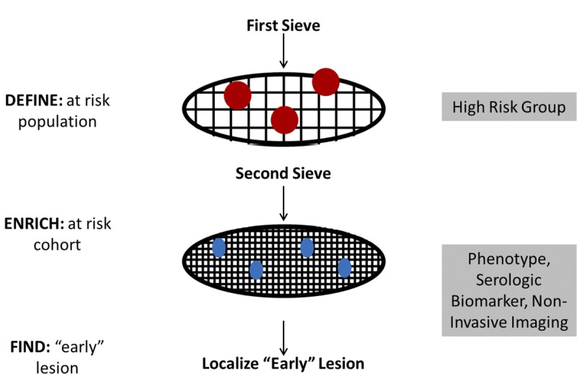
Pancreatic Cancer Surveillance
“D-E-F” Model of Sequential Sieves
Most likely a blood, urine or saliva-based test
Cannot be ivory tower assay
Familial pancreatic cancer
Pancreatic cysts
Adult new-onset diabetes
Kenner, Maitra, Chari, Pancreas 2017

Slide 9
Familial Pancreatic Cancer
Syndrome | Relative Risk of PC | Gene
Familial Atypical Multiple Mole Melanoma (FAMMM) | 13 to 39-fold | CDKN2A
Familial Breast and Ovarian | 2-fold and 3 to 9-fold | BRCA1 and 2
Fanconi Anemia, Breast CA | Unknown | PALB2
FAP | 5-fold | APC
Lynch Syndrome | 9 to 11-fold | MLH1, MSH6 MSH2, PMS2
Peutz-Jeghers Syndrome | 132-fold | STK11/LKB1
Hereditary Pancreatitis | 53-fold | PRSS1
Li-Fraumeni syndrome | 7-fold | p53
Ataxia -telangiectasia | ~3-fold | ATM

Slide 10
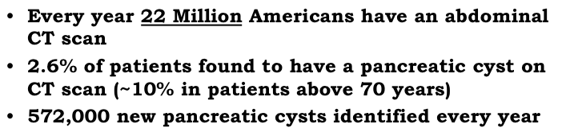

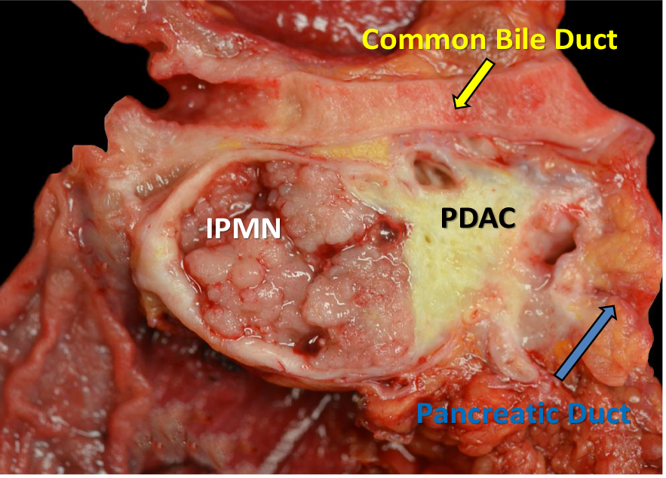
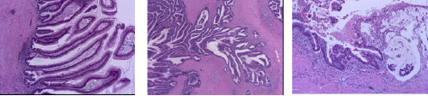
Mucinous pancreatic cysts
Intraductal Papillary Mucinous Neoplasm (IPMN) with progression to pancreatic adenocarcinoma
The vast majority of pancreatic cysts will NOT progress to cancer
~6 million individuals with cysts
~53,000 new cases of pancreatic cancer
~8,000 arise on background of cystic lesions
Aatur Singhi (UPMC)

Slide 11







NCI EDRN: Pancreatic Cyst Biomarker Validation Study
Telomerase
Glucose
DNA Methylation Markers
PancreaSeq
Amphiregulin
Glycoproteins
Gastricsin
Das-1
Cathepsin E
Data Management Coordinating Center
Pancreatic Cyst Biomarker Alliance

Slide 12
NCI EDRN: Pancreatic Cyst Biomarker Validation Study
Mucinous vs. Non-Mucinous Cysts
PancreaSeq
Glycoproteins
Amphiregulin
Glucose
Gastricsin
Cathepsin E
Presence vs. Absence of Advanced Neoplasia
PancreaSeq
DNA Methylation Markers
Das-1
Telomerase
Telomerase
Glucose
PancreaSeq
DNA Methylation Markers
PancreaSeq
Amphiregulin
Glycoproteins
Gastricsin
Das-1
Cathepsin E
>350 Pancreatic Cysts (w/ Dx Path)

Slide 13
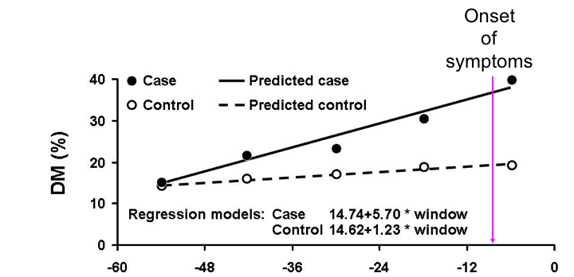
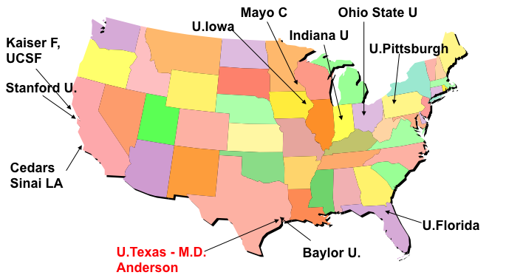
New Onset Diabetes (NOD) as a Risk Factor of Occult Pancreatic Cancer
“The NOD Cohort”
~1% of NOD >50y harbor an occult pancreatic cancer
25-50% of pancreatic cancer patients may have NOD as their first symptom
NOD patients have a 6-8 fold higher risk of PDAC within 3y
10,000 NOD patients >50y recruited prospectively
EMR-based enrichment algorithm
Biomarker studies in pre-diagnostic samples (EDRN)
Chari, Mayo Clinic

Slide 14
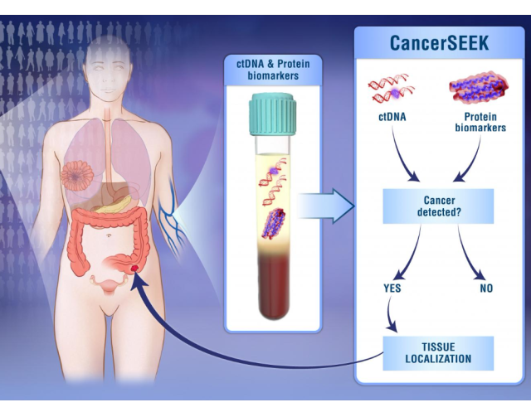
Let’s Talk About the “E” in the “DEF” Model
Pancreatic Cancer Biomarkers
Risk Marker
(Clinical, genetic or biochemical)
BIOMARKER
Early Detection Marker
EDRN GOAL
CA19-9 + Most Biomarkers
Risk
Families
Cyst patients
“Sporadic” Risk
Asymptomatic PDAC
Early stage PDAC
(symptomatic)
Cancer induced NOD
Late stage PDAC (85%)
Polygenic Risk Score
BMI
Smoking history
Metabolites (BCAA)
Surveillance Biomarkers
Cohen….Vogelstein, Science 2018

Slide 15
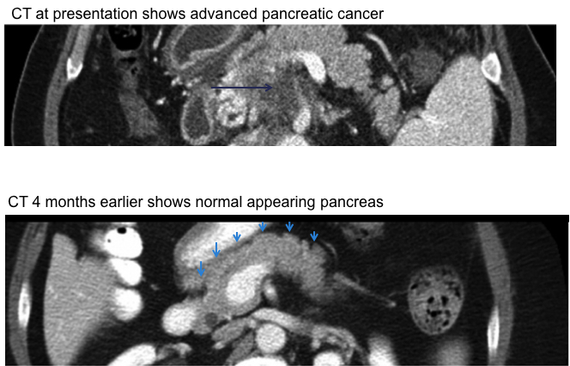
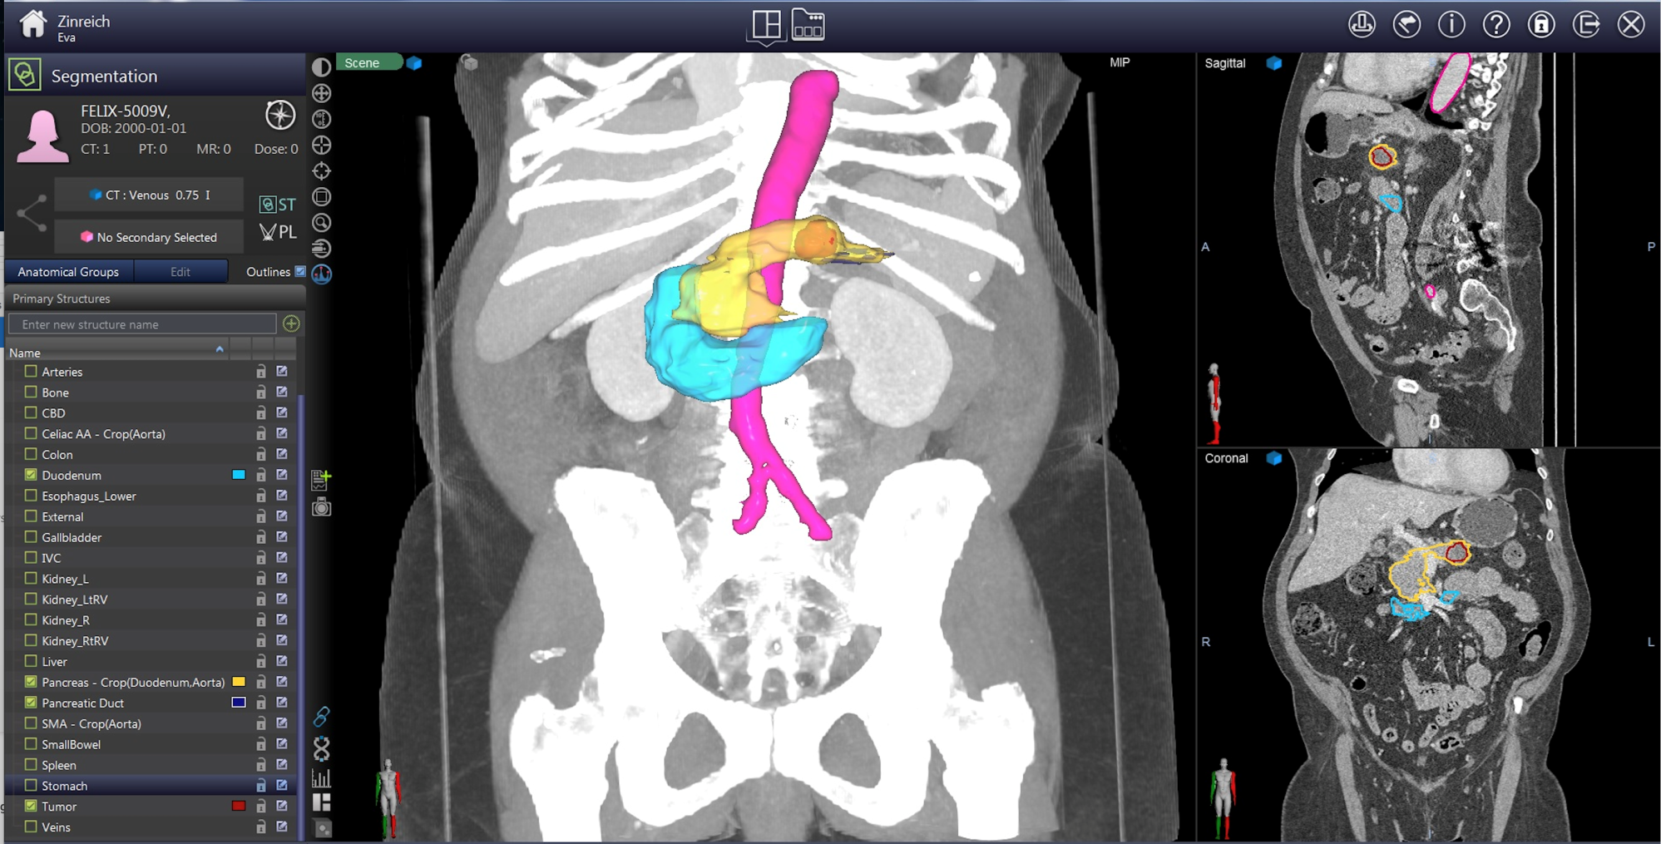
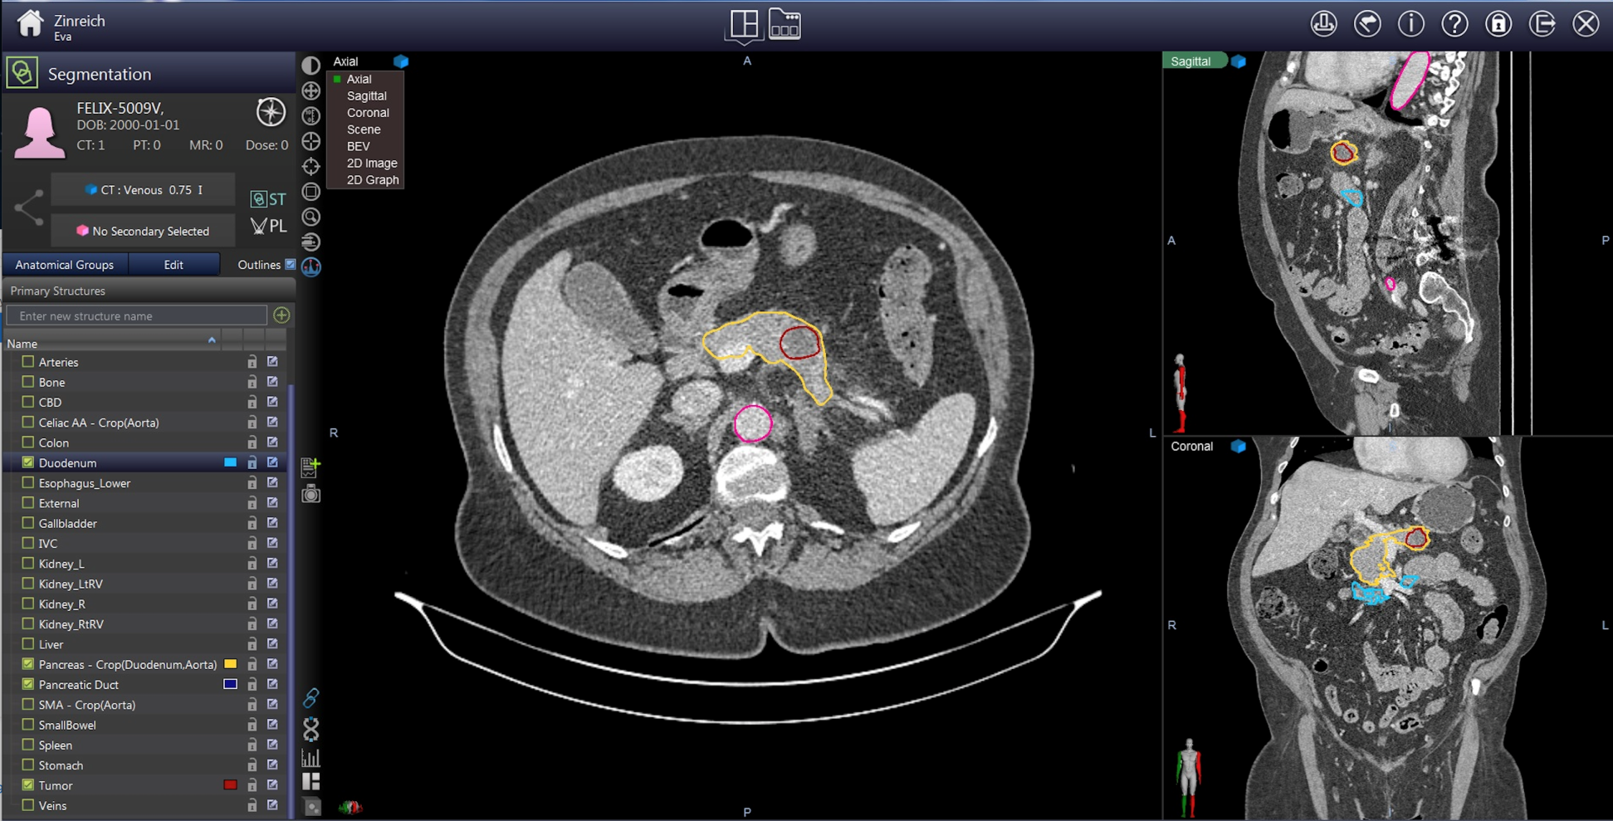
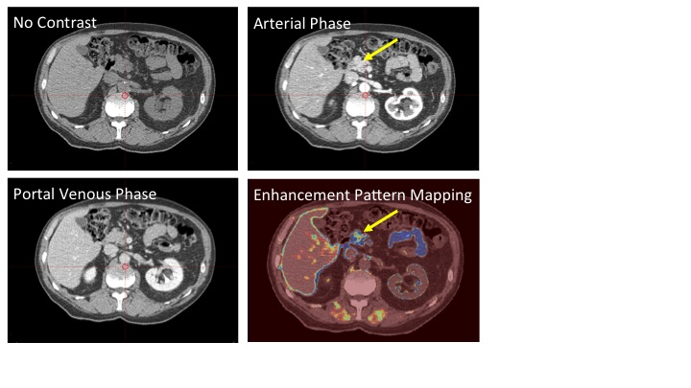
Let’s end with the “F” word in “DEF” Your perfect biomarker is abnormal now what?
Courtesy of Suresh Chari at Mayo Clinic
Deep Learning Algorithm Computer-assisted cancer demarcation
Vogelstein, Fishman et al
Enhancement Pattern Mapping
Eugene Koay, MD Anderson

Slide 16
EDRN As a Critical Hub for Pancreatic Cancer Biomarker Development Efforts “Alliance of Consortia”
NCI MCL Consortium (“Overdiagnosis consortium”)
Pancreatic Cystic Lesions
NCI/NIDDK
CPDPC
NOD cohort
1st phase 3 (+/- phase 4) biomarker and imaging validation study in PDAC
NCI EDRN
NCI PCDC
Source of prospective biospecimens
Additional biomarkers
Imaging modalities
NCI EDRN consortium efforts
Biomarker bakeoff
PCBA
PCA/HTAN

Slide 17
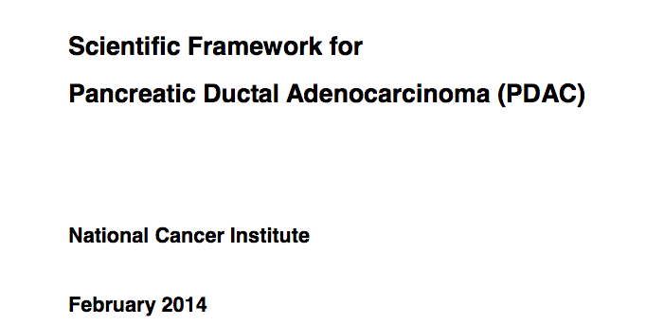
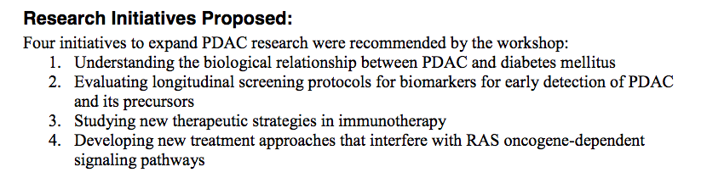
February 2014
Opportunities and Challenges:
Pre-diagnostic biospecimens and imaging repository:
Prospective NOD cohort – to begin Q4 2018 (CPDPC)
Prospective pancreatic cyst cohorts – ongoing (MCL/EDRN/PCDC)
High risk genetic cohorts on surveillance – ongoing (PCDC)
Defining optimal biomarker panels for surveillance in at risk populations – “Bakeoff” studies
Defining “sporadic risk” – incorporates PRS, clinical data, family history - defining who to screen from the average risk population

Slide 18

Sudhir Srivastava
JoAnn Rinaudo
Sharmistha Ghosh-Janjigian
Christos Patriotis
Matthew Young
Jacob Kagan
Lynn Sorbara
Guillermo Marquez
Richard Mazurchuk

