Slide 1

GI Collaborative Overview:
Colon and Esophageal Cancer
Ken Kinzler, Brenda Diergaarde, Robert E. Schoen, Sandy Markowitz, William Grady, Kishore Guda, Paul Lampe, Hans J. Nielsen, Dean Brenner

Slide 2
Overview
Methylation markers for Barrett’s/esophageal CA – S. Markowitz
CancerSEEK – blood test for screen detection and monitoring of cancer: - R. Schoen

Slide 3
CVC’s
Fred Hutchison CVC – Validation of early detection biomarkers for colorectal cancer and adenoma - P. Lampe
GLNE – D. Brenner

Slide 4
Fred Hutch CVC:
Intended clinical applications
1. Develop a blood test that improves on existing fecal tests, such as FIT and Cologuard for use in people unwilling to undergo or with no access to colonoscopy who should be prioritized for colonoscopy (i.e., improve/replace existing FIT and Cologuard tests)

Slide 5
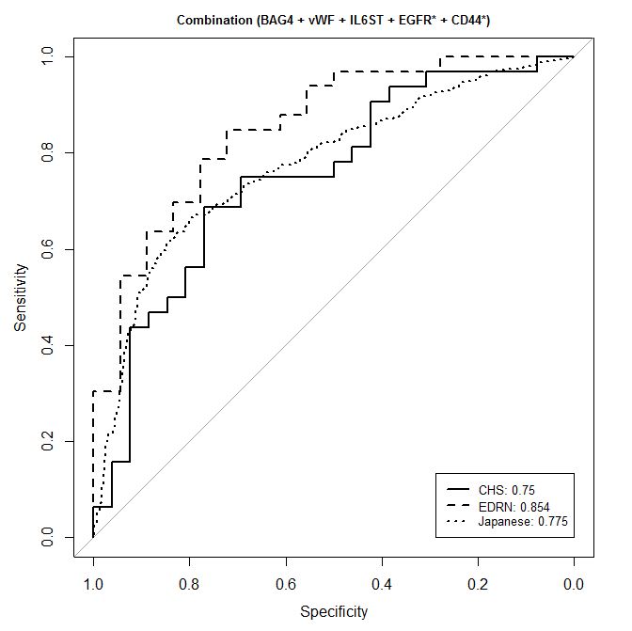
Panel performance across all 3 sample sets
 | CHS | EDRN | Ogaki
AUC | 0.75 | 0.854 | 0.775
95% CI | 0.62-0.88 | 0.74-0.96 | 0.74-0.81
Sens | 40.6% | 54.5% | 51.4%
95% CI | 0.03-0.72 | 0.18-0.85 | 0.41-0.59
Opt Spec | 76.9% | 72.2% | 84.7%
Opt Sens | 68.8% | 84.8% | 61.7%
Equal weight combination

Slide 6
Protein and glycomic plasma markers for early detection of adenoma and colon cancer
Gut, 2018 Mar, 67(3): 473-484. PMID: 27821646 PMC:5420499

Slide 7
Overview
Set Asides
Methylation markers as a complement to CancerSEEK
Assays for screen detection of CRC and adenoma

Slide 8
Blood-based Testing for CRC
A blood test for CRC screening would increase compliance and enhance options for testing
Septin 9, a marker of aberrant methylation, is the only approved blood test, but has limited sensitivity
EDRN is evaluating ctDNA + protein (CancerSEEK) for screening and monitoring of CRC
Markers of aberrantly methylated genes may be informative and complementary to CancerSEEK

Slide 9
Aims of our Set Aside Project
AIM 1. Hypothesis: ctDNA/proteins and aberrantly methylated genes will be more sensitive and specific for detection of colorectal cancer than either marker panel alone.
AIM 2. Hypothesis: ctDNA/proteins and aberrantly methylated genes will be better for monitoring of CRC patients with regional metastatic disease (stage III) than either panel of markers alone.

Slide 10
Colon Collaborative Project
Aim 1
To define sensitivity and specificity of specified plasma biomarkers for the detection of advanced adenoma and/or colorectal cancer with samples with positive and negative FIT tests.
Aim 2
To develop a combination rule for the markers comparing it with FIT and testing.

Slide 11
Critical Question
Blood Test for Cancer Screening – Is that Holy Grail?
Shouldn’t the goal be blood test for Advanced Adenoma?
Don’t we really need a test/prediction rule that successfully predicts colonoscopy outcomes – to triage colonoscopy use for screening and surveillance?

