Slide 1
EDRN is All About Linked Hypotheses

Slide 2
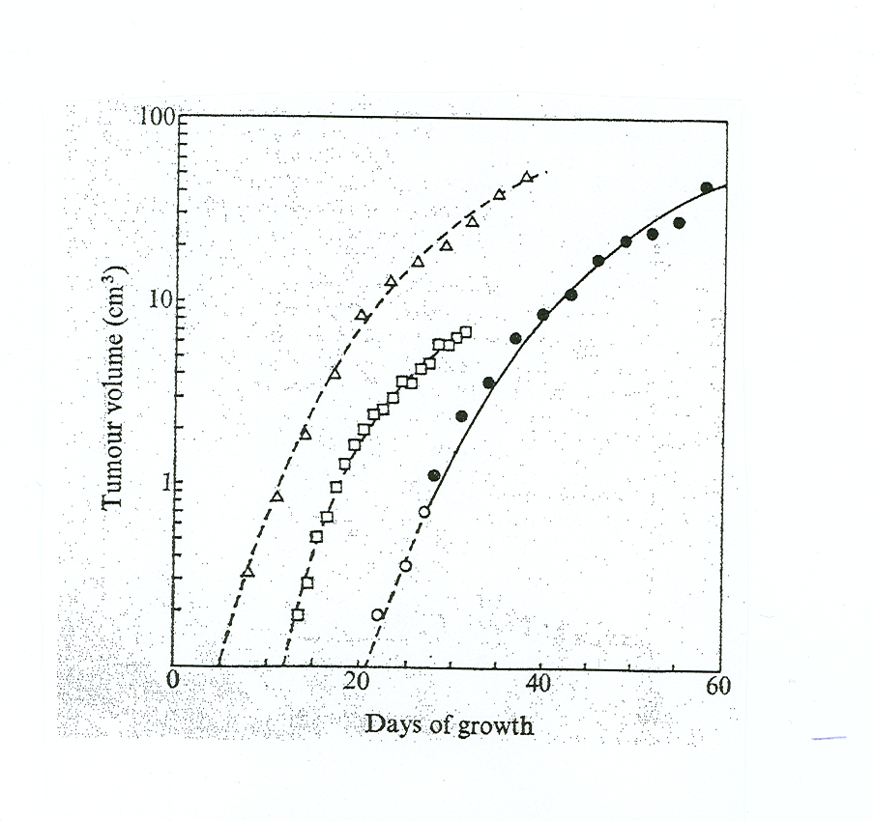
Observation

Slide 3
Observation
Clinical Hypothesis
G.
10¹²
10¹⁰
10⁸
10⁶
10⁴
10²
10⁰
0
40
80
120
160
Weeks of Growth

Slide 4
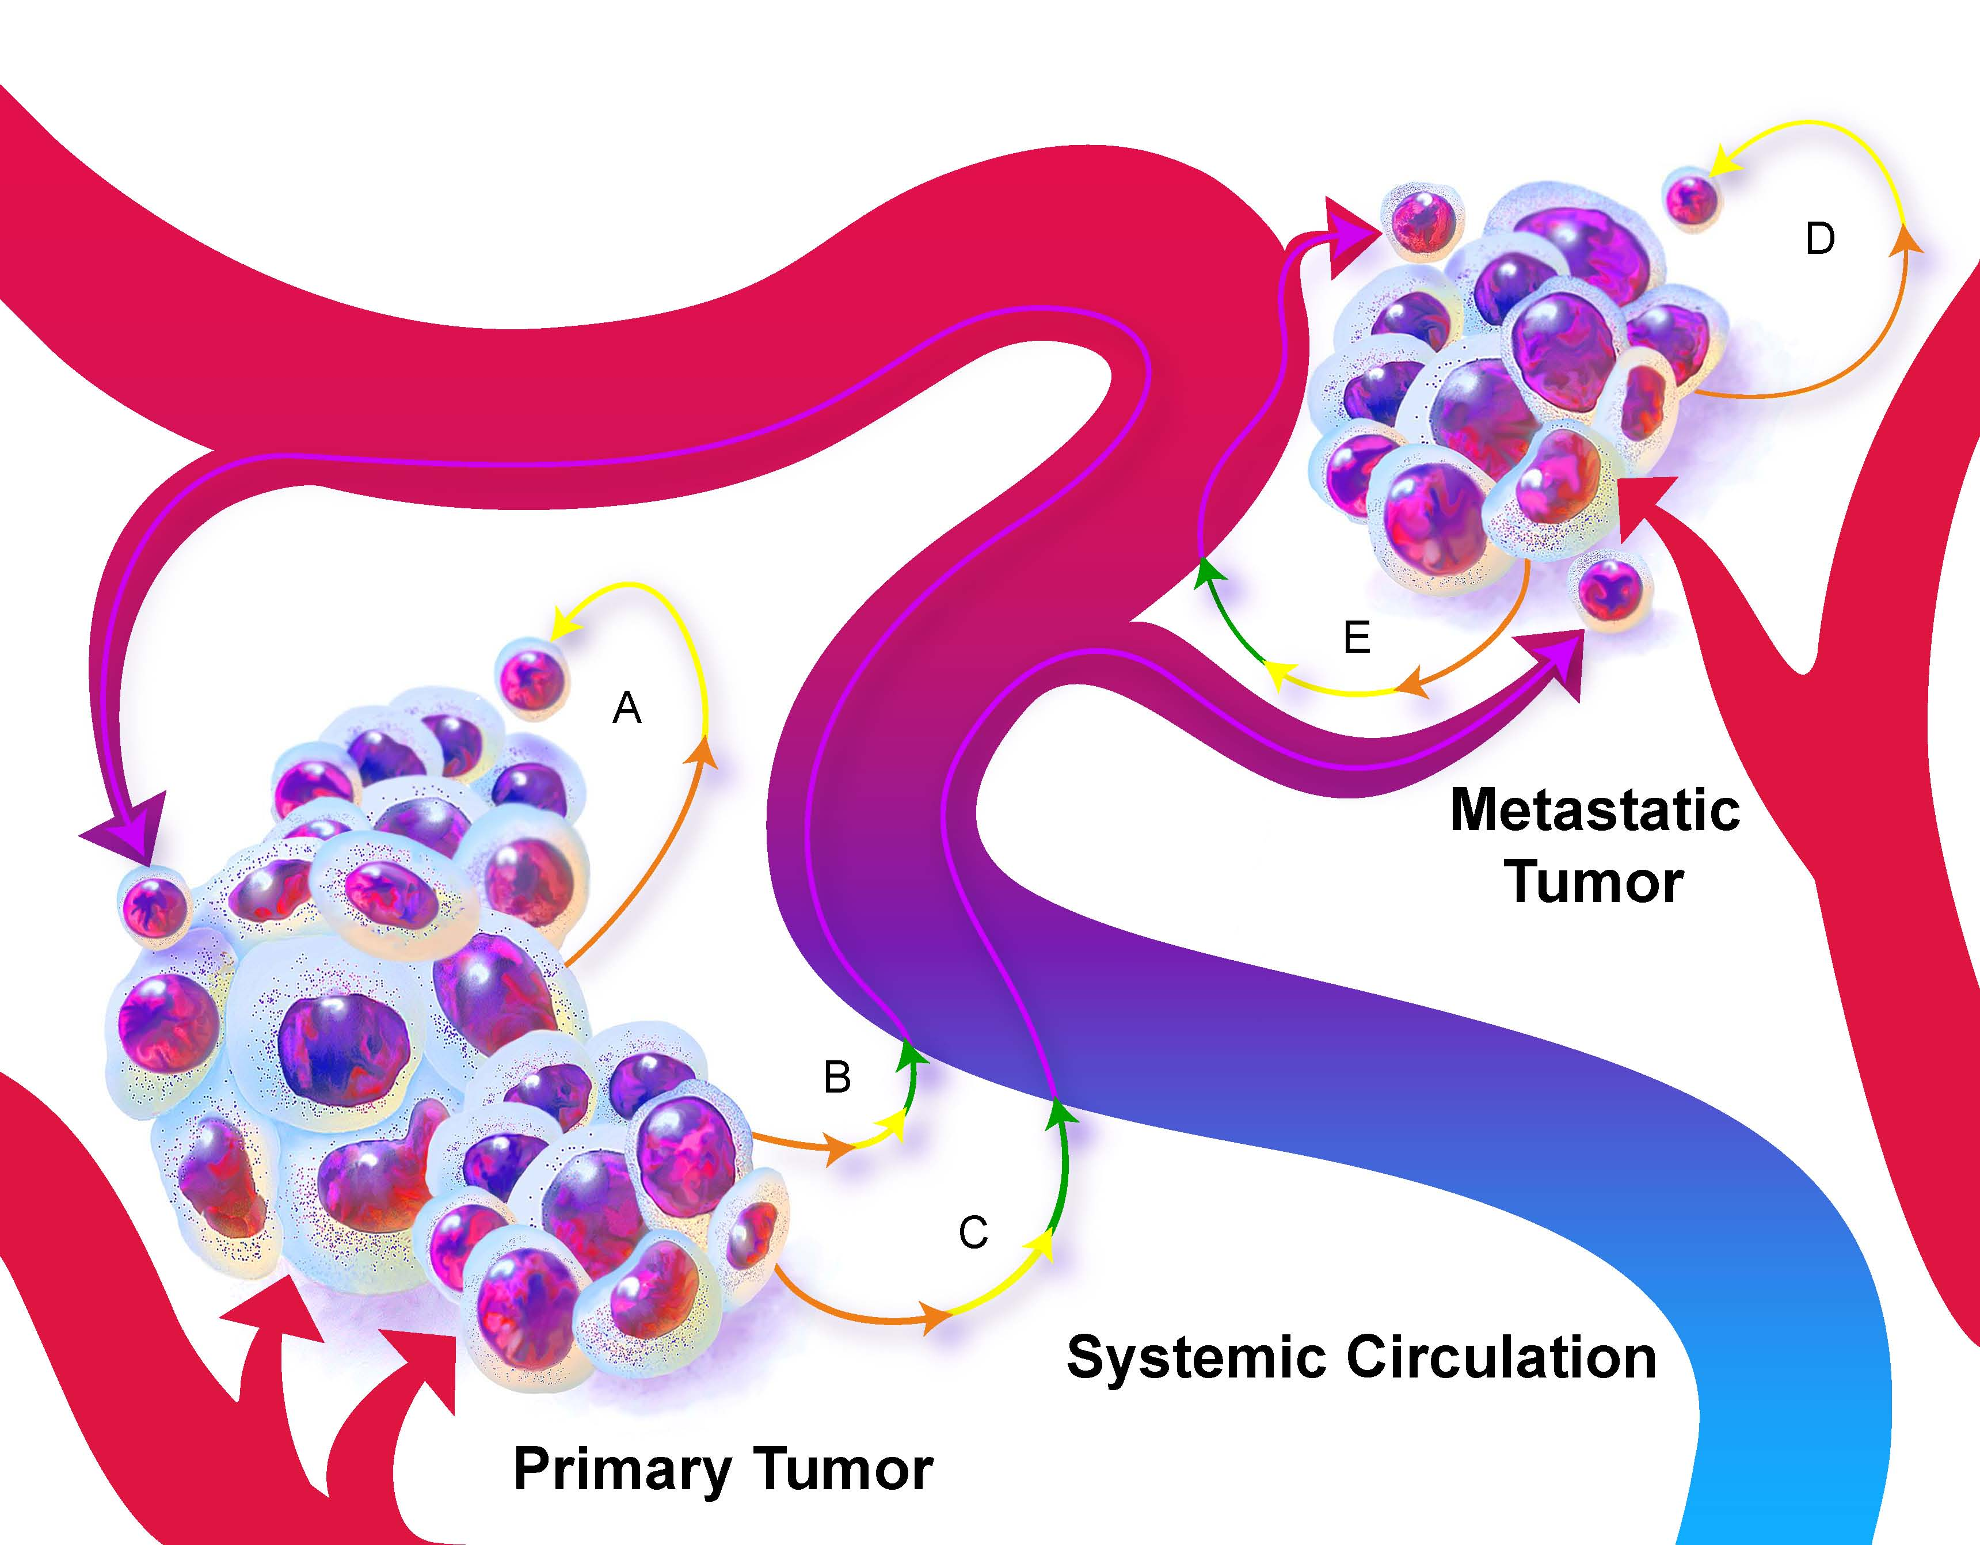
Observation
Clinical Hypothesis
G.
10¹²
10¹⁰
10⁸
10⁶
10⁴
10²
10⁰
0
40
80
120
160
Weeks of Growth
Conceptual Hypothesis

Slide 5
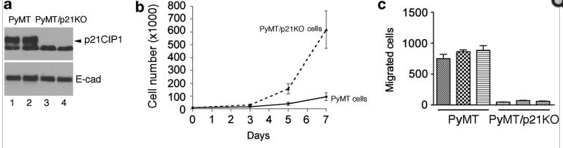
Observation
Clinical Hypothesis
G.
10¹²
10¹⁰
10⁸
10⁶
10⁴
10²
10⁰
0
40
80
120
160
Weeks of Growth
Conceptual Hypothesis
Mechanistic Hypothesis

Slide 6

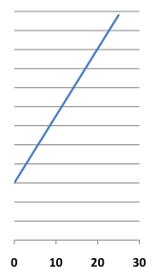
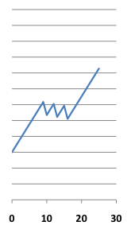
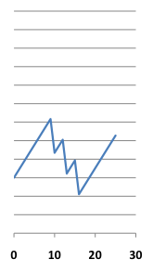
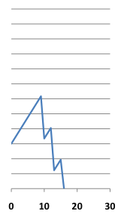
The Log-Kill Model: Cell kill is proportional and multiplicative
No Therapy
One Drug
Two Drugs
Three Drugs
10¹²
10¹⁰
10⁸
10⁶
10⁴
10²
10⁰
Skipper HE, Schabel FM Jr, Wilcox WS. Cancer Chemotherapy Reports, 35:1-111, 1964

Slide 7
The Log-Kill Model: Cell kill is proportional and multiplicative
No Therapy
One Drug
Two Drugs
Three Drugs
10¹²
10¹⁰
90% cell kill per administration
10⁸
10⁶
10⁴
10²
10⁰
Skipper HE, Schabel FM Jr, Wilcox WS. Cancer Chemotherapy Reports, 35:1-111, 1964

Slide 8
The Log-Kill Model: Cell kill is proportional and multiplicative
No Therapy
One Drug
Two Drugs
Three Drugs
10¹²
10¹⁰
10⁸
10⁶
10⁴
10²
10⁰
Skipper HE, Schabel FM Jr, Wilcox WS. Cancer Chemotherapy Reports, 35:1-111, 1964

Slide 9
The Log-Kill Model: Cell kill is proportional and multiplicative
No Therapy
One Drug
Two Drugs
Three Drugs
10¹²
10¹⁰
10⁸
10⁶
10⁴
10²
10⁰
Skipper HE, Schabel FM Jr, Wilcox WS. Cancer Chemotherapy Reports, 35:1-111, 1964

Slide 10
The Log-Kill Model: Cell kill is proportional and multiplicative
No Therapy
One Drug
Two Drugs
Three Drugs
10¹²
10¹⁰
10⁸
10⁶
10⁴
10²
10⁰
Logical! So why are cures so elusive?
Skipper HE, Schabel FM Jr, Wilcox WS. Cancer Chemotherapy Reports, 35:1-111, 1964

Slide 11
The Skipper-Schabel Model is based on exponential growth, but cancers grow by Gompertzian kinetics
Norton L et al., Nature, 1976

Slide 12
Hence, the rate of regression due to therapy should be proportional to the rate of unperturbed growth
G.
10¹²
10¹⁰
10⁸
10⁶
10⁴
10²
10⁰
Norton L et al., Nature, 1976
0
40
80
120
160
Weeks of Growth
Norton L, Sem Oncology, 1997

Slide 13
Hence, dose-dense sequential therapy should maximize the curative impact of cytotoxic chemotherapy
G.
10¹²
10¹⁰
10⁸
10⁶
10⁴
10²
10⁰
Norton L et al., Nature, 1976
0
40
80
120
160
Weeks of Growth
Norton L, Sem Oncology, 1997

Slide 14
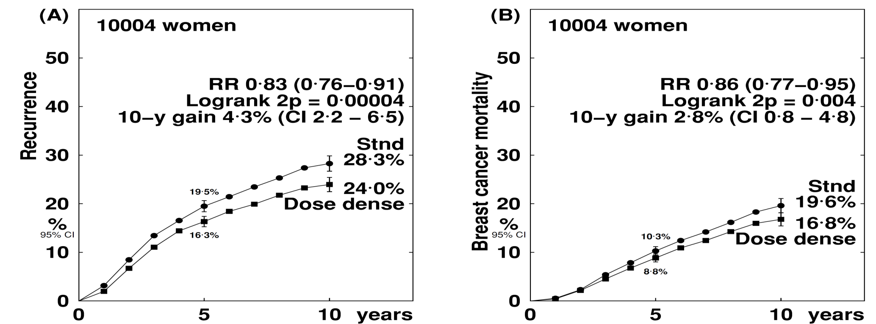
2-weekly (dose dense) vs the same chemotherapy given 3-weekly
Any Recurrence
Breast Cancer Mortality

Slide 15
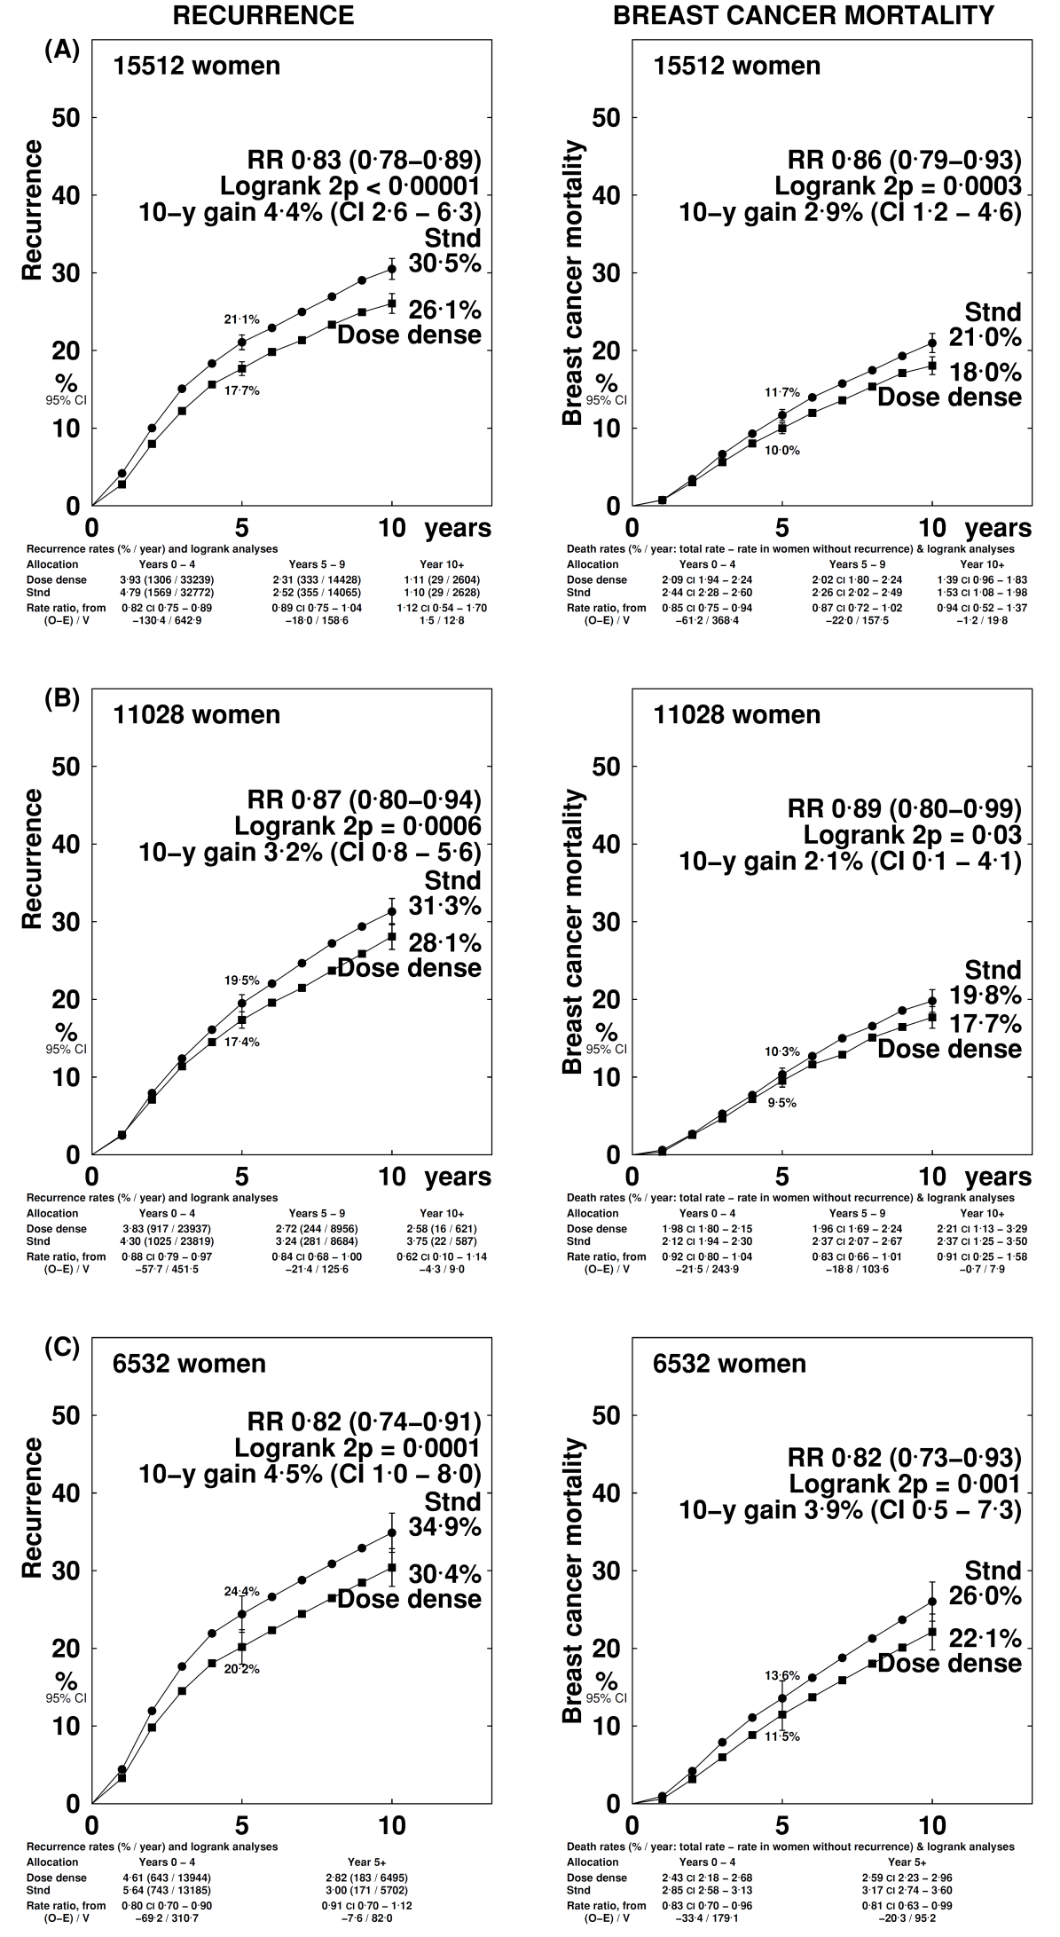
2-weekly vs 3-weekly chemotherapy: all trials (including the 5 trials where chemotherapy differed between arms)
Any Recurrence
Breast Cancer Mortality

Slide 16
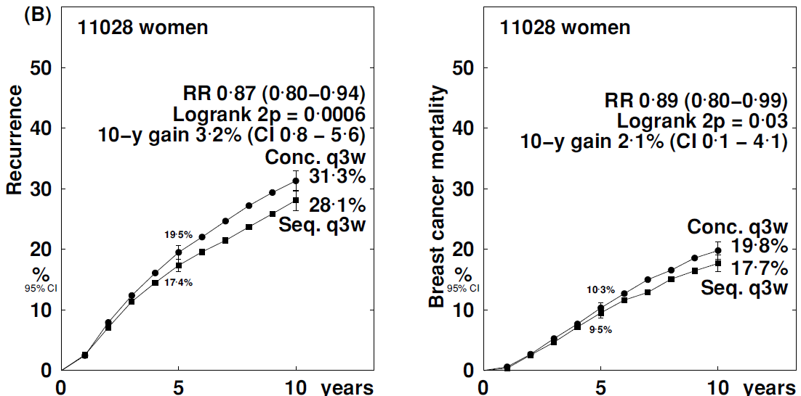
Sequential (3-weekly) vs Concurrent (3-weekly) chemotherapy
Any Recurrence
Breast Cancer Mortality

Slide 17
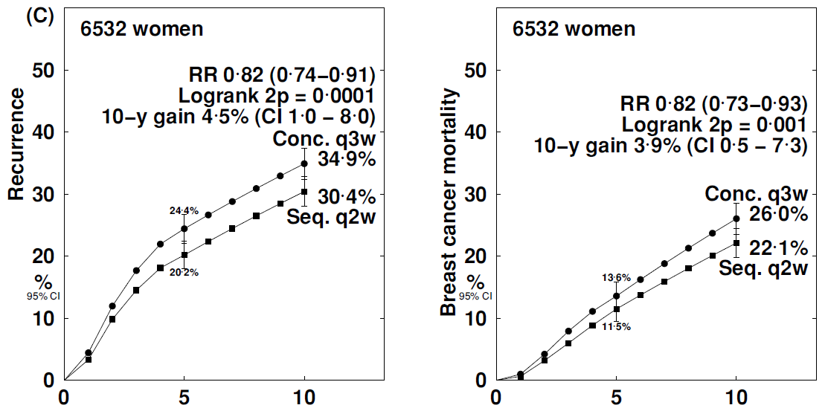
Sequential (2-weekly) vs Concurrent (3-weekly) chemotherapy
Any Recurrence
Breast Cancer Mortality

Slide 18
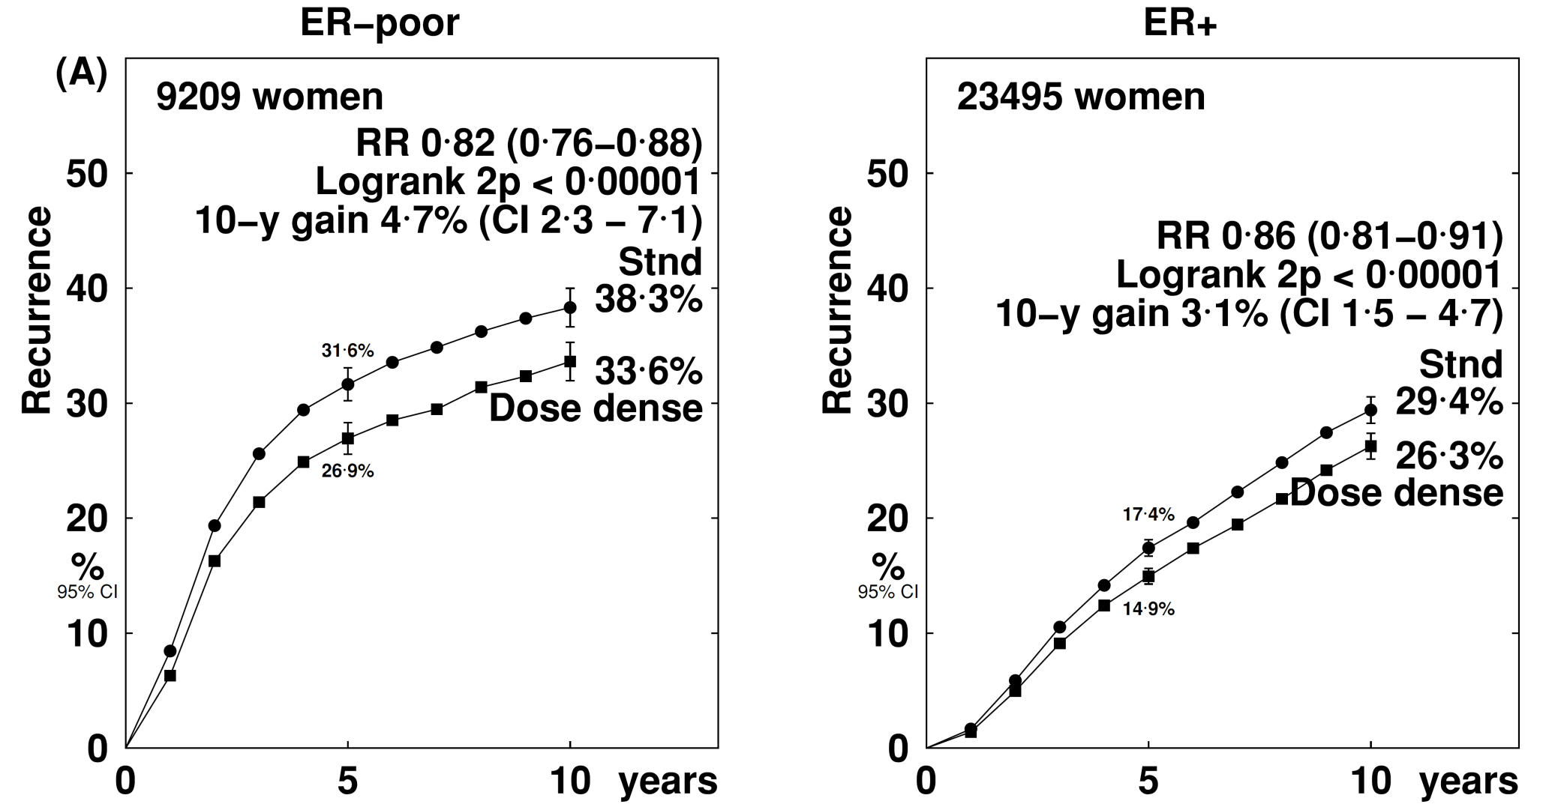
Pooled Analysis: recurrence by ER status
ER- Negative
ER - Positive

Slide 19
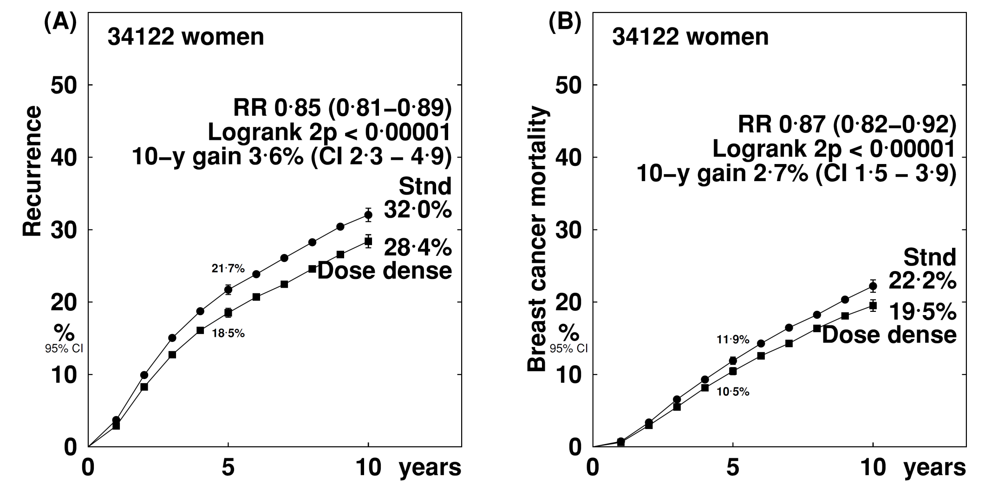
Pooled analysis of all 25 dose-dense and sequential trials
Recurrence
Breast Cancer Mortality

Slide 20
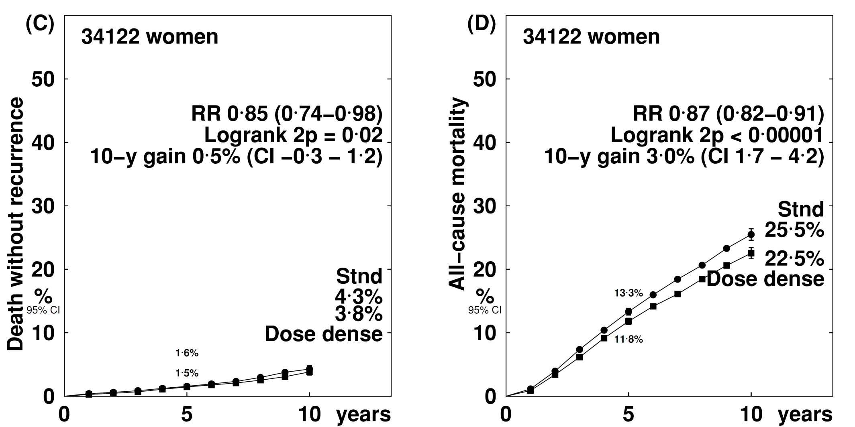
Pooled Analysis
Death without recurrence
All cause mortality

Slide 21
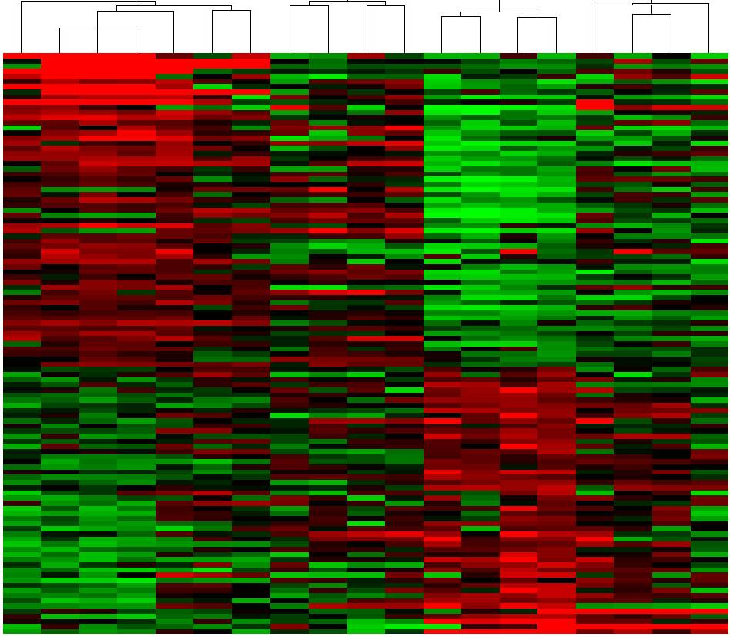
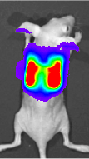
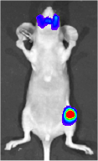
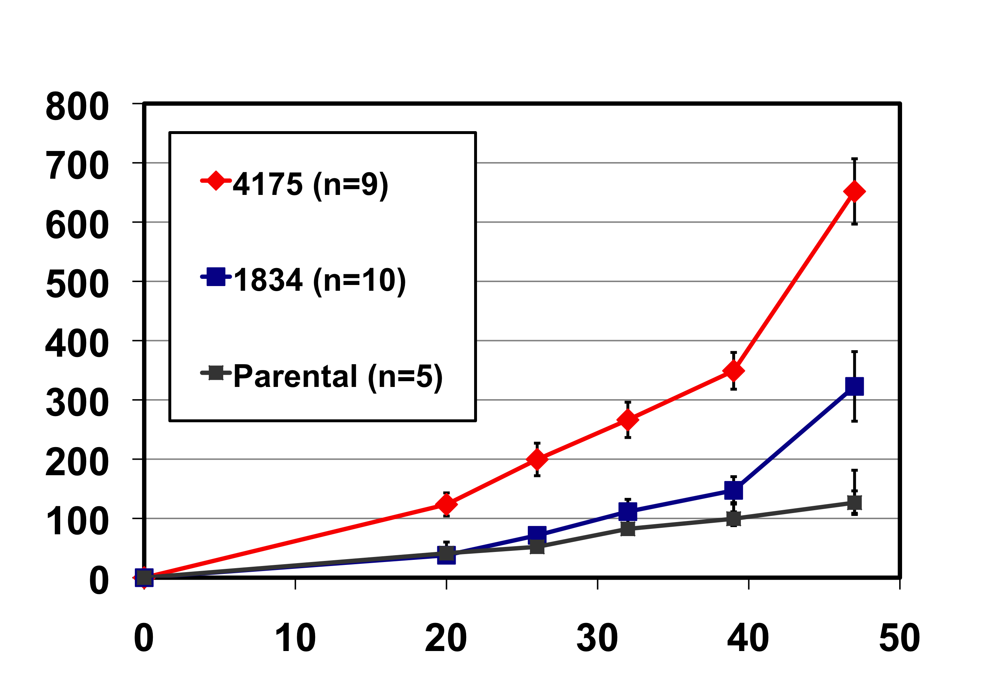
Tumor growth and cancer cell metastases are linked
4175
1834
Parental
MDA MB 231
S-Phase Fraction (Ki67) Not Different
SPARC
Growth in Mammary Fat Pad
IL13RA2
MMP1
ERG
COX2
Tumor volume (mm³)
CXCL1
MMP2
ID1
Days post-injection
RARRES3
EFEMP1
MANT2
LY6E
Minn et al., Nature, 2005

Slide 22
Tumor growth and cancer cell metastases are linked
4175
1834
Parental
MDA MB 231
S-Phase Fraction (Ki67) Not Different
SPARC
Growth in Mammary Fat Pad
IL13RA2
MMP1
ERG
COX2
Tumor volume (mm³)
CXCL1
MMP2
ID1
Days post-injection
RARRES3
EFEMP1
MANT2
LY6E
Minn et al., Nature, 2005

Slide 23
Tumor growth and cancer cell metastases are linked
4175
1834
Parental
MDA MB 231
S-Phase Fraction (Ki67) Not Different
SPARC
Growth in Mammary Fat Pad
IL13RA2
MMP1
ERG
COX2
Tumor volume (mm³)
CXCL1
MMP2
ID1
Days post-injection
RARRES3
EFEMP1
MANT2
LY6E
Minn et al., Nature, 2005

Slide 24
Tumor growth and cancer cell metastases are linked
4175
1834
Parental
MDA MB 231
S-Phase Fraction (Ki67) Not Different
SPARC
Growth in Mammary Fat Pad
IL13RA2
MMP1
ERG
COX2
Tumor volume (mm³)
CXCL1
MMP2
ID1
Days post-injection
RARRES3
EFEMP1
MANT2
LY6E
Minn et al., Nature, 2005

Slide 25
Tumor growth and cancer cell metastases are linked
4175
1834
Parental
MDA MB 231
SPARC
IL13RA2
MMP1
ERG
COX2
CXCL1
MMP2
ID1
RARRES3
EFEMP1
MANT2
LY6E
Norton and Massague, Nature Med, 2006

Slide 26
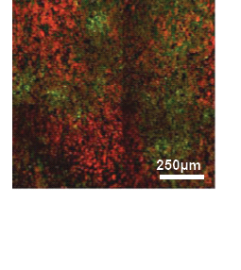
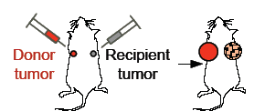
Tumor growth and cancer cell metastases are linked
Kim et al., Cell, 2009

Slide 27
Seeding from outside→in explains the Gompertzian pattern of growth since as objects get larger their surface area to volume ratio decreases

Slide 28
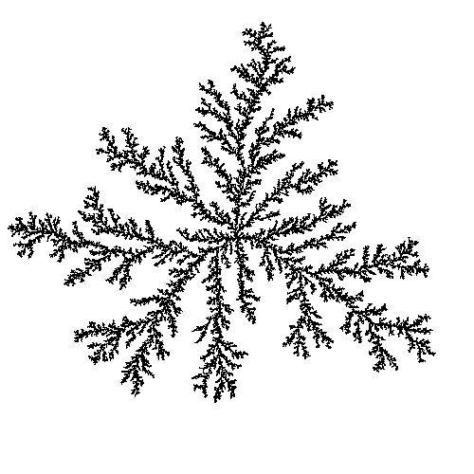
Seeding from outside→in explains the Gompertzian pattern of growth since as objects get larger their surface area to volume ratio decreases
100
1
0.01
Cubic Centimeters
0.0001
0.000001
0.00000001
0
20
40
60
80
100
Arbitrary (Arithmetic) Time Scale

Slide 29
Seeding from outside→in explains the Gompertzian pattern of growth since as objects get larger their surface area to volume ratio decreases
100
1
0.01
Cubic Centimeters
0.0001
0.000001
0.00000001
0
20
40
60
80
100
Arbitrary (Arithmetic) Time Scale

Slide 30
Seeding from outside→in explains the Gompertzian pattern of growth since as objects get larger their surface area to volume ratio decreases
100
1
0.01
Cubic Centimeters
0.0001
0.000001
0.00000001
0
20
40
60
80
100
Arbitrary (Arithmetic) Time Scale

Slide 31
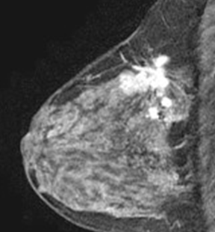
Self-seeded growth explains cancer anatomy

Slide 32
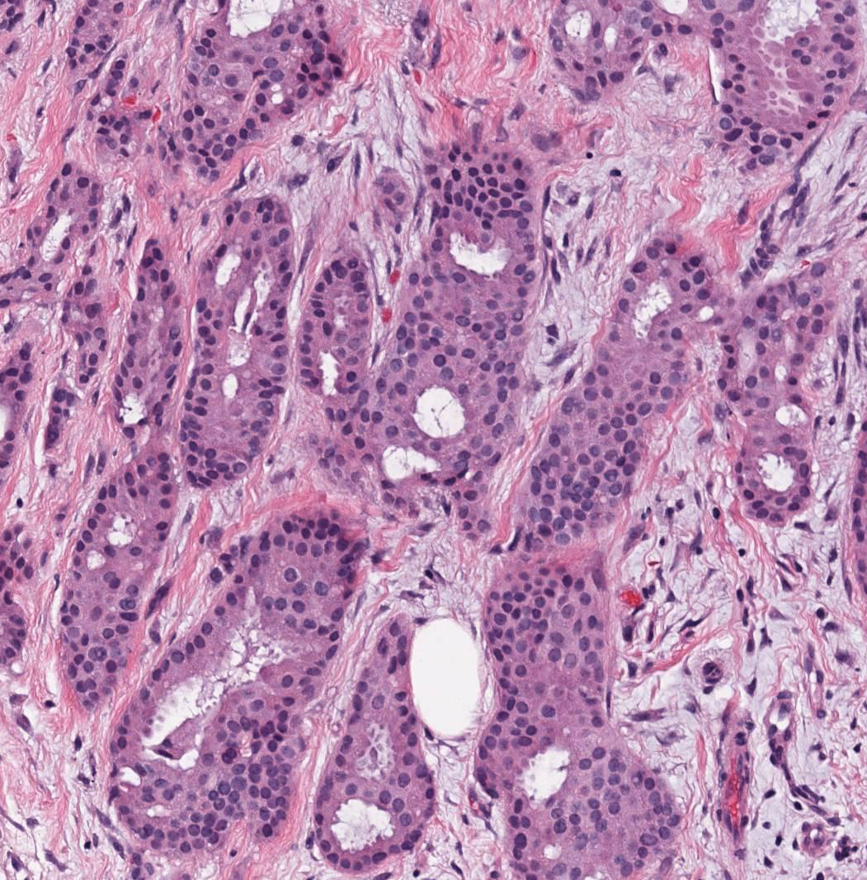
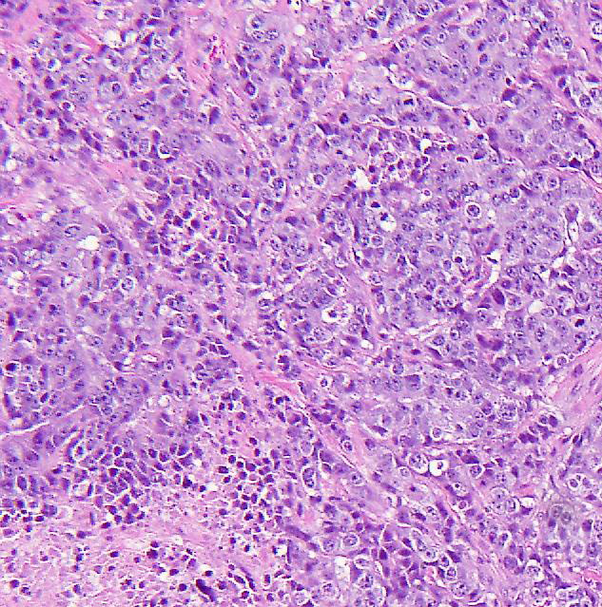
Self-seeded growth explains cancer histopathology
Well-Differentiated
Poorly-Differentiated
Low Self-Seeding
Lower Metastatic Potential
High Self-Seeding
Higher Metastatic Potential

Slide 33
Self-seeded growth explains cancer histopathology
Well-Differentiated
Poorly-Differentiated
Low Self-Seeding
Lower Metastatic Potential
High Self-Seeding
Higher Metastatic Potential

Slide 34
Growth= Cell Gain − Cell Loss
100
1
0.01
Cubic Centimeters
0.0001
0.000001
0.00000001
0
20
40
60
80
100
Arbitrary (Arithmetic) Time Scale

Slide 35
Growth= Cell Gain − Cell Loss
Cell Gain = Mitosis + Immigration (Self Seeding)
100
1
0.01
Cubic Centimeters
0.0001
0.000001
0.00000001
0
20
40
60
80
100
Arbitrary (Arithmetic) Time Scale

Slide 36
Growth= Cell Gain − Cell Loss
Cell Gain = Mitosis + Immigration (Self Seeding)
Cell Loss = Death + Emigration
100
1
0.01
Cubic Centimeters
0.0001
0.000001
0.00000001
0
20
40
60
80
100
Arbitrary (Arithmetic) Time Scale

Slide 37
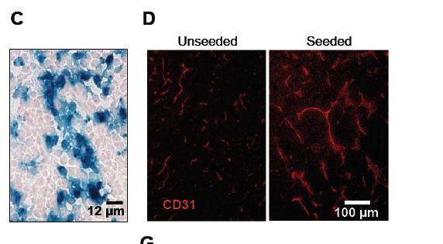
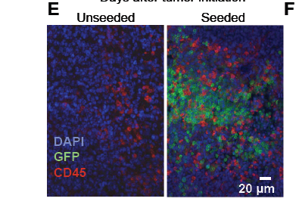
Breast cancer seeds create their own microenvironment by recruitment
Angiogenesis
Leukocytes
Kim MY et al., Cell, 2009

Slide 38
Growth= Cell Gain − Cell Loss
Cell Gain = Mitosis + Immigration (Self Seeding)
Cell Loss = Death + Emigration
Pre -Treatment Growth = Mitosis + Immigration – Death – Emigration

Slide 39
Dose-dense sequential therapy works because the rate of regression of a Gompertzian tumor is proportional to its rate of growth
G.
10¹²
10¹⁰
10⁸
10⁶
10⁴
10²
10⁰
0
40
80
120
160
Weeks of Growth
Post-Treatment Growth = Mitosis + Immigration – Death – Emigration

Slide 40
Dose-dense sequential therapy works because the rate of regression of a Gompertzian tumor is proportional to its rate of growth
G.
10¹²
10¹⁰
10⁸
10⁶
10⁴
10²
10⁰
0
40
80
120
160
Weeks of Growth
Post-Treatment Growth = Mitosis + Immigration – Death – Emigration

Slide 41
Post-Treatment Growth = Mitosis + Immigration – Death – Emigration

Slide 42
Cytotoxic chemotherapy turns p21 on and reduces mitotic rate
p21 off
p21 on
Post-Treatment Growth = Mitosis + Immigration – Death – Emigration
Qian X…Norton L, Hazan R, Oncogene, 2013

Slide 43
…and simultaneously increases cell migration (metastases)
p21
on
p21 off
Post-Treatment Growth = Mitosis + Immigration – Death – Emigration
Qian X…Norton L, Hazan R, Oncogene, 2013

Slide 44
Observation and Experimentation Links Hypotheses
Observation
Clinical Hypothesis
G.
10¹²
10¹⁰
10⁸
10⁶
10⁴
10²
10⁰
0
40
80
120
160
Weeks of Growth
Conceptual Hypothesis
Mechanistic Hypothesis

Slide 45
EDRN is All About Linked Hypotheses

