Slide 1
Identification of Candidate Biomarkers for Early Detection of Aggressive Prostate Cancer using Targeted Proteomics
Tao Liu, Karin Rodland
Pacific Northwest National Laboratory
33rd EDRN Steering Committee Meeting, 9/6/2018, Boston

Slide 2
Identifying a biomarker panel using prostate cancer-associated candidates from genomic studies – PNNL & CPDR
The early detection problem in prostate cancer: discriminating indolent from aggressive disease
In collaboration with the CPDR, we identified a list of 52 biomarker candidates for discriminating indolent from aggressive prostate cancer
Selection was based on the curated literature
  genes statistically associated with prostate cancer prognosis
  prostate cancer associated genes that were up-regulated in transcriptomics studies
  other cancer-related genes
CaP prognosis associated genes | Other CaP associated genes | Other cancer related genes
AKT1 | AMACR | BRAF
ANXA2 | CRISP3 | CAMKK2
AR | pan-ERG | EGFR
AURKA | ERG8 | HIF1A
CCND1 | ETV1 | HPN (TMPRSS1)
CDKN1A | FOLH1 (PSMA) | HSPB1
EZH2 | HOXC6 | MMP2
FGFR1 | KLK2 | MMP9
MUC1 | KLK3 (PSA) | PDGFRB
MUC6 | KLK11 | PIK3CA
MYC | MYO6 | PLA2G7
MYCN | NPY | ODC1
NCOA2 | PSGR | RAF1
PMP22 | SPARC | SERPINI1
SMAD4 | TWIST1 | STAT3
SPINK1 |  | TGFB1
SPP1 (OPN) |  | TP53
TFF3 |  | TPM2
 |  | VEGFA

Slide 3
Experimental design
Clinical Need: ability to identify, at the initial biopsy, low risk prostate cancer patients who are candidates for active surveillance versus aggressive treatment
~340 FFPE samples selected and provided by CPDR (blinded analysis)
  Tissue from radical prostatectomy within 6 months of diagnosis with no neoadjuvant hormone therapy
  Study outcomes
    no observed progression (indolent disease): median time to end of follow-up is 156 months
    biochemical recurrence (BCR) – intermediate response: median time to event is 20 months
    metastatic disease – highly aggressive prostate cancer: median time to event is 80 months
  Initially screened all 52 candidate markers in 105 samples,
  then reconfigured the assays to analyze the top candidates
  in the remaining 233 samples

Slide 4
Descriptive stats for study cohort
Variable |  | Variable
Age at diagnosis (year) |  | Grade Group
Mean (SD) | 59.4 (7.8) | GG1-2 | 120 (43.6)
 |  | GG3-5 | 155 (56.4)
Race
AA | 97 (34.9) | Pathological T Stage
CA & Other | 181 (65.1) | pT2 | 146 (53.3)
 |  | pT3-4 | 128 (46.7)
PSA at diagnosis (ng/mL)
<10 | 218 (78.7) | Surgical margin status
10-19.99 | 45 (16.2) | Negative | 178 (65.7)
≥20 | 14 (5.1) | Positive | 93 (34.3)
Clinical T stage |  | Upgrading*
T1-T2a | 233 (83.5) | No | 112 (44.6)
T2b-c | 36 (13.0) | Yes | 139 (55.4)
T3a or above | 7 (2.5)
Biopsy Gleason sum |  | Event group
≤6 | 142 (55.7) | Non-event | 135 (48.4)
≤7 | 83 (32.5) | BCR | 106 (38.0)
≥8 | 30 (11.8) | Metastasis | 38 (13.6)
NCCN risk |  | Median of FU (month)
Low | 99 (39.3) | Non-event | 153 (121-252)
Intermediate | 109 (43.2) | BCR | 21 (2-141)
High | 44 (17.5) | Metastasis | 67 (1-185)
Used two base models for statistical analysis:
Biopsy base model (at Dx)
= Dx age + Race + NCCN risk strata
- Best for predicting outcomes that involve times point prior to surgery
Pathology base model (post-RP)
= Path T + GG +Surgical margin
- Best for predicting outcomes that involve times points post-RP
*Upgrading:
Biopsy Gleason sum <=6 changed to GG3-5
Biopsy Gleason =3+4 changed to GG3-5

Slide 5
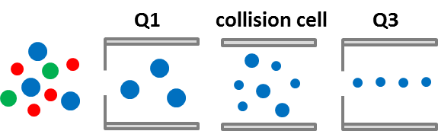
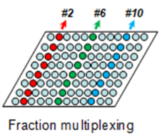
PRISM-SRM provided superior sensitivity than conventional LC-SRM
Highly sensitive, multiplexed PRISM-SRM assays were developed for the 52 candidate markers
24 concatenated PRISM fractions; each run by a 75-min LC gradient
LC-SRM
21 proteins
FFPE tissue samples
PRISM-SRM
42 proteins
Detected proteins
Undetected proteins

Slide 6
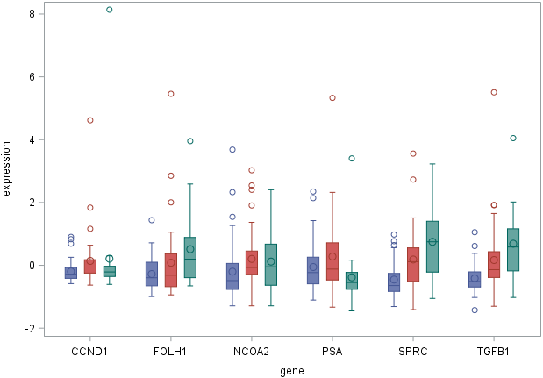
PRISM-SRM analysis of prostate cancer tumors for correlation with clinical outcome – 105 samples
Outcome:
No progression
BCR
Metastasis
Protein | p value
TGFB1 | 0.00001
SPARC | 0.00004
CCND1 | 0.00796
PSA | 0.00813
FOLH1 | 0.01627
NCOA2 | 0.02367
Z-score of protein level
Analysis of 48 non-events, 37 BCR, and 20 metastasis events
Boxplots of 6 potential markers (p <0.05, Kruskal-Wallis test)
Protein

Slide 7
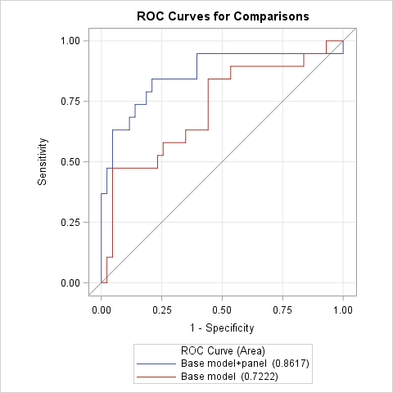
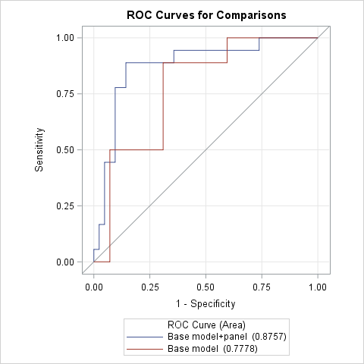
Biomarker panel for predicting metastasis – 105 samples
Biopsy base model
Pathology base model
AUC 0.86
AUC 0.88
Biopsy base model = Dx age + Race + NCCN risk strata
Panel = FOLH1 + SPARC + TGFB1 + EGFR + MUC1
(individual AUC>0.65)
Path base model = Path T + GG +Surgical margin
Panel = FOLH1 + SPARC + TGFB1 + EGFR + MUC1
(individual AUC>0.65)

Slide 8
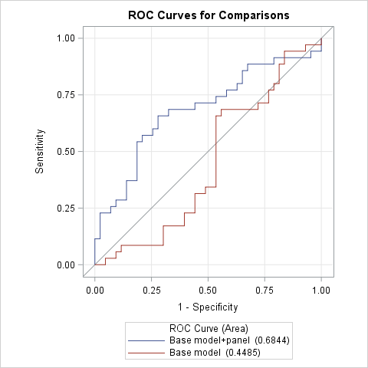
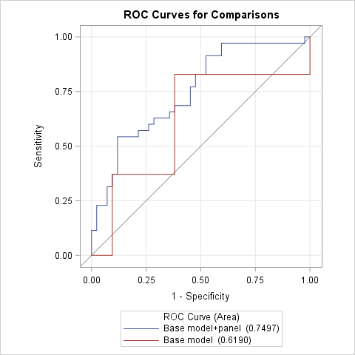
Biomarker panel for predicting BCR – 105 samples
Biopsy base model
Pathology base model
AUC 0.68
AUC 0.75
Biopsy base model = Dx age + Race + NCCN risk strata
Panel = CCND1 + SPARC + TGFB1 + NCOA2
(individual AUC>0.65)
Path base model = Path T + GG +Surgical margin
Panel = CCND1 + SPARC + TGFB1 + NCOA2
(individual AUC>0.65)

Slide 9
Re-configuration of the PRISM-SRM assays for more sensitive and higher throughput screening of the top-16 candidate proteins
Protein | P value |  | Protein | P value |  | Protein | P value |  | Protein | P value
TGFB1 | 1E-05 |  | FOLH1 | 0.0163 |  | SMAD4 | 0.065 |  | MMP9 | 0.1701
SPARC | 4E-05 |  | NCOA2 | 0.0237 |  | MUC1 | 0.0715 |  | TFF3 | 0.1918
CCND1 | 0.008 |  | VEGFA | 0.0546 |  | CAMKK2 | 0.1463 |  | ANXA2 | 0.226
KLK3 | 0.0081 |  | EGFR | 0.065 |  | ERG_pan | 0.1574 |  | SPINK1 | 0.2308
Switching from fraction concatenation (24 fractions) to no concatenation for higher sensitivity
Adding a diluted background peptide “matrix” (a tryptic digestion of Shewanella oneidensis) in each sample after the PRISM fractionation, effectively reducing peptide loss due to non-specific surface absorption
Switching from a 75-min gradient to a 35-min gradient in the 2nd dimension LC-SRM analysis for higher sample throughput

Slide 10
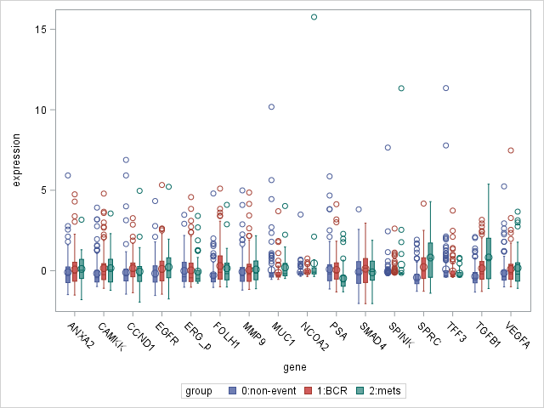
PRISM-SRM analysis of prostate cancer tumors for correlation with clinical outcome – 279 samples
Event group | N | Median of time to event (range), month
Non-event | 135 | 153 (121-252)
BCR | 106 | 21 (2-141)
Metastasis | 38 | 67 (1-185)
Outcome:
No progression
BCR
Metastasis
Gene | P value |  | Gene | P value
ANXA2 | 0.13856 |  | NCOA2 | 0.00096
CAMKK2 | 0.01914 |  | PSA | <.0001
CCND1 | 0.00129 |  | SMAD4 | 0.24571
EGFR | 0.02929 |  | SPINK1 | 0.69625
ERG_pan | 0.80098 |  | SPARC | <.0001
FOLH1 | <.0001 |  | TFF3 | 0.31683
MMP9 | 0.42512 |  | TGFB1 | <.0001
MUC1 | 0.13597 |  | VEGFA | 0.04567
Z-score of protein level
6 proteins with P value <0.01
PSA showed negative correlation with SPARC and TGFB1 – complementarity of the panel
Protein

Slide 11
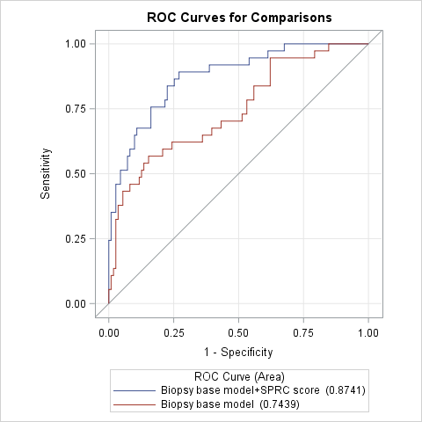
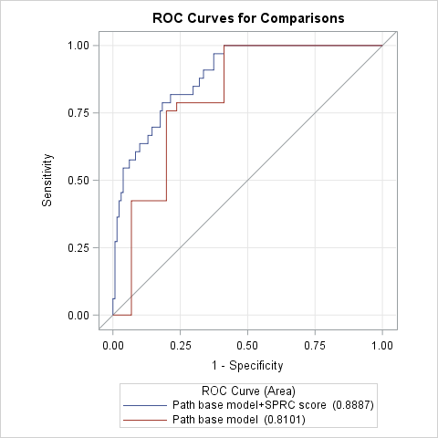
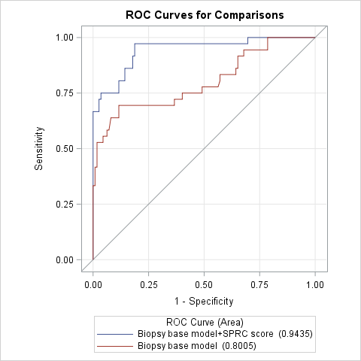
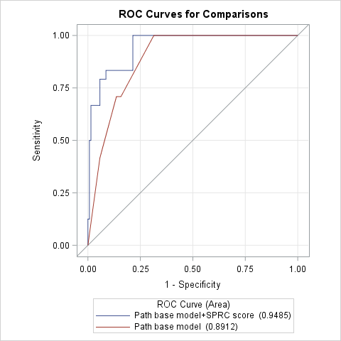
SPARC/PSA score for predicting metastasis in 279 samples
Biopsy base model
Path base model
leave-one-out cross-validation
leave-one-out cross-validation
Good consistency across base model types (biopsy vs. pathology)
Good consistency across statistical technique of bootstrapping vs. “leave one out” approaches
AUC 0.87
AUC 0.89
Bootstrapping
Bootstrapping
AUC 0.94
AUC 0.95

Slide 12
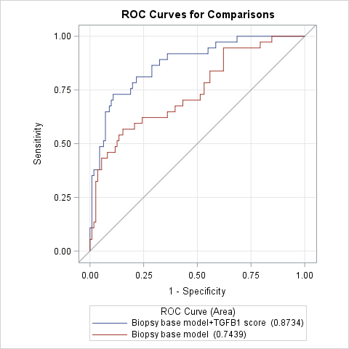
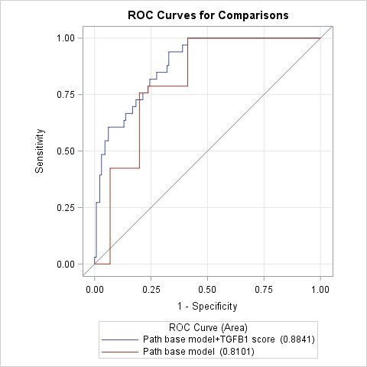

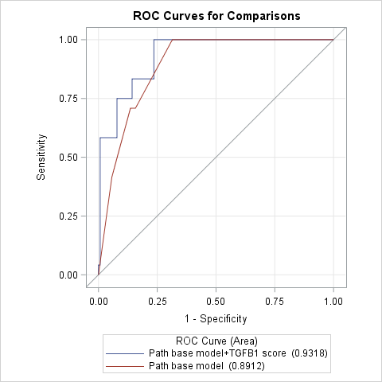
TGFB1/PSA score for predicting metastasis in 279 samples
Biopsy base model
Path base model
leave-one-out cross-validation
leave-one-out cross-validation
Good consistency across base model types (biopsy vs. pathology)
Good consistency across statistical technique of bootstrapping vs. “leave one out” approaches
AUC 0.87
AUC 0.88
Bootstrapping
Bootstrapping
AUC 0.94
AUC 0.93

Slide 13
Summary of the prostatectomy tissue analysis
The PRISM-SRM analysis of all 338 FFPE tissue samples is completed; data show good consistency
The SPARC/PSA and TGFB1/PSA scores predict prostate cancer metastasis with high accuracy
The ability of top biomarker candidates for predicting BCR is more moderate, but still provides additional gain on top of the biopsy and pathology base models
Early data look promising for prediction models for upgrading and high path GG

Slide 14
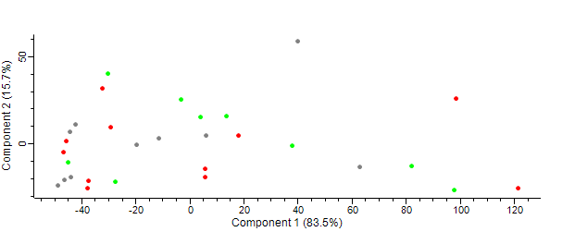
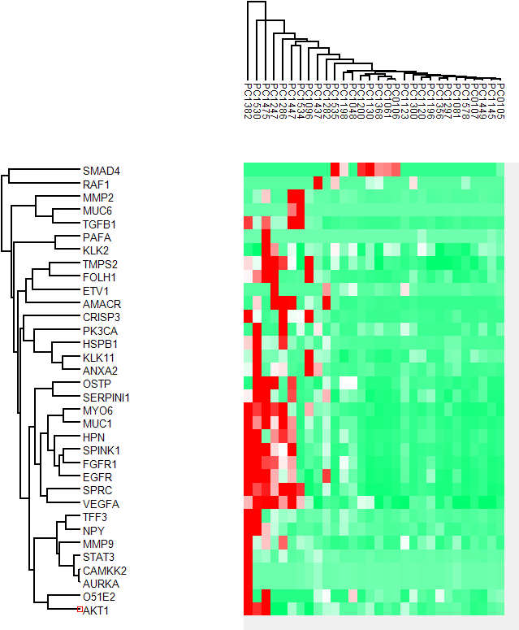
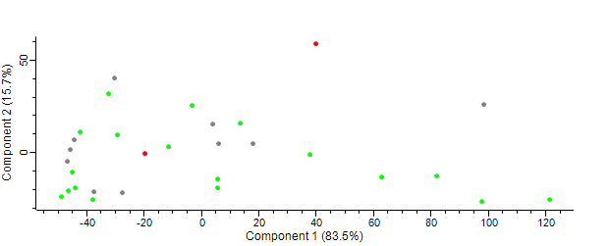
Initial analysis of 30 DRE urine samples (supernatant) – Emory
Gleason score
Risk by Gleason score
Red: 7-8 (10)
Grey: 6 (10)
Green: 0 (10)
D'Amico risk classification
Red: high risk (2)
Grey: intermediate risk (10)
Green: low risk (17)
PRISM-SRM detected 35 of the 52 proteins in the 30 DRE urine samples
TGFB1 and SPARC remained undetected in the urine samples
Initial data analysis showed the inability of these detected markers for separating the urine samples by risk (with or w/o normalization)

Slide 15
Initial MS analysis of exosome of urine test samples (qEV) – Toronto
Healthy urine (exosome) LC-MS/MS | CaP urine (exosome) LC-MS/MS | CaP urine (exosome) LC-SRM | Top-16 candidates (tissue) PRISM-SRM
ANXA2 | ANXA2 | ANXA2 | ANXA2
FGFR1 | FOLH1 | AURKA | CAMKK2
FOLH1 | HSPB1 | CAMKK2 | CCND1
HIF1A | KLK2 | HPN | EGFR
HSPB1 | MUC1 | HSPB1 | ERG_pan
KLK3 | MUC6 | KLK3 | FOLH1
MMP9 | MYO6 | MUC1 | KLK3
MUC1 | NPY | MUC6 | MMP9
MUC6 | PGFRB | MYO6 | MUC1
MYO6 | TFF3 | O51E2 | NCOA2
PGFRB | TMPS2 | PK3CA | SMAD4
SPP1 |  | TMPS2 | SPINK1
TMPS2 |  |  | SPARC
 |  |  | TFF3
 |  |  | TGFB1
 |  |  | VEGFA
Urine exosome contains some of the tissue markers for predicting Met and BCR; however SPARC and TGFB1 remained undetected
Limited peptide yield from 5 mL of DRE urine prevents higher sensitivity analysis by PRISM-SRM: try the carrier-assisted approach
Trial of other exosome isolation methods, e.g., affinity method by Tymora Analytical
Seek urine samples with larger volume

Slide 16
Challenges and plans for the future
Analyze biopsy and plasma/serum samples to validate the utility of the marker panels for predicting metastatic prostate cancer
Examine prediction models for upgrading and high path GG (early data look promising)
Leverage advances in our understanding of prostate cancer biology to identify complementary biomarkers and otherwise guide biomarker selection
Continue to explore the utility of urinary exosome analysis for non-invasive prostate cancer diagnosis, prognosis, or surveillance (e.g., high-quality samples, better methods, new candidates)
Initiate near single-cell proteomics analysis for prostate cancer
  Characterization and screening of very small lesions (e.g., guided by imaging)
  Investigating heterogeneity of prostate tumors and inadequate sampling by biopsy

Slide 17
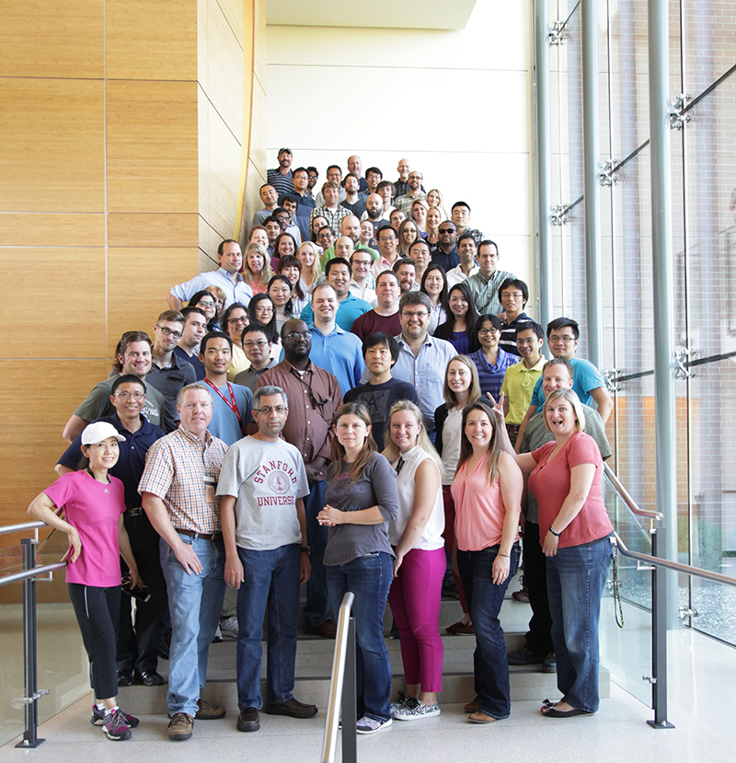

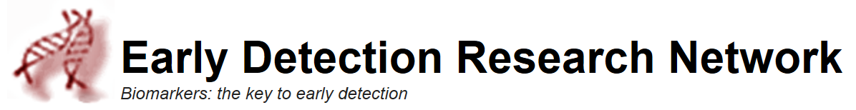
Acknowledgements
The EDRN Team at the Integrative Omics Group, PNNL
Yuqian Gao
Yi-Ting Wang
Hui Wang
Athena Schepmoes
Tujin Shi
Chia-Feng Tsai
Tom Fillmore
Wei-Jun Qian
Karin Rodland
Collaborators
  CPDR: Shiv Srivastava, Jennifer Cullen, Yongmei Chen, George Petrovics, Denise Young, Alagarsamy Srinivasan, Albert Dobi
  UTHSCSA: Ian Thompson, Robin Leach, Brandy Weaver
  Emory: Martin Sanda, Kathryn Pellegrini
  Toronto: Thomas Kislinger, Stanley Liu
  EDRN GU Collaborative Group
EDRN/NCI
  Jacob Kagan, Lynn Sorbara, Sudhir Srivastava

