Slide 1
The Future of Biomarkers – Post Translation Modification

Slide 2

Autoantibodies as Biomarkers for Early Detection of Cancer
Secretion
Cell Death
Immune
Tolerance
No Immune Response
Normal Cells
Normal Proteins
Secretion
Cell Death
Neoantigens
Autoantibodies to Tumor Antigens
Cancer Cells
Normal Proteins & Tumor Antigens
Amplify Signal
Persist after antigen gone
Occur early in disease
Very stable in serum sample
Well established chemistry – excellent detection reagents

Slide 3

From NAPPA discovery to commercial diagnostics
https://provistadx.com
Autoantibody biomarkers discovered in EDRN were licensed by Provista Diagnostics®

Slide 4
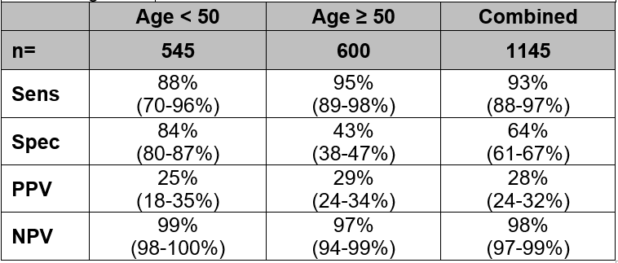
Combined performance of Videssa Breast in women ages 25 – 75 years
*
* Henderson MC, Silver MS, Tran Q, Letsios E, Mulpuri R, Reese DE, Lourenco AP, LaBaer J, Anderson KS, Hollingsworth A, Alpers J, Costantini C, Peterson H, Rohatgi N, Haythem A, Baker K, Northfelt D, Ghosh K, Grobmyer S, Polen W, Wolf J. A Non-Invasive Blood-Based Combinatorial Proteomic Biomarker Assay to Detect Breast Cancer in Post-Menopausal Women with BI-RADS 3, 4, or 5 Assessment. Clin Cancer Res 2018 in press

Slide 5
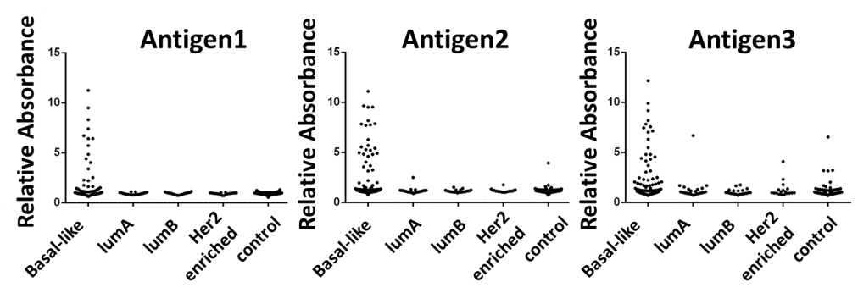
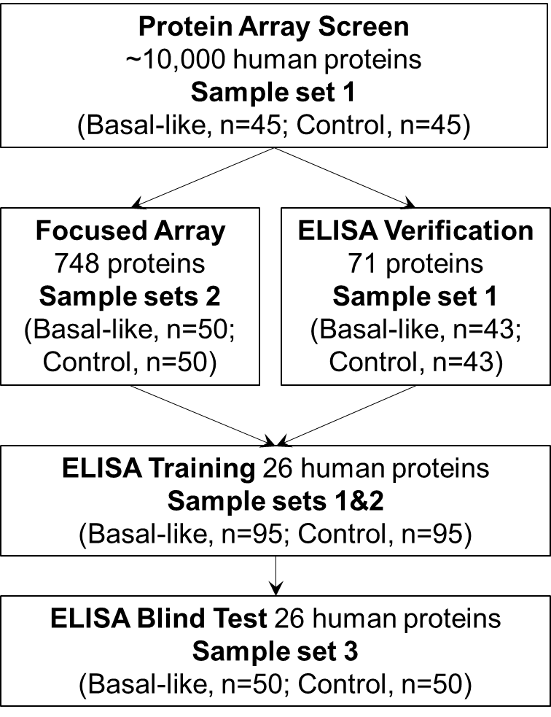
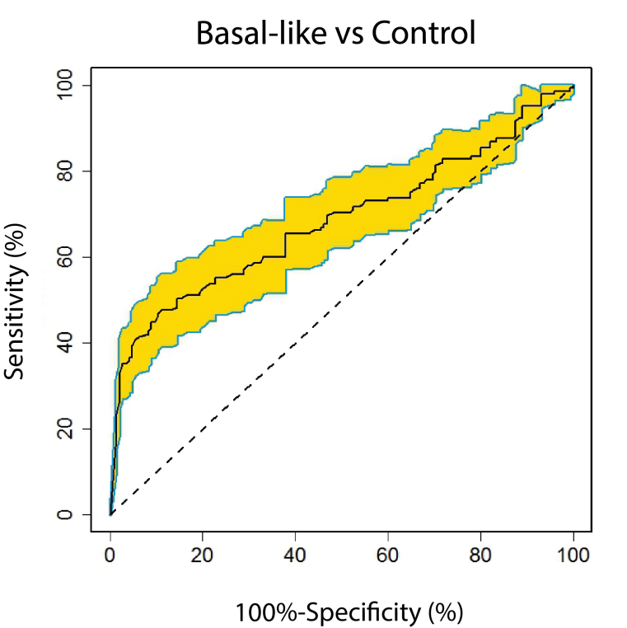
Autoantibodies in Basal-Like Breast Cancer
CTAG2
CTAG1B
TP53

Slide 6
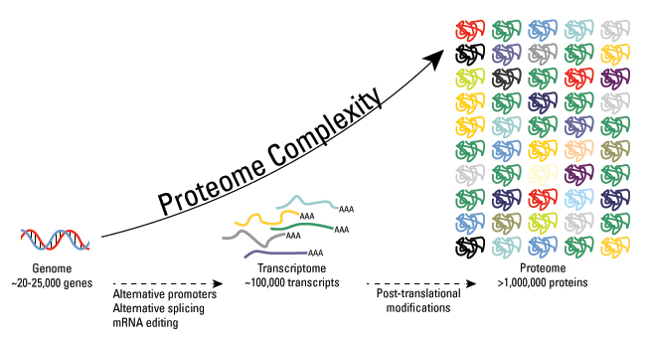
Post-translational modifications increase proteomic diversity
https://www.thermofisher.com/us/en/home/life-science/protein-biology/protein-biology-learning-center/protein-biology-resource-library/pierce-protein-methods/overview-post-translational-modification.html

Slide 7
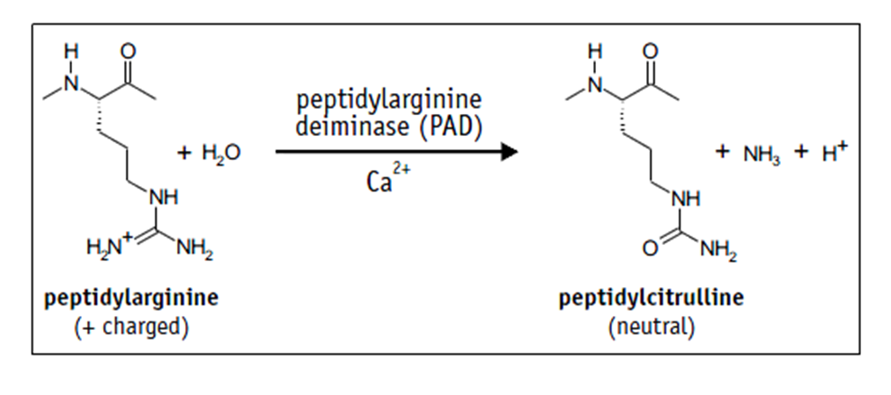
Anti-Citrullinated Protein Antibody (ACPA) and Rheumatoid Arthritis (RA)

Slide 8
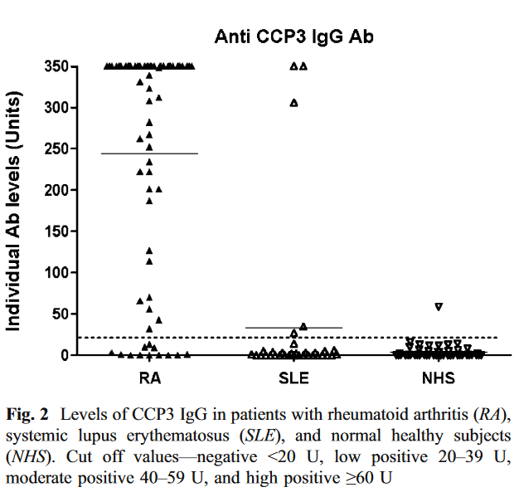
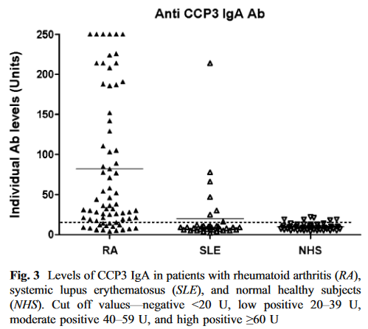
Anti-Citrullinated Protein Antibody (ACPA) and Rheumatoid Arthritis (RA)
Notes:
82.9% sens at 95% spec. IgG
72.9% sens at 95% spec. IgA

Slide 9

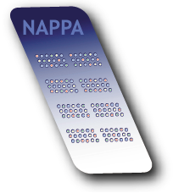
Nucleic Acid Programmable Protein Array
Y
Y
Y
Cell free expression of
target protein
Y
Y
Y

Slide 10






Contra capture protein array concept
HaloTag ligand
Step 1: Dispense cDNA in PDMS wells, add expression lysates, and seal PDMS wells with a ligand coated slide
Step 2: Contra capture expressed proteins onto the cover slide
Step 3: Remove the cover slide and discard PDMS wells
Enzyme for PTM
Add
Step 4: On-array post-translational modification
Serological Analysis
Karthikeyan et. al., Mol Cell Proteomics. 2016;15(7):2324-37

Slide 11
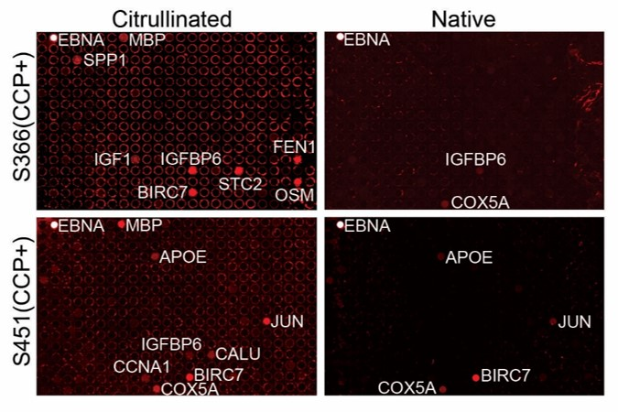
Detection of anti-citrullinated protein antibodies in RA patients on contra capture arrays
Karthikeyan et. al., Mol Cell Proteomics. 2016;15(7):2324-37

Slide 12
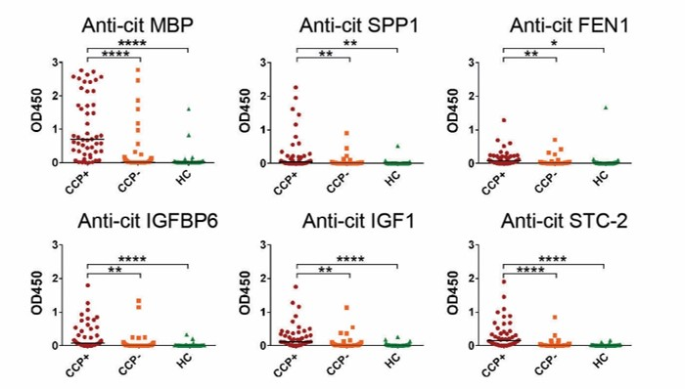
Identification of novel anti-citrullinated protein antibodies in RA patients
Karthikeyan et. al., Mol Cell Proteomics. 2016;15(7):2324-37

Slide 13
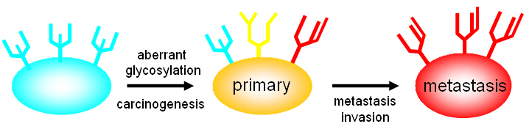
Aberrant glycosylations in cancers
Pinho, S. S. and C. A. Reis (2015). "Glycosylation in cancer: mechanisms and clinical implications." Nat Rev Cancer 15(9): 540-555.
Svarovsky, S. A. and L. Joshi (2014). "Cancer glycan biomarkers and their detection - past, present and future." Analytical Methods 6(12): 3918-3936.

Slide 14
Examples of Serological Markers with Clinical Applications
Pinho, S. S. and C. A. Reis (2015). "Glycosylation in cancer: mechanisms and clinical implications." Nat Rev Cancer 15(9): 540-555.
Notes:
These are all glycosylated
Therefore, it is likely that targeting glycans in combination with the protein backbone will provide greater diagnostic and prognostic performance, with sufficient sensitivity and specificity for clinical applications.

Slide 15
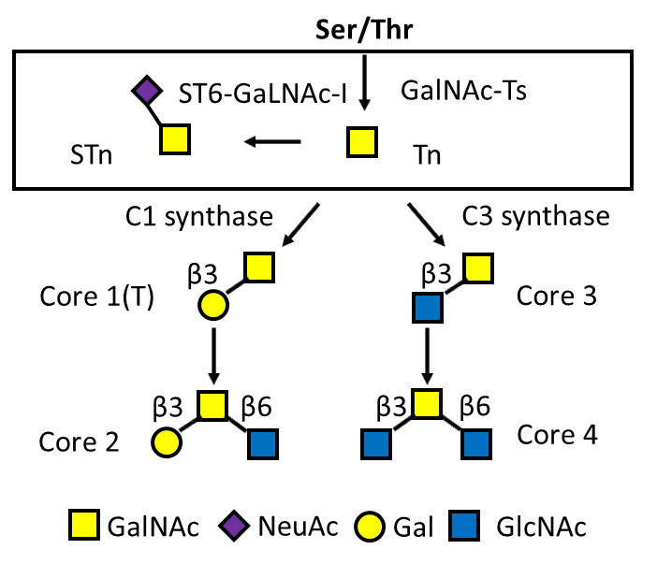
Overexpression of Truncated O-glycans are a Common Tumor Feature
Truncated O-glycan
Tn (GalNAc)
STn (NeuAc (α2,6) GalNAc)

Slide 16
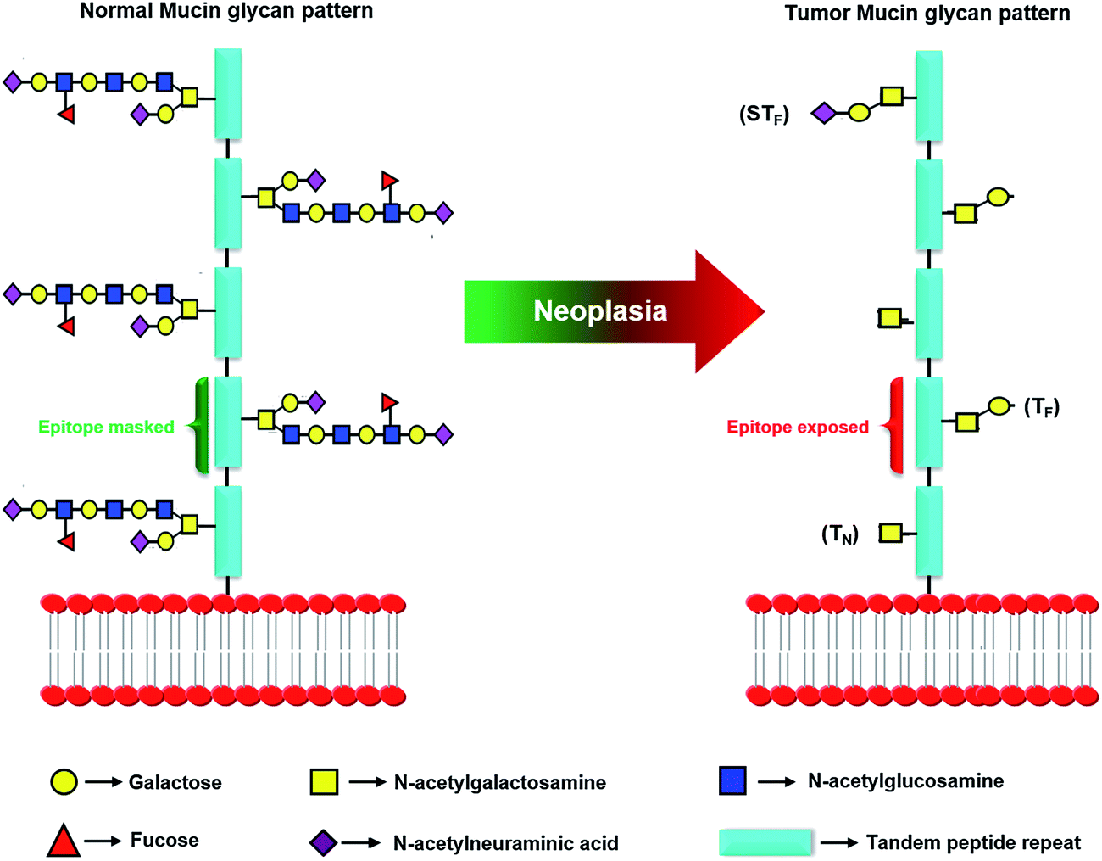

Aberrant O-glycosylations provide opportunity to look for novel biomarkers in cancers
Healthy Cells
O-Glycosylated at specific residues
Complex branched structures
Cancer Cells
Dysregulated glycoprocessing enzyme activity create neoantigens
Truncated glycans
Alternative modification sites
Exposed epitope
Protein X
Protein X
Pinho, S. S. and C. A. Reis (2015). "Glycosylation in cancer: mechanisms and clinical implications." Nat Rev Cancer 15(9): 540-555.
Svarovsky, S. A. and L. Joshi (2014). "Cancer glycan biomarkers and their detection - past, present and future." Analytical Methods 6(12): 3918-3936.

Slide 17

Tumor-associated autoantibody against glycoprotein (TAAb-AGP)
O
O
Tn/STn
Unmodified control arrays
Tn O-glycosylated with GalNT3
STn O-glycosylate with GalNT3 + ST6GalNT-I
Polypeptide /
protein
Tn or STn glycan
Anti-glycoprotein antibody

Slide 18



Verifying glycosylation of in vitro expressed MUC1-TR proteins by MALDI
TEV Protease
Muc1_Tn
Native Muc1
Express HaloTagged proteins from DNA using cell lysate
Capture HaloTagged proteins onto Halolink beads
Glycosylation of proteins by GALNT
Cleavage by TEV protease at HaloTag to obtain purified glycosylated protein
Legend:
Plasmids
HaloTagged expressed proteins
Halolink beads
Glycosylation sugar
HaloTEV protease
Detect modified proteins by MALDI-TOF

Slide 19
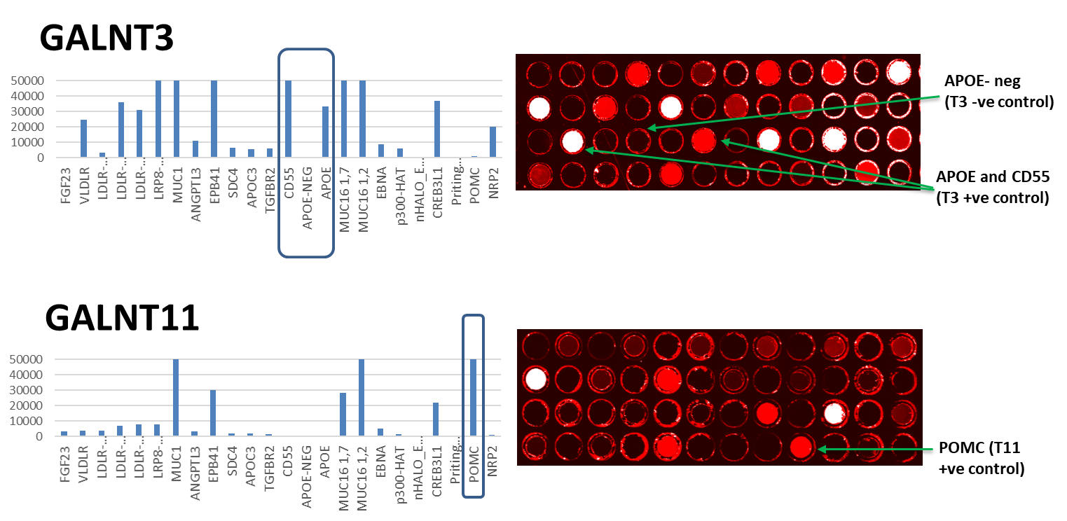
Glycosylation enzyme substrate specificity on arrays

Slide 20
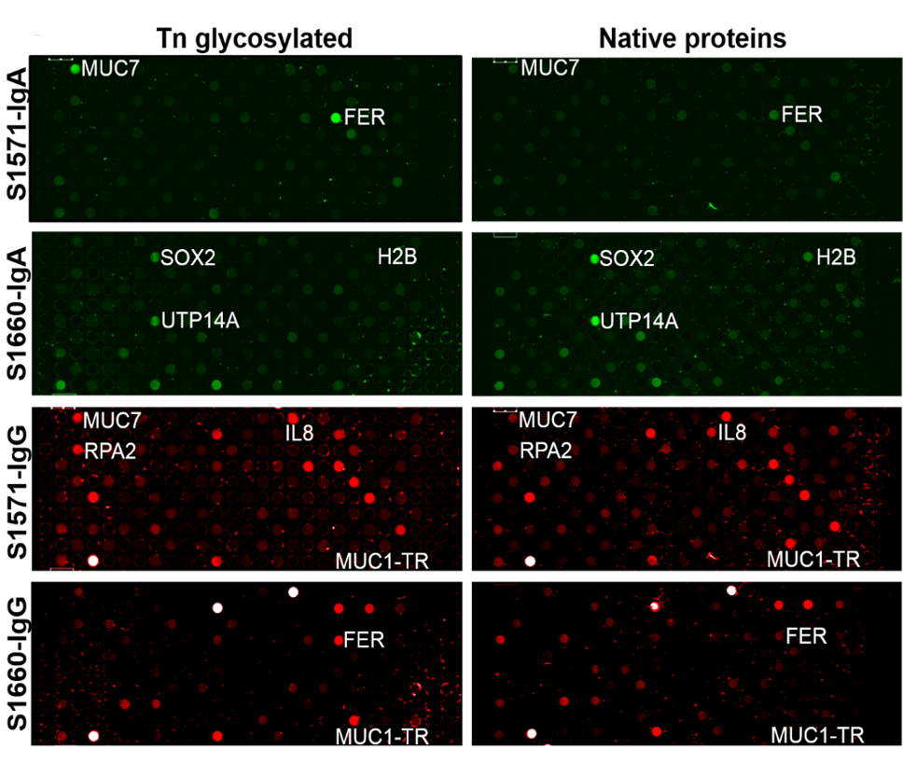
Glycosylation-specific patient responses to tumor antigens
Cancer patients produced specific antibodies against Tn-glycosylated proteins, such as FER, MUC7 and MUC1, but not their native forms.
Karthikeyan et. al., Mol Cell Proteomics. 2016;15(7):2324-37

Slide 21
Anti-Tn-glycosylated S100A7 in breast cancer

Slide 22
Anti-Tn-glycosylated NENF in breast cancer

Slide 23
Proteome Scale Glycoprotein Array Development
Reported breast cancer autoantigens
O-glycoproteome
(simpleCell)
Mucins
Highly-expressed proteins in breast cancer
Annotated membrane or secreted proteins

Slide 24
Our Complete Mucin Collection
Mucins are intimately involved in cancer development
Mucins overexpressed in a wide range of human malignancies
Markers of poor prognosis
Attractive therapeutic target
Unusually difficult genes to clone
Mucin | Length (aa) | Molecular Weight (Da)
1 | 1,255 | 122,102
2 | 5,130 | 540,300
3A | 3,323 | 345,127
4 | 5,284 | 231,518
5AC | 5,654 | 585,570
5B | 5,703 | 596,340
6 | 2,439 | 257,051
7 | 377 | 39,159
8 | 445 | 48,950
9 | 678 | 75,421
12 | 5,478 | 558,164
Mucin | Length (aa) | Molecular Weight (Da)
13 | 512 | 54,604
14 | 261 | 27,452
15 | 334 | 36,294
16 | 14,507 | 1,519,175
17 | 4,493 | 451,741
18 | 646 | 71,607
19 | 8,384 | 805,253
20 | 709 | 71,982
21 | 566 | 54,228
22 | 1,773 | 173,478
24 | 197 | 20,917
Kufe, D. W. (2009). "Mucins in cancer: function, prognosis and therapy." Nature reviews. Cancer 9(12): 874-885.

Slide 25
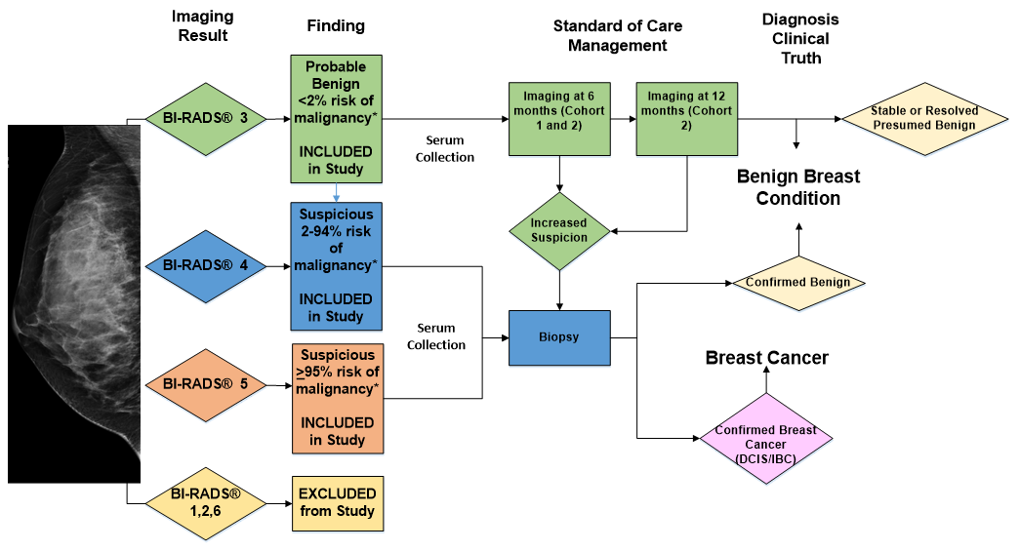
Patients and samples

Slide 26
Experimental Design
Contra capture protein arrays (~2000 antigens)
Un-modified
Tn
sTn
Discovery Set:
40 Cases
40 Benign Controls
Luminex assays (~30 antigens)
Un-modified
Tn
sTn
Validation Set:
40 Cases
120 Benign Controls

Slide 27

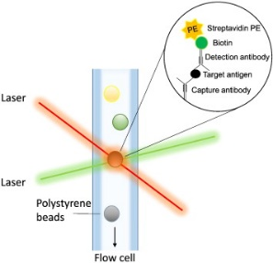




Developing a Multiplex Luminex Assay for Validation
Activate beads and functionalize using HALO-PEG
Express Halo-Tagged proteins by HeLa lysate and capture simultaneously onto HALO-PEG beads
Glycosylate captured proteins by GALNT
Add patient serum samples to detect anti glycosylated proteins antibodies (AGPA)
Add Phycoerythrin (PE) conjugated α-Human antibody
Detect AGPA’s by Luminex
Legend:
Magpix beads
Halo-PEG funtionalized beads
HaloTagged expressed proteins
Glycosylation sugar
Serum antibodies
α-Human Secondary antibody

Slide 28
Antigen display on Luminex Beads coated with HaloTag ligand

Slide 29
(A)Ab detection using Luminex and HaloTagged antigens
Median Fluorescence Intensity (MFI)

Slide 30
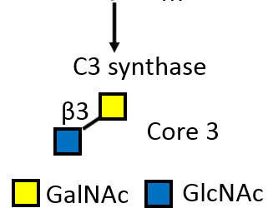
Glycosylated MUC1 on Luminex Beads detected by lectins
Tn glycosylation
Core3 glycosylation

Slide 31
Glycosylated MUC1 on Luminex Beads detected by Serum Samples
Anti-Core3 MUC1 antibodies
Anti-Tn MUC1 antibodies

Slide 32
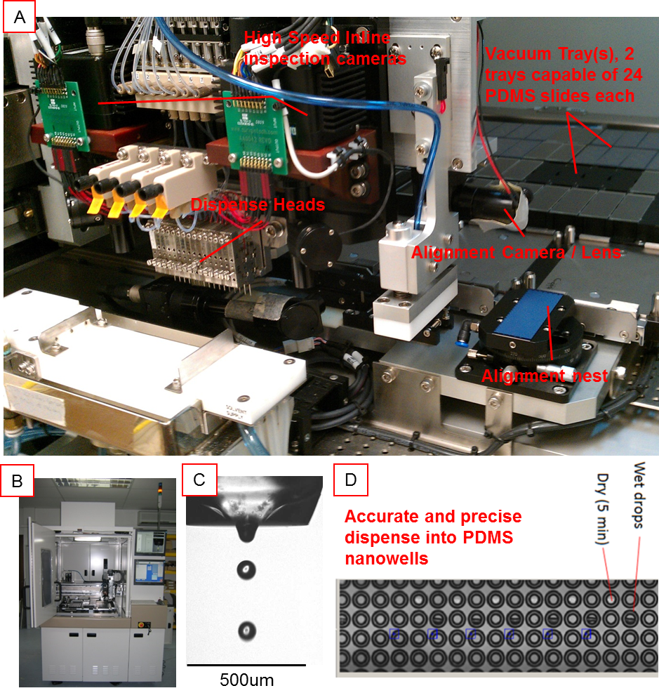
Unique state-of-the-art piezoelectric dispense for printing thousands of genes into PDMS nanowells precisely and accurately

Slide 33
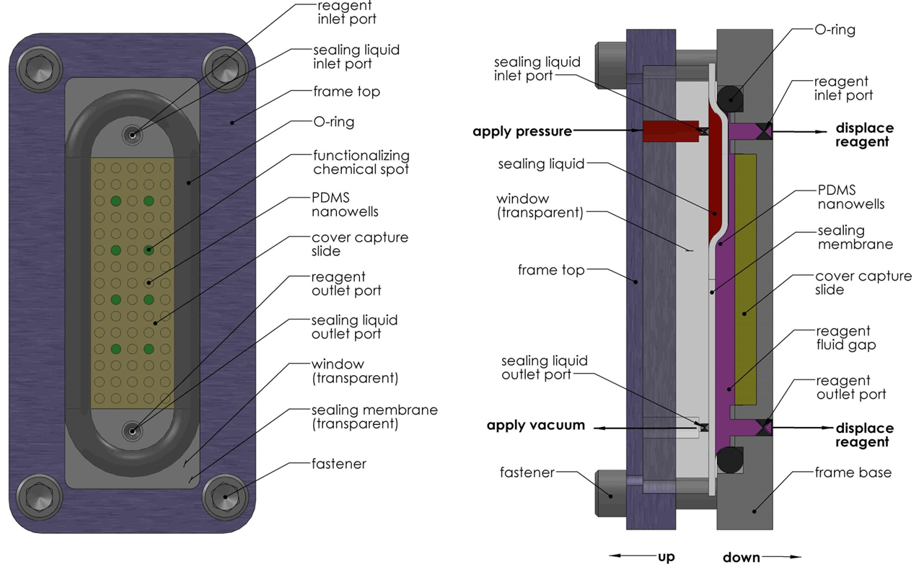
Next generation fill & seal device for the contra capture array

Slide 34
TP53 Autoantibody Study in Ovarian Cancer
Multiple Assays in Comparison – Meso Scale Discovery and RAPID ELISA

Slide 35
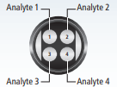
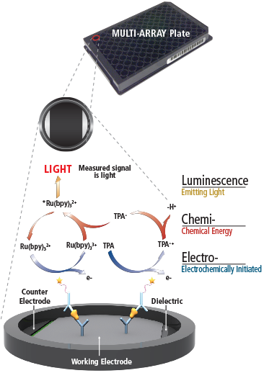
Meso Scale Discovery
MSD assay is an immune multiplex assay platform measuring chemieluminescence signal upon electrical stimulation.
Uses only little sample (here 0.75 uL) to measure multiple analytes
Broad dynamic range
High sensitivity through multiple exitiation cycles to amplify signal
Low background, signal stimulation only on surface of the well and decoupled from detection method
Analytes: TP53, CTAG2, CA125, GST
Samples: Serum from 500 Healthy Controls, 200 Benign Pelvic Masses, 250 Ovarian Cancers, 27 additional Controls positive for p53 autoantibodies
MESO SCALE DIAGNOSTICS, LLC

Slide 36
RAPID ELISA
Rapid antigenic protein in situ display enzyme-linked immunosorbent assay
Antigens: CTAG1A, CTAG2, TP53, GST
Samples: Serum from 500 Healthy Controls, 200 Benign Pelvic Masses, 250 Ovarian Cancers, 27 additional Controls positive for p53 autoantibodies

Slide 37
Publications (since 2016)
Ewaisha R, Meshay I, Resnik J, Katchman BA, and Anderson KS. 2016. Programmable protein arrays for immunoprofiling HPV-associated cancers, Proteomics
Katchman BA, Barderas R, Alam R, Chowell D, Field MS, Esserman LJ, Wallstrom G, LaBaer J, Cramer DW, Hollingsworth MA, Anderson KS. Proteomic mapping of p53 immunogenicity in pancreatic, ovarian, and breast cancers. Proteomics Clin Appl. 2016
Dahlstrom KR, Anderson KS, Sturgis EM. Human Papillomavirus-Associated Oropharyngeal Cancer: Not Just White Men Anymore. JAMA Oncol. 2016
Katchman BA, Chowell D, Wallstrom G, Vitonis AF, LaBaer J, Cramer DW, Anderson KS. Autoantibody biomarkers for the detection of serous ovarian cancer. Gynecol Oncol. 2017
Hanna GJ, Sridharan V, Margalit DN, La Follette SK, Chau NG, Rabinowits G, Lorch JH, Haddad RI, Tishler RB, Anderson KS, Schoenfeld JD. Salivary and serum HPV antibody levels before and after definitive treatment in patients with oropharyngeal squamous cell carcinoma. Cancer Biomarker 2017
Dahlstrom KR, Anderson KS, Field MS, Sturgis EM. HPV16 serostatus and risk of oropharyngeal carcinoma.. (2017) Cancer
Ewaisha R, Panicker G, Maranian P, Unger R, Anderson KS. Serum Immune Profiling for Early Detection of Cervical Disease. Theranostics (2017)
Dahlstrom KR, Anderson KS, Field MS, Chowell D, Ning J, Li N, Wei Q,Li G, Sturgis EM. Diagnostic accuracy of serum antibodies to human papillomavirus type 16 early antigens in the detection of human papillomavirus-related oropharyngeal cancer. Cancer. 2017
Henderson MC, Silver MS, Tran Q, Letsios E, Mulpuri R, Reese DE, Lourenco AP, LaBaer J, Anderson KS, Hollingsworth A, Alpers J, Costantini C, Peterson H, Rohatgi N, Haythem A, Baker K, Northfelt D, Ghosh K, Grobmyer S, Polen W, Wolf J. A Non-Invasive Blood-Based Combinatorial Proteomic Biomarker Assay to Detect Breast Cancer in Post-Menopausal Women with BI-RADS 3, 4, or 5 Assessment. Clin Cancer Res 2018 in press
Anderson KS. Mork J, Langseth H, Wallstrom G. Pre-diagnostic dynamic HPV16 IgG seropositivity and risk of oropharyngeal cancer: Methodologic issues. Oral Oncol. 2018
Kaaks R, Fortner RT, Hüsing A, Barrdahl M, Hopper M, Johnson T, Tjønneland A, Hansen L, Overvad K, Fournier A, Boutron-Ruault MC, Kvaskoff M, Dossus L, Johansson M, Boeing H, Trichopoulou A, Benetou V, La Vecchia C, Sieri S, Mattiello A, Palli D, Tumino R, Matullo G, Onland-Moret NC, Gram IT, Weiderpass E, Sánchez MJ, Navarro Sanchez C, Duell EJ, Ardanaz E, Larranaga N, Lundin E, Idahl A, Jirström K, Nodin B, Travis RC, Riboli E, Merritt M, Aune D, Terry K, Cramer DW, Anderson KS. Tumor-associated autoantibodies as early detection markers for ovarian cancer? A prospective evaluation. Int J Cancer, 2018 Feb
Yu X, Petritis B, Duan H, Xu D, LaBaer J. Advances in cell-free protein array methods Expert Rev Proteomics. 2018
Yu X, Song L, Petritis B, Bian X, Wang H, Viloria J, Park J, Bui H, Li H, Wang J, Liu L, Yang L, Duan H, McMurray DN, Achkar JM, Magee M, Qiu J, LaBaer J., Multiplexed Nucleic Acid Programmable Protein Arrays., Theranostics. 2017
Rivera R, Wang J, Yu X, Demirkan G, Hopper M, Bian X, Tahsin T, Magee DM, Qiu J, LaBaer J, Wallstrom G., Automatic Identification and Quantification of Extra-Well Fluorescence in Microarray Images, J Proteome Res. 2017
Wang D, Yang L, Zhang P, LaBaer J, Hermjakob H, Li D, Yu X., AAgAtlas 1.0: a human autoantigen database., Nucleic Acids Res. 2017
Karthikeyan K, Barker K, Tang Y, Kahn P, Wiktor P, Brunner A, Knabben V, Takulapalli B, Buckner J, Nepom G, LaBaer J, Qiu J., A Contra Capture Protein Array Platform for Studying Post-translationally Modified (PTM) Auto-antigenomes., Mol Cell Proteomics. 2016
Wang J, Shivakumar S, Barker K, Tang Y, Wallstrom G, Park JG, Tsay JC, Pass HI, Rom WN, LaBaerJ, Qiu J., Comparative Study of Autoantibody Responses between Lung Adenocarcinoma and Benign Pulmonary Nodules., J Thorac Oncol. 2016

Slide 38
Future Work
Produce active enzymes for in vitro glycosylation
Produce glycoprotein arrays displaying unmodified and O-glycosylated proteins.
Profiling breast cancer TAAb-AGP
Optimization of Luminex validation assay for TAAb-AGP

