Slide 1

Salient Report from Breast/GYN EDRN Team
EDRN SC Meeting
Cambridge 5-6 September 2018
Steven J. Skates PhD and Chris Li MD PhD
Massachusetts General Hospital and Fred Hutchinson Cancer Research Institute

Slide 2
Summary
Breast Cancer Early Detection
LaBaer/Anderson – detecting auto-antibodies to post-translational modifications (glyco) of plasma proteins (NAPPA)
Marks (Duke) and Heine (Moffitt) - Resources for Diagnosing Breast Cancer – images and blood biospecimens from 1,000 breast cancer screens
Paulovich/Lewis - Combining Avatar Mice and Targeted Mass Spectrometry to Identify Blood Biomarkers for Early Detection of Breast Cancer (detecting human proteins in PDX mice models)
Li - Phase 3 Validation of Early Detection Biomarkers for ER+ Breast Cancer

Slide 3
Critical Questions
Infrastructure and funding for early detection studies across multiple cancer sites - far more cost-effective to screen for multiple cancer sites with one blood draw than screening for individual cancer sites (similar in concept to proposed study in cancerSEEK Nature paper)
Imaging of ovary - multiple blood based candidate biomarker exist, multiple longitudinal CA125 studies performed, but Achilles heal is the trans-vaginal sonography - abnormality often not detected on image until too late.
  Alternatives needing investigation:
  optical imaging of ovaries via cervix/uterine/fallopian tube flexible scope
  non-imaging alternatives such as Bhatia's protease method
  MRI
  SQUID
General population control biospecimen sets - all EDRN teams contribute and all teams have access
Health economics impact of screening for
  each disease site
  combination of target cancers in one test

Slide 4
Seconday Critical Questions
post-translational modifications of proteins as source of new biomarkers
math/stat of integrating information across multiple markers measured at multiple time points
new anatomical approaches to biospecimen acquisition for early detection - e.g. uterine lavage for fallopian tube/ovarian cancer
incorporating clinical, exposure, and germline genetic risk factors into screening decisions - e.g. higher background risk indicates higher frequency of screening - high density breasts -> more frequent screening
methods for amplifying signal - attach nucleic acid barcodes to protein antibodies to leverage PCR for protein assays

Slide 5



Unique approach combining avatar mice and targeted mass spectrometry to identify blood biomarkers for early detection of breast cancer
Amanda Paulovich, M.D., Ph.D.
Member, Clinical Research Division
Fred Hutchinson Cancer Research Center
Michael Lewis, Ph.D.
Professor
Baylor College of Medicine
Steve Skates, Ph.D.
Massachusetts General Hospital

Slide 6
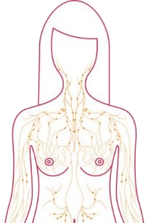


Three-stage Experimental Approach
Fractionate mouse plasma
Shotgun LC-MS/MS
Identify human proteins
Candidates from PDX
Orthotopic
PDX
mouse
Further Prioritization
Expressed in breast cancer
Not expressed in HMECs
Not observed in control plasma
(3/3 pools completed)
≥1,247
candidates
6 Breast Cancer
Plasma Pools
Cancer vs. Control
Fractionate human plasma
Targeted LC-MS/MS
Look for 1,247 PDX candidates
Priority candidates
human
Assay Development
Assay Validation
Clinical Validation
25

Slide 7
Duke/Creatv Microtech BDL
The goal of this group is to augment diagnostic mammography to reduce the number of breast biopsies
The overall approach is to integrate advanced image analysis with candidate circulating biomarkers
Prospective collection of >1000 women undergoing breast biopsy triggered by BI-RADS 4 findings (most of the false positive cases are in this category)
Prospective study is necessary to conduct concurrent measurement of rare cells (focusing on Cancer Associated Macrophage Like cells)
Resource development of matching blood and images from both the prospective and retrospective cohorts

Slide 8

Phase 3 Validation of Early Detection Biomarkers for ER+ Breast Cancer (Li/Lampe)
WHI1
121 ER+cases
121 controls
Completed
WHI2
90 ER+ cases
90 controls
Completed
EDRN Ref Set
115 ER+ cases
149 controls
Completed
WHI2
Completed
EDRN Ref Set
Completed
WHI1
In progress
Proteomics Autoantibody/Glycomics – CVC2 set asides
CVC1
CVC1
CVC2
 | # of markers
List | AAb IgG | AAb IgM | Glyc SleX | Glyc SleA | Criteria
A | 9 | 13 | 11 | 5 | ↑cases/sens ≥30%
B | 17 | 7 | 7 | 9 | ↓cases/sens ≥30%, ↑cases/sens <30%/p≤0.2
C | 39 | 27 | 19 | 18 | ↓cases/sens <30%/p≤0.2 On proteomics list
List | # of markers | Criteria
A | 9 | Sens ≥30%/p≤0.2
B | 6 | Sens <30%/p≤0.2
C | 17 | A-list markers from WHI2 not validated in the EDRN Ref Set

Slide 9
JHU BDL (Zhen Zhang/Ie-Ming Shih)
Incidence of HGSOC/STIC is much higher than previously thought as evidenced by improved path procedures.
Methylation analysis identified tumor-specific alterations readily detectable in early precursor lesions with high accuracy.
Adding plasma ctDNA test to pap brush test improves sensitivity to 60+% yet increases FP to 1.3%. Sensitivity for early stage is relatively still low.
Using a statistically-principled proteomic analysis to identify candidate biomarkers that 1) are tumor specific, or 2) help to enrich prevalence. The selected candidates will be developed as targeted assays to be analyzed in CVS or UL to assess their ability as a part of IVDMIA to improve DNA-based liquid biopsy tests.

Slide 10
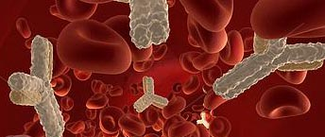
New Biomarkers to improve Early Detection of Ovarian Cancer
September 5, 2018 of
Ovarian
Robert Bast, Karen Lu, Zhen Lu, Wei-Lei Yang (MDACC)
Sam Hanash and Makoto Kobayashi (MDACC)
Amy Skubitz (U. Minnesota)
Steven Skates (MGH)
Notes:
Default title slide layout for Basic presentations
Enter copy in the content placeholders (default formatting shown on example slide above)
Another image may be substituted
To change image:
Delete existing image
Drag a new image into the picture placeholder or select the image placeholder and under the Insert tab, select Pictures and upload your photo

Slide 11
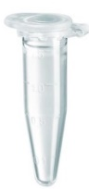
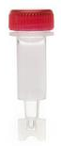
Antigen-antibody Dissociation Procedure
Serum sample (2 μl)
Antigen
Dissociation process
0.1M Glycine-HCl pH3.0 in PBS (48 μl)
Incubate for 30 min @ RT
Zeba™ Spin Desalting Column
(Life Technologies)
Antigen
Buffer exchange process
Immunoglobulins-dissociated serum sample

Slide 12
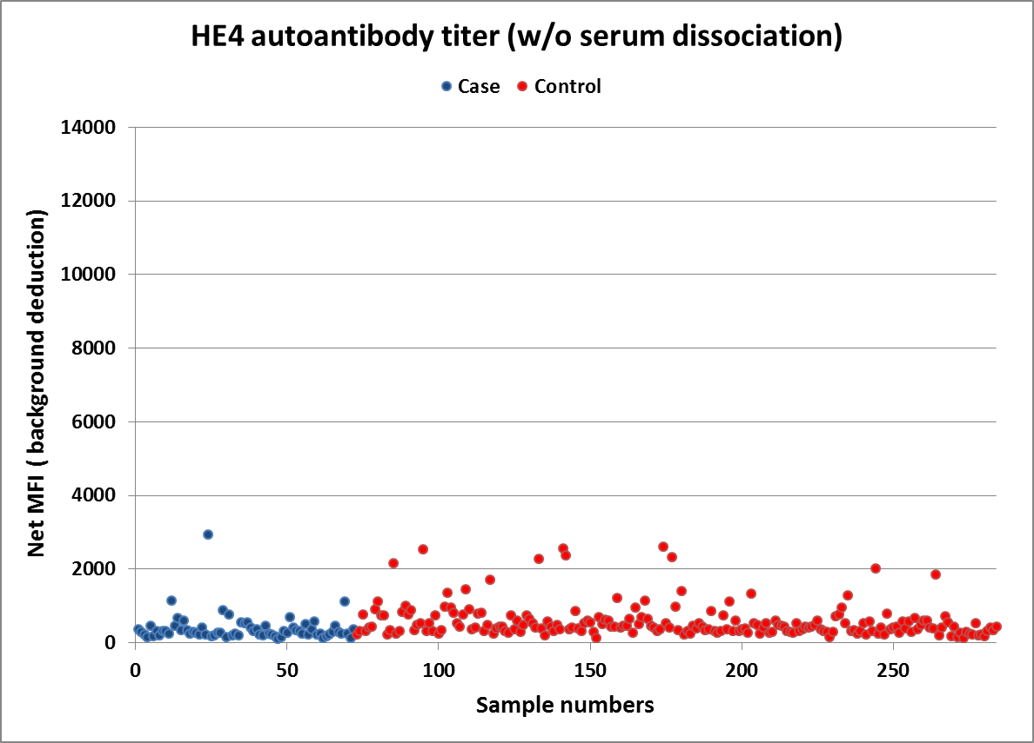
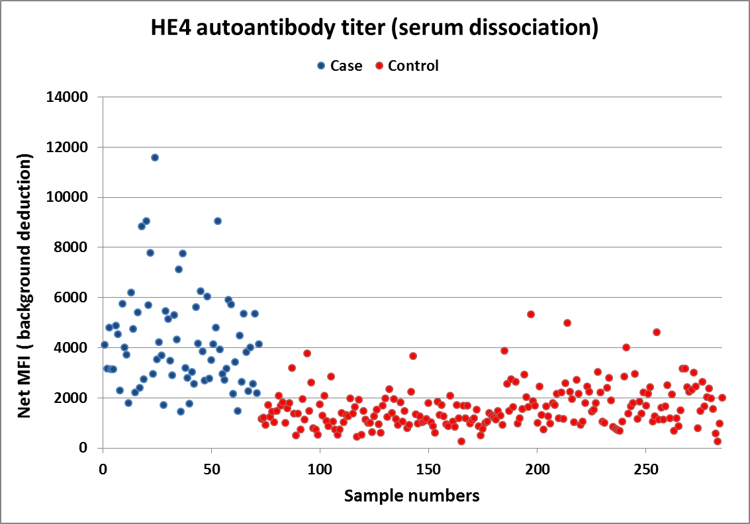
HE4 Antigen-Autoantibody Complex Assays
72 Early stage cases
213 Healthy controls
98% Specificity
HE4 AAbs | Case | Control
(+) | 1/72 | 4/213
% | 1.3% | 1.8%
Biomarker | HE4 | CA125 | CA125+HE4
(+) | 36/72 | 44/72 | 62/72
% | 50.0% | 61.1% | 86.0%

Slide 13
ROC curve analysis for CA125 with HE4 antigen and CA125 with HE4 antigen-antibody complexes in ovarian cancer cases
C
Early stage
D
Late stage
Biomarker | AUC (95% C.I.) | p-Value | pAUC (0.02) | pAUC (0.05) | Sensitivity (95% C.I.)
CA125 | 0.870 (0.81 – 0.92) | <0.001 | 0.01 | 0.03 | 0.62 (0.51 – 0.74)
CA125 + HE4 Ag | 0.869 (0.81 – 0.92) | 0.544 | 0.01 | 0.03 | 0.62 (0.50 – 0.74)
CA125 + HE4 Ag-Ab | 0.985 (0.97 – 0.99) | <0.001 | 0.01 | 0.04 | 0.75 (0.62 – 0.94)
Biomarker | AUC (95% C.I.) | p-Value | pAUC (0.02) | pAUC (0.05) | Sensitivity (95% C.I.)
CA125 | 0.967 (0.93 – 1.00) | <0.001 | 0.02 | 0.05 | 0.92 (0.82 – 0.98)
CA125 + HE4 Ag | 0.974 (0.94 – 1.00) | 0.312 | 0.02 | 0.05 | 0.90 (0.82 – 0.98)
CA125 + HE4 Ag-Ab | 0.985 (0.96 – 1.00) | 0.003 | 0.02 | 0.05 | 0.94 (0.87 – 1.00)

Slide 14
CA125 in 3 women with occult ovarian cancer & 3 women without ovarian cancer
1
3
500
2
CA125-II
50
4
6
5
5
88
89
90
91
92
93
94
Year
Notes:
This figure displays CA125 levels over time prior to detection of any disease from six women in the UK study. Three women in the figure were diagnosed with ovarian cancer and three women did not have ovarian cancer at the end of the study in July 1995. The initial level of CA125 does not distinguish between the women subsequently diagnosed with ovarian cancer and those without ovarian cancer at the end of the study. However the changes in CA125 values over time clearly differentiate between the women with ovarian cancer and the women without ovarian cancer. The Risk of Ovarian Cancer Algorithm will exploit this pattern of CA125 values over time to improve sensitivity while maintaining a very high level of specificity. The pattern of CA125 values over time we expect to see in women with ovarian cancer is best exemplified in subject #5, where we see an initial flat profile, followed by a rise. We refer to this as an “Elbow pattern”. Women #1 and #3 illustrate the latter part of the elbow pattern. The elbow pattern indicates the probable presence of ovarian cancer. In contrast, a flat pattern as illustrated by women #2, #4, and #6, even with a very high level e.g. #2, indicates probable absence of ovarian cancer. For an asymptomatic woman, we determine the relative goodness of fit to her multiple CA125 values between an “elbow pattern” compared with a “flat pattern” to assess her risk of ovarian cancer.

Slide 15
ROCA Screening Trials
UK Pilot Trial (Barts III) 1995 – 2001
    14,000 normal risk women randomized to screen/ no screen
ROCA study 2001 – 2015
    2,400 high risk women, age > 30, CGN/SPORE/EDRN
UKCTOCS 2001 - 2015
    200,000 normal risk, postmenopausal women randomized to screen/ no screen
MDACC study in normal risk women 2001-2011
    4,000 normal risk postmenopausal women
GOG0199 - screening arm 2003-2011
    1,600 high risk women, age > 30
UKFOCSS 2003 – 2013
    4,000 high risk women, age > 35
Jacobs, The Lancet 1988
Skates, JASA 2001
Menon, JCO 2005
Lu, Cancer 2011
Jacobs Menon, The Lancet 2015
Skates, Clinical Cancer Research 2017
Rosenthal, JCO 2017

Slide 16
Olink Proximity Extension Assays (PEAs)
Olink – Developed nucleic acid barcode for each protein antibody
Amplified signal through PCR
Accurate and reproducible assays in complex biological fluids (< 15% CV) from minimal volume – 2 uL
Developed PEAs assays for 1,008 proteins (11 Panels)
Evaluated in longitudinal samples from our screening trials

Slide 17
MUC−16 Q8WXI7

Slide 18
TACSTD2 P09758

Slide 19
Promising Candidate Plasma Early Detection Ovarian Cancer Biomarkers
Promising: 2 standard, 5 new
TACSTD2 P09758
CSTB P04080
MUC−16 Q8WXI7 (CA-125)
WFDC2 Q14508 (HE4)
FGF−21 Q9NSA1
CDH6 P55285
EPO P01588
34 potential other candidates

Slide 20
Rank of Olink identified candidates

Slide 21
Promising Candidate Plasma Early Detection Ovarian Cancer Biomarkers
Promising: 2 standard, 5 new
TACSTD2 P09758
CSTB P04080
MUC−16 Q8WXI7 (CA-125)
WFDC2 Q14508 (HE4)
FGF−21 Q9NSA1
CDH6 P55285
EPO P01588
34 potential other candidates

Slide 22
Critical Questions
Infrastructure and funding for early detection studies across multiple cancer sites - far more cost-effective to screen for multiple cancer sites with one blood draw than screening for individual cancer sites (similar in concept to proposed study in cancerSEEK Nature paper)
Imaging of ovary - multiple blood based candidate biomarker exist, multiple longitudinal CA125 studies performed, but Achilles heal is the trans-vaginal sonography - abnormality often not detected on image until too late.
  Alternatives needing investigation:
  optical imaging of ovaries via cervix/uterine/fallopian tube flexible scope
  non-imaging alternatives such as Bhatia's protease method
  MRI
  SQUID
General population control biospecimen sets - all EDRN teams contribute and all teams have access
Health economics impact of screening for
  each disease site
  combination of target cancers in one test

